Slide 1
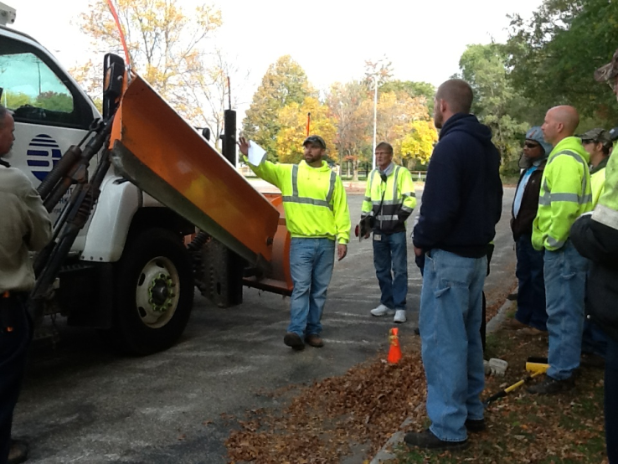
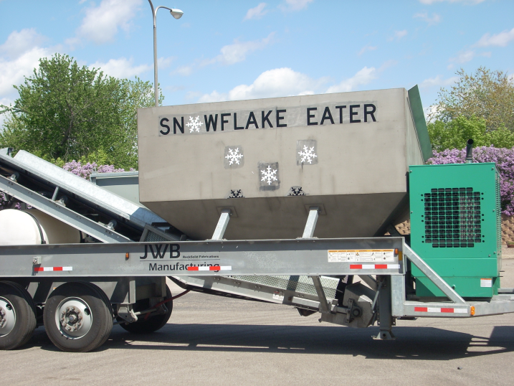

Module 23:
Getting Ready for Winter
Draft
2016 Created for Clear Roads by:
U of MN Center for Transportation Studies &
Fortin Consulting Inc.
Notes:
Hidden slides 7, 11 and 12 describe the goals set forth by Clearroads in the development of this module.
This module also is unique in that most of the content will be provided by each presenter. We have indicated place holders for you to insert state or organizational information that is meaningful to your operations. We have provided examples for you to better understand how each slide was intended to be used. Please remove the examples and replace them with the materials appropriate to your operations. Delete all yellow boxes before making presentation.
Photo credits: left photo: Fortin Consulting, Inc.
Right photo: MnDOT

Slide 2
Training for Winter Maintenance Supervisors and Operators
2016 Created for Clear Roads by:
U of MN Center for Transportation Studies &
Fortin Consulting Inc.

Slide 3
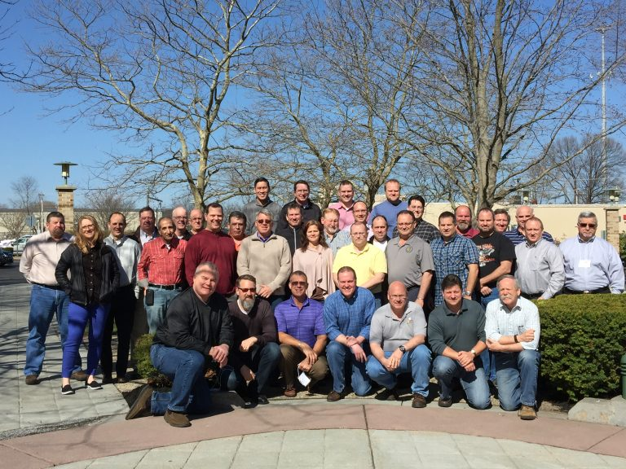
Winter maintenance professionals are a very powerful and important group
Notes:
Photo credit: Clearroads website
Note to presenters: These first 7 slides can be used or hidden.
Or, replace with photos of your staff.

Slide 4
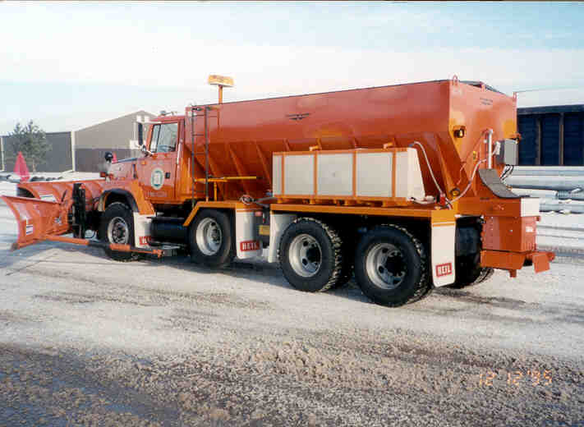
You do a great job of taking care of our roads!

Slide 5
This is one of a series of 22 winter maintenance training modules developed by the Clear Roads Program. All of the modules are available online at www.clearroads.org
Modules include information on the following:
Plowing
Truck operations
Spreading
Material use
Pre-wetting
Brine production
De-icing and anti-icing
Level of service
Ice formation
Freeze point depressants
Environmental issues
Drift control
Weather
Avalanche management
Bridge frost
Safety
Notes:
Note to presenters: The website www.clearroads.org can be accessed here if a live internet connection is available.
A list of all the modules is given here:
Plowing procedures
Truck operations
Spreading
Material use
Pre-wetting
Brine production
De-icing
Anti-icing
Safety
De-icing agent management policy
Level of service
Ice formation
Freeze point depressants
Environmental issues
Drift control
Weather
Bridge frost
Avalanche management
Getting ready for winter
Supervisors and winter maintenance
Drivers education
Record keeping

Slide 6
Module 23:
Getting Ready for Winter
Draft
2016 Created for Clear Roads by:
U of MN Center for Transportation Studies &
Fortin Consulting Inc.
Notes:
Left photo credit: Fortin Consulting, Inc.
Right photo credit : MnDOT
This module also is unique in that most of the content will be provided by you. We have left place holders for you to insert state or organizational information that is meaningful to your operations. We have provided examples for you to better understand how each slide was intended to be used. Please remove the examples and replace them with the materials appropriate to your operations.

Slide 7
FACILITATOR NOTES (do not show during class)
This is a priority 2 module developed for Clear Roads national training. It is only for Supervisors. Slides can be customized for the audience.
Slide Legend
Entry-level plow drivers
Experienced plow drivers
Supervisors
Notes:
Note: this slide does not get shown during class. It is only to inform the presenters of the symbology:
This is a priority 2 module to be developed for clear roads national training.
It will address 3 audiences:
Circle symbol = entry level plow drivers
Triangle symbol = experienced plow drivers
Star symbol = supervisors
Some slides without symbols are for everyone
Also note: To hide a slide in a power point presentation, select the slide and then select “slide show” tab. Select “hide slide”.

Slide 8
This module covers these topics:
Manager and Operator Training
Facility inspection and repair
Stocking of deicers and abrasives
Equipment inspection, repair and calibration
Winter snow plow route review
Meeting with emergency services and neighboring agencies
Notes:
This module covers the listed topics. These topics should all be thought of in light of the module title “Getting ready for winter”. These topics may also apply to winter operations but this module is focusing in on just the aspect of these topics done in the off-season.

Slide 9
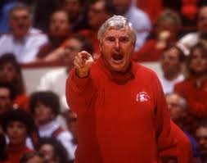
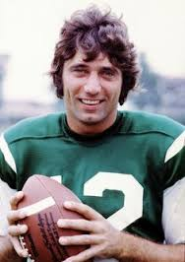
Module 23: Getting Ready for Winter
Champions have something in common…
“The will to succeed is important, but what's more important is the will to prepare. “ Bobby Knight
“What I do is prepare myself until I know I can do what I have to do. “ Joe Namath
Notes:
Photo credits:
Bobby Knight Photo: mydailynews.com
Joe Namath Photo: Pinterest.com

Slide 10
Module 23: Getting Ready for Winter
“Our nation’s economy is dependent on an efficient and reliable transportation system; that is why our winter operations are so critical, and needs to be our top priority during the winter months.”
Norm Ashfeld – Retired MnDOT Metro superintendent
Note to presenters: Insert your “getting ready for winter motto” here. Delete this yellow box before making presentation.
Notes:
This slide is meant to provide an opportunity for a pep talk about the importance of winter maintenance and the importance of properly preparing for it.
One example: Imagine a marathon runner who prepared for his race by watching TV. On race day, he is failing to perform not by lack of good intentions but by lack of preparedness.

Slide 11
Objectives
The objective of the training is to make the attendee aware of what needs to be done prior to winter operations. A successful winter maintenance program begins with properly trained staff, fully functional equipment that has been checked, and a well-stocked inventory of deicing materials. Topics in the module include:
Manager and operator training
Responsibilities of management and operators
Communicating organization goals to all employees, from leadership to the plow operator
Notes:
This is part 1 of the Clearroads committee goals for this training module.
A successful winter maintenance program begins with a properly trained staff, fully functional equipment that has been checked and a well-stocked inventory of deicing materials

Slide 12
Objectives
Other topics include:
Communicating the importance of facility inspection and repair
Stocking adequate amounts of deicers and abrasives
Equipment inspection, repair and calibration
Winter snow plow route review
The importance of meeting with emergency services and neighboring local public agencies
Notes:
This is part 2 of the Clearroads committee goals for this training module.

Slide 13
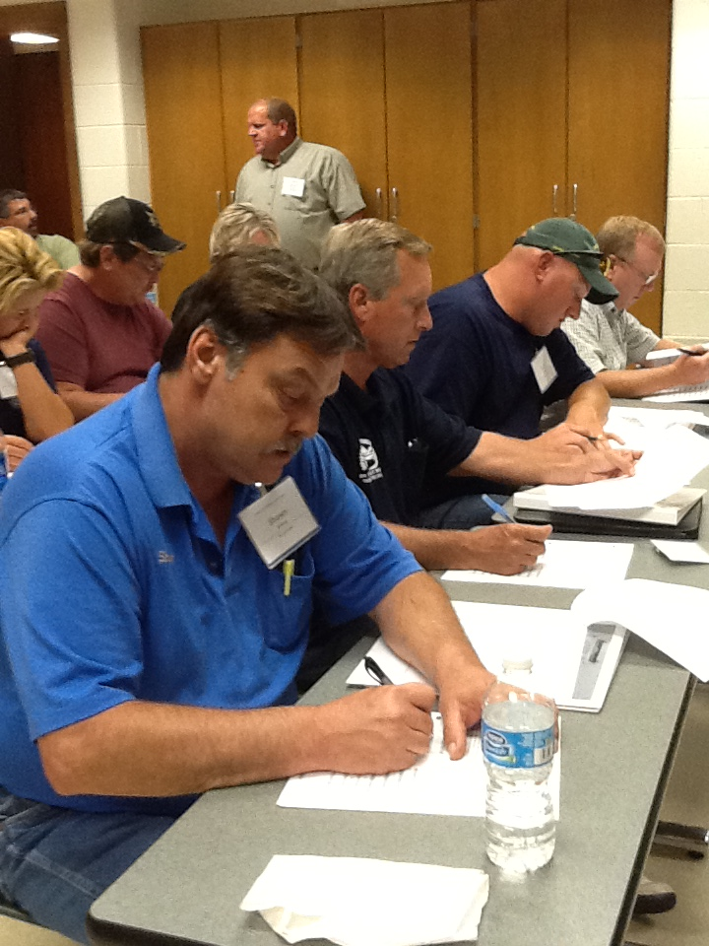
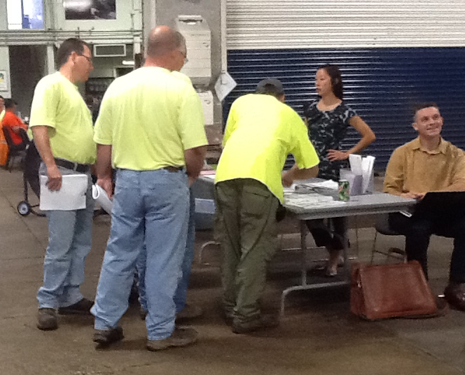
Section 1: Manager and Operator Training
Notes:
Photo credit: Fortin Consulting, Inc.
This section will cover the objective of the training, which is to make the attendee aware of what needs to be done prior to winter operations. A successful winter maintenance program begins with properly trained staff, fully functional equipment that has been checked and a well-stocked inventory of deicing materials. Topic that are included in the module are:
1. Manager and operator training
Responsibilities of management and operators
Ensuring the goals of the organization are known from the leadership to the person in the plow

Slide 14
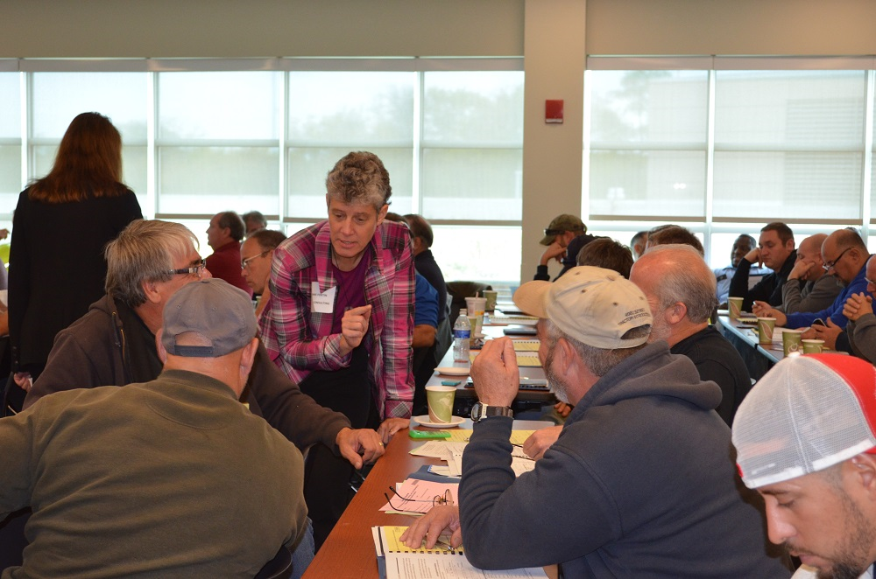
Goals of the Organization
Ensure the goals of the organization are known from the leadership to the person in the plow.
Notes:
Photo credit: Fortin Consulting, Inc.
Goals of the organization are the backbone of your operation. Make sure everyone in your operation understands them. State them often and applaud the staff when the goals are met. Acknowledging and celebrating your successes are very important in team building and creating a positive work environment.

Slide 15

Goals of the Organization
MnDOT District 1, headquartered in Duluth and Virginia, has a time-proven, rapid response plan in place for winter state highway maintenance in Northeastern Minnesota. The goal of this plan is to clear the roadways of snow and ice in a timeframe acceptable to District 1’s customers. This plan is guided by road type and traffic volume.
Note to presenters: Insert your organization’s goals here and how you plan on communicating them. Delete this yellow box before making presentation.
Notes:
Link for MNDOT example goal: http://www.dot.state.mn.us/d1/pdf/winter-maint-2014-2015.pdf
Photo credit from FDOT: www.dot.state.fl.us
Clearly state the goal or goals of your organization. Show them in the training PPT but also find other ways to get the word out, be creative some organizations have used posters, stickers, t-shirts, website, pens, stationary. If your goal is important to you, find ways to make it stick!

Slide 16
Test Question
Who should know the winter goals of the organization?
Everyone involved in winter operations
All union employees
All management employees
All new employees
Notes:
Note to presenters: you may choose to hide this slide.
Test question: Who should know the winter goals of the organization?
Everyone involved in winter operations (yes)
All union employees (no)
All management employees (no)
All new employees(no)

Slide 17
Test Question
Who should know the winter goals of the organization?
Everyone involved in winter operations
All union employees
All management employees
All new employees
Notes:
Note to presenters: you may choose to hide this slide.
Test question: Who should know the winter goals of the organization?
Everyone involved in winter operations (yes)
All union employees (no)
All management employees (no)
All new employees(no)

Slide 18
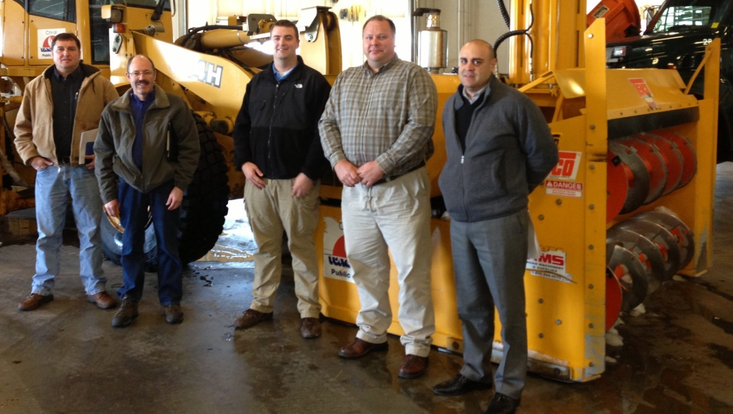
Manager Training
Training suggested for supervisors: MDSS, weather forecasting, route optimization
Training suggested for superintendents: legal issues, public communications
Note to presenters: Insert your training schedule or training objectives for managers here. Delete this yellow box before making presentation.
Notes:
Photo credit: Fortin Consulting, Inc.
A successful winter maintenance program begins with properly trained staff. What training is suggested for your leadership staff? What opportunities exist for them to become educated? Consider conferences they can attend, trade organizations to belong to, ongoing technology training, etc…
Note to presenters: Customize this slide to communicate the opportunities that exist for your maintenance leadership.

Slide 19
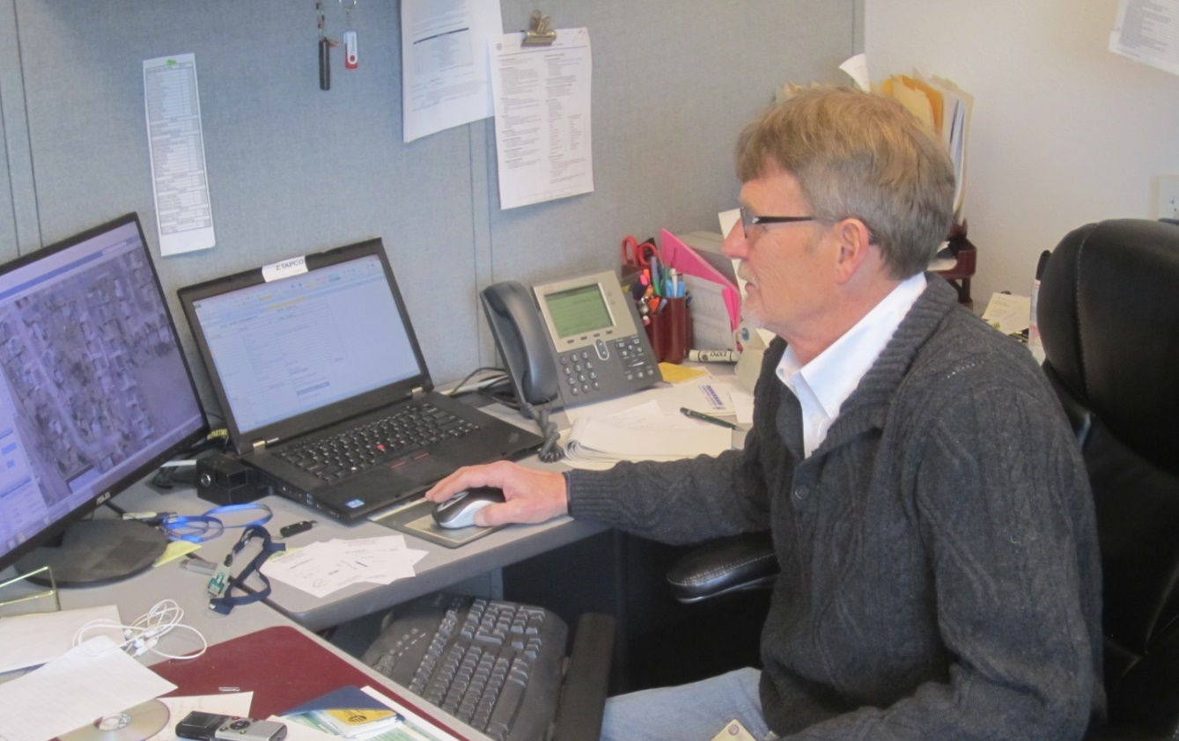
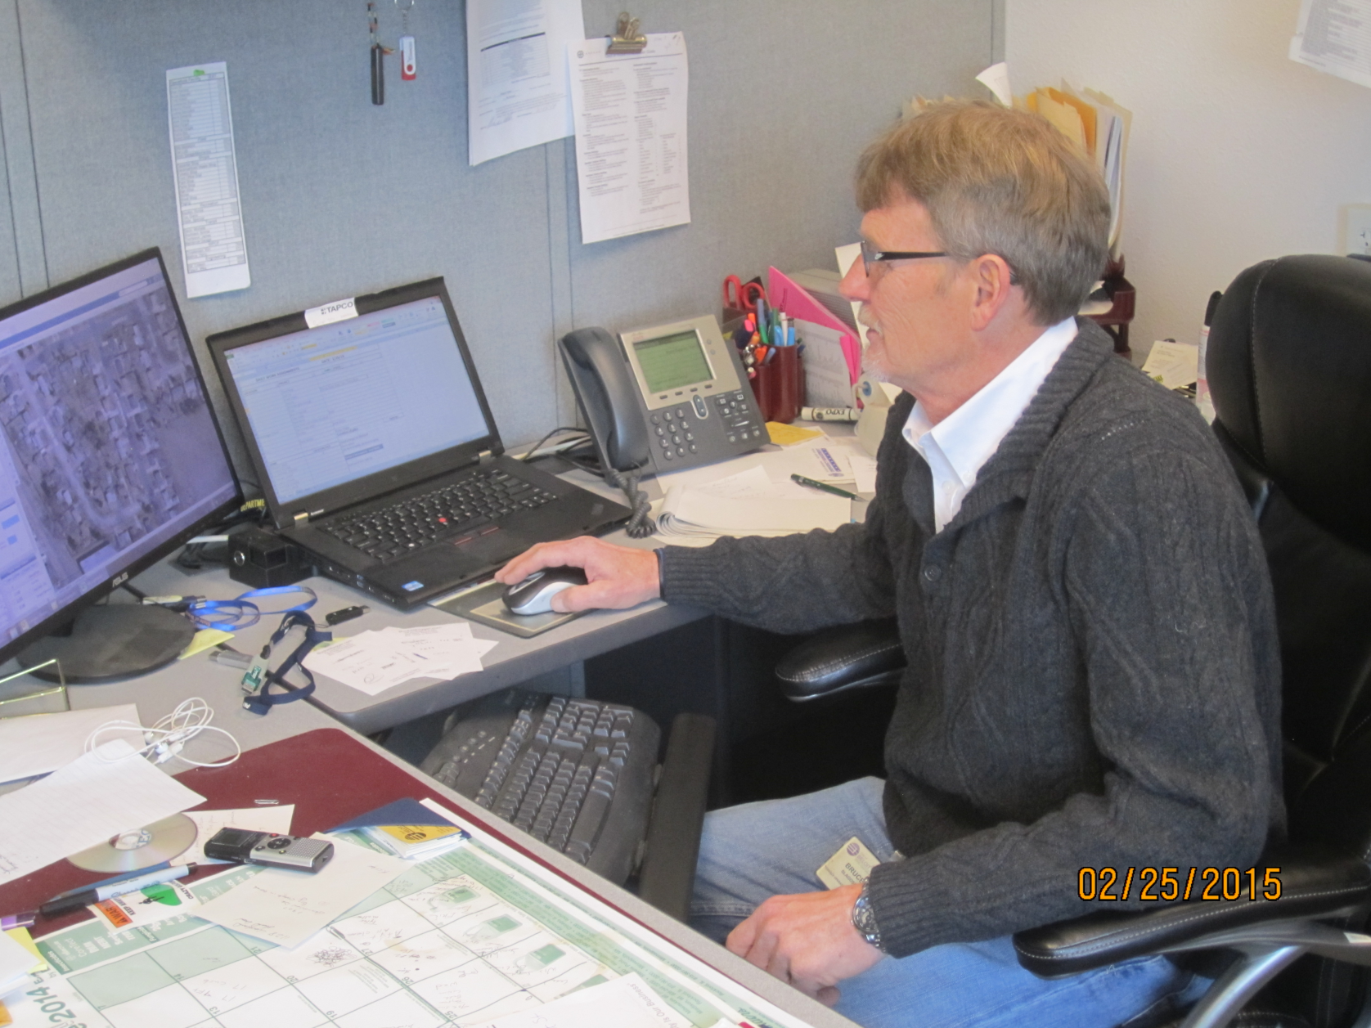
Responsibilities of Management
Example:
1. Route assignments
2. Set call out procedure
3. Level of service determinations
Getting ready
for winter
Note to presenters: insert a list of management responsibilities here. Delete this yellow box before making presentation.
Notes:
Photo credit: City of Beloit, WI
What getting ready for winter responsibilities do you want to highlight for your management team?
This slide is where you can itemize and review those responsibilities.

Slide 20
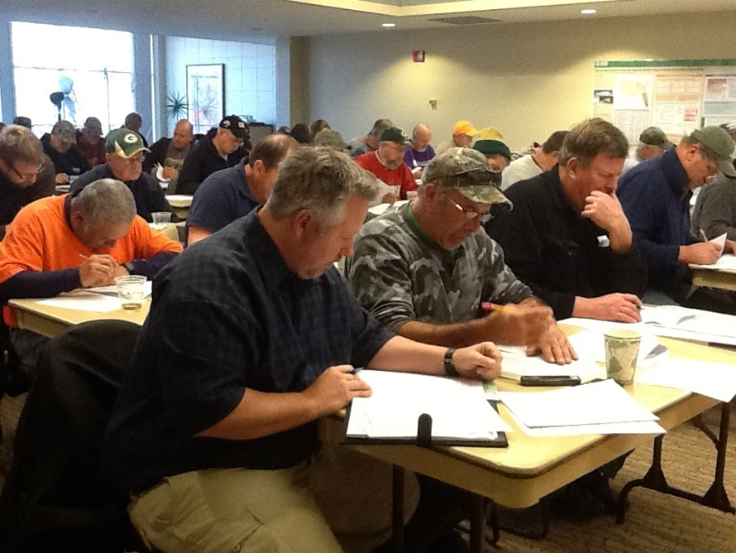
Needs for Operator Training
Example: Each county will conduct annual snow and ice operator training sessions for all regular and auxiliary drivers. Successful completion of this or equivalent training is a prerequisite for participation in snow and ice removal activities.
This training should include, at a minimum:
Safety issues
Labor issues
Anti-icing/deicing practices
Plowing practices and hazards
Equipment function and operation
Environmental concerns
Economic concerns
Radio operations
Truck routing
Note to presenters: Insert your training schedule or training objectives for operators here. Delete this yellow box before making presentation.
Notes:
Photo credit: Fortin Consulting, Inc.
Note that this slide is for management. Evaluate operator needs and set up training to address those needs. Communicate the plan across management to get everyone informed and on the same track. A successful winter maintenance program begins with properly trained staff.

Slide 21
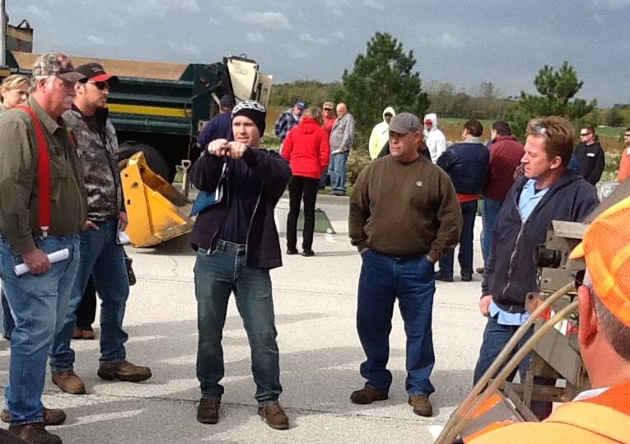
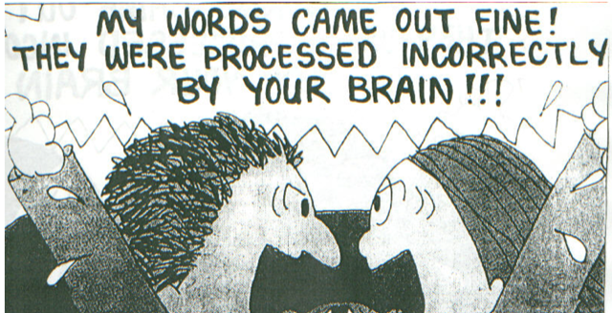
Operator Training
Effective communication is an art.
How are you doing?
Are there new methods you can try?
Notes:
Cartoon credit: Ohio DOT
Photo credit: Fortin Consulting, Inc.
Communication is a skill that always needs to be improved. Where are you successful and where are you struggling?
“Who makes the decision to add calcium chloride, magnesium chloride or other materials to you application when temperatures drop? Is it the manager, the operator or a software program? If everyone is not clear on who makes the decision, the change in material may not take place and the operation will suffer. Everyone needs to be clear on what is to be done and when.” What can you change? Give it a try! Example by Scott Lucas Ohio DOT
In this example the decision-maker should be clearly identified, not at the time of the storm but before the season.

Slide 22

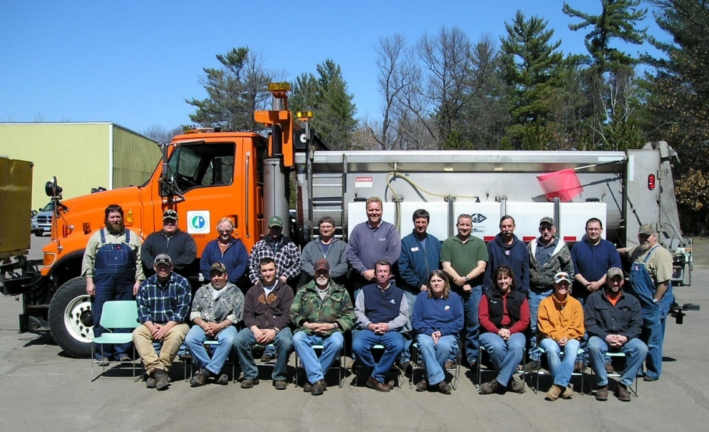
Expectations
How do you clearly communicate your expectations?
Notes:
Photo credit: MnDOT
Image: Microsoft clipart
How do you communicate? What seems clear to you may not seem clear to them.
Presenter: this is a good time for class discussion on what works and idea exchange.

Slide 23
Expectations
Example
“Who makes the decision to add calcium chloride, magnesium chloride or other materials to your application when temperatures drop? Is it the manager, the operator or a software program? If everyone is not clear on who makes the decision, the change in material may not take place and the operation will suffer. Everyone needs to be clear on what is to be done and when.”
In this example the decision maker should be clearly identified; not at the time of the storm, but before the season.
Notes:
Example credit: Scott Lucas, Ohio DOT

Slide 24
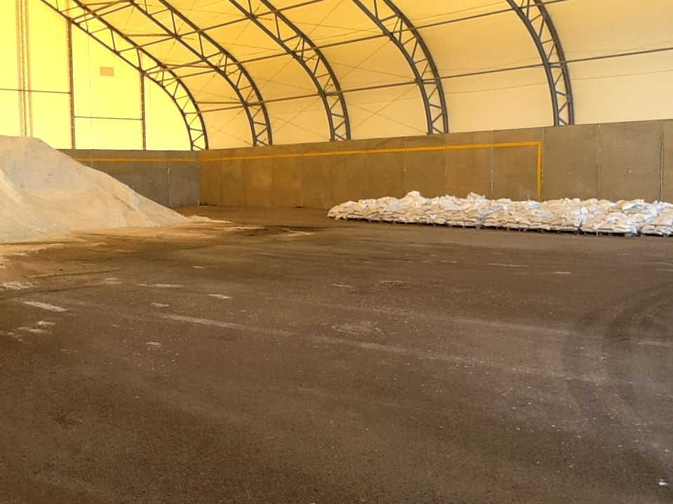
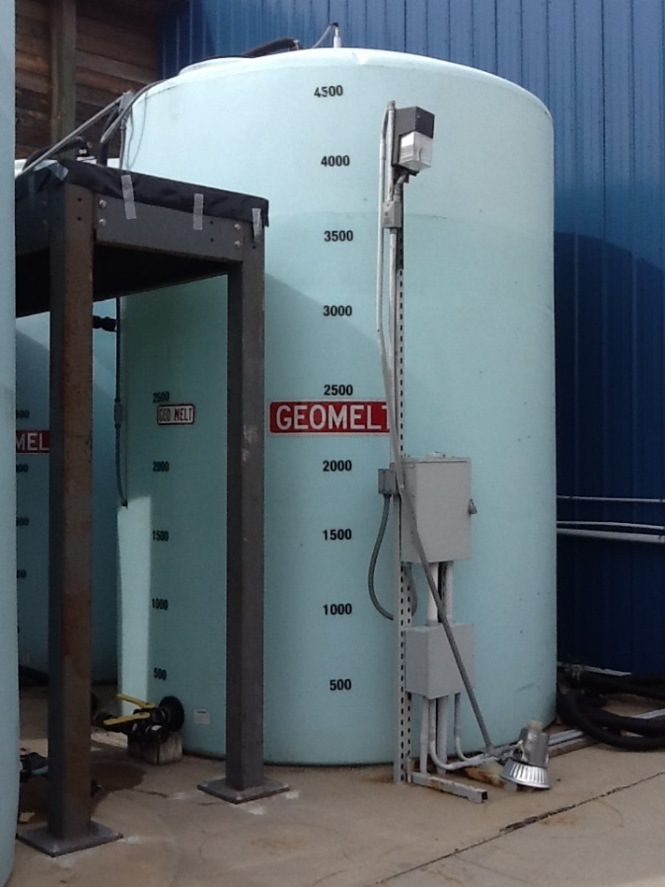
Section 2: Facility Inspection and Repair
Notes:
Photo credit: Fortin Consulting, Inc.
Objectives of this section:
Facility inspection and repair includes:
a. Ensuring that structures are inspected and repaired before deicers and abrasives are ordered
b. Ensuring that facilities meet the needs of the operation, or adjusting the operation to meet limits of the facility
In this photos notice the fill line. This is a good feature to protect the integrity of the structure.
Liquid and granular storage facilities both deserve constant attention. Make a plan for inspecting and repairing both. It is likely a different person or crew that is in charge of these different areas.

Slide 25
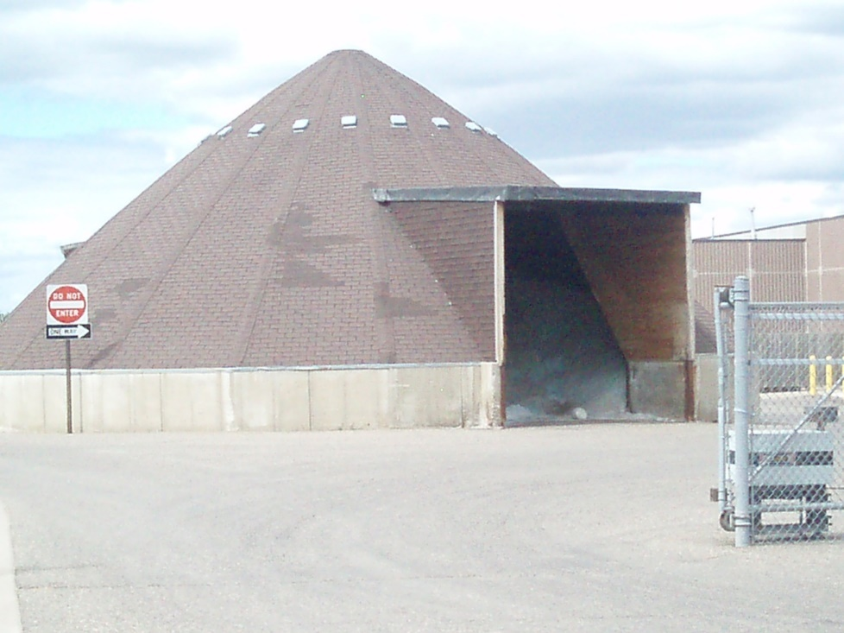
Section 2: Facility Inspection and Repair
Ensure structures are inspected and repaired ….
before receiving delivery of deicers/abrasives.
Notes:
Photo: Fortin Consulting, Inc.
A key point is to make sure your storage buildings are working well before you load them up. Seems like a simple concept but different people may be in charge of different tasks. Coordination is required for a smooth operation.
What do you see on this slide? Any repairs that should be made? What do you think about the amount of salt in the shed?

Slide 26
Test Question
When should you receive delivery of deicers/abrasives?
At any time
Before you inspect your facilities
After you inspect your facilities but before you fix them
After you inspect and have made any needed repairs
Notes:
Note to presenters: you may choose to hide this slide.
Test Question: when should you receive delivery of deicers/abrasives?
At any time (no)
Before you inspect your facilities (no)
After you inspect your facilities but before you fix them (no)
After you inspect and have made any needed repairs (yes)

Slide 27
Test Question
When should you receive delivery of deicers/abrasives?
At any time
Before you inspect your facilities
After you inspect your facilities but before you fix them
After you inspect and have made any needed repairs
Notes:
Note to presenters: you may choose to hide this slide.
Test Question: when should you receive delivery of deicers/abrasives?
At any time (no)
Before you inspect your facilities (no)
After you inspect your facilities but before you fix them (no)
After you inspect and have made any needed repairs (yes)

Slide 28
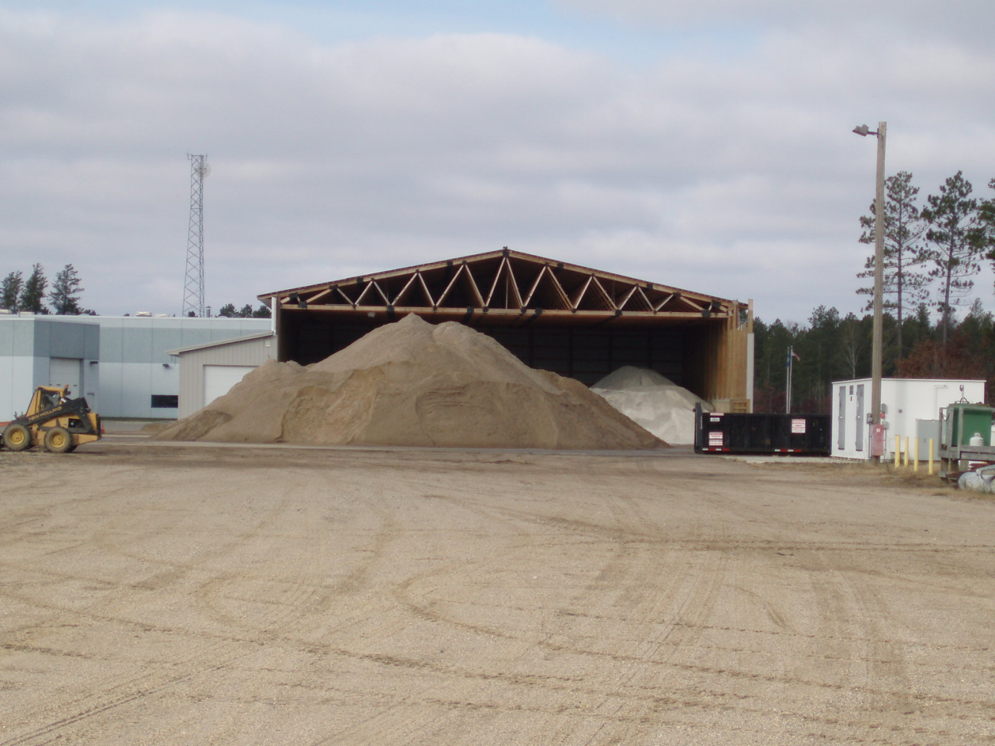
Section 2: Facility Inspection and Repair
Evaluate: do facilities meet the needs of the operation?
Notes:
Proper storage is required for all materials, winter sand included. Although there is adequate space for the stockpile it is not protected from the elements. A new strategy should be developed.

Slide 29
Test Question
Should winter sand be stored outside?
Yes
No
Notes:
Note to presenters: you may choose to hide this slide.
Test question: Should winter sand be stored outside?
Yes (no)
No (yes)

Slide 30
Test Question
Should winter sand be stored outside?
Yes
No
Notes:
Note to presenters: you may choose to hide this slide.
Test question: Should winter sand be stored outside?
Yes (no)
No (yes)

Slide 31
Found a problem? Chart a path!
Ignore
Enclose
Enlarge shed
Add another shed
Use less sand
Use liquids
Tarp
Move sand to another facility
Relocate
Change material
Notes:
Observe the situation
Chart out your options
Choose your path
Take action
Ignore should not be the choice you make!

Slide 32
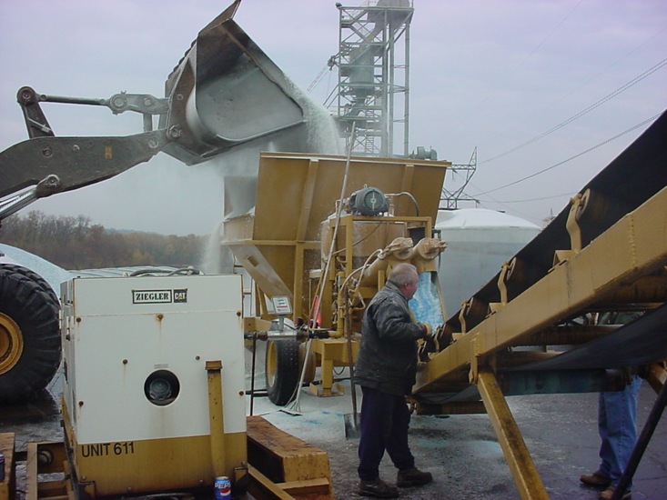
Section 3: Stocking of Deicers and Abrasives
Notes:
Photo credit: Wendy Frederickson, MnDOT
The goal of this section: Stocking of deicers and abrasives, is to review the importance of:
Setting up material contracts
Order and reorder material to meet the needs of the operation

Slide 33

Set up Material Contracts
Notes:
Image: Microsoft clipart
Discuss: What contracts do you have in place, and which ones need to be updated and put in place? Perhaps there are new products and vendors that you want to explore.

Slide 34
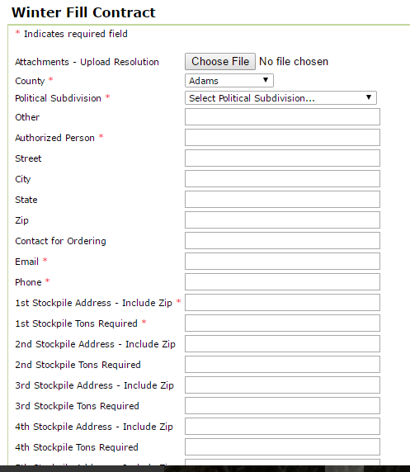
Set up Material Contracts
Develop a process to acquire the materials you need.
Note to presenters: Add details about your contracts here and delete this yellow box before making presentation.
Notes:
Image credit: Ohio DOT
Note to presenters: Add details about your contracts here and delete this yellow box before making presentation.

Slide 35
Order and Reorder Material
To meet the needs of your operation
Rock salt
Sand
Treated salt
Liquids
Additives
Dyes
Example:
2016 -2017 Storage Requirements
Initial fills by November 1
75% of working capacity or 5 year average, which ever is lower from November 1 to January 15
60% on hand February 1
30% on hand March 1
10% on hand April 1
Note to presenters: Describe your process here and delete this yellow box before making presentation.
Notes:
Example: Penn DOT
Once your contracts are in place, you are in a better position to receive shipments as you need them. Work fast to get all storage areas in good repair prior to receiving a shipment. Use your experience in ordering to not overfill your capacity. Have a Plan B ready in case you get more than you can store properly.

Slide 36
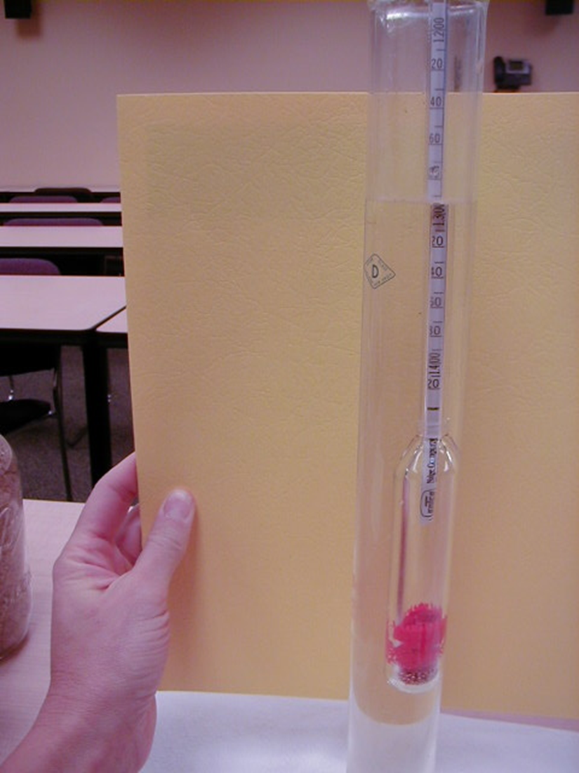
Materials Testing
Put in place: Material specifications and a material testing program.
This insures you get what you ordered.
If you get what you ordered and if you use the material in the right situation and in the proper amount.
It will perform as you expect it to perform.
Notes:
Photo credit: Fortin Consulting, Inc.
More information on material testing is available in Module 10: Deicer Agent Management Policy

Slide 37
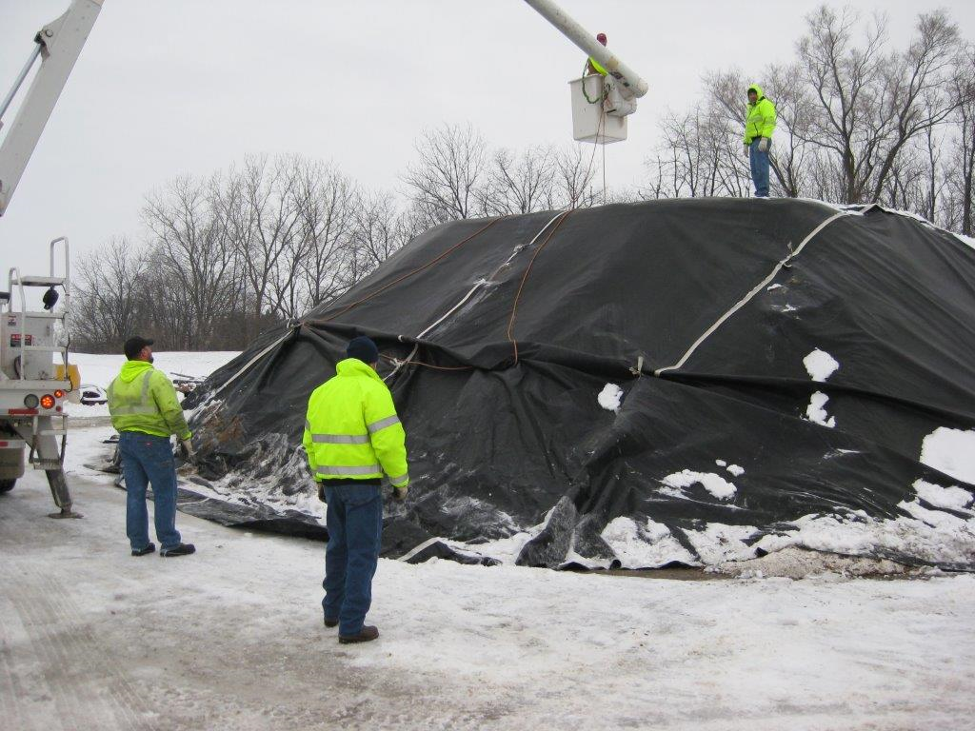
Order and Reorder Material
What is your back up plan if you receive more than you can handle?
Notes:
Photo credit: City of Beloit WI
Once your contracts are in place, you are in a better position to receive shipments as you need them. Work fast to get all storage areas in good repair prior to receiving a shipment. Use your experience in ordering to not overfill your capacity. Have a Plan B ready in case you get more than you can store properly.

Slide 38
Test Question
What should you do if you receive more salt than you can fit into your shed?
Put it outdoors uncovered but use it first
Stuff it into the shed beyond the fill capacity
Mix it with sand to reduce leaching and store outdoors
Tarp and secure the pile
Notes:
Note to presenters: you may choose to hide this slide.
Test question: What should you do if you receive more salt than you can fit into your shed?
Put it outdoors uncovered but use it first (no)
Stuff it into the shed beyond the fill capacity (no)
Mix it with sand to reduce leaching and store outdoors (no)
Tarp and secure the pile (yes)

Slide 39
Test Question
What should you do if you receive more salt than you can fit into your shed?
Put it outdoors uncovered but use it first
Stuff it into the shed beyond the fill capacity
Mix it with sand to reduce leaching and store outdoors
Tarp and secure the pile
Notes:
Note to presenters: you may choose to hide this slide.
Test question: What should you do if you receive more salt than you can fit into your shed?
Put it outdoors uncovered but use it first (no)
Stuff it into the shed beyond the fill capacity (no)
Mix it with sand to reduce leaching and store outdoors (no)
Tarp and secure the pile (yes)

Slide 40
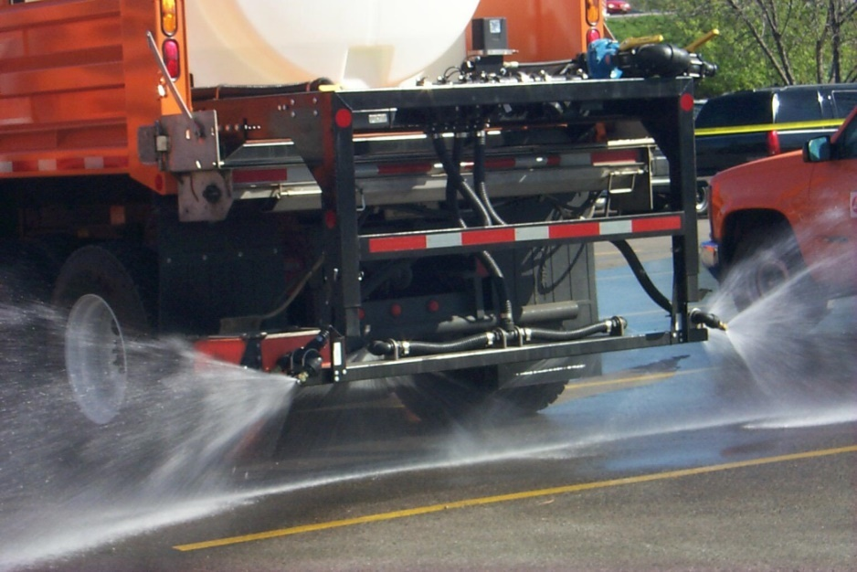
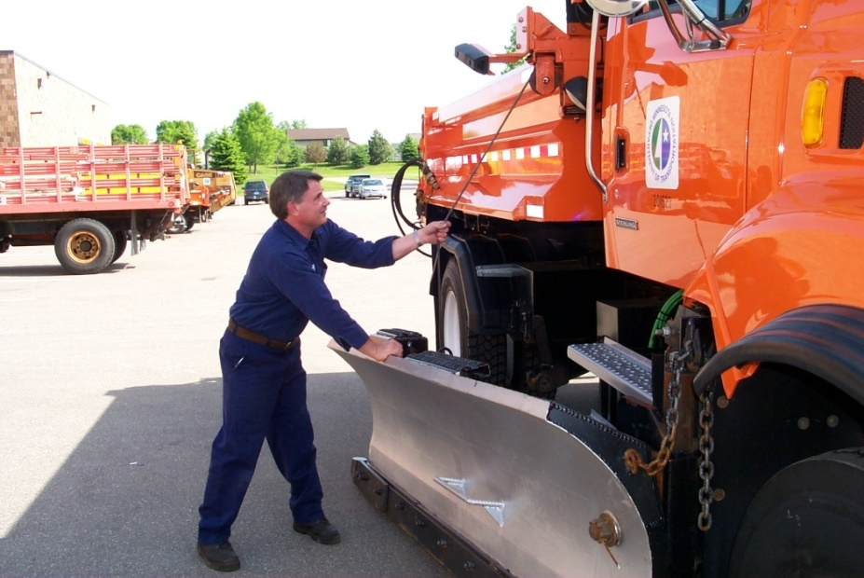



Section 4: Equipment Inspection, Repair & Calibration
Calibrate
Inspect
Repair
Notes:
Left Photo credit: Iowa DOT
Right Photo: credit MnDOT
Goal of this section:
Review the importance of equipment inspection, repair and calibration:
Inspect the equipment after finishing the winter season
Make repairs well in advance of winter operation
Ensure equipment is calibrated and that all involved know the calibration process
Inspect and repair support equipment like brine makers, conveyors and loaders

Slide 41
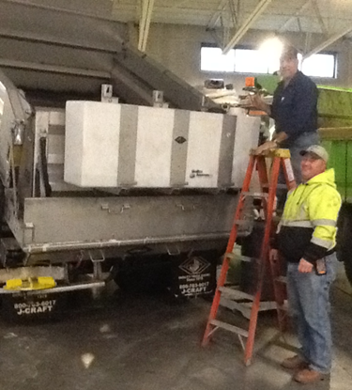
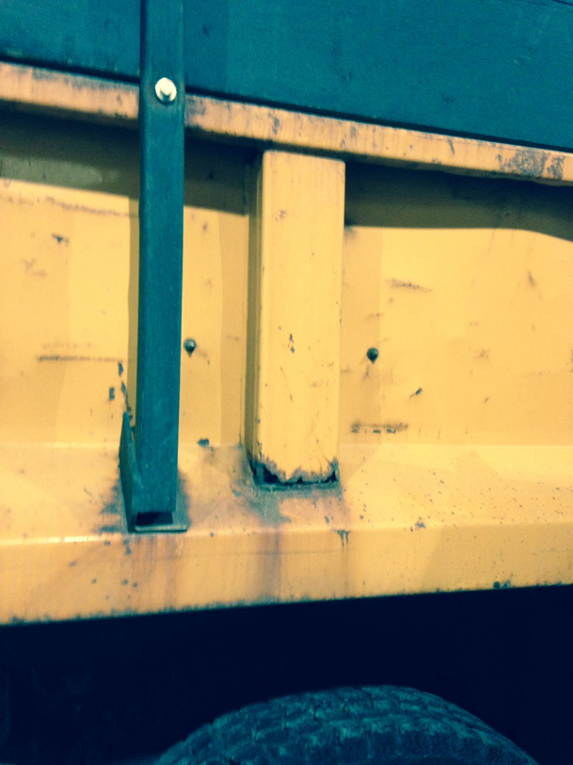

Equipment Inspection
Note to presenters: Insert your process here. Delete this yellow box before making presentation.
902.4 Dry Run Inspection Procedures
Annual dry run inspections are performed to verify the readiness of the Department for the upcoming winter season. Each District will conduct this effort based on the following process:
Establish an inspection team
Select equipment to be inspected
Develop an inspection schedule
Perform the inspections as per guidelines established by the Office of Equipment Management.
Notes:
Photo credit: Fortin Consulting, Inc.
Example: Ohio DOT MAM Volume II, Section 9: Snow and Ice Control
Supervisors, set up the schedule for your equipment to get the attention it needs in the offseason. What equipment needs inspecting in the off season and what is the schedule for this inspection and maintenance? Who is responsible for each aspect of this process? How is it documented so you can be sure everything has been taken care of?
See Clearroads training module 20: Record Keeping for more information on this topic.
Note to presenters: Insert your process here. Delete this yellow box before making presentation.

Slide 42

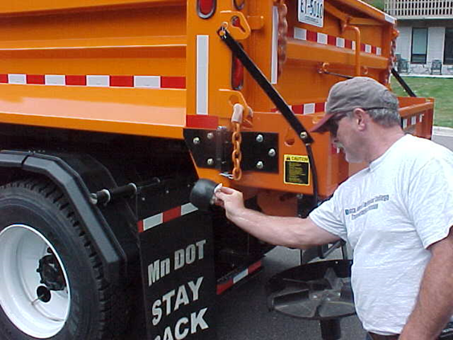
Equipment Repair
Note to presenters: Insert your making presentation. process here and delete this yellow box before making presentation.
- Keep ahead of major problems.
Have an inspection schedule and goals for your equipment.
Who is in charge?
Notes:
Photo credit: MnDOT
Good advice for everyone using equipment: pay attention, inspect, repair minor problems, report larger problems. Find a way to keep your equipment in top working order.
Note to presenters: Insert your making presentation. process here and delete this yellow box before making presentation.

Slide 43

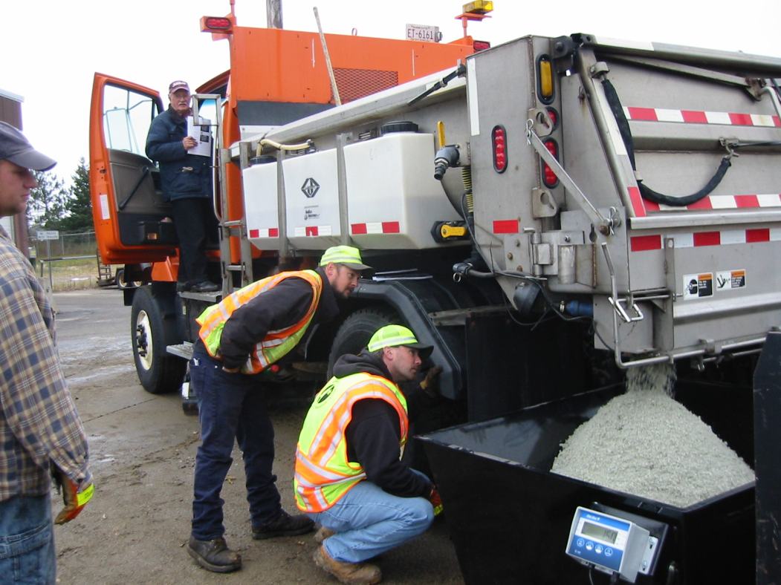
Equipment Calibration
Calibration
- Finds problems
- Saves salt
Saves money
Provides more consistent results
Protects the environment
Lets you know your truck is working properly
Notes:
Photo credit: MnDOT
Calibration is the process of understand how much material leaves the truck at each setting and at each speed. Without this general information the accuracy and efficiency of our operations is very low.
For more information on calibration see the Clearroads Calibration project: http://clearroads.org/project/calibration-accuracy-of-manual-and-ground-speed-control-spreaders/
And:
http://clearroads.org/wp-content/uploads/dlm_uploads/05-02_WisDOT-0092-06-21_Calibration-Final-Calibration-Guide.pdf

Slide 44

Equipment Calibration
Follow the manufacturer’s guidance for calibration
Calibration is the back-bone of a good program!
All equipment should be calibrated at least once a year.
Calibrate more often if there is an equipment change or problem suspected.
Notes:
Photo credit: Microsoft clipart
For more information on calibration and the importance of calibration. See Clearroads training module3: Spreaders.

Slide 45
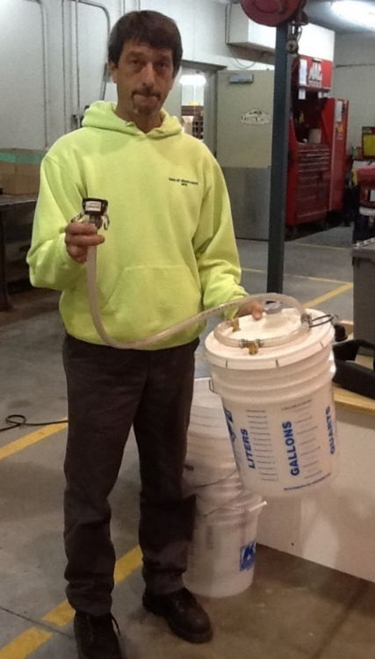
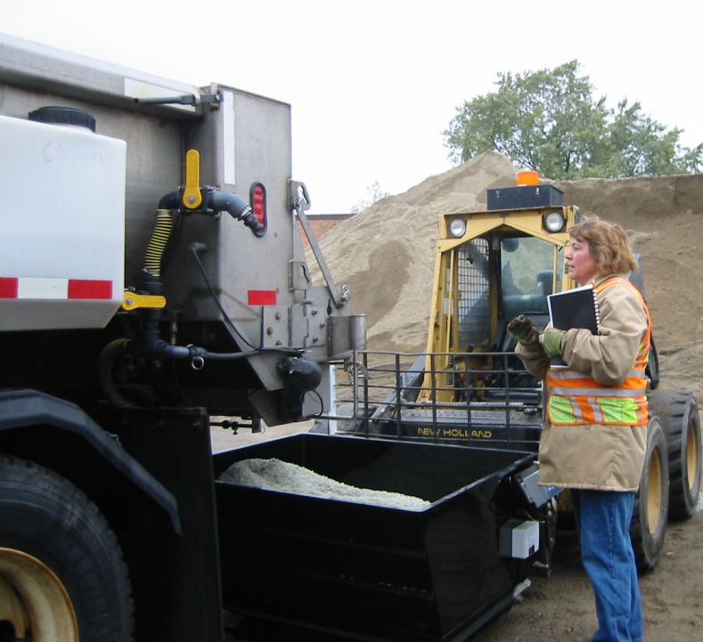
Equipment Calibration
Make sure all involved understand the importance of the calibration process…
and that the drivers know their truck has been calibrated and what that means.
Liquids & Granular
Notes:
Right Photo credit: MnDOT
Left photo credit: Fortin Consulting, Inc.
All products you spread should be calibrated for. That includes salt, salt/sand, liquids, pretreated salt. They all flow differently. The techniques used to calibrate will also vary between equipment types and material types.

Slide 46
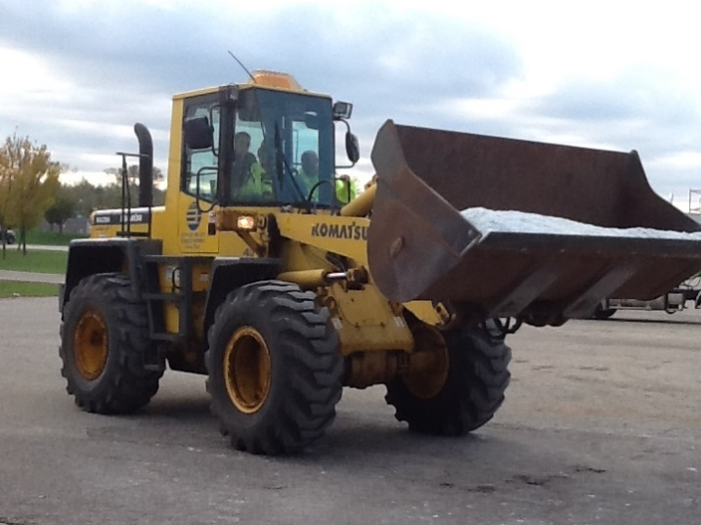
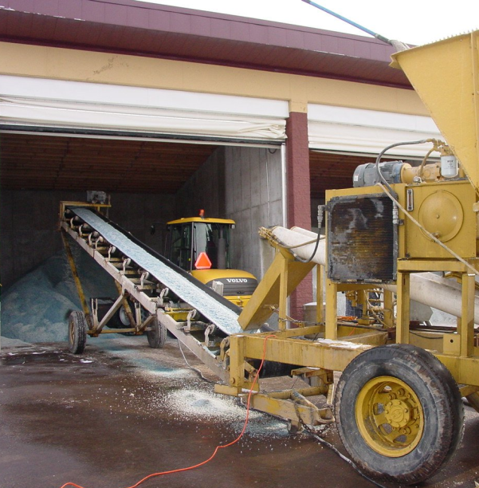
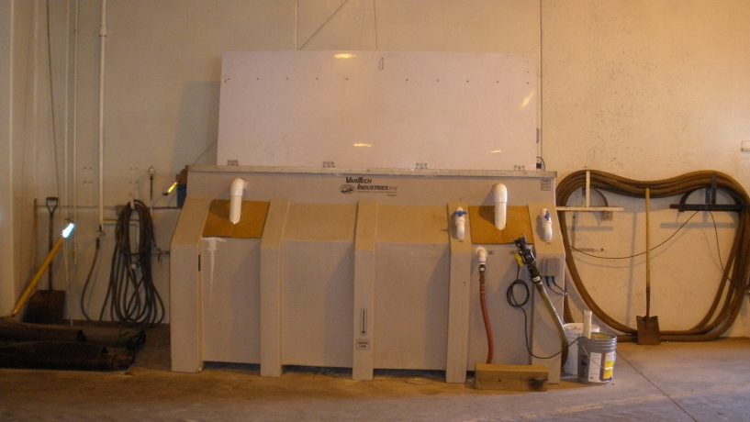
Inspect and Repair Support Equipment
Make a list of all support equipment and assign the inspection & repair of it to the appropriate people.
Lead the way!
Notes:
Photo credit: Fortin Consulting, Inc.
There should be an inventory of all auxiliary equipment needed for winter operations. Inspecting, repairing and getting it good working order prior to the season is work well done!
What is on your list?

Slide 47
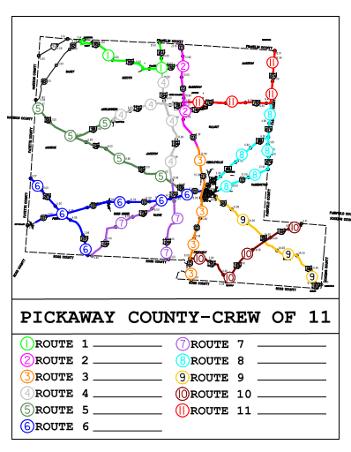
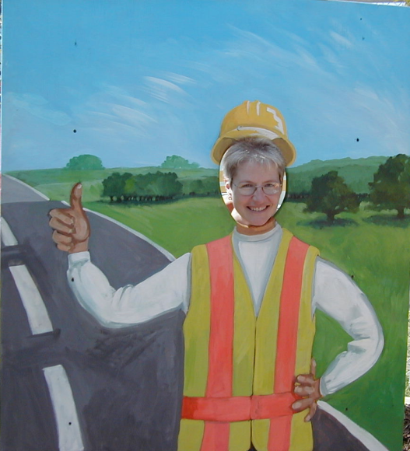
Section 5: Plow Route Review
Ensure that new lanes and routes that were built or reassigned are accounted for in snow plow routing.
Note to presenters: Insert one of your route maps here; list your routes and flag those with changes. Delete this yellow box before making presentation.
Notes:
Photo credit: Ohio DOT
The goal of this section is to review elements of the winter snow plow route:
a. Ensure that new lanes and routes that were either built or reassigned are accounted for in snow plow routing
b. Develop plans for newly constructed roundabouts, specialty interchanges and order special equipment if needed
Presenters: this would be a good time to list your routes and drivers or include the computer link to the file where the routes and drivers can be found.
Ensure that any new lanes or routes have been assigned and accounted for in plowing.

Slide 48
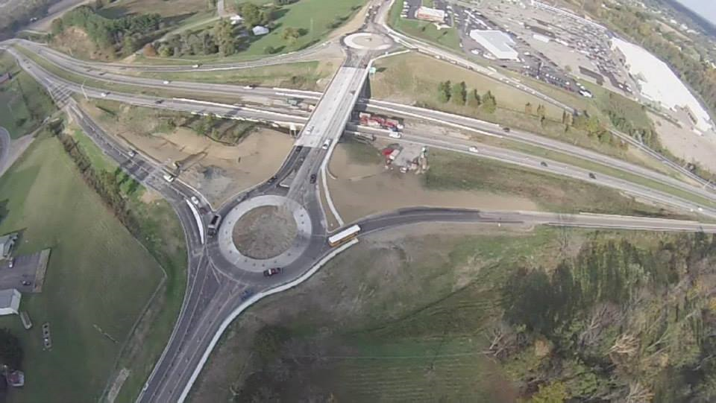
Section 5: Plow Route Review
Develop plowing strategies for newly constructed roundabouts and specialty interchanges, and order special equipment if needed.
Note to presenters: show or list changed areas or areas of concern that need discussion and delete this yellow box before making presentation.
Notes:
Photo credit: Ohio DOT
Managers: review changes to your lanes and account for them in your route planning. Consider if a new piece of equipment or new training would benefit your snow removal or snow storage operations.
Note to presenters: show or list changed areas or areas of concern that need discussion and delete this yellow box before making presentation.

Slide 49
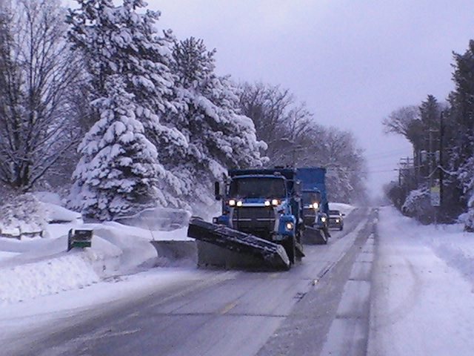
Section 5: Plow Route Review
Identify or have your drivers identify trouble spots, hazards and other areas of concern.
Watch for: mail boxes, low overhead wires, bridges, railroad tracks, manhole covers, bus stops, rivers…
Make sure LOS targets are clearly defined.
Notes:
Photo credit: Ramsey County, Minnesota
For more information on plowing see module1: Plowing Procedures
For more information of LOS see module 19: Supervisors and Winter Maintenance

Slide 50
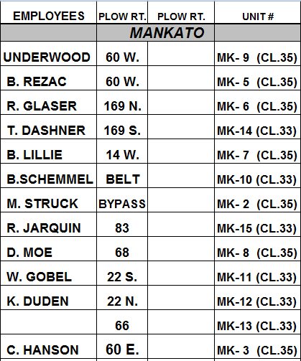
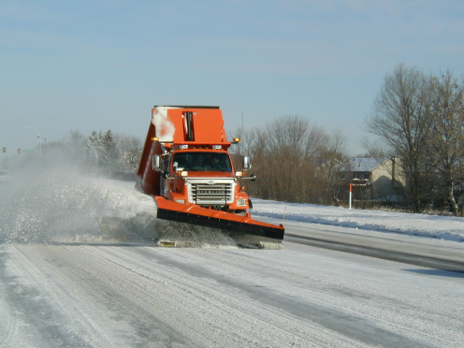
Section 5: Plow Route Review
Proper route planning, and driving the routes before winter puts you in the driver’s seat come the first storm!
Drivers should pay attention to newly constructed roundabouts, specialty interchanges.
Note obstacles for plow blades such as railroad crossings.
Note snow-throwing restriction areas like bridges, bus stops.
Note to presenters: Insert your chart here and delete this yellow box before making presentation.
Notes:
Photo and Chart credit: MN DOT
Being proactive always pays off! The management team should set the stage for good assignments, the operators follow their lead by learning their routes, obstacles and challenges. The first storm is always a challenge and this is one step to a successful season.
Presenters: include other items in the discussion that are relevant to them as a group or to a particular route. Even if the routes are the same as last year, each one should be driven and observed prior to the first event. Things change over the course of the summer and the first event is not a good time for a surprise.

Slide 51
Test Question
What is the benefit to route planning and route practice?
All new lanes and intersections are assigned
Everyone knows their route and route hazards and challenges
Management and operators have exchanged information on each route
All of the above
Notes:
Note to presenters: you may choose to hide this slide.
Test question:
What is the benefit to route planning and route practice?
All new lanes and intersections are assigned (no)
Everyone knows their route and route hazards and challenges (no)
Management and operators have exchanged information on each route (no)
All of the above (yes)

Slide 52
Test Question
What is the benefit to route planning and route practice?
All new lanes and intersections are assigned
Everyone knows their route and route hazards and challenges
Management and operators have exchanged information on each route
All of the above
Notes:
Note to presenters: you may choose to hide this slide.
Test question:
What is the benefit to route planning and route practice?
All new lanes and intersections are assigned (no)
Everyone knows their route and route hazards and challenges (no)
Management and operators have exchanged information on each route (no)
All of the above (yes)

Slide 53
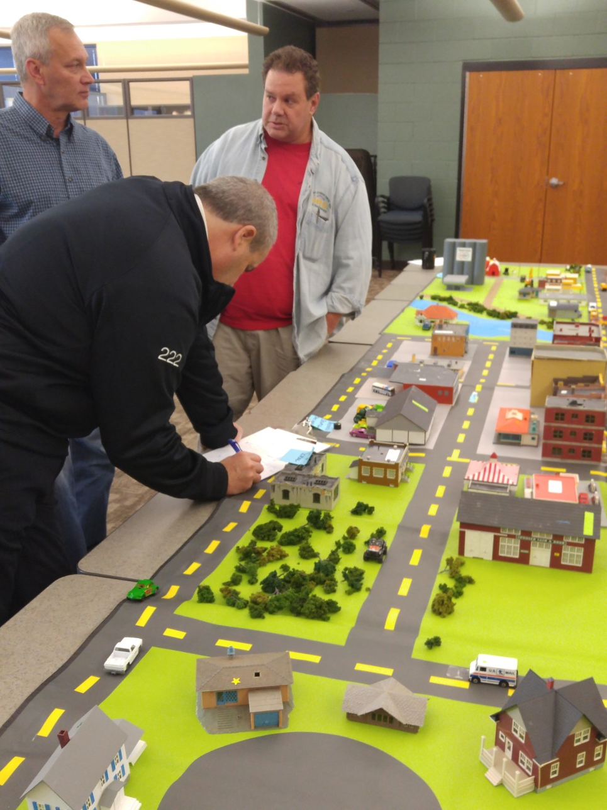
Section 6: Meet with Emergency Services and Neighboring Agencies
Notes:
Photo credit: Eden Prairie, MN Fire Department
The goal of this section is to highlight the importance of meeting with emergency services and neighboring local public agencies.
a. Meeting with emergency services (fire, police, ambulances service) to ensure you know their needs and they know your level of service
b. Ensure that snow plow route turnaround points are known and that boundaries of services are established

Slide 54





You are the Leader in Winter Maintenance
Form relationships with the emergency service providers in your area. Determine what role you all play in winter weather.
Note to presenters: Replace these logos with those of your local emergency service partners, and delete this yellow box before making presentation.
Notes:
Photo credit: Ohio DOT
Logos: Microsoft clipart:
You are responsible for winter maintenance, yet you work side by side with many support services. You should meet with all of the organizations involved and clearly layout how you would like to work with them during snow events. If you do not want other organization calling the shots, take a proactive leadership approach and plan and manage winter events within and outside of your organization.
Note to presenters: Replace these logos with those of your local emergency service partners, and delete this yellow box before making presentation.

Slide 55
Test Question
Who should be in charge of winter road operations?
State Patrol
Fire Department
DOT
Towing company
Notes:
Note to presenters: you may choose to hide this slide.
Test Question:
Who should be in charge of winter road operations?
State Patrol (no)
Fire Department (no)
DOT (yes)
Towing company (no)

Slide 56
Test Question
Who should be in charge of winter road operations?
State Patrol
Fire Department
DOT
Towing company
Notes:
Note to presenters: you may choose to hide this slide.
Test Question:
Who should be in charge of winter road operations?
State Patrol (no)
Fire Department (no)
DOT (yes)
Towing company (no)

Slide 57
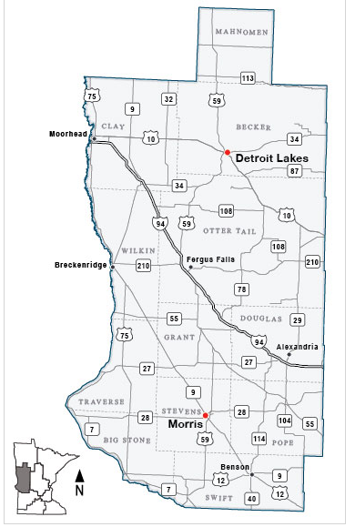
Route Planning
Ensure that snow plow boundaries of services are established.
Note all exceptions such as a city picking up the state highway going through their town.
Note to presenters: insert your agency’s service boundary map here, and delete this yellow box before making presentation.
Notes:
Map credit: MnDOT
If there is a swap of responsibilities between your organization and others, list and map all agreements. For example: a city may agree to maintain the state highway running through their town. Make sure it is documented on the route maps and by some sort of formal agreement between agencies so the service to the travelling public is uninterrupted.
Work with neighboring organizations to create a smooth transition between your roads and theirs.
Note to presenters: insert your agency’s service boundary map here, and delete this yellow box before making presentation.

Slide 58
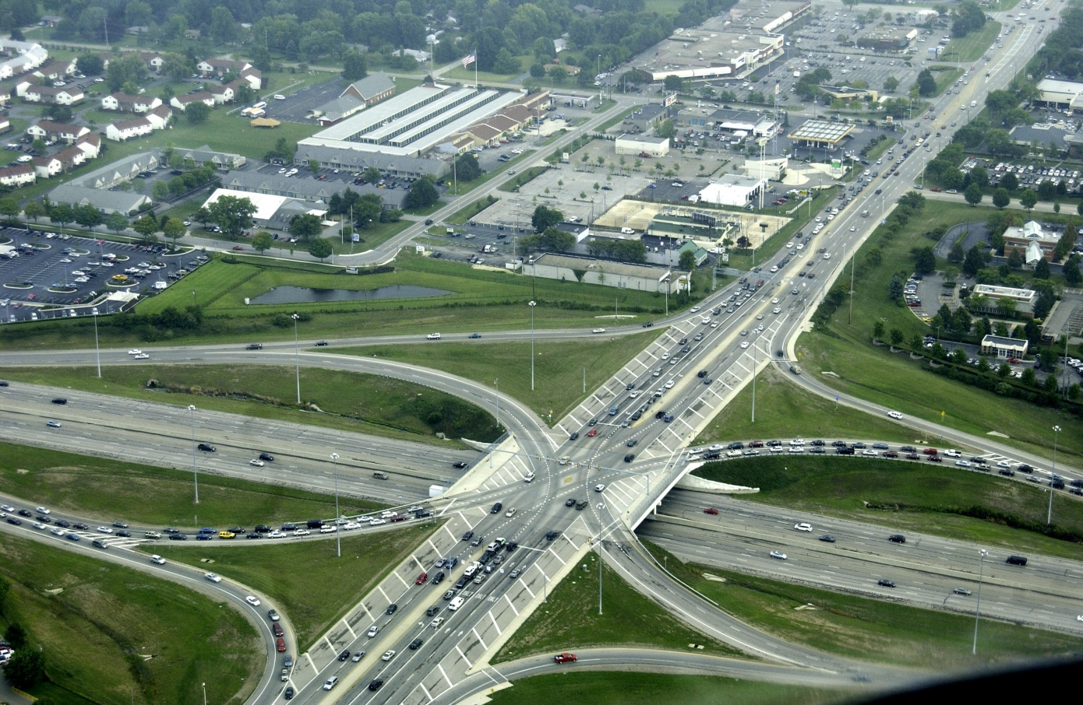
Route Planning
Make sure drivers know turnaround points. Reinforce that they should avoid salting or plowing the overlap unless you communicate with the driver of that route.
Notes:
Photo credit: Ohio DOT
All drivers should understand their route and where their deadhead zone is to reach their route as they drive on other routes. Work with neighboring organizations to create a smooth transition between your roads and theirs.

Slide 59

Organization pays off!
Organization is the key to being prepared.
Being prepared is the key to a great winter season.
Notes:
Organization pays off!

Slide 60
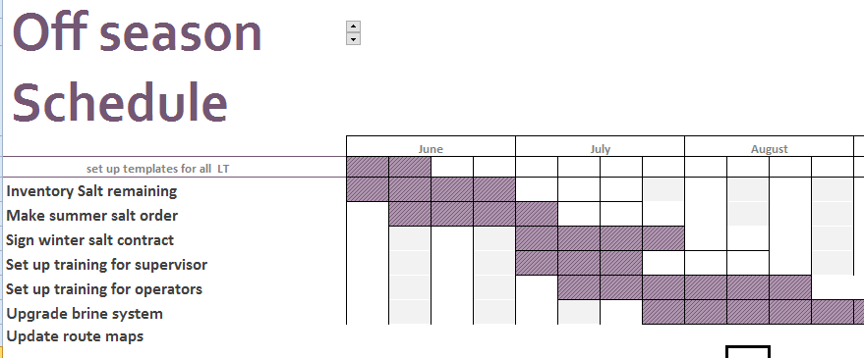
Chart Your Course
Develop a task list
Notes:
During this slide, outline your typical off season schedule. Keep it as a template. Update your current copy throughout the year as you understand the off season tasks that need to be accomplished. Use it to guide you smoothly through the offseason to super prepared status for winter operations.

Slide 61
Chart Your Course
Set up a timeline
June 1 - June 15
June 1 - July 1
June 7- July 7
July 1 - Aug 1
Notes:
Lay out your typical off season schedule. Keep it as a template. Update your current copy throughout the year as you understand the off season tasks that need to be accomplished. Use it to guide you smoothly through the offseason to super prepared status for winter operations.

Slide 62
Chart Your Course
Save it for next year
Notes:
Lay out your typical off season schedule. Keep it as a template. Update your current copy throughout the year as you understand the off season tasks that need to be accomplished. Use it to guide you smoothly through the offseason to super prepared status for winter operations.

Slide 63

Importance of Record Keeping
Shows that you follow policies including Levels of Service
Shows where efficiency can be improved
Helps with planning
Helps protect you from claims
Notes:
Record keeping is important as a means of material accountability, budgeting/cost tracking, performance tracking, support in the event of legal actions, media inquiries, and planning.

Slide 64
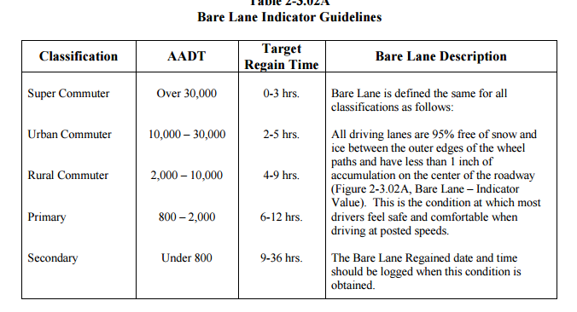
Get to know your policy
Get familiar with the policy contents including
EXAMPLE:
Public Safety
Levels of service
Education
Coordinating with other jurisdictions
Insert a picture of your policy here
Customize this slide for your policy
Notes:
Note to presenters: this slide should be customized to reflect your policy. Outline the details of your winter maintenance policy. This policy may be updated on a yearly basis depending on changes in treatment areas, equipment, or materials. Make sure that all employees are familiar with the parts of the winter maintenance policy that apply to them and that they know where they can access your winter maintenance policy.
Insert an example of your policy here. Delete this yellow box before making presentation.
Credit: MnDOT Maintenance Manual http://www.dot.state.mn.us/maintenance/pdf/manual/Ch2.pdf

Slide 65
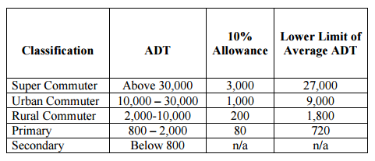
Level of Service
Keeping good records helps
To show you meet your level of service
To show you are following policy
To defend yourself when faced with a lawsuit
Notes:
Ask participants: When is it not possible to meet your level of service and how would you document this?
Credit: MnDOT Maintenance Manual http://www.dot.state.mn.us/maintenance/pdf/manual/Ch2.pdf

Slide 66
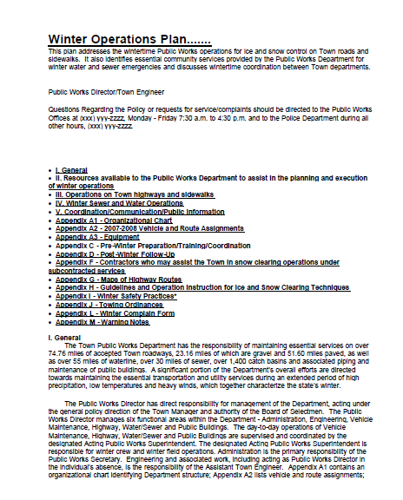
Where can you find your policy?
EXAMPLE:
Website
Break room
Poster
Training
Etc.
EXAMPLE
Customize this slide for your policy
Insert a list where employees can find your policy here. Delete this yellow box before making presentation.
Notes:
It is important for everyone to be familiar with your policy and to follow the record keeping procedures. Stress that following and keeping good records helps when dealing with lawsuits.
Insert an example of your policy here. Delete this yellow box before making presentation.
Credit: Winter Operations Plan ASHTO and Clear Roads

Slide 67
Response to Lawsuits
Crashes are going to occur
Defense will depend on following your plan and records
Document any deviations from policy
Make sure all employees know, follow, and keep records of actions
EXAMPLE
Notes:
Crashes are going to occur. Your organization’s defense will depend on following your plan and keeping records to show that you are following policy. Document any deviations from guidelines and policies, and make sure all employees know, follow, and keep records of actions to prove they follow policy.
Insert an example of your policy here. Delete this yellow box before making presentation.
Credit: Winter Operations Plan ASHTO and Clear Roads

Slide 68
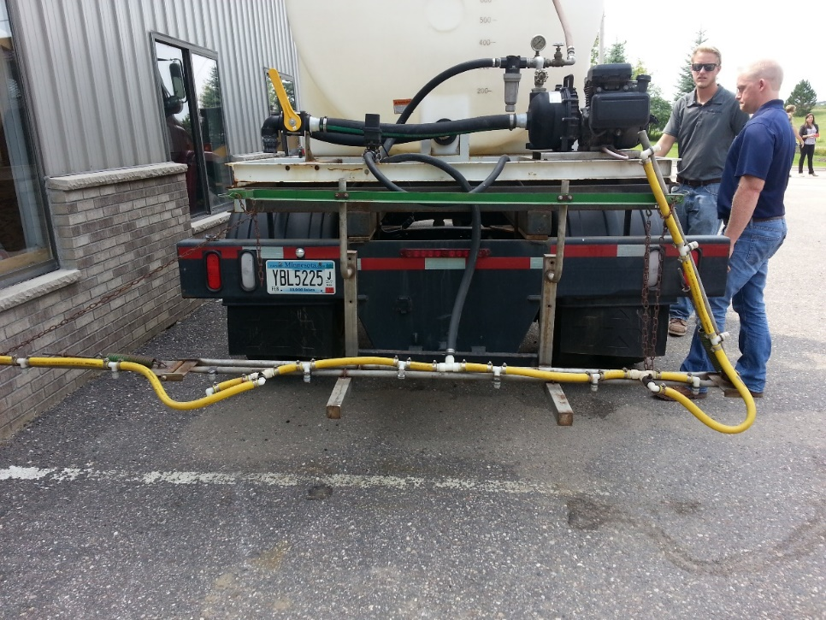
Before the Season
In this section we will be covering these topics:
Records of material purchasing
Records of material quality control
Record equipment inspections
Record equipment calibration
Customize this slide for your operation
Insert a copy of your truck inspection check list and procedure. Delete this yellow box before making presentation.
Notes:
In this section we will be covering the topics shown here.
Note to presenters: If any of the items on this list do not apply to you, delete them from the list, and hide the slides. If there is something else that you do before the season, add it in here and in the provided slide at the end of the section.
Also: insert a copy of your truck inspection checklist and procedure here. Delete this yellow box before making presentation.
Records of material purchasing
Records of material quality control
Record equipment inspections
Record equipment calibration
OTHER?
Note: More about these topics can be found in Module 23 – Getting Ready for Winter.

Slide 69
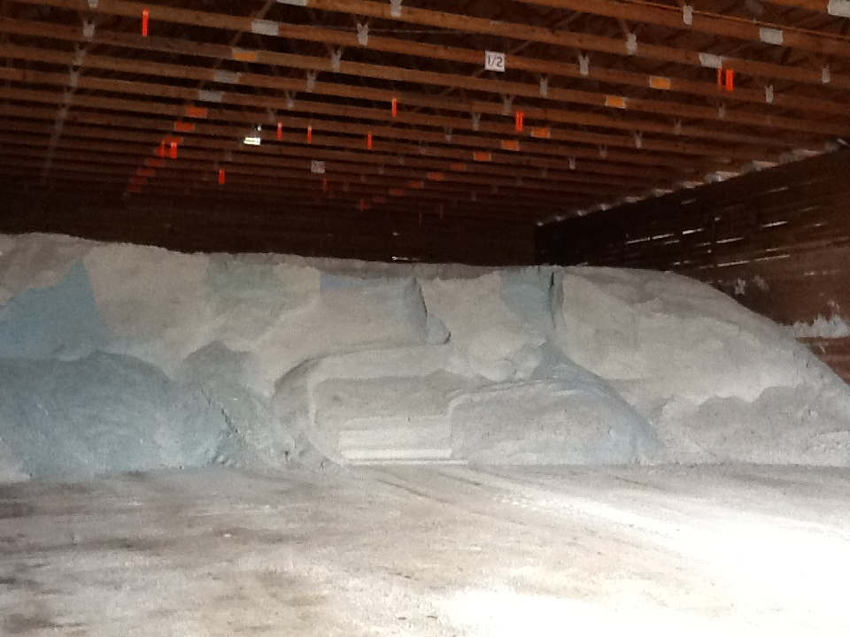
Material Accountability
Know how much you have
Know how much you use
Notes:
It is important to know how much salt you start with, how much you have throughout the season and how much salt you use. Knowing this helps with evaluating salt application efficiency, and for predicting order numbers in the future.

Slide 70

Record Keeping and Quality Control
Test the materials
Solids- test the moisture content
Liquids- test the specific gravity
Check that you get what you ordered
Keep accurate records on quantities ordered, received and used
If you see something wrong, tell your supervisor
Quality Control is vital
Notes:
Quality Control is vital. Every experienced user will inform you just how vital it is. If you do not have a quality control process in place, you can receive very different materials. This translates into effective vs. ineffective operations, environmental contamination, handling difficulties, equipment issues, and on and on.
Test the materials as shown here:
Solids- test the moisture content
Liquids- test the specific gravity
Check that you get what you ordered
Keep accurate records on quantities ordered, received and used
If you see something wrong tell your supervisor
If test results don’t meet the requirements for material ordered, we can reject the delivery.
Note: More information can be found in Module 10 Deicer Agent Management Policy.
Slide credit: CDOT Snow Removal Operator Training

Slide 71

Record Keeping and Materials Testing
Liquids: specific gravity
Document % and compare to specification
Don’t use it if it doesn't match the specification
Insert your state’s policy here. Delete this yellow box before making presentation.
Notes:
If the specific gravity doesn’t match the spec, there’s no way to know the temperature at which it will freeze on the road.
Note: There is more about material testing in Module 10 Deicer Management Policy.
Note to presenters: If you have a form or policy regarding record keeping for materials testing, include that information here (you could insert a photo of the cover of your document as an example).
Delete this yellow box before making presentation.
Photo credit: Fortin Consulting, Inc.

Slide 72
Test Question
True or False: It is important to test and record the concentration of your solution when making brine.
True
False
Notes:
Note to presenters: you may choose to hide this slide.
Test Question: Is it important to record the concentration of your solution when making brine?
a. True (yes)
b. False (no)

Slide 73
Test Question
True or False: It is important to test and record the concentration of your solution when making brine.
True
False
Notes:
Note to presenters: you may choose to hide this slide.
Test Question: Is it important to record the concentration of your solution when making brine?
a. True (yes)
b. False (no)

Slide 74

Pre-season Truck Inspections
Example:
Ensure the “attack angle” is set correctly for plow and wing
Inspect the plows and plow gear for any damage
Ensure salt distribution system is working properly
Insert your pre-season truck inspection method here. Delete this yellow box before making presentation.
Notes:
This slide probably lists mechanic’s tasks rather than a driver’s tasks. As a manager, you should get records of everything that is done. Before winter, trucks must be made winter-ready. This includes adding plows, tanks, and spray bars. This should all be done and records made before the first snow event occurs.
Note to presenters: Insert your pre-season truck inspection here. Delete this yellow box before making presentation.
Photo credit: Fortin Consulting, Inc.

Slide 75

Records of Truck Inspections
Customize this slide for your operation
EXAMPLE
Insert a copy of your truck inspection check list and procedure. Delete this yellow box before making presentation.
Notes:
On this slide, present the basics of how to fill out the truck inspection sheet. These sheets should be filled out and handed in to the supervisor to keep as a record.
Note: For more about truck inspections see Module 23 Getting Ready for Winter.
Note to presenters: Insert a copy of your truck inspection checklist and procedure here. Delete this yellow box before making presentation.

Slide 76
Records of Truck Inspections
Make sure your employees know how to fill out and where to turn in their inspection forms
EXAMPLE
Customize this slide for your operation
Insert a copy of your truck inspection check list and procedure. Delete this yellow box before making presentation.
Notes:
Make sure your crew fills out an inspection form for each truck and submits it to you. Keep them in a safe place. If an action is needed based on this inspection, take the appropriate steps to have any needed repairs or equipment purchased in a timely fashion.
Note: For more about truck inspections see Module 23 Getting Ready for Winter.
Note to presenters: Insert a copy of your truck inspection checklist and procedure here. Delete this yellow box before making presentation.

Slide 77

Calibrate and Record
Setting | Output
2 | 153
3 | 224
4 | 327
5 | 394
Notes:
Calibrate all trucks before the season starts. If you are using more than one material, calibrate for each material. Calibration is an important part of keeping track of materials. It also allows you to better meet your level of service goals as well as estimate how much material is being applied.
Photo credit: Steve Chlebeck

Slide 78



Calibrate and record for liquids too
Notes:
Trucks should be calibrated for any liquids as well.

Slide 79

Records of Truck Calibration
EXAMPLE
Customize this slide for your operation
Insert a copy of your truck calibration form and any instructions. Delete this yellow box before making presentation.
Notes:
Usually there will be a team of people who will calibrate; not all of the drivers. This slide is so that everyone knows that this is taking place.
Note to presenters: Insert a copy of your truck calibration form and any instructions here. Delete this yellow box before making presentation.
Photo credit: MnDOT http://www.dot.state.mn.us/maintenance/pdf/research/SaltSanderCalibrationGuide.pdf

Slide 80

Decision Making Before the Storm
In this section we will be covering these topics:
Pre-storm meeting
Insert a list of record keeping needed in your operation to prepare for a storm. Delete this yellow box before making the presentation.
Notes:
In this section we will be covering these topics. If there is something that doesn’t apply to you, hide those slides. If there is something else that you do before the season, add it in here and in the provided slide at the end of the section.
Pre-storm meeting
Other topics? Insert here before making presentation.
Note to presenters: Insert a list of record keeping needed in your operation to prepare for a storm. Delete this yellow box before making presentation.

Slide 81

Pre-storm Meeting
Make a plan for the storm, for EXAMPLE:
Storm and weather forecast
Staffing
Equipment levels
Customize this slide for your operation
Insert your pre-storm meeting objectives. Delete this yellow box before making the presentation.
Notes:
Take time before the storm to get together to make a plan. You can discuss the forecasted storm, staffing, equipment levels, and expectations for the storm.
Note to presenters: Insert a copy of your pre-storm meeting objectives here. Delete this yellow box before making presentation.

Slide 82


Pre and Post Trip Inspections
EXAMPLE
Insert a your document for pre and or post trip inspections. Delete this yellow box before making the presentation.
Customize this slide for your operation
Notes:
Present your pre and post trip inspections procedure. Include those things that need to be looked over and common problems that operators may come across.
Note to presenters: Insert a copy of your pre and post trip inspection form here. Delete this yellow box before making presentation.
Photo credit: Olmstead County

Slide 83


Document by Material Type
Solids
Liquids
Record any time you load, apply, or replace material
Notes:
It is important to know both what materials and the total of each that were used. This can help to predict the amount needed for future seasons as well as help in evaluating how well treatment went for an event.
Photo credits: Fortin Consulting, Inc.

Slide 84
Test Question
Which items should be documented?
Material use per storm
Material use per season
Material use per crew member
All of the above
Notes:
Note to presenters: you may choose to hide this slide.
Test question: Which items should be tracked?
Salt use per storm (no)
Salt brine use per season (no)
Winter sand use per crew member (no)
All of the above (yes)

Slide 85
Test Question
Which items should be documented?
Material use per storm
Material use per season
Material use per crew member
All of the above
Notes:
Note to presenters: you may choose to hide this slide.
Test question: Which items should be tracked?
Salt use per storm (no)
Salt brine use per season (no)
Winter sand use per crew member (no)
All of the above (yes)

Slide 86
Storm Documentation
EXAMPLE:
Work orders
Patrol log
Material usage log
Equipment work orders
Fuel logs
Time sheets
Diary
TAPER log
Customize this slide for your operation
Insert a list of forms needed to be completed by operators for a storm. Delete this yellow box before making the presentation.
Notes:
Review the storm documentation needed for your agency.
Note to presenters: Insert a list of forms needed to be completed by operators for a storm here. Delete this yellow box before making presentation.
Slide credit: CDOT Snow Removal Operator Training

Slide 87

Document Your Operations
EXAMPLE:
Conditions- weather and road, pavement temp
Material type and quantity used
Timing
# of passes and when
Unusual conditions/circumstances
Customize this slide for your operation
Insert an example of your state’s event log and explain how to fill it out. Delete this yellow box before making the presentation.
Notes:
It is very important that plow drivers document the actions taken in response to a snow/ice event
This will include the road conditions throughout their shift, type and amount of deicer or anti-icer used, timing of operations, and the number of passes and when. If there are unusual conditions that affect the operations, those should be recorded. For example, road construction, accidents, major compaction problems, etc.
Note to presenters: Insert a copy of your state’s event log and explain how to fill it out. Delete this yellow box before making presentation.
Photo credit: INDOT

Slide 88
Example: T A P E R
T = Temperature
A = Application
P = Product
E = Event
R = Results
Notes:
Use this slide if your state uses the TAPER system to help explain. Hide this slide if it doesn’t use the TAPER system.
Slide credit: CDOT Snow Removal Operator Training

Slide 89
Event Log
Insert an example of your state’s event log. Delete this yellow box before making presentation.
Customize this slide for your operation
EXAMPLE
Notes:
Review this sequence of events as illustrated on this report, pay particular attention to the changes that took place in the highlighted entries. Note that this TAPER log really paints a good picture of what was done, when it was done, how it was done, who did it with what and what the outcome was like. If you had this information coming on to shift, would you really even need to talk to the person you are relieving?
Note to presenters: Insert an example of your state’s event log here. Delete the yellow box before making presentation.
Slide credit: CDOT Snow Removal Operator Training

Slide 90
Test Question
What should you record during the storm?
Type of product used
Application rate
Pavement temperature
All of the above
Notes:
Note to presenters: you may choose to hide this slide.
Test question: What do you need to record for the TAPER log?
Product (no)
Results (no)
Temperature (no)
All of the above (yes)

Slide 91
Test Question
What should you record during the storm?
Type of product used
Application rate
Pavement temperature
All of the above
Notes:
Note to presenters: you may choose to hide this slide.
Test question: What do you need to record for the TAPER log?
Product (no)
Results (no)
Temperature (no)
All of the above (yes)

Slide 92

Decision Making After the Storm
In this section we will be covering these topics:
Post storm meeting
Record equipment repairs
Record/verify total material used
Record regain time
Customize this slide for your operation
Insert a list of record keeping needed in your operation after the storm. Delete this yellow box before making presentation.
Notes:
In this section we will be covering these topics. If there is something that doesn’t apply to you, hide those slides. If there is something else that you do before the season, add it in here and in the provided slide at the end of the section.
Note to presenters: Insert a list of record keeping needed in your operation after the storm. Delete this yellow box before making presentation.
Post storm meeting
Record equipment repairs
Record/verify total material used
Record regain time
OTHER
Photo credit: Fortin Consulting, Inc.

Slide 93

Post Storm Meeting
Plan to hold post-storm meetings, to discuss what went well and what could be improved for the next event.
Notes:
You should have a record of what everybody did during the storm with you at the meeting. Review this information during the meeting, discuss how the storm went, how equipment worked, and any other important topics pertaining to the event.
Photo credit: Fortin Consulting, Inc.

Slide 94

Equipment Maintenance
Notes:
Keeping track of when and what maintenance happens on each piece of equipment is an important piece of record keeping.
This information can help to predict the lifespan of different pieces of equipment and how to budget for new equipment.
It could also help to indicate if someone is being harder on equipment than other operators (for example if one person wears through plow blades more quickly than everyone else, maybe they are placing their blade too low.)
Photo credit: MnDOT

Slide 95

Equipment Repairs
Submit this form after each storm to document what’s needed.
Insert your equipment repair form here. Delete this yellow box before making presentation.
EXAMPLE
Notes:
If any problems are noted in your post trip inspection be sure to record them and submit the information so that the truck can be repaired in time for the next event.
Go over your equipment repair form and how to fill it out.
Note to presenters: insert your equipment repair form here. Delete this yellow box before making presentation.
Picture credit: Ohio, http://www.puco.ohio.gov/emplibrary/files/Trans/Enforcement/forms/Vehicle%20Inspection,%20Repair%20and%20Maintenance%20Record%20Form.pdf

Slide 96

Cost-tracking
Review your costs at the end of the year to see where you can be more efficient
Per storm
Winter season total
Equipment purchases
Material purchases
Labor
Customize this slide for your operation
Insert a list of cost tracking needed in your operation after the season. Delete this yellow box before making presentation.
Notes:
Cost tracking is an important part of keeping things running. Costs per storm, for the entire winter season, equipment purchases, material purchases, labor, and fuel and maintenance all go into overall costs. Part of your job is to keep track and manage these costs.
Note to presenters: Insert a list of cost tracking needed in your operation after the season. Delete this yellow box before making presentation.
Photo credit: Microsoft clipart

Slide 97

Planning
Use records from previous years to help predict future materials, equipment, and maintenance needs.
Notes:
While no season or even event is the same, you can use records of previous years to help predict future needs in materials, equipment, and maintenance.
Photo credit: Microsoft clipart

Slide 98

Record Keeping is Important!
You can’t break any records if you’re not keeping track!
You are an important part of the record keeping puzzle!
Notes:
Photo credit: Microsoft clipart

Slide 99

Preparing for Winter Puts US in the Drivers Seat
Note to presenters: insert your state’s seal here or your logo here, and delete this yellow box before making presentation.
Notes:
Image credit: Microsoft clipart

Slide 100
Test Question
Preparing for winter has what major advantage?
Puts us in the drivers seat
Keeps the supervisors busy
Keeps the operators busy
Insures good weather
Notes:
Note to presenters: you may choose to hide this slide.
Test question:
Preparing for winter has what major advantage?
Puts us in the drivers seat (yes)
Keeps the supervisors busy (no)
Keeps the operators busy (no)
Insures good weather (no)

Slide 101
Test Question
Preparing for winter has what major advantage?
Puts us in the drivers seat
Keeps the supervisors busy
Keeps the operators busy
Insures good weather
Notes:
Note to presenters: you may choose to hide this slide.
Test question:
Preparing for winter has what major advantage?
Puts us in the drivers seat (yes)
Keeps the supervisors busy (no)
Keeps the operators busy (no)
Insures good weather (no)

Slide 102

Thank you for your good work!
Notes:
Image credit: Ohio DOT
Thank you for your time today. Have a good winter!

Slide 103
Acknowledgements
Training contents were developed by Fortin Consulting Inc., under the direction of the Clear Roads Advisory Team.
Connie Fortin – connie@fortinconsulting.com
Lauren Tjaden – lauren@fortinconsulting.com
Professional formatting and training aids were developed by the University of Minnesota, Center for Transportation Studies.
Jim Grothaus – Groth020@umn.edu
Ann Johnson – Johns421@umn.edu
Members of the Clear Roads Advisory Team include:
Mike Sproul, Dave Wieder, Cliff Spoonemore, Monty Mills, David Frame,
Mike Lashmet, Clay Adams, Justun Juelfs, and Tom Peters

Slide 104
This presentation was developed with funding from the Clear Roads research program, which brings together transportation professionals and researchers from around the country to drive innovation in the field of winter maintenance.
Find additional information and resources at
http://clearroads.org/

Slide 105
Additional Resources
Equipment Inspection:
Wyoming DOT – Plow Operator Training DVD “Plow Equipment Inspection”
Clear Roads training Module 2: Truck Operations
Facility Inspection: Clear Roads training module 10: Deicer Agent Management Policy
Calibration: Clear Roads training module 3: Spreaders
Clearroads calibration project resources:
http://clearroads.org/project/calibration-accuracy-of-manual-and-ground-speed-control-spreaders/
http://clearroads.org/wp-content/uploads/dlm_uploads/05-02_WisDOT-0092-06-21_Calibration-Final-Calibration-Guide.pdf

Slide 106
Additional Resources
Record Keeping : Clear Roads training module 20: Record Keeping
For more information on plowing see module 1: Plowing Procedures
For more information of LOS see module 19: Supervisors and Winter Maintenance
More information on material testing is available in Module 10: Deicer Agent Management Policy

Slide 107



Thank you for your good work!
Notes:
Thank you for your time today. Have a good winter!

