Slide 1
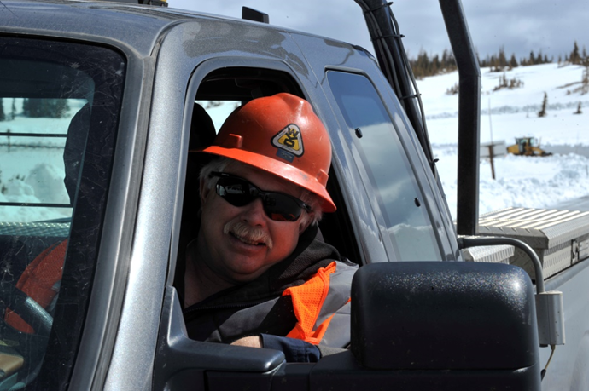

Module 19: Supervisors and Winter Maintenance
2016 Created for Clear Roads by:
U of MN Center for Transportation Studies &
Fortin Consulting Inc.
Notes:
Small Photo: WYDOT
Large Photo: Fortin Consulting Inc.
This training is for supervisors. It is intended to invoke thinking and discussion within the group and beyond the group. The training is not intended to only answer your questions but to encourage the attendees to think big.
This module also provides ample opportunity for group discussion and information exchange.

Slide 2
Training for Winter Maintenance Supervisors and Operators
2016 Created for Clear Roads by:
U of MN Center for Transportation Studies &
Fortin Consulting Inc.

Slide 3
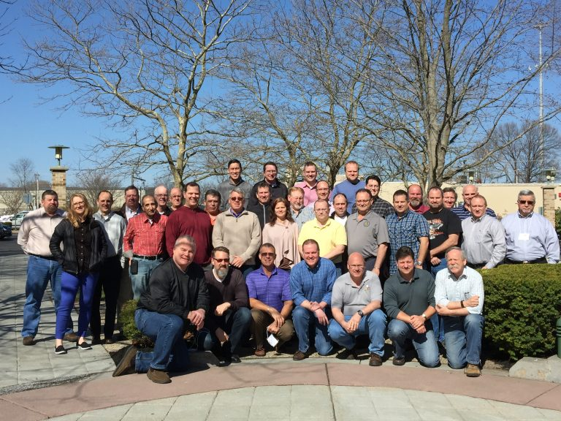
Winter maintenance professionals are a very powerful and important group
Notes:
Photo: clear roads website
Note to presenters: These first 5 slides can be used or hidden.
Or, replace with photos of your staff.

Slide 4
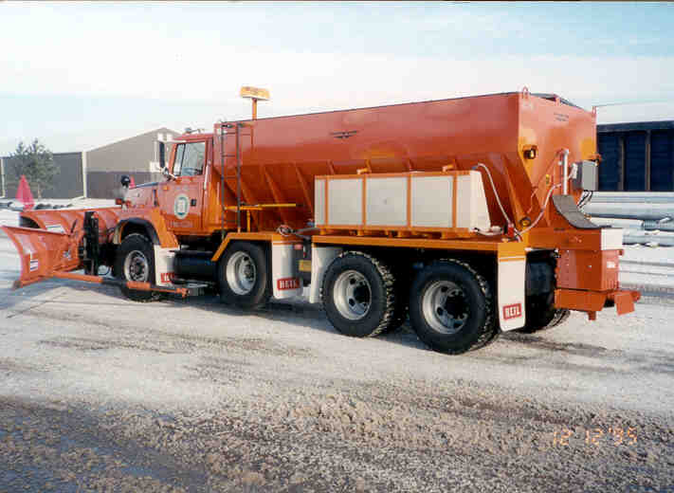
You do a great job of taking care of our roads!

Slide 5
This is one of a series of 22 winter maintenance training modules developed by the Clear Roads Program. All of the modules are available online at www.clearroads.org
Modules include information on the following:
Plowing
Truck operations
Spreading
Material use
Pre-wetting
Brine production
De-icing and anti-icing
Level of service
Ice formation
Freeze point depressants
Environmental issues
Drift control
Weather
Avalanche management
Bridge frost
Safety
Notes:
Note to presenters: The website www.clearroads.org can be accessed here if a live internet connection is available.
A list of all the modules is given here:
Plowing procedures
Truck operations
Spreading
Material use
Pre-wetting
Brine production
De-icing
Anti-icing
Safety
De-icing agent management policy
Level of service
Ice formation
Freeze point depressants
Environmental issues
Drift control
Weather
Bridge frost
Avalanche management
Getting ready for winter
Supervisors and winter maintenance
Drivers education
Record keeping

Slide 6
Module 19: Supervisors and Winter Maintenance
2016 Created for Clear Roads by:
U of MN Center for Transportation Studies &
Fortin Consulting Inc.
Notes:
Small Photo: WYDOT
Large Photo: Fortin Consulting Inc.
This training is for supervisors. It is intended to invoke thinking and discussion within the group and beyond the group. The training is not intended to only answer your questions but to encourage the attendees to think big.
This module also provides ample opportunity for group discussion and information exchange.

Slide 7
FACILITATOR NOTES (do not show during class)
This is a priority 2 module developed for Clear Roads national training. It has been designed for supervisors. Slides can be customized for the audience.
Slide Legend
Supervisors
Notes:
Note: this slide does not get shown during class. It is only to inform the presenters of the symbology:
This is a priority 2 module to be developed for clear roads national training.
It will address 1 audience:
Star symbol = supervisors
Also note: To hide a slide in a power point presentation, select the slide and then select “slide show” tab. Select “hide slide”.

Slide 8
This module will contain these topics:
As the title indicates, the audience is winter maintenance supervisors. The objective is to provide a broad insight with regards to establishing LOS goals, resources required to meet those goals and understanding staff development needs to achieve sustainability. Upon completion, the student will have a basic understanding of the common elements of a winter maintenance program and take away multiple ideas that may be incorporated into their program.
Notes:
This is the paragraph that clearroads used to “spec” this training module. All slides were developed to fulfill the requests in this paragraph.

Slide 9
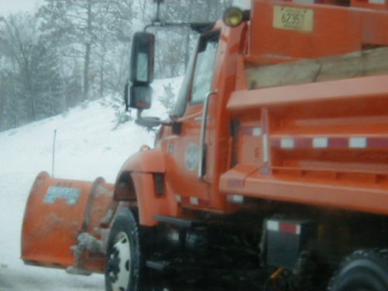
What does this module provide?
Insight to establish Level of Service (LOS) goals.
Understanding staff development needs.
Common elements of a winter maintenance program.
Notes:
This slide is important to set the stage for all of the training modules.
The other 20 training modules in this series will give you ideas on how we can perform winter maintenance in more efficient and effective ways as well as reduce potential problems.

Slide 10
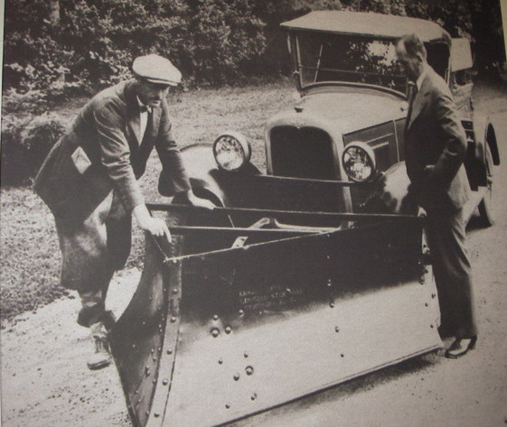
What does a strong program include?
Awareness of the past.
Acting in the present.
Planning for the future.
Notes:
As we discuss the different slides in this training module, it is good to reflect on the past, present and future in each area. It takes all three to be the best you can be.
Many supervisors come up from the ranks. A common challenge is for us to look at how to use new technology to become more effective. You don’t have to know the answer but do need to look for answers.
Engage in opportunities for information exchanges, gather knowledge on technology and regulations.
Look at new equipment, technology, chemicals that can make us become more efficient and effective.

Slide 11
Test Question
What benefits your organization?
Understanding lessons learned from the past
Organizing and running an effective operation today
Looking ahead for innovation that can improve operations
All of the above
Note to presenters: you can hide test questions, mix them in during training or remove them to use as a test at the end. See Instructional Guide for directions. Delete this yellow box before making the presentation.
Notes:
Note to presenter: you may choose to hide this slide.
Test Question:
What benefits your organization?
Understanding lessons learned from the past (no)
Organizing and running an effective operation today (no)
Looking ahead for innovation that can improve operations (no)
All of the above (yes)

Slide 12
Test Question
What benefits your organization?
Understanding lessons learned from the past
Organizing and running an effective operation today
Looking ahead for innovation that can improve operations
All of the above
Notes:
Note to presenter: you may choose to hide this slide.
Test Question:
What benefits your organization?
Understanding lessons learned from the past (no)
Organizing and running an effective operation today (no)
Looking ahead for innovation that can improve operations (no)
All of the above (yes)

Slide 13

How will you lead the way?
The better you perform, the better your organization performs.
Notes:
Image: Microsoft clipart
Discussion questions for participants:
Why have you been moved into a supervisory position? Your organization believes you have the talent and ability to lead.
What do you need to do to keep your skills sharp and current? The industry is changing and what worked last year may not work next year.
Attitude is important. Each day whether you know it or not you are providing an example for your crew. If every day you give your job your best effort, you set the stage for your employees to follow suit. If you come to work with a positive attitude, your employees will be encouraged to do the same.

Slide 14
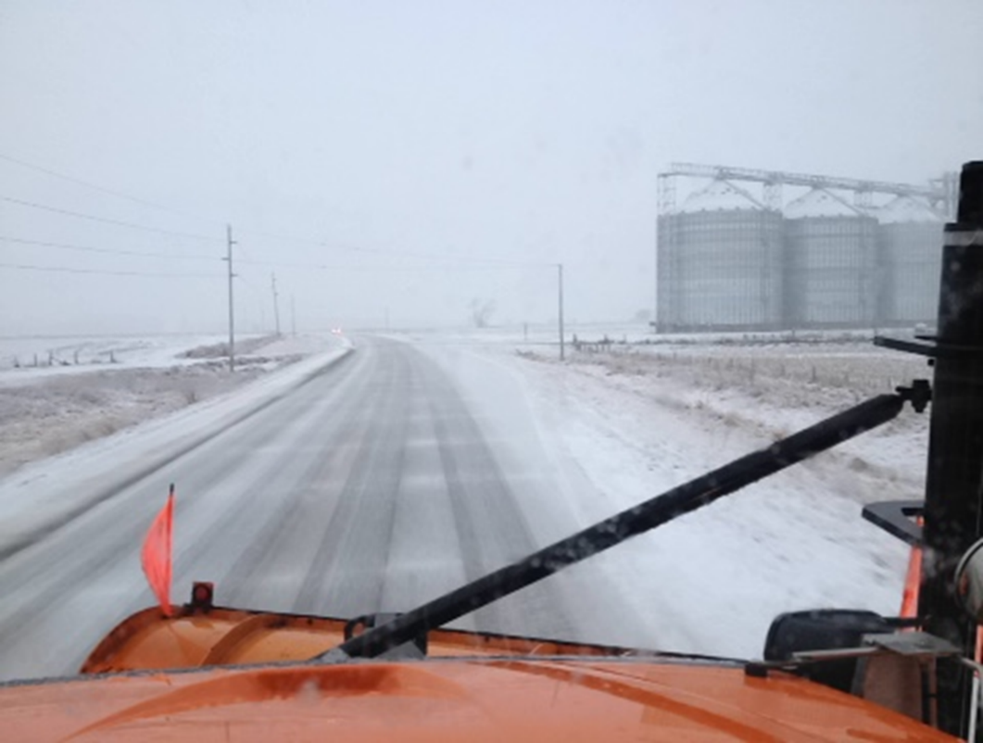
What is the LOS and where is it?
  Setting the stage: include basics on how your LOS was established, who is involved in updating it and where it is located.
Note to presenters: Add any additional information here that explains from a historical perspective how and why your LOS system (winter maintenance policy) was established.
Notes:
Photo credit: Iowa DOT
It was suggested that a brief discussion of how your LOS or Winter Maintenance policy was established and why it was established might be a good start to this section. That the history of how this came to be in your organization and the events leading up to todays policy would be good background information for supervisors.
Note to presenters: Add any additional information here that explains from a historical perspective how and why your LOS system (winter maintenance policy) was established. Delete this yellow slide before making presentation.

Slide 15

How do you plan for the future?
Before winter review and update LOS goals for each route.
Pre-Storm adjustment of LOS due to current events.
LOS is typically a balance of budget, environment, safety and other concerns. Be aware of these factors in your operation.
Notes:
Discussion for participants:
When are you reviewing and updating your Routes and LOS assigned to routes to reflect changes in roadways and changing traffic patterns?
Are you in a position where new lanes are added, more traffic is added which requires more work…but you may not have any additional staff or equipment. Are you documenting this situation. How are you adjusting?
Are you able to get more people or better equipment. If not are you lowering your level of service?
How will this work for your organization this year?

Slide 16
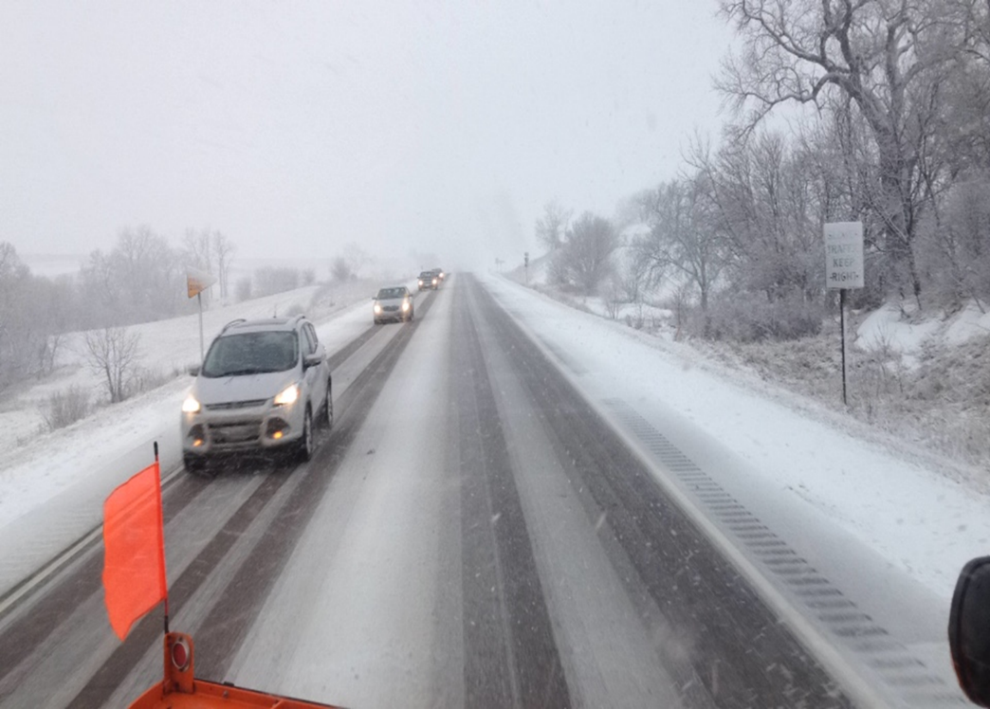
What are your LOS goals?
Over 30,000 ADT super commuter -1 hour.
Under 30,000 ADT commuter - 3 to 4 hours.
Under 10,000 ADT primary - 6 to 8 hours.
Note to presenter: Post your LOS guidelines here. Delete this yellow box before making presentation.
Notes:
Photo credit : Iowa DOT
What is your process for making sure everyone understands what the target is. Is it ok to over perform? More chemicals or other resources may be involved which may not be warranted. Is it okay to underperform?
These issues should be discussed and a strategy developed to help you stay as often as possible in the designated LOS slot.
For the crew, explain things such as: if your target is a low level of service, stick to it; don’t soup it up. Explain that it costs more for a higher level of service. We are trying to optimize our resources.
For the customers or politicians the explanation may be different for example: I am being funded at this level, gives you this level of service, if you don’t like it change my marching orders and/or funding
Note to presenter: Post your LOS guidelines here. Delete this yellow box before making presentation.

Slide 17
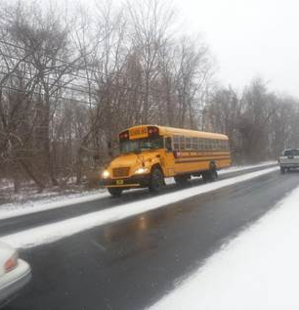
Why hit target?
Example:
Executive management does not want to see thousands of dollars spent to get a third priority roadway clear from white line to white line, when hundreds of dollars in spending is expected to achieve a clear roadway with some snow pack on the edges.
Do you have other examples?
Notes:
This example is from Scott Lucas, Ohio DOT

Slide 18
Test Question
Should you strive to exceed your target level of service?
Yes
No
Notes:
Note to presenter: you may choose to hide this slide.
Test Question:
Should you strive to exceed your target level of service?
Yes (no)
No (yes)

Slide 19
Test Question
Should you strive to exceed your target level of service?
Yes
No
Notes:
Note to presenter: you may choose to hide this slide.
Test Question:
Should you strive to exceed your target level of service?
Yes (no)
No (yes)

Slide 20
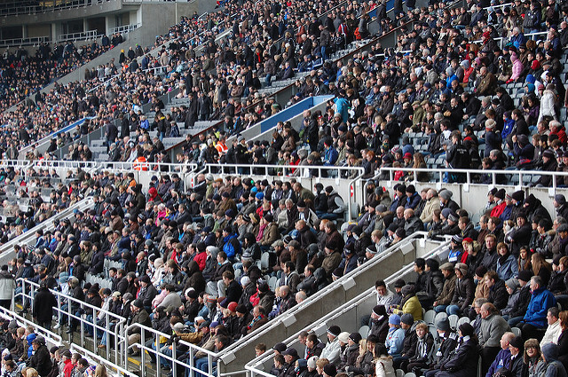

What impacts the level of service?
Fall review: Hwy 77 no new changes, same AADT, still a “ commuter level”.
Pre-storm review : Hwy 77 commuter level but with a game on Sunday, the level of service changes to “super commuter level”.
Notes:
Photo and image: Microsoft clipart
What current events affect your routes and how do you adjust for them? Football/Hockey/Basketball games? Presidential visit, ski race, detours, road closures, avalanche control…?

Slide 21
  What do you need to meet these goals?
Given: I-494 super commuter LOS from Airport to Hamel (22 miles). The road must be clear 1-3 hours after storm.
Resource allocation: cost of equipment, ability of staff and equipment to perform the job.
Notes:
Discuss what do you need to meet this example.

Slide 22
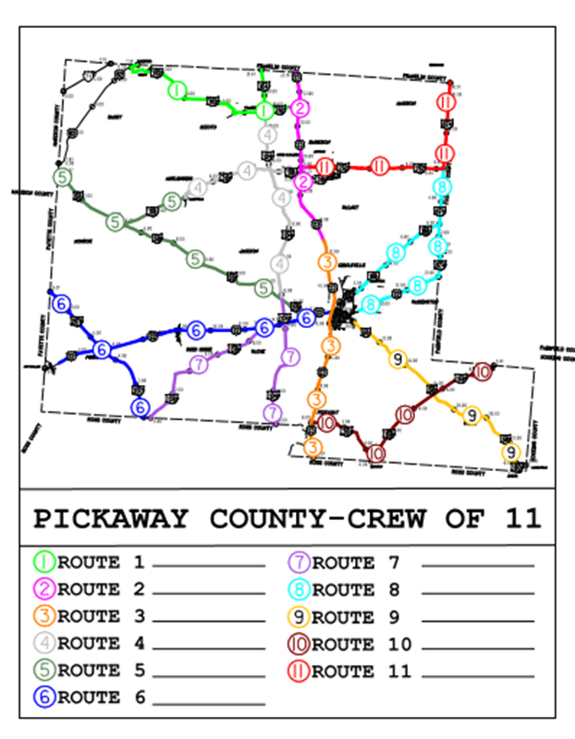
  What else to consider?
Cycle time: To decrease cycle time, make route shorter or add more equipment .
Also consider amount of chemicals needed and the equipment that can carry the appropriate amount.
(Example: 2-lane road under 17 miles, use single axle; over 17 miles and 2-lanes, use tandem axle).
Note to presenters: Insert one of your route maps here. Delete this yellow box before making presentation.
Notes:
Photo: Ohio DOT
Discuss how you have dealt with cycle time and LOS issues. What staffing and equipment changes have you made to help you achieve your goals. Where do problems still exist and what can you do about them?
Note to presenters: Insert one of your route maps here. Delete this yellow box before making presentation.

Slide 23
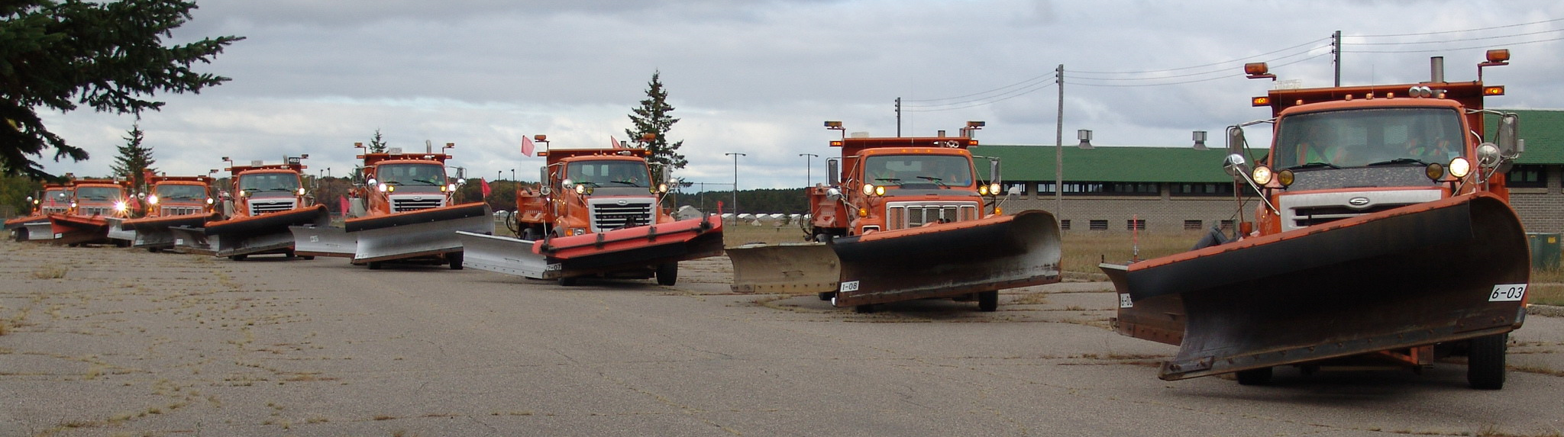
How can you be successful?
“If we don’t have any more resources and have more areas to serve, it either results in a lower level of service or we have to become more effective by using better tools. (Examples include: tow plow, gang plowing, anti-icing, more tandems, supertankers, performance enhancers to brine…)”
Notes:
Notes from: Wayne Gammell and Todd Law of the Vermont DOT
They note: “We usually have the same resources year after year to get more or more work done. If we don’t have any more resources and have more areas to serve it either results in a lower level of service or we have to become more effective by using better tools. (tow example, gang plowing, anti-icing, increased more tandems, supertankers, performance enhancers to brine).”

Slide 24
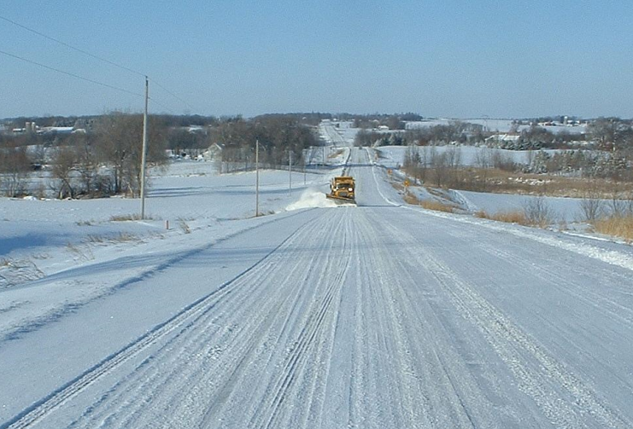
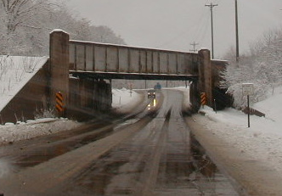
What effects your decision making?
Hwy 83 (2-lane undivided) is 26 miles long with an AADT of 800. Two DOT payroll clerks, bridge supervisor and an engineer live here.
Hwy 60 (2-lane undivided) is 19 miles long with an AADT of 15,000. My wife and my friends live here.
Notes:
Top photo: Ramsey County, MN
Right photo: Fortin Consulting, Inc.
This is on example of the many decisions management must make. For most decisions, the answer is not clear cut. It is a judgment call based on past experience and future goals.
Making decisions and leading are important skills. Also evaluating the results of those decisions and sticking with them if they are successful and modifying them if they are not successful are part of leading the organization.
The only thing constant is change!

Slide 25
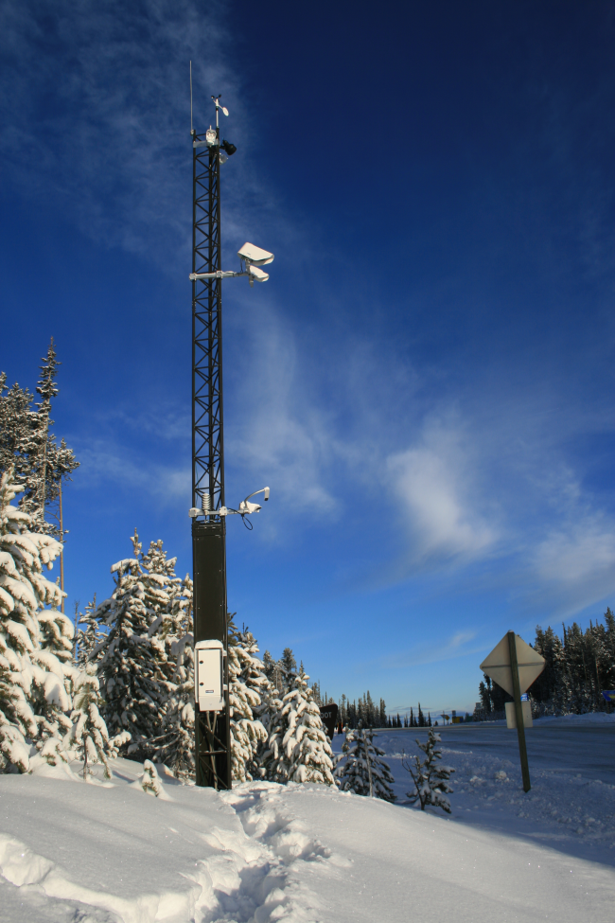
How do you know you hit your target?
Grip?
How much road is open?
Hours after the storm ?
Speed of travelling public?
Other…
RWIS: Grip Sensor
How can you improve your evaluation process?
Notes:
Photo credit: Idaho DOT
In order to measure success, institute a system to quantify the results of your operation. Organizations have different measurements or signals of success. What are you using? Is there something you can add to make your evaluation process more effective and accurate? This might be a good investigative exercise. For example: each supervisor contact a supervisor from a different state to learn what they are doing to establish targets and evaluate their ability to hit their targets Unless you expose yourself to new ideas, you will not improve.
Example from Dennis Jensen, Mobility Services-Winter Operations Coordinator at the Idaho Transportation Department:
“Idaho utilizes 130 RWIS sites to measure grip coefficient from the Vaisala DSC 111 noninvasive sensor. A dry surface is a grip coefficient of 0.82 with lower values indicating degradation of grip as the values decrease. Idaho utilizes 0.60 benchmark to indicate adverse conditions exist below this threshold. The definition of a storm event is anytime there is precipitation on the roadway surface and the surface temperature is below 32 degrees F. Using this storm event definition we want the grip value to be equal or above 0.60 grip coefficient for 60% or more of the storm duration time to meet our LOS expectation. This is a seasonal goal for all events aggregated at seasons end for each of the 44 foreman areas. Our percentage or time above the 0.60 bench mark changes annually as we improve our winter operations. For this next season we are evaluating moving from 60% to 72% above the 0.60 benchmark grip coefficient.”
From http://www.ops.fhwa.dot.gov/weather/best_practices/casestudies/009.pdf
“System Components: Each RWIS site (see Figure ID-1 for an illustration), in addition to the atmospheric sensors, typically has two road surface sensors: one to measure the road’s grip coefficient (DSC111); and one to measure road surface temperatures (DST111). “
“System Operations: In responding to winter storms, the treatment objective is to minimize the “ice-up” time. ITD has developed a performance measure Index. Specifically, the Performance Index is a measure of ice duration per unit of storm severity. Storm severity is modeled using an empirical formula that utilizes wind speed, surface precipitation accumulation, and surface temperature. Ice duration is defined as the amount of time grip falls below 0.6. Data collected from the RWIS stations is used to determine various parameters in the Performance Index formula. This metric allows for accurate evaluation of different treatment strategies and maintenance operations.

Slide 26
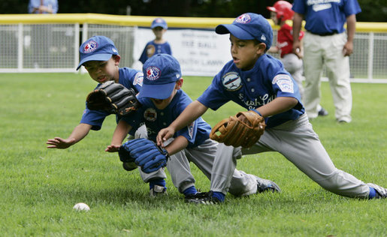
What to do after the storm?
Just like a coach reviews the game and leads drills to improve performance, a supervisor leads a feedback loop, asking questions like:
Did we meet our goals? How might we adjust?
Notes:
Photo: Microsoft clipart
A discussion about what to do after the storm is important for supervisors and staff. We need that feedback loop!
This provides the opportunity to review how equipment , materials, drivers performed.
How does this little league picture remind you of winter maintenance operations?
What does a successful storm look like to you? Have you noticed trends? This is a good class discussion. You can use Vermont’s example to get discussion going: “At the post-storm meeting, compare garages, equipment, material and time. For us if we have an even split of equipment cost, material cost and crew time (in even 1/3’s), it is a good storm.” From Wayne Gammell and Todd Law of the Vermont DOT

Slide 27
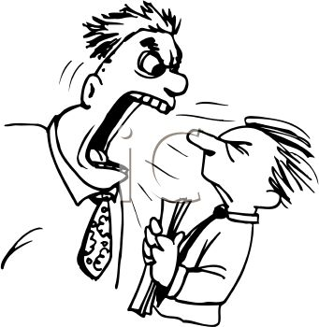
How effective is your communication?
Open communication channels pave the way for successful operations.
Negative communication channels will keep people and their ideas at a distance.
Notes:
This is an opportunity for good class discussion. Everyone could have a different viewpoint on the effectiveness of communication.

Slide 28

What does open communication look like?
amongst maintenance leadership
with those reporting to you
with your customers
with support services
within your crew
Notes:
Image: Microsoft clip art
Presenters: select any one of these bullets for a class exercise to discuss how to improve communication at that level.
Vermont DOT offers this example: A new driver at the end of his route noted a jack-knifed semi-truck on the hill just beyond his route. He did not salt the hill; he turned around and stayed on his route. How could communication prior to this event between supervisor and crew created a different outcome? How could communication between drivers have created a different outcome?
Vermont DOT offers these examples of their public communication: Outreach to schools, information at rest stops, TV ads, radio station blurbs, social media, ride-alongs and so on. What does your organization do and what can you add to your list of outreach efforts?

Slide 29
Test Question
Who needs to work on their communication skills?
New employees
Maintenance leadership
Plow operators
Everyone
Notes:
Note to presenter: you may choose to hide this slide.
Test Question:
Who needs to work on their communication skills?
New employees (no)
Maintenance leadership(no)
Plow operators(no)
Everyone (yes)

Slide 30
Test Question
Who needs to work on their communication skills?
New employees
Maintenance leadership
Plow operators
Everyone
Notes:
Note to presenter: you may choose to hide this slide.
Test Question:
Who needs to work on their communication skills?
New employees (no)
Maintenance leadership(no)
Plow operators(no)
Everyone (yes)

Slide 31
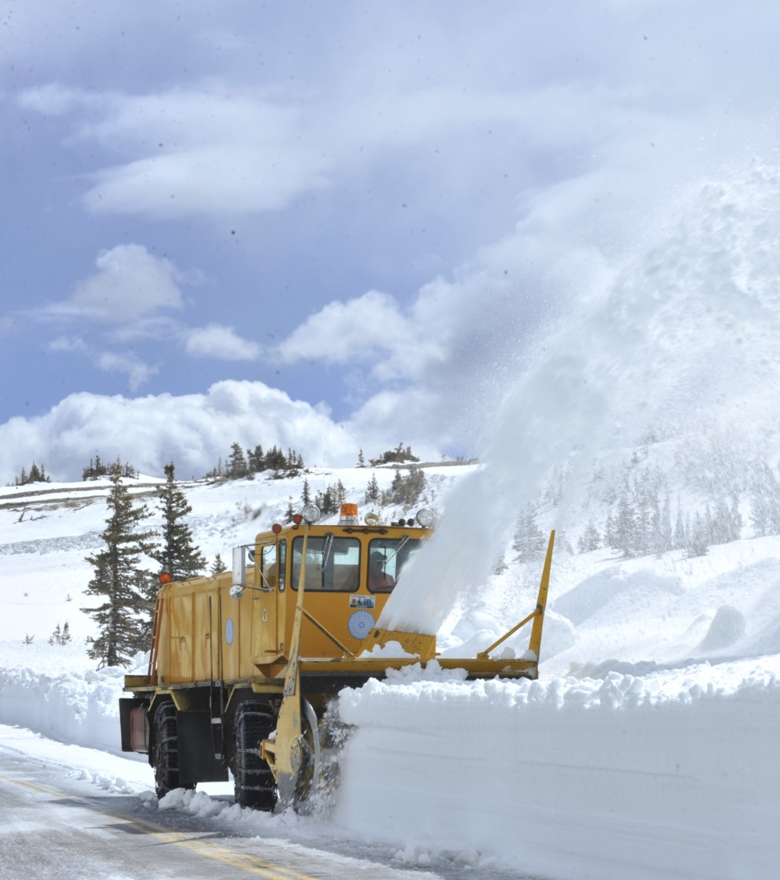
What are your staff development needs?
Is your crew…
simply following orders
or are they also adjusting and improving the process?
Notes:
Photo: WYDOT
What are the basic building blocks of winter maintenance?
Your crew are the eyes and ears of the industry.
Does your crew understand the basic building blocks of winter maintenance?
If they do not understand it they can only follow orders and it may not make any sense to them.
If they understand it, they can follow orders and adjust and improve on them. .

Slide 32
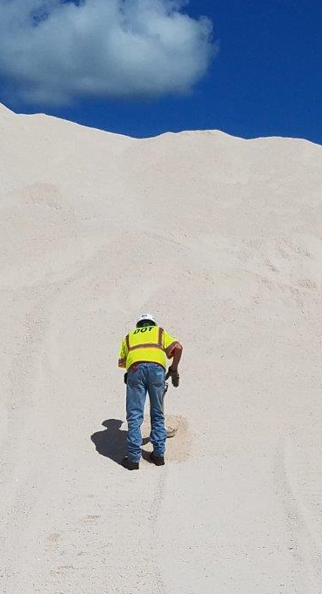
What should your crew know?
Note to presenters: Insert your list here or develop it in class discussion. Delete this yellow box before making presentation.
Is your training adequate?
Note to presenters: Insert your training plan here. Delete this yellow box before making presentation.
Notes:
Photo: Maine DOT
An educated and informed crew will make better decisions. What key information is critical for you crew to understand. How are you educating them? How can your program be improved to fill in knowledge gaps?
Woody Woodruff – retired MnDOT supervisor suggests the following as basic training topics for winter maintenance crews:
- safe and efficient equipment operation
- appropriate chemical use
- knowledge of routes
- How to fill out paperwork (time cards, CDL, material use
- communicate on radio
- Personal Protective Equipment
- Foul or inclement weather clothing
Basic tools: reading, writing, math, speaking skills
Note to presenters: Insert your list here or develop it in class discussion. Delete this yellow box before making presentation.
Note to presenters: Insert your training plan here. Delete this yellow box before making presentation

Slide 33
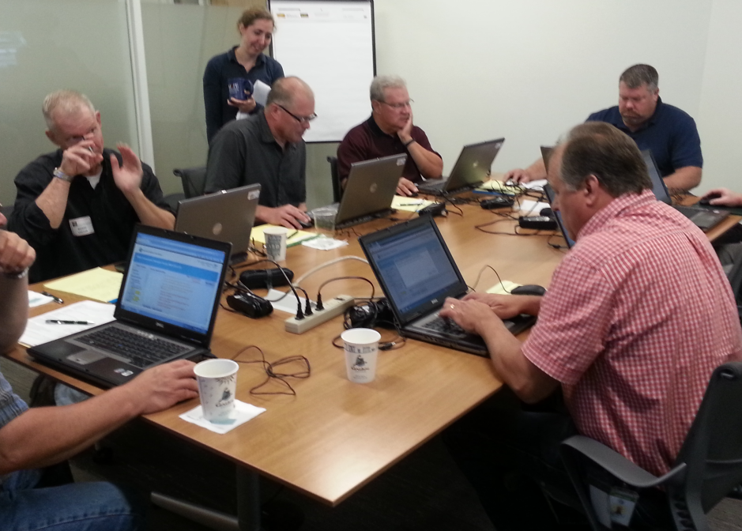
What supervisor training is needed?
Note to presenters: Insert your list here or develop it in class discussion. Delete this yellow box before making presentation.
Note to presenters: Insert your training plan here. Delete this yellow box before making presentation.
Notes:
Photo: Fortin Consulting Inc.
A leadership team who stays current with advances in the industry will strengthen your organization. Where is technology leaving you in the dust? How can you keep up with it?
Woody Woodruff – retired MnDOT supervisor suggests the following as training topics for Supervisors:
how to read/interpret the weather
How to efficiently use your staff to accomplish the work
How to efficiently use your equipment to accomplish the work
Planning
How to develop and maintain policy
What system of documentation supports policy
Microsoft word, excel, powerpoint and other computer software that can speed up your work
Note to presenters: Insert your list here or develop it in class discussion. Delete this yellow box before making presentation.

Slide 34
Test Question
In order to improve the capability of your organization you should:
Look for more and different ways to train operators and supervisors
Increase time spent on projects and reduce time spent in training
Reduce wasted time, train only new employees
Only supervisors are worth investing in, training should be focused on them
Notes:
Note to presenter: you may choose to hide this slide.
Test Question:
In order to improve the capability of your organization you should:
Look for more and different ways to train operators and supervisors (yes)
Increase time spent on projects and reduce time spent in training (no)
Reduce wasted time, train only new employees (no)
Only supervisors are worth investing in, training should be focused on them (no)

Slide 35
Test Question
In order to improve the capability of your organization you should:
Look for more and different ways to train operators and supervisors
Increase time spent on projects and reduce time spent in training
Reduce wasted time, train only new employees
Only supervisors are worth investing in, training should be focused on them
Notes:
Note to presenter: you may choose to hide this slide.
Test Question:
In order to improve the capability of your organization you should:
Look for more and different ways to train operators and supervisors (yes)
Increase time spent on projects and reduce time spent in training (no)
Reduce wasted time, train only new employees (no)
Only supervisors are worth investing in, training should be focused on them (no)

Slide 36
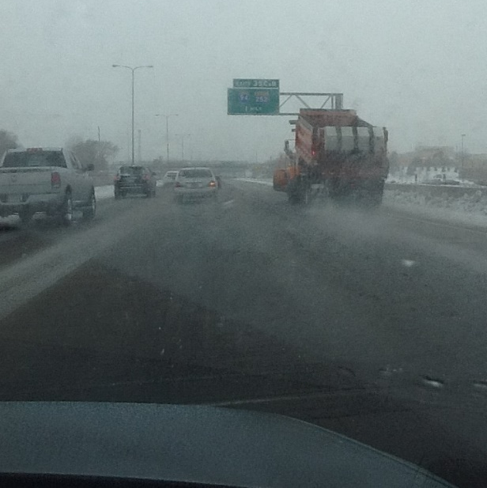
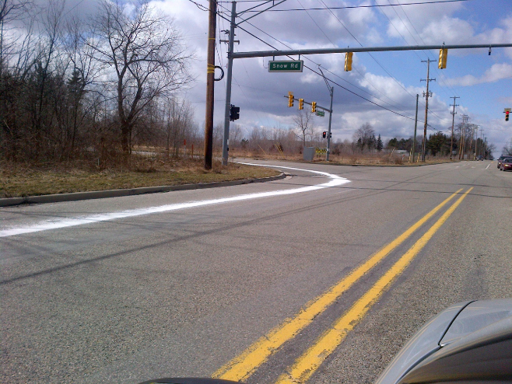
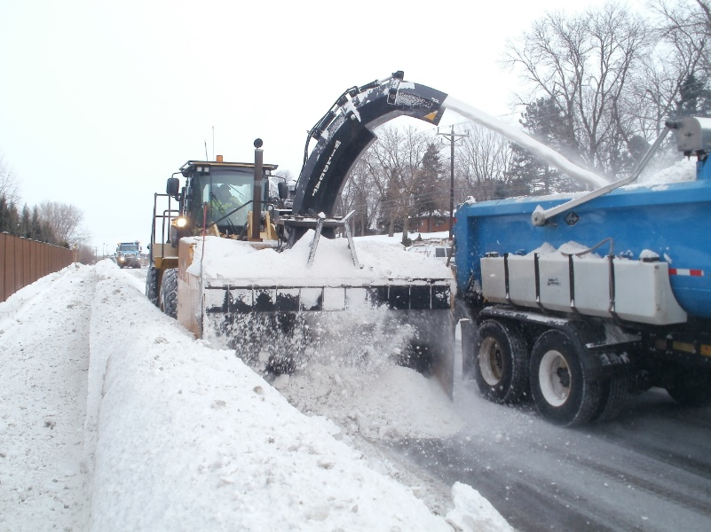
What are some common elements?
Chemicals
Roads
Equipment
Maintenance staff
Weather
Policy
Budget
Environment
Safety
Politics
Notes:
Photo credits: Fortin Consulting, Inc. and Ramsey County, Minnesota
Here are a list of some of the variables that come into play during winter maintenance. Because of the ever-changing factors, we are in an unpredictable line of work. It is up to the supervisor to be prepared, and to lay out the best plan possible in advance of a storm. Before, during and after a storm, the supervisor must be able to adjust for changing conditions. It is because of this that a good supervisor or team of supervisors is invaluable to your agency.
Discussion questions:
Where are you leading the pack? What has made this such as successful part of your operations? How do you replicate this success in other areas? Who had this idea, how did it grow into something that you are proud of? Learn from your successes and plant those seeds of change in other areas as well.
What are your biggest challenges? When is enough enough? How much time do you give your chemicals to work? What chemicals to use? Should you provide 24-hour coverage? Inadequate equipment? Integrating liquids? Teamwork?.....

Slide 37

How do you divide responsibility?
Example
Who makes the decision to add materials to your brine when temperatures drop?
If it is not clear who makes the decision, the change may not take place and the operation will suffer.
Develop a list of the “grey areas” in your operation and work to clarify them.
Notes:
Example from Scott Lucas, Ohio DOT
Image: Microsoft clip art
Presenters: a good class exercise is to have each attendee think of one “gray area” of decision making in winter maintenance and how this can be resolved. Out of class, recommended that participants expand on this to itemize all gray areas and work with the leadership team to resolve these areas of confusion.

Slide 38
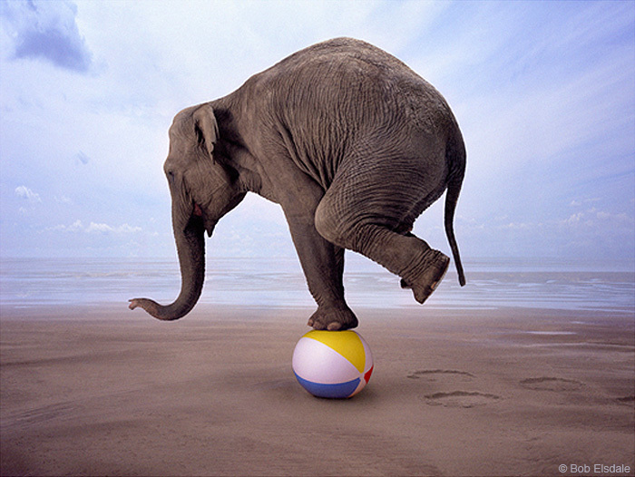
What makes a good supervisor?
Winter maintenance is a balancing act!
Notes:
Issues include: politics, communication, environment, budget, level of service, creating an internal team, creating an external team (highway patrol, TV, city, county, other states…), educating and inspiring staff.
There is no right and wrong in winter maintenance. It is a continually changing field. The following slides show ideas from Clear Roads Supervisors on what they think makes a good supervisor. Apply this if you see merit in them and add your own to share with the supervisors in your area.

Slide 39

What are some tips from experience?
I will think about that tomorrow…
Doing nothing is a decision…it just may not a good one.
Notes:
Tip: Woody Woodruff, retired MnDOT supervisor
Image: Microsoft clipart

Slide 40
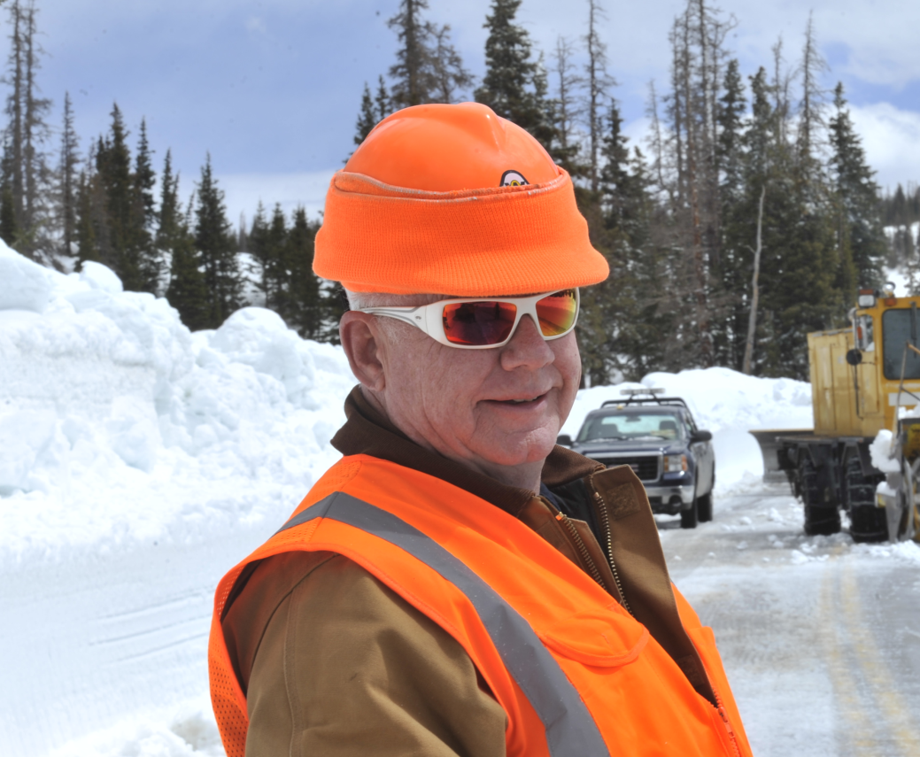
What are some tips?
“Supervisors must remain calm, the crew will be excited…someone needs to be steady and lead”.
Notes:
Quote: Woody Woodruff Retired MnDOT supervisor
Photo credit: WYDOT
Good time to discuss situations that can push your ability to remain calm and think clearly. The group may have some tips for dealing with those stressful situations.

Slide 41

What are some tips?
Put procedures in place.
(i.e. use brine in fall, mag when colder)
But listen and adjust… At one truck station, our operators like the caliber product. They insist it performs better through the whole winter so we let them use it if they can achieve lower rates.
Listen to them; it improves team spirit!
Notes:
Image: Microsoft clipart
Tip from Mark Fischback, retired MnDOT superintendent

Slide 42
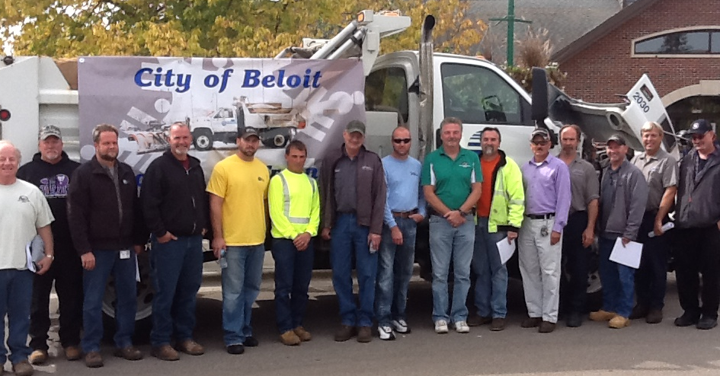
Tips from experienced supervisors
Build a team!
Notes:
Tip from Mark Fischbach, Retired MnDOT superintendent
Photo credit: Fortin Consulting, Inc.

Slide 43
Tips from experienced supervisors
Know when, where, and how much crew and equipment to deploy pre-storm. Call in additional resources as needed.
Ensure that equipment and attachments are ready to go when needed. Ensure that these are maintained between shifts or as needed.
Ensure that stockpiles are full or at least adequate for storm duration.
Keep track of overtime "wheels" so that it is spread evenly. (This isn't an issue for everyone.)
Notes:
Tips from Monty Mills, retired Washington State DOT

Slide 44
Tips from experienced supervisors
Know where crews and equipment are deployed during storm, and move resources as necessary so high priority routes are covered.
Keep communications lines open and managers informed of current situation.
Keep track of crew hours so that time limits aren't exceeded.
Personally drive routes to ensure plan is being carried out.
Respond to media and HQ requests for info.
Notes:
Tips from Monty Mills, retired Washington State DOT

Slide 45

Tips from experienced supervisors
Use the weather prediction services that your state pays for.
Use the MDSS models to set up call out times for the storm event.
Notes:
Tips from Monty Mills and Cliff Spoonemore, WYDOT

Slide 46
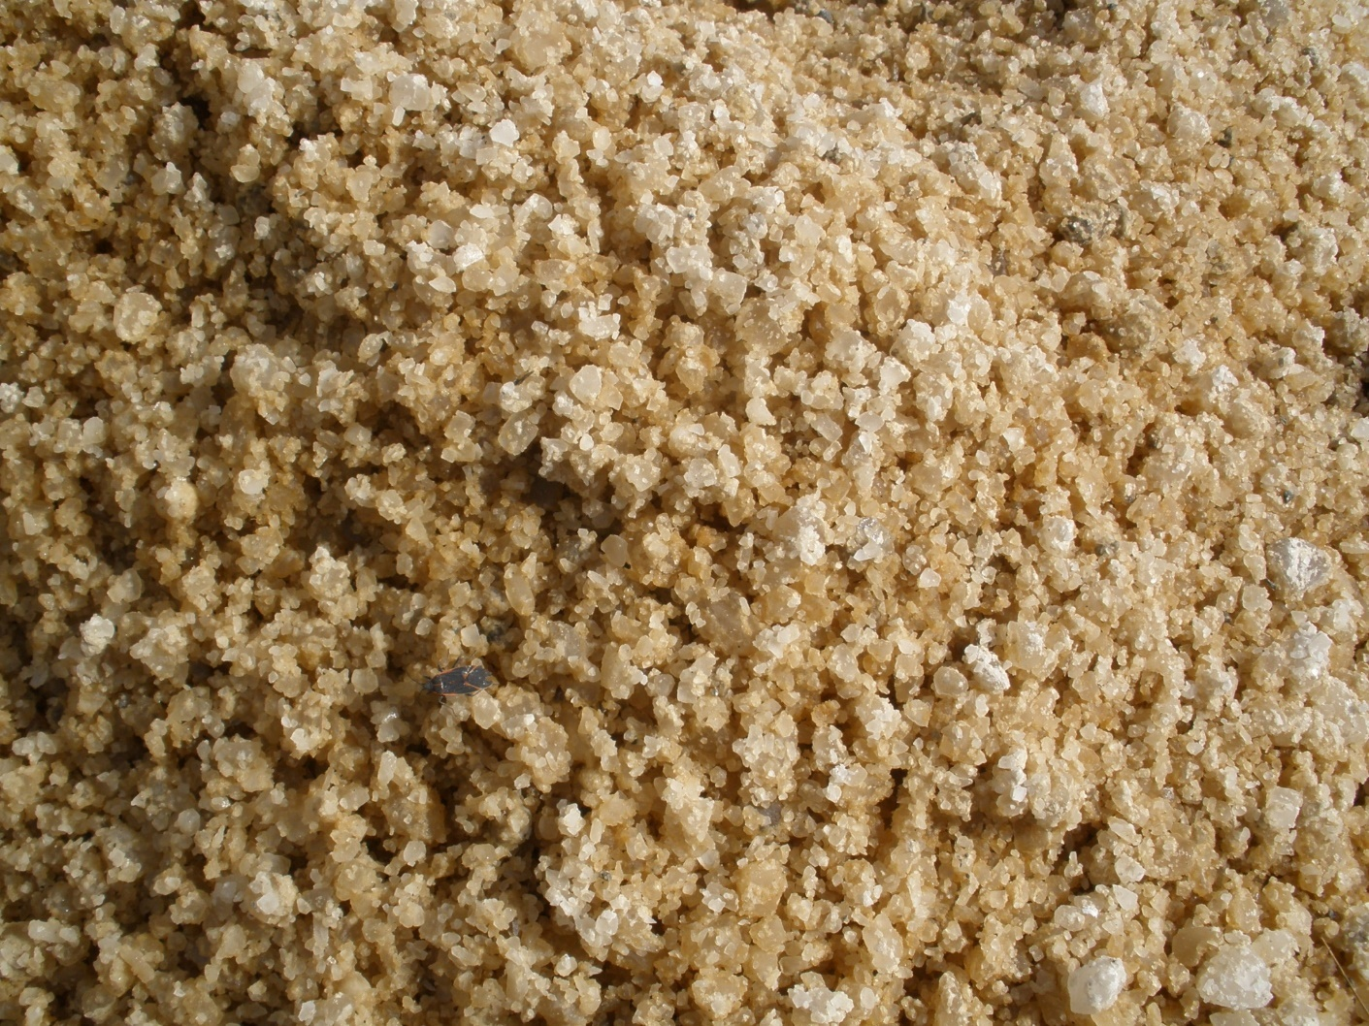
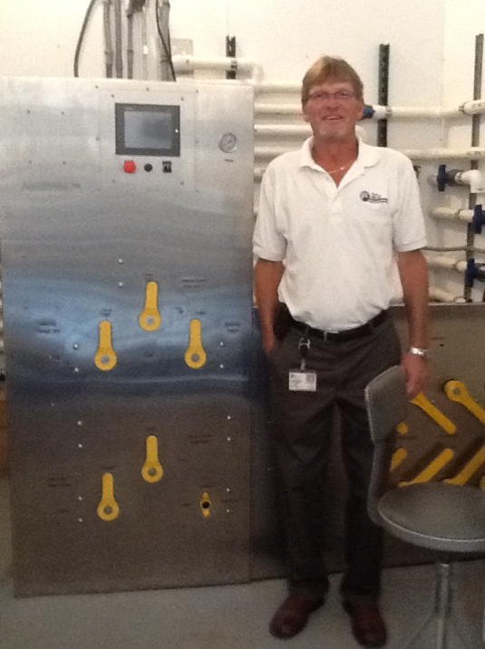
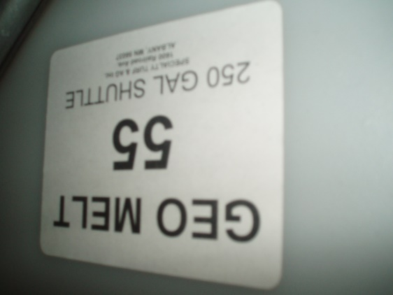
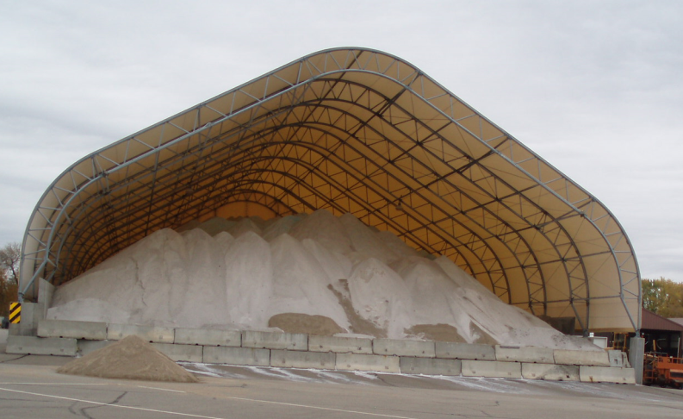
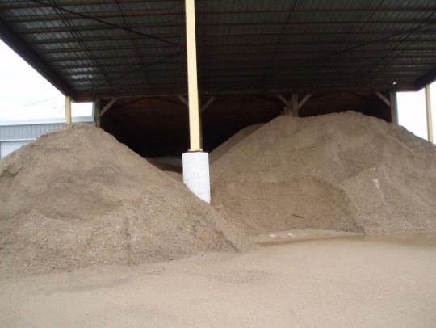
Tips from experienced supervisors
A good supervisor knows when and how to use all traction and deicing material at their disposal.
Notes:
Tips from Chris Smith, California DOT
Photo credits: Fortin Consulting, Inc.

Slide 47
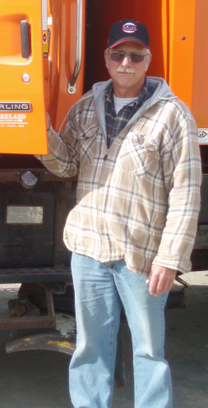
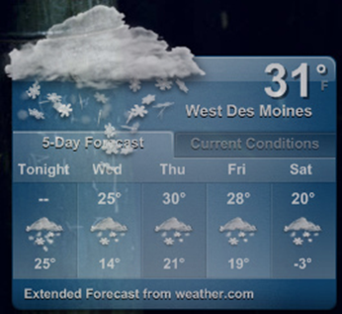
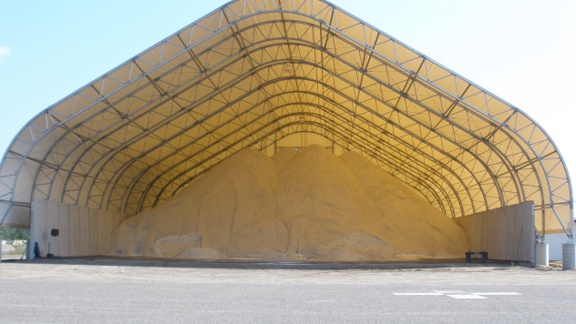
Tips from experienced supervisors
A good winter maintenance supervisor is aware of the condition of their resources. Resources include people, weather forecasting data, material, and equipment.
They manage the storm by monitoring results over resources, meaning they utilize the least amount of resources to achieve the desired result or level of service.
Notes:
Tips from Scott Lucas, Ohio DOT
Photo credits: Fortin Consulting Inc.
Suggest to the audience that although this may be a general philosophy, often one resource is given a higher priority and the balance must be adjusted. For example: sensitive ground water recharge area in a low salt area, so you must manage to reduce salt. What other situations exist where you need to adjust the balance of resources?

Slide 48
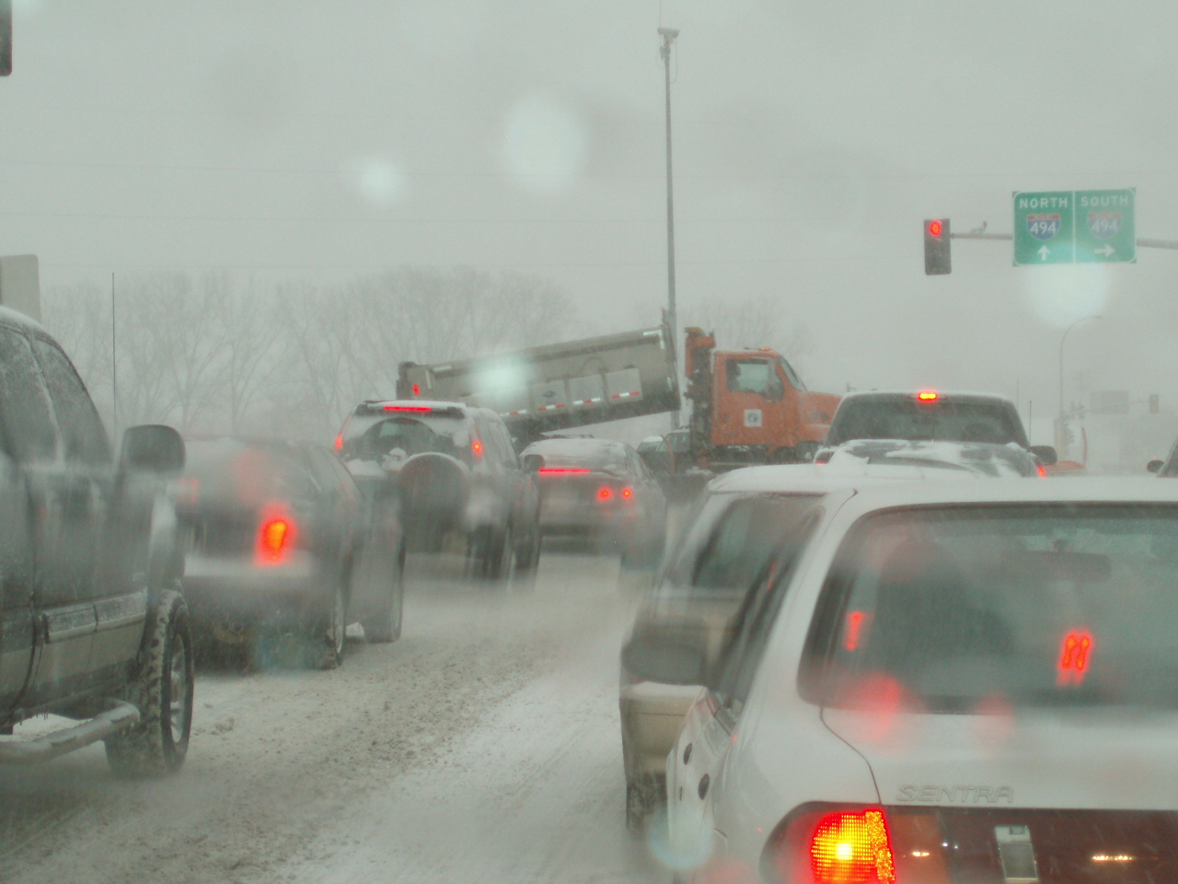
Tips from experienced supervisors
Use the technology that’s proven to reduce salt usage, like prewetting.
Notes:
Tips from Mike Sproul: Wisconsin DOT
Photo: FCI

Slide 49
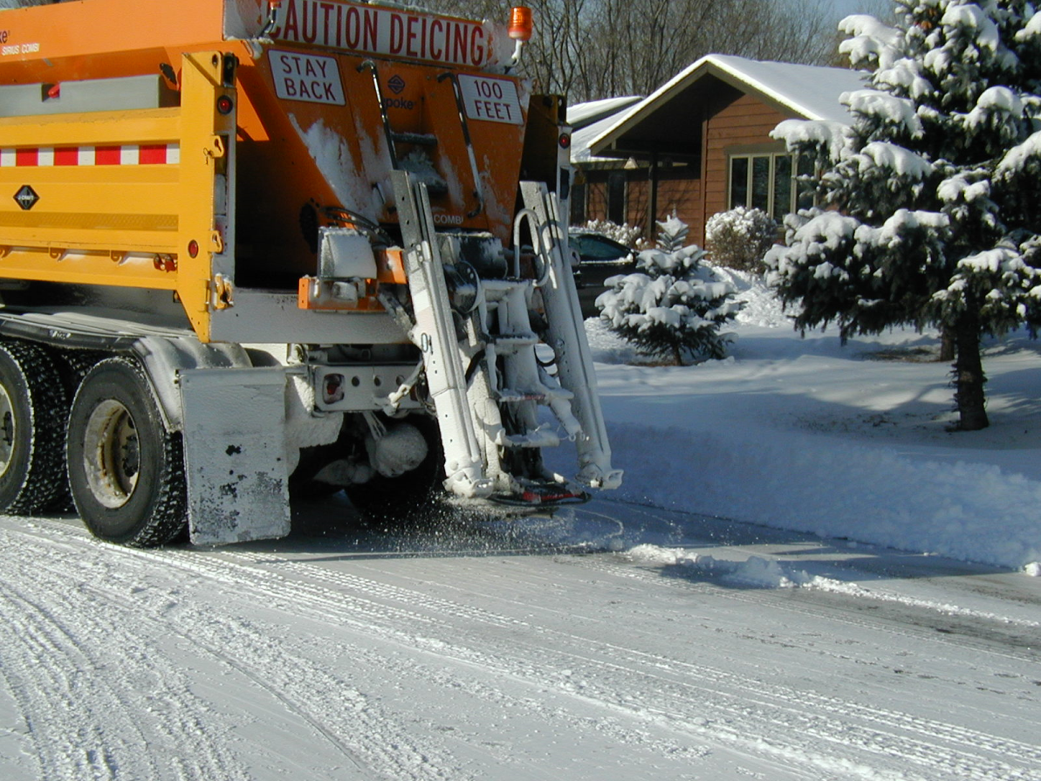
Tips from experienced supervisors
Hold employees accountable to application rates but with some room for good judgment.
Notes:
Tip from Wayne Gammell and Todd Law, Vermont DOT
Photo credit: Fortin Consulting Inc.

Slide 50
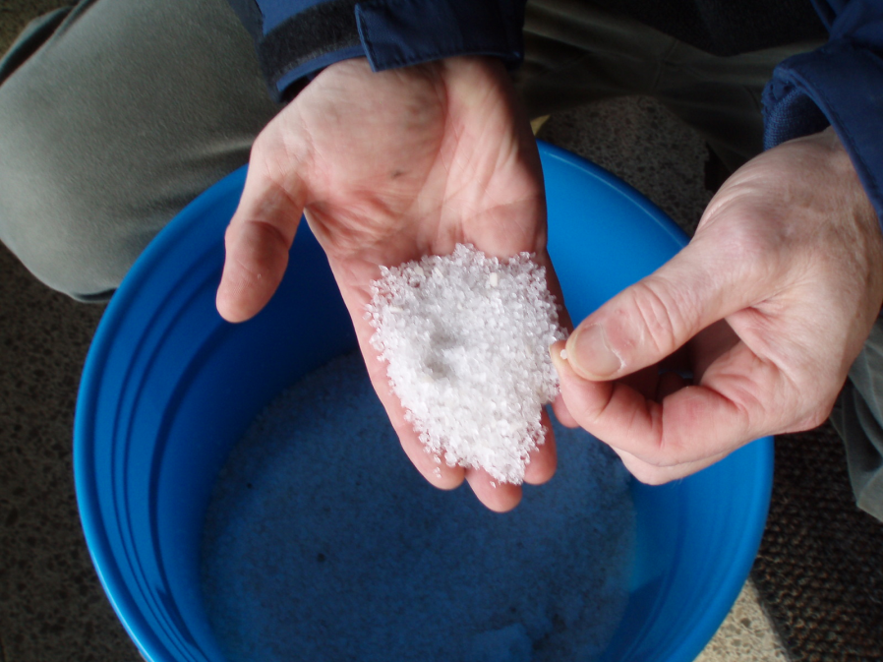
Tips from experienced supervisors
Understand the chemistry of chlorides and how they work in winter operations, how they dilute and the effectiveness of proper usage without over using.
Notes:
Tip from Phillip Anderle, Colorado DOT
Photo credit: Fortin Consulting Inc.

Slide 51
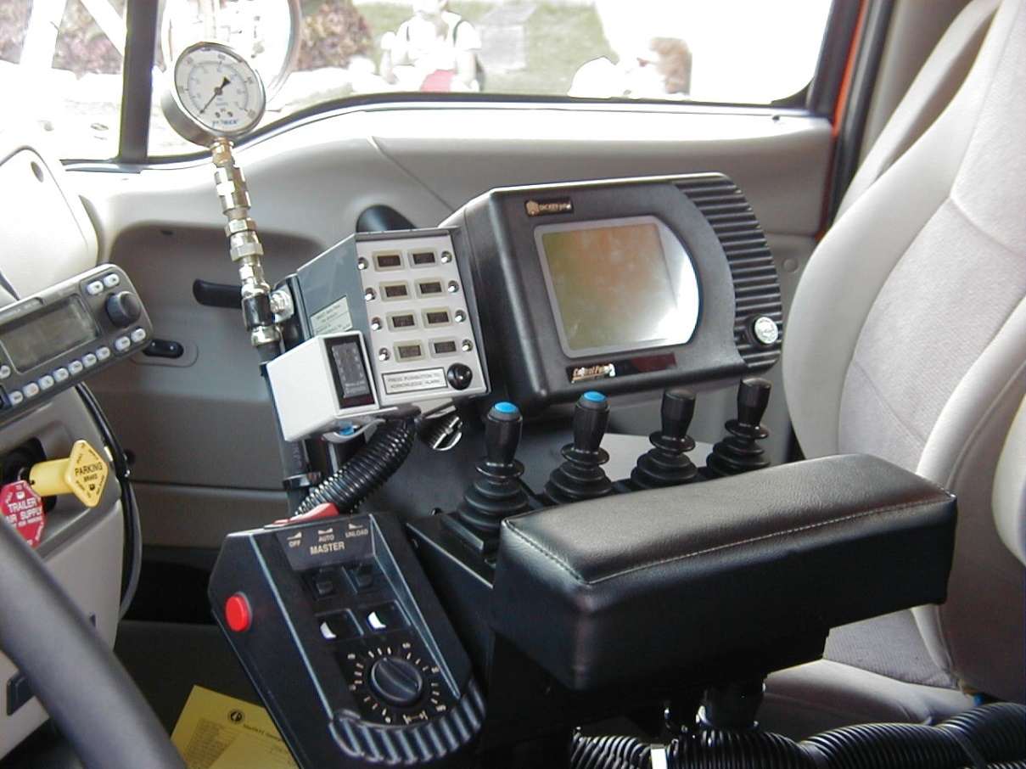
Tips from experienced Supervisors
Good equipment knowledge is important.
You need to know what it will do!
Notes:
Quote from Mark Fischbach, Retired MnDOT superintendent

Slide 52
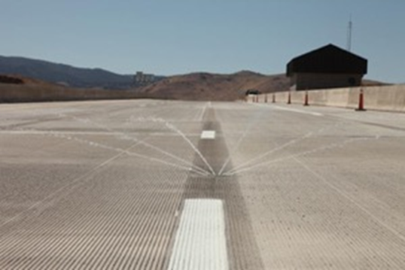
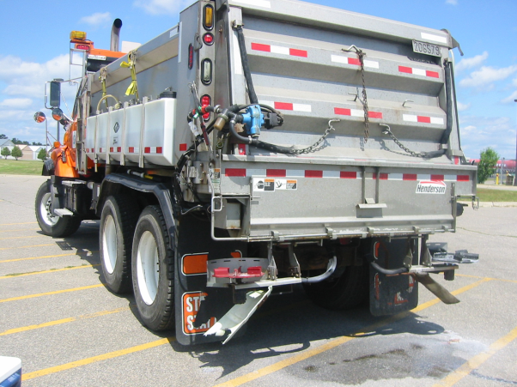
Tips from experienced supervisors
Encourage new ideas.
If the ideas are expensive, run them through through the research group. Example: automated-anti icing
If the ideas are inexpensive, try them at the truck station level. Example: chutes
Notes:
Bottom Photo credit: MnDOT
Top Photo credit: Nevada DOT
Tip from Mark Fischbach, retired MnDOT and similar tip by Wayne Gammell and Todd Law Vermont DOT.
What do you have to lose if an employee wants to experiment? If you think you can do it, it is probably worth an experiment. Do a paired study and see how the idea compares to the traditional approach. If it is a better idea your organization can benefit. If it doesn’t work you have gained the respect of that employee for listening to them and trying out their suggestion. They will also better accept the tried and true approach.

Slide 53
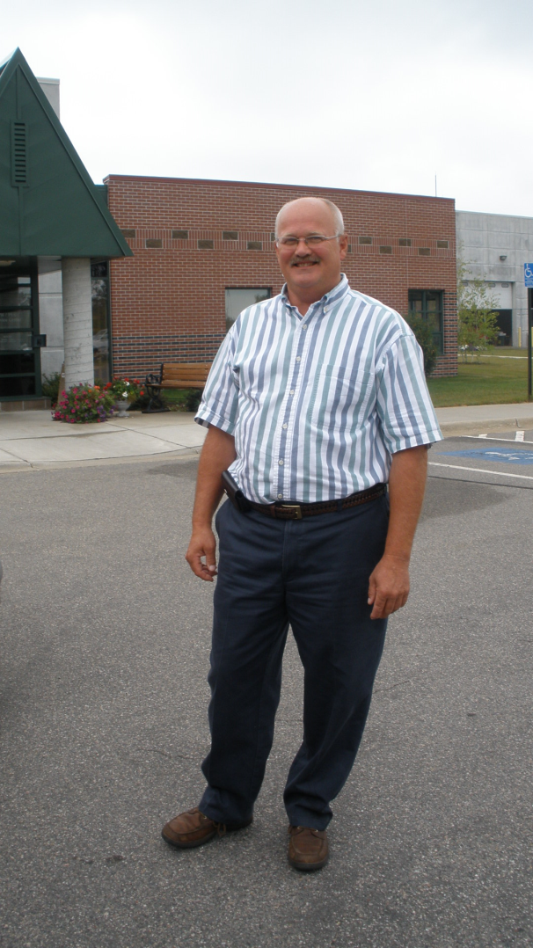
Tips from experienced supervisors
“If an operator wants to try something different, set it up with a comparison route and see how it works. It will either advance your organization or satisfy your operator that the old way really does work better.
This approach also improves the team attitude, operators appreciate that their ideas are taken seriously.”
Notes:
This suggestion is from Vermont DOT, Wayne Gammell and Todd Law

Slide 54
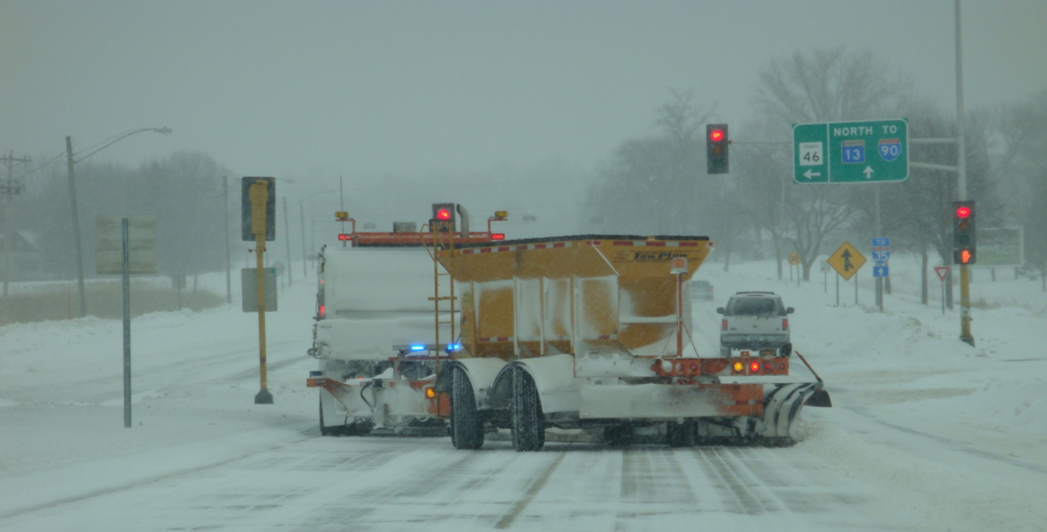
Tips from experienced supervisors
Be innovative, willing and eager to try new materials, equipment, methods or processes and procedures.
Notes:
Tip from Phillip Anderle, Colorado DOT
Photo credit: MnDOT

Slide 55

Tips from experienced supervisors
Gather knowledge on technology and regulations. Look ahead!
Notes:
Tip from Mark Fischbach, Retired MnDOT superintendent
Image: Microsoft clipart

Slide 56
Tips from experienced supervisors
Note to presenters: add any other tips here, or hide this slide during presentation.
Notes:
Note to presenters: add any other tips here, or hide this slide during presentation.

Slide 57
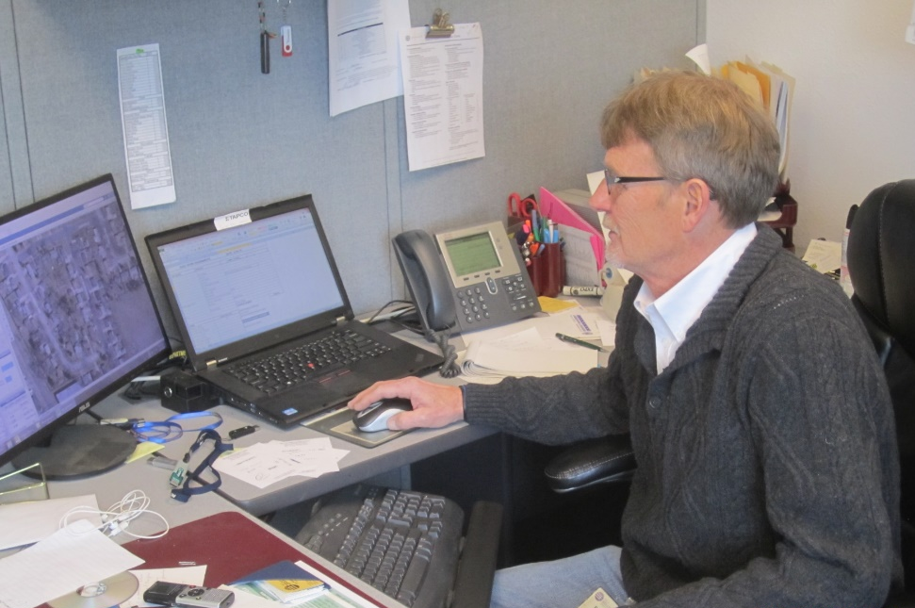
Importance of Record Keeping
An important part of a supervisor’s job is to document your activities and outcomes, as well as your staff’s.
This helps measure process improvements, and protects your agency from liability relating to claims and lawsuits.
Notes:
Record keeping is important as a means of material accountability, budgeting/cost tracking, performance tracking, support in the event of legal actions, media inquiries, and planning.

Slide 58

Importance of Record Keeping
Keep records of materials, equipment, resource allocation, treatments and effectiveness.
This helps you identify areas for improvement, and shows where efficiency can be improved.
Helps with planning for future incidents, and helps protect you from claims.
Notes:
Record keeping is important as a means of material accountability, budgeting/cost tracking, performance tracking, support in the event of legal actions, media inquiries, and planning.

Slide 59
Record Keeping
Keeping good records helps
Demonstrate how goals are met.
Demonstrates that you are following policy.
Identify ways to improve and change your approach.
Notes:
Keeping good records is important. It helps to:
demonstrate how goals are met.
demonstrates that you are following policy.
identifies ways to improve and change your approach.

Slide 60
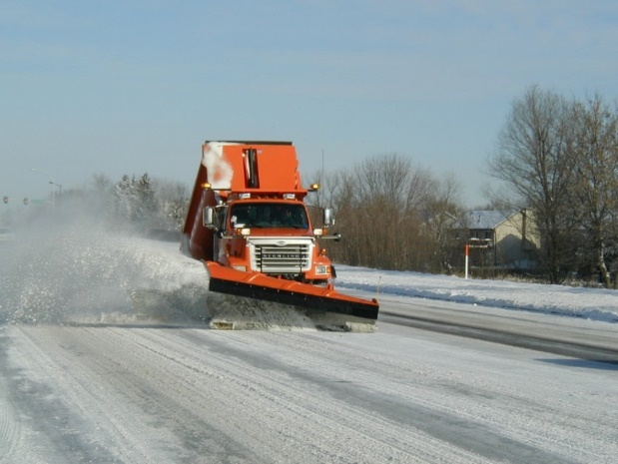
During the Storm
Documentation during a storm includes:
Pre and post trip inspections
  Documenting on appropriate forms
Material application
  What did you use and how much?
Storm information
  Duration and snowfall, air temps, wind speeds, etc
Road conditions
  pavement temperature
Notes:
In this section we will be covering these topics. If there is something that doesn’t apply to you, hide those slides. If there is something else that you do before the season, add it in here and in the provided slide at the end of the section.
Note to presenters: Customize the list of record keeping needed in your operation during the storm here. Delete this yellow box before making presentation.
Record pre and post trip inspections
Record storm information, pavement temperature
Record material Application
Record fuel Log
Record timecards
OTHER? Add here.
You should have an example of each of these forms that you use in your operation, the operators should know how to fill them out. Have a plan in place for saving them and how you can go back to access them later.
Photo credit: City of Eagan, MN

Slide 61
Test Question
Which items should be documented?
Material use per storm
Material use per season
Material use per crew member
All of the above
Notes:
Note to presenters: you may choose to hide this slide.
Test question: Which items should be tracked?
Salt use per storm (no)
Salt brine use per season (no)
Winter sand use per crew member (no)
All of the above (yes)

Slide 62
Test Question
Which items should be documented?
Material use per storm
Material use per season
Material use per crew member
All of the above
Notes:
Note to presenters: you may choose to hide this slide.
Test question: Which items should be tracked?
Salt use per storm (no)
Salt brine use per season (no)
Winter sand use per crew member (no)
All of the above (yes)

Slide 63
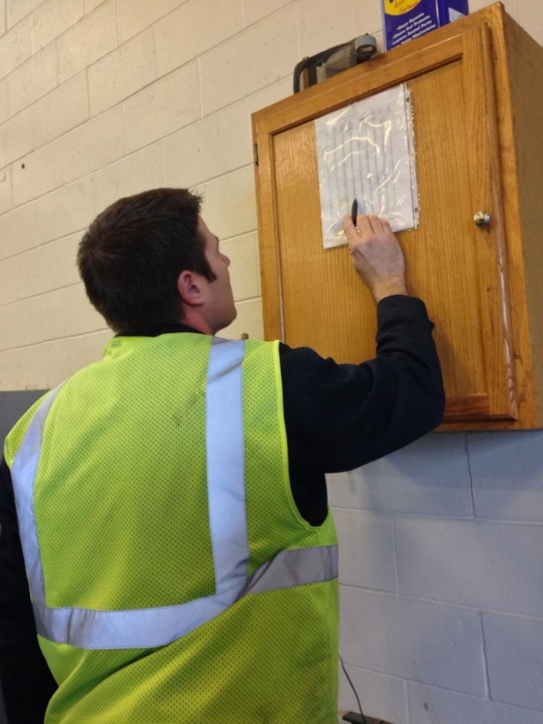
Recording Material Use
Keep track of driver use for insight into:
Individual storms
Each product totals
Winter season total
Leftover product totals
Notes:
You should record several different levels of material use by driver. Combine all this data for insight into individual storms, the winter season total, and what is leftover to store for the next season.
Having all this information helps in evaluating the efficacy of individual storm treatments went, how the whole winter went, and helps in next seasons ordering. It can also help in proving that policy is being followed if a lawsuit is brought against you.
Photo credit: Fortin Consulting, Inc.

Slide 64
Storm Documentation
EXAMPLE:
Work orders
Patrol log
Material usage log
Equipment work orders
Fuel logs
Time sheets
Diary
TAPER log
Customize this slide for your operation
Insert a list of forms needed to be completed by operators for a storm. Delete this yellow box before making the presentation.
Notes:
Review the storm documentation needed for your agency.
Note to presenters: Insert a list of forms needed to be completed by operators for a storm here. Delete this yellow box before making presentation.
Slide credit: CDOT Snow Removal Operator Training

Slide 65
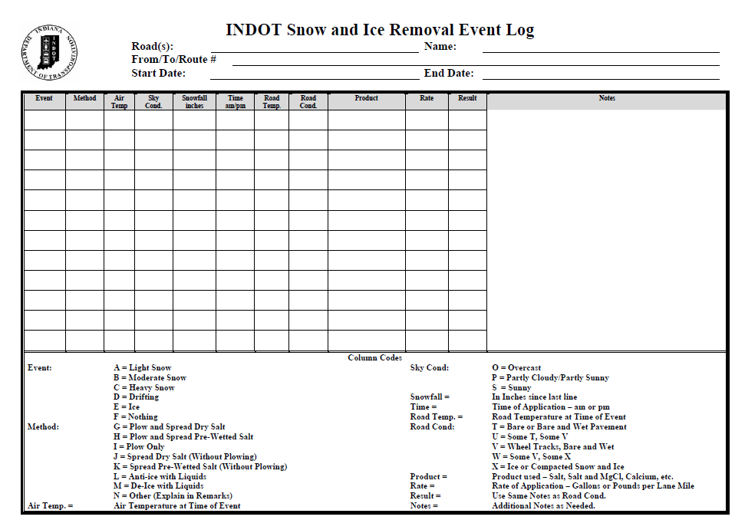
Document Your Operations
EXAMPLE:
Conditions- weather and road, pavement temp
Material type and quantity used
Timing
# of passes and when
Unusual conditions/circumstances
Customize this slide for your operation
Insert an example of your state’s event log and explain how to fill it out. Delete this yellow box before making the presentation.
Notes:
It is very important that plow drivers document the actions taken in response to a snow/ice event
This will include the road conditions throughout their shift, type and amount of deicer or anti-icer used, timing of operations, and the number of passes and when. If there are unusual conditions that affect the operations, those should be recorded. For example, road construction, accidents, major compaction problems, etc.
Note to presenters: Insert a copy of your state’s event log and explain how to fill it out. Delete this yellow box before making presentation.
Photo credit: INDOT

Slide 66
Example: T A P E R
T = Temperature
A = Application
P = Product
E = Event
R = Results
Notes:
Use this slide if your state uses the TAPER system to help explain. Hide this slide if it doesn’t use the TAPER system.
Slide credit: CDOT Snow Removal Operator Training

Slide 67
Event Log
Insert an example of your state’s event log. Delete this yellow box before making presentation.
Customize this slide for your operation
EXAMPLE
Notes:
Review this sequence of events as illustrated on this report, pay particular attention to the changes that took place in the highlighted entries. Note that this TAPER log really paints a good picture of what was done, when it was done, how it was done, who did it with what and what the outcome was like. If you had this information coming on to shift, would you really even need to talk to the person you are relieving?
Note to presenters: Insert an example of your state’s event log here. Delete the yellow box before making presentation.
Slide credit: CDOT Snow Removal Operator Training

Slide 68
Test Question
What should you record during the storm?
Type of product used
Application rate
Pavement temperature
All of the above
Notes:
Note to presenters: you may choose to hide this slide.
Test question: What do you need to record for the TAPER log?
Product (no)
Results (no)
Temperature (no)
All of the above (yes)

Slide 69
Test Question
What should you record during the storm?
Type of product used
Application rate
Pavement temperature
All of the above
Notes:
Note to presenters: you may choose to hide this slide.
Test question: What do you need to record for the TAPER log?
Product (no)
Results (no)
Temperature (no)
All of the above (yes)

Slide 70

A job well done is a job well documented
Filling out paperwork is important because it:
Shows that you follow policy
Improves efficiency of operations
Helps with planning
Notes:
Presenters: give a pep talk here! Everyone knows that filling out paperwork during or at the end of a long shift can be hard to be motivated to do, but it is very important because it:
Shows that you follow policy
Improves efficiency of operations
Helps with planning

Slide 71
Test Question
When you’ve been working all night and you’re tired, do you still have to fill out your paper work?
No
Yes
Notes:
Note to presenters: you may choose to hide this slide.
Test question: When you’ve been working all night and you’re tired do you still have to fill out your paper work?
No (no)
Yes (yes)

Slide 72
Test Question
When you’ve been working all night and you’re tired, do you still have to fill out your paper work?
No
Yes
Notes:
Note to presenters: you may choose to hide this slide.
Test question: When you’ve been working all night and you’re tired do you still have to fill out your paper work?
No (no)
Yes (yes)

Slide 73
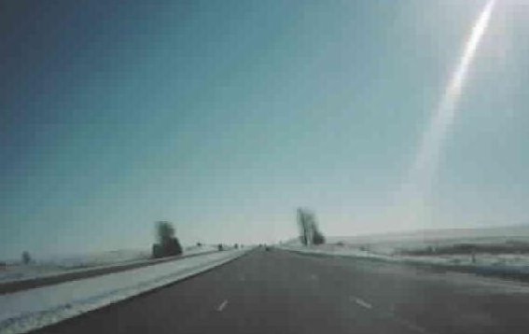
After the Storm
Documentation after a storm includes:
Minutes from the post storm meeting
Need for equipment repairs
Record/verify total material used
Record regain time
Notes:
In this section we will be covering these topics. If there is something that doesn’t apply to you, hide those slides. If there is something else that you do before the season, add it in here and in the provided slide at the end of the section.
Note to presenters: Insert a list of record keeping needed in your operation after the storm.
Post storm meeting
Record equipment repairs
Record/verify total material used
Record regain time
OTHER
Photo credit: Fortin Consulting, Inc.

Slide 74
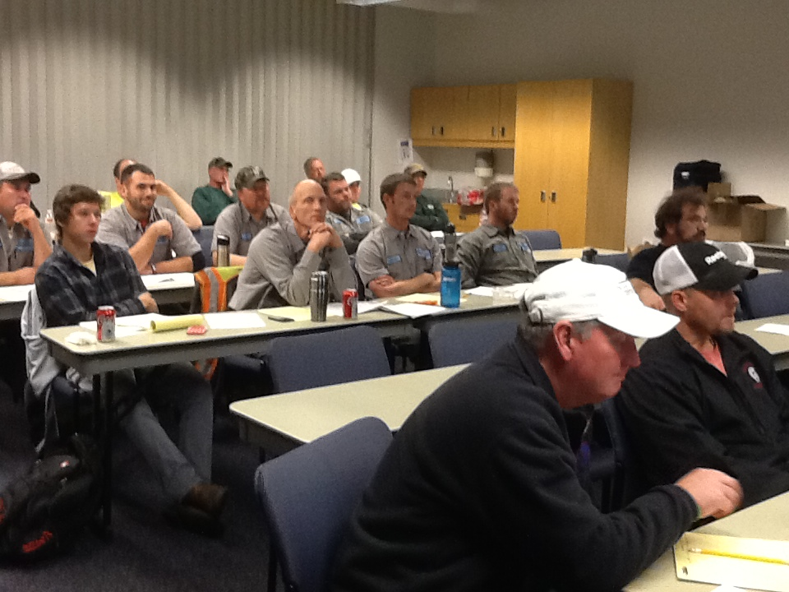
Post Storm Meeting
Discuss and document what went well and what could be improved for the next event
Notes:
You should have a record of what everybody did during the storm with you at the meeting. Review this information during the meeting, discuss how the storm went, how equipment worked, and any other important topics pertaining to the event.
Photo credit: Fortin Consulting, Inc.

Slide 75
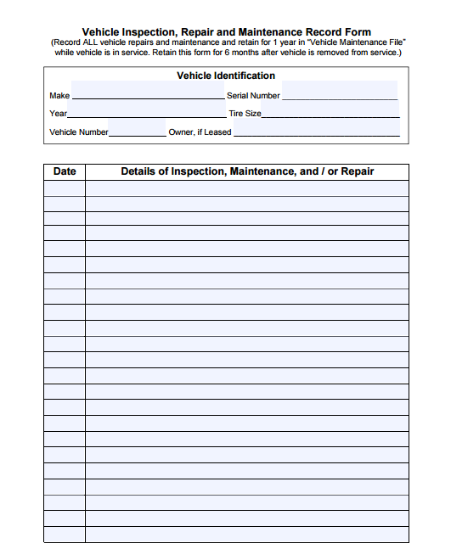

Equipment Repairs
Document and submit this form for needed repairs
Insert your equipment repair form here. Delete this yellow box before making presentation.
EXAMPLE
Notes:
If any problems are noted in your post trip inspection be sure to record them and submit the information so that the truck can be repaired in time for the next event.
Go over your equipment repair form and how to fill it out.
Note to presenters: insert your equipment repair form here. Delete this yellow box before making presentation.
Picture credit: Ohio, http://www.puco.ohio.gov/emplibrary/files/Trans/Enforcement/forms/Vehicle%20Inspection,%20Repair%20and%20Maintenance%20Record%20Form.pdf

Slide 76
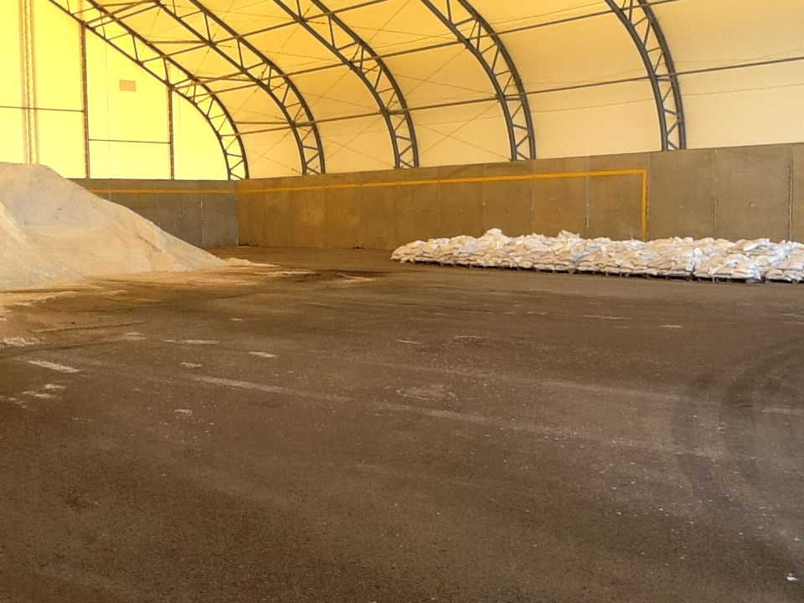
Check Records and Verify Total Materials Used
Notes:
As the winter progresses, reviewing records and verifying how much material has been used can help with planning, seeing if and when you need new shipments of salt, if a driver is over plowing, how well records are being kept.
This can be looked at on a storm to storm basis and up to the current point of the season.
Photo credit: Fortin Consulting, Inc.

Slide 77
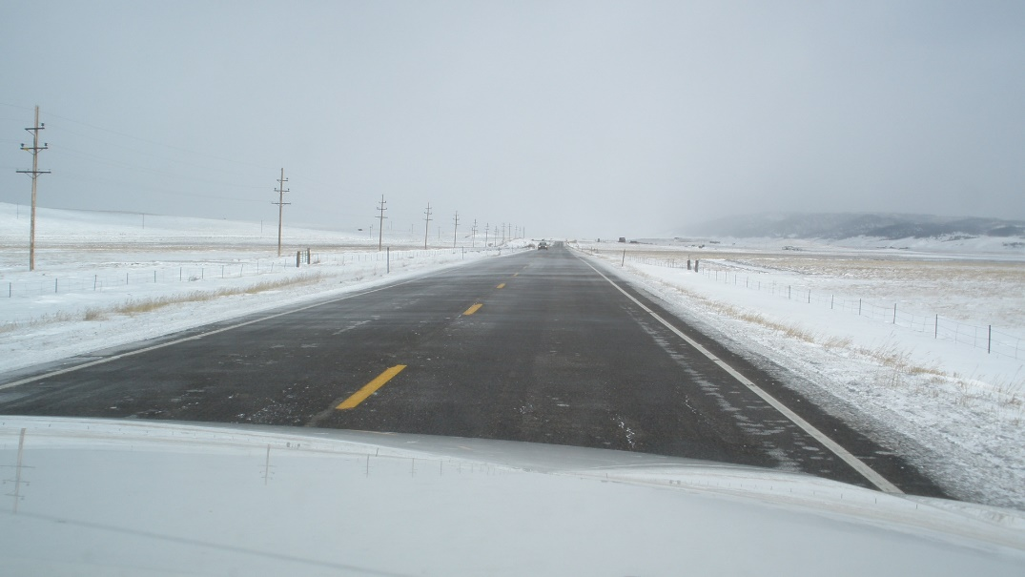

Level of Service Goal
Reviewing event documentation:
Materials Used + Plowing Strategy + # of Cycles + Other Factors
Are you able to meet your LOS goals?
Notes:
There are many factors that go into trying to meet your level of service goals such as material type and amount, plowing strategies, number of cycles, and others (ask for input). After each storm it is good to look at how the event went. How did you do and how can you improve for the next event?
Photo credits: Iowa DOT

Slide 78

After the Season
Review all records to summarize the season in an annual report.
EXAMPLE
Notes:
Once you have the season summarized you can share a high level summary with your operators, you may release a report to the public. It’s important to get everybody on the same page.
Note to presenters: Insert a list of record keeping needed in your operation after the season.
Photo credit: Wisconsin DOT

Slide 79

Cost-tracking
Review your costs at the end of the year to see where you can be more efficient
Per storm
Winter season total
Equipment purchases
Material purchases
Labor
Notes:
Cost tracking is an important part of keeping things running. Costs per storm, for the entire winter season, equipment purchases, material purchases, labor, and fuel and maintenance all go into overall costs. Part of your job is to keep track and manage these costs.
Note to presenters: Insert a list of cost tracking needed in your operation after the season.
Photo credit: Microsoft clipart

Slide 80

Planning
Use records from previous years to help predict future materials, equipment, and maintenance needs.
Notes:
While no season or even event is the same, you can use records of previous years to help predict future needs in materials, equipment, and maintenance.
Photo credit: Microsoft clipart

Slide 81

Record Keeping is Important!
You can’t break any records if you’re not keeping track!
You are an important part of the record keeping puzzle!
Notes:
Photo credit: Microsoft clipart

Slide 82
Supervisors Sowing Seeds of Success
Your vision and your work is important to the future of your organization and our country.
Notes:
Photo credit: Clear roads

Slide 83



Thank you for your good work!
Notes:
Photo credits: Fortin Consulting, Inc.
Thank you for your time today. Have a good winter!

Slide 84
Acknowledgements
Training contents were developed by Fortin Consulting Inc., under the direction of the Clear Roads Advisory Team.
Connie Fortin – connie@fortinconsulting.com
Professional formatting and training aids were developed by the University of Minnesota, Center for Transportation Studies.
Jim Grothaus – Groth020@umn.edu
Ann Johnson – Johns421@umn.edu
Members of the Clear Roads Advisory Team include:
  Scott Lucas, Wayne Gammel, Todd Law, Mike Sproul, Dave Wieder, Cliff Spoonemore, Monty Mills, David Frame,
  Mike Lashmet, Clay Adams, Justun Juelfs, and Tom Peters

Slide 85
Additional Resources
Online winter maintenance assessment tool: Google “MPCA WMAT”, and follow the links
Preparing for winter checklist: contact chris.smith@dot.ca.gov
Level of service examples and policies: MnDOT Maintenance Manual found online at: http://www.dot.state.mn.us/maintenance/manual.html

Slide 86
This presentation was developed with funding from the Clear Roads research program, which brings together transportation professionals and researchers from around the country to drive innovation in the field of winter maintenance.
Find additional information and resources at
http://clearroads.org/

