Slide 1
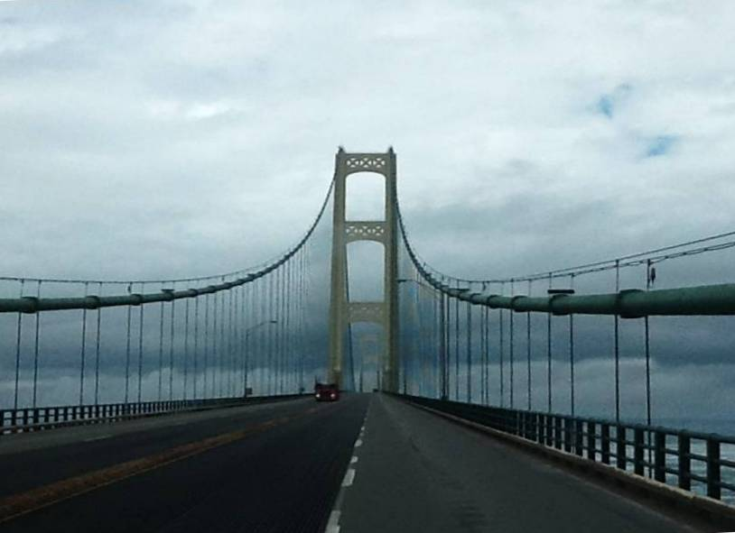

Module 17 - Bridge Frost
2016 Created for Clear Roads by:
U of MN Center for Transportation Studies &
Fortin Consulting Inc.

Slide 2
Training for Winter Maintenance Supervisors and Operators
2016 Created for Clear Roads by:
U of MN Center for Transportation Studies &
Fortin Consulting Inc.

Slide 3
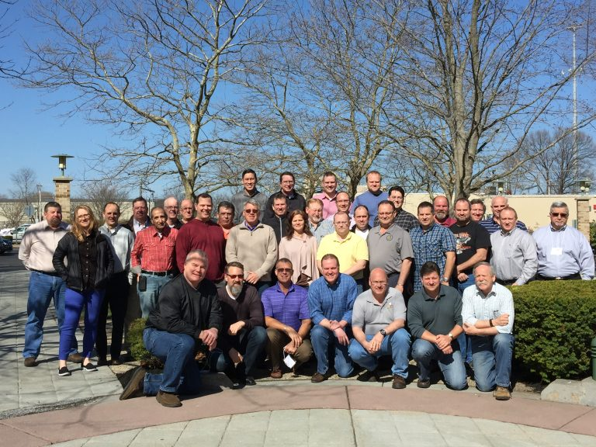
Winter maintenance professionals are a very powerful and important group
Notes:
Photo: clear roads website
Note to presenters: These first 7 slides can be used or hidden.
Or, replace with photos of your staff.

Slide 4
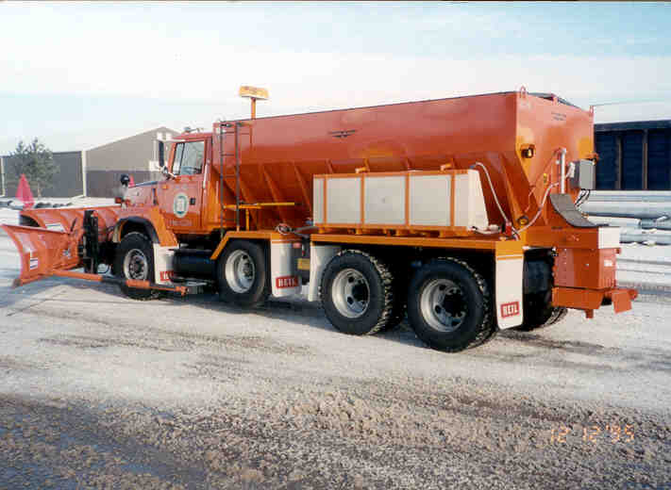
You do a great job of taking care of our roads!

Slide 5
This is one of a series of 22 winter maintenance training modules developed by the Clear Roads Program. All of the modules are available online at www.clearroads.org
Modules include information on the following:
Plowing
Truck operations
Spreading
Material use
Pre-wetting
Brine production
De-icing and anti-icing
Level of service
Ice formation
Freeze point depressants
Environmental issues
Drift control
Weather
Avalanche management
Bridge frost
Safety
Notes:
Note to presenters: The website www.clearroads.org can be accessed here if a live internet connection is available.
A list of all the modules is given here:
Plowing procedures
Truck operations
Spreading
Material use
Pre-wetting
Brine production
De-icing
Anti-icing
Safety
De-icing agent management policy
Level of service
Ice formation
Freeze point depressants
Environmental issues
Drift control
Weather
Bridge frost
Avalanche management

Slide 6
Module 17 - Bridge Frost
2016 Created for Clear Roads by:
U of MN Center for Transportation Studies &
Fortin Consulting Inc.

Slide 7
FACILITATOR NOTES (do not show during class)
This is a priority 1 module to be developed for Clear Roads national training. It will address three audiences. Slides can be customized for the audience.
Slide Legend
Entry-level plow drivers
Experienced plow drivers
Supervisors
Notes:
Note to facilitator: do not show this slide during class

Slide 8
This module will contain these topics:
How bridge frost and black ice develop.
How to use weather forecasts to know when bridge frost is possible.
When to anti-ice in anticipation of bridge frost.
How to anti-ice or treat bridges.
Notes:
This module covers how bridge ice develops, weather conditions optimal for bridge ice formation, and anti-icing treatments for bridges

Slide 9
How bridge frost and black ice develop
Notes:
Next we’ll discuss how bridge frost and black ice develop.

Slide 10
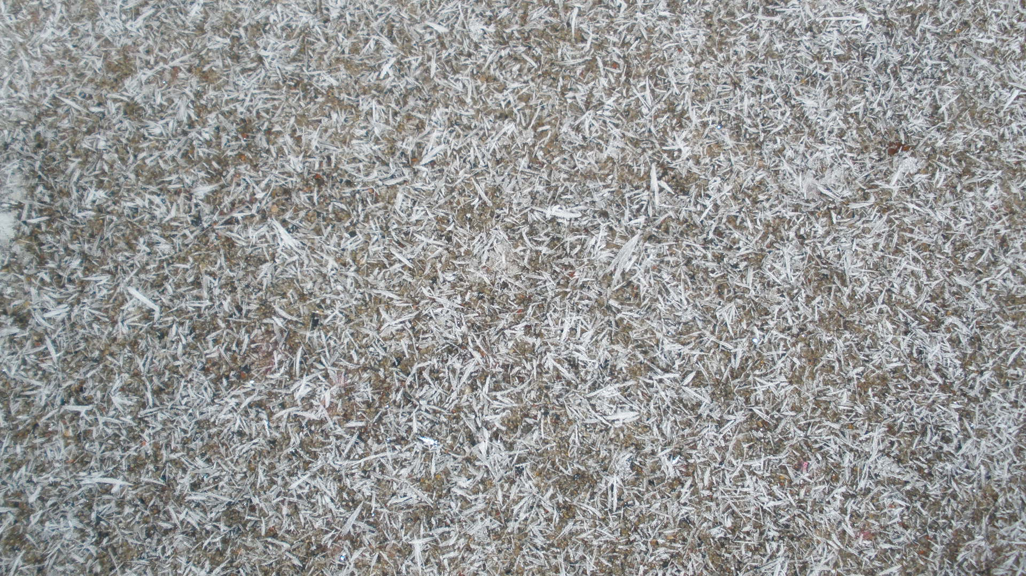
Frost
Frost occurs when the pavement temperature drops below the dew point
and is equal to or less than freezing.
Moisture from the air freezes directly
on the road surface.
Frost looks something like this
Notes:
Frost is a coating of ice that may form in humid air in cold conditions, usually overnight. It forms most commonly as fragile white crystals on the road surface.
Moisture from the air freezes directly onto the road surface.
Frost occurs when the pavement temperature drops below the dew point and is equal to or less than freezing.
Frost can cause the road to become slippery, or cause car tires to lose traction on the road and create hazardous driving conditions.

Slide 11
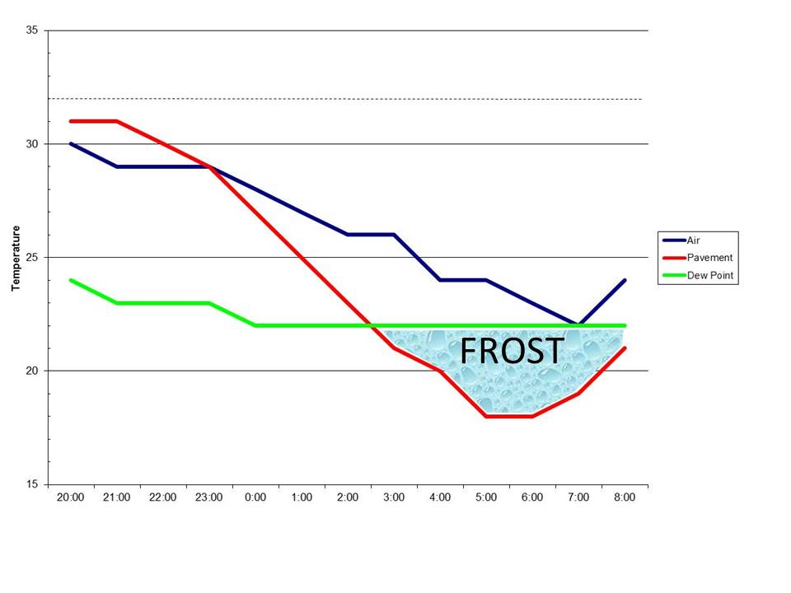
Frost
Air
Pavement
Dew Point
Warning: When red and green lines converge, frost may occur
Notes:
Frost conditions are illustrated on the graph. You can see that the pavement temperature (red line) is below 32 degrees F. When the line drops below the dew point (green line) the graph shows that frost may occur. This is shown by the blue area labeled “FROST”.
Photo credit: Weather Management Solutions

Slide 12
Test Question
When is frost likely to occur?
When pavement temp and dew point come together and road is above freezing
When pavement temp and dew point come together and road is below freezing
When pavement temp and dew point are far apart
When you breathe and see steam from your breath
Notes:
Note to presenters: you may choose to hide this slide.
Test Question:
When is frost likely to occur?
When pavement temp and dew point come together and road is above freezing
When pavement temp and dew point come together and road is below freezing
When pavement temp and dew point are far apart
When you breath and see steam from your breath

Slide 13
Test Question
When is frost likely to occur?
When pavement temp and dew point come together and road is above freezing
When pavement temp and dew point come together and road is below freezing
When pavement temp and dew point are far apart
When you breath and see steam from your breath
Notes:
Note to presenters: you may choose to hide this slide.
Test Question:
When is frost likely to occur?
When pavement temp and dew point come together and road is above freezing
When pavement temp and dew point come together and road is below freezing
When pavement temp and dew point are far apart
When you breath and see steam from your breath

Slide 14
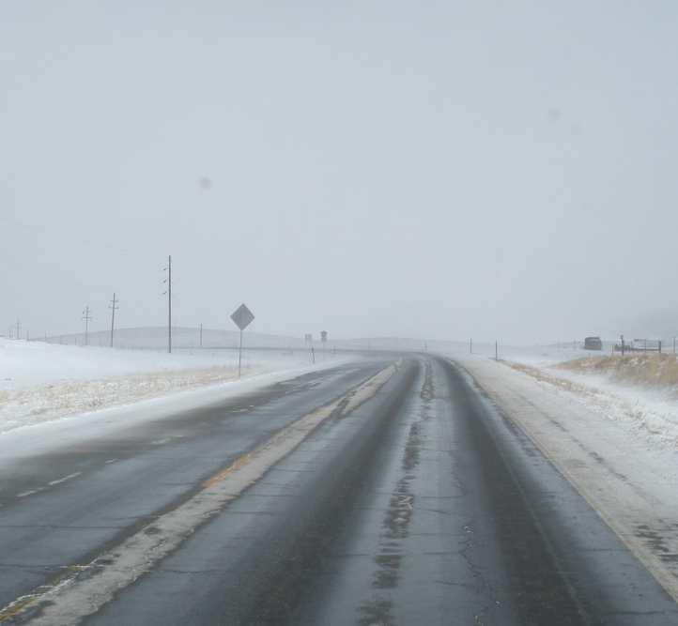
Black Ice
Book definition of black ice:
The pavement temperature is above freezing.
Then drops to temperatures equal or less than freezing.
Pavement temps are at or below the dew point.
Black ice is a thin sheet of ice
Notes:
Black ice is a thin layer of ice that forms on the surface which is virtually transparent, making it difficult to see.
The book definition of black ice refers to when moisture in the air condenses as water on the road surface, then freezes as the pavement temperature drops.
Black ice forms similarly to frost, except pavement temperatures begin above freezing then drop below the dew point to temperatures equal or less than freezing.
This creates largely invisible slick icy patches that can cause tires to lose traction and skid or spin. Black ice can be all but invisible to drivers, which can be very dangerous. Black ice can be removed by using chemical deicing.
Picture credit: Fortin Consulting, Inc.

Slide 15
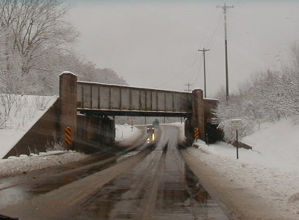
Many forms of ice could be considered “black ice”
Refreeze
Freezing rain
Exhaust from cars freezes on the road
But today we will only talk about the book definition
Notes:
Many forms of ice could be considered “Black Ice”. These forms and more are discussed more thoroughly in Clear Roads Training Module 12: Principals of Ice Formation.
Those definitions include:
Refreeze
Freezing rain
Exhaust from cars freezes on the road
But today we will only talk about the book definition:
Moisture in the air condenses into water on the pavement, which freezes as the pavement temperature drops

Slide 16
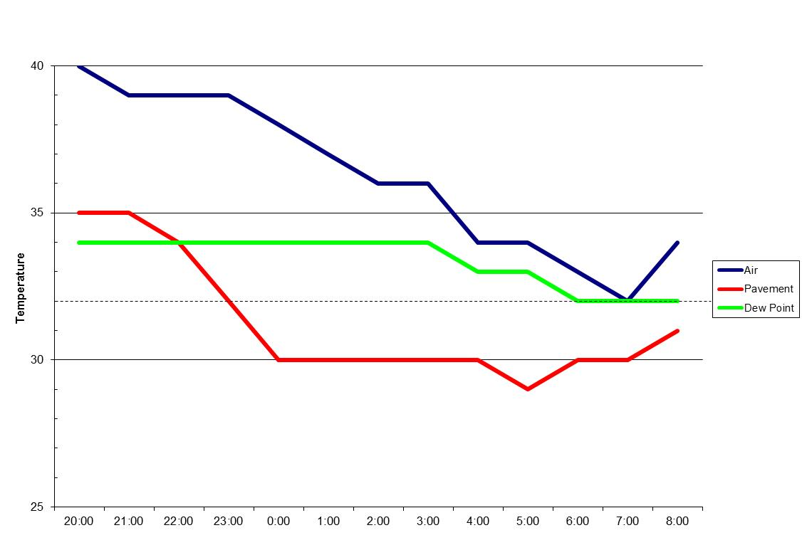

Black Ice
Air
Pavement
Dew Point
BLACK ICE
Notes:
Black ice conditions are illustrated on the graph. You can see that the pavement temperature (red line) begins above 32 degrees F. When the line drops below freezing (the dotted line) and the dew point (green line) the graph shows that black ice may occur. This is shown by the blue area labeled “BLACK ICE”.
Photo credit: Weather Management Solutions

Slide 17
Test Question
What is true about the pavement temperature when black ice is likely to occur?
The pavement temperature begins above freezing, but drops below freezing
The pavement temperature stays above freezing
The pavement temperature and dew point are far apart
The pavement temperature does not matter
Notes:
Note to presenters: you may choose to hide this slide.
Test question:
What is true about the pavement temperature when black ice is likely to occur?
The pavement temperature begins above freezing, but drops below freezing (yes)
The pavement temperature stays above freezing (no)
The pavement temperature and dew point are far apart (no)
The pavement temperature does not matter (no)

Slide 18
Test Question
What is true about the pavement temperature when black ice is likely to occur?
The pavement temperature begins above freezing, but drops below freezing
The pavement temperature stays above freezing
The pavement temperature and dew point are far apart
The pavement temperature does not matter
Notes:
Note to presenters: you may choose to hide this slide.
Test question:
What is true about the pavement temperature when black ice is likely to occur?
The pavement temperature begins above freezing, but drops below freezing (yes)
The pavement temperature stays above freezing (no)
The pavement temperature and dew point are far apart (no)
The pavement temperature does not matter (no)

Slide 19


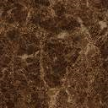
Bridges
Bridge pavement temperatures change faster than road pavement temperatures because they are surrounded by air.
Air
Air
Soil
Air
Notes:
Bridge pavement temperatures change much faster than road pavement temperatures because they are surrounded on all sides by air. When the air temperature changes, the road (which is buffered by the ground on all but one side) changes more slowly than the bridge because it is buffered by the soil. The bridge is exposed, so the bridge pavement temperature will change faster with the air temperature.
Graphic credit: Fortin Consulting Inc.

Slide 20
Test Question
True or false, bridge temperatures change faster than road temperatures?
True
False
Notes:
Note to presenters: you may choose to hide this slide.
Test question:
True or false, bridge temperatures change faster than road temperatures?
True (yes)
False (no)

Slide 21
Test Question
True or false, bridge temperatures change faster than road temperatures?
True
False
Notes:
Note to presenters: you may choose to hide this slide.
Test question:
True or false, bridge temperatures change faster than road temperatures?
True (yes)
False (no)

Slide 22
Frost or black ice is less likely to form if there is…
Chemical residue on the surface
High traffic volume
Strong wind
Cloud cover
Notes:
Other weather conditions can influence frost formation. Knowing what these are can help you predict whether or not frost may form.
1. Amount of chemical residue on the surface – if there is chemical residue on the road surface at high enough concentrations, this can mitigate a threat of frost. That is why anti-icing is used to prevent frost from forming.
2. Traffic volume – friction from tires on the road can warm the road surface. High traffic can reduce the likelihood of frost forming.
3. Wind – frost is unlikely to form when there are windy conditions, above 6 mph. Light winds, 3 to 5 mph are optimal conditions for frost formation.
4. Cloud cover – cloud cover keeps the air and pavement temperatures warmer in the over night hours when frost is most likely to form, making it less likely to occur.

Slide 23
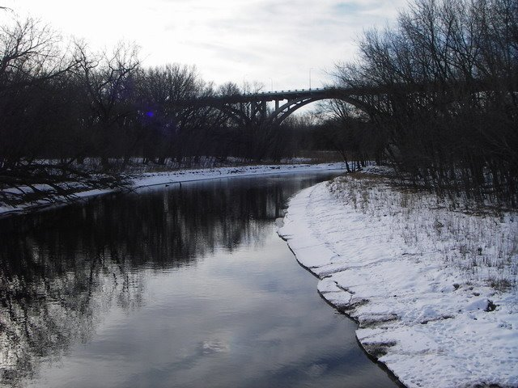
Tip from experienced drivers
In general, bridges over water are more likely to have frost or back ice problems:
It is not a rule.
It is important to know the trouble spots on your roads.
Notes:
In general, bridges over water are more likely to have frost or black ice problems.
This tip comes from discussions with Woody Woodruff, Retired MnDOT supervisor
Picture credit: Fortin Consulting, Inc.

Slide 24
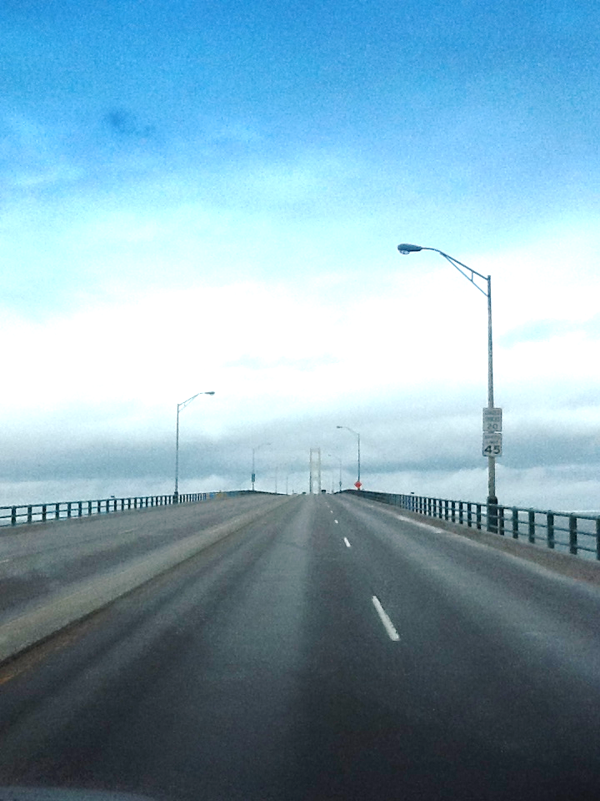
How to use weather forecasts to
know when bridge frost is possible
Is there a frost predicted?
Look at:
Pavement temperature
Dew point
Wind speed
Cloud cover
Notes:
Some weather services such as RWIS or MDSS have frost prediction or frost warnings. These will alert you to the likelihood of frost occurring.
When you are looking at a forecast to determine if frost is likely to occur, take into consideration the pavement temperature, dew point, wind speed, and cloud cover. Cloud cover is particularly important if you do not have access to pavement temperatures.
Picture credit: Fortin Consulting Inc.

Slide 25
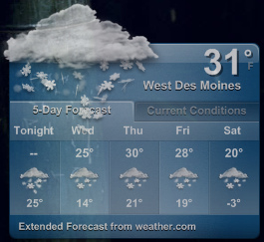
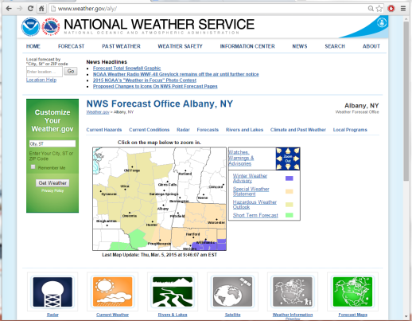
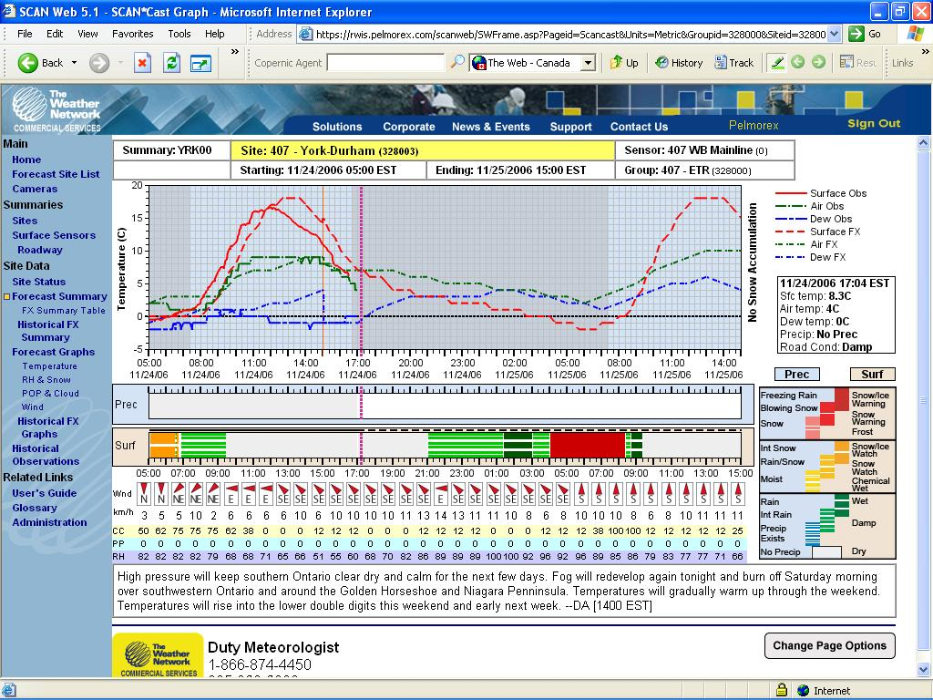
How to get dew point, cloud cover, and wind speed
Dew point, cloud cover, and wind speed forecasts are commonly available. Look for them on:
Media - TV weather forecasts.
Internet weather forecasts.
Government services (NOAA or NWS).
Value Added Meteorologists.
Notes:
Dew point, cloud cover, and wind speed forecasts are commonly available. Look for them on:
Media - TV weather forecasts
Internet weather forecasts
Government Services (NOAA or NWS)
Value Added Meteorologists
Picture credit left: Jake Bouma
Forecast: snow. https://www.flickr.com/photos/30885355@N00/2245250544 are licensed under a Creative Commons Attribution Share-Alike 3.0 License
Photo credit middle: Briefing provided by NY DOT
Photo credit right: Complete-program-2012-Milwaukee.ppt

Slide 26
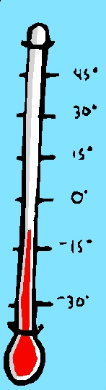
Pavement temperature
Pavement temperature is important
when monitoring for frost or black ice
Access to pavement temperatures forecasts:
Road Weather Information Sensor
(RWIS)
Maintenance Decision Support
Systems (MDSS)
Infrared pavement sensors
Notes:
Pavement temperature is important when monitoring for frost of black ice. Pavement can vary from air temperature by up to 40 degrees.
Ways to access pavement temperature include Road Weather Information Sensor (RWIS) or Maintenance Decision Support
Systems (MDSS)
Infrared pavement sensors are a way pavement temperatures can be tracked to help predict pavement temperature trends

Slide 27
Test Question
How can access pavement temperature forecasts?
Road Weather Information Sensor (RWIS)
Maintenance Decision Support Systems (MDSS)
Infrared pavement sensors
All of the above
Notes:
Note to presenters: you may choose to hide this slide.
Test question:
How can access pavement temperature forecasts?
Road Weather Information Sensor (RWIS) (no)
Maintenance Decision Support Systems (MDSS) (no)
Infrared pavement sensors (no)
All of the above (yes)

Slide 28
Test Question
How can access pavement temperature forecasts?
Road Weather Information Sensor (RWIS)
Maintenance Decision Support Systems (MDSS)
Infrared pavement sensors
All of the above
Notes:
Note to presenters: you may choose to hide this slide.
Test question:
How can access pavement temperature forecasts?
Road Weather Information Sensor (RWIS) (no)
Maintenance Decision Support Systems (MDSS) (no)
Infrared pavement sensors (no)
All of the above (yes)

Slide 29
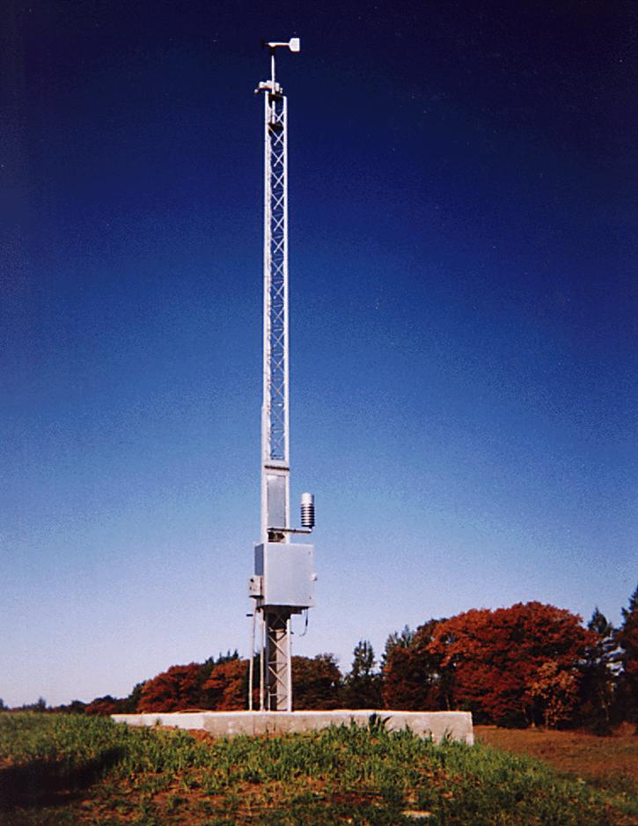
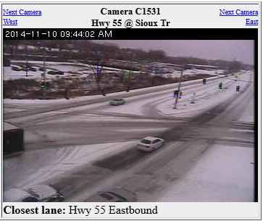
RWIS
Note to presenters: If your state has access, place your website access info here, e.g. www.rwis.dot.state.mn.us
Delete this yellow box before presenting.
Notes:
Note to presenters: If your state has RWIS access, put the information on this slide. Delete this yellow box before making presentation.
Picture credit: Fortin Consulting Inc.

Slide 30
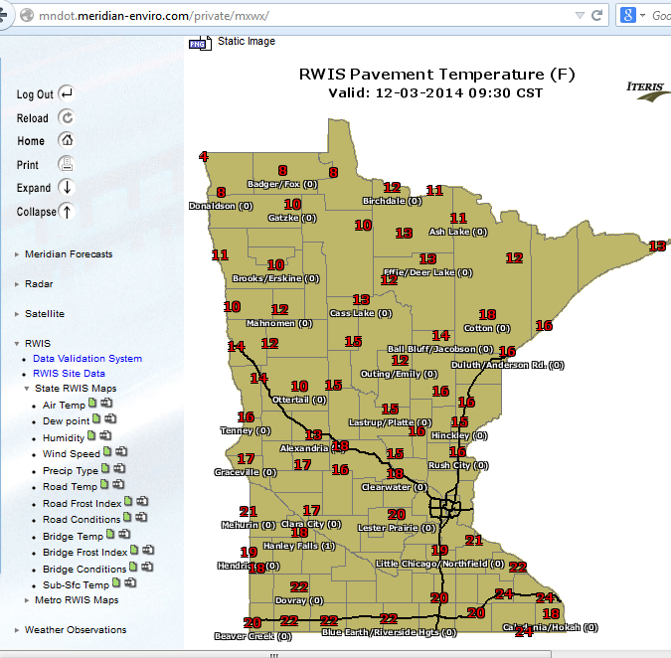
Note to presenters: Insert your pavement temperature map here. Delete this yellow box before making presentation.
Statewide pavement temperatures
Notes:
An additional feature of RWIS is map views. This example is from Iowa RWIS. It is an interactive map that shows a variety of RWIS data that can be turned on or off. Insert your pavement temperature map here. Delete this yellow box before making presentation.
Photo credit: http://rwis.dot.state.mn.us/

Slide 31
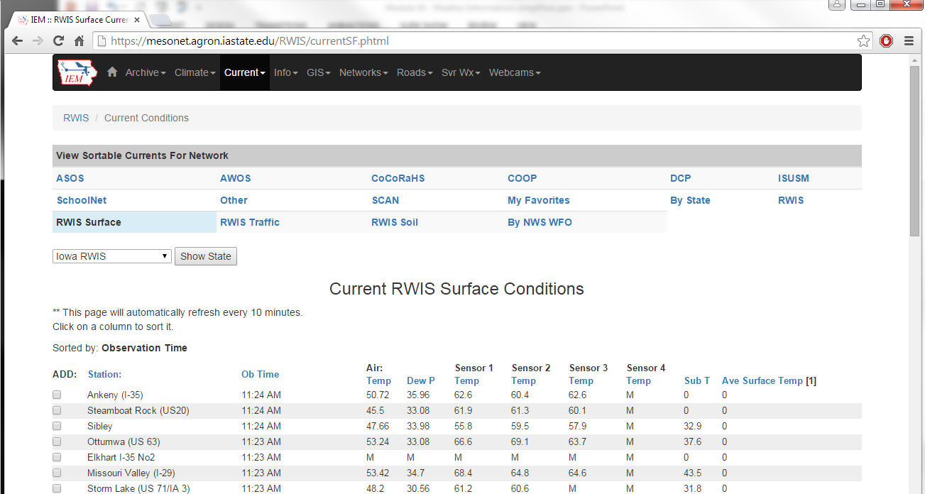
Many state’s RWIS information can be found at: https://mesonet.agron.iastate.edu/RWIS/currentSF.phtml
Select State here!
Notes:
If you have live internet, go to this website.
Many state’s RWIS information can be found at: https://mesonet.agron.iastate.edu/RWIS/currentSF.phtml
Photo credit: https://mesonet.agron.iastate.edu/RWIS/currentSF.phtml

Slide 32
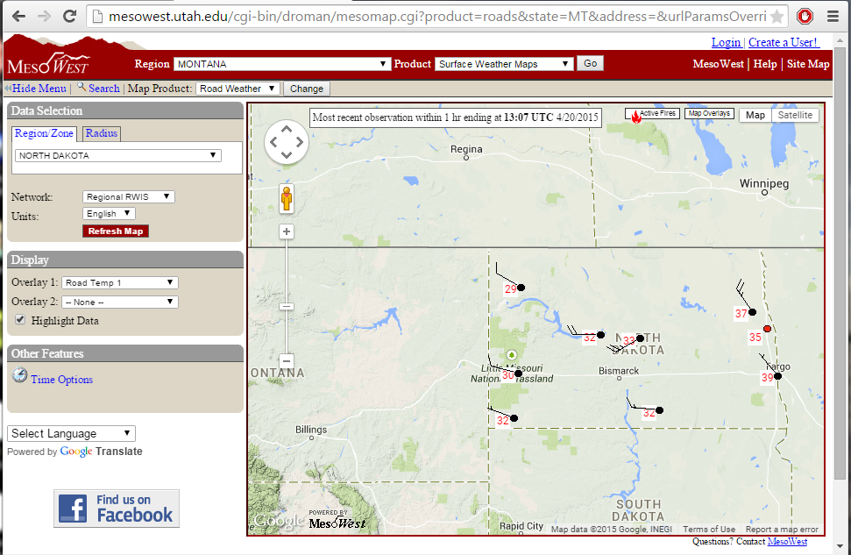
Or at http://mesowest.utah.edu
Select your state and road weather to get road weather information for your area.
Notes:
This slide shows another example. Go to this website if a live internet connection is available.
Photo credit: http://mesowest.utah.edu

Slide 33
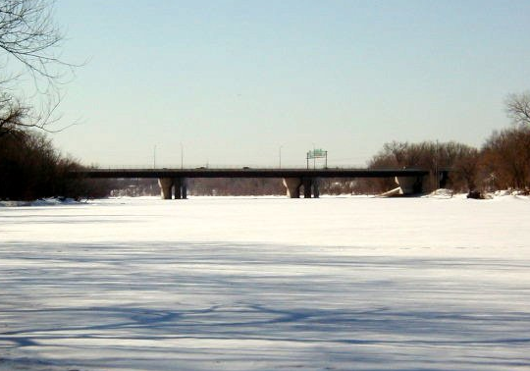
Tip from experienced drivers
Forecasts are helpful, but if there is a likelihood of frost, drive the bridges to check for frost.
Notes:
Frost can be unpredictable. If conditions are optimal for frost, send out a scout to check for signs of frost.
Checking for frost helps prevent over application which can strain salt supplies, cause degradation of the bridge structure, as well as increase environmental burdens.
Photo credit: Fortin Consulting Inc.

Slide 34
When to anti-ice in anticipation of bridge frost
Notes:
The next section outlines when to anti-ice in anticipation of bridge frost.

Slide 35

Looking for frost
Is the pavement temperature below or about to drop below freezing?
No
Yes
Is the pavement temperature near the dew point, within
2-3°F?
No
Frost unlikely, no anti-icing needed
Yes
Is it windy (above 6 mph)?
Yes
No
Frost likely,
anti-icing needed
Notes:
Note to presenter: If you have pavement temperatures available, use this flow chart.
It is very difficult to predict frost without pavement temperatures
Walk through the steps for looking for frost:
Is the pavement temperature below or about to drop below freezing?
Is the pavement temperature at or below the dew point?
Is it windy (above 6 mph)?

Slide 36
How to anti-ice or treat bridges
Notes:
Next, we’ll discuss how to anti-ice or treat bridges.

Slide 37
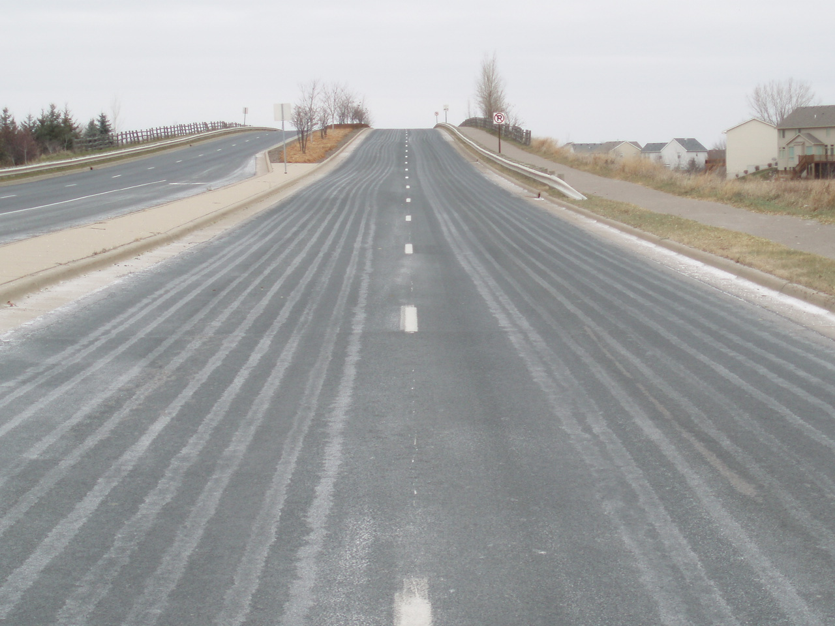
Anti-icing
Anti-icing can be used to prevent frost or black ice from forming on the roads by applying a chemical freeze point depressant.
Notes:
Anti-icing is the process of applying chemical freeze point depressants to roads prior to an event to prevent frost or black ice from forming.
For bridges the anti-icing application can be applied by trucks or by an automated anti-icing system built on the bridge.
Photo credit: Fortin Consulting Inc.

Slide 38
Test Question
True or false: Anti-icing helps to prevent frost formation.
True
False
Notes:
Note to presenters: you may choose to hide this slide.
Test question:
True or false: Anti-icing helps to prevent frost formation.
True (yes)
False (no)

Slide 39
Test Question
True or false: Anti-icing helps to prevent frost formation.
True
False
Notes:
Note to presenters: you may choose to hide this slide.
Test question:
True or false: Anti-icing helps to prevent frost formation.
True (yes)
False (no)

Slide 40
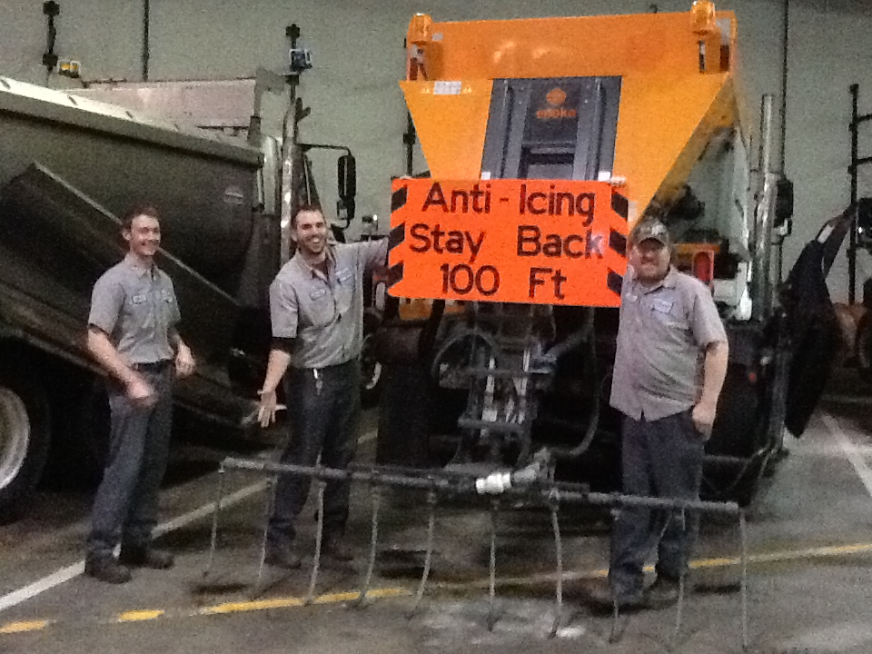
Tip from experienced drivers
Anti-ice application is based on predicted frost, not on a schedule such as every Tuesday and Friday. It will save you money and help protect our environment!
Notes:
Anti-ice based on predicted frost, not on a schedule such as every Tuesday and Friday. It will save you money and help protect our environment!
Checking for frost helps prevent over application which can strain salt supplies, cause degradation of the bridge structure, as well as increase environmental burdens.
Photo credit: Fortin Consulting Inc.

Slide 41
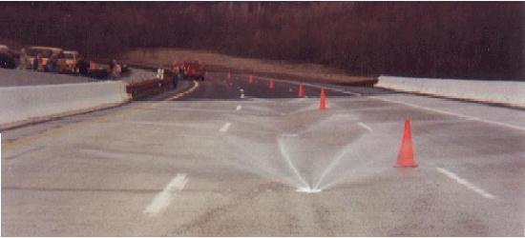
Automatic anti-icing systems
Sprinkler systems built into the bridge
Can be programmed to automatically distribute anti-icing liquid.
Can be manually activated.
Notes:
This slide shows a sprinkler systems built into the bridge. These can be programed to automatically distribute anti-icing liquid when road conditions are optimal for frost or black ice. They can also be manually activated.
Photo credit: NYSDOT
Find online at: https://www.dot.ny.gov/divisions/engineering/environmental-analysis/environmental-initiative/environmental-initiative-examples/evaluation-of-anti-icing-agents

Slide 42
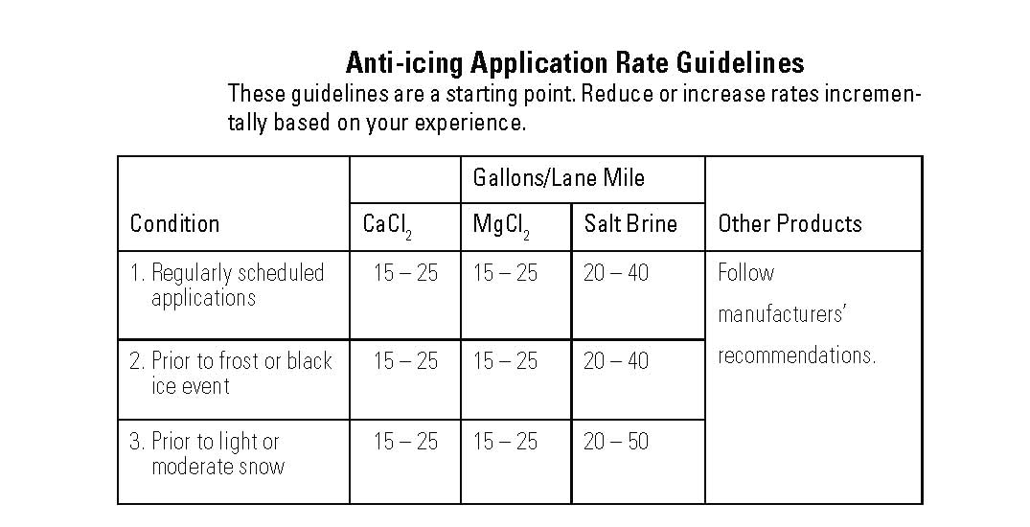
Anti-icing application rate guidelines
Note to presenters: insert your anti-icing application rate guidelines here. Delete this yellow box before making presentation.
Condition | Gallons/Lane Mile |  |  | Other Products
 | CaCl₂ | MgCl₂ | Salt Brine
Regularly scheduled applications | 15 – 25 | 15 – 25 | 20 – 40 | Follow manufacturers’ recommendations
Prior to frost or black ice | 15 – 25 | 15 – 25 | 20 – 40
Prior to light snow or moderate snow | 15 – 25 | 15 – 25 | 20 – 50
Notes:
Know your policy on anti-icing application rates. Initial anti-icing may only occur at high risk locations for ice, such as on bridges, ramps, etc. Note that Module 8: Anti-icing further covers this topic.
Note to presenters: insert your anti-icing application rate guidelines here. Delete this yellow box before making presentation.
Chart credit: Minnesota Snow and Ice Control Handbook

Slide 43
Example: Bridge frost treatment
50% chance of frost expected Tuesday at 1 am
Monday: send crew out to anti-ice the bridges before the end of their normal shift
Should you call road patrol in at 3 am to check for frost?
  On bridges?
  On areas not anti-iced?
Note to presenters: You may choose to replace this scenario with a snow scenario typical of your operations. Delete this yellow box before making presentation.
Notes:
Note to presenters: Use this scenario, or replace with another. Delete this yellow box before making presentation.

Slide 44

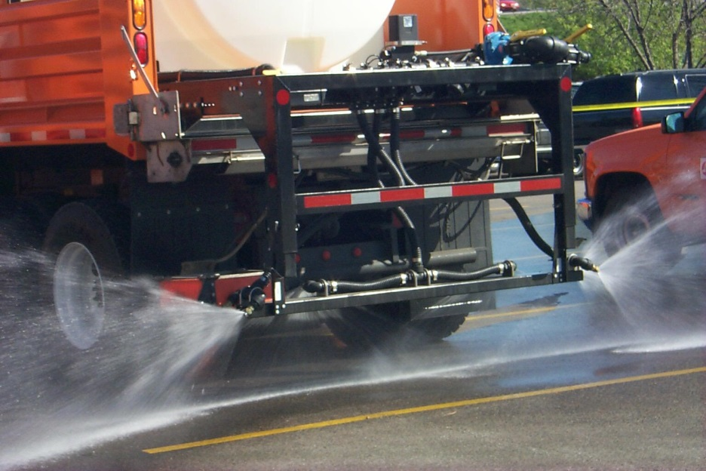
If you have frost
Best choice: use a direct liquid application.
Next best choice: use pre-wet salt at a low application rate.
Notes:
If you have frost on your roads that you need to treat use a direct liquid application if you have the equipment available. If you don’t, use pretreated or pre-wet salt instead of dry salt. This will allow the deicing to work more quickly, as it needs moisture to activate.
It also helps prevent over application which can strain salt supplies, cause degradation of the bridge structure, as well as increase environmental burdens.

Slide 45
Test Question
What is the best choice for treatment if you have frost?
Dry salt
Pretreated salt
Direct liquid
Pre-wet salt
Notes:
Note to presenters: you may choose to hide this slide.
Test question:
What is the best choice for treatment if you have frost?
Dry salt (no)
Pretreated salt (no)
Direct liquid (yes)
Pre-wet salt (no)

Slide 46
Test Question
What is the best choice for treatment if you have frost?
Dry salt
Pretreated salt
Direct liquid
Pre-wet salt
Notes:
Note to presenters: you may choose to hide this slide.
Test question:
What is the best choice for treatment if you have frost?
Dry salt (no)
Pretreated salt (no)
Direct liquid (yes)
Pre-wet salt (no)

Slide 47

Importance of Record Keeping
Keep records of materials, treatments and effectiveness.
This helps you know what is and isn’t working, and where efficiency can be improved.
Notes:
Record keeping is important as a means of material accountability, budgeting/cost tracking, performance tracking, support in the event of legal actions, media inquiries, and planning.

Slide 48
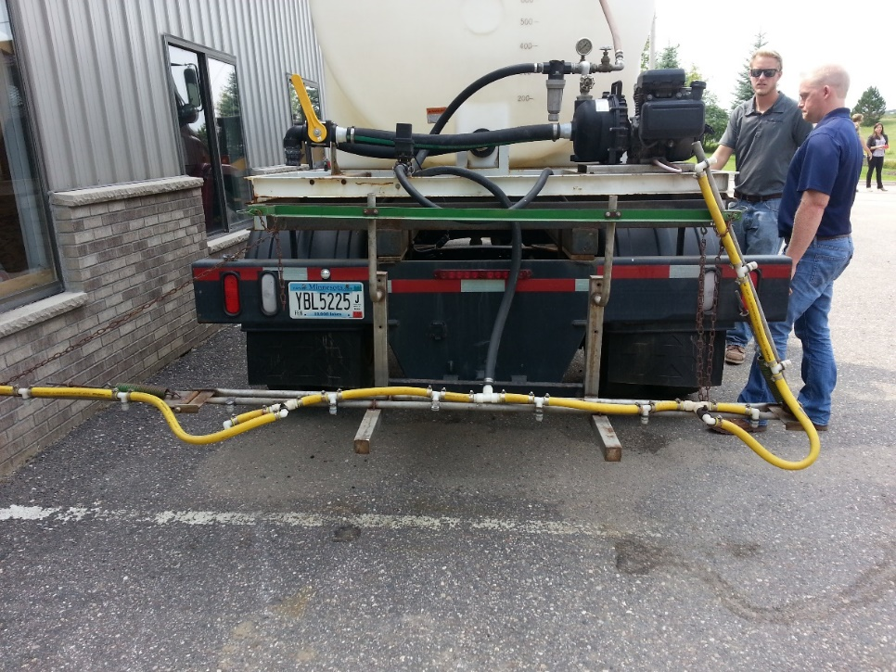
Before the Season
In this section we will be covering these topics:
Records of material purchasing
Records of material quality control
Record equipment inspections
Record equipment calibration
Customize this slide for your operation
Insert a copy of your truck inspection check list and procedure. Delete this yellow box before making presentation.
Notes:
In this section we will be covering the topics shown here.
Note to presenters: If any of the items on this list do not apply to you, delete them from the list, and hide the slides. If there is something else that you do before the season, add it in here and in the provided slide at the end of the section.
Also: insert a copy of your truck inspection checklist and procedure here. Delete this yellow box before making presentation.
Records of material purchasing
Records of material quality control
Record equipment inspections
Record equipment calibration
OTHER?
Note: More about these topics can be found in Module 23 – Getting Ready for Winter.

Slide 49
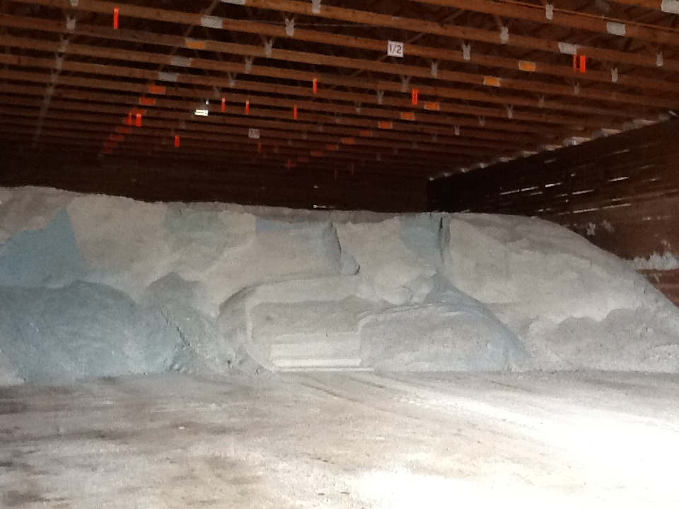
Material Accountability
Know how much you have
Know how much you use
Notes:
It is important to know how much salt you start with, how much you have throughout the season and how much salt you use. Knowing this helps with evaluating salt application efficiency, and for predicting order numbers in the future.

Slide 50
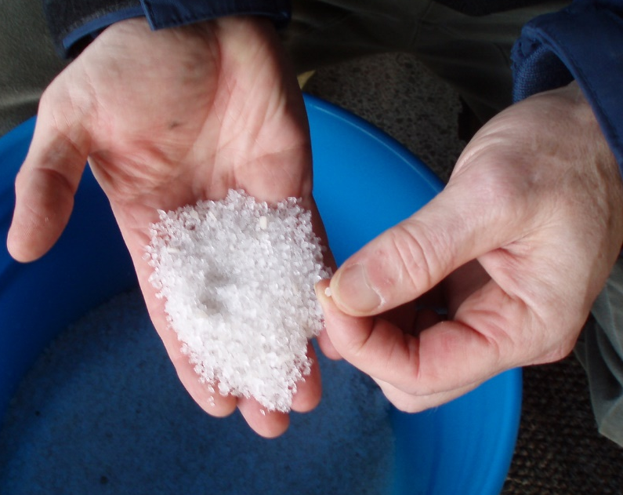
Record Keeping and Quality Control
Test the materials
Solids- test the moisture content
Liquids- test the specific gravity
Check that you get what you ordered
Keep accurate records on quantities ordered, received and used
If you see something wrong, tell your supervisor
Quality Control is vital
Notes:
Quality Control is vital. Every experienced user will inform you just how vital it is. If you do not have a quality control process in place, you can receive very different materials. This translates into effective vs. ineffective operations, environmental contamination, handling difficulties, equipment issues, and on and on.
Test the materials as shown here:
Solids- test the moisture content
Liquids- test the specific gravity
Check that you get what you ordered
Keep accurate records on quantities ordered, received and used
If you see something wrong tell your supervisor
If test results don’t meet the requirements for material ordered, we can reject the delivery.
Note: More information can be found in Module 10 Deicer Agent Management Policy.
Slide credit: CDOT Snow Removal Operator Training

Slide 51
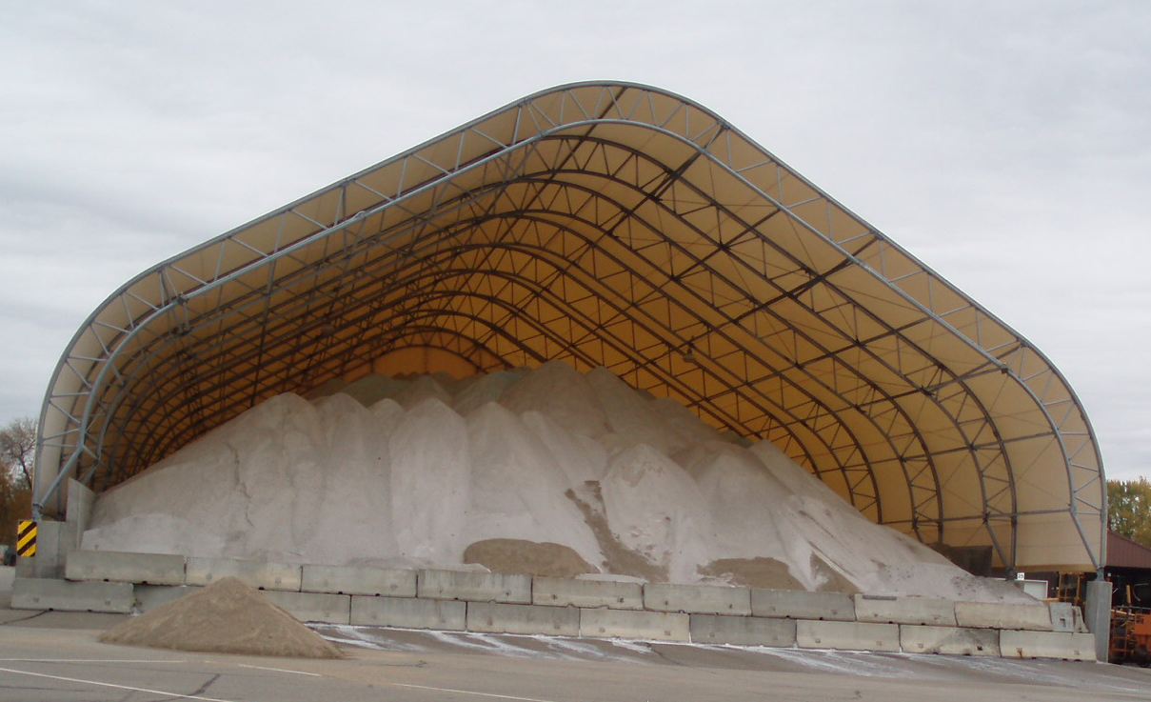
Record Keeping and Quality Control
Take a small sample from each load
  Weigh it as soon as you take it
  Remove the water, weigh it again
  Determine % moisture
  Compare to your spec
  Record results
  Take appropriate action
For less dispute, use a lab testing service or established DOT lab.
Notes:
Reference: Minnesota Snow and ice control field handbook for snowplow operators explains how to do this step by step. (Pg 23-25)
Find it online at this link:
http://www.lrrb.org/media/reports/200501REV.pdf
You can do testing yourself or if you want the results to be less disputed, enlist the help of professional services within our outside of your organization.
Photo credit: Fortin Consulting, Inc.

Slide 52
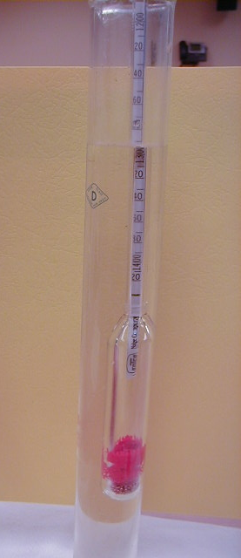
Record Keeping and Materials Testing
  Liquids: specific gravity
  Document % and compare to specification
  Don’t use it if it doesn't match the specification
Insert your state’s policy here. Delete this yellow box before making presentation.
Notes:
If the specific gravity doesn’t match the spec, there’s no way to know the temperature at which it will freeze on the road.
Note: There is more about material testing in Module 10 Deicer Management Policy.
Note to presenters: If you have a form or policy regarding record keeping for materials testing, include that information here (you could insert a photo of the cover of your document as an example).
Delete this yellow box before making presentation.
Photo credit: Fortin Consulting, Inc.

Slide 53
Test Question
True or False: It is important to test and record the concentration of your solution when making brine.
True
False
Notes:
Note to presenters: you may choose to hide this slide.
Test Question: Is it important to record the concentration of your solution when making brine?
a. True (yes)
b. False (no)

Slide 54
Test Question
True or False: It is important to test and record the concentration of your solution when making brine.
True
False
Notes:
Note to presenters: you may choose to hide this slide.
Test Question: Is it important to record the concentration of your solution when making brine?
a. True (yes)
b. False (no)

Slide 55
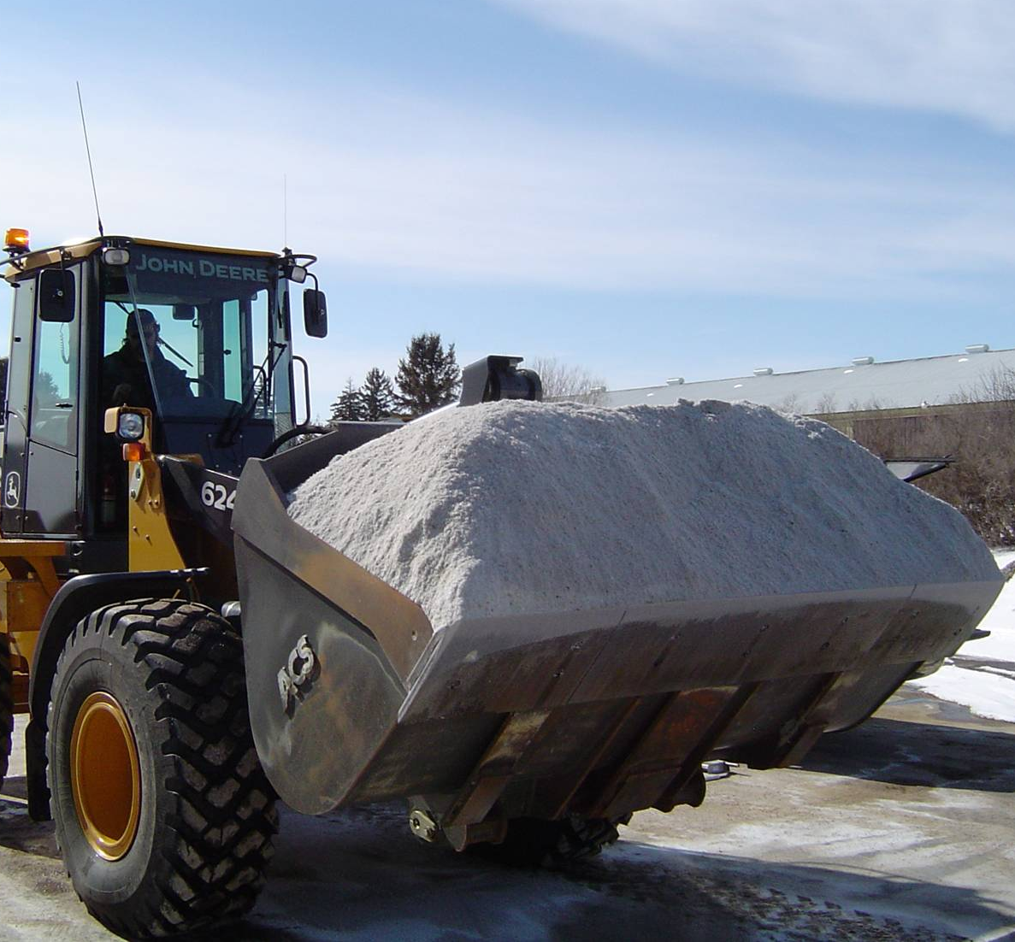
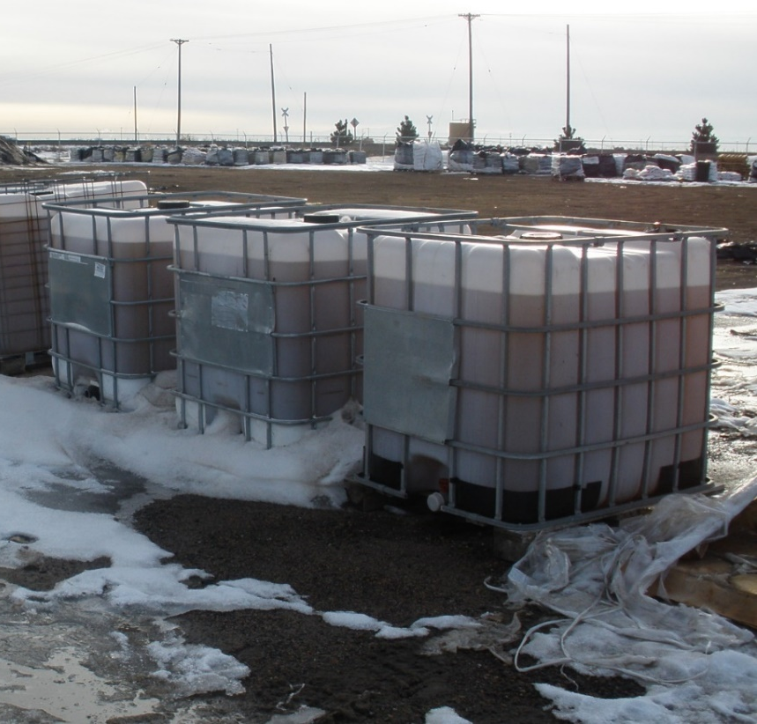
Track by Material Type
Solids
Liquids
Record any time you load, apply, or replace material
Notes:
It is important to know both what materials and the total of each that were used. This can help to predict the amount needed for future seasons as well as help in evaluating how well treatment went for an event.
Photo credits: Fortin Consulting, Inc.

Slide 56
Test Question
Which items should be tracked?
Material use per storm
Material use per season
Material use per crew member
All of the above
Notes:
Note to presenters: you may choose to hide this slide.
Test question: Which items should be tracked?
Salt use per storm (no)
Salt brine use per season (no)
Winter sand use per crew member (no)
All of the above (yes)

Slide 57
Test Question
Which items should be tracked?
Material use per storm
Material use per season
Material use per crew member
All of the above
Notes:
Note to presenters: you may choose to hide this slide.
Test question: Which items should be tracked?
Salt use per storm (no)
Salt brine use per season (no)
Winter sand use per crew member (no)
All of the above (yes)

Slide 58
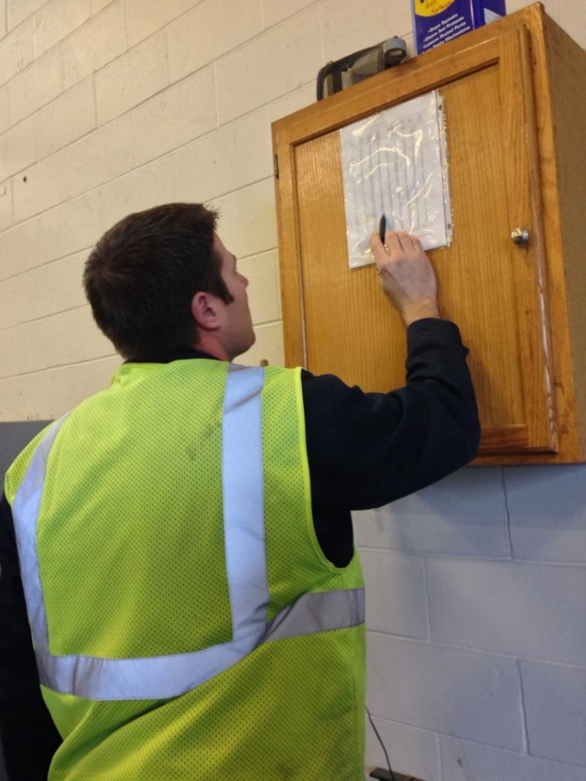
Recording Material Use
Keep track of driver use for insight into:
Individual storms
Each product totals
Winter season total
Leftover product totals
Notes:
You should record several different levels of material use by driver. Combine all this data for insight into individual storms, the winter season total, and what is leftover to store for the next season.
Having all this information helps in evaluating the efficacy of individual storm treatments went, how the whole winter went, and helps in next seasons ordering. It can also help in proving that policy is being followed if a lawsuit is brought against you.
Photo credit: Fortin Consulting, Inc.

Slide 59
Storm Documentation
EXAMPLE:
Work orders
Patrol log
Material usage log
Equipment work orders
Fuel logs
Time sheets
Diary
TAPER log
Customize this slide for your operation
Insert a list of forms needed to be completed by operators for a storm. Delete this yellow box before making the presentation.
Notes:
Review the storm documentation needed for your agency.
Note to presenters: Insert a list of forms needed to be completed by operators for a storm here. Delete this yellow box before making presentation.
Slide credit: CDOT Snow Removal Operator Training

Slide 60
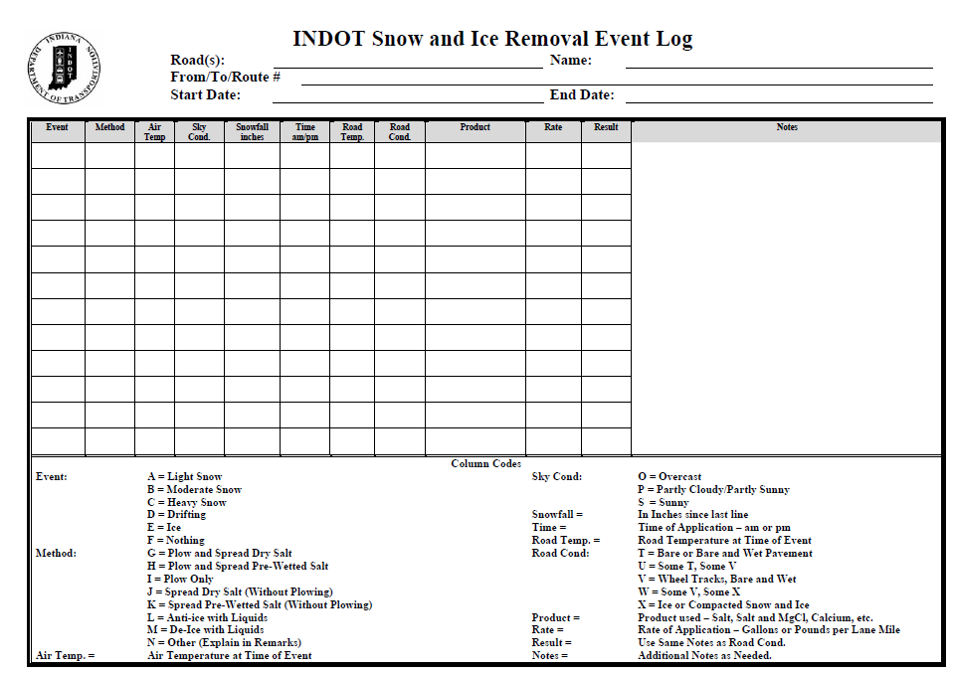
Document Your Operations
EXAMPLE:
Conditions- weather and road, pavement temp
Material type and quantity used
Timing
# of passes and when
Unusual conditions/circumstances
Customize this slide for your operation
Insert an example of your state’s event log and explain how to fill it out. Delete this yellow box before making the presentation.
Notes:
It is very important that plow drivers document the actions taken in response to a snow/ice event
This will include the road conditions throughout their shift, type and amount of deicer or anti-icer used, timing of operations, and the number of passes and when. If there are unusual conditions that affect the operations, those should be recorded. For example, road construction, accidents, major compaction problems, etc.
Note to presenters: Insert a copy of your state’s event log and explain how to fill it out. Delete this yellow box before making presentation.
Photo credit: INDOT

Slide 61
Example: T A P E R
T = Temperature
A = Application
P = Product
E = Event
R = Results
Notes:
Use this slide if your state uses the TAPER system to help explain. Hide this slide if it doesn’t use the TAPER system.
Slide credit: CDOT Snow Removal Operator Training

Slide 62
Event Log
Insert an example of your state’s event log. Delete this yellow box before making presentation.
Customize this slide for your operation
EXAMPLE
Notes:
Review this sequence of events as illustrated on this report, pay particular attention to the changes that took place in the highlighted entries. Note that this TAPER log really paints a good picture of what was done, when it was done, how it was done, who did it with what and what the outcome was like. If you had this information coming on to shift, would you really even need to talk to the person you are relieving?
Note to presenters: Insert an example of your state’s event log here. Delete the yellow box before making presentation.
Slide credit: CDOT Snow Removal Operator Training

Slide 63
Test Question
What should you record during the storm?
Type of product used
Application rate
Pavement temperature
All of the above
Notes:
Note to presenters: you may choose to hide this slide.
Test question: What do you need to record for the TAPER log?
Product (no)
Results (no)
Temperature (no)
All of the above (yes)

Slide 64
Test Question
What should you record during the storm?
Type of product used
Application rate
Pavement temperature
All of the above
Notes:
Note to presenters: you may choose to hide this slide.
Test question: What do you need to record for the TAPER log?
Product (no)
Results (no)
Temperature (no)
All of the above (yes)

Slide 65

A job well done is a job well documented
Filling out paperwork is important because it:
Shows that you follow policy
Improves efficiency of operations
Helps with planning
Notes:
Presenters: give a pep talk here! Everyone knows that filling out paperwork during or at the end of a long shift can be hard to be motivated to do, but it is very important because it:
Shows that you follow policy
Improves efficiency of operations
Helps with planning

Slide 66
Test Question
When you’ve been working all night and you’re tired, do you still have to fill out your paper work?
No
Yes
Notes:
Note to presenters: you may choose to hide this slide.
Test question: When you’ve been working all night and you’re tired do you still have to fill out your paper work?
No (no)
Yes (yes)

Slide 67
Test Question
When you’ve been working all night and you’re tired, do you still have to fill out your paper work?
No
Yes
Notes:
Note to presenters: you may choose to hide this slide.
Test question: When you’ve been working all night and you’re tired do you still have to fill out your paper work?
No (no)
Yes (yes)

Slide 68
OTHER
Insert any additional during the storm record keeping needs here, otherwise delete this slide. Delete this yellow box before making presentation if you use this slide.
Customize this slide for your operation
Notes:
Note to presenters: add any other information you’d like to include regarding decision making during the storm here. If you do not use this slide, hide it.

Slide 69

Great job!
You have bridged the gap for bridge frost knowledge! You can use this information to keep your bridges safe for drivers and for the environment!
Notes:
You have bridged the gap for bridge frost knowledge! You can use this information to keep your bridges safe for drivers!
Photo credit: bridges
Find more at https://blogiarenillas.wikispaces.com/ are licensed under a Creative Commons Attribution Share-Alike 3.0 License

Slide 70
Additional resources
AASHTO, Clear Roads Computer Based training:
  Anti-icing/RWIS: Lesson 5 Weather and Roadway Monitoring Information and Lesson 7 Anti-icing Practice in Winter Maintenance Operations
Iowa DOT New Operator Snow and Ice Training Slides
Clear Roads Training Module 8: Anti-Icing
Clear Roads Training Module 12: Principals of Ice Formation
Clear Roads Training Module 16: Weather Basics
Notes:
This slide shows additional resources.

Slide 71
Acknowledgements
Training contents were developed by Fortin Consulting Inc., under the direction of the Clear Roads Advisory Team.
Connie Fortin – connie@fortinconsulting.com
Professional formatting and training aids were developed by the University of Minnesota, Center for Transportation Studies.
Jim Grothaus– Groth020@umn.edu
Ann Johnson – Johns421@umn.edu
Members of the Clear Roads Advisory Team include:
  Mike Sproul, Dave Wieder, Cliff Spoonemore, Monty Mills, David Frame,
  Mike Lashmet, Clay Adams, Justun Juelfs, and Tom Peters

Slide 72
This presentation was developed with funding from the Clear Roads research program, which brings together transportation professionals and researchers from around the country to drive innovation in the field of winter maintenance.
Find additional information and resources at
http://clearroads.org/

Slide 73
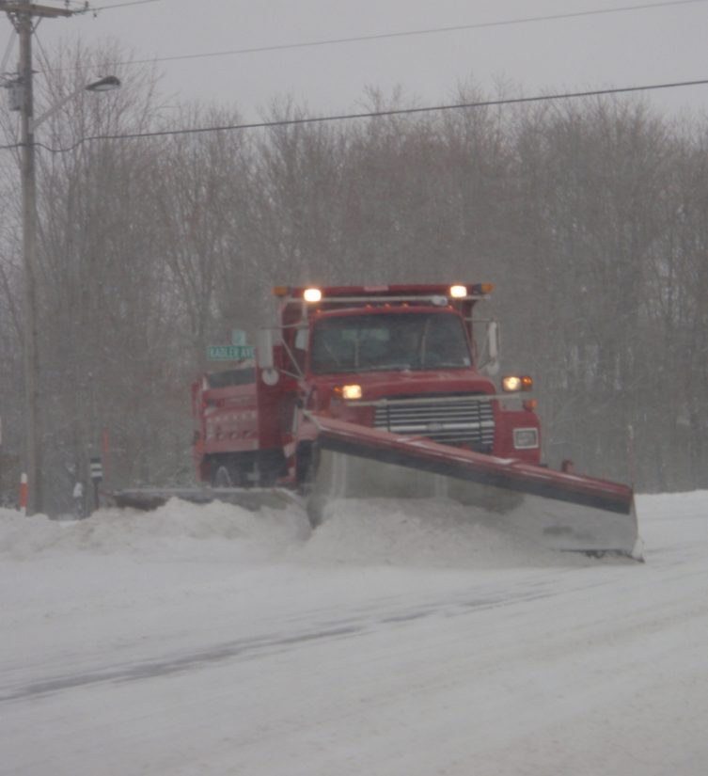
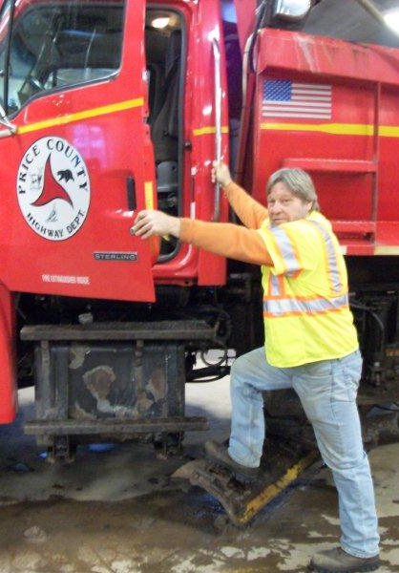
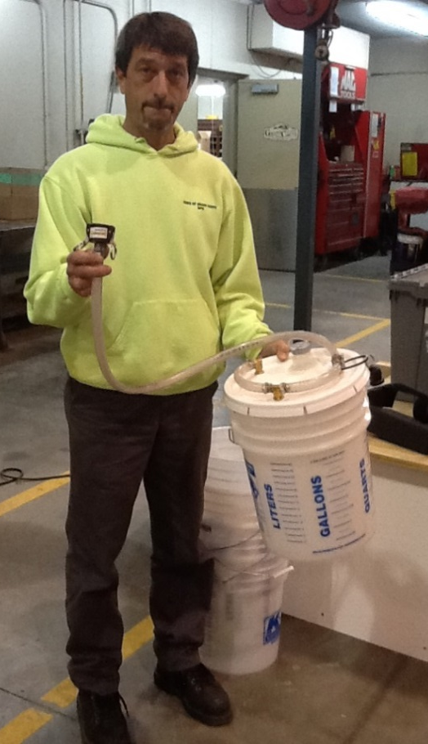
Thank You for your Good Work!
Notes:
Thank you for your time today. Have a good winter!

