Slide 1
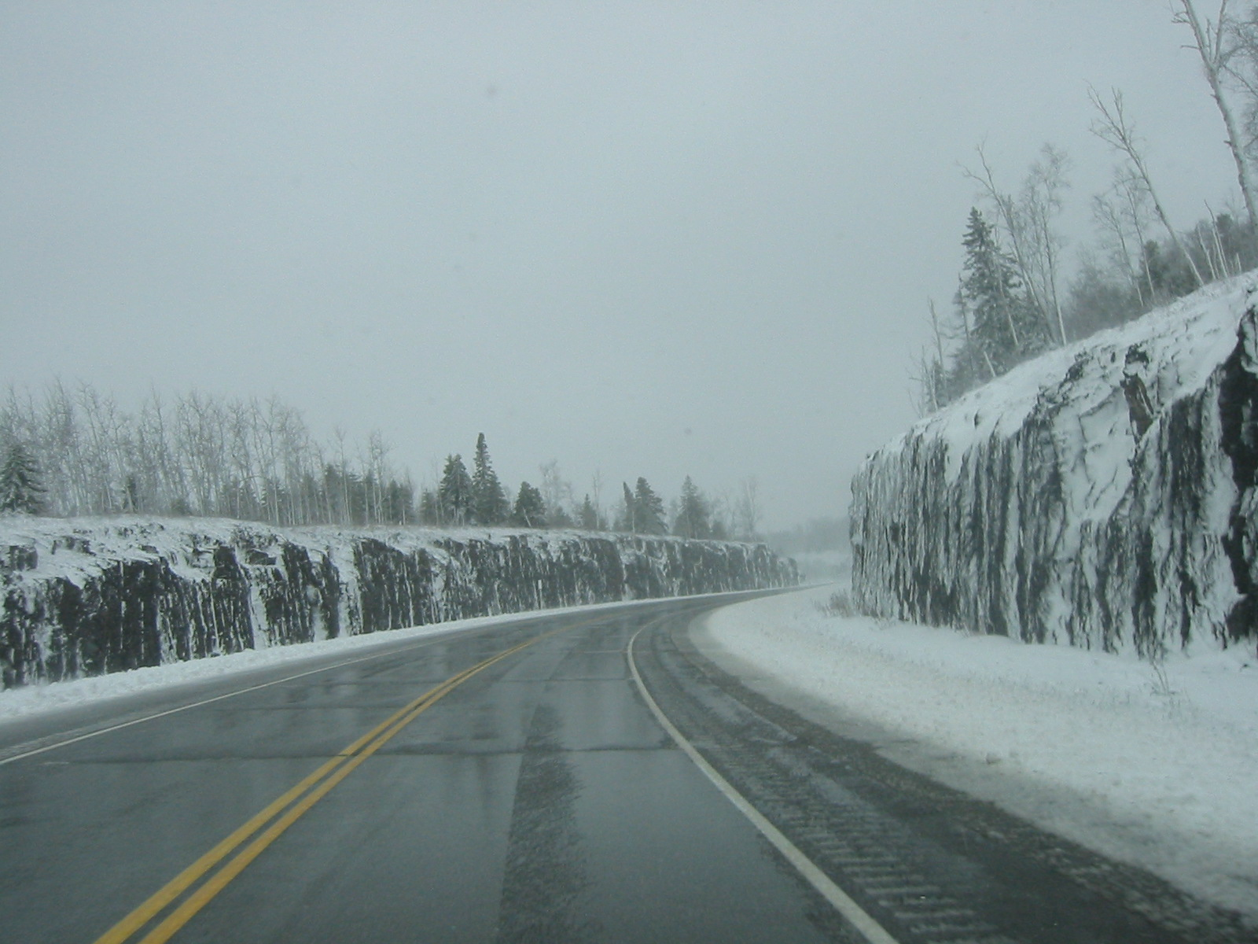

Module 16: Weather Basics
2016 Created for Clear Roads by:
U of MN Center for Transportation Studies &
Fortin Consulting Inc.

Slide 2
Training for Winter Maintenance Supervisors and Operators
2016 Created for Clear Roads by:
U of MN Center for Transportation Studies &
Fortin Consulting Inc.

Slide 3
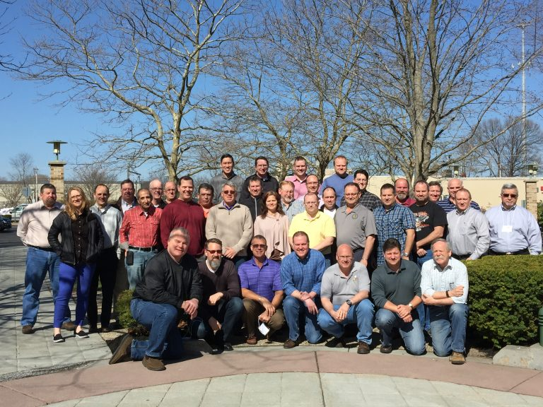
Winter maintenance professionals are a very powerful and important group
Notes:
Photo: clear roads website
Note to presenters: These first 7 slides can be used or hidden.
Or, replace with photos of your staff.

Slide 4
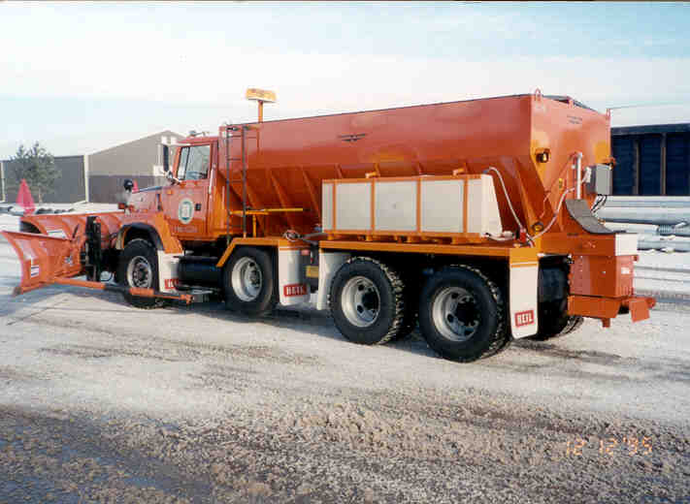
You do a great job of taking care of our roads!

Slide 5
This is one of a series of 22 winter maintenance training modules developed by the Clear Roads Program. All of the modules are available online at www.clearroads.org
Modules include information on the following:
Plowing
Truck operations
Spreading
Material use
Pre-wetting
Brine production
De-icing and anti-icing
Level of service
Ice formation
Freeze point depressants
Environmental issues
Drift control
Weather
Avalanche management
Bridge frost
Safety
Notes:
Note to presenters: The website www.clearroads.org can be accessed here if a live internet connection is available.
A list of all the modules is given here:
Plowing procedures
Truck operations
Spreading
Material use
Pre-wetting
Brine production
De-icing
Anti-icing
Safety
De-icing agent management policy
Level of service
Ice formation
Freeze point depressants
Environmental issues
Drift control
Weather
Bridge frost
Avalanche management

Slide 6
Module 16: Weather Basics
2016 Created for Clear Roads by:
U of MN Center for Transportation Studies &
Fortin Consulting Inc.

Slide 7
FACILITATOR NOTES (do not show during class)
This is a priority 1 module to be developed for Clear Roads national training. It will address three audiences. Slides can be customized for the audience.
Slide Legend
Entry-level plow drivers
Experienced plow drivers
Supervisors
Notes:
Note to facilitator: do not show this slide during class

Slide 8
This module contains these topics:
Weather forecasts.
Weather tracking.
Weather and decision making.
Road Weather Information Systems (RWIS).
Maintenance Decision Support Systems (MDSS).
Notes:
This module covers

Slide 9
Weather forecasts
What are weather forecasts
Weather information options
Local media
Government agencies
Internet
Private companies
Look out the window
Notes:
For presenters only: this is the beginning of a section, it outlines what will be covered in the upcoming slides about weather forecasts
RWIS
National Weather Service
Private company
Online weather sites
Take a drive or look out the window

Slide 10
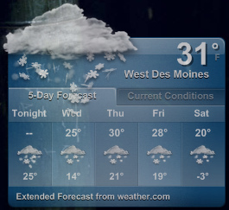
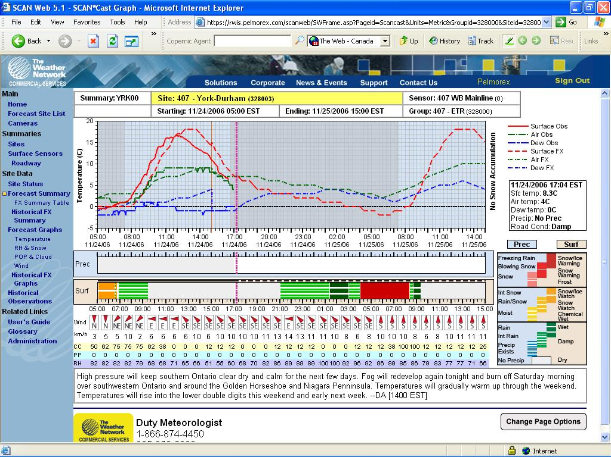
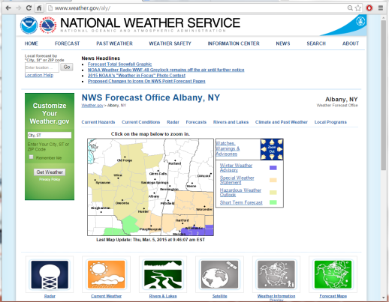
What are weather forecasts?
Using technology to predict how weather may act in the future.
Can get from many sources.
Can get in various levels of detail.
Notes:
Weather forecasts are technology based predictions of how weather may act in the future.
The decision regarding whether or not to initiate a treatment, when to start and what treatment to apply, can only be made if good weather information is available.
There are many different sources for weather forecasts which vary in type and amount of information.
Picture credit left: Jake Bouma, Forecast: snow. https://www.flickr.com/photos/30885355@N00/2245250544 are licensed under a Creative Commons Attribution Share-Alike 3.0 License
Picture credit middle: Briefing provided by NY DOT
Picture credit right: Complete-program-2012-Milwaukee.ppt

Slide 11
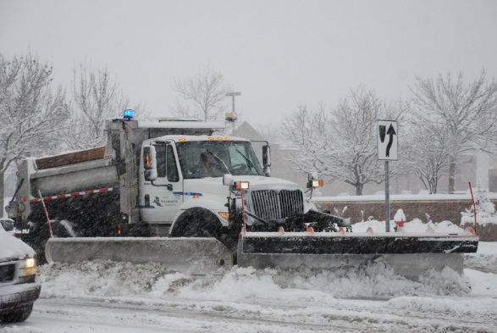
Forecasts
Long-term forecasts
Good for general planning
Short-term forecasts
Good for planning for specific events
Notes:
Long term forecasts are often used for agricultural purposes where they need to know long-term trends, such as over a season. For snow and ice control, long term forecasting can be used for general planning.
For actual treatment short-term forecasting is much more useful. These reports can alert you to when a storm is likely to occur and what treatments to use. Hourly and minute-by-minute condition updates can be used to stay ahead of the storm.
Picture credit: Fortin Consulting, Inc.

Slide 12
Test Question
True or false: Short-term forecasts are good for general planning for the season?
True
False
Notes:
Note to presenters: you may choose to hide this slide.
Test question:
True or False: short term forecasts are good for general planning for the season.
True(no)
False (yes)

Slide 13
Test Question
True or false: Short-term forecasts are good for general planning for the season?
True
False
Notes:
Note to presenters: you may choose to hide this slide.
Test question:
True or False: short term forecasts are good for general planning for the season.
True(no)
False (yes)

Slide 14


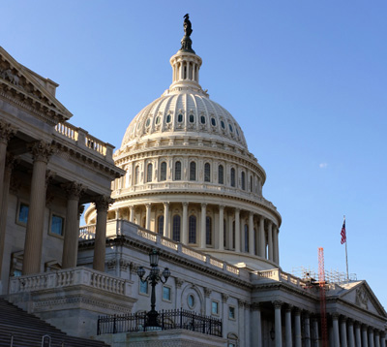
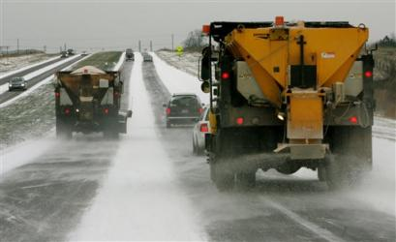

Weather information sources
Internet
Media
Government Services
Look out the window
Private Companies
Notes:
There are many sources for weather information, media such as television or radio forecasts, and the internet has a wide variety or weather forecasting sites.
Presenter ask the participants: Do any of you use a specific site? (take feedback from the audience if they like a particular internet site for getting weather or insert your own preferences here)
There are also government services such as the National Weather Service or NOAA, as well as private companies (could also be known as Value Added Meteorologists) such as DTN, Meridian Forecasts. Most likely you use a combination of these sources to stay up to date on the latest weather.
Slide adapted from Complete-program-2012-Milwaukee.ppt slide 35

Slide 15
Test Question
What is a reliable source for weather forecasts?
Local media
Government agencies
Internet
Private companies
Windows (the glass kind)
All of the above
Notes:
Note to presenters: you may choose to hide this slide.
Test question:
What is a reliable source for weather forecasts?
A. Local media
B. Government agencies
C. Internet
D. Private Companies
E. Windows (the glass kind)
F. All of the above

Slide 16
Test Question
What is a reliable source for weather forecasts?
Local media
Government agencies
Internet
Private companies
Windows (the glass kind)
All of the above
Notes:
Note to presenters: you may choose to hide this slide.
Test question:
What is a reliable source for weather forecasts?
A. Local media
B. Government agencies
C. Internet
D. Private companies
E. Windows (the glass kind)
F. All of the above

Slide 17
Media and internet
Did you know that the temperature given on TV news is air temperature and is measured 6 feet or more above our roads?
Not pavement temps!
Notes:
There are dangers is using a consumer product in industrial applications. Television, radio and internet sources are good to excellent for observations and range from poor to fair for forecasting services.
This is because most media sources are giving information about the air temperature as opposed to the pavement temperature, which is important for making decisions on which product to use. These two temperatures can vary by 10 to 20 degrees.
In addition, it is because of their nature (7 seconds to 3 or 4 minutes to cover the local to national forecasts, respectively) and the nature of the atmosphere which is quite detailed across a breadth of time and spatial scales.
Picture credit left: Minnesota Road Training
Picture credit right: Jake Bouma, Forecast: snow. https://www.flickr.com/photos/30885355@N00/2245250544 are licensed under a Creative Commons Attribution Share-Alike 3.0 License
Test question: TV news temperature forecasts are based off:
Pavement temperatures (no)
Windchill temperatures (no)
Air temperatures (yes)
Pure speculation (no)

Slide 18
Test Question
True or false: Weather forecasts are always reliable.
True
False
Notes:
Note to presenters: you may choose to hide this slide.
Test question:
True or false: Weather forecasts are always reliable.
A. True (no)
B. False (yes)

Slide 19
Test Question
True or false: Weather forecasts are always reliable.
True
False
Notes:
Note to presenters: you may choose to hide this slide.
Test question:
True or false: Weather forecasts are always reliable.
A. True (no)
B. False (yes)

Slide 20
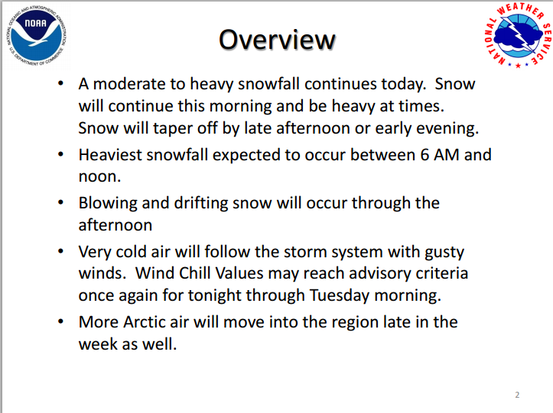
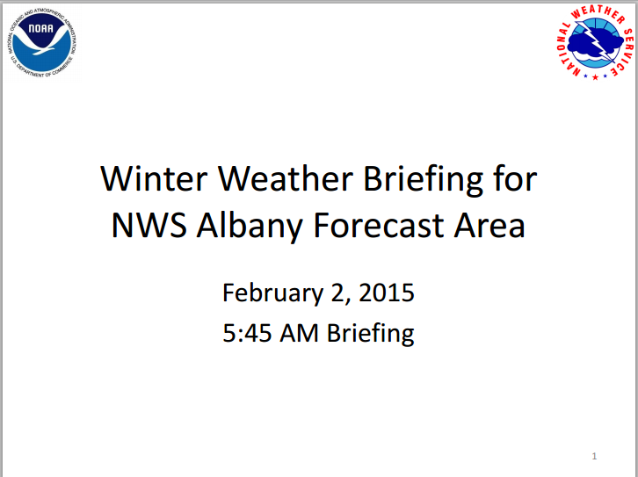
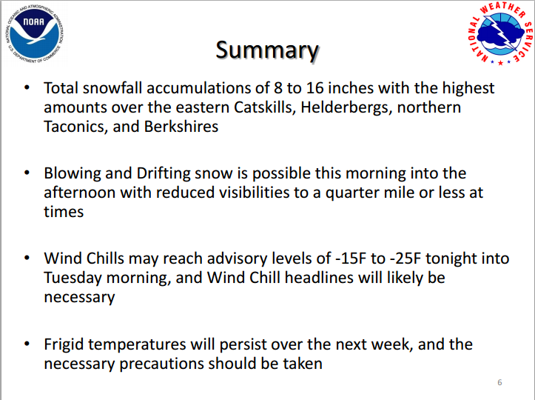
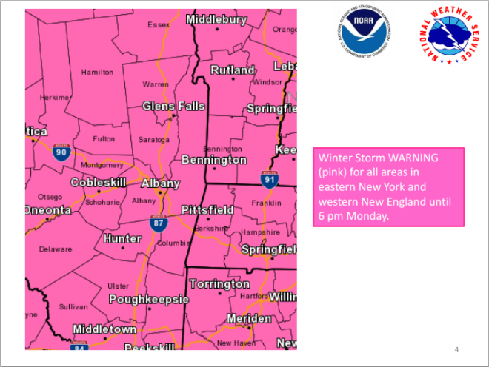
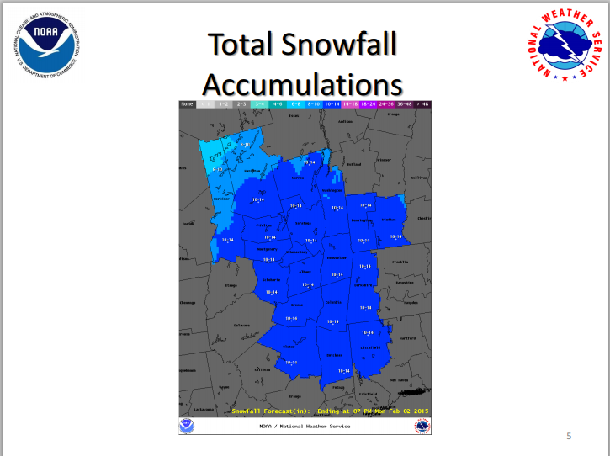
National Weather Service
Good overview of weather
No pavement temps!
Notes:
The National Weather Service can send out Weather Briefings, and also has a website which provides information on precipitation, temperature, dew point, wind chill and more. However they do not provide information on pavement temperatures. This is helpful for knowing when a storm is coming, but may not be helpful when considering putting down materials on the road.
Picture credits: Briefing provided by NY DOT

Slide 21
Value-added meteorologists
There are many private companies that can provide individualized weather information for a fee.
This allows you to have a meteorologist on call to answer questions.
Note to presenter: if you subscribe to one of these services, put local information in this slide. For example:
Web address
Username
Password
Delete this yellow box before making presentation.
Notes:
Value Added Meteorologists (or private companies) such as Schneider Electric, Iteris, and others can provide additional weather information for a fee.
Note to presenters: If your state subscribes to one of these services add your information here. Give access information, brief statement of benefits, how it can be used. Then delete the yellow box before making the presentation.

Slide 22
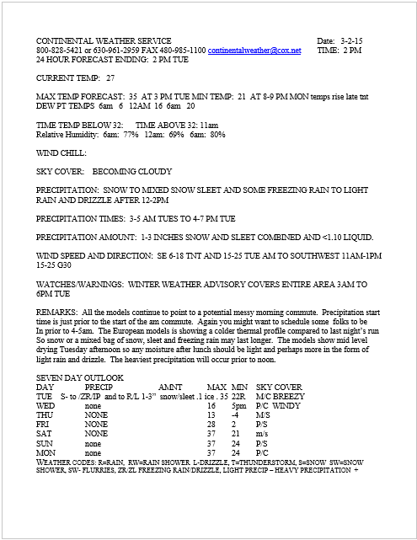
Example report
This report is from Continental Weather Service for the City of Beloit, WI
Note to presenter: Insert YOUR EXAMPLE REPORT HERE instead of this one. Delete this yellow box before making presentation.
Notes:
This slide is an example of the report that Beloit, WI receives from the Continental Weather Service.
Note to presenter: Insert YOUR EXAMPLE REPORT HERE instead of this one. Delete the yellow box before making presentation.

Slide 23
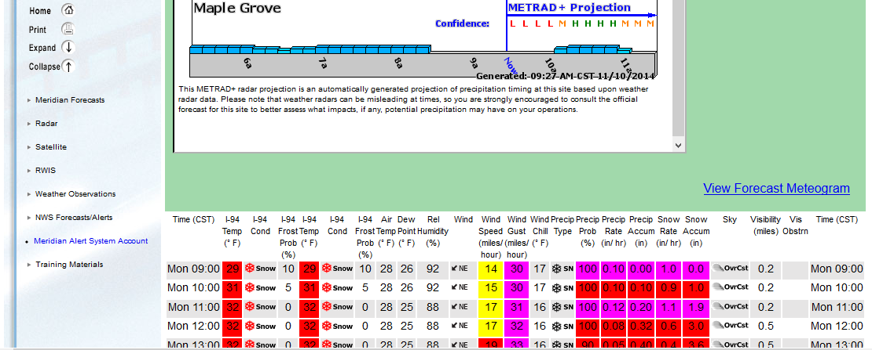
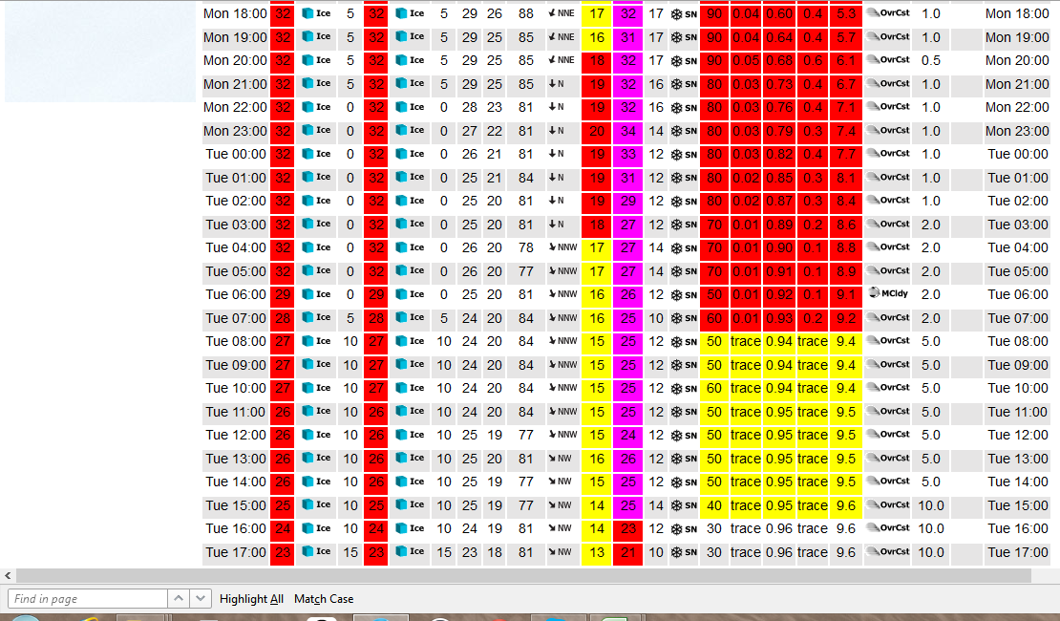
Example report
This report is from Iteris for the City of Maple Grove, MN
Note to presenter: Insert YOUR EXAMPLE REPORT HERE instead of this one. Delete this yellow box before making presentation.
Notes:
This is an example of Minnesota’s Iteris system for the City of Maple Grove. This service provides the following information:
Pavement temperature
Road condition
Frost probability
Air temperature
Dew point
Relative humidity
Wind direction, average speed, and gust speed
Wind chill
Precipitation type, probability, rate, and accumulation
Visibility
Note to presenter: Insert YOUR EXAMPLE REPORT HERE instead of this one. Delete the yellow box before making presentation.

Slide 24
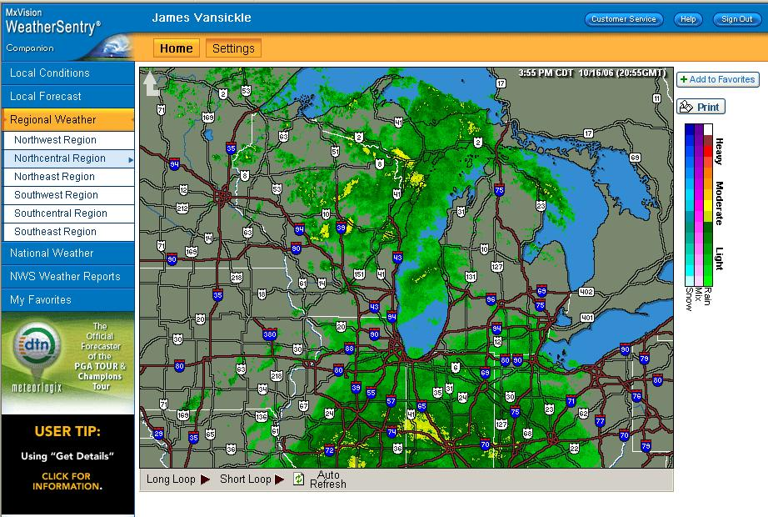
Example report
Note to presenter: Insert YOUR EXAMPLE REPORT HERE instead of this one. Delete this yellow box before making presentation.
This is an example of Schneider Electric Weather Centers from Iowa, and provides:
Pavement, frost and general weather forecasts
Current conditions & radar
Notes:
This slide shows another example.
Note to presenter: Insert YOUR EXAMPLE REPORT HERE instead of this one. Delete the yellow box before making presentation.
Slide from IowaDOT_New-Operator-Snow-and-Ice-Training_slides_91-118 ppt

Slide 25
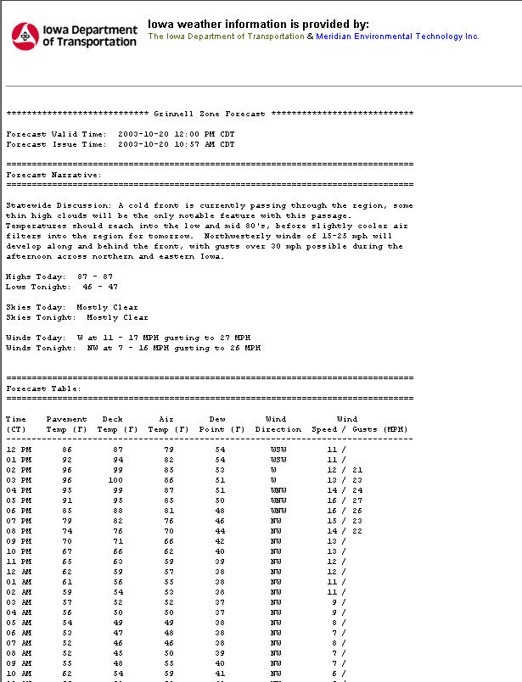
Example report
Note to presenter: Insert YOUR EXAMPLE REPORT HERE instead of this one. Delete this yellow box before making presentation.
Notes:
Final forecast format was not available when this presentation prepared. This is a prototype.
This report gives information on:
Pavement temperature
Deck temperature
Air temperature
Dew Point
Wind direction, average speed, and gust speed
Precipitation forecast
Note to presenter: Insert YOUR EXAMPLE REPORT HERE instead of this one. Delete the yellow box before making presentation.
Slide from IowaDOT_New-Operator-Snow-and-Ice-Training_slides_91-118 ppt

Slide 26
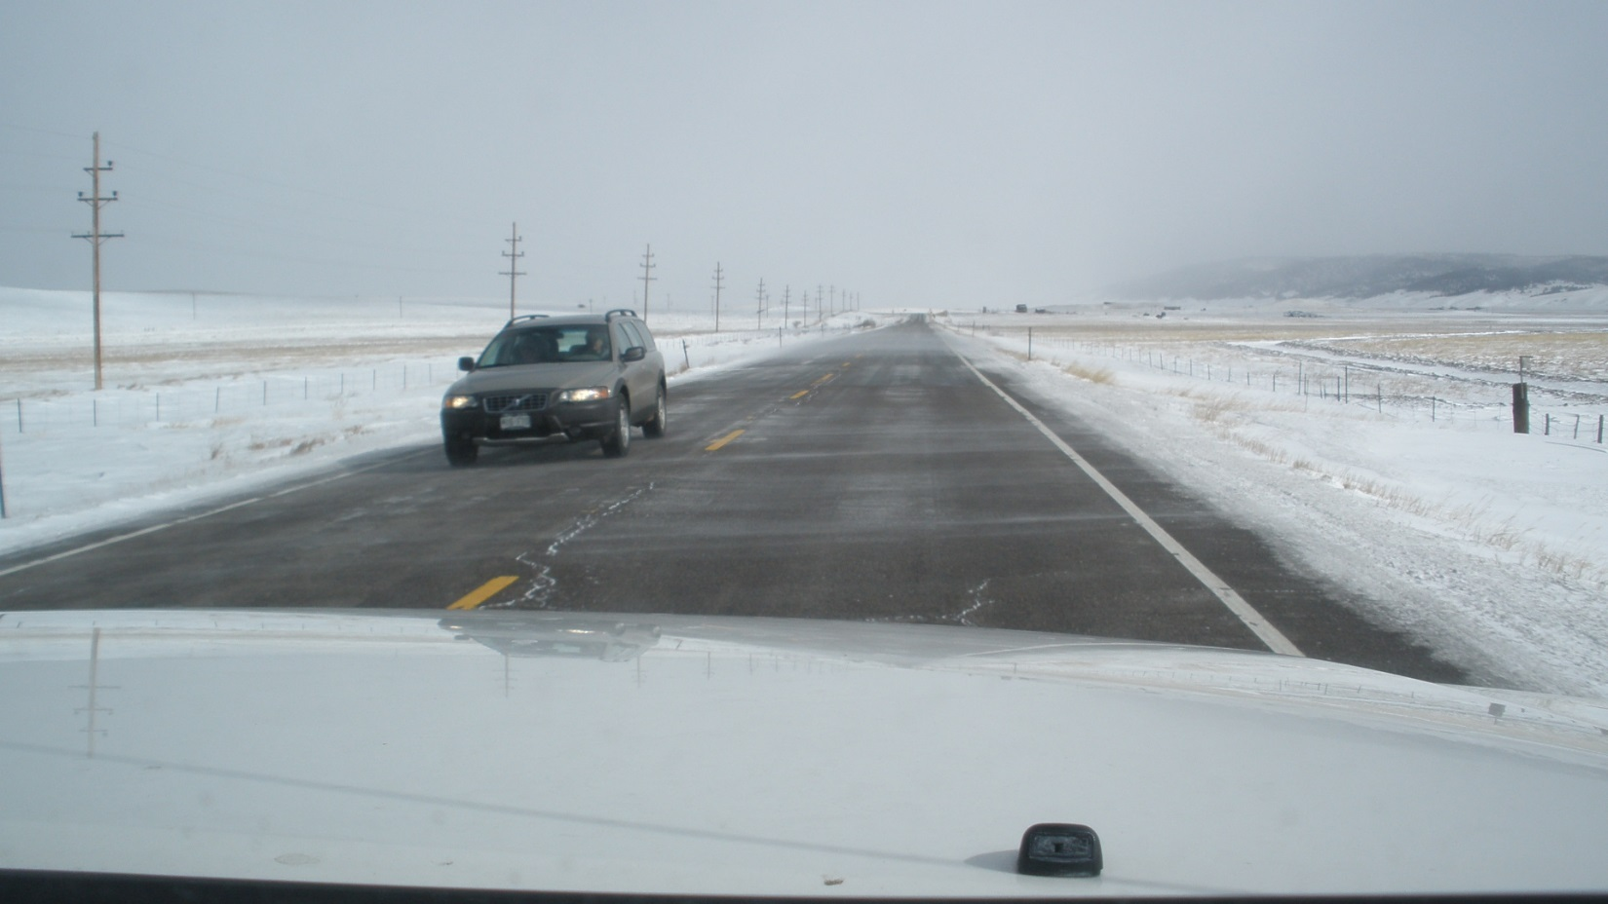
Look out the window!
This only works for current conditions, not future conditions!
Notes:
The most reliable source for knowing what is going on outside is to look out your window. Though it will not tell you what is going to happen in the near future, this can be a very valuable tool!
Picture credit: Fortin Consulting, Inc.

Slide 27
Weather tracking
How does the weather move into your area?
Always expect the unexpected.
Check in the morning, continue to check throughout the day.
Is there a meteorologist you can call?
Note frost, snow, wind, dropping pavement temps.
What is happening as the storm wraps up/ after the storm?
Notes:
The next section of the presentation will focus on weather tracking.

Slide 28
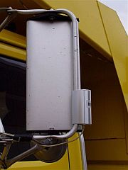
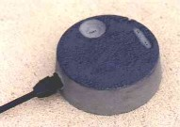
Pavement vs. air temperature
Air measured 6 feet above ground
Possible variance of 0° To 40° from air temperature
Pavement type, frozen ground, day/night, sun/shade all influence pavement temperature
Notes:
Air temperature is measured 6 feet or more above ground. Air temperature can be found using media or internet sources and is readily available.
There is a possible variance of 10 to 40 degrees from air temperature to pavement temperature.
Pavement type, frozen ground, day/night, sun/shade all influence pavement temperature. Pavement temperature may follow an air temperature trend of rising or falling, but it will most likely not be the same temperature as the air.
Slide from Complete-program-2012-Milwaukee.ppt

Slide 29
Test Question
True or false: Air and pavement temperatures are always the same.
True
False
Notes:
Note to presenters: you may choose to hide this slide.
Test question:
True or false: Air and pavement temperatures are always the same.
A. True (no)
B. False (yes)

Slide 30
Test Question
True or false: Air and pavement temperatures are always the same.
True
False
Notes:
Note to presenters: you may choose to hide this slide.
Test question:
True or false: Air and pavement temperatures are always the same.
A. True (no)
B. False (yes)

Slide 31

Pavement temperature
Pavement temperature - the temperature of the pavement.
Pavement temp will determine effectiveness of chemicals.
First thing you must have is a way to monitor it:
Notes:
No matter where in the United States you work, temperatures are almost always at or near freezing during a winter event.
The temperature of the pavement, not the air temperature, determines how effective chemicals will be on the road.
Pavement temperature - the temperature of the pavement, is an important measure for choosing a deicing chemical.
Slide from Tailoring the Approach to the Storm.ppt

Slide 32
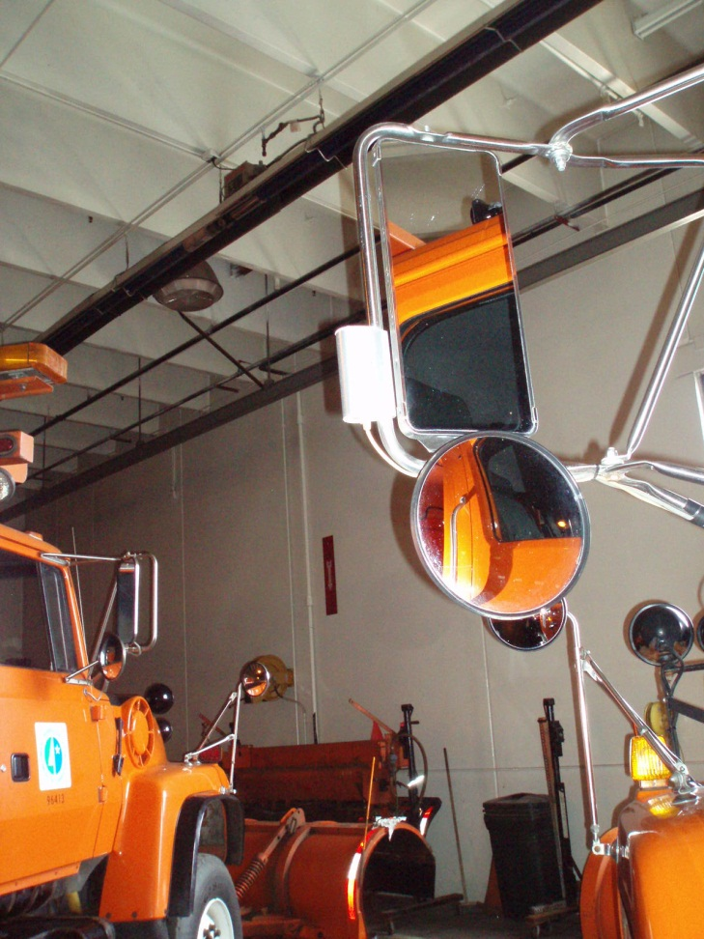
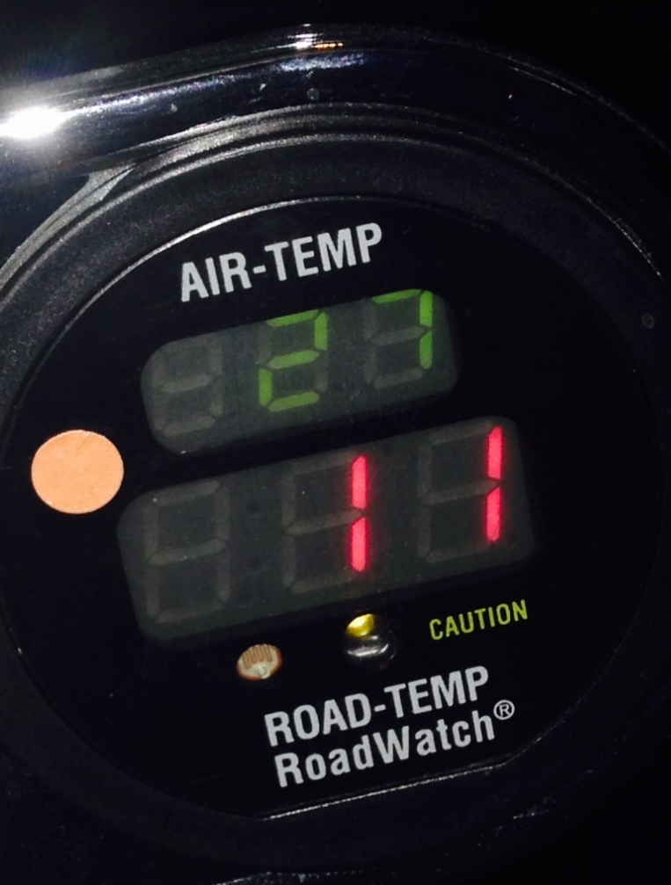
Monitoring pavement temperature
Can use infrared temperature sensors
Notes:
One option for monitoring the pavement temperature is through infrared temperature sensors that can be mounted on trucks, which conveys this information into the cab for drivers.
Photo credit: City of Grand Rapids

Slide 33
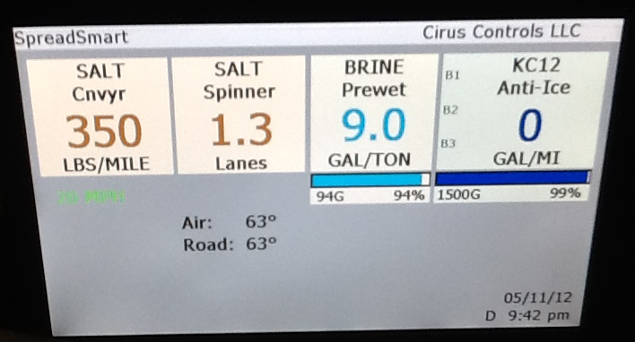
Some have temperature on display screen
Notes:
33
Some ground speed control spreaders have infrared sensors as a part of their package.
Picture credit: Fortin Consulting, Inc.

Slide 34
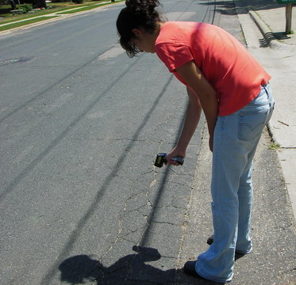
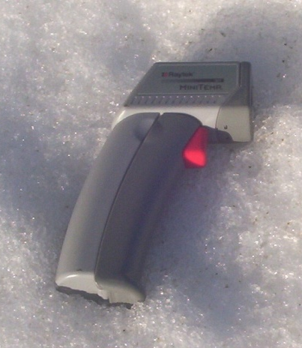
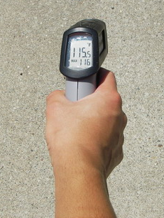
Handheld pavement temperature sensors
Inexpensive
Easily lost
Best used when truck is stopped
Think of it as a tool you can use until you can get something better.
Notes:
Handheld temperature sensors are an inexpensive, readily available alternative that can be purchased at auto parts stores. If you are purchasing a hand held temperature sensor, make sure that it can measure at cold temperatures.
Handheld temperature sensors should be used when the truck is stopped as a way to estimate the road temperatures if you have no better way to measure, not while on the road.
Picture credit: Fortin Consulting, Inc.
Test question: How can you obtain the pavement temperature?
Truck mounted infrared temperature sensor (no)
Hand held Infrared temperature sensor (no)
RWIS (no)
All of the above(yes)

Slide 35
Test Question
In order to best choose a treatment option, you must first know the:
Current weather
Time and date
Temperature of the pavement
Temperature of the air
Notes:
Note to presenters: you may choose to hide this slide.
Test question:
In order to best choose a treatment option, you must first know the:
A. Current weather
B. Time and date
C. Temperature of the pavement (yes)
D. Temperature of the air

Slide 36
Test Question
In order to best choose a treatment option, you must first know the:
Current weather
Time and date
Temperature of the pavement
Temperature of the air
Notes:
Note to presenters: you may choose to hide this slide.
Test question:
In order to best choose a treatment option, you must first know the:
A. Current weather
B. Time and date
C. Temperature of the pavement (yes)
D. Temperature of the air

Slide 37
Test Question
How can you obtain the pavement temperature?
Truck mounted infrared temperature sensor
Hand held Infrared temperature sensor
RWIS
All of the above
Notes:
Note to presenters: you may choose to hide this slide.
Test question:
Test question: How can you obtain the pavement temperature?
Truck mounted infrared temperature sensor (no)
Hand held Infrared temperature sensor (no)
RWIS (no)
All of the above(yes)

Slide 38
Test Question
How can you obtain the pavement temperature?
Truck mounted infrared temperature sensor
Hand held Infrared temperature sensor
RWIS
All of the above
Notes:
Note to presenters: you may choose to hide this slide.
Test question:
Test question: How can you obtain the pavement temperature?
Truck mounted infrared temperature sensor (no)
Hand held Infrared temperature sensor (no)
RWIS (no)
All of the above(yes)

Slide 39
Road Weather Information Systems (RWIS)
How does it work?
What are some features?
Which states have it?
Notes:
The next section will cover Road Weather Information Systems.

Slide 40
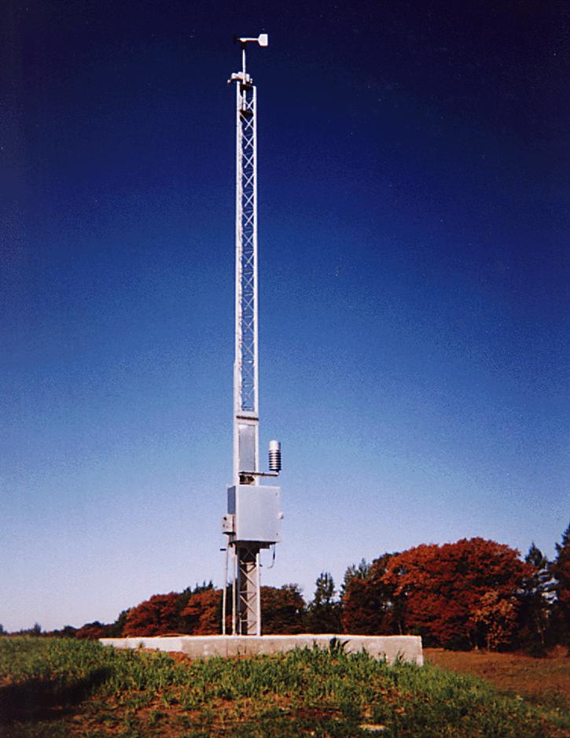
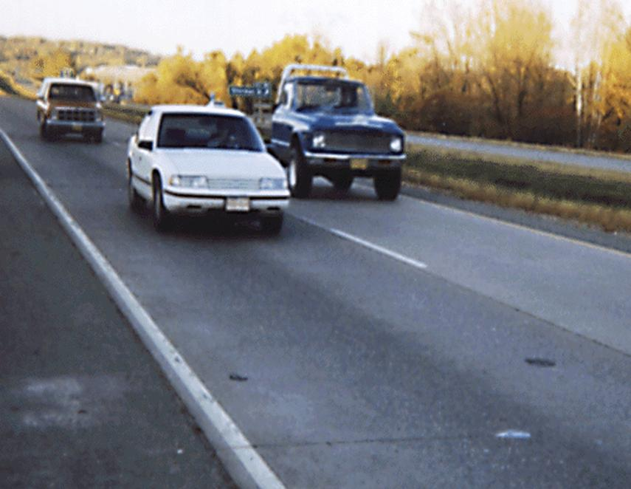
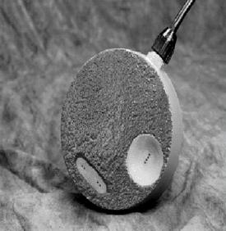
Road Weather Information System (RWIS) provides pavement temperatures
Notes:
One other option for pavement temperatures and much more information is your state’s RWIS or Road Weather Information System.
Let’s talk more about RWIS, Road Weather Information Systems.
Picture credit: Fortin Consulting, Inc.

Slide 41
Test Question
What does RWIS stand for?
Ready for Winter Ice Storm
Rapid Warming in Spring
Road Weather Information System
Real Work Is Shoveling
Notes:
Note to presenters: you may choose to hide this slide.
Test question:
What does RWIS stand for?
Ready for Winter Ice Storm (no)
Rapid Warming in Spring (no)
Road Weather Information System (yes)
Real Work Is Shoveling (no)

Slide 42
Test Question
What does RWIS stand for?
Ready for Winter Ice Storm
Rapid Warming in Spring
Road Weather Information System
Real Work Is Shoveling
Notes:
Note to presenters: you may choose to hide this slide.
Test question:
What does RWIS stand for?
Ready for Winter Ice Storm (no)
Rapid Warming in Spring (no)
Road Weather Information System (yes)
Real Work Is Shoveling (no)

Slide 43
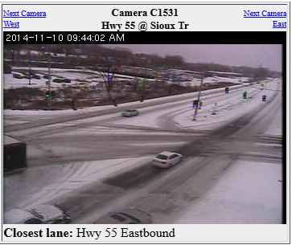
RWIS
Note to presenters: If your state has access to RWIS data, place your website access info here. MnDOT’s is www.rwis.dot.state.mn.us
Delete this yellow box before making presentation.
Notes:
Note to presenters: If your state has access to RWIS data, place your website access info here. MnDOT’s is www.rwis.dot.state.mn.us
Delete the yellow box before making the presentation.
Picture credit: Fortin Consulting, Inc.

Slide 44
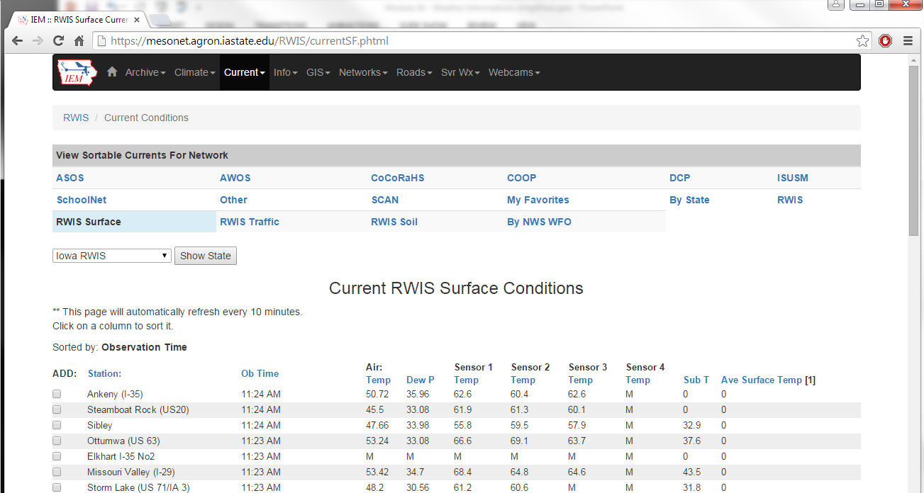
RWIS information for many states can be found at: https://mesonet.agron.iastate.edu/RWIS/currentSF.phtml
Select State here!
Notes:
Note to presenter: If you have a live internet connection, you may choose to access this website and navigate it for the participants.
Access this website by copying it into the search bar in internet explorer:
https://mesonet.agron.iastate.edu/RWIS/currentSF.phtml

Slide 45
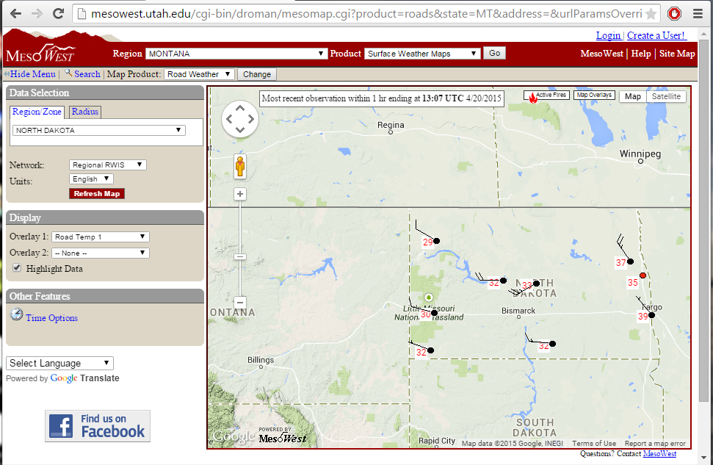
Or at: http://mesowest.utah.edu
Select your state and road weather to get road weather information for your area
Notes:
This slide shows another possible website to navigate to. Do NOT delete this yellow box, as it provides information to the participants.
Access this website by copying it into the search bar in internet explorer:
http://mesowest.utah.edu

Slide 46
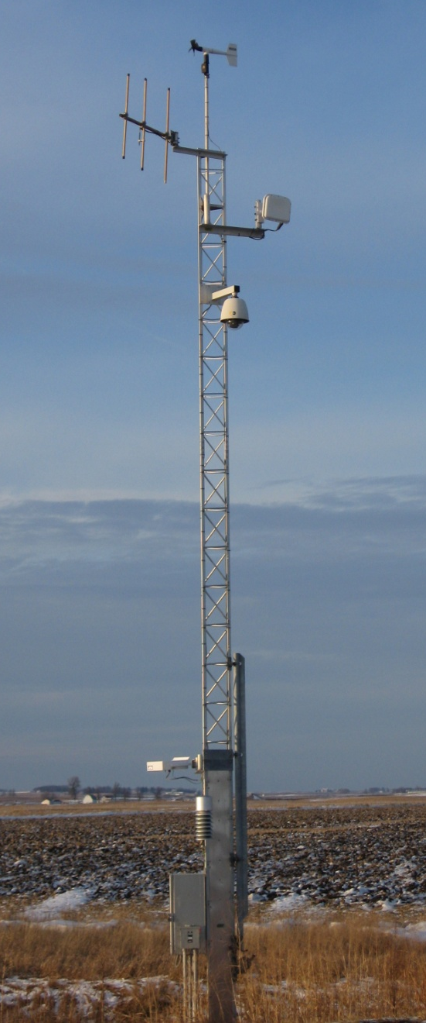
Road Weather Information System (RWIS)
Pavement and bridge temperature.
Subsurface temperature.
Wind speed and direction.
Air temperature.
Relative humidity.
Precipitation.
Cameras.
Notes:
For this slide, emphasize that RWIS is a way to measure pavement and bridge deck temperatures, subsurface temperatures, wind speed and direction, air temperature, relative humidity, precipitation, and see sites.
Slide reference: Iowa PP

Slide 47
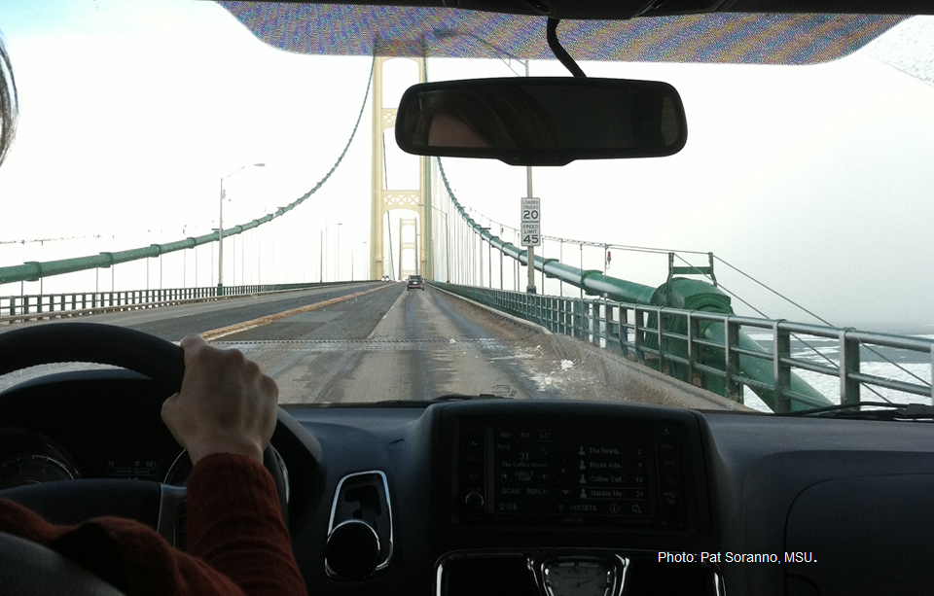
RWIS benefits
Pavement and bridge surface temperatures.
Actual roadside weather and surface conditions.
Better ability to predict how road conditions will change.
Newer pavement sensors indicate.
salt concentration on the roadway
depth of precipitation
freezing point of the solution on the road surface
Ability to monitor conditions remotely.
Notes:
Benefits of RWIS include:
Pavement and bridge surface temperatures
Actual roadside weather and surface conditions (wind speed/direction, dew point, chemical concentrations, etc.)
Better ability to predict how road conditions will change
Newer pavement sensors indicate salt concentration on the roadway, depth of precipitation and freezing point of the solution on the road surface
Slide reference: Iowa PP
Picture credit: Fortin Consulting, Inc.

Slide 48
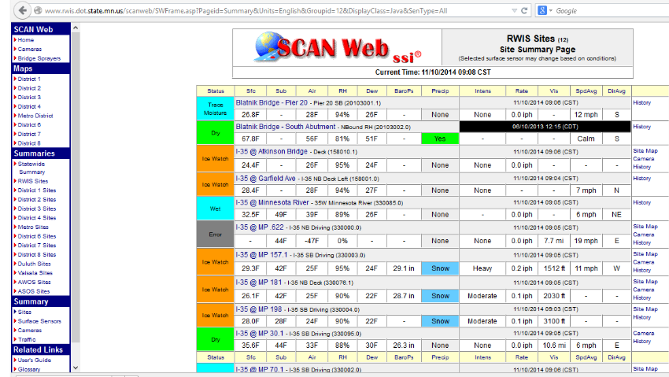
Area Overview
Note to presenter: If you have sample RWIS data, insert YOUR EXAMPLE REPORT HERE instead of this one. Delete this yellow box before making presentation.
Notes:
Take a look at a picture of an RWIS site. This is the Minnesota RWIS site page. Circled is the surface temperature and status. Knowing the pavement temperature and whether the surface is dry or wet are critical pieces of information used in the decision making process.
Point out pavement temp vs. air temp columns to reinforce that they can greatly vary as well as other information listed such as the wind speed (SpdAvg) or Dew Point (Dew).
Note to presenter: If you have sample RWIS data, insert YOUR EXAMPLE REPORT HERE instead of this one. Delete this yellow box before making presentation. Also: Try to find a time when a storm is happening! It makes it more interesting to look at.
Photo credit: http://rwis.dot.state.mn.us/

Slide 49
Test Question
RWIS provides information regarding:
Pavement and bridge temperature
Subsurface temperature
Wind speed and direction
Air temperature
All of the above
Notes:
Note to presenters: you may choose to hide this slide.
Test question:
RWIS provides information regarding:
A. Pavement and bridge temperature
B. Subsurface temperature
C. Wind speed and direction
D. Air temperature
E. All of the above (yes)

Slide 50
Test Question
RWIS provides information regarding:
Pavement and bridge temperature
Subsurface temperature
Wind speed and direction
Air temperature
All of the above
Notes:
Note to presenters: you may choose to hide this slide.
Test question:
RWIS provides information regarding:
A. Pavement and bridge temperature
B. Subsurface temperature
C. Wind speed and direction
D. Air temperature
E. All of the above (yes)

Slide 51
Test Question
What is one thing that RWIS can provide that media or internet weather reports cannot?
Wind speed and direction
Dew point
Pavement temperature
Air temperature
Notes:
Note to presenters: you may choose to hide this slide.
Test question:
Test question: What is one thing that RWIS can provide that media or internet weather reports cannot?
A. Wind speed and direction (no)
B. Dew point (no)
C. Pavement temperature (yes)
D. Air temperature (no)

Slide 52
Test Question
What is one thing that RWIS can provide that media or internet weather reports cannot?
Wind speed and direction
Dew point
Pavement temperature
Air temperature
Notes:
Note to presenters: you may choose to hide this slide.
Test question:
Test question: What is one thing that RWIS can provide that media or internet weather reports cannot?
A. Wind speed and direction (no)
B. Dew point (no)
C. Pavement temperature (yes)
D. Air temperature (no)

Slide 53
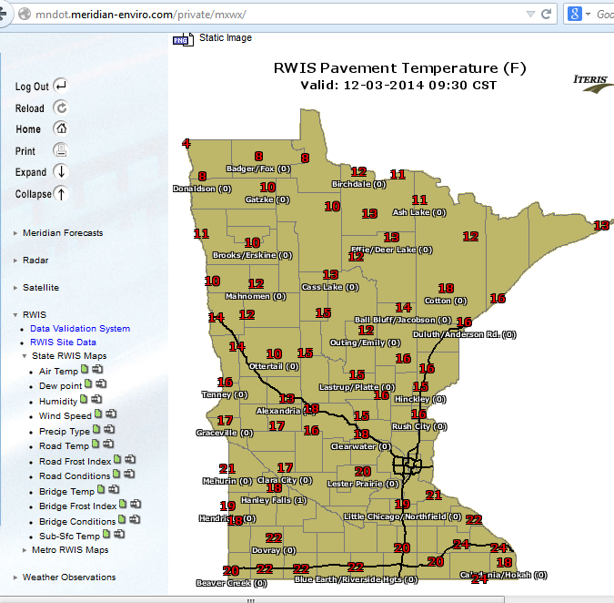
Statewide pavement Temperatures
Note to presenter: Insert your state’s pavement temperature map here instead of this one. Delete this yellow box before making presentation.
Notes:
An additional feature of RWIS is map views. This example is from Iowa RWIS. It is an interactive map that shows a variety of RWIS data that can be turned on or off.
Note to presenter: Insert your state’s pavement temperature map here instead of this one. Delete the yellow box before making presentation
This website is located at this link:
http://rwis.dot.state.mn.us/

Slide 54
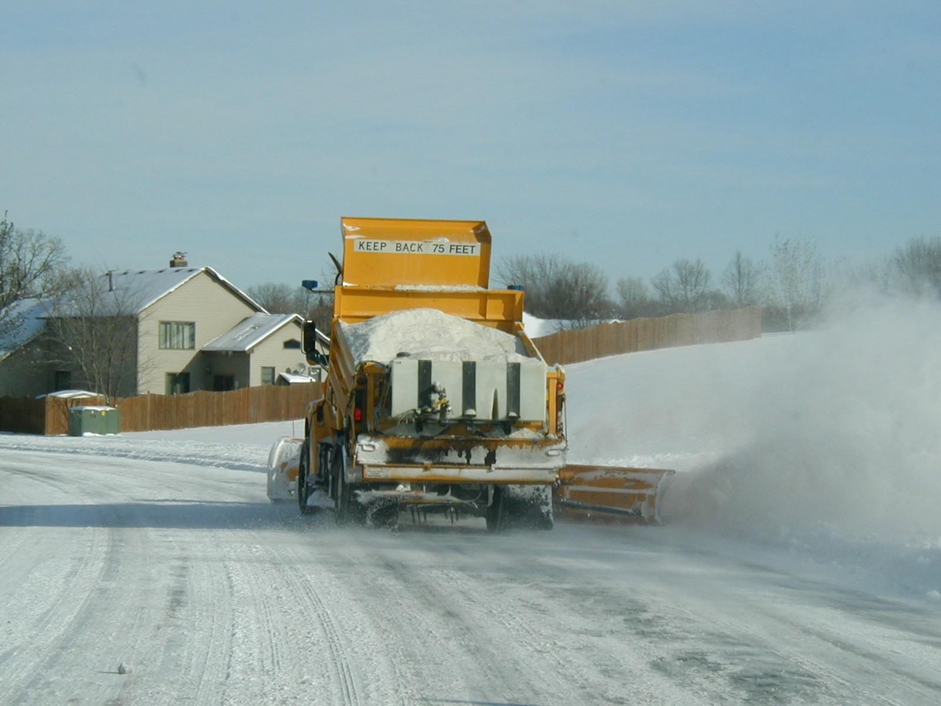
When applying chemical you need the right pavement temperature!
Notes:
When applying chemical, you should be looking at pavement temperatures!
Photo credit: Fortin Consulting, Inc.

Slide 55


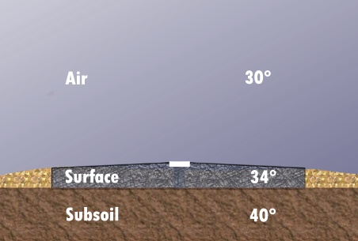






Subsurface: fall scenario
Precipitation does not freeze on the pavement, even though air temperature is below freezing
Notes:
In the fall, precipitation does not freeze on the pavement, even though air temperature is below freezing because the pavement temp is not below freezing. This is aided by higher subsurface temperatures in the fall.
Slide from IowaDOT_New-Operator-Snow-and-Ice-Training_slides_119-127 ppt

Slide 56



Subsurface: winter scenario
Precipitation will likely freeze on the pavement, unless treated with proper deicing chemicals
Notes:
In the winter, when the pavement temperature is below freezing precipitation will likely freeze on the pavement, unless treated with proper deicing chemicals
Slide from IowaDOT_New-Operator-Snow-and-Ice-Training_slides_119-127 ppt

Slide 57

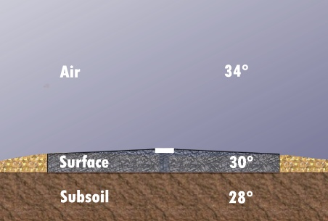

Subsurface: spring scenario
Precipitation will freeze on the pavement, even though air temperature is above freezing
Notes:
In the spring air temperatures may rise above freezing, however, precipitation will freeze on the pavement if the pavement temperature is not above zero. Subsurface cooling may increase the time it takes for pavement temperatures to rise.
Sun vs. cloud cover can also be a large factor. We will look at this next.
Slide from IowaDOT_New-Operator-Snow-and-Ice-Training_slides_119-127 ppt

Slide 58
Test Question
During what season does the subsurface hold the most heat?
Fall
Winter
Spring
It does not change
Notes:
Note to presenters: you may choose to hide this slide.
Test question:
During what season does the subsurface hold the most heat?
A. Fall (yes)
B. Winter (no)
C. Spring (no)
D. It does not change (no)

Slide 59
Test Question
During what season does the subsurface hold the most heat?
Fall
Winter
Spring
It does not change
Notes:
Note to presenters: you may choose to hide this slide.
Test question: During what season does the subsurface hold the most heat?
A. Fall (yes)
B. Winter (no)
C. Spring (no)
D. It does not change (no)

Slide 60
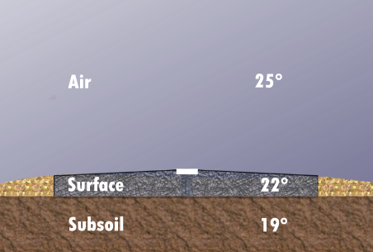
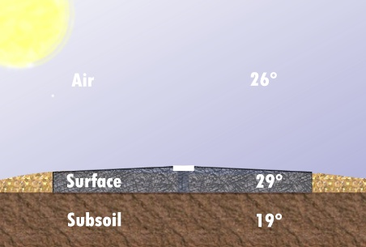
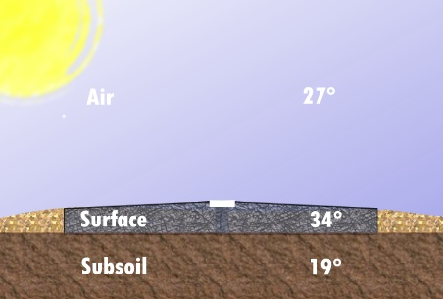
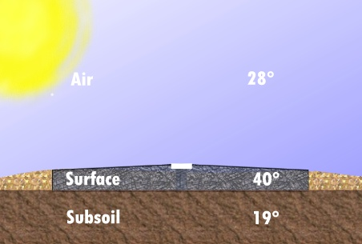
Influence of the sun on pavement temperatures
7:00 a.m.
10:00 a.m.
1:00 p.m.
3:00 p.m.
Notes:
This slide shows how the pavement temperature can increase when exposed to sunlight throughout the day even with below zero air and sub-pavement temperatures.
Note to presenter: Talk to the audience about the shaded area under bridges and how it can remain or become icy on a sunny day.
Slide from IowaDOT_New-Operator-Snow-and-Ice-Training_slides_119-127 ppt

Slide 61
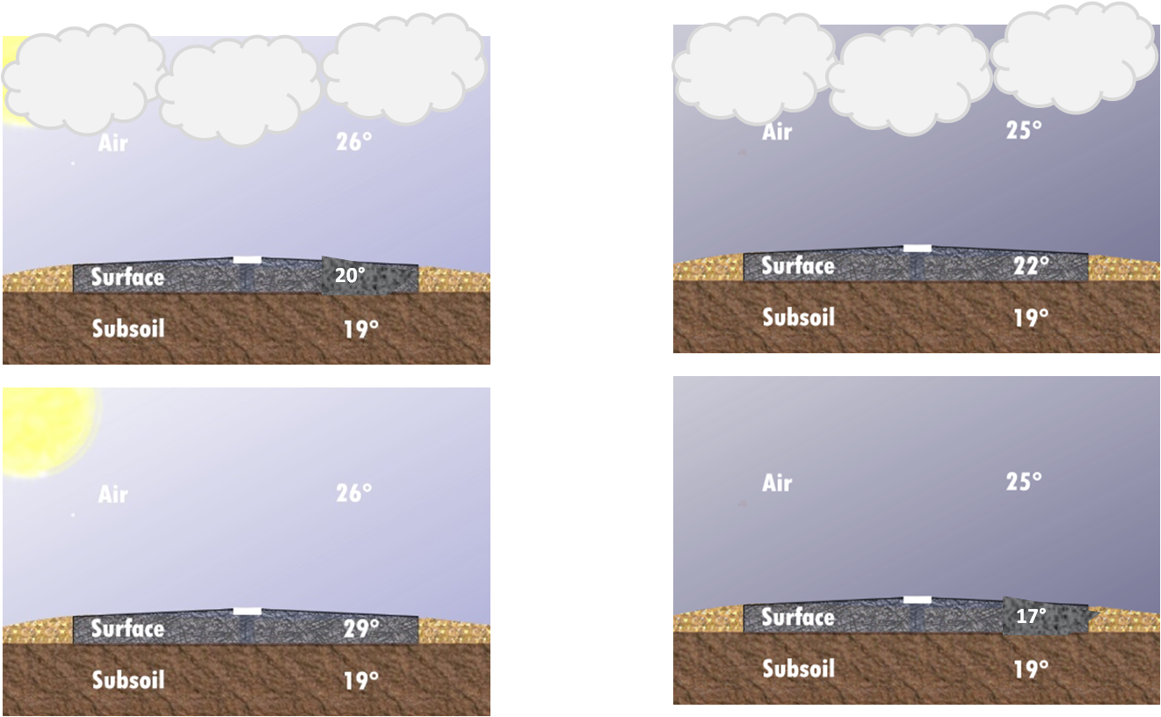
Influence of cloud cover
Day time (cooler)
Night time (warmer)
Notes:
If you compare the temperature trend of pavement when there is cloud cover to when there is not:
During the daytime cloud cover will cause the pavement surface to be cooler (because the sun is not getting through and beating down on the surface). When sun is beating down on the surface, it may cause melting and can be a good time for manual removal of previously compacted snow or ice from pavement.
During the night, the reverse occurs. Without clouds at night the heat escapes and cooling occurs.
Original picture from IowaDOT_New-Operator-Snow-and-Ice-Training_slides_119-127 ppt

Slide 62


Influence of wind
Winds and wet pavement (dries and cools)
25°
Blowing winds: do not anti-ice
Notes:
The wind can have a drying effect on a wet pavement: as water evaporates, it cools the pavement.
Wind can also cause plowed snow to drift or blow back onto the pavement. So, if you have drifting or blow back you should not anti-ice. The blowing snow can stick to the road surface where the anti-icing has been placed.
At high speeds, blowing snow may reduce visibility.
Original picture from IowaDOT_New-Operator-Snow-and-Ice-Training_slides_119-127 ppt

Slide 63
Test Question
What can impact the temperature of pavement?
Ambient air temperature
Subsurface temperature
Wind speed and direction
Precipitation
All of the above
Notes:
Note to presenters: you may choose to hide this slide.
Test question:
What can impact the temperature of pavement?
A. Ambient air temperature
B. Subsurface temperature
C. Wind speed and direction
D. Precipitation
E. All of the above (yes)

Slide 64
Test Question
What can impact the temperature of pavement?
Ambient air temperature
Subsurface temperature
Wind speed and direction
Precipitation
All of the above
Notes:
Note to presenters: you may choose to hide this slide.
Test question:
What can impact the temperature of pavement?
A. Ambient air temperature
B. Subsurface temperature
C. Wind speed and direction
D. Precipitation
E. All of the above (yes)

Slide 65

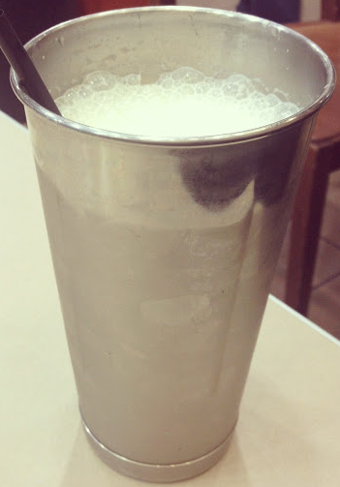
Dew point
The dew point is the temperature at which the air will be fully saturated with moisture:
liquid
When the air temperature is cooled to the dew point, water vapor will condense into:
Can temperature: 35°F
solid
Cup temperature: 30°F
Notes:
The dew point represents the condition when the air is fully saturated with moisture; in other words the air is “holding” as much water vapor as it can.
The closer the dew point is to the air temperature, the more moisture there is in the air; whereas if the dew point and air temperature are farther apart, there is less moisture in the air.
When the air temperature is cooled to the dew point, water vapor will condense into either a liquid (as warm air that condenses on a cold glass) or solid (as frost that forms on a cold surface).
Left picture credit: http://m7science.wikispaces.com/ are licensed under a Creative Commons Attribution Share-Alike 3.0 License
Right picture credit: http://awifescharmedlife.blogspot.com/2012/08/the-great-bagel-coffee-company.html

Slide 66
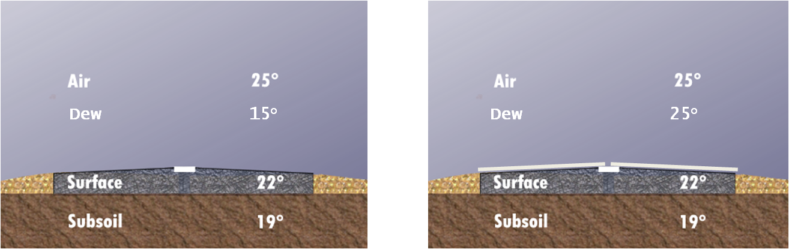
Beware when dew point and pavement temps converge
If the surface temperature is below freezing and falls below the dew point, black ice or frost can form, like we saw in the previous slide.
Notes:
If we have cold roadway surface or bridge deck surface has fallen below the dew point, black ice or frost can form, like described in the previous slide.
Note: bridge decks will generally freeze before pavement surfaces because they have no subsurface with retained heat to help keep the surface from freezing.
Frost and black ice are less likely to form when conditions are windy. Frost will often start at the outer edges of the surface and move toward the middle of the road. It is most likely to form in the early hours of the morning.
Original picture from IowaDOT_New-Operator-Snow-and-Ice-Training_slides_119-127 ppt

Slide 67
Test Question
When is frost likely to occur?
When pavement temp and dew point come together and road is above freezing
When pavement temp and dew point come together and road is below freezing
When pavement temp and dew point are far apart
When you breathe and see steam from your breath
Notes:
Note to presenters: you may choose to hide this slide.
Test Question:
When is frost likely to occur?
When pavement temp and dew point come together and road is above freezing
When pavement temp and dew point come together and road is below freezing
When pavement temp and dew point are far apart
When you breath and see steam from your breath

Slide 68
Test Question
When is frost likely to occur?
When pavement temp and dew point come together and road is above freezing
When pavement temp and dew point come together and road is below freezing
When pavement temp and dew point are far apart
When you breath and see steam from your breath
Notes:
Note to presenters: you may choose to hide this slide.
Test Question:
When is frost likely to occur?
When pavement temp and dew point come together and road is above freezing
When pavement temp and dew point come together and road is below freezing
When pavement temp and dew point are far apart
When you breath and see steam from your breath

Slide 69
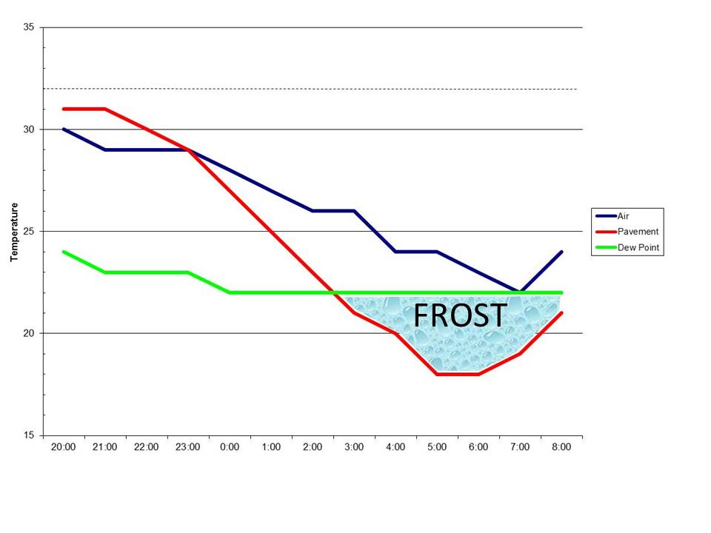
Warning: When red and green lines converge, frost may occur
Notes:
Here is an example of a weather forecast showing the pavement temperature (red line), air temperature (green line), and dew point (blue line).
Presenter, point out that the pavement temp (red) and dew point temp (green) are coming together and the pavement temp (red) is below freezing, so there is a higher chance of frost.
Photo credit: Weather Management Solutions

Slide 70
Test Question
True or False: The dew point affects pavement conditions.
True
False
Notes:
Note to presenters: you may choose to hide this slide.
Test question:
True or False: The dew point affects pavement conditions.
A. True
B. False

Slide 71
Test Question
True or False: The dew point affects pavement conditions.
True
False
Notes:
Note to presenters: you may choose to hide this slide.
Test question:
True or False: The dew point affects pavement conditions.
A. True
B. False

Slide 72
Maintenance Decision Support Systems (MDSS)
MDSS is a computer-based, customizable program that provides winter maintenance personnel with route-specific weather forecast information and treatment recommendations.
Minnesota DOT estimates a 53% average annual savings using MDSS¹
Note to presenters: Insert a photo of your MDSS display here. Delete this yellow box before making presentation.
Notes:
MDSS is a computer-based, customizable program that provides winter maintenance personnel with route-specific weather forecast information and treatment recommendations.
Note to presenters: Insert a photo of your MDSS display here. Delete the yellow box before making presentation.
¹ http://freshwater.org/wp-content/uploads/joomla/2012/roadsalt/pape.pdf

Slide 73
MDSS
Route specific treatment recommendations
Advanced weather prediction
Advanced road condition prediction
Rules of practices for anti-icing and deicing
Notes:
MDSS is a prime example of an integrated solution, enabling maintenance managers to make better, more effective decisions on when and how to deploy resources and treat roads.

Slide 74
Maintenance Decision Support System (MDSS)
Road Weather Forecasting
Tactical Forecasts, 48-72 Hr Windows
Frequent Updates
Multiple Weather Attributes
Point And Area Observations
Pavement Predictions
Surface Temperatures
Moisture Phase
Snow Accumulation And Icing Potential
Treatment Recommendations
Anti-ice
Application Time
Application Rate
Notes:
Maintenance Decision Support System (MDSS) is a road weather forecasting that does tactical forecasts for the upcoming 48 to 72 hours. It provides pavement predictions for temperature and snow accumulation, icing potential along with treatment recommendations.
Slide from Complete-program-2012-Milwaukee.ppt

Slide 75
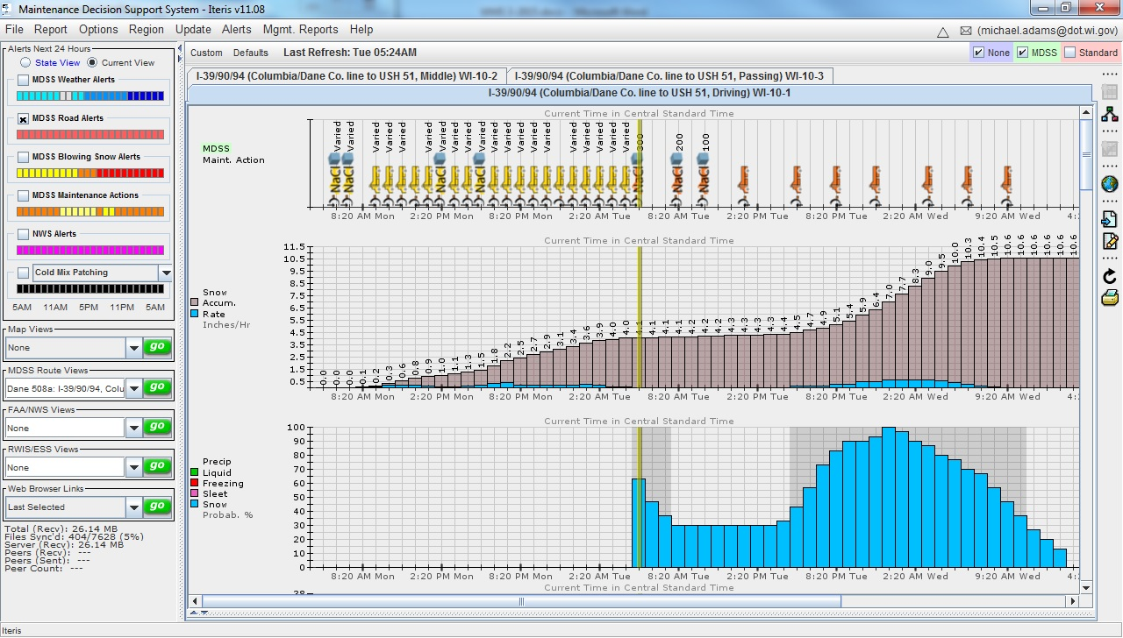
The supervisor in the shop is looking at the MDSS screen and telling the operators in the truck what to do.
Notes:
Most states don’t have an MDSS read-out in the trucks because doing so violates a patent.
In Wisconsin the supervisor in the shop is looking at the MDSS screen and telling the operators in the truck what to do. Or the operator in the truck looks at the screen before they go out or while on break. Here is a typical screen shot at the start of a big storm on the interstate in Wisconsin.
Photo credit: Wisconsin DOT

Slide 76

Application rate recommendations
Notes:
The MDSS will give application rate recommendations.

Slide 77
Test Question
MDSS can be helpful in making:
Tactical forecasts
Pavement predictions
Treatment recommendations
All of the above
Notes:
Note to presenters: you may choose to hide this slide.
Test question:
MDSS can be helpful in making:
A. Tactical forecasts
B. Pavement predictions
C. Treatment recommendations
D. All of the above

Slide 78
Test Question
MDSS can be helpful in making:
Tactical forecasts
Pavement predictions
Treatment recommendations
All of the above
Notes:
Note to presenters: you may choose to hide this slide.
Test question:
MDSS can be helpful in making:
A. Tactical forecasts
B. Pavement predictions
C. Treatment recommendations
D. All of the above

Slide 79
Weather and decision making
Notes:
The next unit is on weather and decision-making.

Slide 80
Applied Weather: The use of weather information
How Do We Use All This Weather Information ?
It Provides Guidance To Make Better Decisions.
We Use It To Answer Particular Questions
Notes:
When making winter operations decisions, we need weather information. But how do we use all of this weather information to make those operations decisions?
We use it to answer certain questions before, during, and at the end of or after a storm to determine the correct way to approach an oncoming storm.
Slide from Complete-program-2012-Milwaukee.ppt

Slide 81
Applied weather – before the storm
What Is The Forecast In General?
What Is The Probability Of Precipitation?
What Is The Wind Forecast?
Can We Anti-Ice?
Is There Blowing Or Drifting Snow Expected?
What Is The Forecast Confidence With The Storm?
What And How Much Is Forecasted ?
When will the Precipitation Start?
Notes:
Note to presenter:
Ask participants: What questions do you think we need to answer?
Why is that question important to ask?
Go through the questions on the slide and discuss why they are important to think about. They are not listed in order of importance.
**************************************
What are the general background conditions? (season, time of day, day of week, traffic patterns)
What is the forecast in general? (big storm, little storm)
What is the probability of precipitation? Below X% chance (40%?) you will not make plans for this storm but will continue to monitor.
How soon will the precipitation start? Make sure crews are in and ready to start when the storm does! Do you use a split shift? When do you need to inform staff if this is being enacted?
What precipitation and how much is forecast? (types, amounts by type, rates)
What is the dew point forecast? Is there a risk of frost?
Can we anti-ice? Don’t anti-ice if it’s going to be windy, blowing snow may stick.
Is there blowing or drifting snow expected? If there is you should not anti-ice. Will it help clear the snow off the roads for you?
Slide from Complete-program-2012-Milwaukee.ppt

Slide 82

Using weather information: Before the storm
Note to presenter: INSERT your procedure for before the storm, such as these items:
Keeping an eye on the forecast
Making shift changes
Getting trucks ready
Delete this slide before making presentation.
Notes:
Note to presenter: use this slide to discuss procedures before the storm. Delete the yellow box before making the presentation.

Slide 83


Using weather information – during the storm
Are There Restrictions To Visibility Forecast?
What Cloud Cover Is Expected?
Is The Forecast Going As Planned?
When will the storm end?
What Is The Dew Point Forecast And Is It Relevant?
Notes:
Note to presenter:
Ask participants: What questions do you think we need to answer during the storm? Why is that question important to ask? Go through the questions on the slide and why they are important to think about. They are not listed in order of importance.
*****************************
These are not listed in any order of importance.
What is the forecast? Is it going as planned?
What additional precipitation, if any, is forecast?
What is the dew point forecast?
What is forecast for winds? What is the speed? What is the direction?
Is this a Storm Track?
Is there a change? Is it getting better or worse?
How far can we see? If you can’t see very far, expect larger accumulations
What is the cloud cover expected?
What is the pavement temperature forecast?
What is the season?
Slide from Complete-program-2012-Milwaukee.ppt

Slide 84







Using weather information – near or after the storm
When Is the forecasted end to the storm?
What weather is forecasted following the storm?
Is blowing and/or drifting expected?
Sunshine, clear skies?
Lake-effect/upslope snow squalls possible?
Dew point forecast, will there be a re-freeze?
Notes:
Note to presenter:
Ask participants: What questions do you think we need to answer near or after the storm? Why is that question important to ask?
Go through the questions on the slide and why they are important to think about. They are not listed in order of importance.
***********************************
When is the storm forecasted to end?
What weather is forecasted following the storm?
Blowing and/or drifting expected?
Sunshine, clear skies?
Lake-effect/upslope snow squalls possible?
Dew point forecast, will there be a refreeze?
Slide from Complete-program-2012-Milwaukee.ppt

Slide 85

Some organization have a flow chart to help them standardize their processes
Note to presenter: Insert your own flow chart here. Delete this box before making presentation.
Notes:
Some DOTs have a guide for decision making based off the type of precipitation, amount of precipitation, pavement temperature, and other factors. This example is of one of Michigan DOT’s charts that advises on actions for light snow storms. This is one tool that would be used in decision making for an upcoming storm event along with look at detailed forecasts.
Note to presenter: Insert your own flow charts here. Delete the yellow box before making the presentation.
Chart reference: Pages_165-170_from_MDOT_Winter-Operations-Trucking-Driving-School.pdf

Slide 86
Test Question
True or False: Weather information can only be used before the storm.
True
False
Notes:
Note to presenters: you may choose to hide this slide.
Test question:
True or False: Weather information can only be used before the storm.
A. True
B. False

Slide 87
Test Question
True or False: Weather information can only be used before the storm.
True
False
Notes:
Note to presenters: you may choose to hide this slide.
Test question:
True or False: Weather information can only be used before the storm.
A. True
B. False

Slide 88

Optional operations discussion
Note to presenters: It might be useful to talk through weather scenarios with your crew, some examples follow. Delete this yellow box before making presentation.
Notes:
Let’s talk through some scenarios and what steps you would go through when approaching the storm.
Note to presenters: It might be useful to talk through weather scenarios with your crew, some examples follow. Delete this yellow box before making presentation.
You can create your own scenarios of common events you encounter. Walk through the steps you would take in looking at forecasts before, during, and after the storm.
If possible, during a weather event take pictures of the weather information systems you are using to make decisions to help with the step by step walk through.
Picture credit: Fortin Consulting, Inc.

Slide 89
Scenario 1: Wednesday 2 inch snow storm predicted at 5 am lasting until noon
Tuesday: check weather, make a decision on start time for shift.
Notify staff about start time.
Start operations at 4 am on Wednesday trucks ready (pre shift check and load) to be on the road by 5 (morning rush hour is coming).
Wed. early morning: Supervisor checking weather right away to see how storm progresses, if anything has changed in forecast.
By Wed. 6 am tell second shift if they are coming in normal or splitting shift (agreement with labor).
Storm acted as predicted, second shift came in at 7, left at 3:30. Normal operations resumed the next day.
Note to presenters: You may choose to replace this scenario with a snow scenario typical of your operations. Delete this yellow box before making presentation.
Notes:
Note to presenters: Use this scenario, or replace with another. Delete this yellow box before making presentation.

Slide 90
Scenario 2: High chance of frost overnight
50% chance of frost expected Tuesday at 1 am
Monday: send crew out to anti-ice the bridges before the end of their normal shift
Should you call road patrol in at 3 am to check for frost?
On bridges?
On areas not anti-iced?
Note to presenters: You may choose to replace this scenario with a snow scenario typical of your operations. Delete this yellow box before making presentation.
Notes:
Note to presenters: Use this scenario, or replace with another. Delete this yellow box before making presentation.

Slide 91
Scenario 3
Note to presenter: INSERT your typical scenario here. Use this to walk your crew through some situations you have experienced. Delete this yellow box before making presentation, or delete this slide altogether.
Notes:
Note to presenters: Use this scenario, or replace with another. Delete this yellow box before making presentation.

Slide 92

Importance of Record Keeping
Shows that you follow policies including Levels of Service
Shows where efficiency can be improved
Helps with planning
Helps protect you from claims
Notes:
Record keeping is important as a means of material accountability, budgeting/cost tracking, performance tracking, support in the event of legal actions, media inquiries, and planning.

Slide 93

Level of Service
Keeping good records helps
To show you meet your level of service.
To show you are following policy.
To defend yourself when faced with a lawsuit.
Notes:
Ask participants: When is it not possible to meet your level of service and how would you document this?
Credit: MnDOT Maintenance Manual http://www.dot.state.mn.us/maintenance/pdf/manual/Ch2.pdf

Slide 94

Document Your Operations
EXAMPLE:
Conditions- weather and road, pavement temp
Material type and quantity used
Timing
# of passes and when
Unusual conditions/circumstances
Customize this slide for your operation
Insert an example of your state’s event log and explain how to fill it out. Delete this yellow box before making the presentation.
Notes:
It is very important that plow drivers document the actions taken in response to a snow/ice event
This will include the road conditions throughout their shift, type and amount of deicer or anti-icer used, timing of operations, and the number of passes and when. If there are unusual conditions that affect the operations, those should be recorded. For example, road construction, accidents, major compaction problems, etc.
Note to presenters: Insert a copy of your state’s event log and explain how to fill it out. Delete this yellow box before making presentation.
Photo credit: INDOT

Slide 95

Good job!
Being prepared makes all the difference!
Make use of the weather tools you have.
Search for new and better tools!
Notes:
Do not delete this yellow box. Note that being prepared makes all the difference!

Slide 96
Test Question
True or False: Discussing different scenarios with your crew can help them be better prepared for various weather situations.
True
False
Notes:
Note to presenters: you may choose to hide this slide.
Test question:
True or False: Discussing different scenarios with your crew can help them be better prepared for various weather situations.
A. True
B. False

Slide 97
Test Question
True or False: Discussing different scenarios with your crew can help them be better prepared for various weather situations.
True
False
Notes:
Note to presenters: you may choose to hide this slide.
Test question:
True or False: Discussing different scenarios with your crew can help them be better prepared for various weather situations.
A. True
B. False

Slide 98
Additional resources
AASHTO, Clear Roads Computer Based training:
Anti-icing/RWIS: Lesson 4 Weather Basics and Lesson 5 Weather and Roadway Monitoring for Anti-icing Decisions
Deicing: Unit 5 Application Guidelines
Winter Maintenance Management: Unit 3 Operational Methods
Iowa DOT New Operator Snow and Ice Training Slides 92-127.pptx
Maine DOT National Weather Service.pptx
MDOT Winter Operations Trucking Driving School Pages 165-170.pdf
Notes:
This slide provides additional resources relating to weather basics.

Slide 99
Additional resources
Ohio DOT Snow and Ice Control Course Presentation 105 slides 50-82.pptx and Snow and Ice Control Course Manual 105 Pages 21-31.pdf
Tailoring the Approach to the Storm Webinar 2013.pptx
Wisconsin Winter Maintenance Supervisor Training Guide Reference Weather and Decision Making.pptx
Online resources:
National Weather Service: http://www.weather.gov/
MDSS: http://www.rap.ucar.edu/projects/rdwx_mdss/
RWIS: https://mesonet.agron.iastate.edu/RWIS/currentSF.phtml
DTN: http://online.dtn.com/online/
Notes:
This slide provides additional resources relating to weather basics.

Slide 100
Acknowledgements
Training contents were developed by Fortin Consulting Inc., under the direction of the Clear Roads Advisory Team.
Connie Fortin – connie@fortinconsulting.com
Professional formatting and training aids were developed by the University of Minnesota, Center for Transportation Studies.
Jim Grothaus – Groth020@umn.edu
Ann Johnson – Johns421@umn.edu
Members of the Clear Roads Advisory Team include:
Mike Sproul, Dave Wieder, Cliff Spoonemore, Monty Mills, David Frame,
Mike Lashmet, Clay Adams, Justun Juelfs, and Tom Peters

Slide 101
This presentation was developed with funding from the Clear Roads research program, which brings together transportation professionals and researchers from around the country to drive innovation in the field of winter maintenance.
Find additional information and resources at
http://clearroads.org/

Slide 102



Thank you for your good work!
Notes:
Thank you for your time today. Have a good winter!

