Slide 1
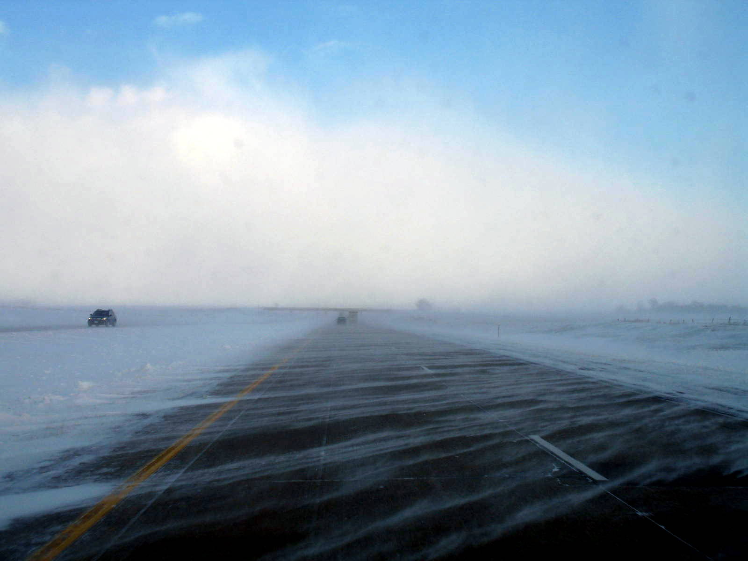

Module 15: Drift Control and Wind
2016 Created for Clear Roads by:
U of MN Center for Transportation Studies &
Fortin Consulting Inc.

Slide 2
Training for Winter Maintenance Supervisors and Operators
2016 Created for Clear Roads by:
U of MN Center for Transportation Studies &
Fortin Consulting Inc.

Slide 3
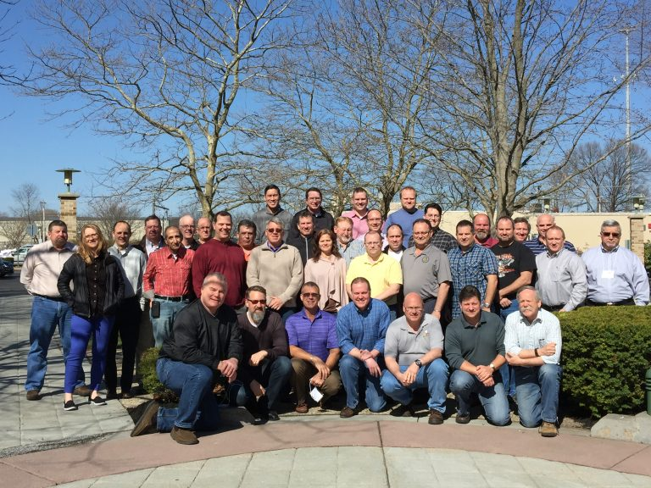
Winter maintenance professionals are a very powerful and important group
Notes:
Photo: clear roads website
Note to presenters: These first 7 slides can be used or hidden.
Or, replace with photos of your staff.

Slide 4
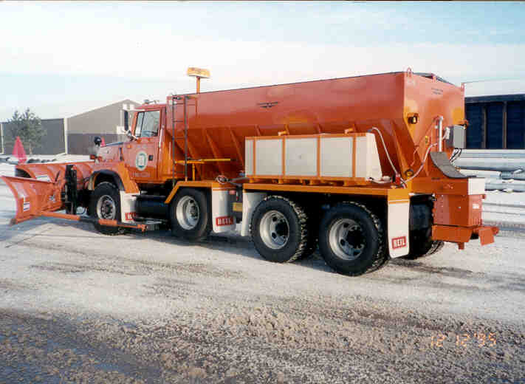
You do a great job of taking care of our roads!

Slide 5
This is one of a series of 22 winter maintenance training modules developed by the Clear Roads Program. All of the modules are available online at www.clearroads.org
Modules include information on the following:
Plowing
Truck operations
Spreading
Material use
Pre-wetting
Brine production
De-icing and anti-icing
Level of service
Ice formation
Freeze point depressants
Environmental issues
Drift control
Weather
Avalanche management
Bridge frost
Safety
Notes:
Note to presenters: The website www.clearroads.org can be accessed here if a live internet connection is available.
A list of all the modules is given here:
Plowing procedures
Truck operations
Spreading
Material use
Pre-wetting
Brine production
De-icing
Anti-icing
Safety
De-icing agent management policy
Level of service
Ice formation
Freeze point depressants
Environmental issues
Drift control
Weather
Bridge frost
Avalanche management

Slide 6
Module 15: Drift Control and Wind
2016 Created for Clear Roads by:
U of MN Center for Transportation Studies &
Fortin Consulting Inc.

Slide 7
FACILITATOR NOTES (do not show during class)
This is a priority 1 module to be developed for Clear Roads national training. It will address three audiences. Slides can be customized for the audience.
Slide Legend
Entry-level plow drivers
Experienced plow drivers
Supervisors
Notes:
Note to facilitator: do not show this slide during class

Slide 8
This module will contain these topics:
Effects of wind on snow.
Drift control best practices.
Selection of drift control BMP.
Drift control case studies.
Notes:
This module covers forecasts, blowing snow, wind during the daytime or nighttime, wind behavior by region, and how wind effects road treatments.

Slide 9
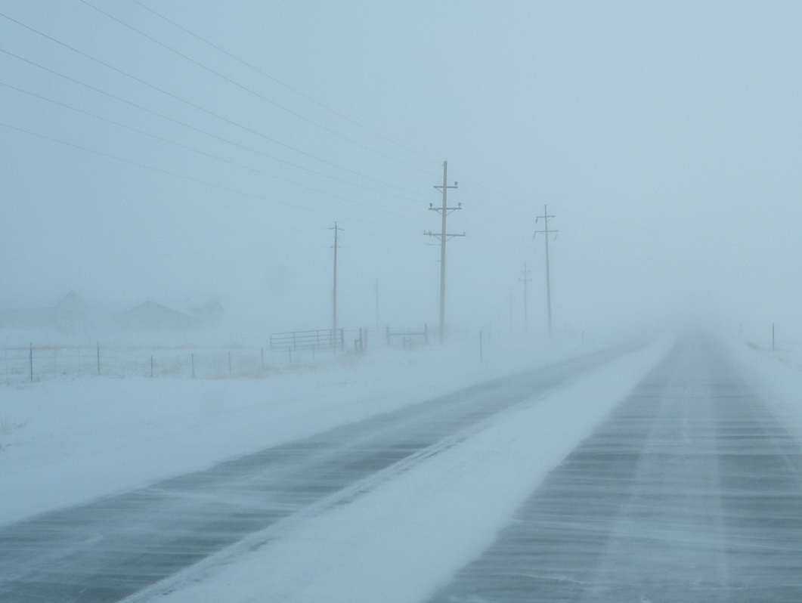
Controlling drifting snow is important to:
Reduce maintenance costs.
Reduce closure times.
Increase visibility.
Decrease crash incidences.
Reduce road icing.
Notes:
Blowing snow can be dangerous. Controlling drifting snow is important to reduce maintenance costs, reduce road closure times, increase visibility, decrease crash incidences, and reduce road icing. In this module, we will talk about wind and its effects on snow, drift control best practices, selection of drift control, and some drift control case studies.

Slide 10
Effects of wind on snow
When snow will begin to move.
How it causes it to move over the surface.
How it behaves at higher elevation and velocity.
Notes:
This section will cover the effects of wind on snow.

Slide 11
Public Enemy #1
WIND
© Copyright 2003 Ronald D. Tabler
Notes:
Wind can cause snow to drift. This can cause decreased visibility for drivers. It can also cause snow to accumulate on road surfaces, or if the blowing snow melts on the road surface, ice formation.
Slide from WYDOT, credit to Ronald D. Tabler

Slide 12
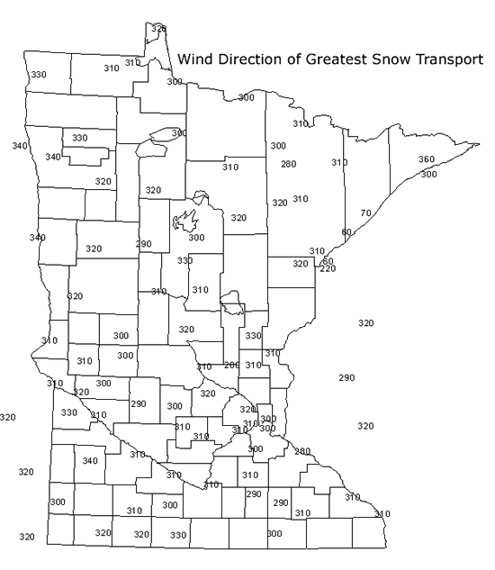
Prevailing wind direction
In most areas, there is a prevailing wind direction that can help to predict the direction of the blowing snow.
Note to presenters: insert your state map here. Delete this yellow box before making presentation.
Notes:
In most areas, there is a prevailing wind direction that can help to predict the direction of the blowing snow.
This picture of wind direction for Minnesota shows the prevailing wind direction for given areas.
Note to presenters: insert your state map here. Delete this yellow box before making presentation.
Photo credit: http://snowcontroltools.umn.edu/design/index.html

Slide 13
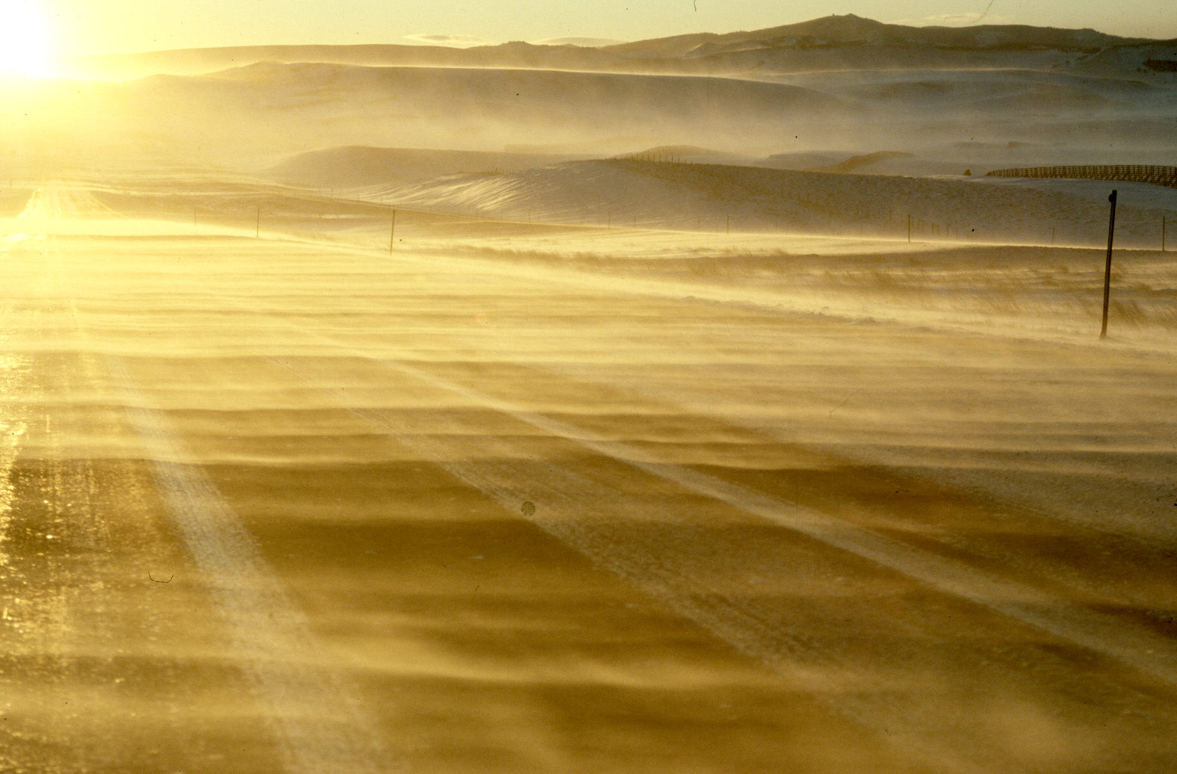
The various ways snow moves across the road…
“Ground drifting” snow begins to be dislodged at wind speeds of 13 mph.
Notes:
When snow is dislodged and moves along the surface, it is known as “ground drifting.” Snow begins to be dislodged with wind speeds of 13 mph.
Slide from WYDOT, credit to Ronald D. Tabler

Slide 14
Test Question:
At what speed does snow begin to dislodge and move?
10 mph
15 mph
13 mph
8 mph
Notes:
Note to presenters: you may choose to hide this slide.
Test Question:
At what speed does snow begin to dislodge and move?
10 mph (no)
15 mph (no)
13 mph (yes)
8 mph (no)

Slide 15
Test Question:
At what speed does snow begin to dislodge and move?
10 mph
15 mph
13 mph
8 mph
Notes:
Note to presenters: you may choose to hide this slide.
Test Question:
At what speed does snow begin to dislodge and move?
10 mph (no)
15 mph (no)
13 mph (yes)
8 mph (no)

Slide 16
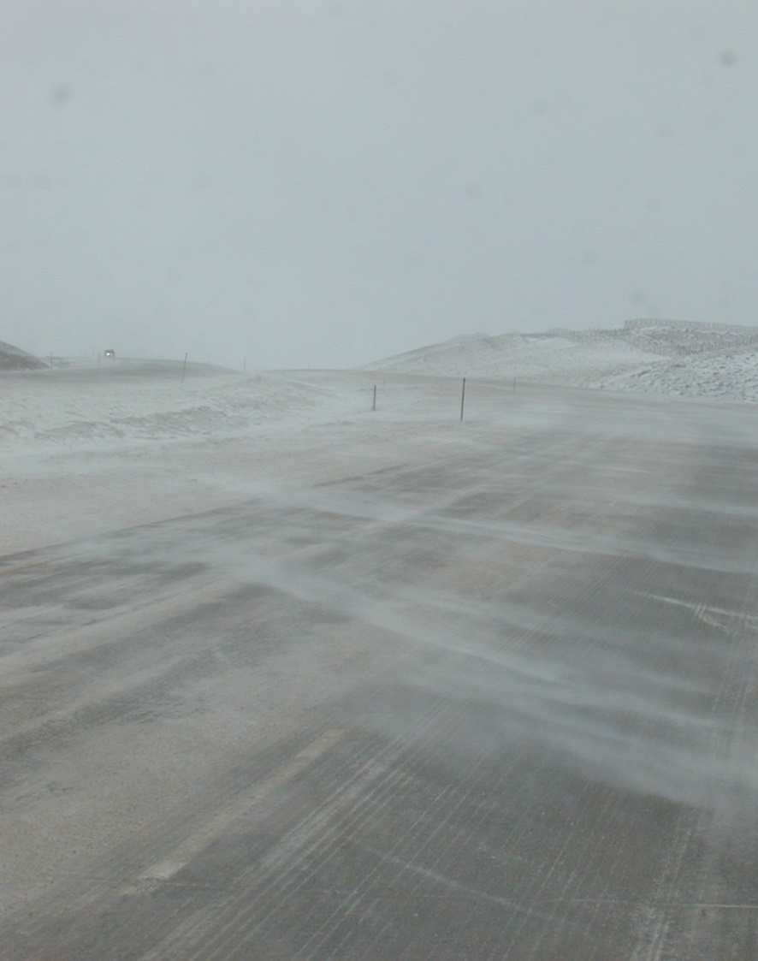
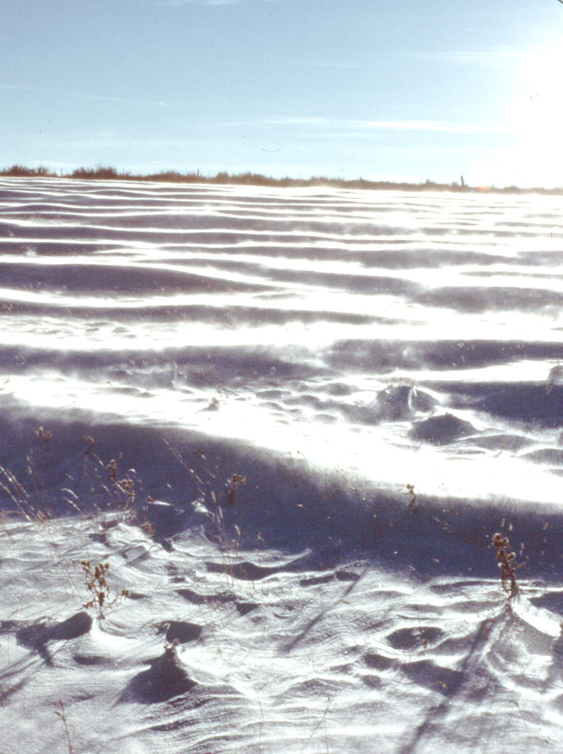
Snow snakes
Rolling and creeping
Notes:
At lower wind speeds, snow can move in different ways such as snow snakes (as shown on the left) or rolling and creeping (as shown on the right).
Snow snakes are tendrils of snow that, as the name implies, snake across area.
Rolling and creeping snow create drifts or waves in the snow.
Slide from WYDOT, credit to Ronald D. Tabler

Slide 17
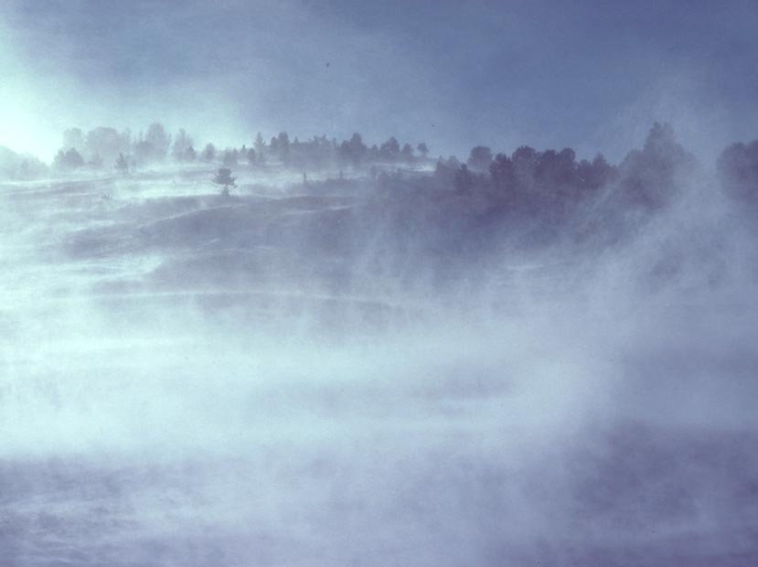
Turbulent diffusion
…any which way it moves across the road, we have to deal with it!
Notes:
As wind speeds increase, the blowing snow becomes more turbulent. This is also known as Diffusion, as many snow particles are swept into the air and scattered. This is when it can begin to impair driver visibility.
Slide from WYDOT, credit to Ronald D. Tabler

Slide 18
The faster the wind, the higher the altitude the blowing snow reaches.
WIND
Height
Notes:
© Copyright 2003 Ronald D. Tabler
The basic principal is: the faster the wind, the higher blowing snow reaches. This is why there are times when a car is driving and struggling with visibility, while a semi truck passes at a much higher speed. They can see better, because they are higher up.
Slide from WYDOT, credit to Ronald D. Tabler

Slide 19
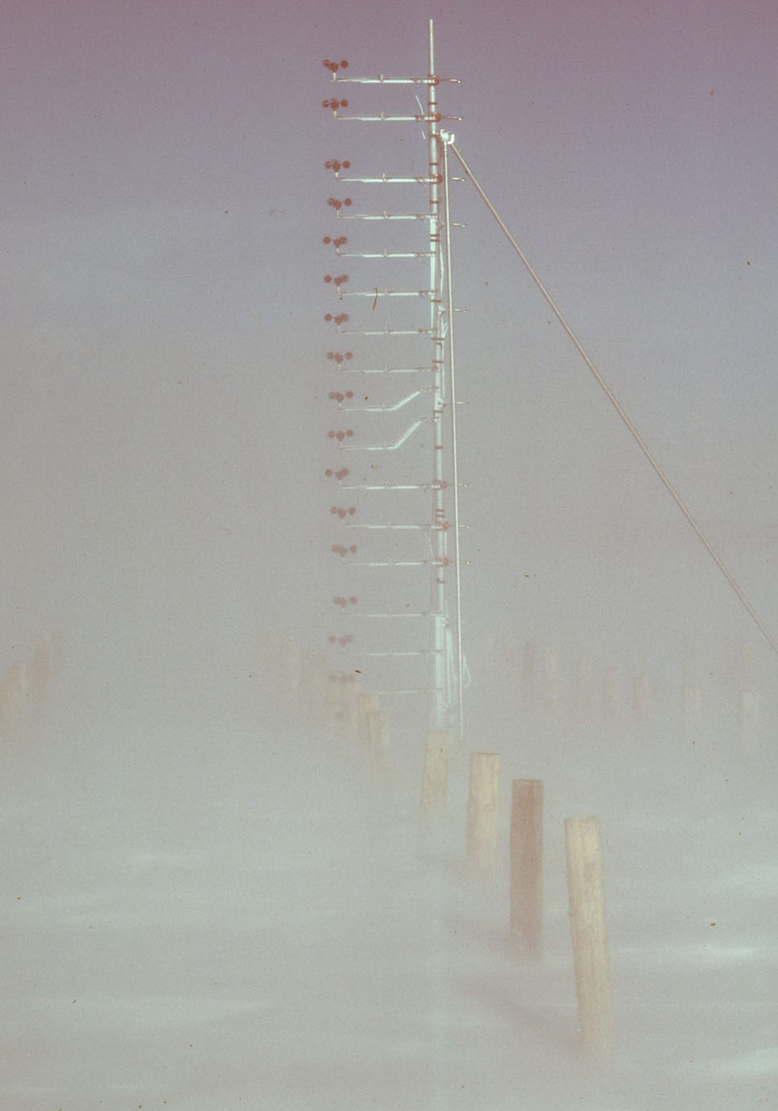
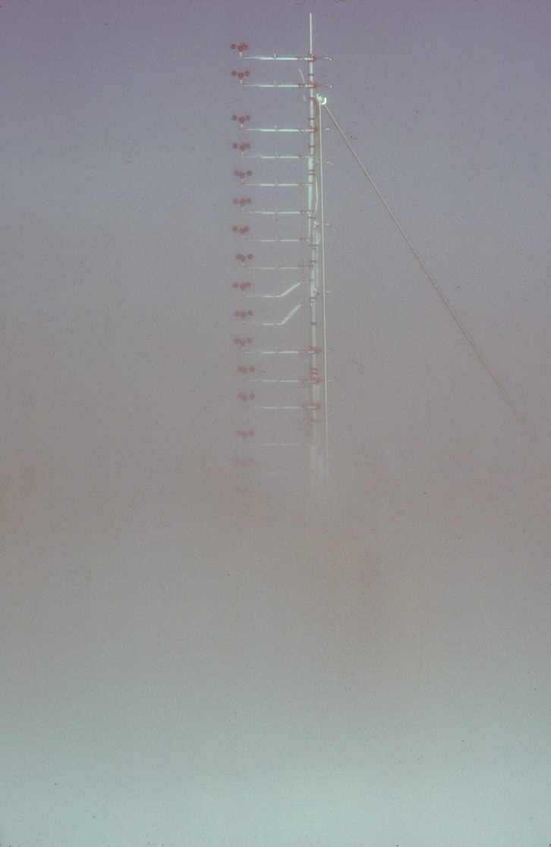
25 mph
50 mph
Notes:
On the left, there is a picture of visibility conditions at 25mph, and on the right side visibility at 50 mph. As the wind speed rises, the visibility at lower heights decreases, and the blowing snow rises making it harder to see at higher levels.
This is why, even when cars may have very low visibility and difficult driving conditions, semis may be speeding past. They are seated much higher, and can see over the blowing snow.
Slide from WYDOT, credit to Ronald D. Tabler

Slide 20
As wind speed increases at low elevations, the driving visibility decreases.
30 mph vs. 10 mph

Slide 21
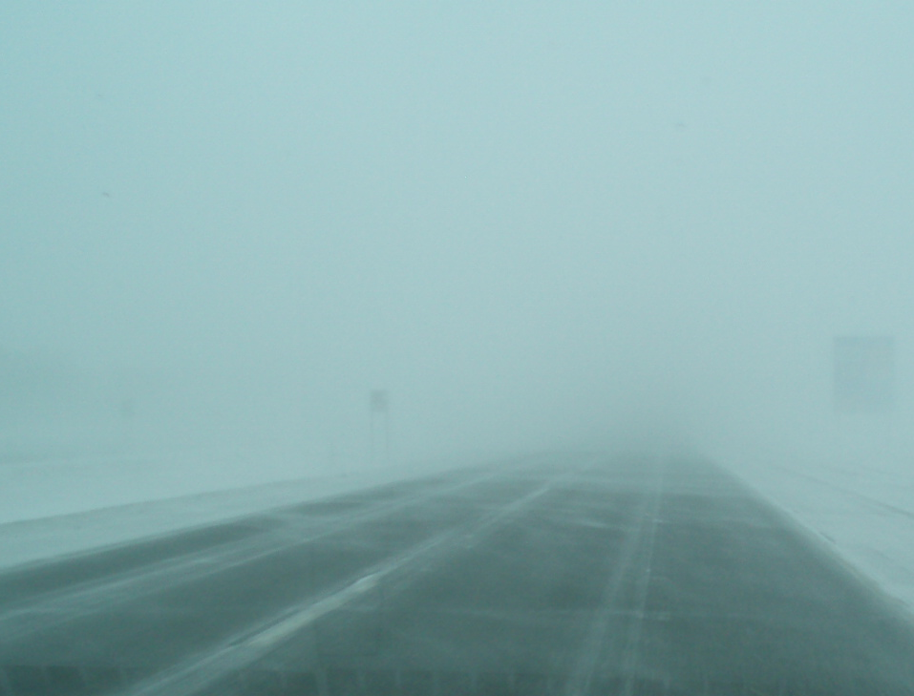
Whiteout conditions
Notes:
Here is an example of decreased visibility due to high winds, also known as white out conditions.
Photo credit: Fortin Consulting Inc.

Slide 22
How visibility varies with wind speed
26
70
110
200
380
Blizzard Conditions
830
2,070
6,300
Notes:
This chart demonstrates how wind speed changes the visual range of drivers. You can see that as the wind speed rises, the visibility decreases.
Blizzard conditions begin at wind speeds of 35 mph.
Slide from WYDOT, credit to Ronald D. Tabler

Slide 23
Test Question:
As the wind speed increases, how does it change visibility?
Visibility increases
No change in visibility
Visibility decreases
Notes:
Note to presenters: you may choose to hide this slide.
Test Question:
As the wind speed increases, how does it change visibility?
Visibility increases (yes)
No change in visibility
Visibility decreases

Slide 24
Test Question:
As the wind speed increases, how does it change visibility?
Visibility increases
No change in visibility
Visibility decreases
Notes:
Note to presenters: you may choose to hide this slide.
Test Question:
As the wind speed increases, how does it change visibility?
Visibility increases
No change in visibility
Visibility decreases (yes)

Slide 25
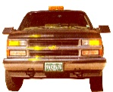
Snow shrinks as it blows
MAXIMUM TRANSPORT DISTANCE, T
FETCH, F
EVAPORATION
Maximum snow transport distance is about 2 miles.
Notes:
As snow is transported along a distance, say the fetch (the open distance leading up to the road), it begins to evaporate. The snow particle becomes smaller and smaller until it is completely evaporated. The maximum transport distance is about 2 miles.
If your fetch is longer than 2 miles, you will only have to deal with the snow within the two miles closest to the road.
Slide from WYDOT, credit to Ronald D. Tabler

Slide 26
Test Question:
Wind-blown snow particles ________ in size.
Increase
Decrease
Double
Triple.
Notes:
Note to presenters: you may choose to hide this slide.
Test Question:
Wind-blown snow particles ________ in size.
Increase
Decrease (yes)
Double
Triple.

Slide 27
Test Question:
Wind-blown snow particles ________ in size.
Increase
Decrease
Double
Triple.
Notes:
Note to presenters: you may choose to hide this slide.
Test Question:
Wind-blown snow particles ________ in size.
Increase
Decrease (yes)
Double
Triple.

Slide 28

Stages of snow drift
WIND
Final shape
If you let the snow blow, it starts as a small drift and grows, eventually having the shape in white.
Notes:
There are seven stages to snow drift formation. Snow begins depositing higher up the slope and grows downward. If enough snow is allowed to accumulate, the equilibrium slope will form, as is pointed out on the picture.
When you start to observe this forming, it is a warning sign.
Slide from WYDOT, credit to Ronald D. Tabler

Slide 29
Snow can accumulate in any of these ways
WIND
Downwind Drift
Upwind Drift
Combination
Notes:
Topography plays a large role in how snow is deposited. Downwind drift, upwind drift (or back drift), and a combination.
Topography can be used to predict how snow will accumulate at certain places along the road. Wyoming DOT’s GEOPAK tool can be used to predict snow accumulation and make decisions about road placement and design.
Photo credits: Ronald D. Tabler

Slide 30
Test Question:
True or false: Snow drifts can only form downwind.
True
False
Notes:
Note to presenters: you may choose to hide this slide.
Test Question:
True or False: Snow drifts can only form downwind.
True
False (false)

Slide 31
Test Question:
True or false: Snow drifts can only form downwind.
True
False
Notes:
Test Question:
True or False: Snow drifts can only form downwind.
True
False (false)

Slide 32
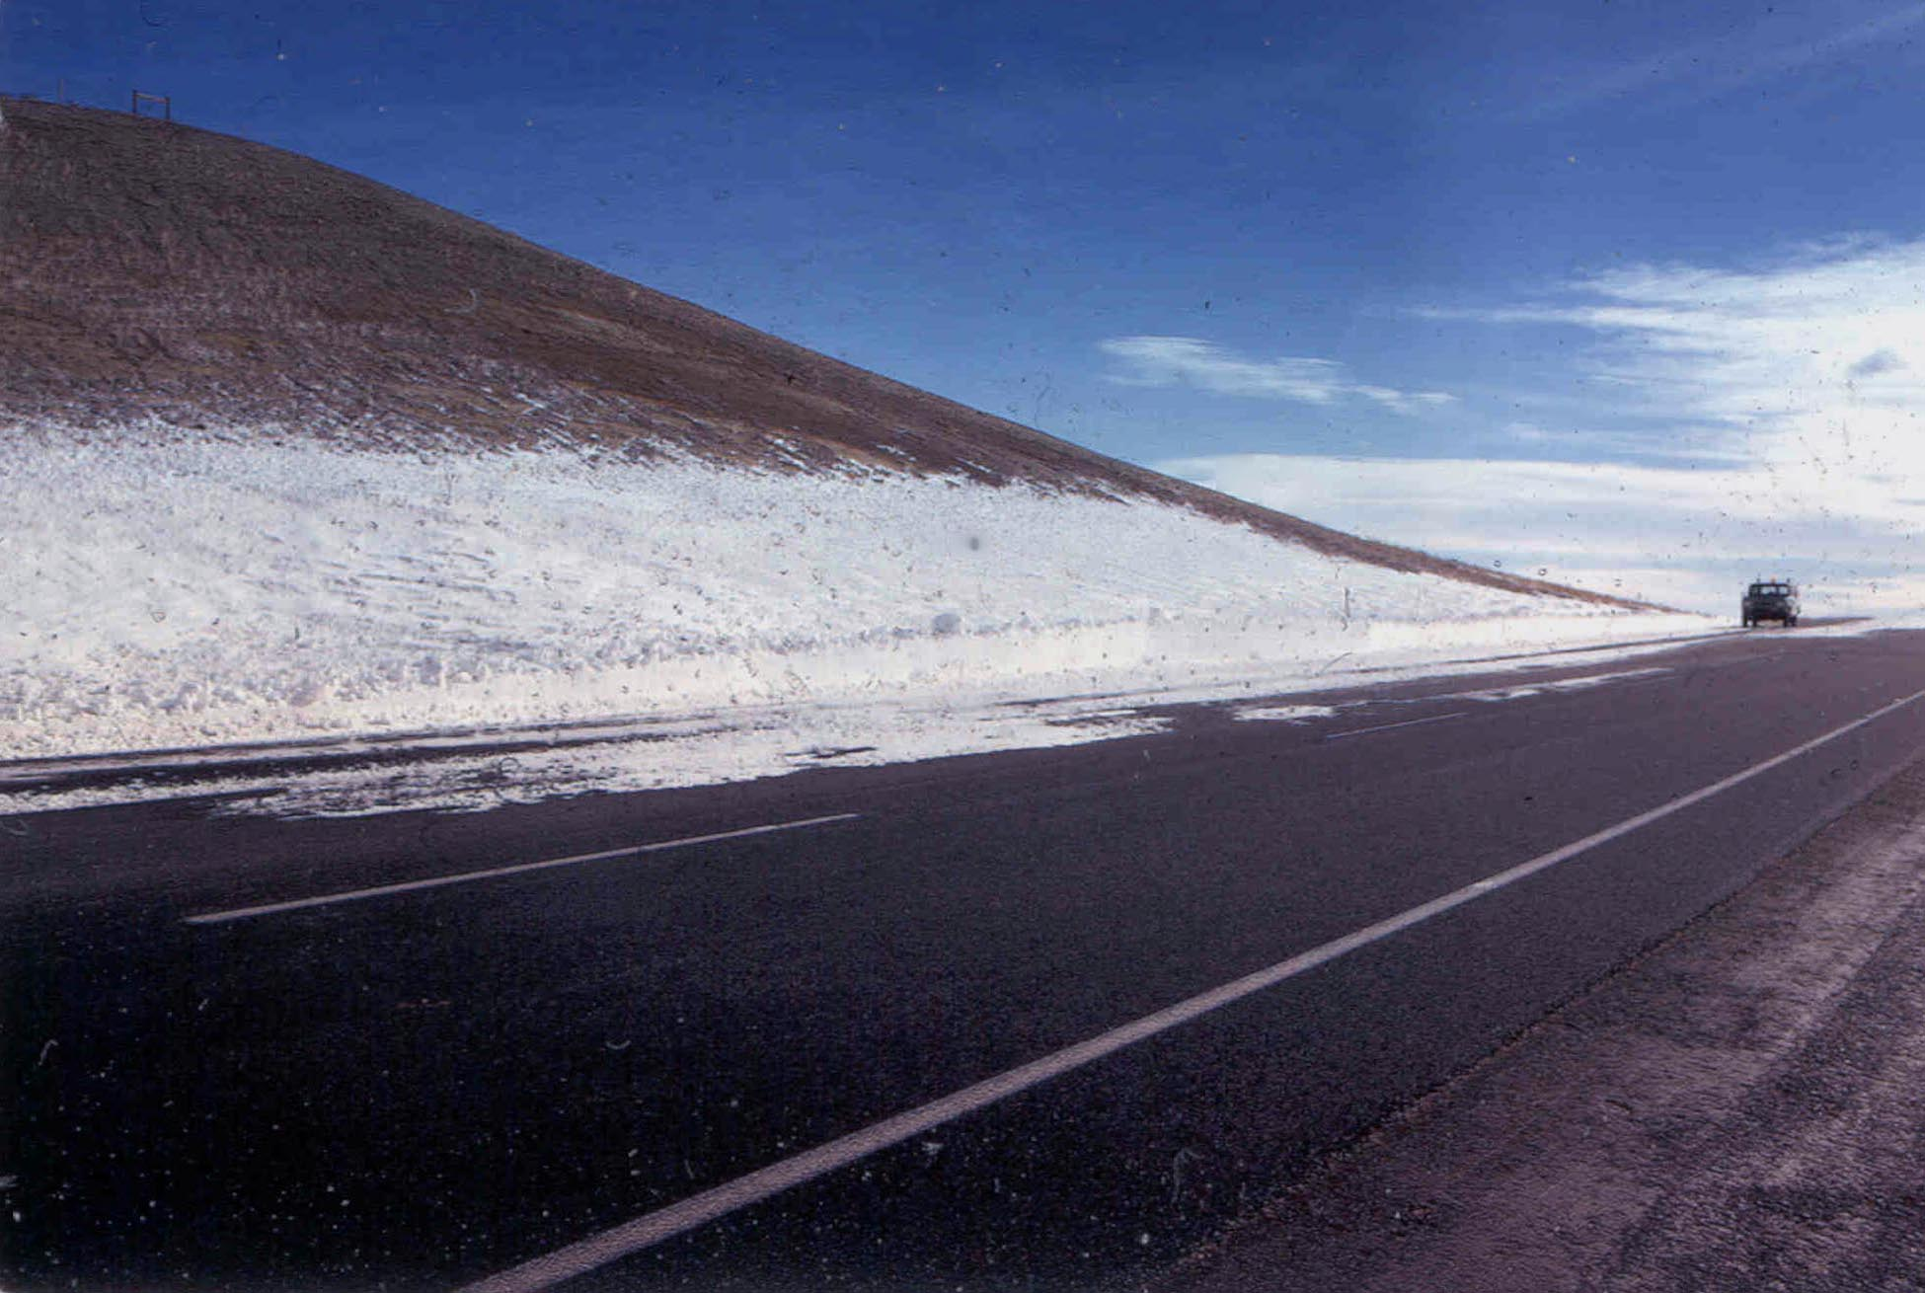
WIND
Upwind drift or back drift
Notes:
This picture shows an example of upwind drift, also known as back drifting. The wind is unable to push the snow up the slope, so it settles at the bottom, eventually drifting back onto the road.
Slide from WYDOT, credit to Ronald D. Tabler

Slide 33
Drift control best practices
Living snow fences
Standing corn rows
Structural snow fences
Grading
Notes:
This section will cover drift control.

Slide 34

What we are going to do about blowing snow?
Notes:
Next, we are going to talk about options for dealing with wind and blowing snow. Work with engineers to determine the best option for your problem sections.

Slide 35
What we are going to do about blowing snow?
Collaborate with engineers to determine the best option
Notes:
Next, we are going to talk about options for dealing with wind and blowing snow. Work with engineers to determine the best option for your problem sections.

Slide 36

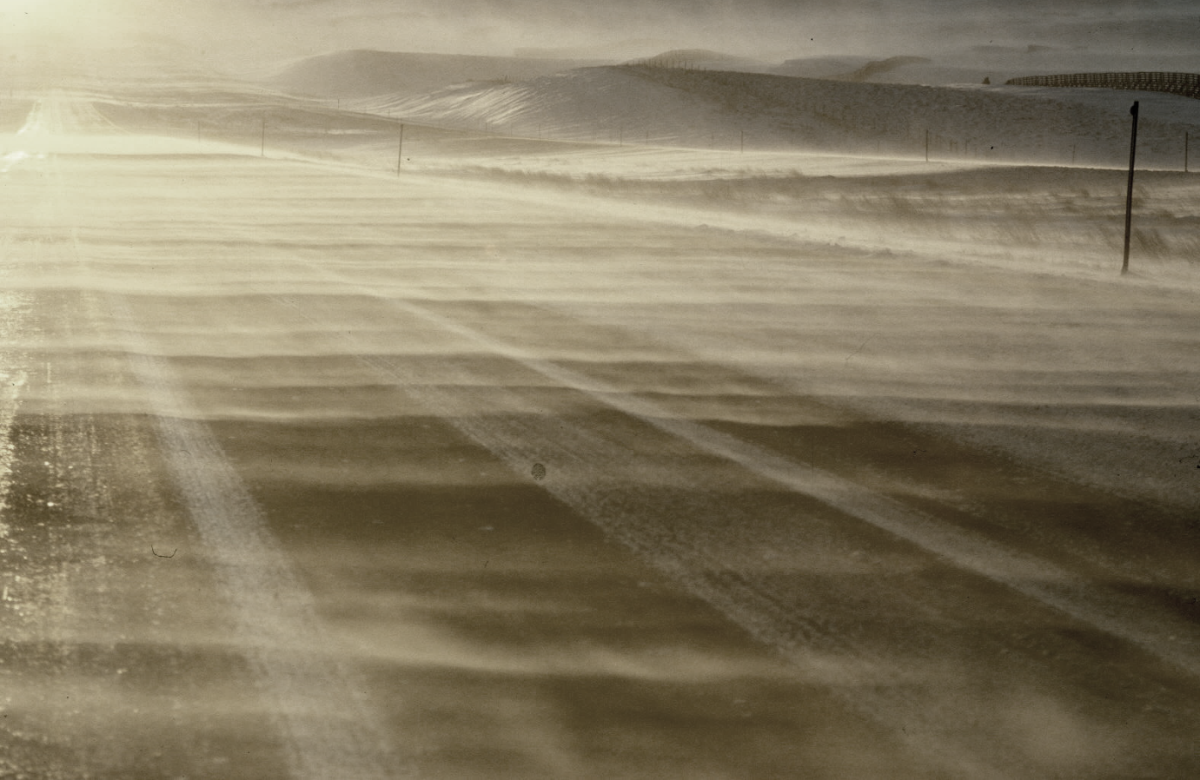
Don’t salt if snow is blowing across the road
Notes:
Don’t salt when snow is blowing across the road. Salting can cause snow to melt and trap more snow on the road. It can also cause snow to refreeze, creating icy road conditions.
Photo credit: Ronald Tabler

Slide 37
Test Question:
Should we salt the road if snow is blowing across it?
Yes
No
Notes:
Note to presenters: you may choose to hide this slide.
Test Question:
Should we salt the road if snow is blowing across it?
Yes
No

Slide 38
Test Question:
Should we salt the road if snow is blowing across it?
Yes
No
Notes:
Note to presenters: you may choose to hide this slide.
Test Question:
Should we salt the road if snow is blowing across it?
Yes
No

Slide 39
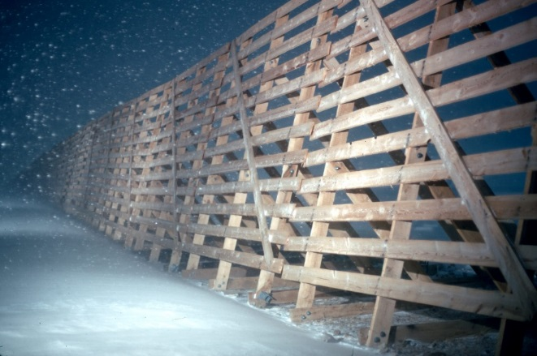
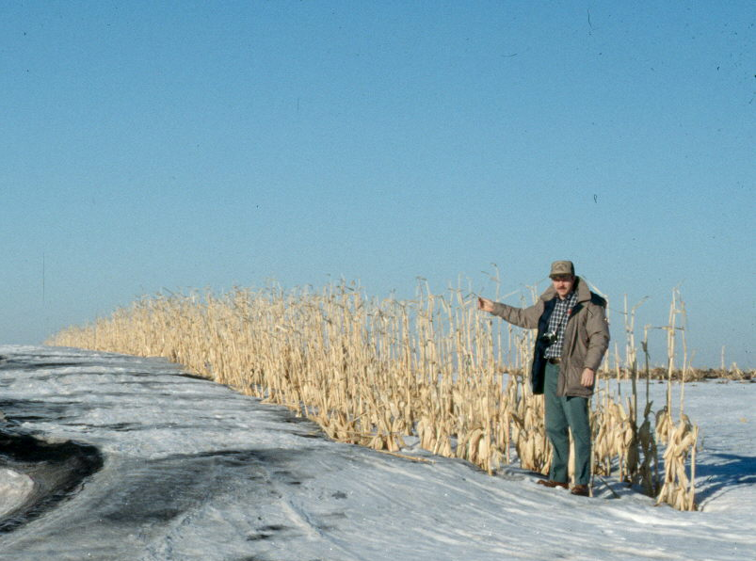
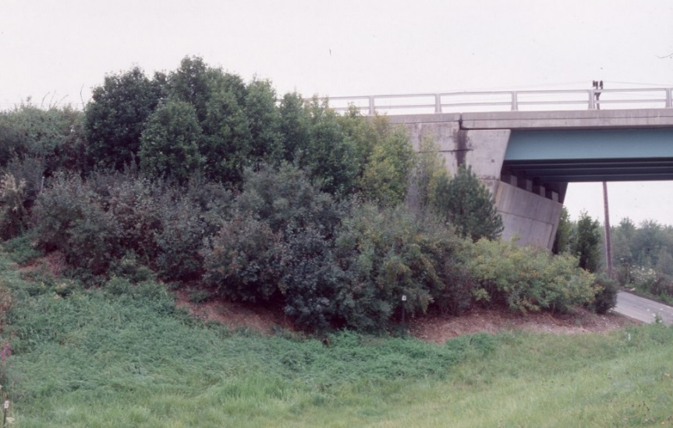
Types of drift control
Structural snow fences
Living snow fences
Standing corn rows
Grading – road design
Notes:
There are many types of drift control.
Structural snow fences are a permanent structure that is put up as a snow break and engineered to catch snow.
Living snow fences are plants, trees, shrubs, or even prairies in the snow catch area that are grown and maintained in a particular spot to catch snow.
Standing corn rows are rows of corn in a farmer’s field that are intentionally not cut down to create a snow break to catch snow.
Grading is using earthworks to change the back slope or road level in order to create a snow basin and more snow storage.
Photo credit to Ronald D. Tabler

Slide 40
Test Question:
True or false: snow fences are made of snow.
True
False
Notes:
Note to presenters: you may choose to hide this slide.
Test Question:
True or False: Snow fences are made of snow.
True
False (false)

Slide 41
Test Question:
True or false: snow fences are made of snow.
True
False
Notes:
Note to presenters: you may choose to hide this slide.
Test Question:
True or False: Snow fences are made of snow.
True
False (false)

Slide 42
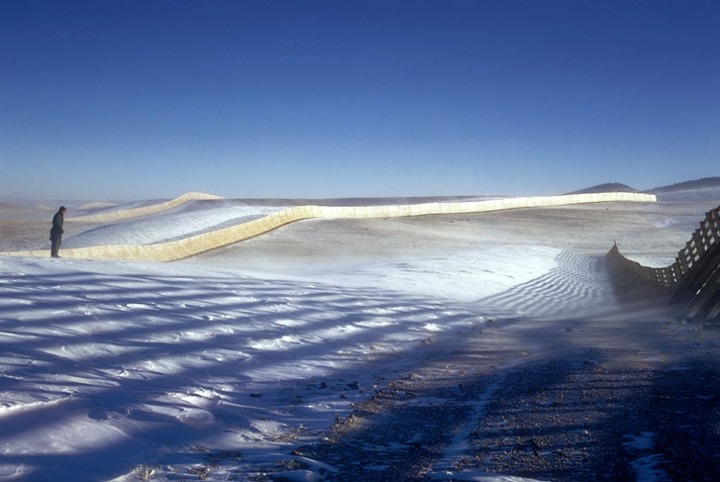
Properly designed fence systems
Prevent drifts from forming on roads.
Improve visibility.
Improve road surface conditions.
Reduce accidents.
Reduce winter maintenance costs.
Notes:
A properly engineered fence system:
Prevent drifts
Improve visibility
Improve road surface conditions
Reduce accidents
Reduce winter maintenance costs
Slide from WYDOT, credit to Ronald D. Tabler

Slide 43
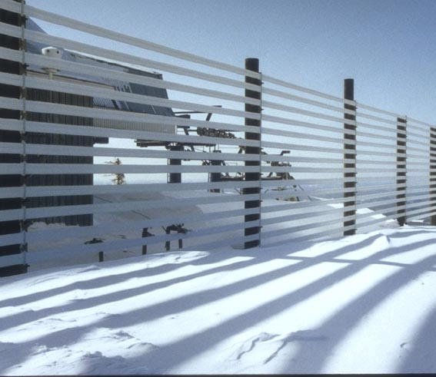
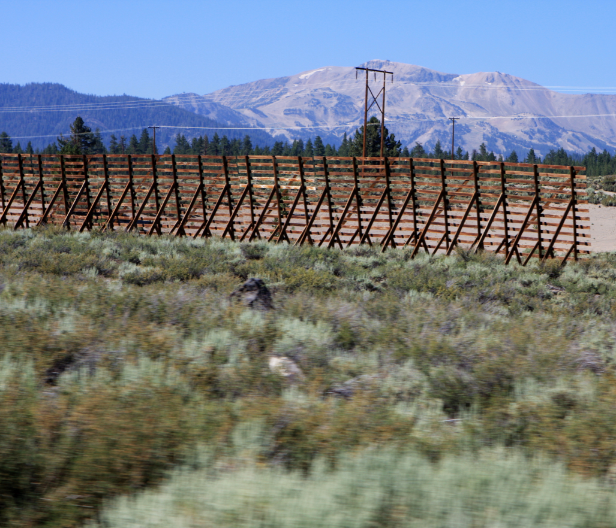
Fence types
Truss-type
Post-supported
Notes:
Fences may be supported by steel or wood posts set in the ground ("post-supported”), or by a surface-mounted framework, anchored or counterweighted to resist overturning in the wind ("truss-type"). There are advantages and disadvantages to each of these two types.
Left photo credit: Ronald D. Tabler
Right photo credit: Wisconsin DOT

Slide 44
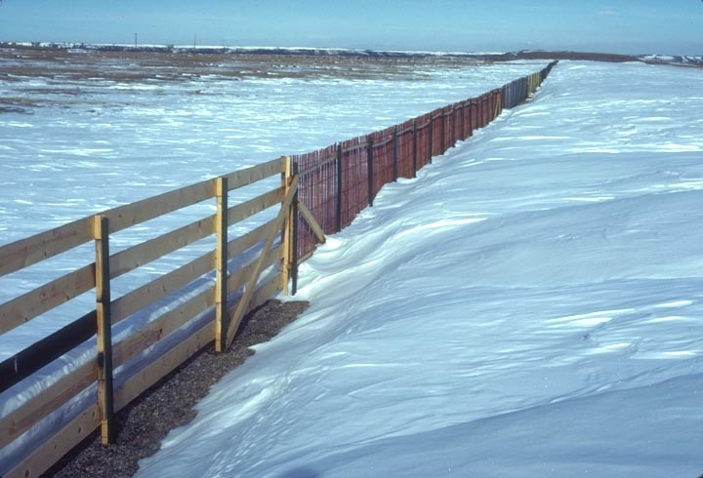
Horizontal rails less prone to burial
Notes:
Horizontal rails are less prone to burial than vertical. This is helped by a bottom gap that allows the pass through.
Slide from WYDOT, credit to Ronald D. Tabler

Slide 45
Test Question:
Are horizontal (sideways) or vertical (up and down) rails more effective?
Vertical
Horizontal
The same
Notes:
Note to presenters: you may choose to hide this slide.
Test Question:
Are horizontal (sideways) or vertical (up and down) rails more effective?
Vertical (no)
Horizontal (yes)
The same (no)

Slide 46
Test Question:
Are horizontal (sideways) or vertical (up and down) rails more effective?
Vertical
Horizontal
The same
Notes:
Note to presenters: you may choose to hide this slide.
Test Question:
Are horizontal (sideways) or vertical (up and down) rails more effective?
Vertical (no)
Horizontal (yes)
The same (no)

Slide 47
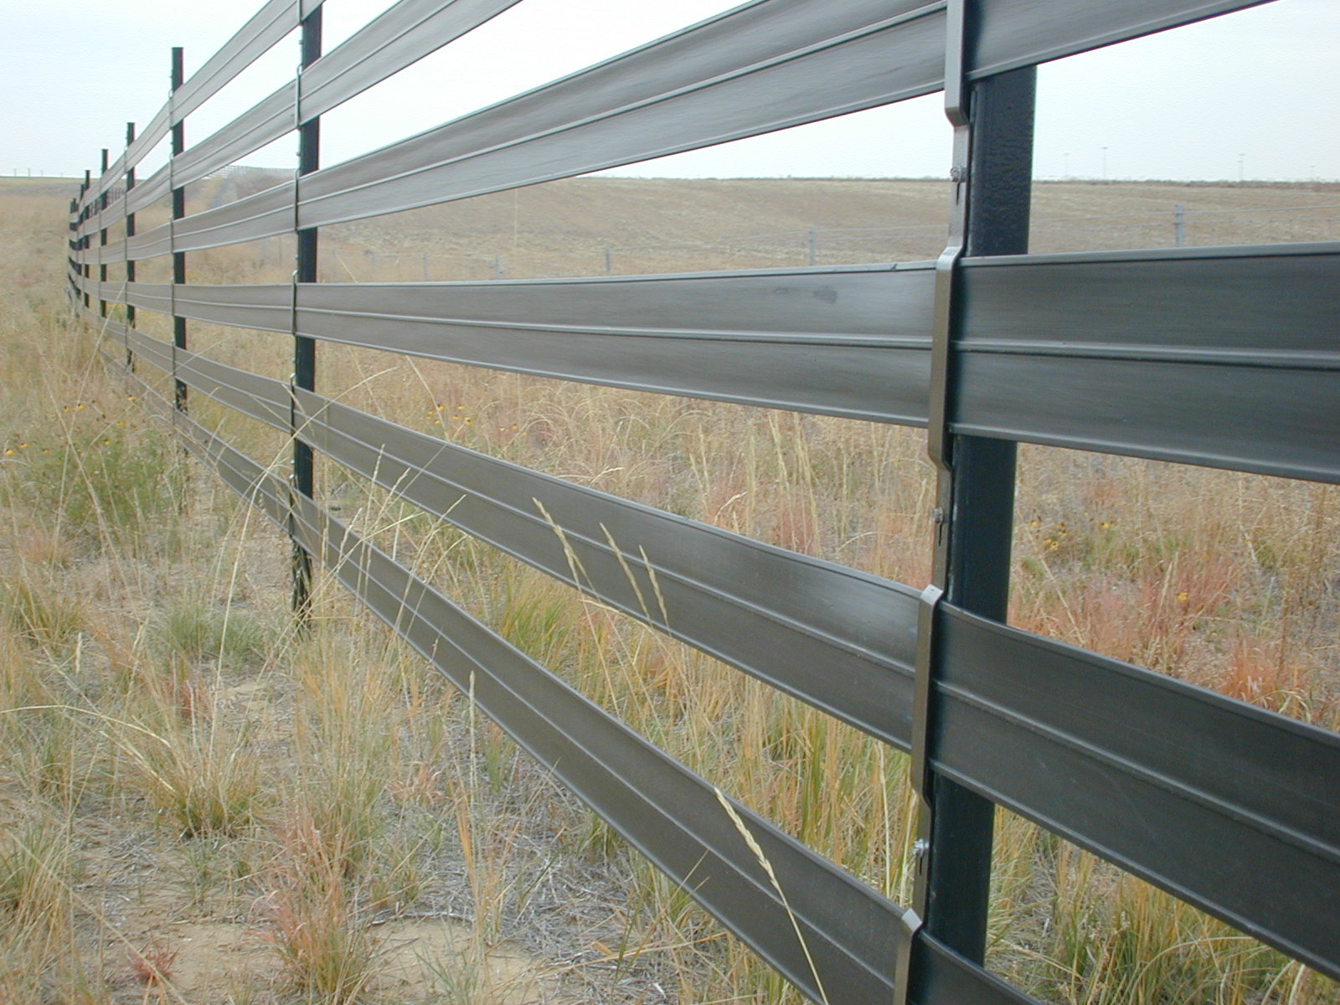
Advantages of post-supported fence
Easily installed and maintained.
Resistant to damage by snow settlement and creep.
Allows construction of fences of any desired porosity or height.
No roots plugging tile line.
Can’t spray and kill with herbicides.
Notes:
Advantages of Flexible Composite Rail Structure Snow Fence:
Easily installed and maintained
Resistant to damage by snow settlement and creep
Allows construction of fences of any desired porosity or height
No roots plugging tile line
Can’t spray and kill with herbicides
Photo credit to Ronald D. Tabler

Slide 48
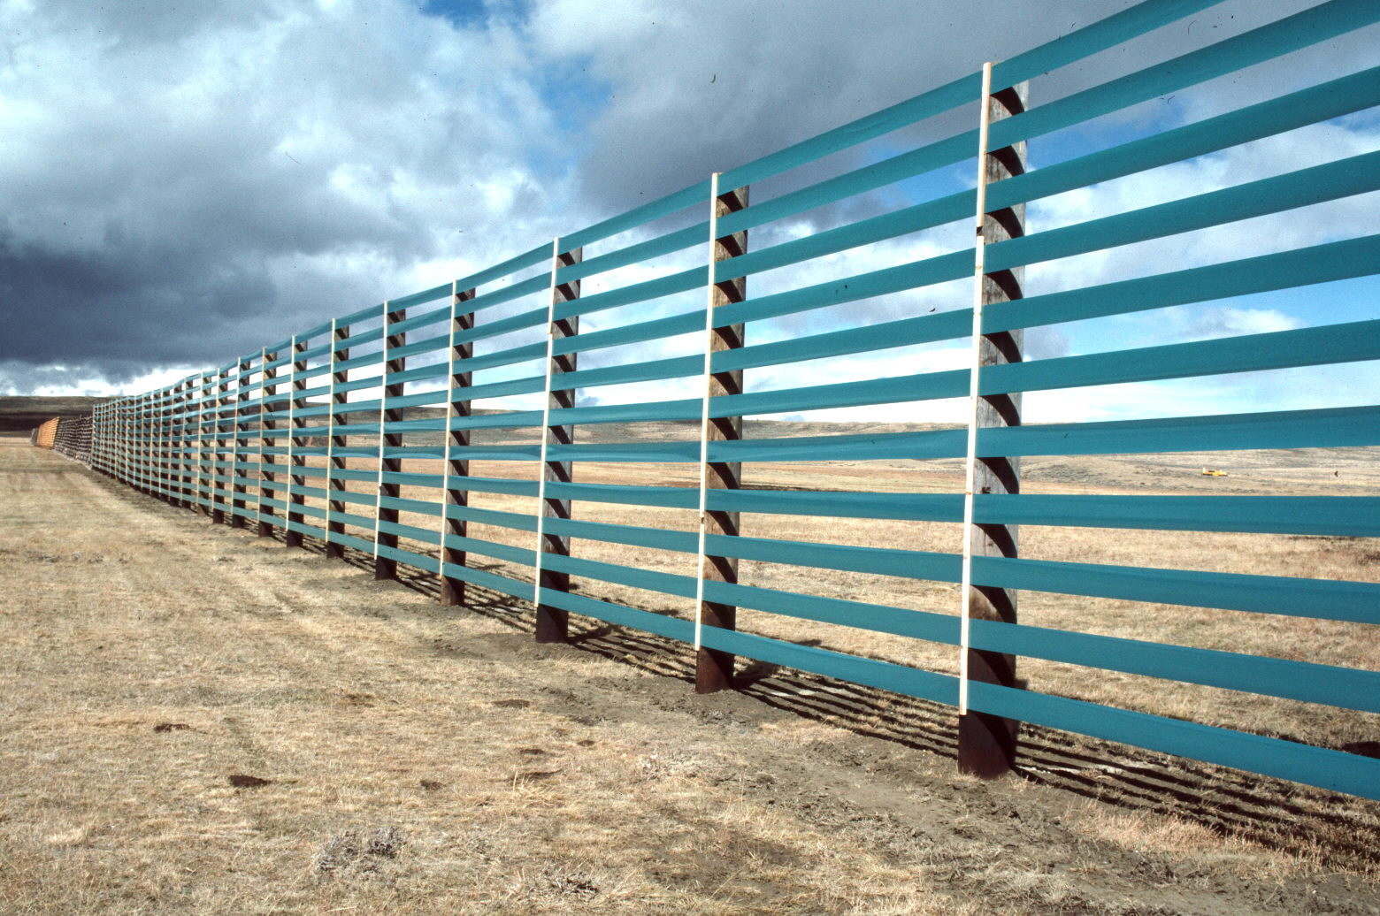
Disadvantages of post-supported fence
Usually more expensive than truss-type.
More time is required for field construction.
Notes:
Although initial costs are often higher than for a Wyoming fence construction, the maintenance costs over a 25 year period easily makes up the difference.
Photo credit: Ronald Tabler

Slide 49
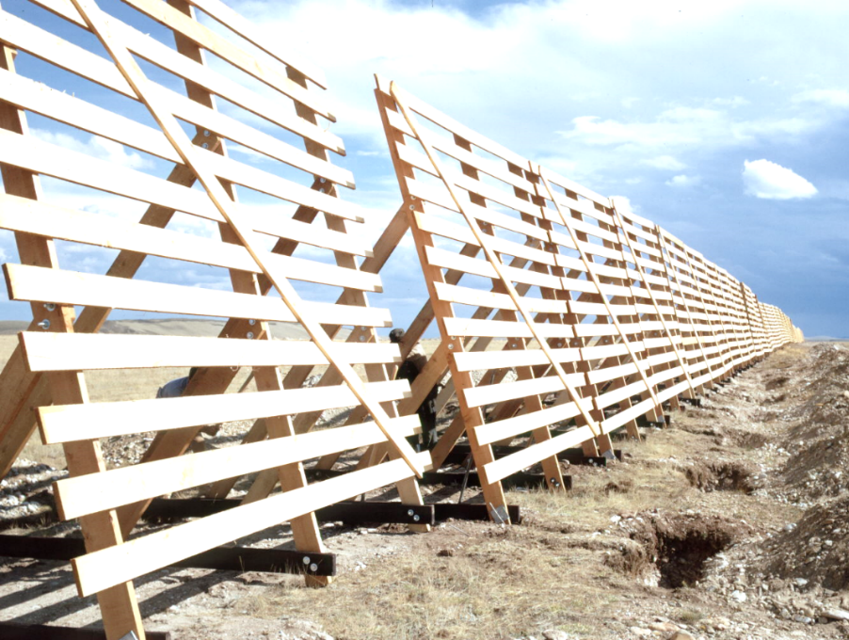
Advantages of truss-type fence
Least expensive to build in most locations.
Relatively easy to remove or relocate.
Can be prefabricated to reduce field construction time.
Notes:
Advantages of truss-type Wyoming snow fences include:
Least expensive to build in most locations.
Relatively easy to remove and relocate.
Can be prefabricated to reduce field construction time.
Photo credit: Ronald Rabler

Slide 50
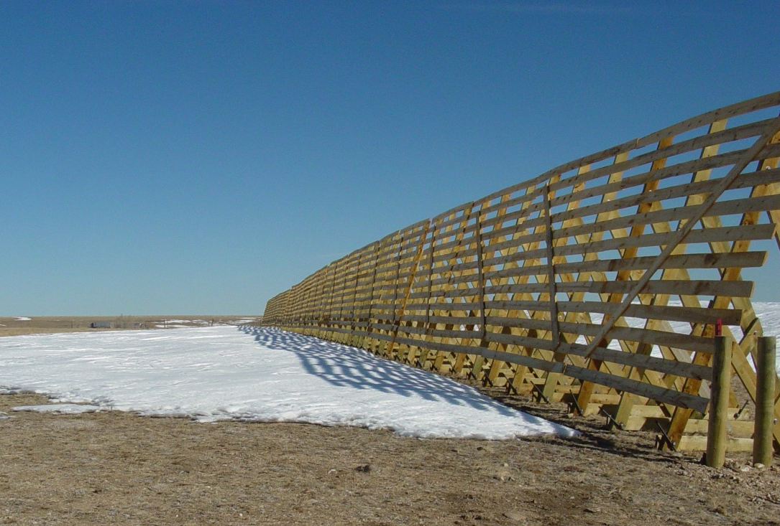
Disadvantages of truss-type fence
Susceptible to damage by snow creep or glide on steep slopes.
Occupies significant land area.
High maintenance costs.
Notes:
Disadvantages of truss-type Wyoming snow fence
Susceptible to damage by snow creep or glide on steep slopes.
Occupies significant land area.
Maintenance costs
Photo credit: Ronald Tabler

Slide 51
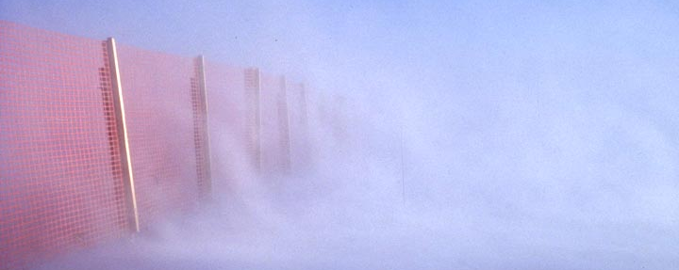
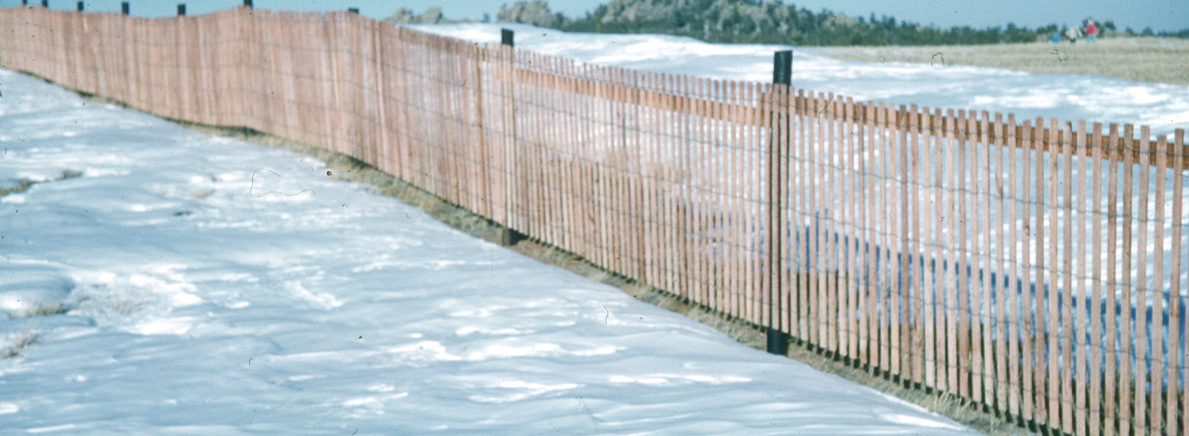
When to use “short” fencing
For smaller amounts of accumulating blowing snow.
For less costly option.
Notes:
Shorter fences can be used when there is less blowing snow. These fences can be temporary and are less expensive than taller fences. If there is too much blowing snow, they can become buried and no longer useful. That is a good indication that a taller fence or different solution is needed.
Photo credits: Ronald Tabler

Slide 52
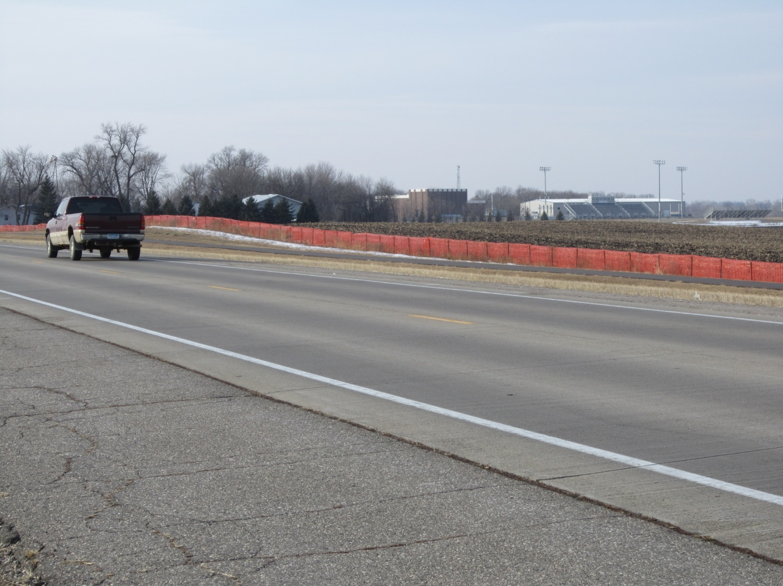
Example of a snow fence along highway to alleviate drifting.
Notes:
Photo credits: Dan Gullickson, MNDOT
Example of a snow fence along a highway. Notice the substantial fetch created by the placement of the farmer’s field directly behind the snow fence.

Slide 53
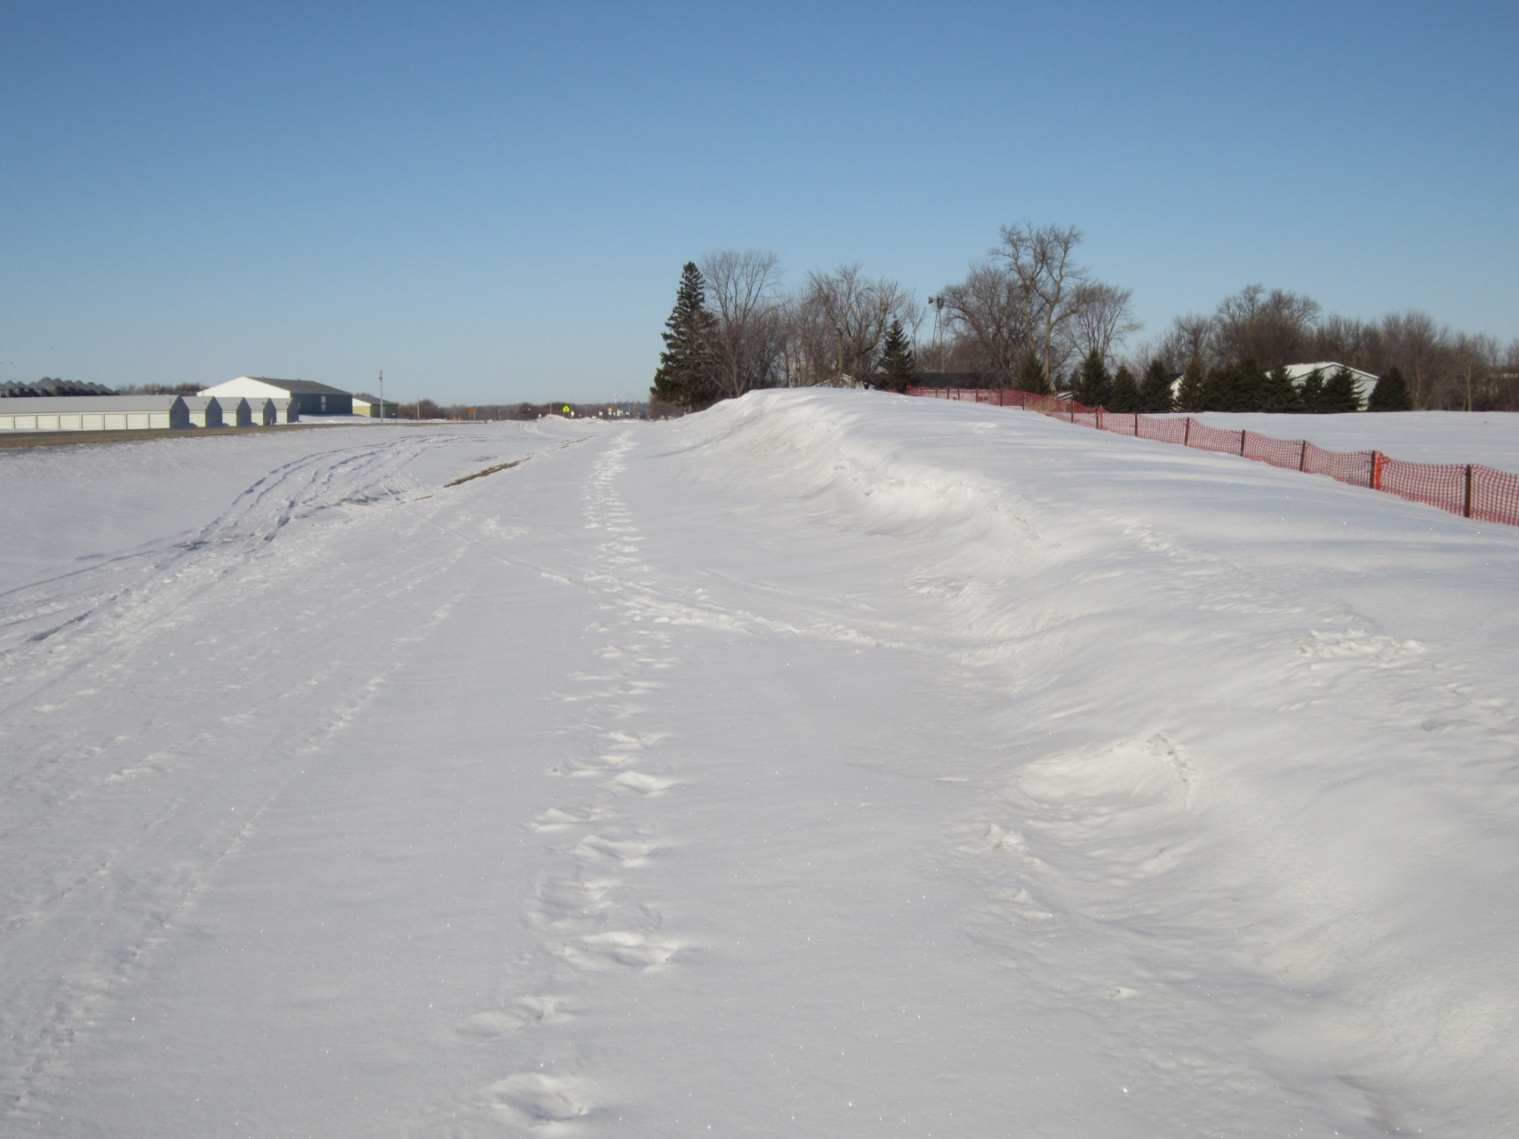
Drift captured by snow fence
Notes:
Photo credits: Dan Gullickson, MNDOT
This slide shows drift captured by snow fence.

Slide 54
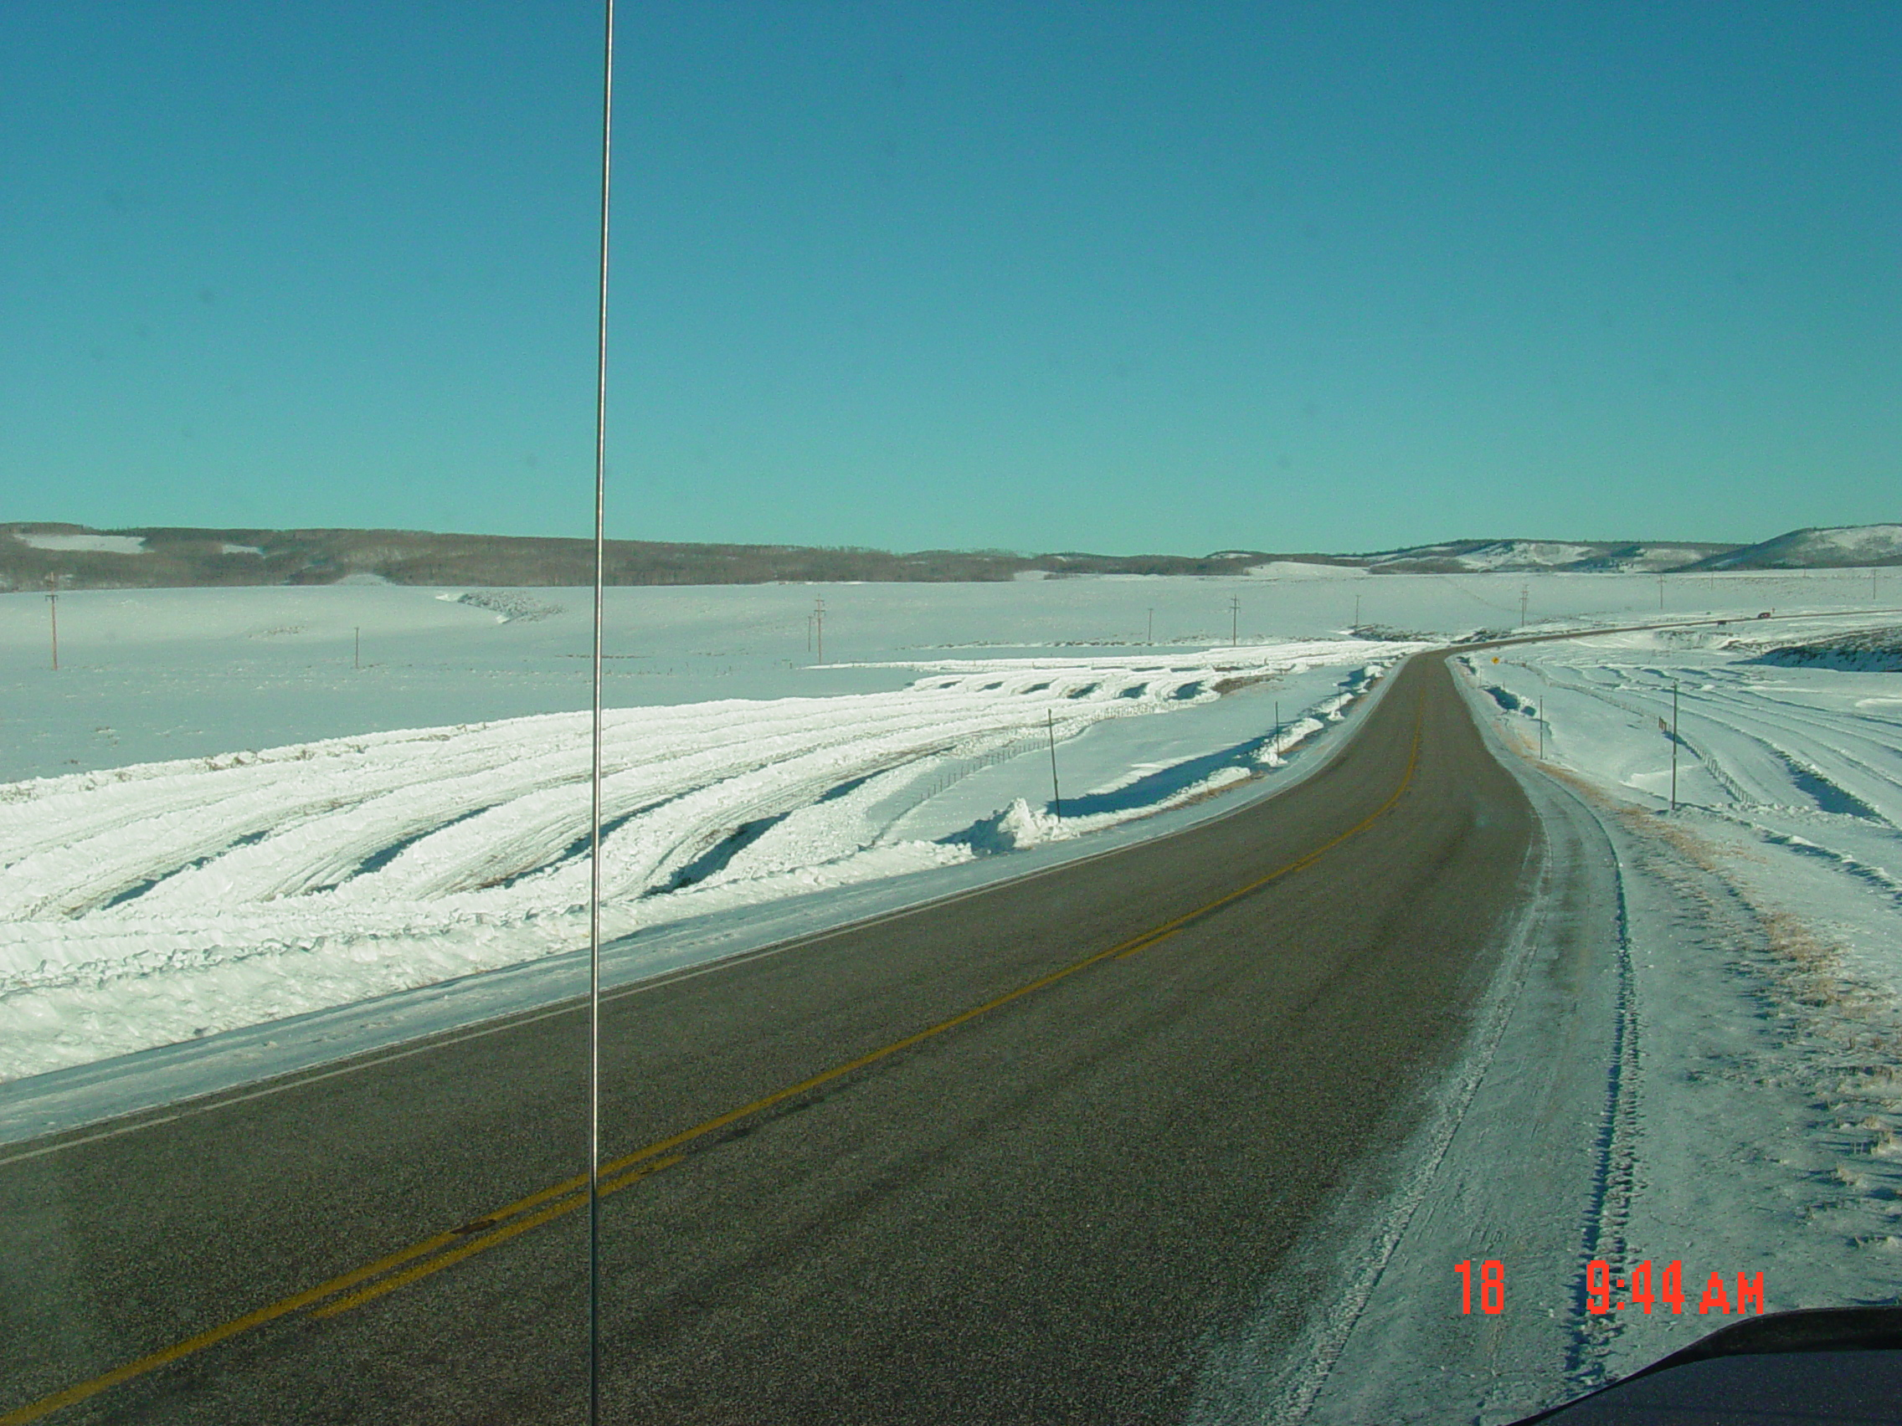
Fences from snow ridges
Inexpensive
Must have enough snow on the ground
Will only last 1 day if wind comes up
Notes:
Snow can be plowed into rows to create temporary drift control. It is an inexpensive method that can help trap snow. Enough snow must have fallen to create piles, so it cannot be done right away. Also these snow cuts will on last one day if the wind comes up. Drawback to their use is a long to operate a dozer and a short life span when the wind blows.
Photo credit: WY DOT

Slide 55
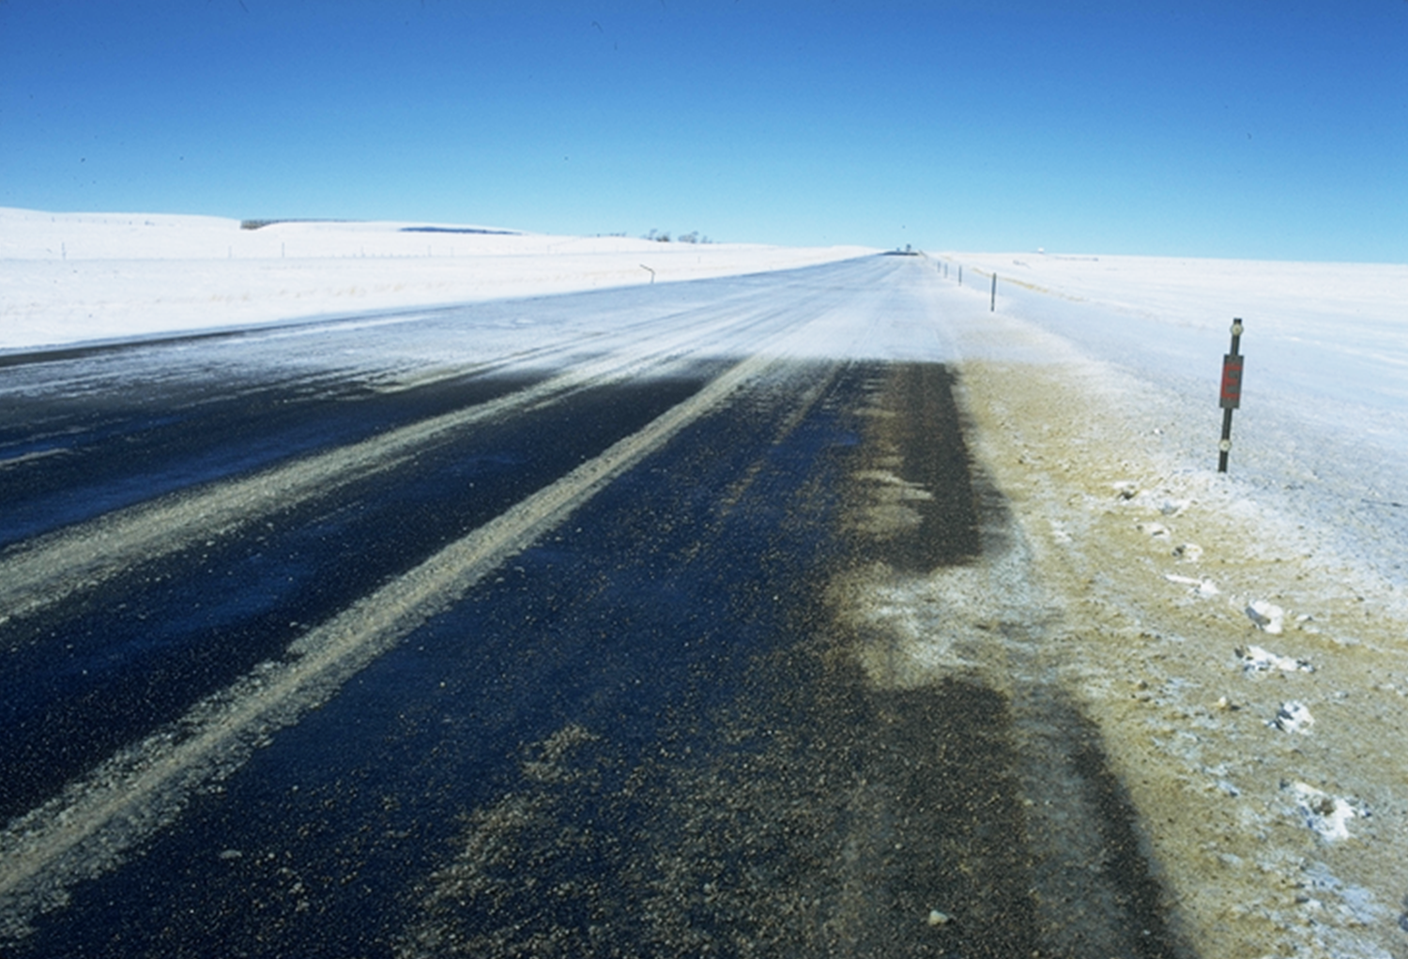
Do they work?
No snow fence
Snow fence
Notes:
Snow fences can work well when properly designed. Next we will look at a few examples.
The picture on this slide shows the difference an effective snow fence can make. On the near side there is a snow fence, and on the far side there is not.
Slide credit: MNDOT http://dot.state.nm.us/content/dam/nmdot/Research/NM09SAF_01_SnowBarrier_MultimediaPresentation.pdf
Photo credit: WYDOT, Ronald Tabler

Slide 56
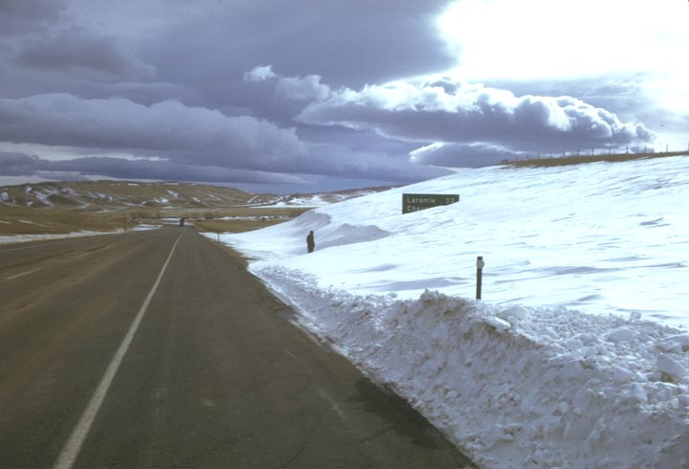
Before
Notes:
Here’s what the roadside looks like without snow fences. Notice the depth of snow at the sign by the arrow.

Slide 57
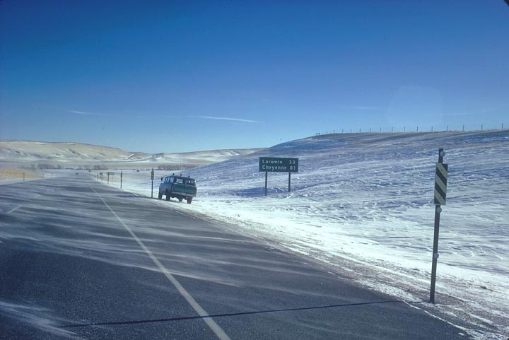
After
Notes:
Here’s the same roadside with snow fences. Notice the snow depth at the sign here.

Slide 58
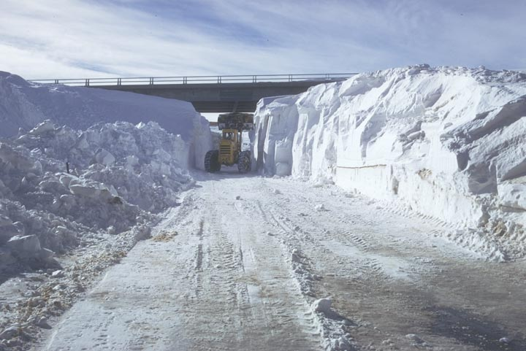
Before
Notes:
This slide shows snow depth without snow fences.

Slide 59
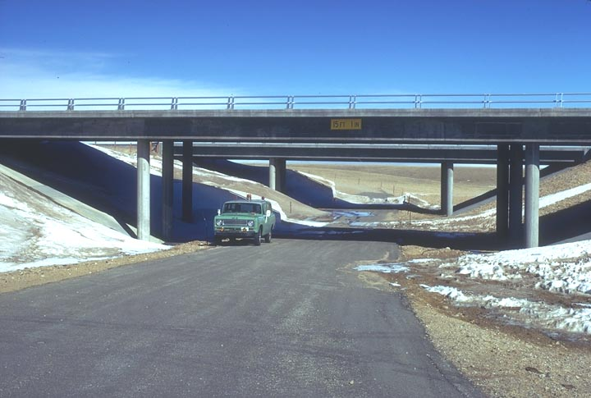
After
Notes:
And this is after the installation.

Slide 60
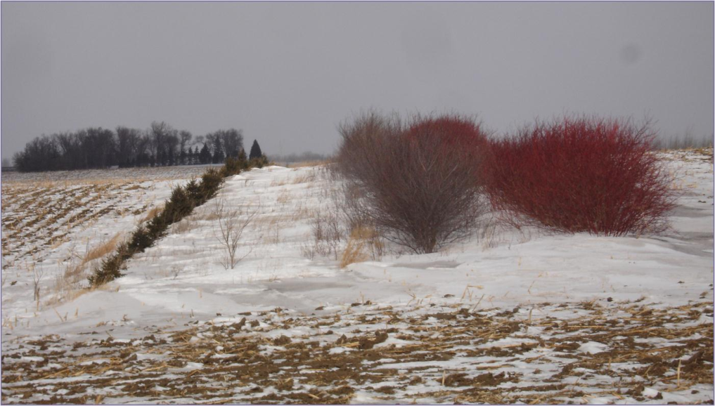
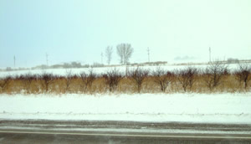
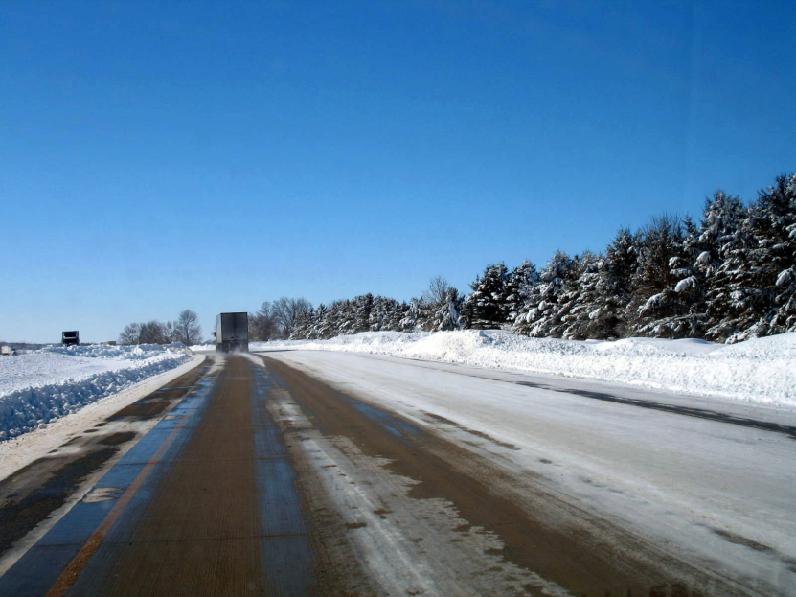
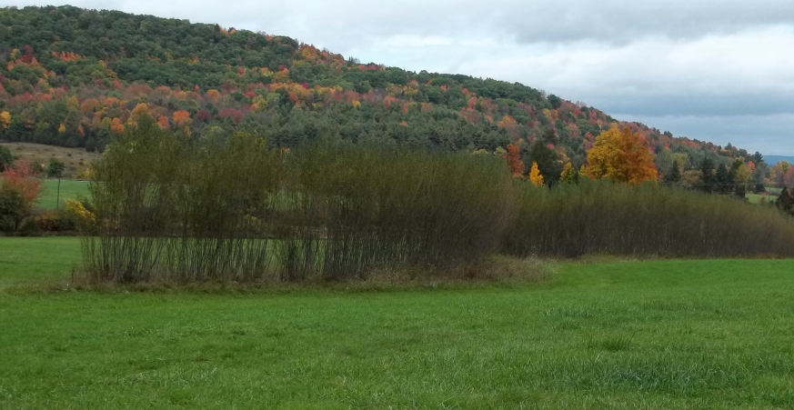
Living snow fences
Using trees, shrubs, grasses, or other plants to trap snow.
Notes:
Living snow fences use trees, shrubs, grasses, or other plants to trap snow.
Top left photo credit: MNDOT
Top right photo credit: http://www.nacaa.com/journal/index.php?jid=184
Bottom left photo credit: NYDOT
Bottom right photo credit: WIDOT

Slide 61
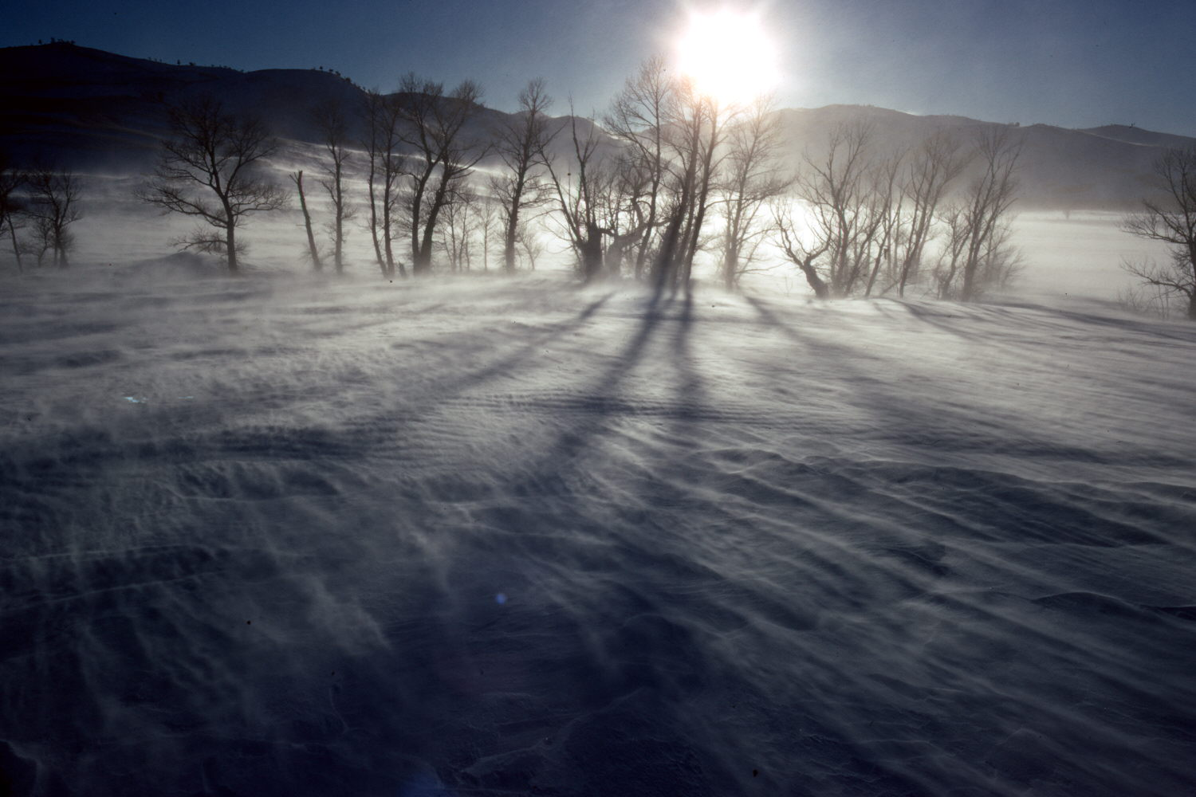
How living fences differ from structural fences
Height increases with growth.
Open spaces (porosity) decreases with growth.
Open spaces (porosity) not uniform.
Effectiveness starts low, but increases with time.
May be damaged by fire, weather, insects or disease.
Notes:
Living snow fences differ from structural fences in these ways:
Height increases with growth.
Porosity decreases with growth.
Porosity not uniform.
Effectiveness initially minimal, but increases with time.
Susceptible to damage by insects, disease, and biotic factors.
Photo credit: Ronald Tabler

Slide 62
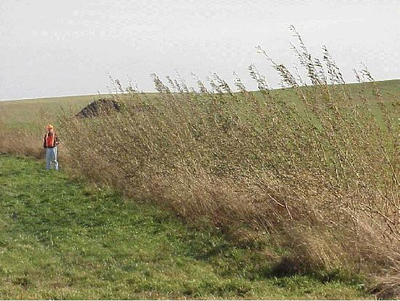
Advantages of living snow fences
Habitat is provided for wildlife.
Little maintenance is required after plants are established.
Soil erosion control.
Living snow fences are more pleasing in appearance than structural fences.
Living snow fences can be a part of the roadside beautification plan.
Notes:
Advantages of living snow fences:
Habitat is provided for wildlife.
Little maintenance is required after plants are established.
Soil erosion control
Living snow fences are more pleasing in appearance than structural fences.
Living snow fences can be a part of the roadside beautification plan.
Photo credit: New York Department of Transportation

Slide 63
Test Question:
Living snow fences serve which of the following purposes:
Habitat is provided for wildlife
Soil erosion control
Roadside beautification plan
Snow drift control
All of the above
Notes:
Note to presenters: you may choose to hide this slide.
Test Question:
Living snow fences serve which of the following purposes:
Habitat is provided for wildlife.
Soil erosion control.
Roadside beautification plan.
Snow drift control.
All of the above.

Slide 64
Test Question:
Living snow fences serve which of the following purposes:
Habitat is provided for wildlife
Soil erosion control
Roadside beautification plan
Snow drift control
All of the above
Notes:
Note to presenters: you may choose to hide this slide.
Test Question:
Living snow fences serve which of the following purposes:
Habitat is provided for wildlife.
Soil erosion control.
Roadside beautification plan.
Snow drift control.
All of the above.

Slide 65
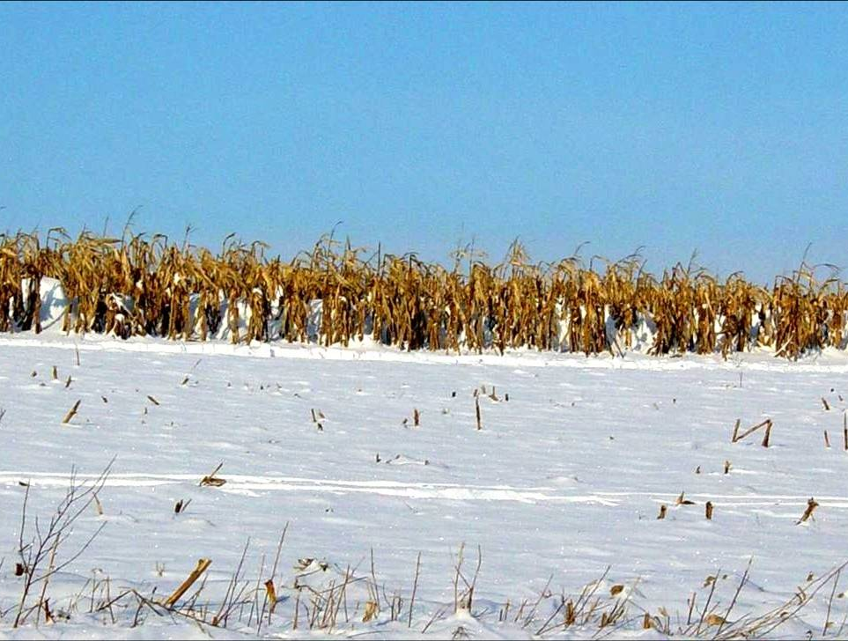
Advantages of standing corn rows
Cheapest.
Can be a starting point to work with farmer in the future.
No maintenance cost.
Don’t have to build and install a structure.
Notes:
Advantages of standing corn rows:
Inexpensive
Can be a starting point to work with farmer in the future
No maintenance cost
Don’t have to build or install a structure
U of Minnesota has created a cost benefit tool kit for LSF/ corn rows. That was you can determine if paying the landowner year after year is worth the savings on the roadway. This will provide proof to those that are concerned about the budget. More information is given about this cost benefit tool on slides 85 and 86.
Photo credit: NYDOT

Slide 66
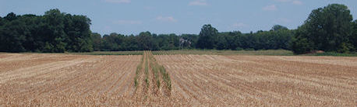
Disadvantages of standing corn rows
Temporary.
Crops can change year to year.
Hassle for farmers.
Corn left on the field
Spring tillage required
Notes:
Disadvantages of standing corn rows
Temporary
Crops can change year to year
Hassle for farmers
Corn left on the field
Spring tillage required

Slide 67
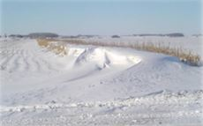
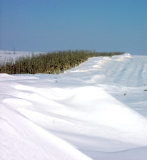
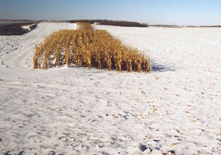
Does it work?
Notes:
Doe they work? Yes. Standing corn rows can catch blowing snow before it reaches the road. Above you can see examples of snow caught in standing corn rows.
Photo credit: http://www.newsline.dot.state.mn.us/archive/05/feb/2.html

Slide 68
Test Question:
True or false: standing corn rows are a cost-effective method of drift control.
True
False
Notes:
Note to presenters: you may choose to hide this slide.
Test Question:
True or false: standing corn rows are a cost-effective method of drift control.
True
False

Slide 69
Test Question:
True or false: standing corn rows are a cost-effective method of drift control.
True
False
Notes:
Note to presenters: you may choose to hide this slide.
Test Question:
True or false: standing corn rows are a cost-effective method of drift control.
True
False

Slide 70
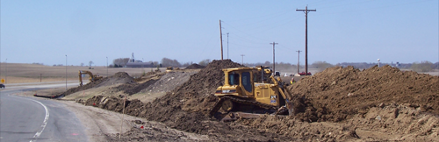
Grading concepts
Raise the grade – elevate road above surrounding snow cover
Flatten the back slope, widen ditches:
Provide space for plowed snow
Provide space for snow sloughing
Notes:
Grading Basic Concepts
Elevate above surrounding snow cover
Eliminate safety barrier
Widen ditches:
Provide space for plowed snow
Provide space for snow sloughing
Picture credit: MNDOT

Slide 71
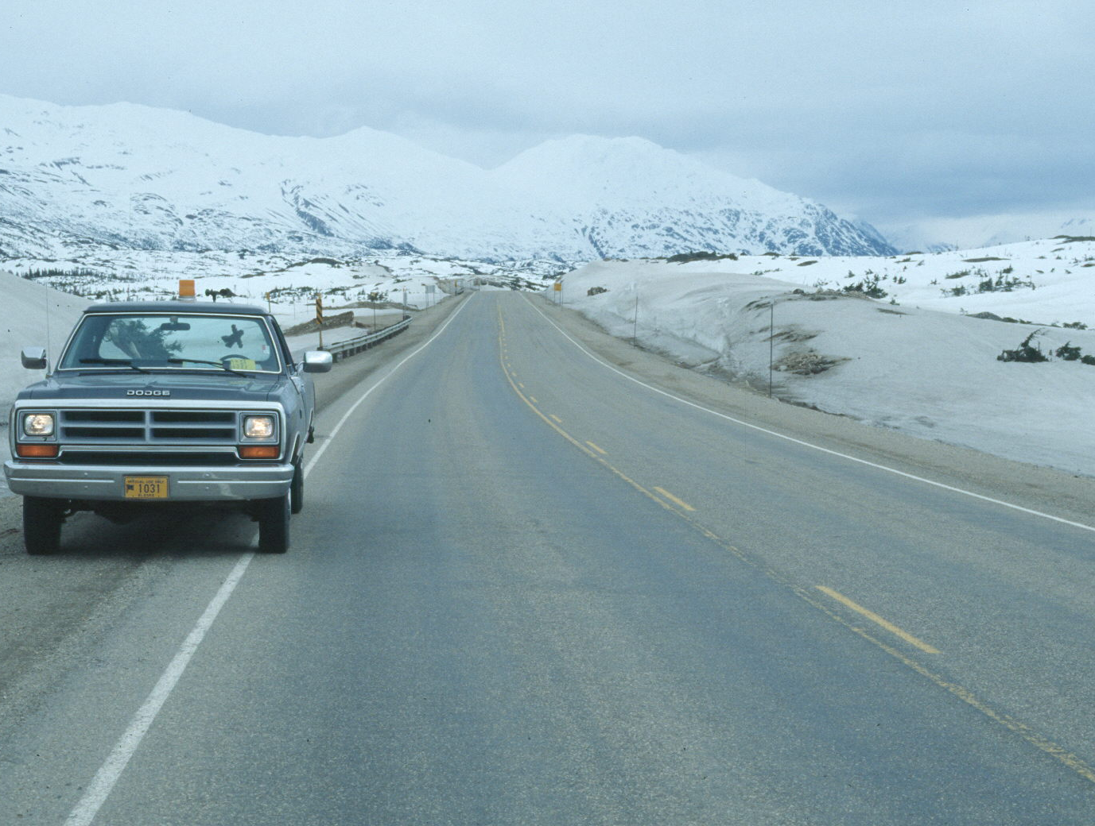
Wider ditch section =
40% reduction in snow removal costs
Notes:
Properly designed, wider sections allow for snow trapping and extra snow holding capacity. Wider section can reduce snow removal costs up to by 40%.
Slide from WYDOT, credit to Ronald D. Tabler

Slide 72
Advantages of grading changes
More efficient use of truck-mounted displacement plows
Provides space to store plowed snow
Increases required time between plow cycles
Eliminates snow sliding into traffic lanes
Reduces snowdrift encroachment
Notes:
Advantages of grading changes include:
More efficient use of truck-mounted displacement plows
Provides space to store plowed snow
Increases required time between plow cycles
Eliminates snow sliding into traffic lanes
Reduces snowdrift encroachment

Slide 73
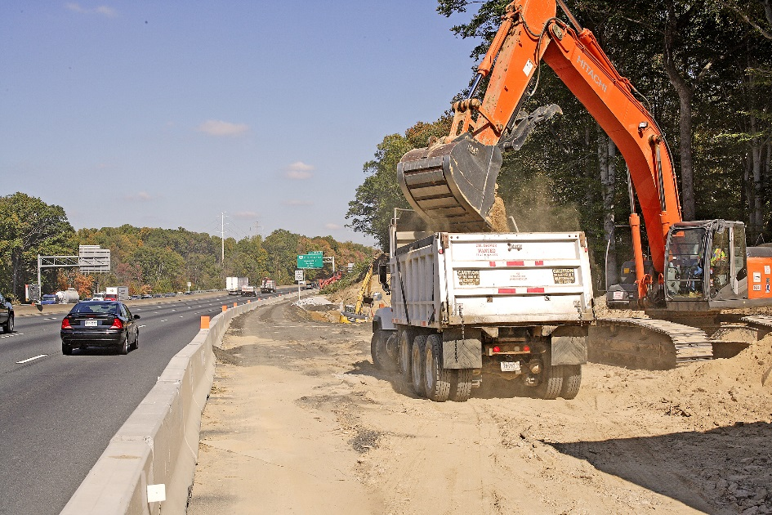
Disadvantages of grading changes
Costly, easiest to do when already have equipment on site.
May need more rights of way space.
May have to close roads to complete.
Notes:
Disadvantages of grading changes include
Costly, easiest to do when already have equipment on site
May need more right of way space
May have to close roads to complete
Photo credit: http://fleetowner.com/blog/greener-road-construction

Slide 74
Test Question:
True or false: grading can be effective in providing drift control; however, it is the most costly of the solutions.
True
False
Notes:
Note to presenters: you may choose to hide this slide.
Test Question:
True or False:
Grading can be effective in providing drift control, however it is a costly solution.
True
False

Slide 75
Test Question:
True or false: grading can be effective in providing drift control; however, it is the most costly of the solutions.
True
False
Notes:
Note to presenters: you may choose to hide this slide.
Test Question:
True or False:
Grading can be effective in providing drift control, however it is a costly solution.
True
False

Slide 76

Mowing roadsides
Increases snow storage capacity
Helps keep snow from accumulating on roadways
Notes:
Mowing rights-of-way increases the snow storage capacity of a ditch.
Helps keep snow from accumulating on roadways. Tall grasses and weeds catch the snow and cause it to deposit on the road.
Picture credit: http://www.fhwa.dot.gov/real_estate/publications/alternative_uses_of_highway_right-of-way/rep03.cfm

Slide 77
Test Question:
True or false: mowing roadsides will help with blowing snow.
True
False
Notes:
Note to presenters: you may choose to hide this slide.
True or False:
Test question: True or false, mowing road sides will help with blowing snow.
True (yes)
False (no)

Slide 78
Test Question:
True or false: mowing roadsides will help with blowing snow.
True
False
Notes:
Note to presenters: you may choose to hide this slide.
True or False:
Test question: True or false, mowing road sides will help with blowing snow.
True (yes)
False (no)

Slide 79



Your best option may to be to combine more than one practice!
WIND
Road
shoulder
WIND
Road
shoulder
Trees
Widen ditch
Shrubs
150 feet
150 feet
Notes:
Your best option may to be to combine more than one practice! Talk with your engineers about what your best option is based on the area and budget for your project.
Graphics credit: Ronald Tabler

Slide 80

Factors affecting snow fence design
Height
Porosity
Bottom gap
Length
Placement
Notes:
There are many factors that affect the capacity of a snow fence. They are the height, porosity (amount of area that lets air through), bottom gap, placement, and length of the fence. These rules generally hold true for both structural and living snow fences. We will discuss each of these factors briefly.

Slide 81

Poorly designed snow fences can cause problems
For example: if the snow fence is too close to the road, the snow will catch and drift onto the road.
Use the resources below to help select correct drift control type and placement.
Notes:
Poorly designed snow fences can cause problems
For example: if the snow fence is too close to the road, the snow will catch and drift onto the road.
Use resources below to help select correct drift control type and placement.
Picture credit: WIDOT
Test question: Does it matter how close to the road you place your snow fence?
Yes (yes)
No (no)

Slide 82
Test Question:
Does it matter how close to the road you place a snow fence?
Yes
No
Notes:
Note to presenters: you may choose to hide this slide.
Test question:
Does it matter how close to the road you place a snow fence?
Yes
No

Slide 83
Test Question:
Does it matter how close to the road you place a snow fence?
Yes
No
Notes:
Note to presenters: you may choose to hide this slide.
Test question:
Does it matter how close to the road you place a snow fence?
Yes (yes)
No (no)

Slide 84

Help is available
snowcontroltools.umn.edu
Notes:
There are many different types of fencing available. Knowing the height, porosity, length, and other factors can help you determine which fence is right for you.
The University of Minnesota has a design tool that can help to determine the properties of a fence or road design specific to your site. The tool is located at snowcontroltools.umn.edu
Photo credit: snowcontroltools.umn.edu

Slide 85

How to maximize your investment
snowcontroltools.umn.edu
Notes:
The University of Minnesota also has a cost benefit tool on their website. This online tool allows transportation agencies to estimate the return on investment of implementing blowing snow control practices such as living snow fences or standing corn rows on private lands.
Photo credit: snowcontroltools.umn.edu

Slide 86

Enter road and maintenance details and find out the cost and benefits of each drift control option.
Cost benefit tool
COST
Benefit
Notes:
The tool allows you to put details for your roads and maintenance procedures, then calculates the cost and return of each of the different drifting control options we have talked about in this module.
Photo credit: snowcontroltools.umn.edu

Slide 87
Test Question:
True or false: cost is never a consideration when determining the proper method for drift control.
True
False
Notes:
Note to presenters: you may choose to hide this slide.
Test question:
True or false: cost is never a consideration when determining the proper method for drift control.
True
False

Slide 88
Test Question:
True or false: cost is never a consideration when determining the proper method for drift control.
True
False
Notes:
Note to presenters: you may choose to hide this slide.
Test question:
True or false: cost is never a consideration when determining the proper method for drift control.
True
False

Slide 89

Importance of Record Keeping
Keep records of drift locations, frequency, treatments and effectiveness.
This helps you know where danger areas occur, and shows where efficiency can be improved.
Helps with planning for future incidents, and helps protect you from claims.
Notes:
Record keeping is important as a means of material accountability, budgeting/cost tracking, performance tracking, support in the event of legal actions, media inquiries, and planning.

Slide 90
Record Keeping
Keeping good records helps
Demonstrate how goals are met.
Demonstrates that you are following policy.
Identify ways to improve and change your approach.
Notes:
Keeping good records is important. It helps to:
demonstrate how goals are met.
demonstrates that you are following policy.
identifies ways to improve and change your approach.

Slide 91

You have the tools!
Know your options.
Examine your area.
Choose what works best for you.

Slide 92
Additional resources
AASHTO, Clear Roads Computer Based training:
Blowing Snow Mitigation: Unit 1 The Problem of Blowing Snow, Unit 2 How Snow Fences Work, Unit 3 Identifying and Analyzing Problem Areas, Unit 4 Structural Snow Fence Design, Unit 5 Living Snow Fences, and Unit 6 Road Design to Mitigate Blowing Snow
Gullickson, Dan; Moline, Dennis; Wyatt, Gary. Informal Snow Control by Design Training. September 23, 2015.
Perma-Rail International Inc. http://snowfence.com/
Tabler, Ronald D. Snow Fence Guide. Strategic Highway Research Program. https://www.extension.iastate.edu/forestry/publications/PDF_files/SHRP-H-320.pdf
Tabler, Ronald D. Controlling Blowing and Drifting Snow with Snow Fences and Road Design. 2003. http://sicop.transportation.org/documents/Tabler.pdf
Wyoming Department of Transportation. Blowing and Drifting Snow Mitigation Presentations. Tabler & Associates.
University of Minnesota Snow Control Tools snowcontroltools.umn.edu

Slide 93
Acknowledgements
Training contents were developed by Fortin Consulting Inc., under the direction of the Clear Roads Advisory Team.
Connie Fortin – connie@fortinconsulting.com
Professional formatting and training aids were developed by the University of Minnesota, Center for Transportation Studies.
Jim Grothaus – Groth020@umn.edu
Ann Johnson – Johns421@umn.edu
Members of the Clear Roads Advisory Team include:
Mike Sproul, Dave Wieder, Cliff Spoonemore, Monty Mills, David Frame,
Mike Lashmet, Clay Adams, Justun Juelfs, and Tom Peters

Slide 94
This presentation was developed with funding from the Clear Roads research program, which brings together transportation professionals and researchers from around the country to drive innovation in the field of winter maintenance.
Find additional information and resources at
http://clearroads.org/

Slide 95



Thank You for Your Good Work!
Notes:
Thank you for your time today. Have a good winter!

