Slide 1
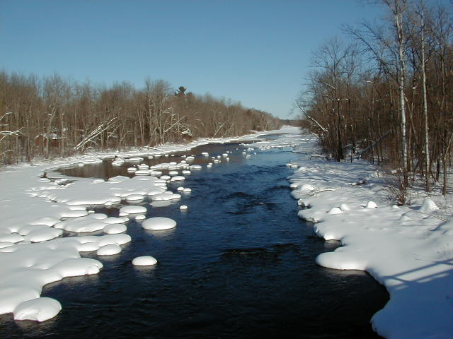

Module 14: Snow and Ice Control Agents and the Environment
2016 Created for Clear Roads by:
U of MN Center for Transportation Studies &
Fortin Consulting Inc.

Slide 2
Training for Winter Maintenance Supervisors and Operators
2016 Created for Clear Roads by:
U of MN Center for Transportation Studies &
Fortin Consulting Inc.

Slide 3
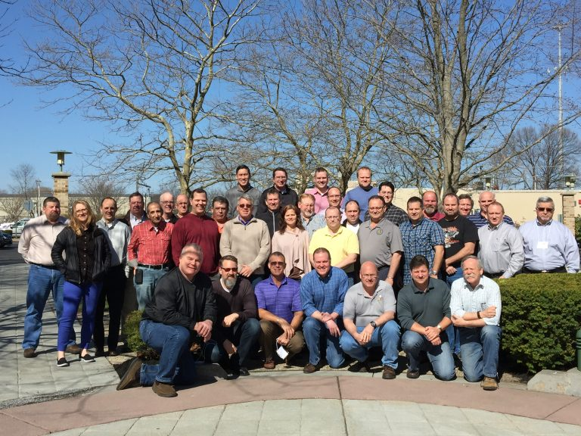
Winter maintenance professionals are a very powerful and important group
Notes:
Photo: clear roads website
Note to presenters: These first 7 slides can be used or hidden.
Or, replace with photos of your staff.

Slide 4
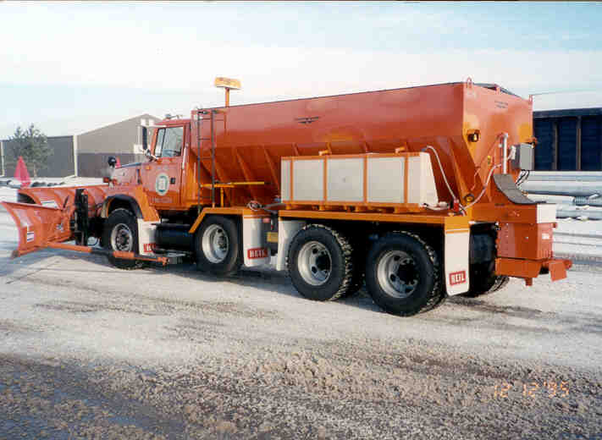
You do a great job of taking care of our roads!

Slide 5
This is one of a series of 22 winter maintenance training modules developed by the Clear Roads Program. All of the modules are available online at www.clearroads.org
Modules include information on the following:
Plowing
Truck operations
Spreading
Material use
Pre-wetting
Brine production
De-icing and anti-icing
Level of service
Ice formation
Freeze point depressants
Environmental issues
Drift control
Weather
Avalanche management
Bridge frost
Safety
Notes:
Note to presenters: The website www.clearroads.org can be accessed here if a live internet connection is available.
A list of all the modules is given here:
Plowing procedures
Truck operations
Spreading
Material use
Pre-wetting
Brine production
De-icing
Anti-icing
Safety
De-icing agent management policy
Level of service
Ice formation
Freeze point depressants
Environmental issues
Drift control
Weather
Bridge frost
Avalanche management

Slide 6
Module 14: Snow and Ice Control Agents and the Environment
2016 Created for Clear Roads by:
U of MN Center for Transportation Studies &
Fortin Consulting Inc.

Slide 7
FACILITATOR NOTES (do not show during class)
This is a priority 1 module to be developed for Clear Roads national training. It will address three audiences. Slides can be customized for the audience.
Slide Legend
Entry-level plow drivers
Experienced plow drivers
Supervisors
Notes:
Note to facilitator: do not show this slide during class

Slide 8
This module will contain these topics:
Chlorides and the environment
Organics and the environment
Abrasives and the environment
Notes:
This module covers the impacts of chloride, organic, and abrasive de-icers on the environment.

Slide 9
This training module will:
Identify potential environmental impacts resulting from winter maintenance activities.
Illustrate the need for continued pursuit of best practices.
Notes:
This slide is important to set the stage for all of the training modules. In this module you will learn how road chemicals and abrasives impact the eco-system. In the other training modules, we will cover best practices and industry innovation to help minimize these impacts and do the best possible job of winter maintenance.

Slide 10
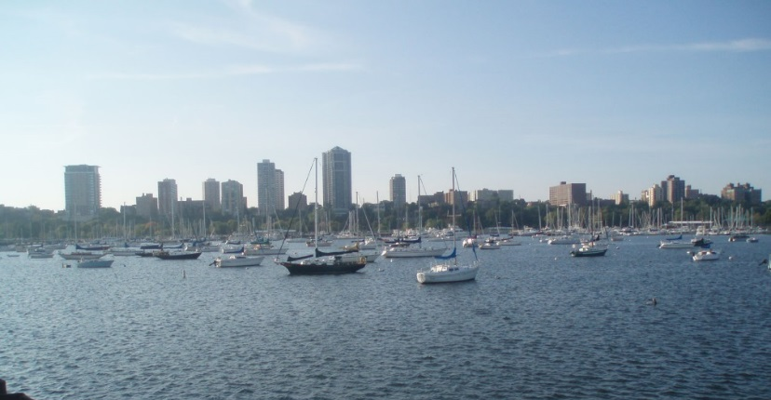
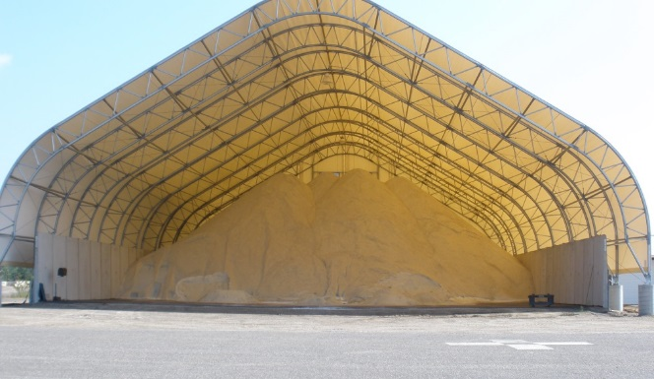
We have big challenges
Salt is the most common snow & ice control agent.
It is readily available
It is cost-effective compared to other chemicals
Salt moves from the road into the water.
The amount of salt in the water increases year after year.
because it does not biodegrade
We don’t have a good replacement for salt.
We don’t have a good way to remove it from the water.
Notes:
Salt works great to melt snow and ice, especially at warm temperatures. However once we apply it, we cannot recover it. It moves into our water and stays there. We do not know how to get it out of the drinking water without great expense. And, we do not know how to get it out of the surface water without damaging the food chain.
Everyone wants safe roads and clean water. We are using the best tools available for winter maintenance but the best tools available are leaving us with a problem we do not know how to fix.
Photo credit: Fortin Consulting Inc.

Slide 11
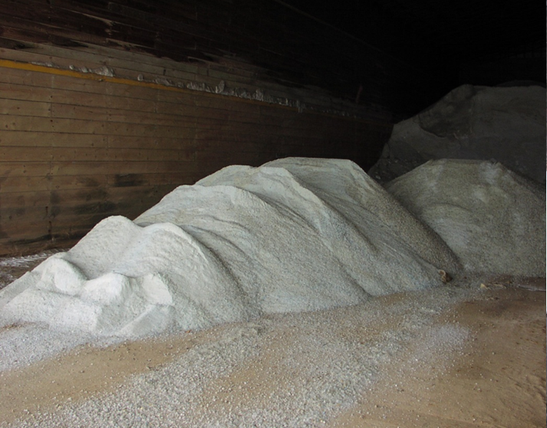
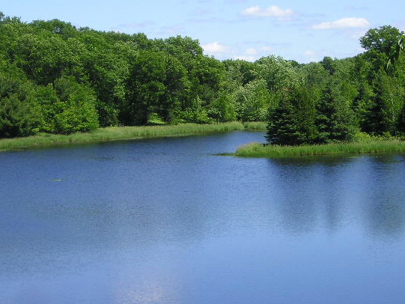
Salt and water
Notes:
Salt has negative impacts on:
Surface water
Ground water
Soil
Vegetation
Aquatic life
Wild life
Infrastructure
We will cover some of these impacts in this presentation.
We use salt because it works, it is relatively safe to handle for the workers, it is affordable and we know how to use it in a way that keeps traffic moving on our roads.
Photo credit: Fortin Consulting Inc.

Slide 12
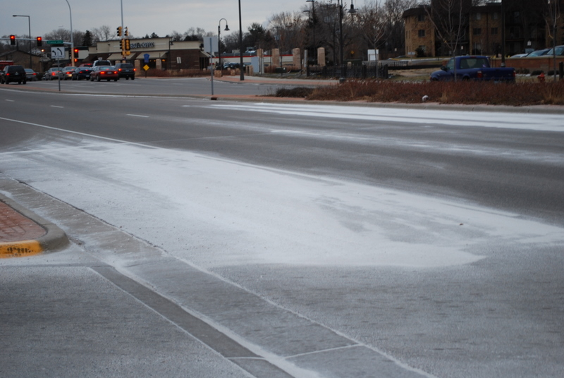
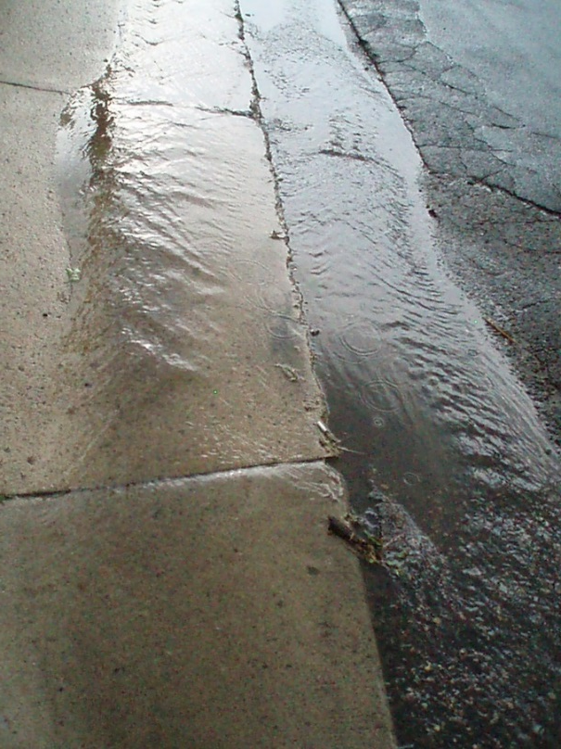
Salt is sodium chloride (NaCl)
We can see it when it is applied,
but we cannot see it once it is dissolved.
Notes:
Salt dissolves into a clear brine that cannot be distinguished from water by looking at it. Unlike sand, in the spring there is no salt pile forming in our holding ponds, ditches, along our guardrails or at the the lake inlet.
Photo credit: Fortin Consulting Inc.

Slide 13

We are more worried about the chloride
When salt dissolves, the Na and Cl separate and move in different directions.
Cl
Find the water Cl
Stay in the soil Na
Na
Notes:
When Sodium Chloride (NaCl) enters water it dissolves, breaking apart into positively charged sodium ions (Na⁺) and negatively charged chloride ions (Cl ⁻). We are more concerned about the chloride ion because it stays in the water and is considered a toxin by US EPA. Sodium is also found in our water though it is less of a problem for aquatic life. Sodium can be a human health problem as we are all aware that the medical profession advises us on a low sodium diet.
Image credit: Microsoft clipart

Slide 14
Test Question
What is another name for road salt?
Sodium Chloride
Magnesium Chloride
Potassium Acetate
Calcium chloride
Notes:
Note to presenters: you may choose to hide this slide.
Test question:
What is another name for road salt?
Sodium chloride (yes)
Magnesium chloride (no)
Potassium chloride (no)
Calcium chloride (no)

Slide 15
Test Question
What is another name for road salt?
Sodium Chloride
Magnesium Chloride
Potassium Acetate
Calcium chloride
Notes:
Note to presenters: you may choose to hide this slide.
Test question:
What is another name for road salt?
Sodium chloride (yes)
Magnesium chloride (no)
Potassium chloride (no)
Calcium chloride (no)

Slide 16
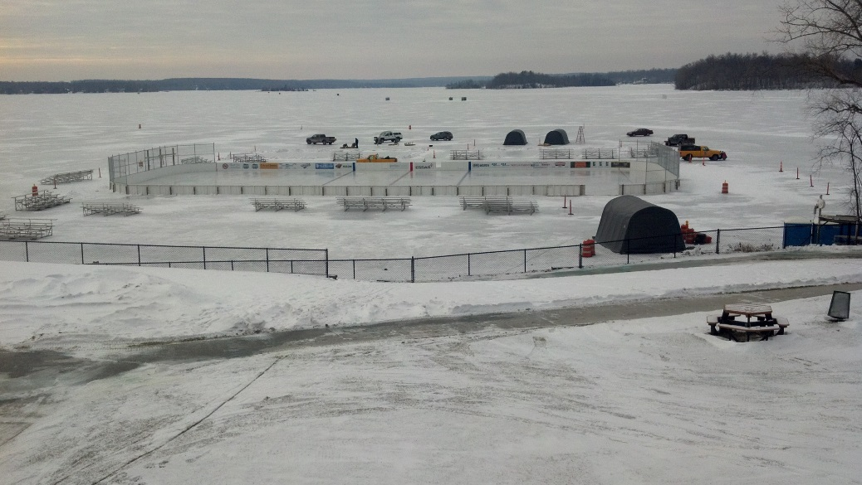
Chloride doesn’t go away
Once chloride is in the water, it stays in the water.
It does not biodegrade or go away. Each year we salt our roads, the concentration increases in our water.
Notes:
Chloride may move around in the water, it flows in and out of lakes, streams, wetland and groundwater. As all of various types of water features are connected they share the water and the salt moves with the water. The basic principle is that it is a conservative pollutant, it will not bio-degrade or be used up in some way. It is there to stay.
Photo credit: Fortin Consulting Inc.

Slide 17
Test Question
Once chloride gets in the water, does it bio-degrade or go away?
Yes
No
Notes:
Note to presenters: you may choose to hide this slide.
Test question:
Once chloride gets in the water does it bio-degrade or go away?
Yes (no)
No (yes)

Slide 18
Test Question
Once chloride gets in the water, does it bio-degrade or go away?
Yes
No
Notes:
Note to presenters: you may choose to hide this slide.
Test question:
Once chloride gets in the water does it bio-degrade or go away?
Yes (no)
No (yes)

Slide 19
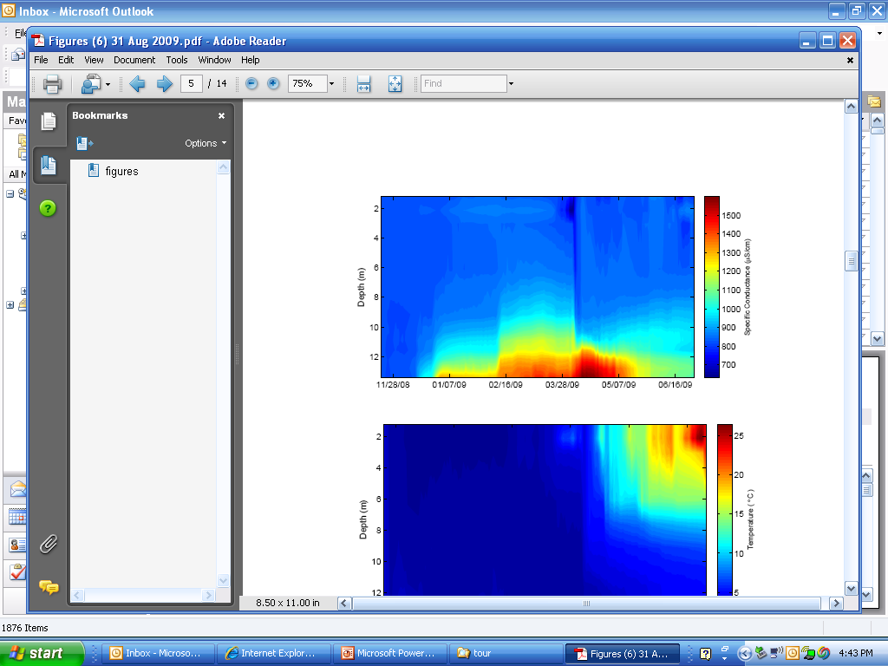
Saltwater is heavier than freshwater and may form a saltwater layer at the lake bottom.
Salt’s impact on lakes
This saltwater layer can disrupt the normal mixing cycle of the lake.
Notes:
This figure shows the concentration of chloride in the bottom of a Tanners Lake in Minnesota. The chart shows conductivity, not chloride as conductivity is often used as a less expensive and quicker test. In this area a conductivity of 1000 is roughly equal to 230 mg/l of chloride. Each state and even smaller areas would have a different conductivity-to-chloride ratio. (Note: This information is not important to go over in detail, but is provided if your audience asks why conductivity is showing up on the slide not chloride.)
When you monitor for chlorides, monitor at the bottom of the lake not the top.
Studies have shown that the mixing of lakes is influenced by the saltwater layer. That lakes can become chemically stratified. This stratification can cause the lake to become meromictic. (A meromictic lake has layers of water that do not intermix. In ordinary, "holomictic" lakes, at least once each year, there is a physical mixing of the surface and the deep waters.) Deep lakes that have smaller surface area and high input of salt are more likely to experience this. Large shallow lakes have an advantage of more wind mixing to prevent or reduce the chemical stratification.
Those that fish are often familiar with the mixing or “turnover” of lakes they may notice in the spring or fall of the year that the temperature in the lake to become uniform. It is a normal lake process.
For additional information about chloride effects in lakes read “Road Salt Effects on the Water Quality of Lakes in the Twin Cities Metropolitan Area” By Eric Novotny, Dan Murphy and Heinz Stefan. Report 505 prepared by St. Anthony falls Laboratory for the Local Road Research Board (LRRB) and Minnesota Department of Transportation. December 2007.
Graphic credit: Eric Novotny – St. Anthony Falls Laboratory

Slide 20
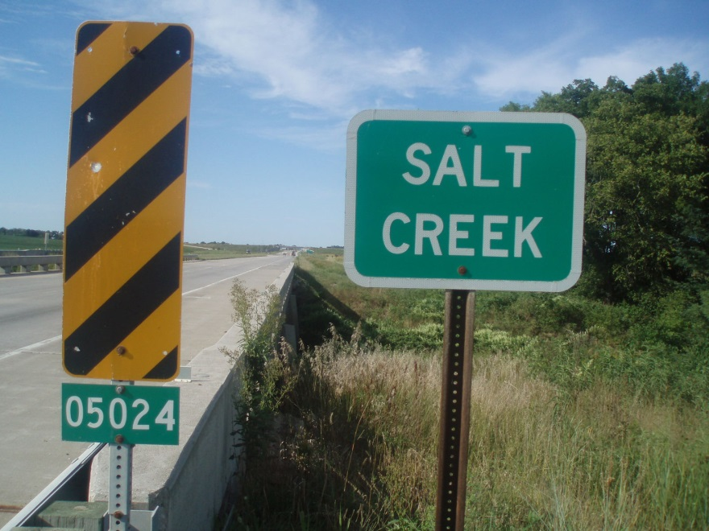
Water and chloride move around
For example:
Saltwater from the road can run into the ditch.
Ditch flows to lake.
Lake connects to ground water and a stream.
Groundwater supplies drinking water ….
Proper storage and wise use of materials will put less in the water.
Notes:
Just because a road is next to a lake doesn’t mean the salt will stay in that lake. It likely will enter the lake but lakes are often connected to groundwater and streams and the salt can move anywhere the water moves. This movement of salt is different than the salt disappearing; we can still find the salt if we follow the flow of the water.
Contamination of drinking water wells happens from salt use, and in particular salt storage. For example, Clay Adams of Kansas DOT notes that they are in the process of removing and replacing 3,000 cubic yards of salt contaminated soil to protect against the ground water contamination.
Photo credit: Fortin Consulting Inc.

Slide 21
Test Question
Where does the salt from our roads end up?
Our rivers and streams
Our lakes, ponds and wetlands
Our groundwater
All of the above
Notes:
Note to presenters: you may choose to hide this slide.
Test question:
Where does the salt from our roads end up?
Our rivers and streams (no)
Our lakes, ponds and wetlands (no)
Our groundwater (no)
All of the above (yes)

Slide 22
Test Question
Where does the salt from our roads end up?
Our rivers and streams
Our lakes, ponds and wetlands
Our groundwater
All of the above
Notes:
Note to presenters: you may choose to hide this slide.
Test question:
Where does the salt from our roads end up?
Our rivers and streams (no)
Our lakes, ponds and wetlands (no)
Our groundwater (no)
All of the above (yes)

Slide 23

US chloride standard for drinking and surface water
When salt is dissolved, the sodium & chloride ions separate.
Chloride is considered a toxin in our water at these concentrations:
230 mg/l – lakes, rivers
250 mg/l – drinking water
Notes:
This slide provides the US chloride standard for drinking and surface water. Not all states adopt the federal standard. Check with your state to see if it has adopted the federal standard, or has created a different state chloride standard.

Slide 24
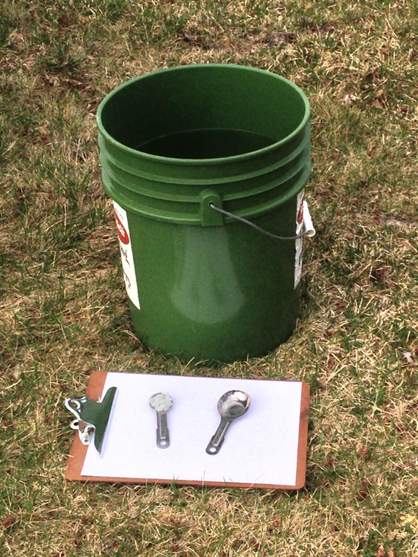
230 mg/L is about the same as:
1 teaspoon of salt mixed into 5 gallons of water
Each time you use 1 teaspoon less, you protect 5 gallons of water
Notes:
Note: 230 mg/l is about the same concentration as 1 teaspoon of salt mixed into 5 gallons of water.
Photo credit: Fortin Consulting Inc.

Slide 25
Test Question
How much salt pollutes 5 gallons of water?
1 ton
1 pound
1 cup
1 teaspoon
Notes:
Note to presenters: you may choose to hide this slide.
Test question:
How much salt pollutes 5 gallons of water?
1 Ton (no)
1 pound (no)
1 Cup (no)
1 teaspoon (yes)

Slide 26
Test Question
How much salt pollutes 5 gallons of water?
1 ton
1 pound
1 cup
1 teaspoon
Notes:
Note to presenters: you may choose to hide this slide.
Test question:
How much salt pollutes 5 gallons of water?
1 Ton (no)
1 pound (no)
1 Cup (no)
1 teaspoon (yes)

Slide 27

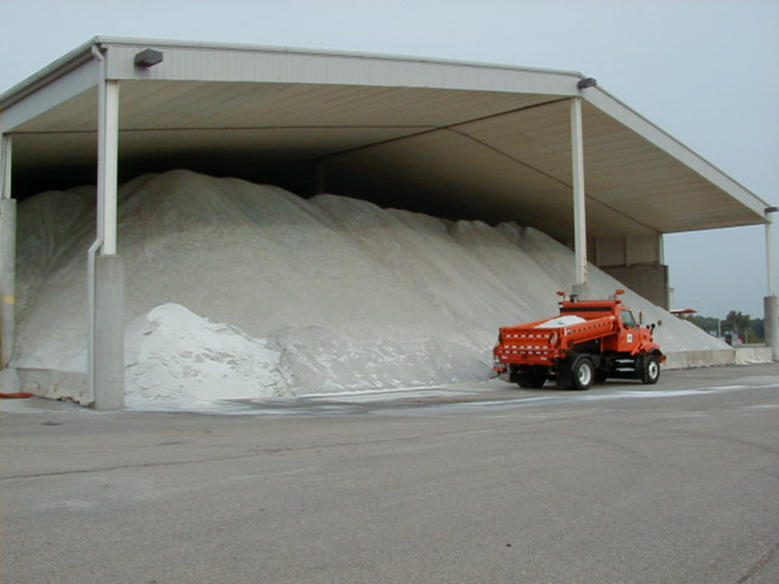
How many teaspoons of salt in a 10 yard load?
If you use 1 less load this winter:
you will protect about 8 million gallons of water from being polluted
Notes:
Note: 10 yards of salt pollutes about 8 million gallons of water, reaching the 230 mg/l threshold.
Photo credit: Fortin Consulting Inc.

Slide 28
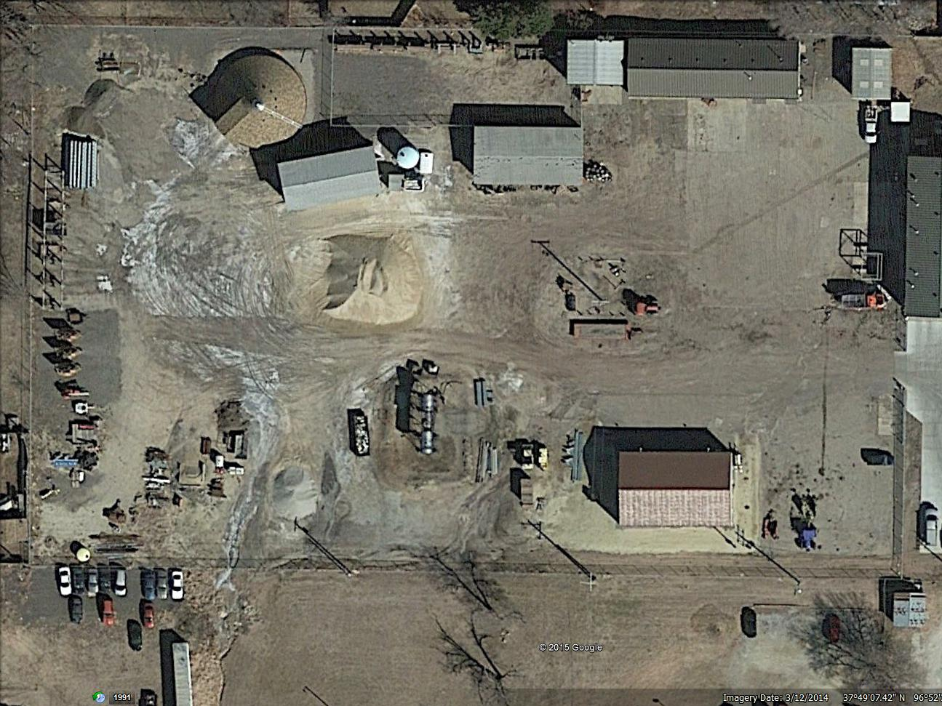
Proper salt storage is important
Poor storage will create water contamination. Don’t skimp on storage - the problem is easily tracked back to you!
Notes:
This photo shows poor storage. Salt can leave the shed, water can enter the shed, brine is accumulating on the pad. Any cracks in the pad, and the brine is heading to the groundwater.
For more information on salt storage see Module 10 of this series: De-icing Agent Management Policy. This module talks about storage of liquid and granular products.
Photo: Google earth image

Slide 29
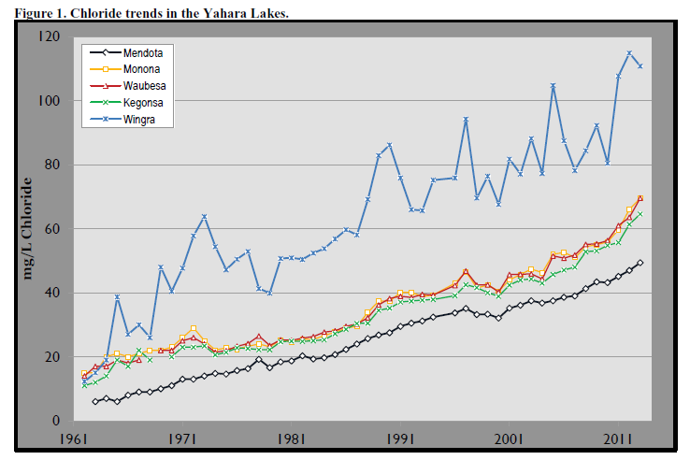
Chloride trend in Madison lakes
Presenters, insert your local water
quality trends here. Delete this yellow box before making presentation.
Notes:
Slide credit: http://www.publichealthmdc.com/publications/documents/RoadSaltRpt2013.pdf
Note to presenters: Insert your local monitoring data here. Otherwise, just select and then delete the yellow bar and use this chart for Madison, Wisconsin lakes. This chart is very typical for urban/suburban lakes in cold weather states.

Slide 30
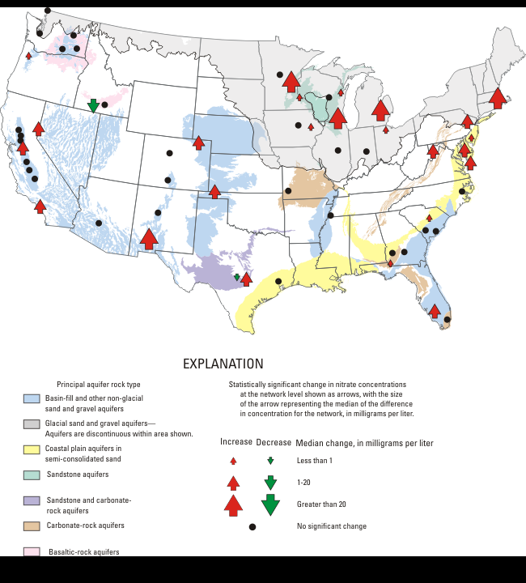
Chloride trends in ground water
USGS: Chloride changes in groundwater
1988-2000 to
2001-2010
http://water.usgs.gov/nawqa/studies/gwtrends/map.php?map=CL
Notes:
Map credit: http://water.usgs.gov/nawqa/studies/gwtrends/map.php?map=CL
This United States Geological Survey (USGS) study shows the chloride trend in our groundwater. Where you see the small red arrows, the chloride is rising a small amount, the medium red arrows reflect a slightly larger increased trend in chloride levels in groundwater. Where you see the big red arrows you will find the highest upward trend for chlorides in the groundwater.
The USGS has conducted many studies on chloride in our water across the nation and they are a good source of information.

Slide 31
Salt and aquatic life
Notes:
The next section discusses the impact of chlorides on aquatic life.
Photo credit: Fortin Consulting Inc.

Slide 32
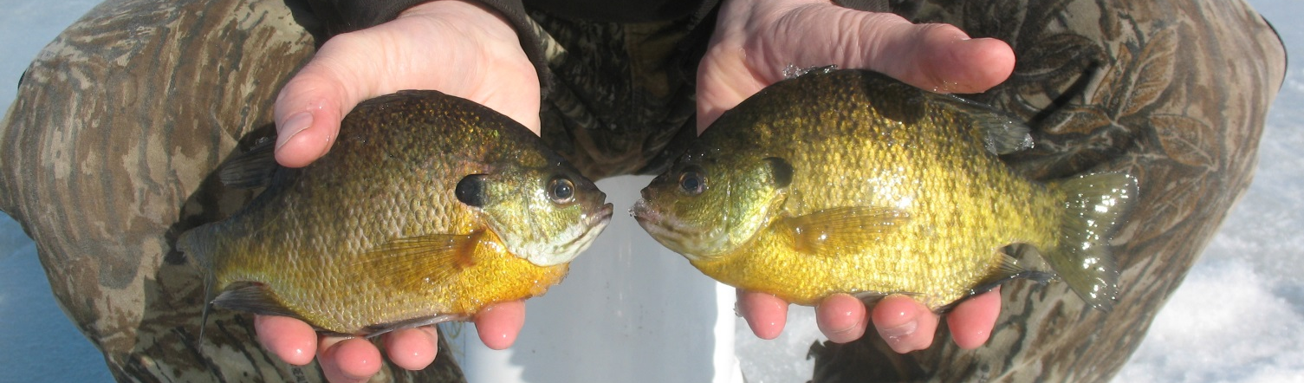
Chloride can be toxic to aquatic life
It affects small sensitive species first.
For example: a mayfly will have problems before a bluegill.
It is likely to cause trouble for species to reproduce.
At high enough concentrations chloride can cause death.
For example: fish eggs are more sensitive to salt than adult fish.
Loss or reduction of a species affects the food chain.
Notes:
The 230 mg/l chronic chloride standard has been set by the federal government to protect aquatic life. Most lab testing on toxicity is done with algae, water flea and minnows. There is a lot of information on the toxicity of salt and other deicers and their impact on these 3 species. There is less information on the toxicity to other species.

Slide 33
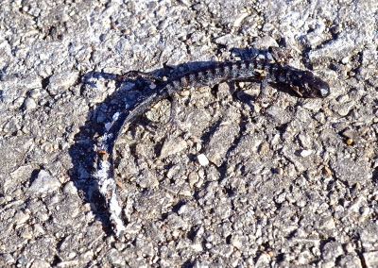
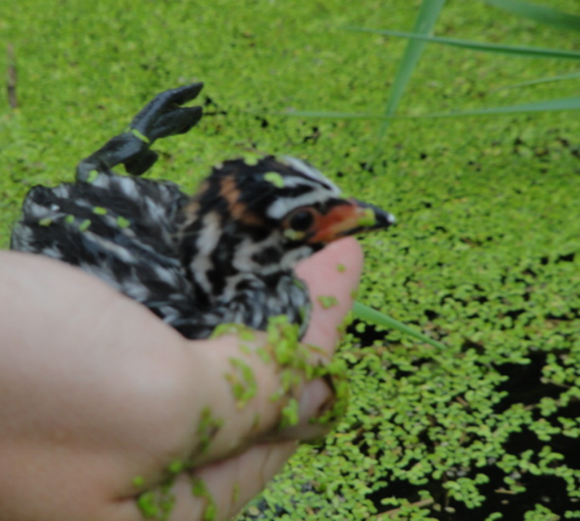
Chloride can be toxic other species
In birds and mammals, harm is caused by ingesting salt; their bodies cannot process it. Birds rank highest in causalities.
Amphibians experience adverse effects of salt through their skin.
Notes:
Chlorides are toxic to other species as well, as indicated by the following quotes and studies:
1. “Multiple studies (both laboratory and field) have clearly linked salt concentration to harmful effects on the survival and/or reproduction of frogs and salamanders.” … “High Cl- inputs from roadways and snow melt during spring threaten embryonic and larval stages of amphibians, especially early breeding species, including salamanders (Collins and Russell 2009). This would suggest that salamanders are perhaps one of the most intolerant amphibians with regard to salt concentration.”
Source: Road Salt and Its Effects on Amphibians: A Concern for North Carolina? R. J. Winston1 , W. F. Hunt2 , and W.T. Pluer, Department of Biological and Agricultural Engineering North Carolina State University
2. “Based on this evidence, we argue that efforts to protect local populations of A. maculatum and R. sylvatica in roadside wetlands should, in part, be aimed at reducing application of road salt near wetlands.” Ecol Appl. 2008 Apr;18(3):724-34. Impacts of road deicing salt on the demography of vernal pool-breeding amphibians.
Karraker NE¹, Gibbs JP, Vonesh JR. (Note: A. Macalatum is a spotted salamander and R.Sylvatica is a wood frog)
3. In another study, we see an adaptation to road salt by the spotted salamander (Steven P. Brady. 2012. Road to evolution? Local adaptation to road adjacency in an amphibian (Ambystoma maculatum). Scientific Reports, 2012; 2 DOI)
4. It appears that the salamanders could adapt to saline water: “New Haven, Conn. — Spotted salamanders exposed to contaminated roadside ponds are adapting to their toxic environments, according to a Yale paper in Scientific Reports. This study provides the first documented evidence that a vertebrate has adapted to the negative effects of roads apparently by evolving rapidly. Salamanders breeding in roadside ponds are exposed to a host of contaminants from road runoff. Chief among these is sodium chloride from road salt, which reaches average concentrations of 70 times higher in roadside ponds compared to woodland ponds located several hundred feet from the road.”
Source: http://www.herpnation.com/hn-blog/salamanders-and-road-salt/?simple_nav_category=john-c-murphy
Photo credits:
Bird Photo: Fortin Consulting, Inc.
Salamander photo: Vestal Grove http://vestalgrove.blogspot.com/

Slide 34
Test Question
The species that suffers the most death due to chlorides is:
Salamanders
Frogs
Birds
Deer
Notes:
Note to presenters: you may choose to hide this slide.
Test question:
The species that suffers the most death due to chlorides is:
Salamanders (no)
Frogs (no)
Birds (yes)
Deer (no)

Slide 35
Test Question
The species that suffers the most death due to chlorides is:
Salamanders
Frogs
Birds
Deer
Notes:
Note to presenters: you may choose to hide this slide.
Test question:
The species that suffers the most death due to chlorides is:
Salamanders (no)
Frogs (no)
Birds (yes)
Deer (no)

Slide 36
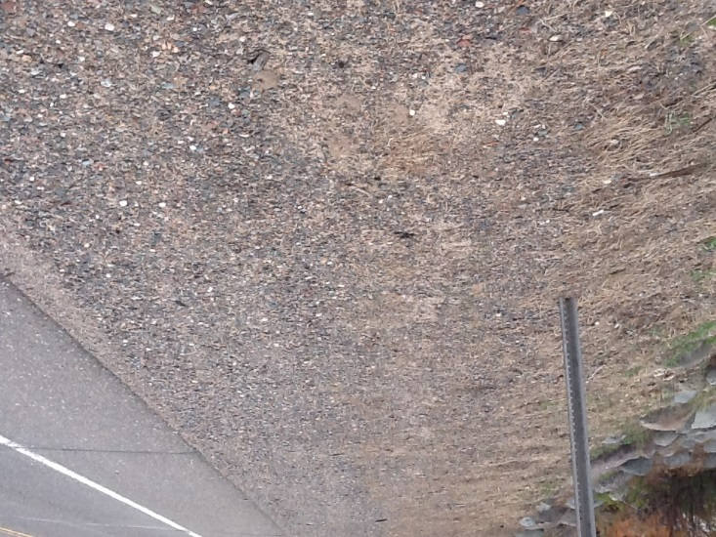
Salt and soil
Salt changes the structure of the soil.
It doesn’t stay together as well (clump).
It is easily compacted.
Contains poor water and air permeability.
Water can’t soak in, so nothing will want to grow here.
Therefore: look for increased
erosion and water runoff in
high salt areas.
Notes:
From: http://learningstore.uwex.edu/assets/pdfs/A2970.pdf :
“Too much salt in the soil can alter the physical structure of the soil. Excess sodium prevents soil from forming clumps. Poor clumping
makes soil vulnerable to compaction, reducing soil permeability and aeration and increasing the likelihood of soil erosion and surface runoff. “
Here are some of the things that salt change in roadside soils:
Swelling and compaction of soil
Change electrical conductivity
Loss of soil stability
Osmotic Stress
Mobilization of nutrients
Increased release of heavy metals from soil as salinity increases
Deteriorates soil structure impeding soil drainage
Photo credit: Fortin Consulting Inc.

Slide 37
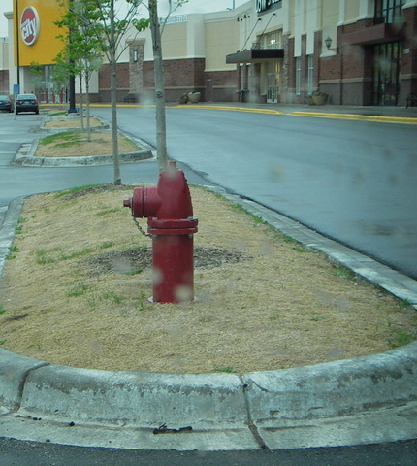
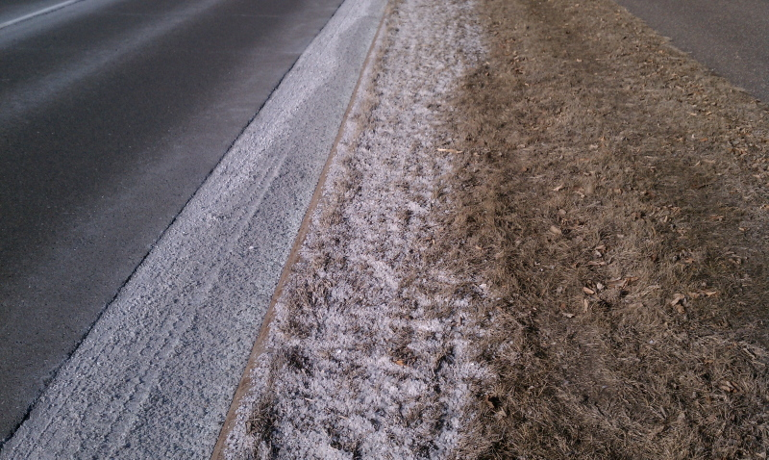
Salt and vegetation
Salt can harm vegetation through changes in the soil.
Largest changes to soils are close to roadway.
Big changes 60 feet or less.
Salt changes the soil texture and soil composition.
With the chemistry change, it holds water more tightly within the soil and provides less water to the plant.
Notes:
Photos: FCI
Page 6 of NCHRP synthesis 449 discusses these basic changes in soil due to input of road salt.
So does Minimizing De-icing Salt Injury to Trees - Gary R. Johnson and Ed Sucoff ,U of MN extension 2000.
From: http://learningstore.uwex.edu/assets/pdfs/A2970.pdf
“Salt that enters the soil harms plants differently than salt spray. Salt
disrupts the balance of nutrients and water between the soil and the plant,
causing plant decline. Salt causes soil particles to absorb moisture in the
same way a salt shaker attracts moisture under humid conditions. Because
the soil particles hold water more tightly, less water is available for
uptake by the plant. “
Here are some of the things that salt change in roadside soils
Swelling and compaction of soil
Change electrical conductivity
Loss of soil stability
Osmotic Stress
Mobilization of nutrients
Increased release of heavy metals from soil as salinity increases
Deteriorates soil structure impeding soil drainage

Slide 38
Test Question
How does salt damage roadside soils and vegetation?
By plugging the soil pores and reducing permeability.
By chemically altering the water-holding capabilities of the soil.
By creating a hostile environment for plants to thrive.
All of the above.
Notes:
Note to presenters: you may choose to hide this slide.
Test question:
How does salt damage roadside soils and vegetation?
By plugging the soil pores and reducing permeability (yes)
By chemically altering the water-holding capabilities of the soil. (yes)
By creating a hostile environment for plants to thrive. (yes)
All of the above. (yes)

Slide 39
Test Question
How does salt damage roadside soils and vegetation?
By plugging the soil pores and reducing permeability
By chemically altering the water-holding capabilities of the soil.
By creating a hostile environment for plants to thrive.
All of the above.
Notes:
Note to presenters: you may choose to hide this slide.
Test question:
How does salt damage roadside soils and vegetation?
By plugging the soil pores and reducing permeability (yes)
By chemically altering the water-holding capabilities of the soil. (yes)
By creating a hostile environment for plants to thrive. (yes)
All of the above. (yes)

Slide 40
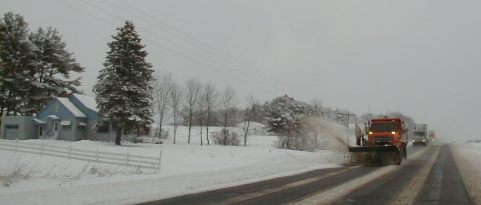
Salt spray injures trees
Broadleaf trees: kills buds, causing odd branching or witches’ brooming.
Conifers: salt browns tree needles.
Notes:
What can we do about it? We can plow the snow first and salt later. This will minimize the salt in the snow spray that lands on the vegetation.
Photo credit: Fortin Consulting Inc.

Slide 41

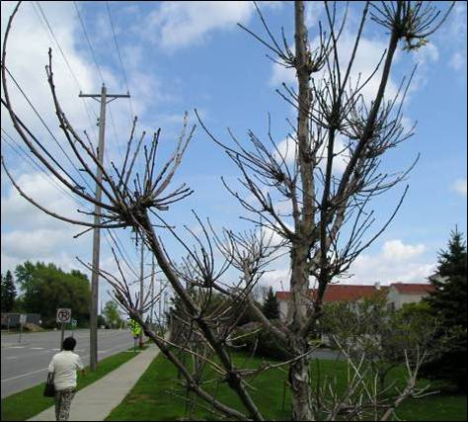
Witches’ brooming
Notes:
Salt spray causes bud death and twig dieback. Then, the new growth results in unusual branching termed “witches’ brooms”.
Also, the tree is likely to leaf out later than a tree not injured with salt spray.
“Usually, when boulevard trees show symptoms of deicing salt spray drift, it is only on deciduous trees; it shows up as witches’ brooming; it is usually confined to arterial streets with traffic levels of 10,000 vehicles per day usage rates; and speed limits 45 mph or greater.” Gary Johnson Professor/Extension Professor, Urban and Community Forestry, University of Minnesota
Left Photo: Fortin Consulting Inc.
Right Photo: Gary Johnson University of Minnesota

Slide 42
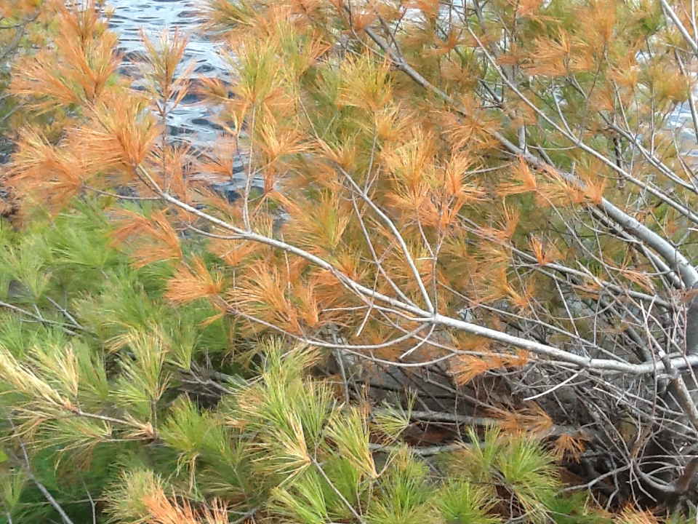
Needle burn
Notes:
In this slide we see the white pine tree is damaged from salt. Most everyone has seen this present in conifers planted along a busy roadway.
Photo credit: Fortin Consulting Inc.

Slide 43
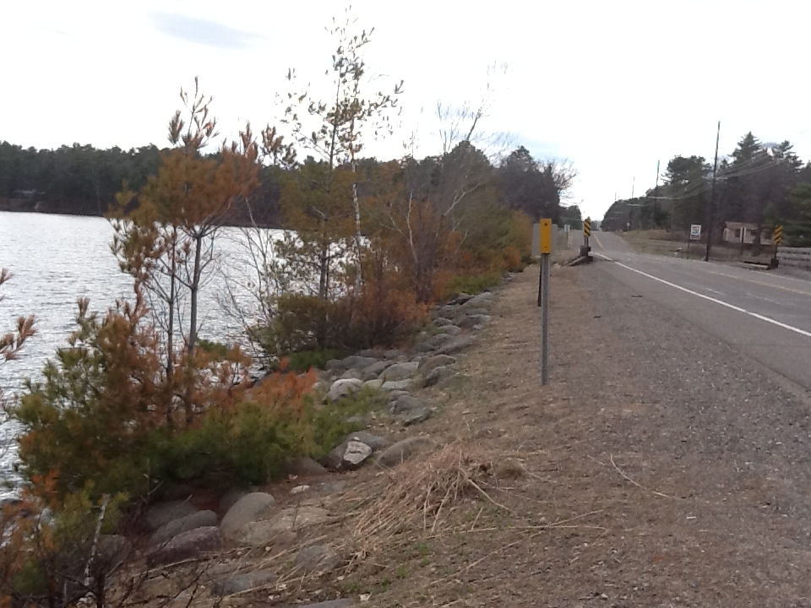
What story does this picture tell?
Do we have any options?
Notes:
In this slide we see the white pine trees damaged from salt. But we also see the road, roadside soils, white pines and the lake. In the background we can see guardrail over a small bridge. Salt will damage all of these things.
Do you think the salt got into the lake or only onto the trees?
Photo credit: Fortin Consulting Inc.

Slide 44
Test Question
How can road salt damage plants?
By spraying onto the plant
By changing the soil the plant depends on
By adding nutrients for predators
Both 1 and 2
Notes:
Note to presenters: you may choose to hide this slide.
Test question:
How can road salt damage plants?
By spraying onto the plant (no)
By changing the soil the plant depends on (no)
By adding nutrients for predators (no)
Both 1 and 2 (yes)

Slide 45
Test Question
How can road salt damage plants?
By spraying onto the plant
By changing the soil the plant depends on
By adding nutrients for predators
Both 1 and 2
Notes:
Note to presenters: you may choose to hide this slide.
Test question:
How can road salt damage plants?
By spraying onto the plant (no)
By changing the soil the plant depends on (no)
By adding nutrients for predators (no)
Both 1 and 2 (yes)

Slide 46
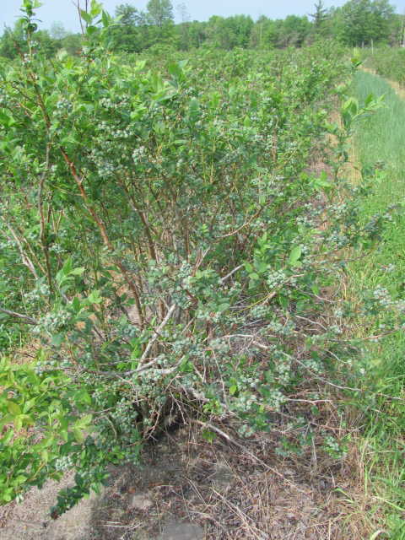
Crops
Salt can move from the highway to adjacent farm fields. It impacts the soils and the plants growing in the soil.
Michigan Blueberry farmers worked with U of M extension and road authorities to reduce salt load entering their fields. Good progress was made.
Notes:
Michigan started working with the blueberry farmers many years ago trying to reduce salt use close to their blueberry fields. They monitored and saw a drop in salt entering the blueberry fields after they changed their maintenance practices. Many crop fields are located near our roadways. What, if anything, are you trying to do to reduce salt damage to crops?
Photo credit: Garcia-Salazar, Carlos (garcias4@anr.msu.edu)

Slide 47
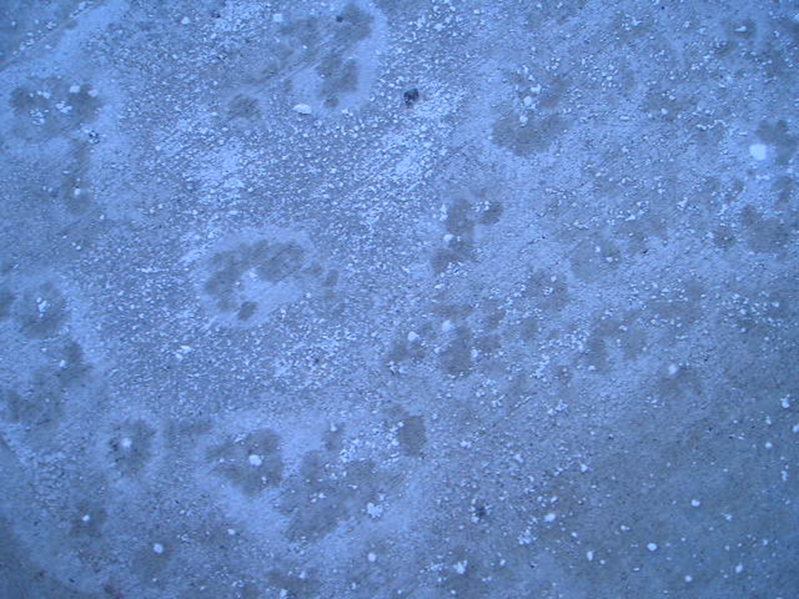
What to do about salt?
Use less
Once we apply it is too late…we can’t get it back
USE LESS SALT
There are many ways to use less! Choose your path!
Notes:
To combat the impacts of salt, use less of it.

Slide 48
Test Question
What can we do about the salt problem?
There is nothing we can do
Find ways to use less salt
Notes:
Note to presenters: you may choose to hide this slide.
Test question:
Test Question: What can we do about the salt problem?
There is nothing we can do (no)
Find ways to use less salt (yes)

Slide 49
Test Question
What can we do about the salt problem?
There is nothing we can do
Find ways to use less salt
Notes:
Note to presenters: you may choose to hide this slide.
Test question:
Test Question: What can we do about the salt problem?
There is nothing we can do (no)
Find ways to use less salt (yes)

Slide 50
Organics and the environment
BOD
Wildlife
Notes:
Start of a mini section

Slide 51
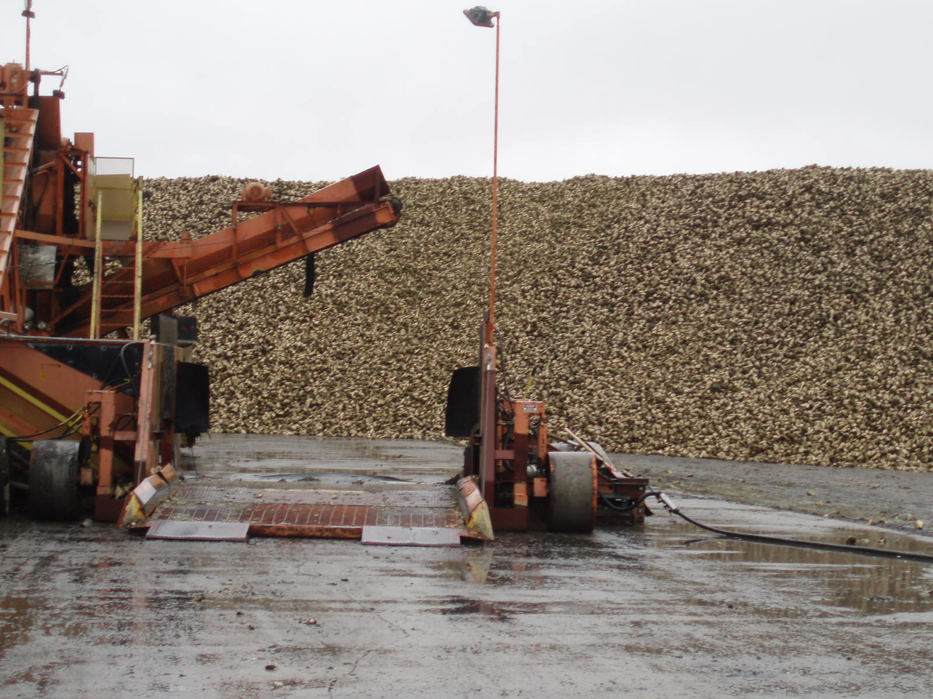
Organic additives
Liquids made out of plants such as beets or corn that we add to our salt or into our brine
Notes:
Organics are used to supplement the salt. They make it stickier, and reduce the freezing point of the brine in your tanks. By themselves, they do not melt snow and ice.

Slide 52

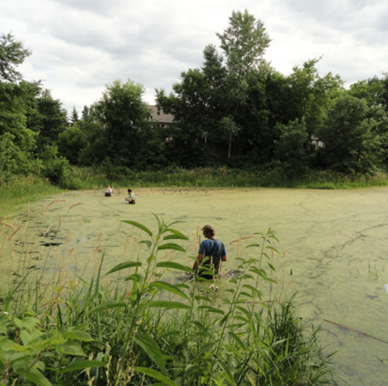
How can something organic be harmful?
Put any plant material in a lake, and it creates a phosphorous (fertilizer) load.
It will green it up the lake giving the algae a banquet!
As it decomposes, it uses oxygen from the lake, competing with fish & other organisms who also need it.
Notes:
Both Biological Oxygen Demand and Chemical Oxygen Demand are big concerns with the use of organic additives. Understand that there are many other ways we input nutrients into our water besides winter maintenance. Grass clippings, leaves and such also create the same problems when they enter our lakes.
Photo: Fortin Consulting Inc.
Image: Microsoft clipart

Slide 53
Test Question
How do organic additives harm the water?
Turn the water a different color
Add “fertilizer” to the water
Make the lake shallower
Kills the plants
Notes:
Note to presenters: you may choose to hide this slide.
Test Question:
How do organic additives harm the water?
Turn the water a different color (no)
Add “fertilizer” to the water (yes)
Make the lake shallower (no)
Kills the plants (no)

Slide 54
Test Question
How do organic additives harm the water?
Turn the water a different color
Add “fertilizer” to the water
Make the lake shallower
Kills the plants
Notes:
Note to presenters: you may choose to hide this slide.
Test Question:
How do organic additives harm the water?
Turn the water a different color (no)
Add “fertilizer” to the water (yes)
Make the lake shallower (no)
Kills the plants (no)

Slide 55
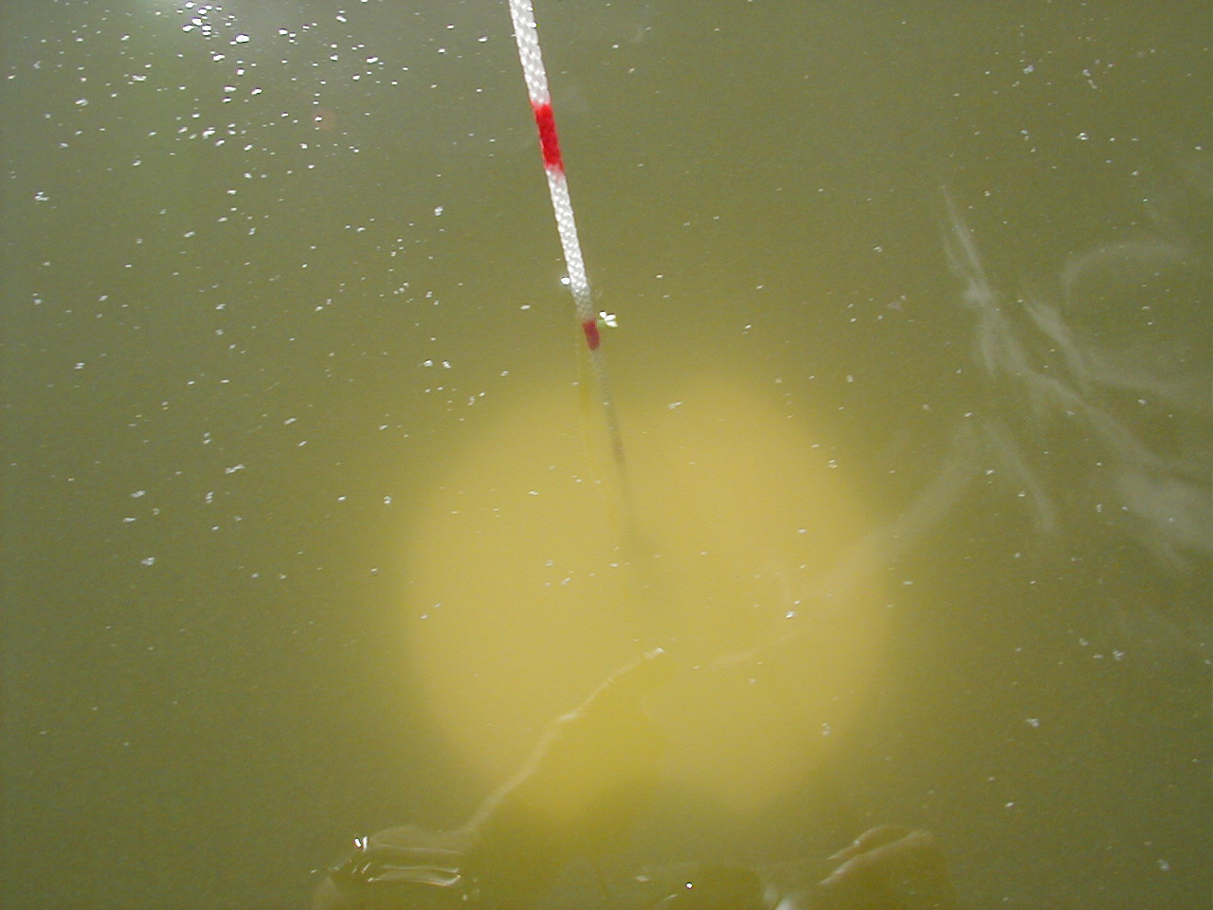
Extra phosphorus (P) greens up our lakes
The “limiting” nutrient for many lakes is phosphorus.
Algae will grow based on the amount of phosphorus because there is already enough of the other nutrients.
Notes:
55
This is a secci disk, a tool used to measure water clarity. The clearer the water, the healthier the water (this is over simplified because many other parameters determine water health). Secci disk measurements are one of the most common and widely used methods by professionals and volunteers alike.
Photo credit: Fortin Consulting Inc.

Slide 56
Abrasives and the environment
Air quality
Fish habitat
Heavy metals
Notes:
Start of a mini section

Slide 57
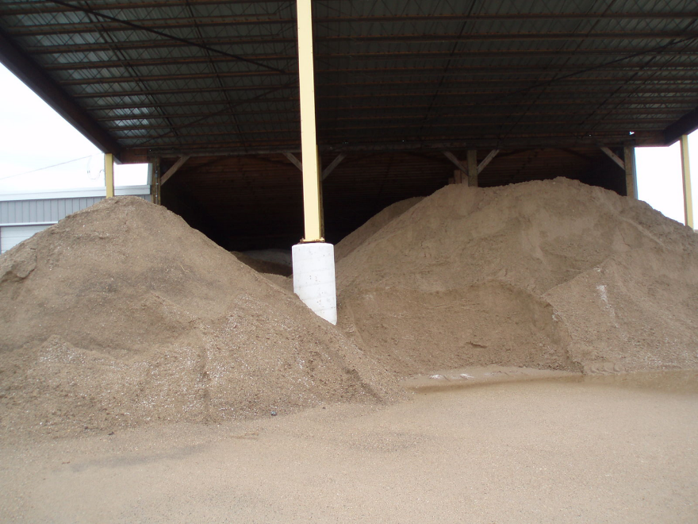
What’s the problem with sand?
Moves from the road to the ditches and storm drains.
Creates water pollution
Moves from the road into the air as it is pulverized by the traffic.
Creates air pollution
Moves from the road to the nearby land.
Changes soil composition along the roadway
Increases the height of soil near guardrails
Notes:
Sand moves downhill with the water. It pollutes our water and fills in our ponds and wetlands. It makes deltas in our streams and lakes. Lakes age too: when they get old they get shallower. Use of winter sand accelerates this aging process. Other things accelerate the lake aging process, such as us putting a load of sand on our beach.
Photo: Fortin Consulting Inc.

Slide 58
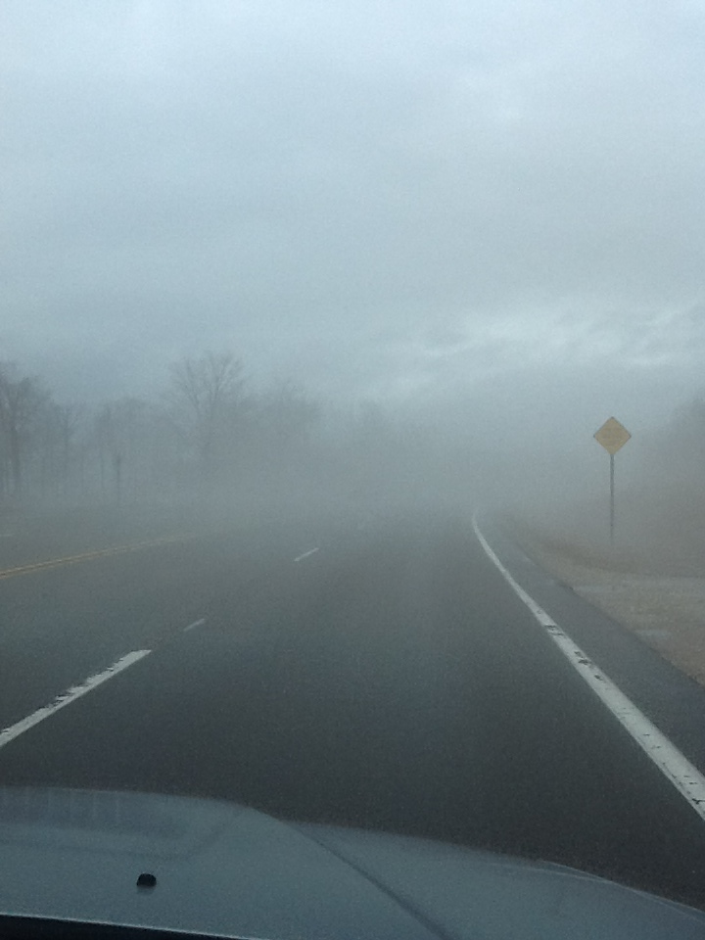
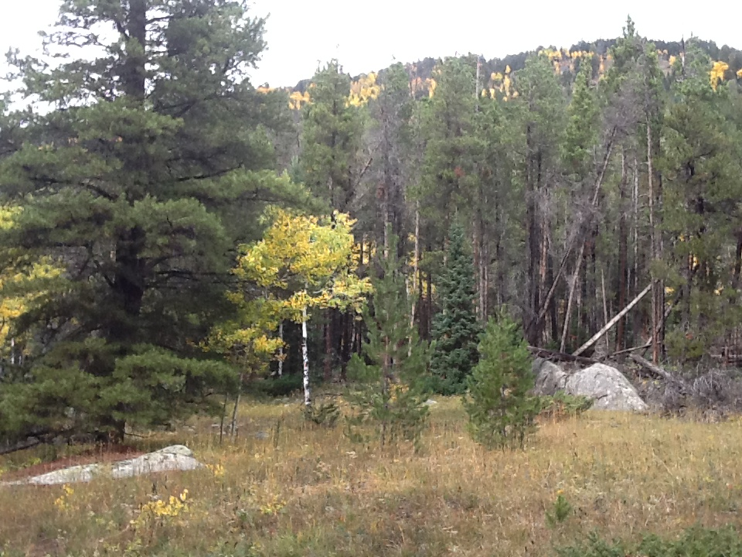
Pulverized sand can be an airborne pollutant
Notes:
Colorado DOT‘s Air Quality Expert, Jordan Rudel stated that the reason they do the extra sweeping is because Colorado was previously in "non-attainment" status for PM 10. Whether or not your state violates air quality standards is not the issue, the issue is if Colorado can figure out a way to do aggressive winter sweeping, so can you.
Discuss: How much of the sand you apply is recovered? How many years have you been sanding? Have you seen any side effects of unrecovered winter sand?
Photo credit: Fortin Consulting Inc.

Slide 59
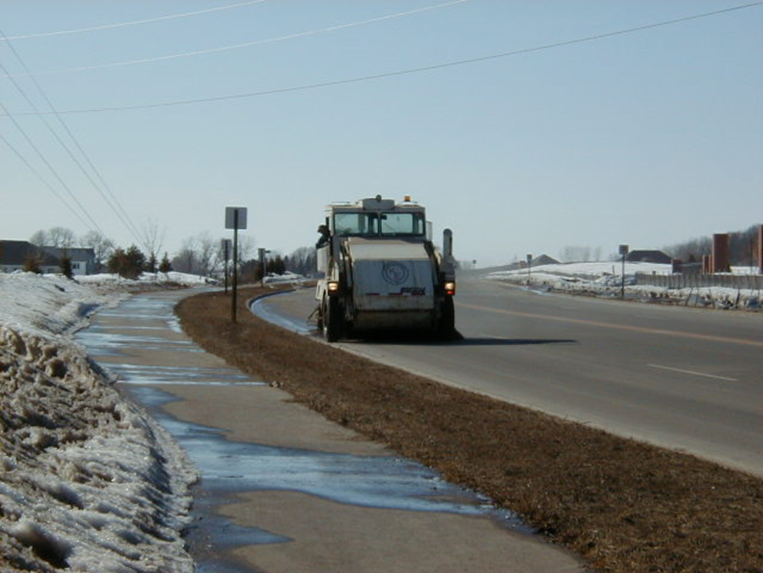
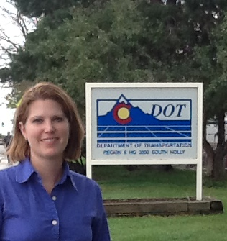
Winter sweeping should be a part of your operations if you use sand
Note to presenters: Insert your sweeping policy here, or discuss it with participants. Delete this yellow box before making presentation.
“CDOT is required to sweep used traction sand within 48 hours of the storm event in Metropolitan areas” for Region 3.
Notes:
Winter sweeping should be a part of your operations if you use sand.
Note to presenters: insert your sweeping policy here, or discuss it with participants.
Topics: How much of the sand you apply is recovered? How many years have you been sanding? Have you seen any side effects of unrecovered winter sand? In MN one city reported the loss of their pond skating rinks, the ponds have filled in with sand from winter sanding so they can no longer be used in the winter for skating.
Photo credit: Fortin Consulting Inc.

Slide 60
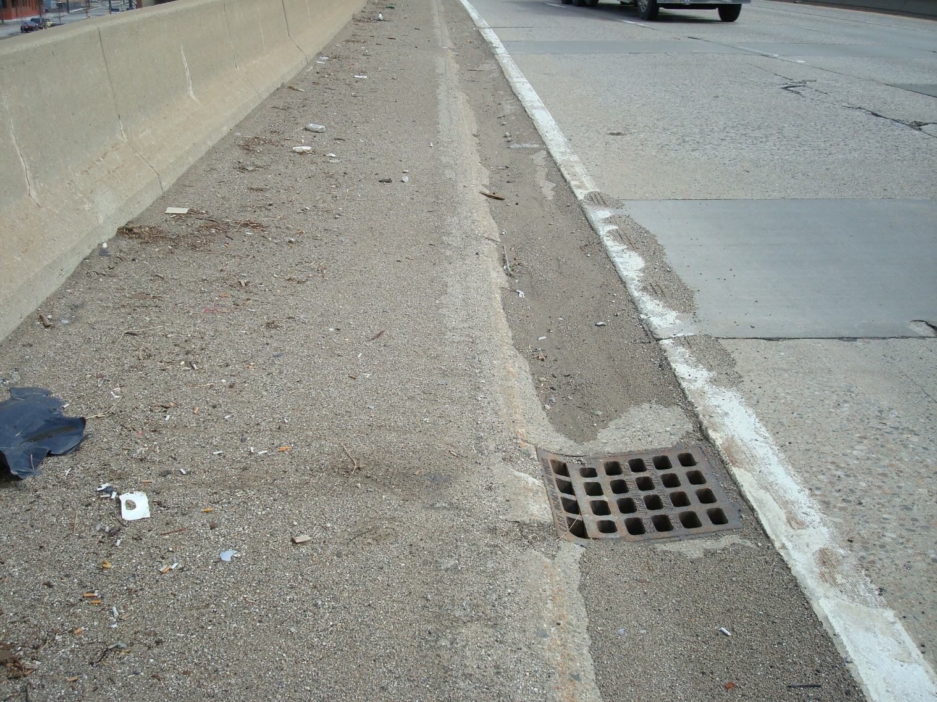
Storm drains connect the land to the water. Here we see that sand will be washed into the storm drain, then discharged into a nearby lake, river, or pond.
Notes:
One of the problems with sand is it doesn’t stay put. It very quickly migrates out of the wheel paths. Once it is out of the wheel paths it never returns to the wheel path and is essentially useless.
Sand just isn't sand. Sand once applied to the road bonds with oil, transmission fluid, rubber from tires, grease, and anything that is also found on the road. Sand, when it moves into our water, brings all of this with it.
Photo: Michigan DOT

Slide 61
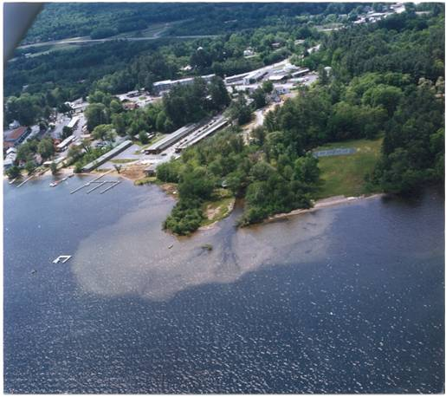
Turbid River discharging to lake
Water and pollutants flow downhill. Sand we apply on the road can become a water pollutant.
Notes:
This photo shows a good example of sediment transport. We rarely get a bird’s eye view of the problems we contribute to, but it would be a great training tool if we did.
In this example a brook is emptying into Lake George in the Adirondacks.
Photo credit: NYSDOT

Slide 62
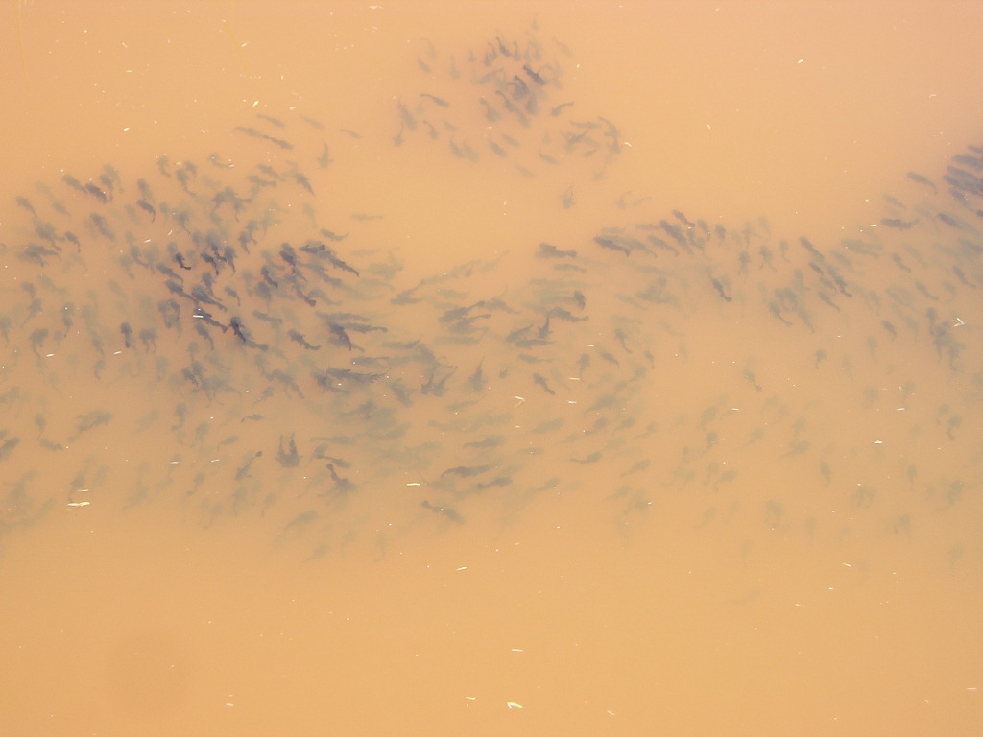
Those species adapted to living in turbid conditions will do okay, but other species will decline.
What fish species is this?
Notes:
Sand scratches the gills of fish causing injury and opening for disease. Rough fish are more tolerant of low oxygen, low clarity water than the sport fish such as walleye and bass. The species of fish shown here are bullheads, a rough fish undesirable to most fishermen.

Slide 63
Test Question
How does sand affect the appearance of our lakes and rivers?
Makes it brown and cloudy
Makes it blue and transparent
Notes:
Note to presenters: you may choose to hide this slide.
Test Questions: How does sand affect the appearance of our lakes and rivers?
Makes it brown and cloudy (yes)
Makes it blue and transparent (no)

Slide 64
Test Question
How does sand affect the appearance of our lakes and rivers?
Makes it brown and cloudy
Makes it blue and transparent
Notes:
Note to presenters: you may choose to hide this slide.
Test Questions: How does sand affect the appearance of our lakes and rivers?
Makes it brown and cloudy (yes)
Makes it blue and transparent (no)

Slide 65
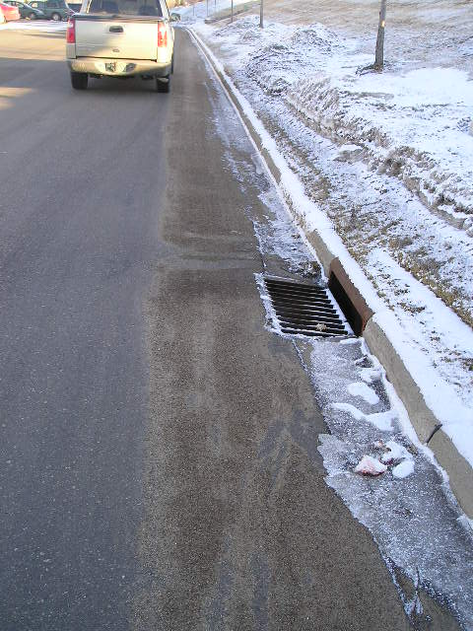
Much of the environmental concern surrounding sand can be reduced by frequent winter sweeping
Notes:
This is a bonus of using sand. With salt we never have the chance to recover it.

Slide 66
Test Question
If you use sand, will winter sweeping protect our water?
Yes
No
Notes:
Note to presenters: you may choose to hide this slide.
Test question:
If you use sand, will winter sweeping protect our water?
Yes (yes)
No (no)

Slide 67
Test Question
If you use sand, will winter sweeping protect our water?
Yes
No
Notes:
Note to presenters: you may choose to hide this slide.
Test question:
If you use sand, will winter sweeping protect our water?
Yes (yes)
No (no)

Slide 68
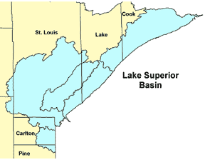
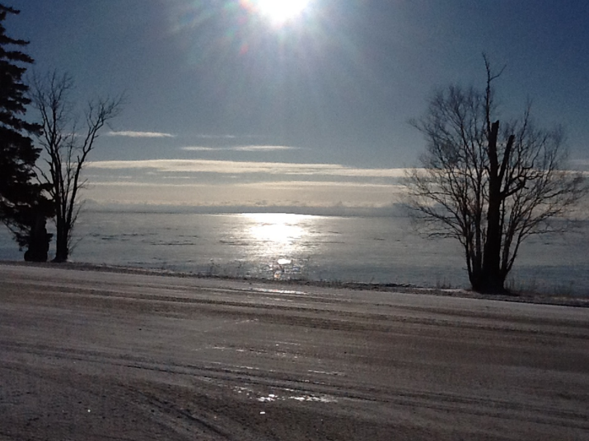
Winter of 2008/2009 study: 25% recovery rate of sand, in MN area draining to Lake Superior
63,000 tons of unrecovered sand in one year.
In this case, how many truckloads of sand are likely to enter the lake, ditches, wetlands, and local streams in one year?
How many years have we been sanding?
Note to presenters: Insert sand use and sand recovery numbers if you have them.
Notes:
This information comes from the Minnesota Erosion Control Association Study. WWW.mnerosion.org
Note to presenters: Insert your own sand use and recovery numbers here if they are available.
Photo credit: Fortin Consulting Inc.

Slide 69
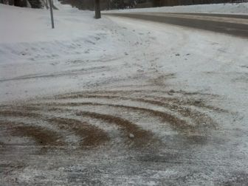
Keep it in perspective: salt & sand
Salt melts snow & ice and provides a higher level of service, however:
Salt will permanently impact water bodies it infiltrates.
We do not yet know how to remove salt from water bodies.
Future generations will have to fix the problems we are causing, because we do not know how to do it.
Notes:
Salt and sand are very different tools, offering very different level of service and causing very different environmental problems.
Sand provides traction on top of snow or ice and a lower level of service. Sand fills in ponds, forms deltas in rivers and lakes changes the height of the guard rails and so on. It fills in our stormwater infrastructure so the water cannot properly move off of the roadways. Because it changes our drainage we spend time each year removing sand (if we are using it). Sand is a hazard for bike riders and motorcyclists.
Salt melts snow and ice and provides a higher level of service. Salt changes the water chemistry of our lakes, rivers, and groundwater. To remove salt from water we can use evaporation or reverse osmosis. Neither are affordable or practical techniques.
It is likely the level of service that will dictate which of these tools you use. Whichever path you choose make the smartest choices you can to use the least material.
Photo credit: Fortin Consulting Inc.

Slide 70
Keep it in perspective: salt & sand
Sand provides traction and a lower level of service, however:
Sand has less overall permanent impact on water bodies than salt.
Although harmful to fish habitat, sand is prone to disbursement in streams.
Sand can cause air quality issues in urban areas.
Sand is a lot of work and expense to recover (it is a pain!)
Notes:
Salt and sand are very different tools, offering very different level of service and causing very different environmental problems.
Sand provides traction on top of snow or ice and a lower level of service. Sand fills in ponds, forms deltas in rivers and lakes changes the height of the guard rails and so on. It fills in our stormwater infrastructure so the water cannot properly move off of the roadways. Because it changes our drainage we spend time each year removing sand (if we are using it). Sand is a hazard for bike riders and motorcyclists.
Salt melts snow and ice and provides a higher level of service. Salt changes the water chemistry of our lakes, rivers, and groundwater. To remove salt from water we can use evaporation or reverse osmosis. Neither are affordable or practical techniques.
It is likely the level of service that will dictate which of these tools you use. Whichever path you choose make the smartest choices you can to use the least material.
Photo credit: Fortin Consulting Inc.

Slide 71

Importance of Record Keeping
Keep records of materials,quantities, treatments and effectiveness.
Monitor any environmental impacts.
Record how washwater is treated and any testing conducted on it.
This helps you know what is and isn’t working, and where efficiency can be improved.
Notes:
Record keeping is important as a means of material accountability, budgeting/cost tracking, performance tracking, support in the event of legal actions, media inquiries, and planning.

Slide 72
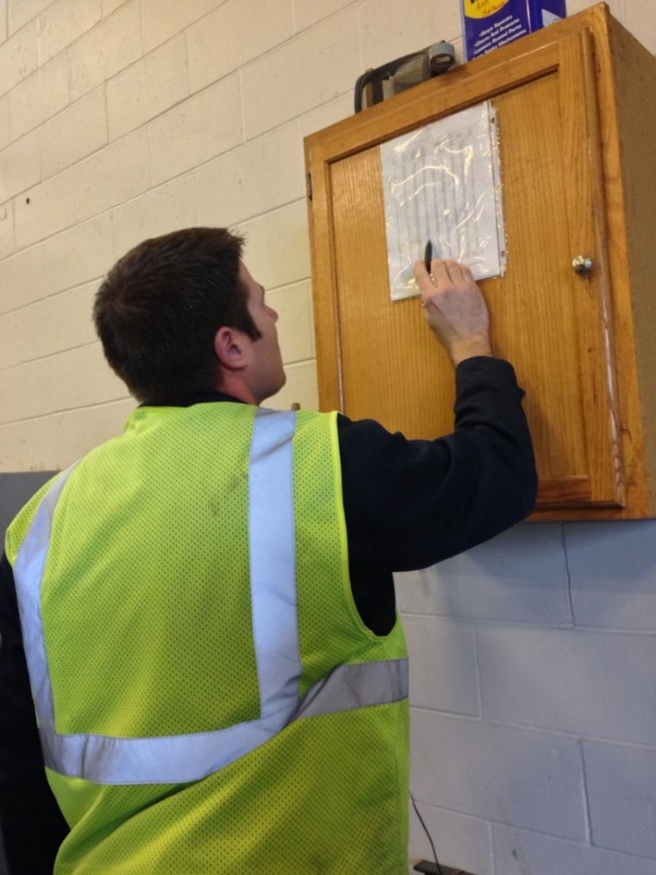
Recording Material Use
Keep track of driver use for insight into:
Individual storms
Each product totals
Winter season total
Leftover product totals
Notes:
You should record several different levels of material use by driver. Combine all this data for insight into individual storms, the winter season total, and what is leftover to store for the next season.
Having all this information helps in evaluating the efficacy of individual storm treatments went, how the whole winter went, and helps in next seasons ordering. It can also help in proving that policy is being followed if a lawsuit is brought against you.
Photo credit: Fortin Consulting, Inc.

Slide 73
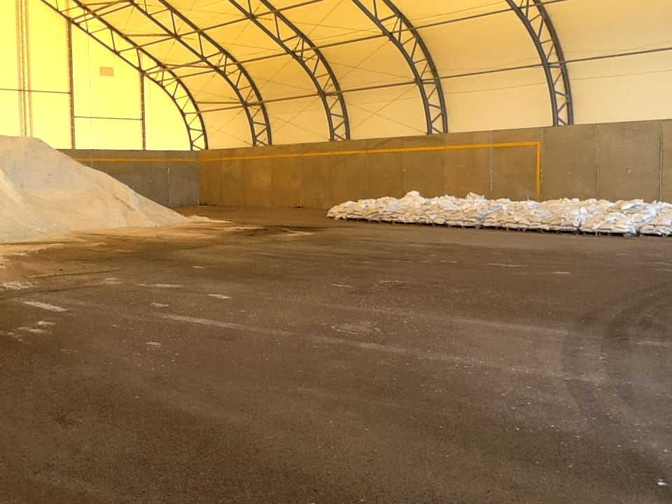
Check Records and Verify Total Materials Used
Notes:
As the winter progresses, reviewing records and verifying how much material has been used can help with planning, impact monitoring, if a driver is over-plowing, and how well records are being kept.
This can be looked at on a storm to storm basis and up to the current point of the season.
Photo credit: Fortin Consulting, Inc.

Slide 74
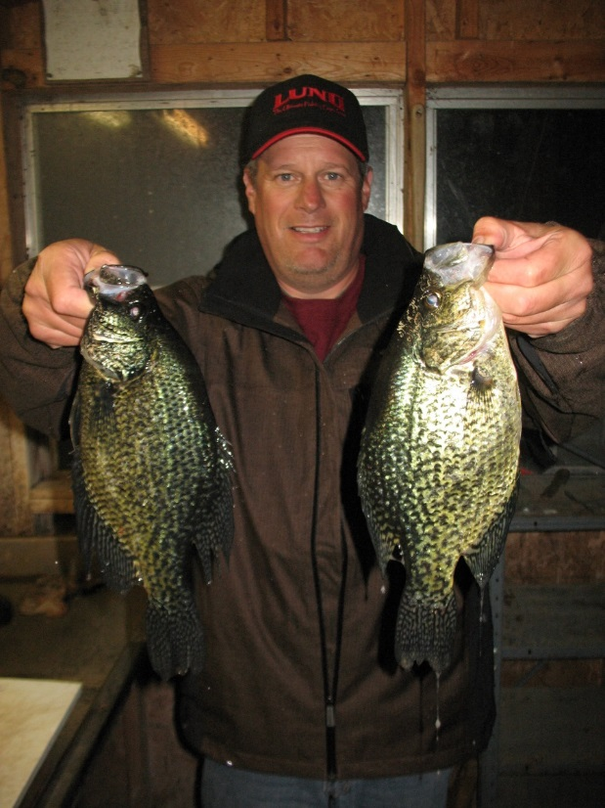
Using any of these products is a privilege
In order to continue using these products, we need to be aware of the environmental concerns and use them carefully!
We love our lakes and rivers!
We have the power to protect them!
Let’s show it in our winter maintenance activities.
Notes:
Start here
By understanding how the various de-icers and abrasives negatively impact the environment we have the chance to weigh the costs and benefits of each product. With this information we can make smarter decisions for road maintenance and environmental protection.
Photo credit: Fortin Consulting Inc.

Slide 75
Test Question
Who can protect our lakes and rivers?
My boss
The people I work with
Me
All of the above
Notes:
Note to presenters: you may choose to hide this slide.
Test question: Who can protect our lakes and rivers?
My boss (no)
The people I work with (no)
Me (no)
All of the above (yes)

Slide 76
Test Question
Who can protect our lakes and rivers?
My boss
The people I work with
Me
All of the above
Notes:
Note to presenters: you may choose to hide this slide.
Test question: Who can protect our lakes and rivers?
My boss (no)
The people I work with (no)
Me (no)
All of the above (yes)

Slide 77

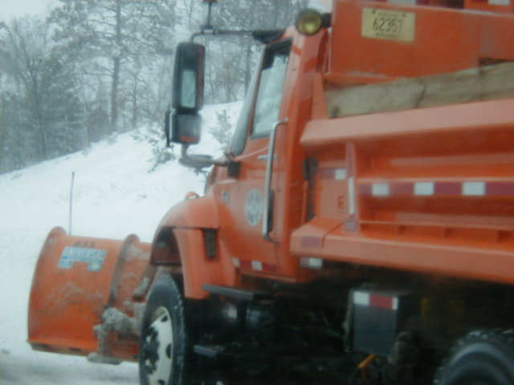
Be BOLD and BRAVE in winter maintenance
We cannot solve our problems with the same thinking we used when we created them.
Albert Einstein
We can do it!
Notes:
Note to presenters: Give a pep talk here about the opportunity to move the industry ahead.
Knowing that a problem exists is a good start. Doing something about it is what we expect. Maintenance professionals are good at fixing problems however they cannot fix something if they do not know it is broken. After this training segment they will understand the problem that faces this industry. The other training modules will help provide ideas that can move us ahead towards overcoming or at least reducing these problems.
Photo credit: Microsoft clip art

Slide 78
The 17 other training modules will provide you with many ideas on how we can reduce impacts to the environment.
Thank you for your concern about the environment!
Notes:
Thank you for your time today. Have a good winter!
Photo credit: Fortin Consulting Inc.

Slide 79
Acknowledgements
Training contents were developed by Fortin Consulting Inc., under the direction of the Clear Roads Advisory Team.
Connie Fortin – connie@fortinconsulting.com
Professional formatting and training aids were developed by the University of Minnesota, Center for Transportation Studies.
Jim Grothaus – Groth020@umn.edu
Ann Johnson – Johns421@umn.edu
Members of the Clear Roads Advisory Team include:
Mike Sproul, Dave Wieder, Cliff Spoonemore, Monty Mills, David Frame,
Mike Lashmet, Clay Adams, Justun Juelfs, and Tom Peters

Slide 80
This presentation was developed with funding from the Clear Roads research program, which brings together transportation professionals and researchers from around the country to drive innovation in the field of winter maintenance.
Find additional information and resources at
http://clearroads.org/

Slide 81
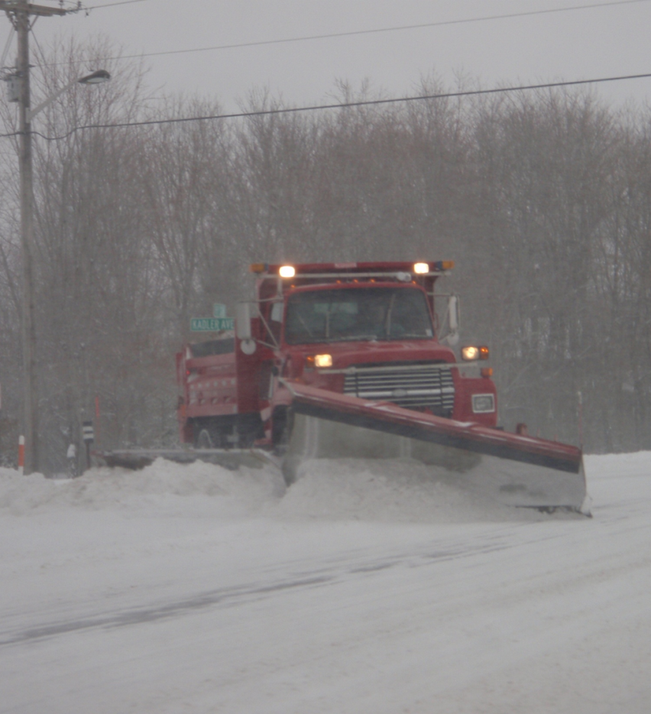
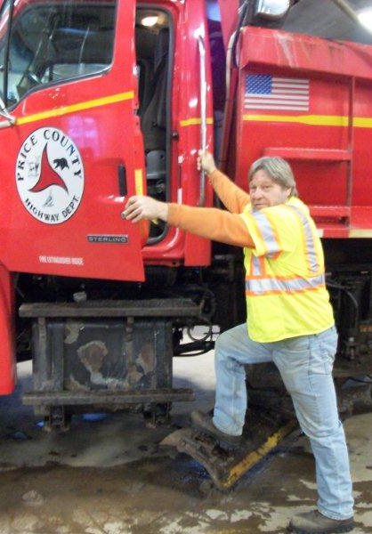

Thank you for your good work!
Notes:
Thank you for your time today. Have a good winter!

Slide 82
Additional resources
AASHTO, Clear Roads Computer Based training:
Selecting Snow and Ice Control Materials to Mitigate Environmental Impacts: Unit 2 Potential Impacts to the Natural Environment
NCHRP Report 577 Guidelines for the Selection of Snow and Ice Control Materials to Mitigate Environmental Impacts
http://onlinepubs.trb.org/Onlinepubs/nchrp/nchrp_rpt_577.pdf
NCHRP Synthesis 449 Strategies to Mitigate the Impacts of Chloride Roadway Deicers on the Natural Environment
http://onlinepubs.trb.org/onlinepubs/nchrp/nchrp_syn_449.pdf
Minimizing De-icing Salt Injury to Trees - Gary R. Johnson and Ed Sucoff ,U of MN extension 2000
Chloride effects in lakes
Novotny, E. and Stefan, H. (2012). ”Road Salt Impact on Lake Stratification and Water Quality,” Journal of Hydraulic Engineering, 138(12), 1069–1080

