Slide 1
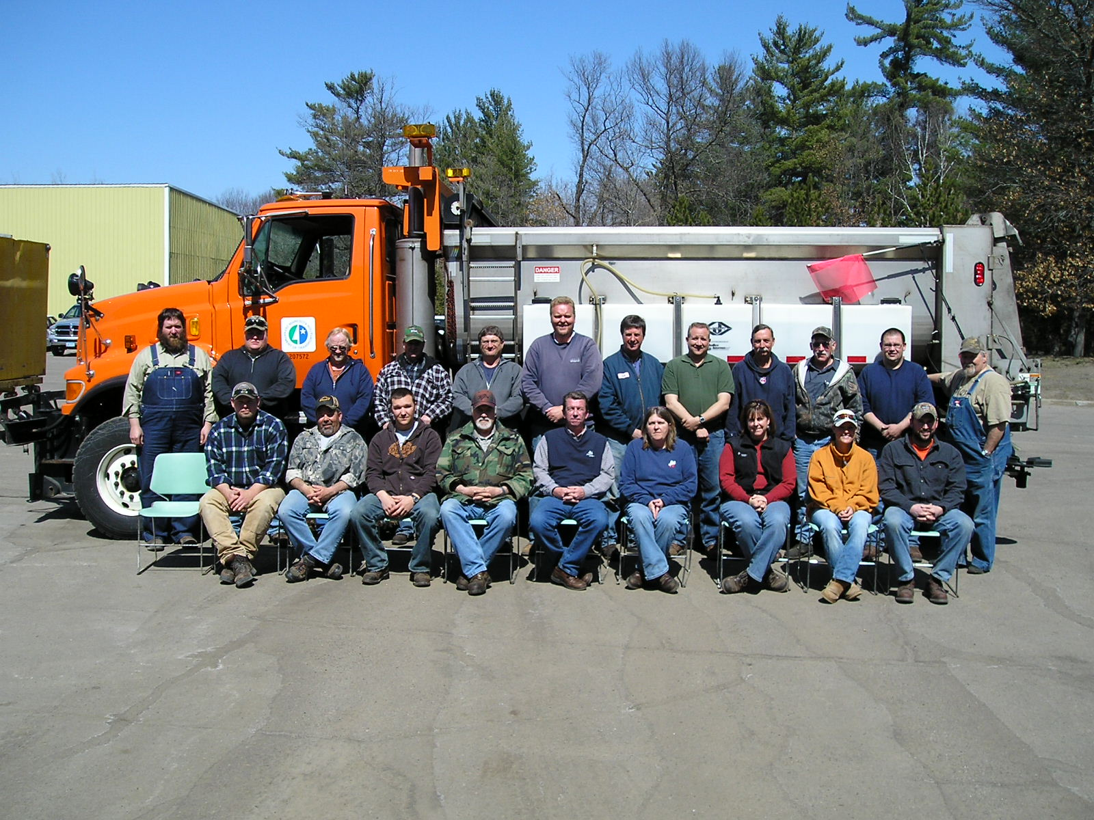

Module 9: Safety
2016 Created for Clear Roads by:
U of MN Center for Transportation Studies &
Fortin Consulting Inc.

Slide 2
Training for Winter Maintenance Supervisors and Operators
2016 Created for Clear Roads by:
U of MN Center for Transportation Studies &
Fortin Consulting Inc.

Slide 3
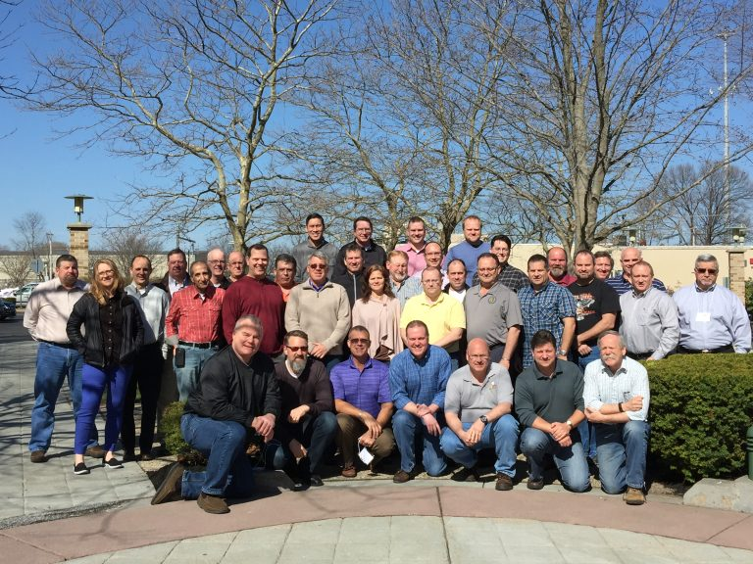
Winter maintenance professionals are a very powerful and important group
Notes:
Photo: clear roads website
Note to presenters: These first 7 slides can be used or hidden.
Or, replace with photos of your staff.

Slide 4
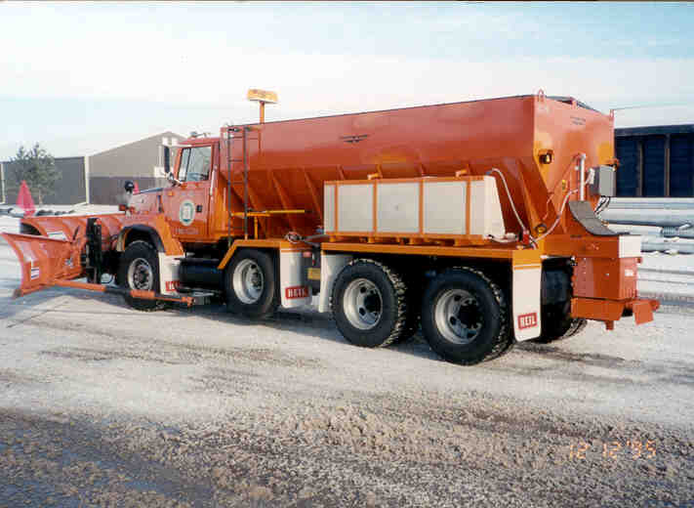
You do a great job of taking care of our roads!

Slide 5
This is one of a series of 22 winter maintenance training modules developed by the Clear Roads Program. All of the modules are available online at www.clearroads.org
Modules include information on the following:
Plowing
Truck operations
Spreading
Material use
Pre-wetting
Brine production
De-icing and anti-icing
Level of service
Ice formation
Freeze point depressants
Environmental issues
Drift control
Weather
Avalanche management
Bridge frost
Safety
Notes:
Note to presenters: The website www.clearroads.org can be accessed here if a live internet connection is available.
A list of all the modules is given here:
Plowing procedures
Truck operations
Spreading
Material use
Pre-wetting
Brine production
De-icing
Anti-icing
Safety
De-icing agent management policy
Level of service
Ice formation
Freeze point depressants
Environmental issues
Drift control
Weather
Bridge frost
Avalanche management

Slide 6
Module 9: Safety
2016 Created for Clear Roads by:
U of MN Center for Transportation Studies &
Fortin Consulting Inc.

Slide 7
FACILITATOR NOTES (do not show during class)
This is a priority 1 module to be developed for Clear Roads national training. It will address three audiences. Slides can be customized for the audience.
Slide Legend
Entry-level plow drivers
Experienced plow drivers
Supervisors
Notes:
Note to facilitator: do not show this slide during class

Slide 8
Background (do not show)
The objective of this training module is to describe the issues that require special consideration to operate safely during the winter. The trainee should gain understanding of the various hazards that they will be exposed to including (but not limited to): slippery surfaces, cold weather, poor visibility (both in the yard and out on the highway) ,working at night, and working long hours. At the end of the training, the trainee should be prepared to take extra precautions, not to hurry, watch out for others, and promote safety among the crew.
Notes:
Note to presenters: Hide this slide when making presentation.
The objective of this training module is to describe the issues that require special consideration to operate safely during the winter. The trainee should gain understanding of the various hazards that they will be exposed to including (but not limited to): slippery surfaces, cold weather, poor visibility (both in the yard and out on the highway) ,working at night, and working long hours. At the end of the training, the trainee should be prepared to take extra precautions, not to hurry, watch out for others, and promote safety among the crew.

Slide 9
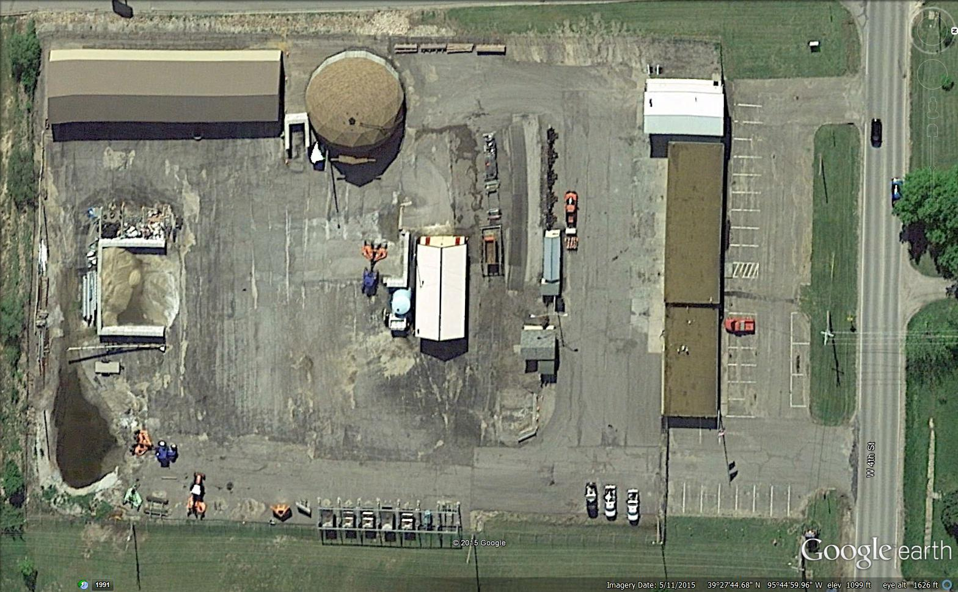
Safety in the yard
Notes:
This is the first of 3 safety sections:
Safety in the yard
Safety on the road
Personal safety
This section is a collection of tips about safe practices while working at the truck station. Use the module as it has been developed, and add any other safety concerns or suggestions that meet your needs.
Photo credit: KSDOT
To start this training module, we have an aerial view of a yard or truck station. All the areas on the photo have safety concerns associated with them All Use this as a opening class discussion to get people thinking about safety.

Slide 10
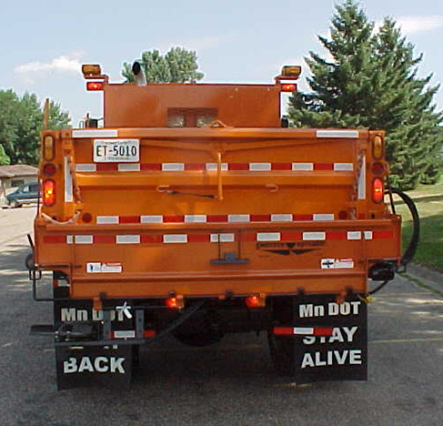
Backing up tips
Avoid backing if possible!
Use a spotter.
Verify swing clearance.
Get out! Check above, under, to the sides and to the rear.
Warn others that truck is backing up.
Turn off radio/music.
Go slow.
Use mirrors.
Back towards driver’s side if possible.
Other?
Beep...Beep…Beep
Backing up: #1 cause of CMV crashes
Notes:
Photo & bullet points taken from MNDOT: 9-SPOT-Ripley_Backing.ppt
This is one of the most frequent and dangerous maneuvers. Present this slide, and ask for safe backing tips from the audience. There are many more precautions other than those listed on this slide that can be taken. Your organization may have more official backing procedures. If so, this is a good time to cover them.

Slide 11
Test Question 1
What is one of the most dangerous maneuvers in the yard?
Driving forward
Backing up
Loading salt
Washing trucks
Notes:
Note to presenters: you may choose to hide this slide.
Test question
What is one of the most dangerous maneuvers in the yard?
Driving forward
Backing up
Loading salt
Washing trucks

Slide 12
Test Question 1
What is one of the most dangerous maneuvers in the yard?
Driving forward
Backing up
Loading salt
Washing trucks
Notes:
Note to presenters: you may choose to hide this slide.
Test question
What is one of the most dangerous maneuvers in the yard?
Driving forward (no)
Backing up (yes)
Loading salt (no)
Washing trucks (no)

Slide 13
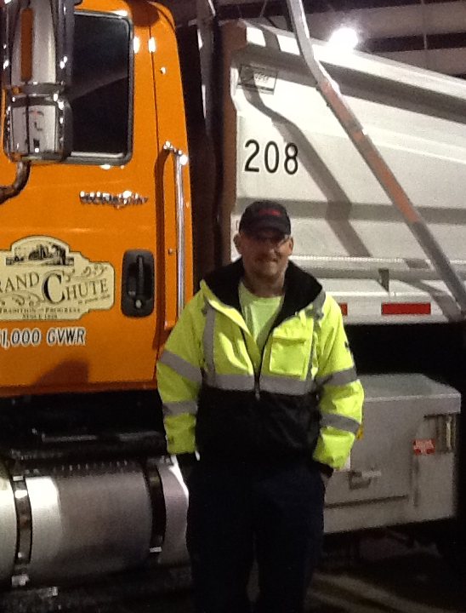
“The circle of safety”
Walk around your truck before moving it
Especially before backing up.
You are not able to see things behind or on the side of the truck.
Notes:
Walking around your truck prior to moving it is the only way to ensure there are no unseen obstacles in your way. This should be done every time you move your truck, especially when you are planning on backing up.

Slide 14
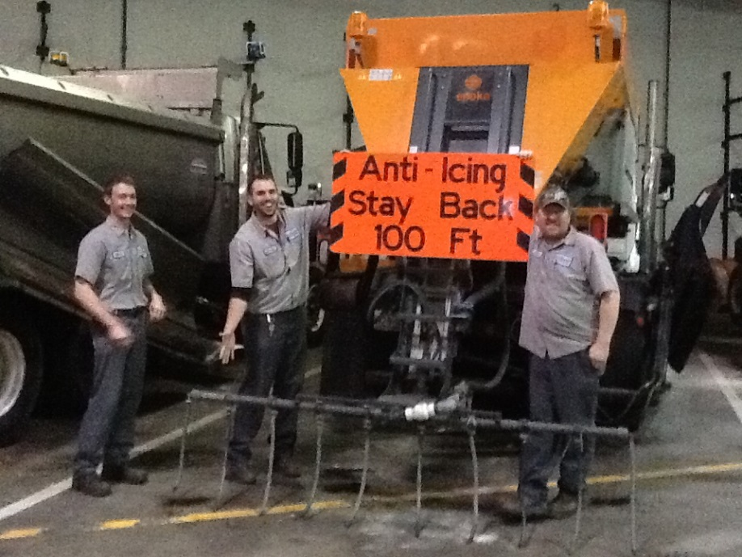
What is on the back of your truck ?
Spinner
Chute
Trailer
Lights
Tailgate down
Tailgate tanks
Raised box
Spray bar
All of these items are easily damaged by backing maneuvers.
Notes:
The back end of your truck may have a variety of equipment attached to it or be in various states of open/close, up/down. Before backing up with your truck, take the time to walk behind it and confirm there are no obstacles in the way. The time it takes to do this is worth the time it would take to fix a new problem we might cause.
Photo credit: Fortin Consulting Inc.

Slide 15
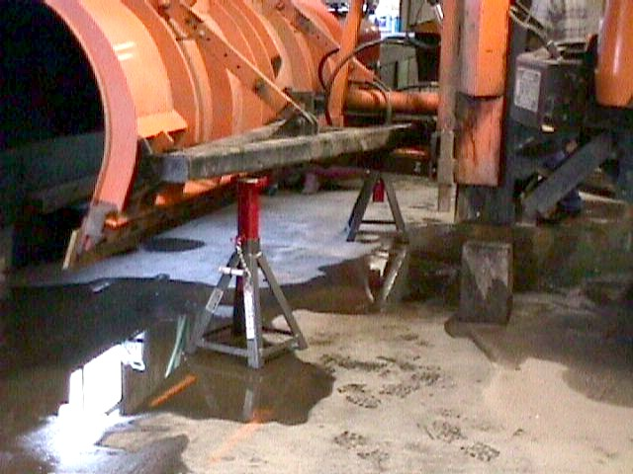
Changing blades
Block plow before changing blades
Working safely may get old but so do those who practice it. – Author Unknown
Notes:
Photo credit: CDOT

Slide 16
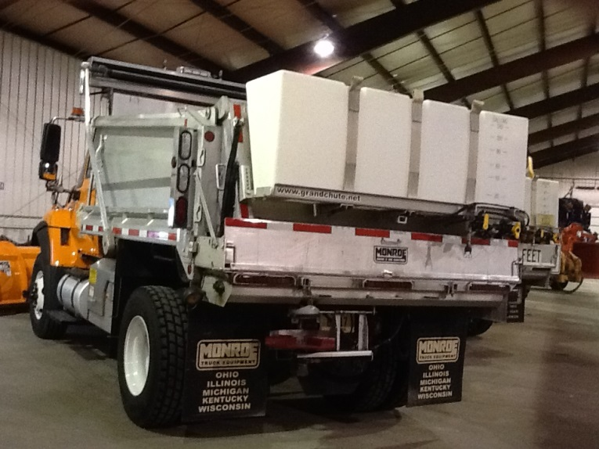
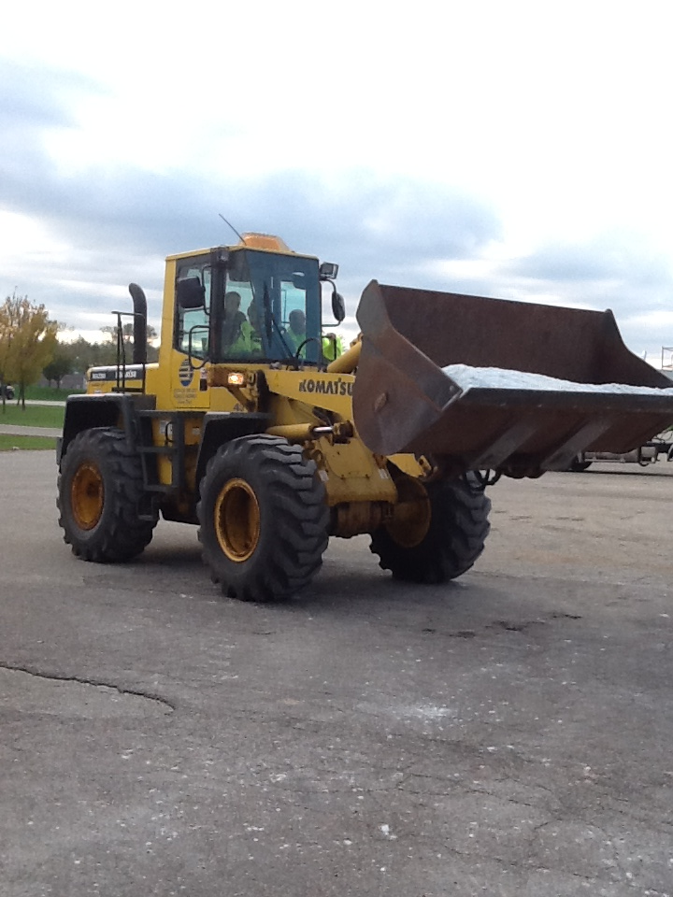
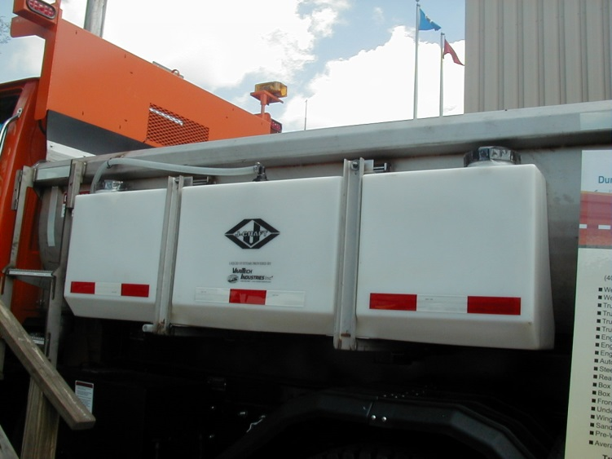
Loading
I’ve learned the tanks aren’t loader proof
Notes:
Take your time and use caution when filling the box. The tanks are susceptible to being damaged by the loader.
Photo credit: Fortin Consulting Inc.

Slide 17
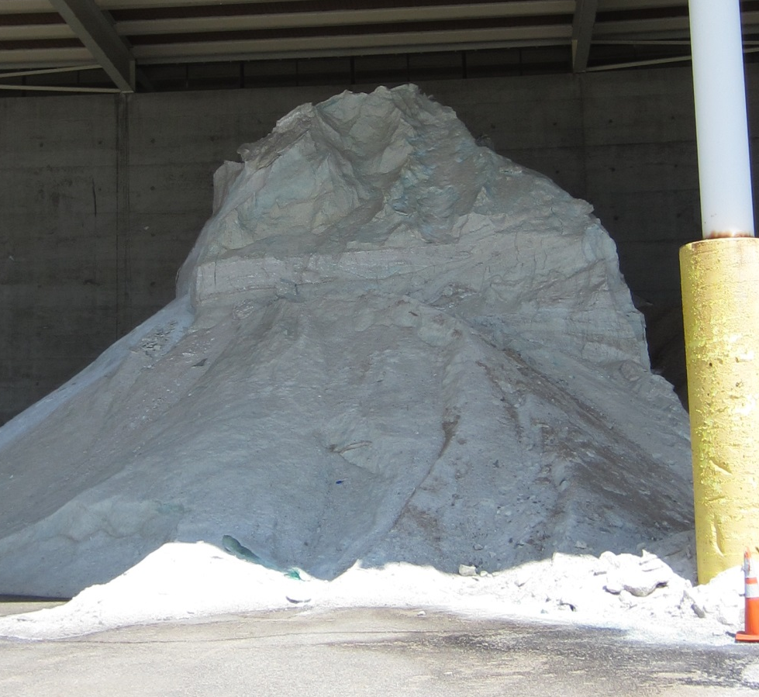
Stockpile safety tips
Be aware that stockpiles can avalanche or collapse.
Keep an open space behind you so you don’t get pinned in (no walls or equipment immediately behind you).
Don’t get too close to vertical faces of the pile.
Note to presenters: Review your safety procedures for working near stockpiles. Delete this yellow box before making presentation.
Notes:
If you have stockpile safety guidance, put it here. Otherwise, use this slide as it is. Below is the salt institute’s guidance, which has more detail than the slide. It would be helpful for the instructor to read through that as well.
Source: Salt institute http://www.saltinstitute.org/wp-content/uploads/2013/09/Salt-Storage-Handbook-2015.pdf
“Never approach the vertical face of a stockpile on foot or in a vehicle closer than the vertical dimension of the pile; it might collapse and cover you in an avalanche.
Never park next to a stockpile or next to equipment working a stockpile.
Never position yourself between the face of a stockpile and an immovable object (such as a loader or other vehicle).
When working on top of a stockpile, never approach the crest closer than 15 feet.
Always ensure that you have proper footing when accessing the top of a stockpile, and always be alert for sinkholes or other openings in the surface of the pile.”
Note to presenters: Review your safety procedures for working near stockpiles. Delete this yellow box before making presentation.
Photo credit: Fortin Consulting Inc.

Slide 18
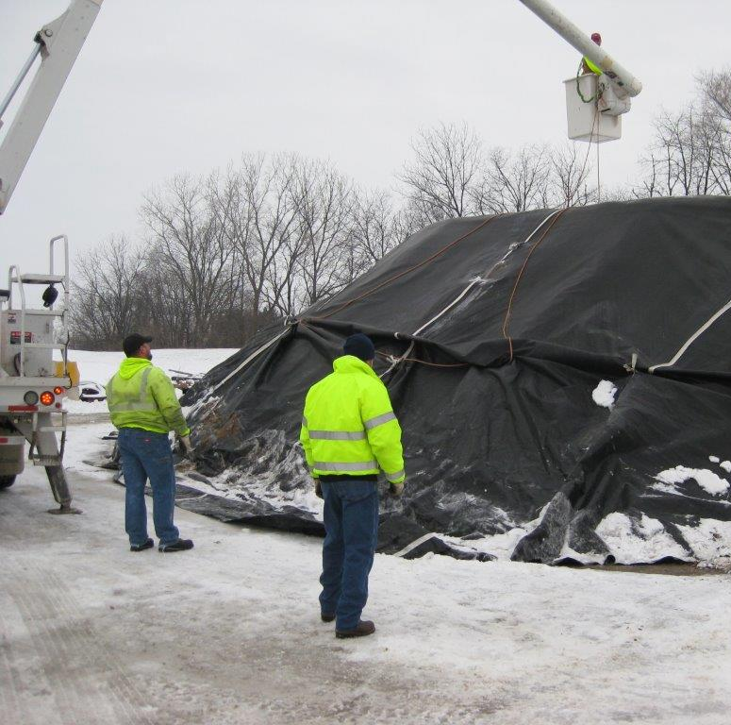
Avoid walking on stockpiles; sinkholes are possible.
Notes:
Find other ways to get your work done besides walking on the top of a stockpile. It is dangerous.
Photo credit: City of Beloit

Slide 19
Test Question
Are salt stockpiles safe to walk on?
Yes
No
Notes:
Note to presenters: you may choose to hide this slide.
Test question
Are salt stockpiles safe to walk on?
Yes – no
No - yes

Slide 20
Test Question
Are salt stockpiles safe to walk on?
Yes
No
Notes:
Note to presenters: you may choose to hide this slide.
Test question
Are salt stockpiles safe to walk on?
Yes – no
No - yes

Slide 21
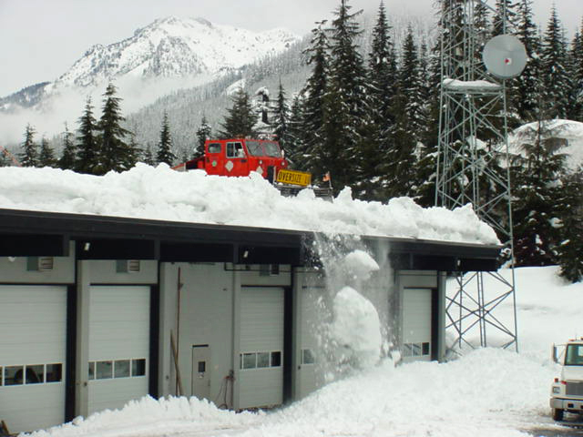

Look up!
We don’t need a mountain for an avalanche… snow will also avalanche off of roofs.
http://www.dailymotion.com/video/x2yk8ve
Notes:
Note to presenters: Here is a link to a video that shows how sensitive snow accumulating on a roof might be. Our concern in this training module is not how to clear the snow but to be aware of snow accumulating on the buildings in your work area and stay safe around them.
Click on the link to access the video. You must have a live internet connection to watch this. Also, make sure that you have connected an audio cable so that sound is working.
Link: http://www.dailymotion.com/video/x2yk8ve
Photo credit: Washington DOT

Slide 22
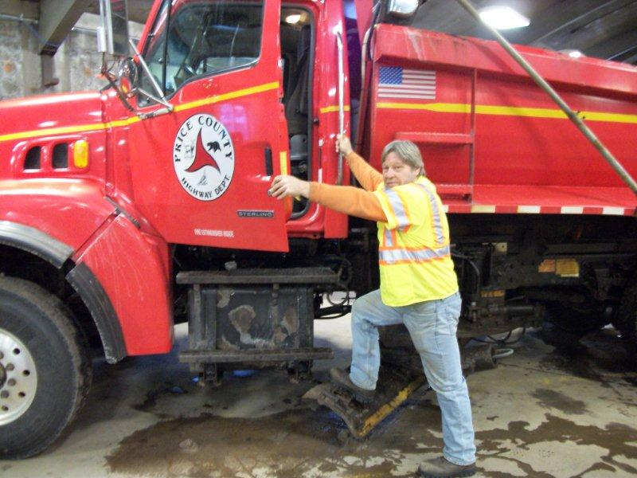
Time to get on the road!
Proper entry and exit
Face the machine.
Maintain 3 points of contact.
Keep boots clean.
Keep the steps clean.
Never jump out of the truck.
Expect steps to be icy and slippery
Notes:
Take your time and use proper technique to enter and exit the cab of your truck. If you take shortcuts, the chances of hurting yourself greatly increase.
Photo credit: Price County, Wisconsin

Slide 23
Test Question
How should you enter and exit the cab of your plow?
Face the truck and maintain 3 points of contact
Face away from the truck and maintain 3 points of contact
Climb in and jump out of the truck
Any way that works best for you
Notes:
Note to presenters: you may choose to hide this slide.
Test question:
How should you enter and exit the cab of your plow?
Face the truck and maintain 3 points of contact - yes
Face away from the truck and maintain 3 points of contact - no
Climb in and jump out of the truck- no
Any way that works best for you - no

Slide 24
Test Question
How should you enter and exit the cab of your plow?
Face the truck and maintain 3 points of contact
Face away from the truck and maintain 3 points of contact
Climb in and jump out of the truck
Any way that works best for you
Notes:
Note to presenters: you may choose to hide this slide.
Test question:
How should you enter and exit the cab of your plow?
Face the truck and maintain 3 points of contact - yes
Face away from the truck and maintain 3 points of contact - no
Climb in and jump out of the truck- no
Any way that works best for you - no

Slide 25
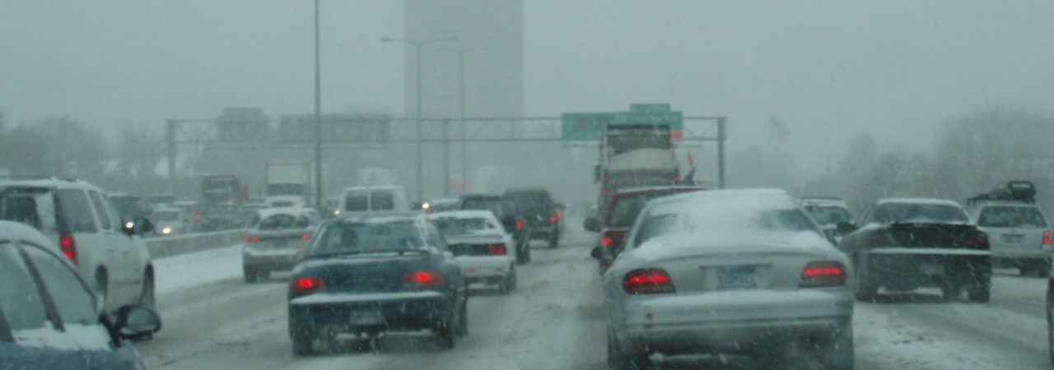
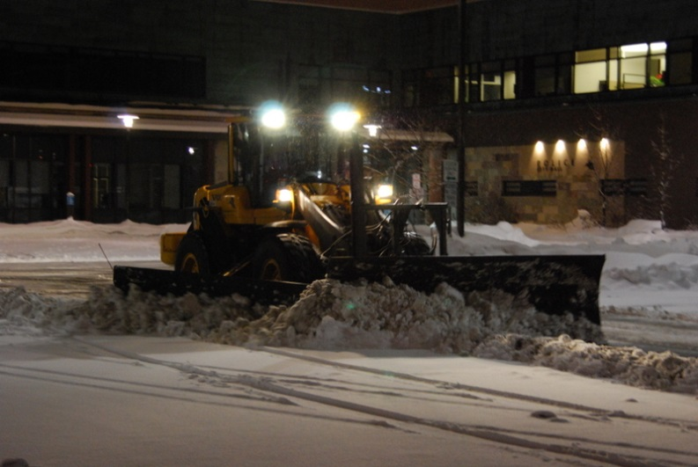
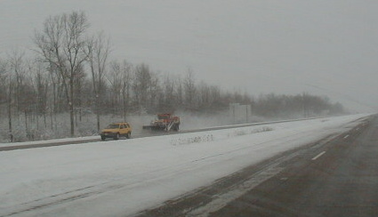
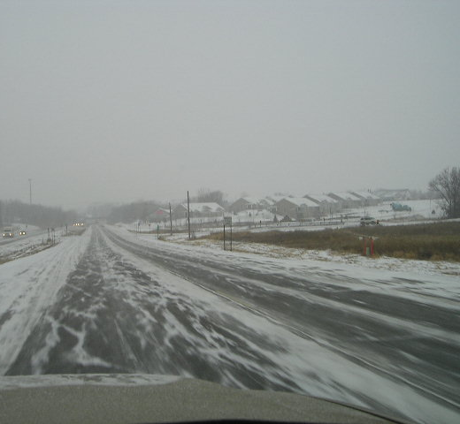
Safety on the road
Notes:
This is the second of three safety sections:
Safety in the yard
Safety on the road
Personal safety
This section is a collection of tips about safe practices while driving winter maintenance equipment. Use the module as it has been developed, and add any other safety concerns or suggestions to meet your needs.
What safety concerns do we have on the road?
To start this training module, we have a few pictures to start discussion about safety on the road. What areas on the photos have safety concerns associated with them? Use this as a opening class discussion to get people thinking about safety.

Slide 26
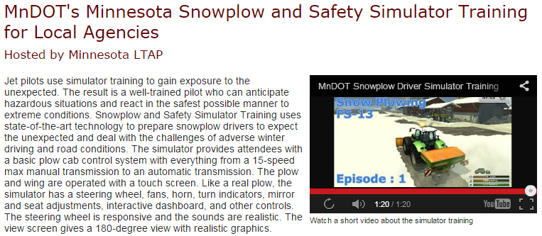
Simulator training
Note to presenters: enter information about your simulator training or hide this slide. Delete this yellow box before making the presentation.
Notes:
Note: this slide is for plow drivers only. If you offer snow plow simulator training that covers safety issues, include information about it on this slide. If this is not available to you, hide this slide.
Additional note to presenters: enter information about your simulator training or hide this slide. Delete this yellow box before making the presentation.

Slide 27
Simulator training
If you have simulator training, insert it here and instead of discussing how to get simulator training, discuss how to improve simulator training.
To view simulator video clip: https://www.youtube.com/watch?v=vrkw_meK2fI
Notes:
Note to presenters: This slide is for supervisors only. Supervisors, would this type of simulator training be useful for your plow drivers? Consider talking to MnDOT or other states using this tool to discuss the cost and benefits they are seeing this this program.
If you have simulator training, insert it here and instead of discussing how to get simulator training, discuss how to improve simulator training.
The link here is for a simulator video clip that is just over one minute long. To start the video, click on the link. It will only work with a live internet connection. Make sure you also have audio cables and a projector connected:
http://www.mnltap.umn.edu/training/topic/maintenance/snowplow/index.html

Slide 28
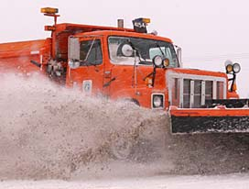
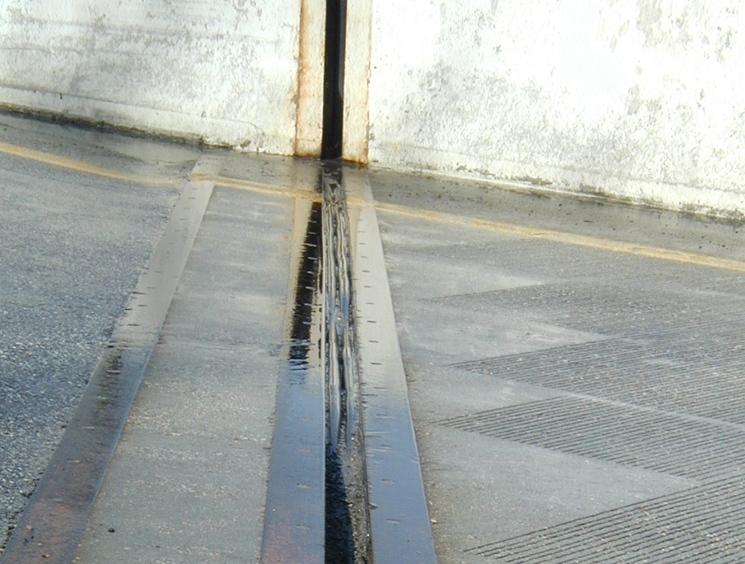
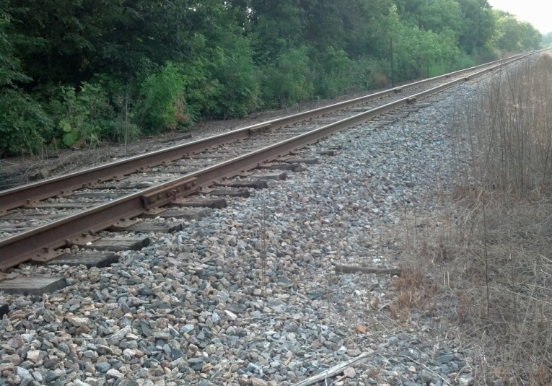
Know your route: road hazards
RR crossing
Manhole covers
Expansion joints
Curbs
Guardrails
Storm drains and so on
Tips from experienced operators: drive your plow route in the fall and make notes of any obstacles.
Notes:
The plow can catch on a variety of raised surfaces causing damage to the plow and possible injury to yourself. Drive your routes before winter and note where these obstacles exist. Put them on your route map, and create some easy reminders for yourself. There will be someone, perhaps everyone in the room, who has hit or has some experience with these obstacles. Ask the experience plow drivers if they have encountered any of these hazards. The new operators should pay close attention to the discussion.
Examples of hazards:
1) bridge rails
2) expansion joints at bridges
3) accident sites where debris could be on road
4) gore areas at clover leafs and ramps where curb can catch the plow
5) guardrail that may have been hit and sticking out into traffic
6) keep truck tires on pavement at all times when plowing shoulder to prevent losing control
7) erratic drivers
8) broken curb areas that could hook plow
9) light pole bases that can be hit with a plow
10) curb areas that can be covered by snow and not seen
Photo credits:
Left Photo: MnDOT
Right lower Photo: Fortin Consulting Inc.
Right upper photo: MDDOT

Slide 29
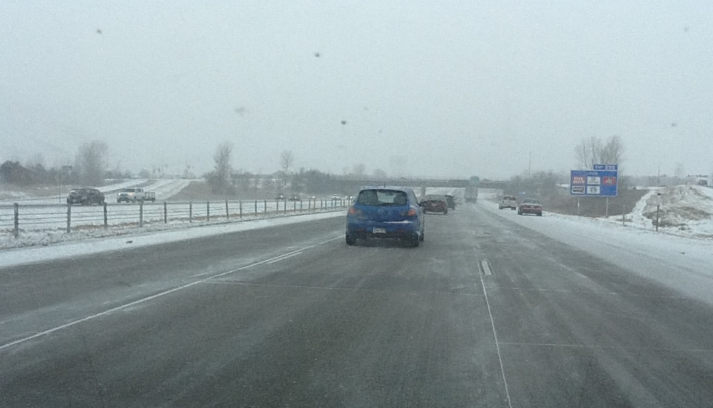
Defensive driving
Drive in such a way that you do not involve yourself in the actions or mistakes of others.
Look 10 to 12 seconds ahead in the city.
Look 15 to 18 seconds ahead on the highway.
Notes:
Drive defensively by:
Looking ahead and staying alert to changes.
Observing the entire situation.
Recognizing potential hazards.
Deciding on an appropriate response.
Carrying out your plan.
Looking 10 to 12 seconds ahead in the city.
Looking 15 to 18 seconds ahead on the highway.
Identify the hazards in this photo:
Cars pulled over on the shoulder.
A bridge.
Semi truck in left lane.
Line of traffic in right lane.
Entrance ramp up ahead.
Conditions of road and weather.
All are good to keep an eye on and be aware of.
Photo credit: Fortin Consulting Inc.

Slide 30
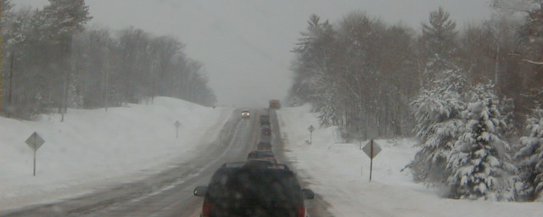
What are your strategies to control your truck?
How fast can your truck stop with a full load?
How does your truck handle with an empty load?
How does your truck perform with the box up?
Notes:
Things to consider:
Plow trucks do not maintain a constant center of gravity.
Load stability changes constantly during a shift.
Load stability is in constant flux.
Load can shift front to rear and side to side.
Plow and wing components can increase instability.
Raising/lowering the dump box will change the center of gravity.
Amount of material in the dump box will change the center of gravity.
Photo credit: Fortin Consulting Inc.

Slide 31
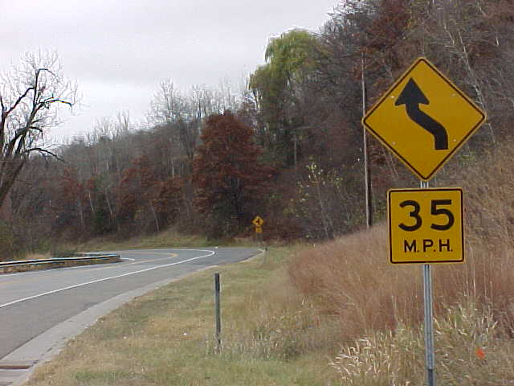
Negotiating curves
Enter curves at least 5 mph below posted speed limit.
Avoid braking in a curve.
Start at a slower speed and accelerate when moving into the curve.
Notes:
Caution is especially important when negotiating a curve. Be sure to observe the following practices:
Enter curves at least 5 mph below posted speed limit.
Avoid braking in a curve.
Start at a slower speed and accelerate when moving into the curve.
Photo credit: MnDOT

Slide 32
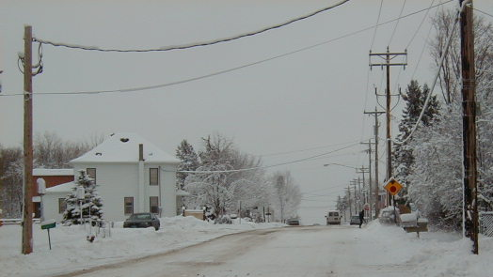
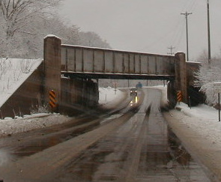
Box height
Lower box before going in buildings, under bridges, and under wires.
Tips from experienced drivers: The higher the truck bed, the lower the truck’s speed should be.
Notes:
The higher the truck bed, the lower the truck’s speed should be - MDDOT_Snow-College-Part-1_slides_9-12.pptx
In most classes, there is someone who has experienced or witnessed problems associated with raised boxes. Everyone knows this is an issue, but the key is how to keep it in mind during winter operations. Ask for suggestions from the class.
Photo credits: Fortin Consulting Inc.

Slide 33
Test Question
What should you be looking for on a pre-season route inspection?
Raised surfaces that could catch the plow blade.
Low overhead hazards.
Bridges, curves, steep hills.
All of the above.
Notes:
Note to presenters: You may hide this slide.
Test Question
What should you be looking for on a pre-season route inspection?
Raised surfaces that could catch the plow blade- no
Low overhead hazards - no
Bridges, curves, steep hills - no
All of the above - yes

Slide 34
Test Question
What should you be looking for on a pre-season route inspection?
Raised surfaces that could catch the plow blade.
Low overhead hazards.
Bridges, curves, steep hills.
All of the above.
Notes:
Note to presenters: You may hide this slide.
Test Question
What should you be looking for on a pre-season route inspection?
Raised surfaces that could catch the plow blade- no
Low overhead hazards - no
Bridges, curves, steep hills - no
All of the above - yes

Slide 35
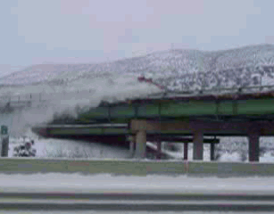
Beware of bridges
Bridge surface temperatures change faster than roads and may become icy faster.
Beware of expansion joints with the plow.
Don’t plow snow over side of bridge.
Low overhead may cause problems with raised boxes.
Tip from experienced operator: During rain events, feel the backside of your mirror. If it is starting to freeze, so are the bridges.
Notes:
Bridges create different areas of concern in maintenance. They are often the first to freeze over or ice up. The have expansion joints, which can catch on the plow blades. Plowing snow over the bridge may create a hazard for motorists or pedestrians below. Plowing snow over the bridge may also cause water pollution to rivers, lakes or wetlands below.
Photo credits:
Top photo: CDOT
Lower 2 Photos: Fortin Consulting Inc.

Slide 36
Test Question
Do bridge decks change temperature faster than roads?
Yes. Air surrounds them, and air changes temperature faster than land.
No. Air surrounds them, and air changes temperature slower than land.
Notes:
Note to presenters: You may choose to hide this slide.
Test question:
Do bridge decks change temperature faster than roads?
Yes, air surrounds them and air changes temperature faster than land– yes
No, air surrounds them and air changes temperature slower than land - no

Slide 37
Test Question
Do bridge decks change temperature faster than roads?
Yes. Air surrounds them, and air changes temperature faster than land.
No. Air surrounds them, and air changes temperature slower than land.
Notes:
Note to presenters: You may choose to hide this slide.
Test question:
Do bridge decks change temperature faster than roads?
Yes, air surrounds them and air changes temperature faster than land– yes
No, air surrounds them and air changes temperature slower than land - no

Slide 38
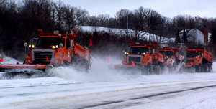
Group plowing
Concentration and communication are keys to keeping yourself, others in the group, and the traveling public safe.
Notes:
Remember, the faster your speed, the more unstable your truck. The group should move at a reasonable speed set by an experienced driver.
Tips:
Maintain safe following distance.
Try to prevent traffic from passing between trucks.
Use warning signs when possible (VMS).
Use caution, be alert.
Communicate with other plows.
Photo credit: MnDOT

Slide 39
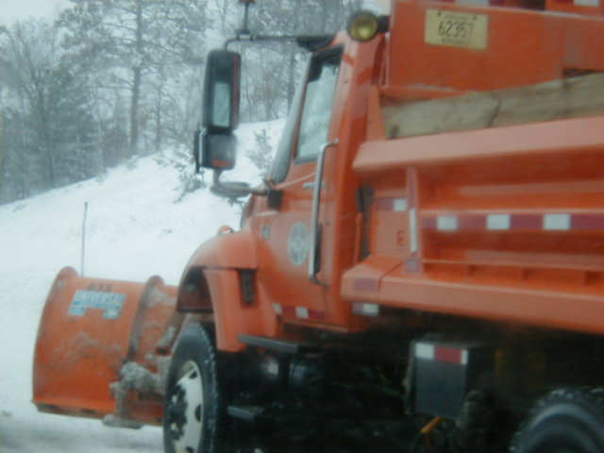

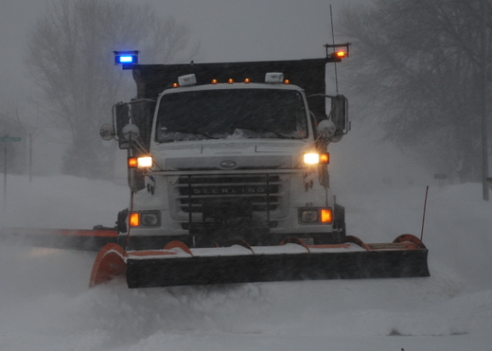

Strive for the best visibility
Strive for the best visibility
you can achieve while plowing…
Keep windshield, lights, and mirror clean.
Note to presenters: Insert your guidelines for stopping operations until there is adequate visibility. Delete this yellow box before making presentation.
Notes:
There are many innovations in lighting and equipment that can improve the visibility for the driver. It is up to the driver to keep the windshield, mirror, and lights as free of snow and ice as possible. Conditions may arise when the visibility is not adequate to continue plowing. Each organization has their own guidelines of how and when to stop and resume operations. This is a good time to discuss your guidelines. Your guidelines may also call for the discontinuation of operations in extreme cold.
Note to presenters: Insert your guidelines for stopping operations until there is adequate visibility. Delete this yellow box before making presentation.
Photo credit: Fortin Consulting Inc.

Slide 40
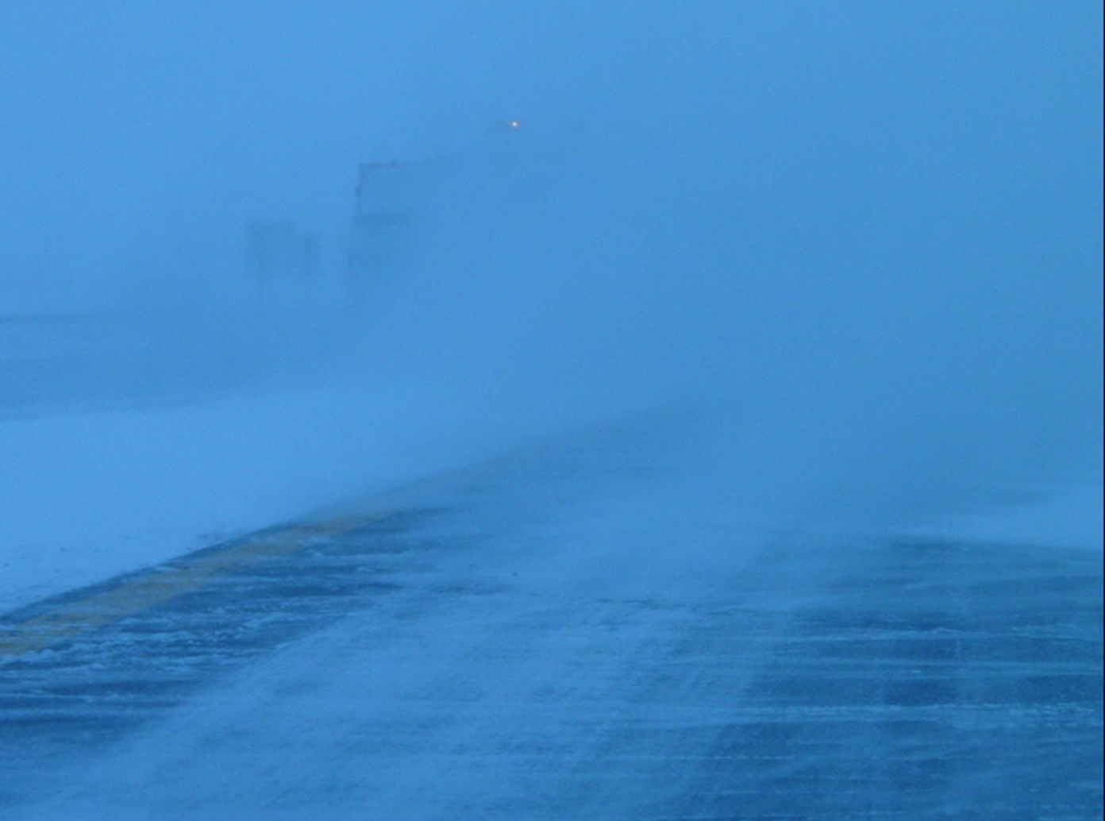
Poor visibility
If visibility is too poor, stop plowing operations.
Tip from experience drivers: use power poles or other roadside features as a rough guide for where you should be during periods of heavy snowfall when you have "lost" the roadway in rural areas.
Notes:
Tip from Monty Mills, Washington DOT
Photo credit: Iowa DOT

Slide 41
Test Question
If visibility is too poor for you to see…
Keep plowing.
Stop plowing.
Notes:
Note to presenters: you may choose to hide this slide.
Test question:
If visibility is too poor for you to see…
Keep plowing - no
Stop plowing - yes

Slide 42
Test Question
If visibility is too poor for you to see…
Keep plowing.
Stop plowing.
Notes:
Note to presenters: you may choose to hide this slide.
Test question:
If visibility is too poor for you to see…
Keep plowing - no
Stop plowing - yes

Slide 43
Night plowing
Tips from experienced drivers:
“During heavy snowfall, use the truck headlights on dim rather than the high mounted ‘plow lights.’ The plow lights tend to reflect heavy snowfall, blinding the operator.”
“If the road is wet, the temp is likely to drop as it gets dark, which could cause ice. Keep a close eye on the surface temp. As it starts to set up, it might sparkle under the head lights. Use bridge decks as a first read.”
Notes:
First tip from Monty Mills, Washington DOT
Second tip from Justun Juelfs, MTDOT
Third tip: ”I have driven on roads where the wind is blowing in the same direction and at the same speed which you are trying to travel (i.e. wind from the west blowing at 25 mph and you are travel east bound at about 25 mph). The snow appears to be falling straight down, reducing visibility. You may have to reduce speed so that you are not travelling at the same speed as the wind. You may also have to adjust the plow direction so the snow plume does not reduce visibility even more. “ from Cliff Spoonmore, Wyoming DOT.

Slide 44
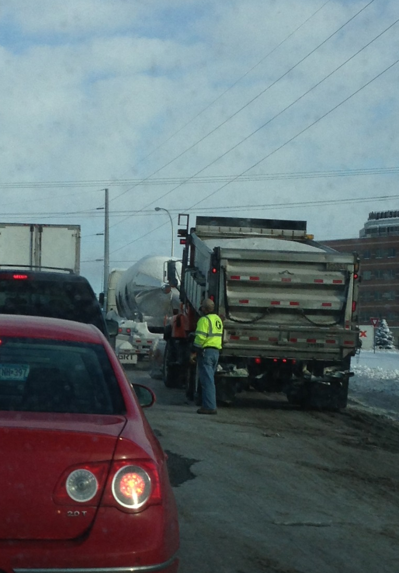
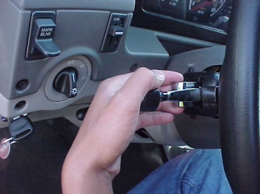
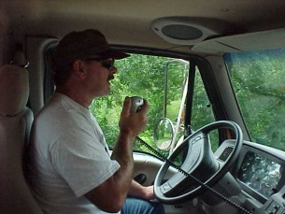
Truck problems
Protect yourself – do not get out of the truck until it is safe to do so.
Protect other motorists – put flags out and turn lights on to warn others.
Call dispatch/state patrol for help with traffic.
Protect your vehicle – shut off anything that might compound the breakdown.
?
Note to presenters: use this slide to discuss your policy/guideline for stalled or disabled vehicles. Delete this yellow box before making presentation.
Notes:
If you experience truck problems:
Get to the side of the road, if possible.
Protect yourself – do not get out of the truck until safe.
Protect other motorists – put safety triangles, flares, and turn lights on to warn traffic.
Call dispatch/state patrol/supervisor for help with traffic.
Stay with your vehicle until help arrives; this is especially important if during a storm or cold weather.
Protect your vehicle – shut off anything that might compound the breakdown.
Note to presenters: Use this photo to lead a class discussion. What observations can be made regarding the right and wrong things the driver is doing?
One set of suggestions from an experienced supervisor:
1. He should be watching for oncoming traffic.
2. Unless he has a good reason to be out of the truck, he should either be in the truck or off to the side where he would have an escape route if a vehicle approached from the rear.
3. Flashing lights should be on.
4. The truck bed should be lowered so that any lighting installed on top of the cab would be visible to the rear.
5. It is good that he is not standing in front of the dump truck.
Example of what can happen: Last winter a dump truck broke down on the shoulder, and another dump truck came and parked behind it. The rear truck was rear ended by another driver, and an employee was crushed between the two trucks. He has just recently returned to work, with restrictions.
Photo credits:
Left Photo: Fortin Consulting Inc.
Right photos: MnDOT

Slide 45
Test Question
If you have truck problems what should you do?
Call your supervisor.
Stay in the truck until it is safe to exit.
Put out safety cones or flags to warn traffic.
All of the above.
Notes:
Note to presenters: you may choose to hide this slide.
Test question:
If you have truck problems what should you do?
Call your supervisor -no
Stay in the truck until it is safe to exit -no
Put out safety cones or flags to warn traffic- no
All of the above - yes

Slide 46
Test Question
If you have truck problems what should you do?
Call your supervisor.
Stay in the truck until it is safe to exit.
Put out safety cones or flags to warn traffic.
All of the above.
Notes:
Note to presenters: you may choose to hide this slide.
Test question:
If you have truck problems what should you do?
Call your supervisor -no
Stay in the truck until it is safe to exit -no
Put out safety cones or flags to warn traffic- no
All of the above - yes

Slide 47

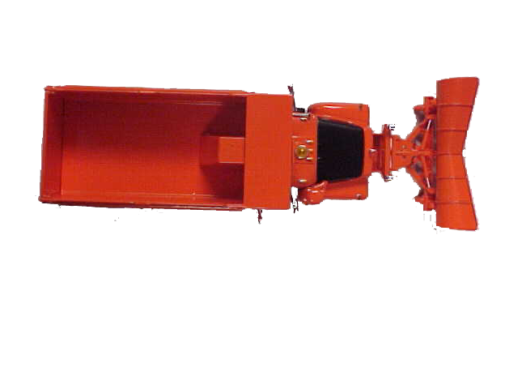
Warning device placement
Two-lane, two-way road:
100 ft
10 ft
100 ft
Note to presenters: modify this figure if your standards are different. Delete this yellow box before making presentation.
Notes:
As you are placing the warning devices, hold the devices in front of you and watch for vehicles that may not see you.
Note to presenters: modify this figure if your standards are different. Delete this yellow box before making presentation.
Image credit: MnDOT

Slide 48
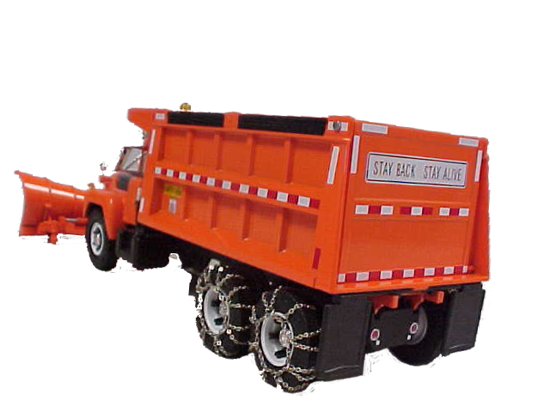
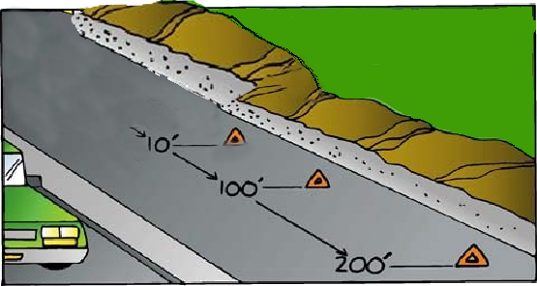
Warning device placement
One-way or divided highway:
Note to presenters: modify this figure if your standards are different. Delete this yellow box before making presentation.
Notes:
As you are placing the warning devices, hold the devices in front of you and watch for vehicles that may not see you.
Note to presenters: modify this figure if your standards are different. Delete this yellow box before making presentation.
Image credit: MnDOT

Slide 49
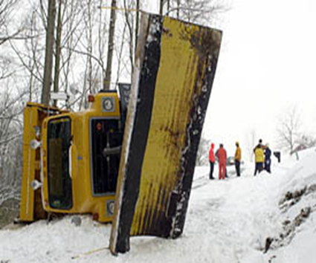
Be prepared for the unexpected
Note to presenters: insert your guidelines for emergencies here. Delete this yellow box before making presentation.
Notes:
It is impossible to foresee all eventualities. Develop action plans for as many common scenarios as possible, keeping in mind that the unexpected may happen.
Note to presenters: insert your guidelines for emergencies here. Delete this yellow box before making presentation.
Photo credit: Iowa DOT

Slide 50

Personal safety
Personal protective equipment is self-defense. ~Author Unknown
Notes:
This is the last of 3 safety sections:
Safety in the yard.
Safety on the road.
Personal safety.

Slide 51
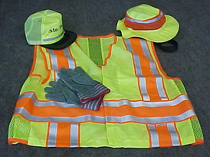
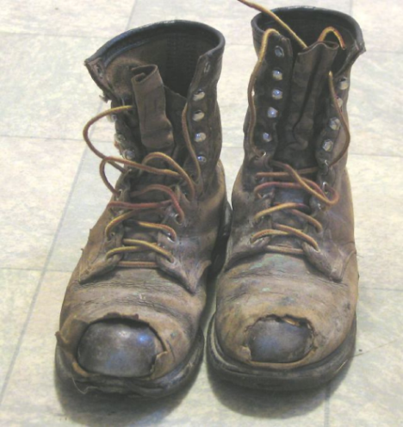
Clothing
Wear proper protective equipment to match the task!
Steel toe boots, high visibility clothes, ear protection, eye protection, gloves.
Note to presenters: insert your guidelines for personal safety equipment and clothing here. Delete this yellow box before making presentation.
Be Seen, Be Safe!
Notes:
Various tasks will demand different safety equipment. However, high visibility clothing and steel toe boots are always recommended.
Note to presenters: insert your guidelines for personal safety equipment and clothing here. Delete this yellow box before making presentation.
Photo credit: MnDOT
Left photo: https://powerplantmen.files.wordpress.com/2014/02/old-work-boots.jpg

Slide 52
Test Question
What is the advantage of high visibility clothing?
You can see each other and the public can see you.
Keeps you warm.
Can also be used for fishing and hunting.
Costs less than other clothing.
Notes:
Note to presenters: you may choose to delete this slide.
Test question:
What is the advantage of high visibility clothing?
You can see each other and the public can see you - yes
Keeps you warm -no
Can also be used for fishing and hunting- no
Costs less than other clothing- no

Slide 53
Test Question
What is the advantage of high visibility clothing?
You can see each other and the public can see you.
Keeps you warm.
Can also be used for fishing and hunting.
Costs less than other clothing.
Notes:
Note to presenters: you may choose to delete this slide.
Test question:
What is the advantage of high visibility clothing?
You can see each other and the public can see you - yes
Keeps you warm -no
Can also be used for fishing and hunting- no
Costs less than other clothing- no

Slide 54
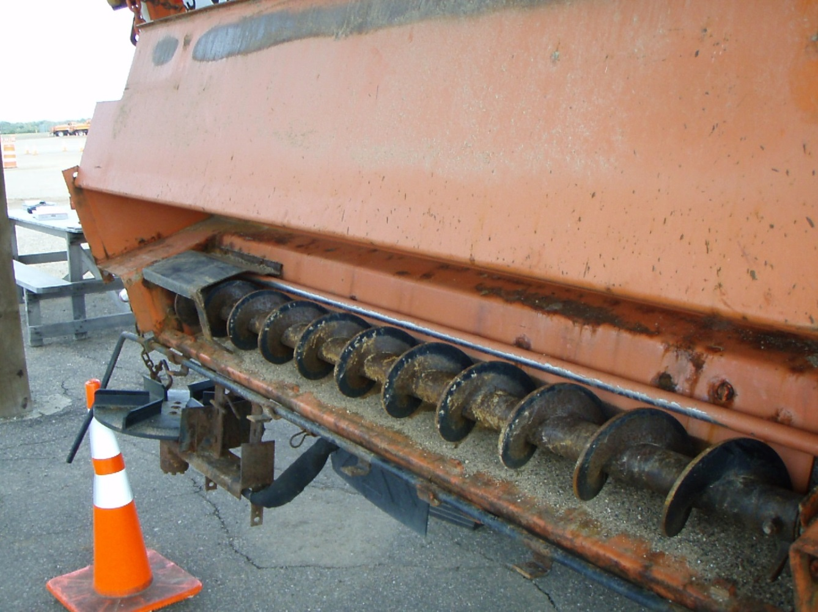
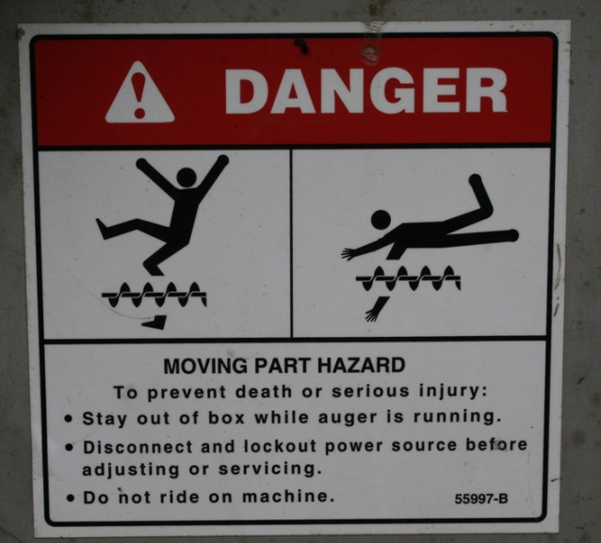
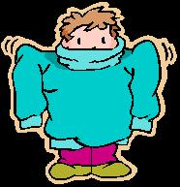
USE EXTREME CAUTION WHEN WORKING AROUND EQUIPMENT
Wearing loose clothing and jewelry is discouraged when working around moving parts.
Don’t use your foot or hand to unclog auger or spinner.
Notes:
PennDOT_Snow-Academy-Part-4_slides_11-16.pptx
Turn off truck motor, release hydraulic pressure, and then use a tool to carefully unclog the spreader. Don’t get into the habit of sticking your hand into the auger area.
Image credit: Microsoft clipart
Photo credit: FCI

Slide 55
Test Question
Are loose fitting clothes a hazard when working around equipment?
Yes
No
Notes:
Note to presenters: you may choose to delete this slide.
Test question:
Are loose fitting clothes a hazard when working around equipment?
Yes (yes)
No (no)

Slide 56
Test Question
Are loose fitting clothes a hazard when working around equipment?
Yes
No
Notes:
Note to presenters: you may choose to delete this slide.
Test question:
Are loose fitting clothes a hazard when working around equipment?
Yes (yes)
No (no)

Slide 57
Stay Alert
Tips from experienced operators: Although there are many tips for how to stay alert, it will require you to come up with a system that works best for you. Each operator is different.
Come in rested for your shift.
While plowing:
Stay hydrated – drink water.
Eat healthy snacks – keep even energy level.
Avoid the ups and downs of high sugar or high caffeine drinks/foods.
Open the window.
Keep a cool cab.
Get out and walk around when re-fueling, re-filling.
Sing/talk out loud.
Move during your breaks, don’t just sit.
Communicate with supervisor if longer breaks are needed.
Other suggestions?
Notes:
Tip from Cliff Spoonemore, WYDOT
What works to keep one operator alert, may not work for the next. Above are some tips that have been shown to help operators. It would be good to ask the audience, especially the senior operators, what works for them.

Slide 58
Test Question
Which of these strategies would be most likely help you stay alert while plowing?
In the fall, practice staying awake all night.
Eat sugary foods and drink highly caffeinated beverages.
Come to work rested, bring healthy snacks and a water bottle.
Put in your ear buds and listen to your favorite music.
Notes:
Note to presenters: you may choose to hide this slide.
Test Question:
Which of these strategies would be most likely help you stay alert while plowing?
In the fall, practice staying awake all night - no
Eat sugary foods and drink highly caffeinated beverages- no
Come to work rested, bring healthy snacks and a water bottle- yes
Put in your ear buds and listen to your favorite music- no

Slide 59
Test Question
Which of these strategies would be most likely help you stay alert while plowing?
In the fall, practice staying awake all night.
Eat sugary foods and drink highly caffeinated beverages.
Come to work rested, bring healthy snacks and a water bottle.
Put in your ear buds and listen to your favorite music.
Notes:
Note to presenters: you may choose to hide this slide.
Test Question:
Which of these strategies would be most likely help you stay alert while plowing?
In the fall, practice staying awake all night - no
Eat sugary foods and drink highly caffeinated beverages- no
Come to work rested, bring healthy snacks and a water bottle- yes
Put in your ear buds and listen to your favorite music- no

Slide 60



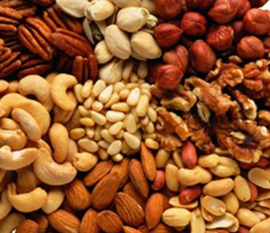


Be prepared
Dress in layers
Gloves, winter hat
Healthy snacks
Water
Long hours
Variable weather
Notes:
Dress in layers, so you have the ability to remove layers to stay comfortable in the cab but have adequate protection from the cold when you need to be outdoors.
Images from Microsoft clipart

Slide 61
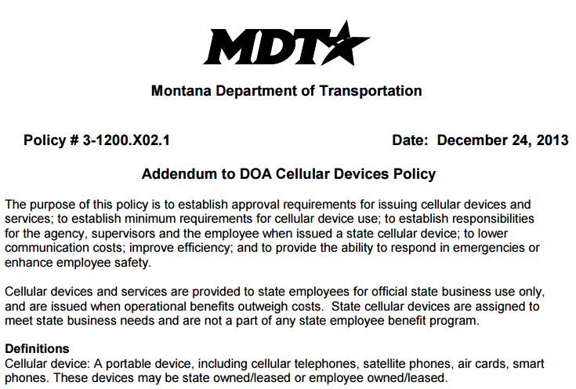

Reduce Distractions
Music
Phone calls
Texting
Other?
Note to presenters: Insert your agency’s policy here. Delete this yellow box before making presentation.
A new FMCSA rule restricts the use of all hand-held mobile devices by drivers of commercial motor vehicles (CMVs). This rule restricts a CMV driver from holding a mobile device to make a call, or dialing by pressing more than a single button. CMV drivers who use a mobile phone while driving can only use a hands-free phone located in close proximity.
Notes:
To increase safety, decrease distractions. Allow yourself the opportunity to focus on your job, your safety, and the safety of the driving public. Discuss your policy at this time, or refer people to a location where they can read the details of your policy. If giving general guidance to a mixed group, you can use your policy as an example.
http://www.fmcsa.dot.gov/driver-safety/distracted-driving/mobile-phone-restrictions-fact-sheet “A new FMCSA rule restricts the use of all hand-held mobile devices by drivers of commercial motor vehicles (CMVs). This rule restricts a CMV driver from holding a mobile device to make a call, or dialing by pressing more than a single button. CMV drivers who use a mobile phone while driving can only use a hands-free phone located in close proximity.”
Note to presenters: Insert your agency’s policy here. Delete this yellow box before making presentation.

Slide 62
Test Question
Is it okay to text and plow?
Yes if it is an emergency.
Yes if the visibility is ok.
Yes if the traffic volume is low.
No it is never okay to text and plow.
Notes:
Note to presenters: you may choose to hide this slide.
Test Question:
Is it ok to text and plow?
Yes if it is an emergency-no
Yes if the visibility is ok- no
Yes if the traffic volume is low - no
No it is never ok to text and plow - yes

Slide 63
Test Question
Is it okay to text and plow?
Yes if it is an emergency.
Yes if the visibility is ok.
Yes if the traffic volume is low.
No it is never okay to text and plow.
Notes:
Note to presenters: you may choose to hide this slide.
Test Question:
Is it ok to text and plow?
Yes if it is an emergency-no
Yes if the visibility is ok- no
Yes if the traffic volume is low - no
No it is never ok to text and plow - yes

Slide 64

Importance of Record Keeping
Keep records of safety training, frequency, and certifications.
This helps your staff be prepared, and lets you know when classes or training sessions need to be scheduled.
Helps with planning, resource management, and helps protect you from claims.
Notes:
Record keeping is important as a means of accountability, performance tracking, support in the event of legal actions, media inquiries, and planning.

Slide 65
Record Keeping
Keeping good records helps
Demonstrate how goals are met.
Demonstrates that you are following policy.
Identify ways to improve and change your approach.
Notes:
Keeping good records is important. It helps to:
demonstrate how goals are met.
demonstrates that you are following policy.
identifies ways to improve and change your approach.

Slide 66

Safety doesn’t happen by accident. ~Author Unknown
Don’t be in a hurry, watch out for others, and promote safety among the crew.

Slide 67
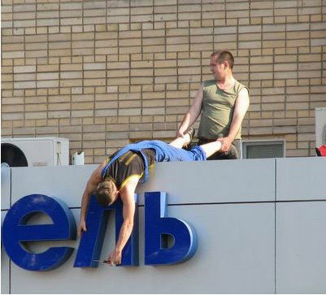
Safety is #1
Safety is a component of everything you do and should be foremost in your thoughts and actions always!
Notes:
Slide courtesy of: IowaDOT_New-Operator-Snow-and-Ice-Training_Slides_25-27.pptx
As our background slide mentioned: “…be prepared to take extra precautions to avoid the need to hurry. Also, remember to watch out for others, and promote safety among the crew."

Slide 68
Additional Resources
AASHTO, Clear Roads Computer Based training:
Proper Plowing Techniques: Unit 3 covers safety tips
Deicing: Unit 3 Material Manufacturing, Handling and Storage
Safety around stockpiles: Salt Institute Salt Storage handbook:
http://www.saltinstitute.org/wp-content/uploads/2013/09/Salt-Storage-Handbook-2015.pdf page 13

Slide 69
Acknowledgements
Training contents were developed by Fortin Consulting Inc., under the direction of the Clear Roads Advisory Team.
Connie Fortin – connie@fortinconsulting.com
Professional formatting and training aids were developed by the University of Minnesota, Center for Transportation Studies.
Jim Grothaus – Groth020@umn.edu
Ann Johnson – Johns421@umn.edu
Members of the Clear Roads Advisory Team include:
Mike Sproul, Dave Wieder, Cliff Spoonemore, Monty Mills, David Frame,
Mike Lashmet, Clay Adams, Justun Juelfs, and Tom Peters

Slide 70
This presentation was developed with funding from the Clear Roads research program, which brings together transportation professionals and researchers from around the country to drive innovation in the field of winter maintenance.
Find additional information and resources at
http://clearroads.org/

Slide 71
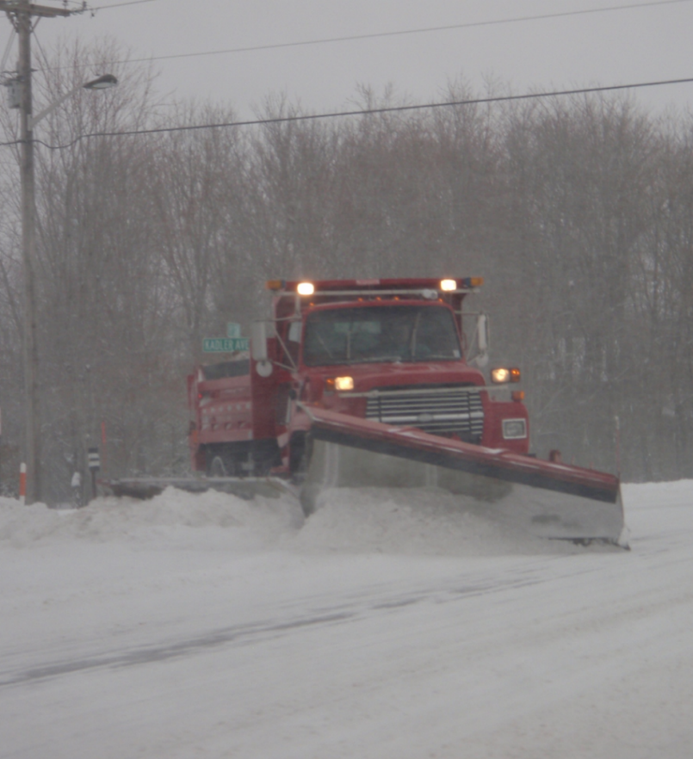
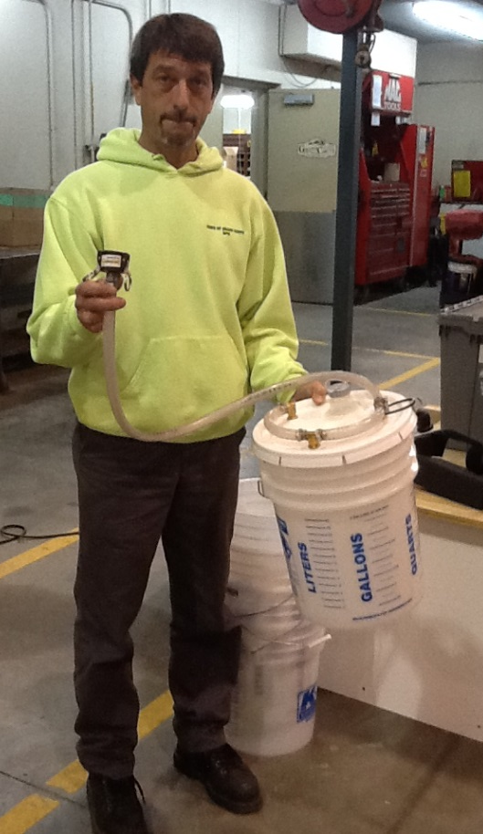
Thank you for your good work!
Notes:
Thank you for your time today. Have a good winter!

