Slide 1
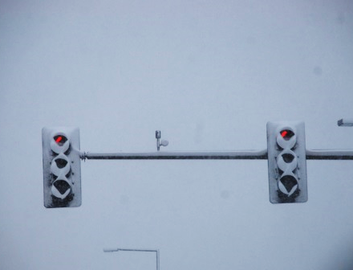

Module 12: Principles of ice formation
2016 Created for Clear Roads by:
U of MN Center for Transportation Studies &
Fortin Consulting Inc.

Slide 2
Training for Winter Maintenance Supervisors and Operators
2016 Created for Clear Roads by:
U of MN Center for Transportation Studies &
Fortin Consulting Inc.

Slide 3
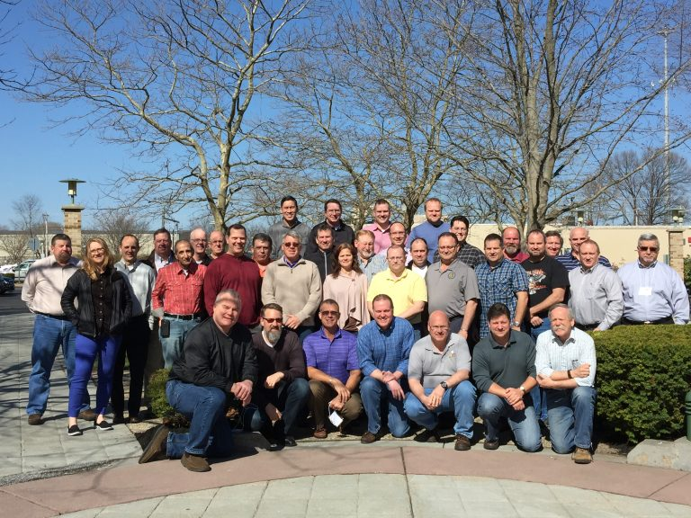
Winter maintenance professionals are a very powerful and important group
Notes:
Photo: clear roads website
Note to presenters: These first 7 slides can be used or hidden.
Or, replace with photos of your staff.

Slide 4
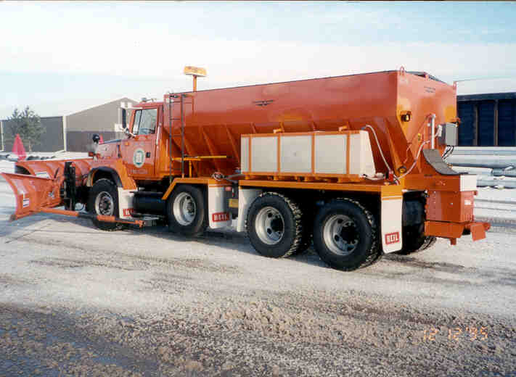
You do a great job of taking care of our roads!

Slide 5
This is one of a series of 21 winter maintenance training modules developed by the Clear Roads Program. All of the modules are available online at www.clearroads.org
Modules include information on the following:
Plowing
Truck operations
Spreading
Material use
Pre-wetting
Brine production
De-icing and anti-icing
Level of service
Ice formation
Freeze point depressants
Environmental issues
Drift control
Weather
Avalanche management
Bridge frost
Safety
Notes:
Note to presenters: The website www.clearroads.org can be accessed here if a live internet connection is available.
A list of all the modules is given here:
Plowing procedures
Truck operations
Spreading
Material use
Pre-wetting
Brine production
De-icing
Anti-icing
Safety
De-icing agent management policy
Level of service
Ice formation
Freeze point depressants
Environmental issues
Drift control
Weather
Bridge frost
Avalanche management

Slide 6
Module 12: Principles of ice formation
2016 Created for Clear Roads by:
U of MN Center for Transportation Studies &
Fortin Consulting Inc.

Slide 7
FACILITATOR NOTES (do not show during class)
This is a priority 1 module to be developed for Clear Roads national training. It will address three audiences. Slides can be customized for the audience.
Slide Legend
Entry-level plow drivers
Experienced plow drivers
Supervisors
Notes:
Note to facilitator: do not show this slide during class

Slide 8
This module will contain these topics
Traffic compaction/snow-packed ice.
Black ice.
Snow glaze.
Blow ice.
Freezing rain.
Notes:
This module covers traffic compaction/snow-packed ice, black ice, snow glaze, blow ice and freezing rain.

Slide 9
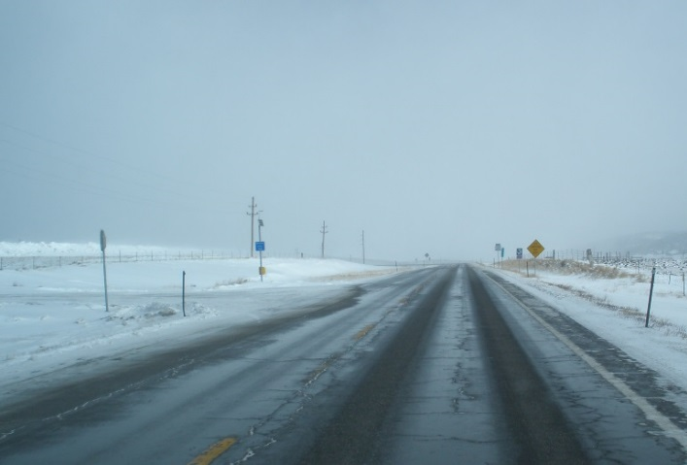
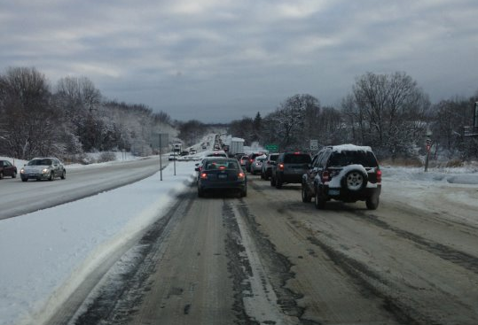
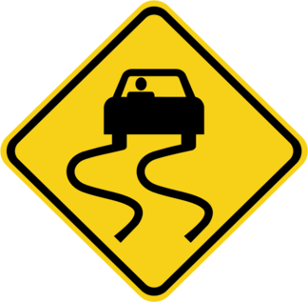
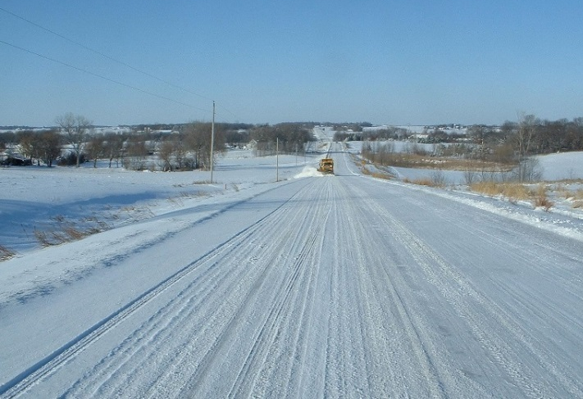
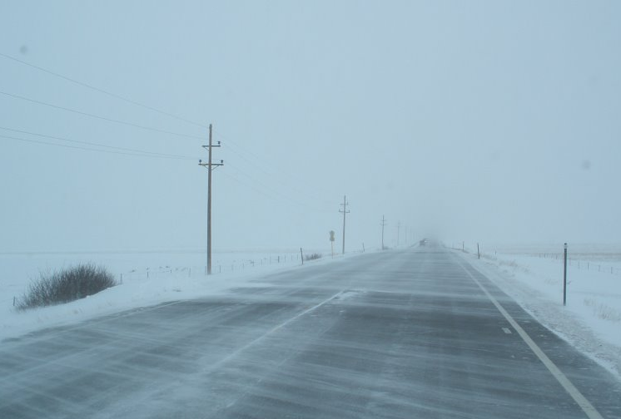
Today we will learn about the
Type
Cause
Prevention
Mitigation
…of different types of road ice.
Notes:
There are many different ways that ice can form on the road throughout the winter snow and ice season. In this module we will talk about the main types of ice: black ice, glaze ice, compaction ice, blow ice, and freezing rain. The module will review the conditions under which each type of ice is formed, ways to help prevent the formation, and how to mitigate the ice once it has formed.
It is important to remember that these are general guidelines and that having a policy in place and following that policy is important for any winter maintenance facility.
Picture credits: Fortin Consulting Inc.

Slide 10
Black ice
Conditions and temperatures that lead to black ice
How to mitigate black ice
Notes:
The next section covers black ice.

Slide 11
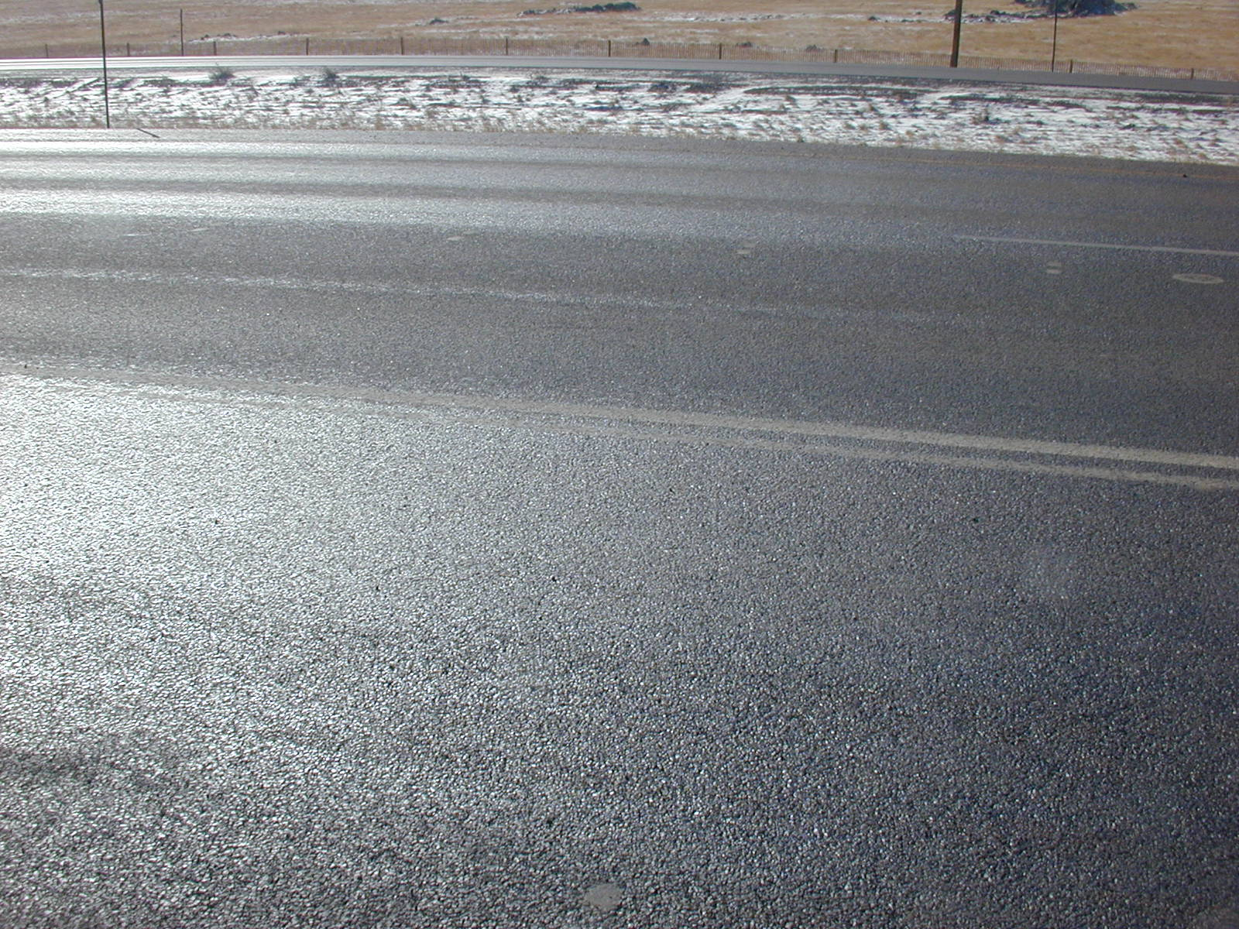
Black Ice
Notes:
Black ice, or clear ice is a thin layer of ice that forms on the surface that can be difficult to see and restricts a vehicle’s tires from gripping road.
Black ice is clear, the asphalt below it shows through, giving it its ‘black’ ice name. The clear ice layer makes it very difficult to see. The thin ice layer can also occur on concrete or other pavement surfaces.
Black Ice - is really a very thin layer of ice. When it gets thicker, then it moves into glaze ice and the color changes. It is difficult to notice and difficult to prevent.
Photo credit: © Copyright 2003 Ronald D. Tabler

Slide 12
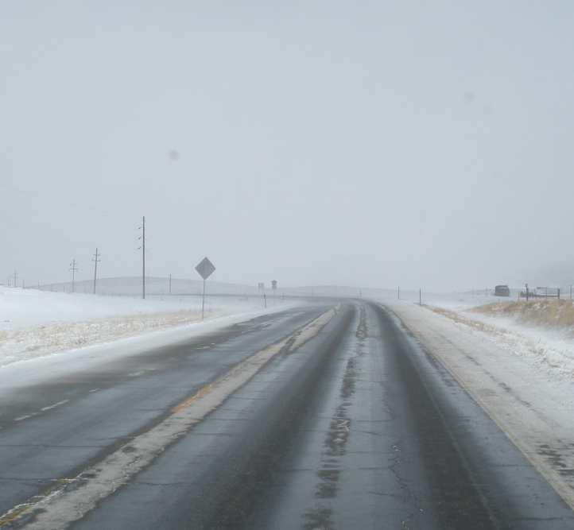
How black ice forms
Book definition of black ice:
The pavement temperature is above freezing.
AND
Pavement temp near or below the dew point.
THEN
Moisture condenses onto the road.
Notes:
The book definition of black ice refers to when moisture in the air condenses as water on the road surface, then freezes as the pavement temperature drops.
Black ice occurs when the pavement temperature is above freezing, moisture from the air condenses onto the road surface forming a thin wet layer.
Picture credit: Fortin Consulting Inc.

Slide 13


How black ice forms
Book definition of black ice:
IF pavement temps stay warmer than freezing moisture will not freeze
OR
IF pavement temps drop below freezing moisture will freeze
Notes:
The pavement temp then drops to or below freezing, creating the clear ice layer also known as black ice on the road.
Look for black ice when the pavement temperature and dew point are close (within 2 to 5 degrees F) and near and below freezing, there are low winds, and if there is a sunny day.
Picture credit: Fortin Consulting Inc.

Slide 14
Test Question
How does black ice form?
The pavement temperature is above freezing then drops below
Moisture condenses onto the road
The pavement temperature is near or below the dew point
All of the above
Notes:
Note to presenters: you may choose to hide this slide.
Test question:
How does black ice form?:
The pavement temperature is above freezing then drops below (no)
Moisture condenses onto the road (no)
The pavement temperature is near or below the dew point (no)
All of the above (yes)

Slide 15
Test Question
How does black ice form?
The pavement temperature is above freezing then drops below
Moisture condenses onto the road
The pavement temperature is near or below the dew point
All of the above
Notes:
Note to presenters: you may choose to hide this slide.
Test question:
How does black ice form?:
The pavement temperature is above freezing then drops below (no)
Moisture condenses onto the road (no)
The pavement temperature is near or below the dew point (no)
All of the above (yes)

Slide 16
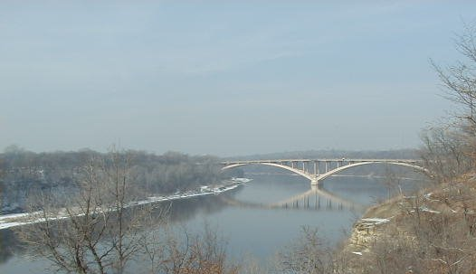
Where black ice is likely to form
Bridges
Ramps
Other?
Notes:
Black ice is likely to form on bridges and ramps.
Change of air temperature has a greater effect on the change of pavement temperatures for bridges because they are surrounded on all sides by air. This greater change in temperature makes it more susceptible to black ice formation.
Ramps do not get the same amount of traffic as mainline roadways. Thus the heating elements from a traffic load is not there and the surface air is allowed to maintain a steady temperature drop.
When going through your route, pay special attention to these areas to check for ice formation.
More information about ice on bridges can be found in Clear Roads Module 17: Bridge Frost.
Picture Credit: Fortin Consulting Inc.

Slide 17
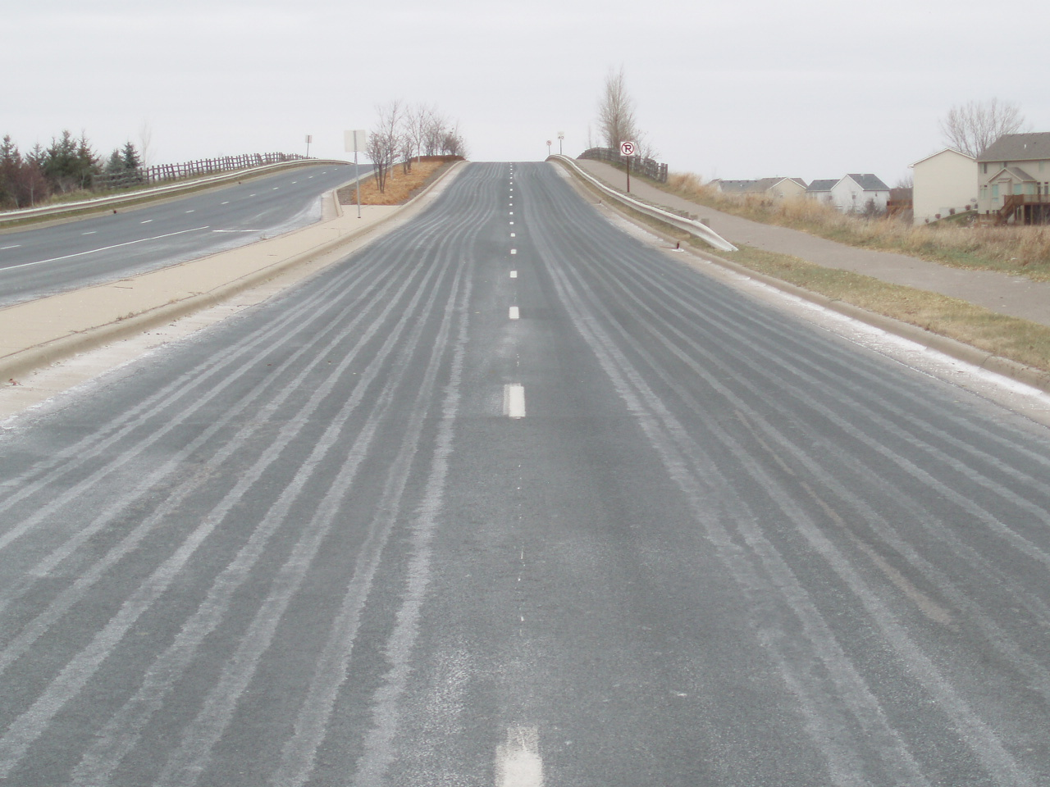
Preventing black ice
Anti-icing will help stop the formation of black ice.
It helps prevent the ice forming or bonding to the road.
Note to presenters: if you have a procedure for preventing black ice, insert it here. Delete this yellow box before making presentation.
Notes:
Black ice can help be prevented by anti-icing using appropriate products and rates. It may prevents the ice from forming or bonding to the pavement surface.
Anti-ice when the pavement temperature and dew point are close (within 2 to 5°F) and near and below freezing, and there are low winds. This is when black ice is likely to occur.
Most shops will not anti-ice at 32ºF and yet that is when black ice begins to form. The road temp will hover at 32ºF for a period of time. Then either the weather or time of day will cause a change in the temp to either warm up or drop down further. Reviewing your existing RWIS readings and knowing the forecast can help your shop be proactive.
More information on anti-icing practices can be found in Module 8: Anti-Icing
Photo credit: Fortin Consulting Inc.

Slide 18
Test Question
What is the most efficient way to prevent black ice?
Do nothing
Anti-icing
Leave a layer of compaction on your roads
Sand
Notes:
Note to presenters: you may choose to hide this slide.
Test question:
What is the most efficient way to prevent black ice?
Do nothing (no)
Anti-icing (yes)
Leave a layer of compaction on your roads (no)
Sand (no)

Slide 19
Test Question
What is the most efficient way to prevent black ice?
Do nothing
Anti-icing
Leave a layer of compaction on your roads
Sand
Notes:
Note to presenters: you may choose to hide this slide.
Test question:
What is the most efficient way to prevent black ice?
Do nothing (no)
Anti-icing (yes)
Leave a layer of compaction on your roads (no)
Sand (no)

Slide 20
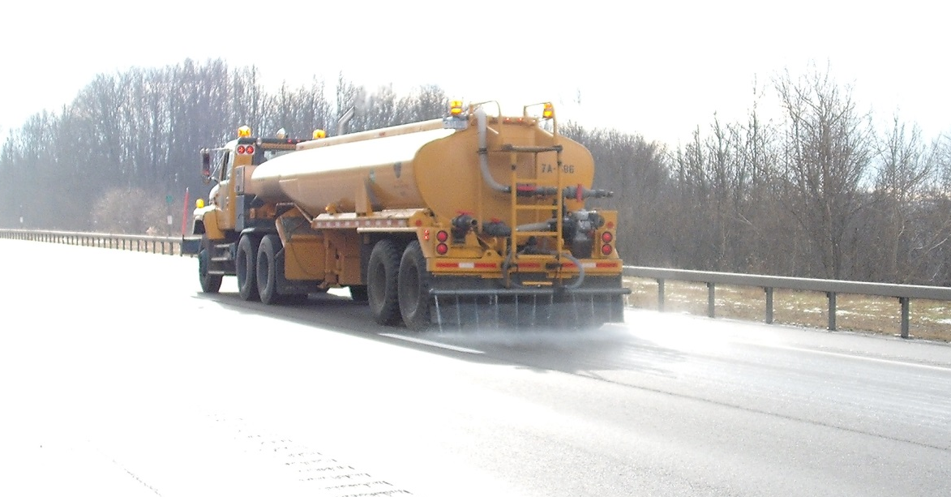
If black ice has already formed
The best options for deicing treatment is a Direct Liquid Application (D.L.A.)
If this is not available, use a pre-wet salt at a very low application rate.
At very cold temperatures, sand may be used.
Check your weather forecast.
Note to presenters: if you have a procedure for preventing black ice, insert it here. Delete this yellow box before making presentation.
Notes:
If black ice has already formed the best treatment option is a direct liquid application (D.L.A.) based on the current conditions such as temperature and wind speed. If DLA is not an option, use a pre-wet salt at a very low application rate. This will work faster than dry salt because it already has the liquids available to start the melting process.
Monitor the pavement temperatures and weather. If it is likely to warm up, chemical treatment may not be necessary. Only apply chemicals that are appropriate for the pavement temperature. At very cold temperatures sand may be used.
More information about liquid applications can be found in Clear Roads Module 4: Material Use and Module 7: Deicing.
Photo credit: NYS DOT

Slide 21
Test Question
What is the most efficient way to treat black ice?
Dry rock salt at a heavy application rate
Dry rock salt at a low application rate
Liquid deicer if appropriate for pavement temperature
Sand
Notes:
Note to presenters: you may choose to hide this slide.
Test question:
What is the most efficient way to treat black ice?
Dry rock salt at a heavy application rate (no)
Dry rock salt at a low application rate (no)
Liquid deicer if appropriate for pavement temperature(yes)
Sand (no)

Slide 22
Test Question
What is the most efficient way to treat black ice?
Dry rock salt at a heavy application rate
Dry rock salt at a low application rate
Liquid deicer if appropriate for pavement temperature
Sand
Notes:
Note to presenters: you may choose to hide this slide.
Test question:
What is the most efficient way to treat black ice?
Dry rock salt at a heavy application rate (no)
Dry rock salt at a low application rate (no)
Liquid deicer if appropriate for pavement temperature(yes)
Sand (no)

Slide 23
Snow glaze
Conditions and temps that lead to snow glaze
How to mitigate snow glaze
Notes:
The next section will cover snow glaze.

Slide 24
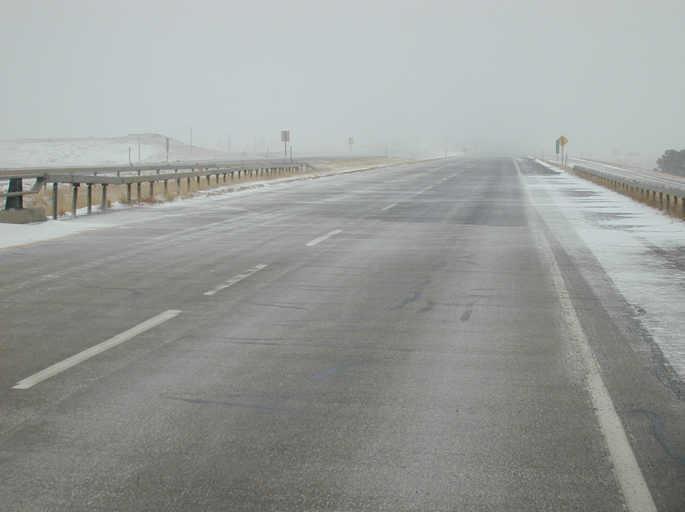
Glaze Ice
Deceptively Slick
Notes:
Snow glaze or glaze ice is a thin layer of ice on the roadway surface.
Slide credit: © Copyright 2003 Ronald D. Tabler

Slide 25
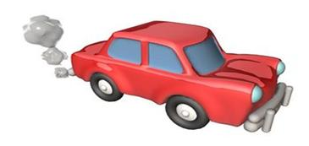
How glaze ice forms
There are very cold air and pavement temperatures.
Moisture freezes to the road.
  One example is when vehicle exhaust melts existing moisture on the road and it refreezes on the road surface.
Notes:
Snow glaze forms when road temps are below freezing and there is little to no sun. When there is cold air temps and cold pavement temps moisture freezes to the road causing glaze ice.
One example is as vehicle exhaust melts exiting moisture on the road and it refreezes on the road surface. Can you think of any other examples?

Slide 26
Test Question
Test question: Glaze ice forms when moisture freezes to very cold pavements.
  True
  False
Notes:
Note to presenters: you may choose to hide this slide.
Test question:
Glaze ice forms when moisture freezes to very cold pavements.
True (yes)
False (no)

Slide 27
Test Question
Test question: Glaze ice forms when moisture freezes to very cold pavements.
  True
  False
Notes:
Note to presenters: you may choose to hide this slide.
Test question:
Glaze ice forms when moisture freezes to very cold pavements.
True (yes)
False (no)

Slide 28
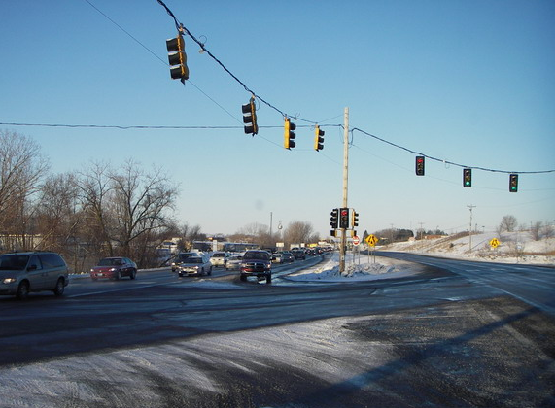
Where glaze ice is likely to form
Where there is stop and go traffic
Other?
Notes:
Glaze ice is likely to form at intersections or where there is stop and go traffic such as rush hour.
Picture credit: Fortin Consulting, Inc.

Slide 29
Test Question
Where is glaze ice likely to form?
Fast moving traffic
Stop and go traffic areas
Thin traffic areas
Right lanes
Notes:
Note to presenters: you may choose to hide this slide.
Test question:
Where is glaze ice likely to form?
Fast moving traffic (no)
Stop and go traffic areas (yes)
Thin traffic areas (no)
Right Lanes(no)

Slide 30
Test Question
Where is glaze ice likely to form?
Fast moving traffic
Stop and go traffic areas
Thin traffic areas
Right lanes
Notes:
Note to presenters: you may choose to hide this slide.
Test question:
Where is glaze ice likely to form?
Fast moving traffic (no)
Stop and go traffic areas (yes)
Thin traffic areas (no)
Right Lanes(no)

Slide 31
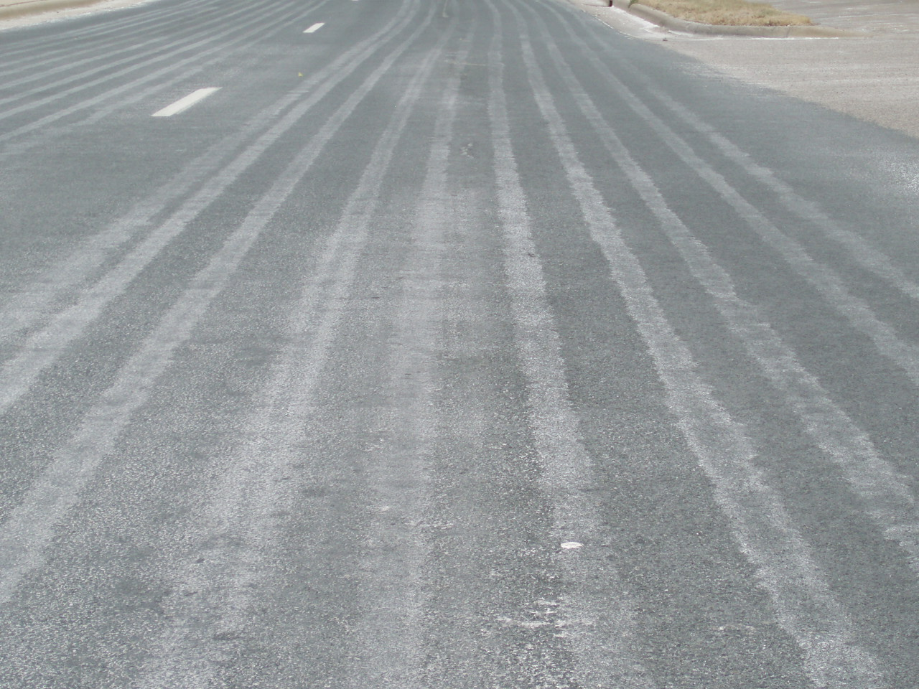
Preventing glaze ice
Anti-icing can help to stop the formation of glaze ice.
It prevents the ice forming or bonding to the road.
Note to presenters: if you have a procedure for preventing black ice, insert it here. Delete this yellow box before making presentation.
Be conscious of the pavement temperature
and what product you choose to use.
Notes:
Anti-icing can help to stop the formation of glaze ice. It prevents the ice forming or bonding to the road.
Be conscious of the pavement temperature and what product you choose to use since glaze ice forms when pavement temperatures are very cold. Sodium chloride may not work. Its practical working temperature is 15 degrees F.
Note to presenters: if you have a procedure for preventing black ice, insert it here. Delete this yellow box before making presentation.

Slide 32
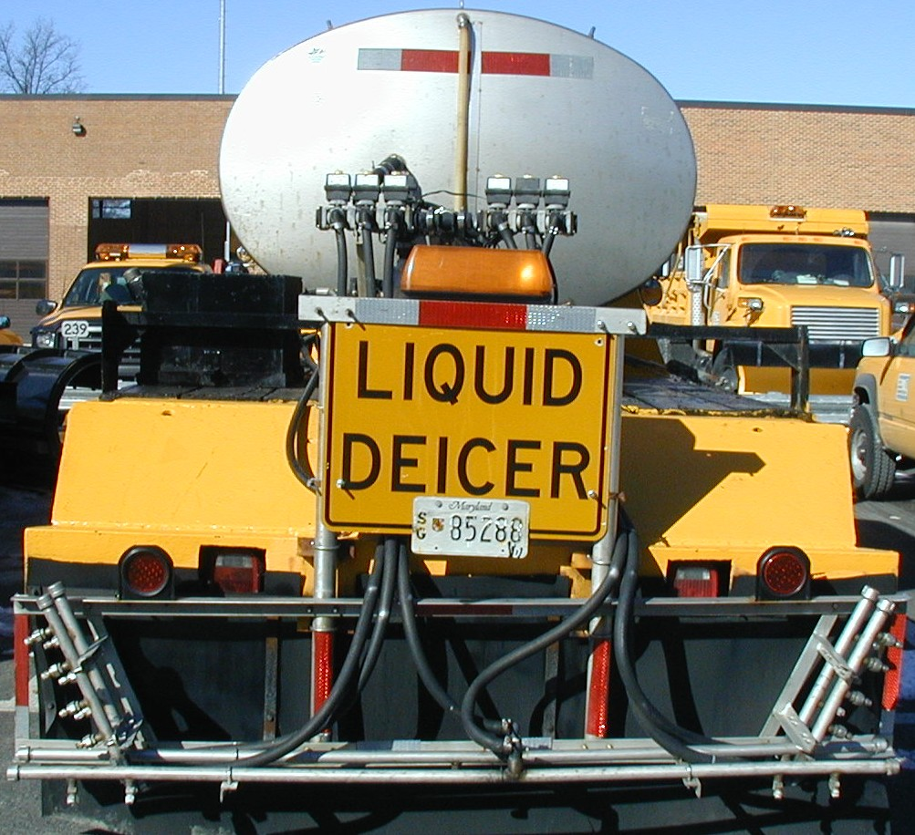
If glaze ice has already formed
DLA with a cold pavement temperature product.
Pre-wet salt, liquid work at cold pavement temperatures.
If too cold, do not apply a chemical product. Sand may be used to give traction.
Note to presenters: if you have a procedure for preventing black ice, insert it here. Delete this yellow box before making presentation.
Notes:
DLA can be used if the product works at cold pavement temperatures. Pre-wet is another option, but the liquid must work at cold pavement temperatures. Wetting the salt allows it to act more quickly.
If the pavement temperature is too cold, do not apply a chemical product. Sand may be used to give traction.
More information about liquid applications can be found in Clear Roads Module 4: Material Use and Module 7: Deicing.
Note to presenters: if you have a procedure for preventing black ice, insert it here. Delete this yellow box before making presentation.
Photo credit: NYS DOT

Slide 33
Freezing rain
Conditions and temperatures that lead to freezing rain
How to mitigate freezing rain
Notes:
The next section covers freezing rain.

Slide 34
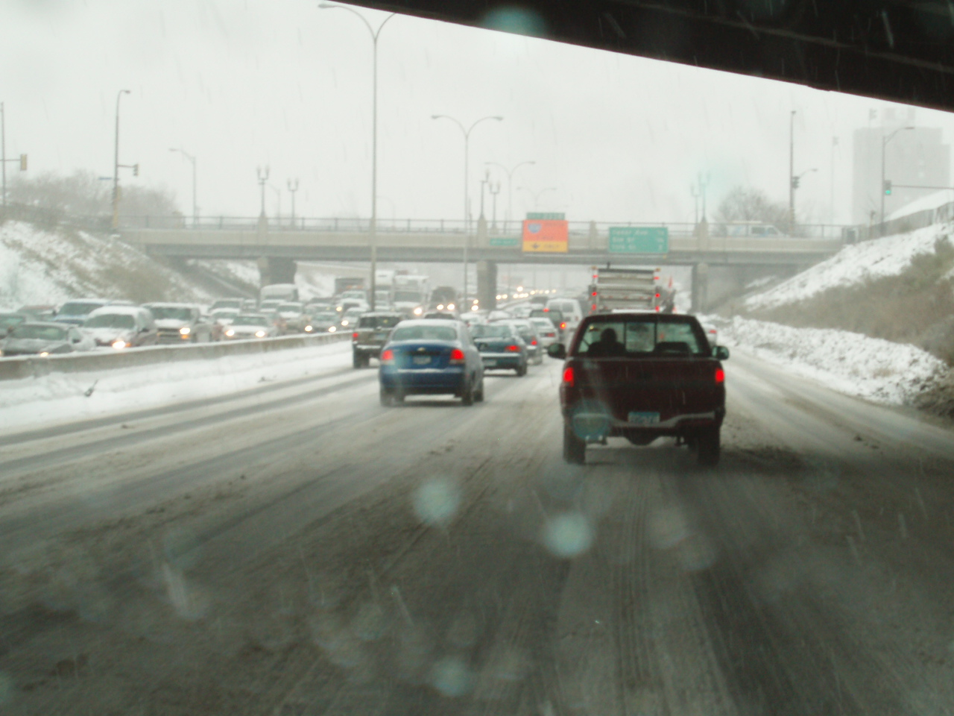
Freezing rain
Rain that falls when surface temperatures are slightly above or below freezing.
Notes:
Super cooled droplets of liquid precipitation falling on a surface whose temperature is below or slightly above freezing, resulting in a hard, slick, generally thick coating of ice commonly called a glaze or clear ice. Non-super cooled raindrops falling on a surface whose temperature is well below freezing will also result in a glaze.
Picture: Fortin Consulting Inc.

Slide 35
Test Question
How does freezing rain form ice?
Anytime rain falls
Rain falls on cold pavement
Snow falls and gets compacted on pavement
Rain falls on warm pavement
Notes:
Note to presenters: you may choose to hide this slide.
Test question:
How does freezing rain form ice?
Anytime rain falls (no)
Rain falls on cold pavement(yes)
Snow falls and gets compacted on pavement (no)
Rain falls on warm pavement(no)

Slide 36
Test Question
How does freezing rain form ice?
Anytime rain falls
Rain falls on cold pavement
Snow falls and gets compacted on pavement
Rain falls on warm pavement
Notes:
Note to presenters: you may choose to hide this slide.
Test question:
How does freezing rain form ice?
Anytime rain falls (no)
Rain falls on cold pavement(yes)
Snow falls and gets compacted on pavement (no)
Rain falls on warm pavement(no)

Slide 37

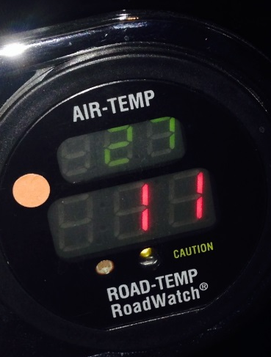

Preventing freezing rain
Preventing freezing rain from turning to ice can be difficult since product will dilute quickly.
Abrasives can be used to help give drivers traction.
Note to presenters: if you have a procedure for preventing black ice, insert it here. Delete this yellow box before making presentation.
Notes:
Preventing freezing rain from turning to ice can be difficult since product will dilute quickly. Abrasives can be used to help give drivers traction on icy roads.
Keep drivers informed of dangerous road conditions and warn to keep off roads if possible.
Note to presenters: if you have a procedure for preventing black ice, insert it here. Delete this yellow box before making presentation.

Slide 38
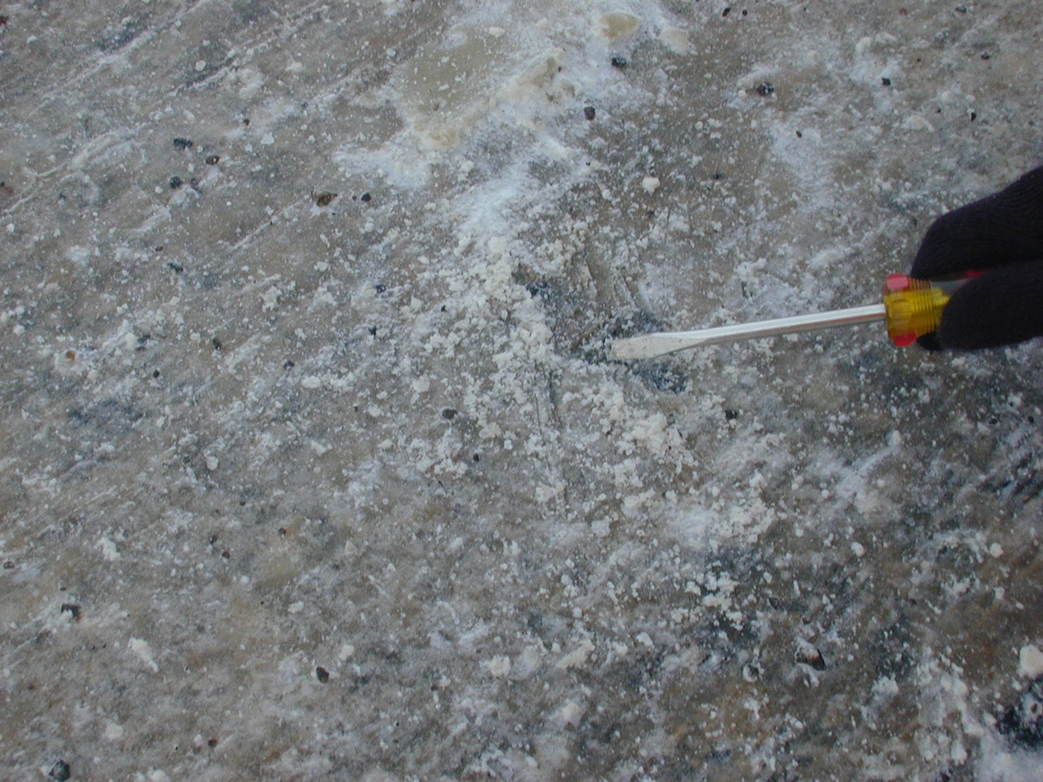
Mitigating freezing rain
Rain can cause a variety of problems, solutions range based on the conditions created
If ice is formed, try pre-wet salt.
If slushy, try dry salt.
Pre-wet abrasives can be used to get a sandpaper effect.
Note to presenters: if you have a procedure for preventing black ice, insert it here. Delete this yellow box before making presentation.
© Copyright 2003 Ronald D. Tabler
Notes:
Rain can cause a variety of problems, solutions range based on the conditions created.
If ice is formed, try pre-wet salt
If slushy, try dry salt
Pre-wet abrasives can be used to get a sandpaper effect
Be aware of temperature trends and how the conditions of the roads can change quickly, even as a route is being driven.
Note to presenters: if you have a procedure for preventing black ice, insert it here. Delete this yellow box before making presentation.
Photo credit: Fortin Consulting Inc.

Slide 39
Test Question
What is the easiest way to melt ice formed by freezing rain?
Pre-wet salt
Abrasives
Dry salt
Wait for summer
Notes:
Note to presenters: you may choose to hide this slide.
Test question:
What is the easiest way to melt ice formed by freezing rain?
Pre-wet salt (yes)
Abrasives (no)
Dry salt (no)
Wait for summer (no)

Slide 40
Test Question
What is the easiest way to melt ice formed by freezing rain?
Pre-wet salt
Abrasives
Dry salt
Wait for summer
Notes:
Note to presenters: you may choose to hide this slide. You can start a discussion here about why waiting for summer is not a real solution even though it may be the “easiest” if anyone chose that answer.
Test question:
What is the easiest way to melt ice formed by freezing rain?
Pre-wet salt (yes)
Abrasives (no)
Dry salt (no)
Wait for summer (no)

Slide 41
Traffic Compaction
Conditions and temps that lead to traffic compaction
How to mitigate traffic compaction
Notes:
This section covers traffic compaction.

Slide 42
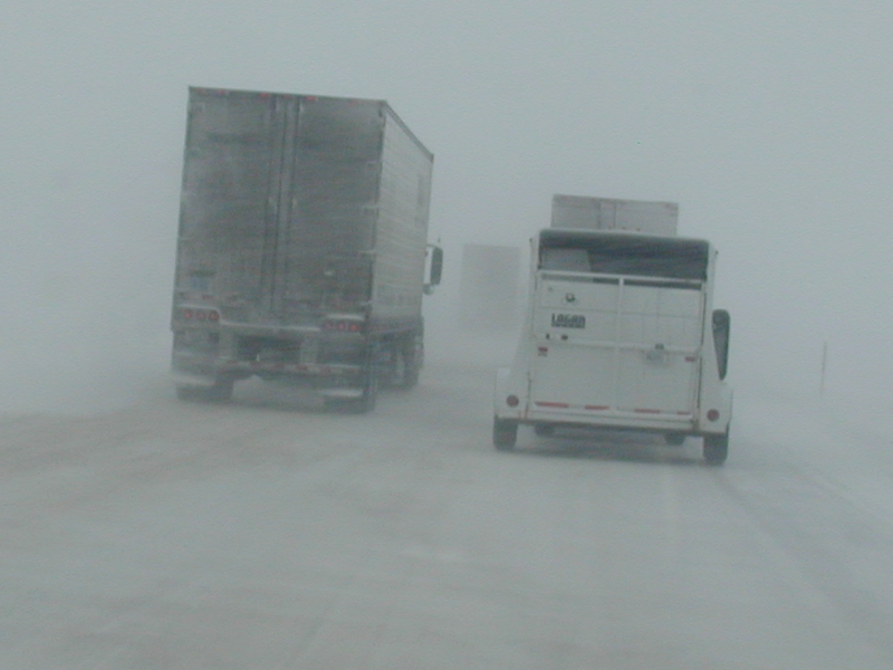
Traffic compaction
© Copyright 2003 Ronald D. Tabler
Notes:
Traffic compaction or snow pack is a thick layer of snow that is compacted to the road surface and can be very difficult to remove.
Slide credit: WYDOT

Slide 43
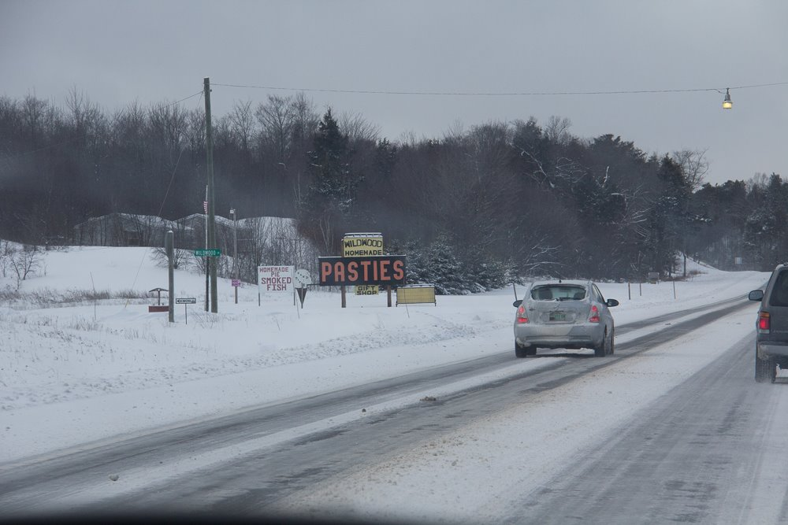
Snow accumulates.
Bottom layer bonds to the road.
Temperature drops freezing bottom layer in place.
Notes:
Snow pack or traffic compaction is caused by a thick layer of snowfall that becomes compressed between the road and vehicle tires.
Snow pack can occur under many circumstances, but is more likely when there is heavy snow. Traffic compaction is a thick ice formed from snow on the roads that is driven over repeatedly.
It forms when snow on the road is compacted under tires of heavy vehicles during the storm, pavement temperatures often drop after the storm making it difficult to remove.
Slide credit: WYDOT

Slide 44
Test Question
How does traffic compaction ice form?
Snow on the road is compressed by vehicle tires
Thick layer of freezing mist
Exhaust from cars
Snow blows across the road and sticks to wet places forming ice
Notes:
Note to presenters: you may choose to hide this slide.
Test question:
How does traffic compaction ice form?
Snow on the road is compressed by vehicle tires (yes)
Thick layer of freezing mist (no)
Exhaust from cars (no)
Snow blows across the road and sticks to wet places forming ice (no)

Slide 45
Test Question
How does traffic compaction ice form?
Snow on the road is compressed by vehicle tires
Thick layer of freezing mist
Exhaust from cars
Snow blows across the road and sticks to wet places forming ice
Notes:
Note to presenters: you may choose to hide this slide.
Test question:
How does traffic compaction ice form?
Snow on the road is compressed by vehicle tires (yes)
Thick layer of freezing mist (no)
Exhaust from cars (no)
Snow blows across the road and sticks to wet places forming ice (no)

Slide 46
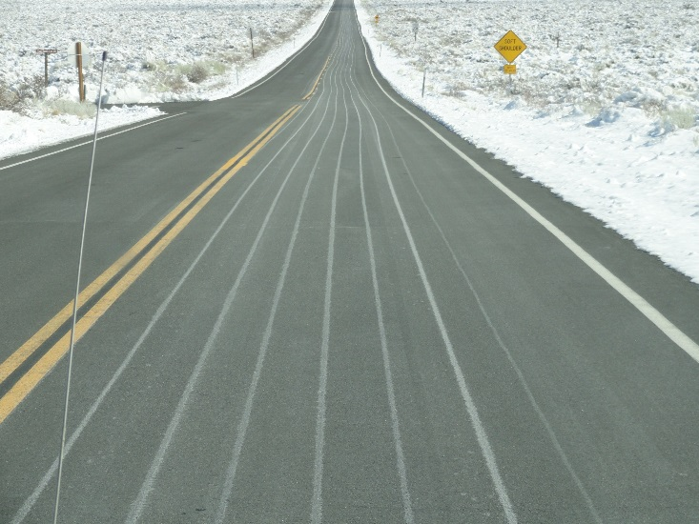
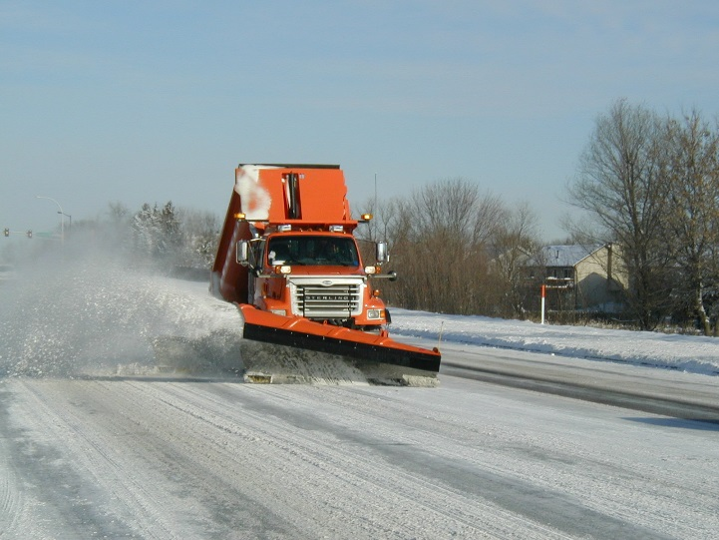
Preventing traffic compaction
Anti-icing
Early plowing
Frequent plowing
Note to presenters: insert your procedure here. Delete this yellow box before making presentation.
Notes:
Anti-icing before the storm will keep the snow from bonding to the road. It can help make it easier for plows to take snow off the road.
Plowing regularly during or after a big storm to keep snow from accumulating and becoming compacted beneath cars is also helpful for preventing traffic compaction from occurring.
Pictures credits: Fortin Consulting

Slide 47
Test Question
What can you do to help prevent compaction?
Early plowing
Frequent plowing
Anti-icing
All of the above
Notes:
Note to presenters: you may choose to hide this slide.
Test question: What can you do to help prevent compaction?
Early plowing (no)
Frequent plowing(no)
Anti-icing (no)
All of the above (yes)

Slide 48
Test Question
What can you do to help prevent compaction?
Early plowing
Frequent plowing
Anti-icing
All of the above
Notes:
Note to presenters: you may choose to hide this slide.
Test question: What can you do to help prevent compaction?
Early plowing (no)
Frequent plowing(no)
Anti-icing (no)
All of the above (yes)

Slide 49
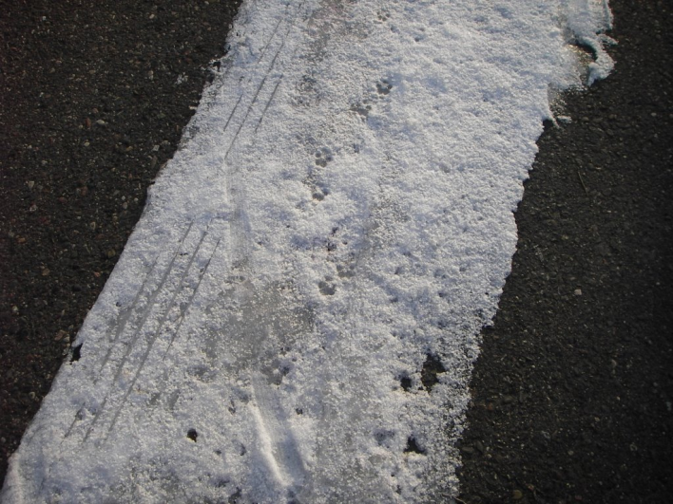
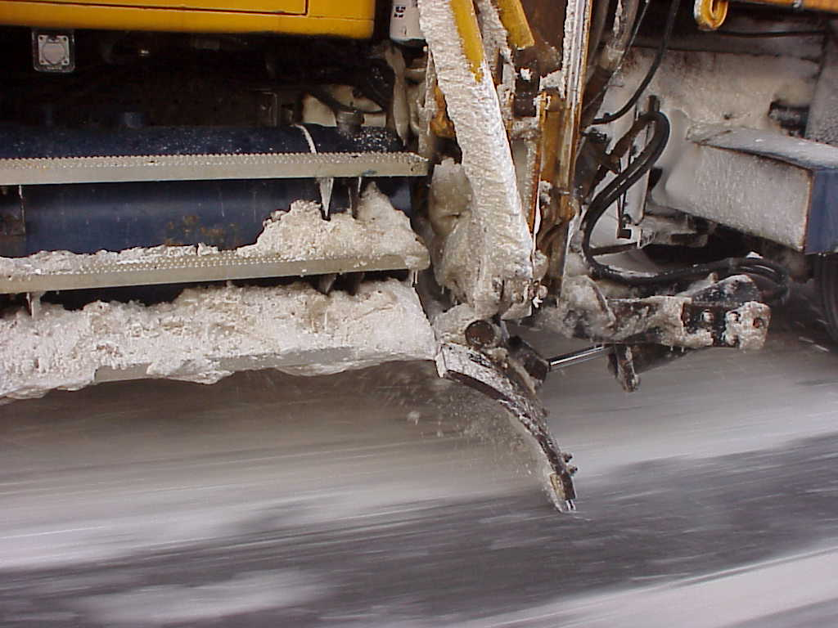
Mitigating traffic compaction
Pre-wet deicers appropriate for pavement conditions
Plowing with underbodies with good down pressure or other specialized equipment
Note to presenters: Insert your procedure here. Delete this yellow box before making presentation.
Notes:
Traffic compaction can be one of the most difficult types of ice to treat. It often occurs under cold weather conditions, rendering sodium chloride (NaCl) products ineffective. Chemical deicers may work to remove traffic compaction if the deicer used is appropriate for the pavement conditions.
It may still be able to be removed by plowing, but it is difficult and may require specialized equipment such as underbody plows or large amounts of salt to break the bonds between the road surface and the snow pack.
Note to presenters: Insert your procedure here. Delete this yellow box before making presentation.
Top Picture credit: Fortin Consulting Inc.
Bottom Picture credit: NYDOT

Slide 50
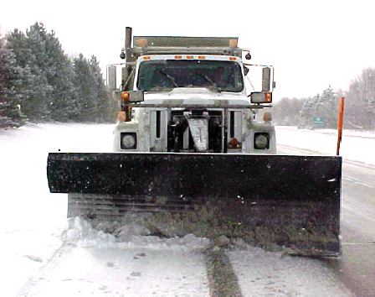
Tip from experienced drivers
Use of a segmented rubber blade with carbide tips may eliminate the need for underbodies. They are flexible and scrape better.
Notes:
In Lacrosse County, WI they are using segmented rubber blades with carbide tips on their plows and finding that it has eliminated the need for underbodies. Joma blades are one example of this.
Advice from Ron Chamberlain of LaCrosse County, WI
Photo credit: Fortin Consulting, Inc.

Slide 51
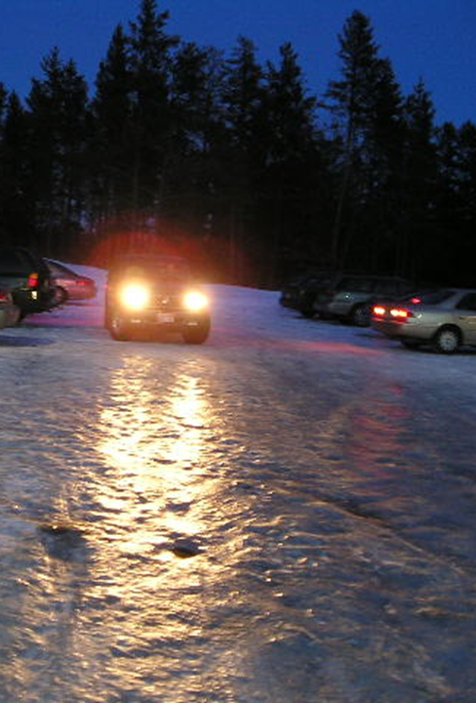
Compaction = the storm has gotten ahead of us
We were not proactive enough.
We need to review our procedures.
Compaction requires us to use much more salt.
Notes:
When we have compaction the storm has gotten ahead of us. We need to review our techniques to keep this from happening. Chemical deicers may work to remove traffic compaction if the deicer used is appropriate for the pavement conditions.
It can lead to using large amounts of salt. Once compaction has occurred it requires much more salt to remove it than it would to have prevented it from forming.
Here is an example of the storm getting ahead that you could use: the storm moves in late at night with only one operator on duty. He is charged with calling in the team when it is time. He is trying to allow his team as much sleep as possible but by the time he realizes the storm is here and our trucks are going to be behind the power curve. It is too late and we have more work to do.
Picture credit: Fortin Consulting Inc.

Slide 52
Blow ice
Conditions and temps that lead to blow ice
How to mitigate blow ice
Notes:
The next section covers blow ice.

Slide 53
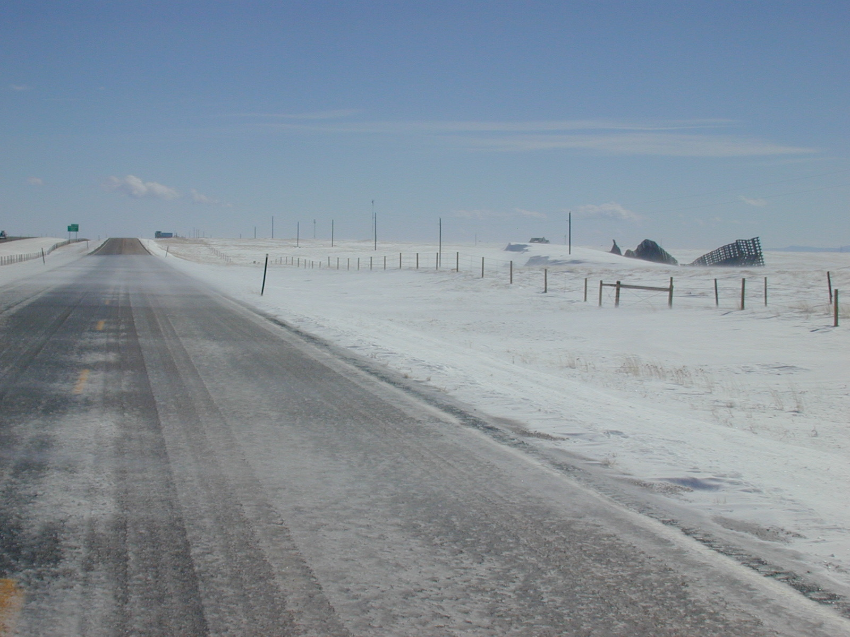

Blow ice
Notes:
Blow ice is formed when blowing or drifting snow sticks to roads that are above freezing, snow that is blowing across the warm pavement then melts and refreezes on the road forming a gray rough texture surface. If conditions persist, ice can accumulate forming a thick layer on roads.
It can also occur if blowing snow sticks to melted snow and ice on a sunny day causing a slush to form, then freeze as pavement temperatures drop if not removed from the road.
Photo credit: © Copyright 2003 Ronald D. Tabler

Slide 54
Test Question
How does blow ice form?
Need winds of at least 30mph
Snow blowing across the road, melts and sticks to the road
Blowing snow keeping moving across the road
Wind must blow from North to South
Notes:
Note to presenters: you may choose to hide this slide.
Test question:
How does Blow Ice form?
Need winds of at least 30mph (no)
Snow blowing across the road, melts and sticks to the road(yes)
Blowing snow keeping moving across the road(no)
Wind must blow from North to South (no)

Slide 55
Test Question
How does blow ice form?
Need winds of at least 30mph
Snow blowing across the road, melts and sticks to the road
Blowing snow keeping moving across the road
Wind must blow from North to South
Notes:
Note to presenters: you may choose to hide this slide.
Test question:
How does blow ice form?
Need winds of at least 30mph (no)
Snow blowing across the road, melts and sticks to the road(yes)
Blowing snow keeping moving across the road(no)
Wind must blow from North to South (no)

Slide 56
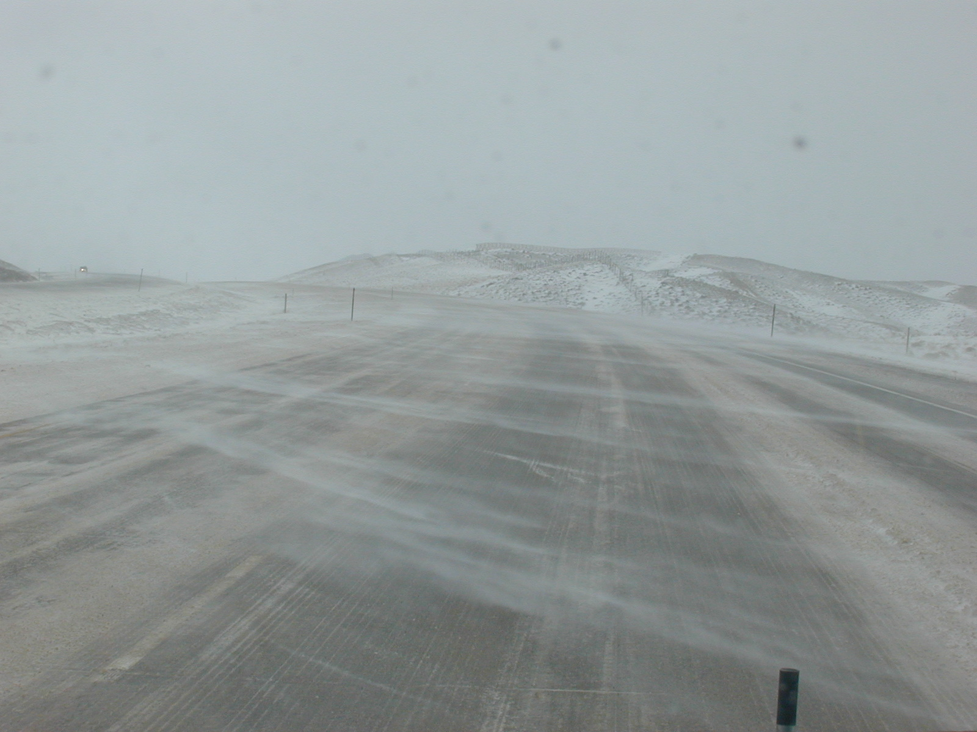
Occurs in windy conditions
Tips from experienced operator: Wind speed above 12 mph
Notes:
Blow ice occurs in windy conditions, above 12 mph. Often there will be problem spots where blow ice forms regularly. It is important to take note of these spots on the route.
Slide credit: WYDOT

Slide 57
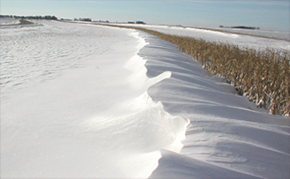
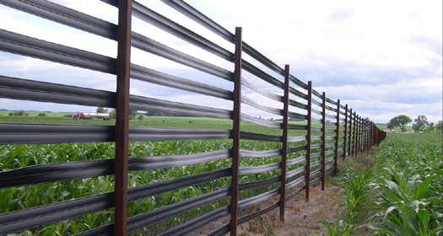
Preventing blow ice
Drift control
  Snow fence
  Standing corn rows
  Structural snow fence
  Redesign of roadways if possible
Deicing and anti-icing are not recommended
Note to presenters: Insert your procedure here. Delete this yellow box before making presentation.
Notes:
The main cause of blow ice is blowing snow. If there is a spot on the roads where blow ice occurs regularly, the best option for preventing blow ice may be to use drift control such as a snow fence, standing corn rows, a structural snow fence, or changing the grading of the road. This topic is discussed in detail in Clear Roads Module 15: Drift Control and Wind.
Anti-icing is not recommended. There is a risk of blow ice occurring if anti-icing or salt residue persists on the road. As snow is blown across the road, salt can cause the snow to melt, diluting brine solution and eventually refreeze on the road.
Note to presenters: Insert your procedure here. Delete this yellow box before making presentation.
Photo credits: MN DOT http://www.dot.state.mn.us/environment/livingsnowfence/antidrifting.html

Slide 58
Test Question
How can blow ice be prevented?
Dry salt
Anti-icing
Prewet salt
Snow fence
Notes:
Note to presenters: you may choose to hide this slide.
Test question:
How can blow ice be prevented?
Dry salt (no)
Anti-icing (no)
Prewet salt (no)
Snow fence (yes)

Slide 59
Test Question
How can blow ice be prevented?
Dry salt
Anti-icing
Prewet salt
Snow fence
Notes:
Note to presenters: you may choose to hide this slide.
Test question:
How can blow ice be prevented?
Dry salt (no)
Anti-icing (no)
Prewet salt (no)
Snow fence (yes)

Slide 60
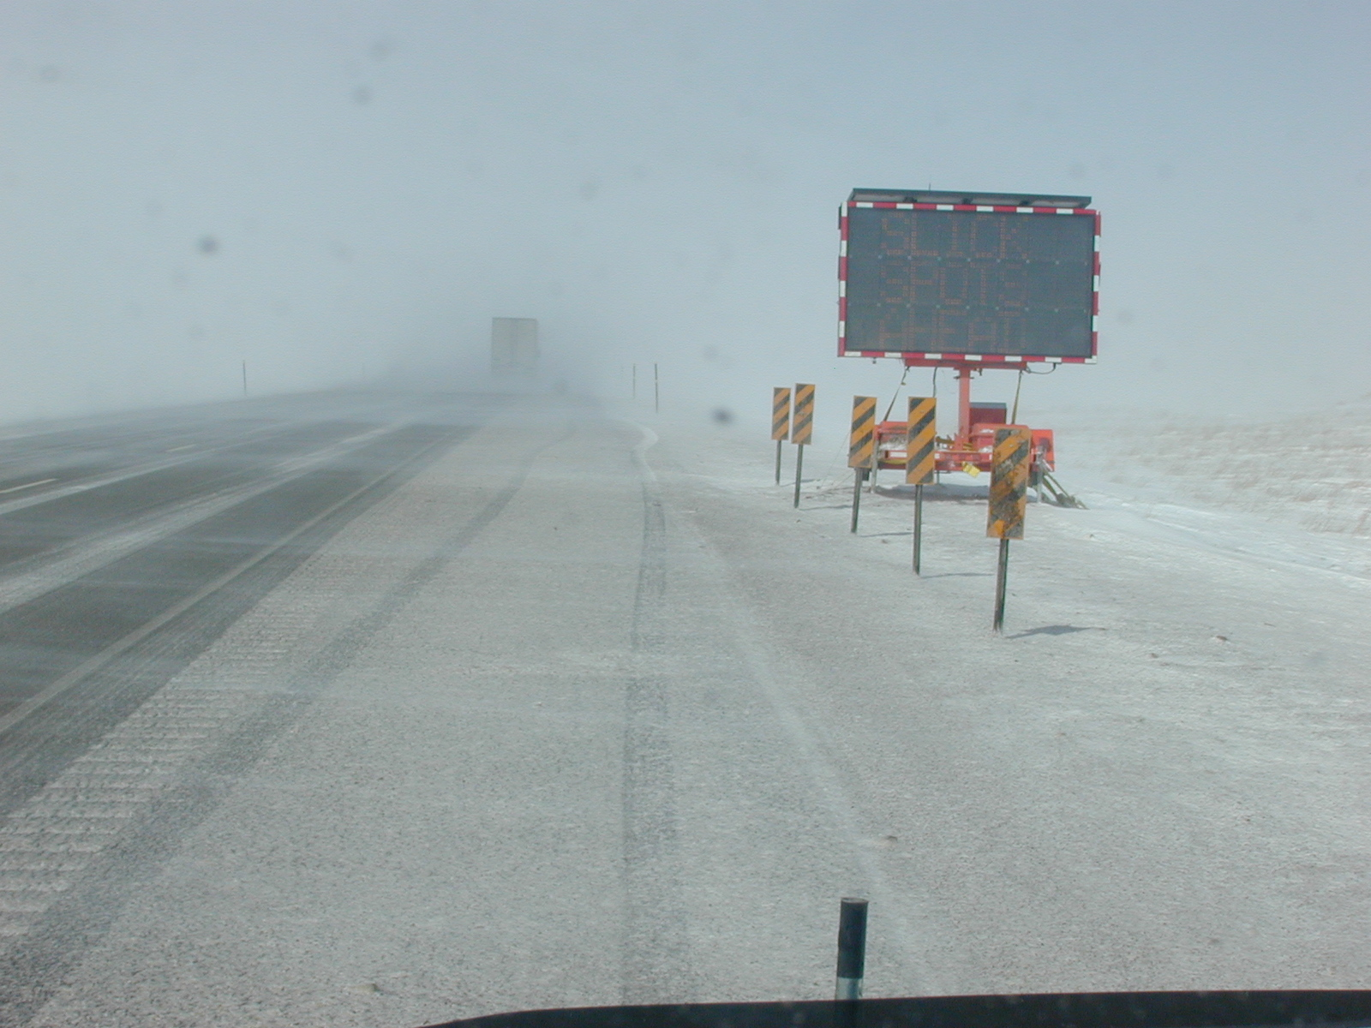
Mitigating Blow Ice
What are your options?
Patrol and plow.
Keep snow blowing across the road.
Warn drivers of slick spots on roads.
May need to close the road.
SLICK
SPOTS
AHEAD
Note to presenters: insert your procedure here. Delete this yellow box before making presentation.
Notes:
What are your options? Open up the discussion to the group. When the road gets to this point the options are pretty limited. Talk about your operations procedures.
When there is drift occurring patrolling and plowing is the best remedy unless ice forms which can’t be controlled through patrolling and plowing. At this point you have committed to applying salt for the duration of the event.
Chemical deicers should not be used under windy conditions that cause blow ice. High winds may cause the treatment to blow off the road. Ice that is melted using chemical deicers can become diluted and cause refreeze ice on the roads.
Warn drivers of slick spots on the roads.
Note to presenters: insert your procedure here. Delete this yellow box before making presentation.
Photo credit: © Copyright 2003 Ronald D. Tabler

Slide 61
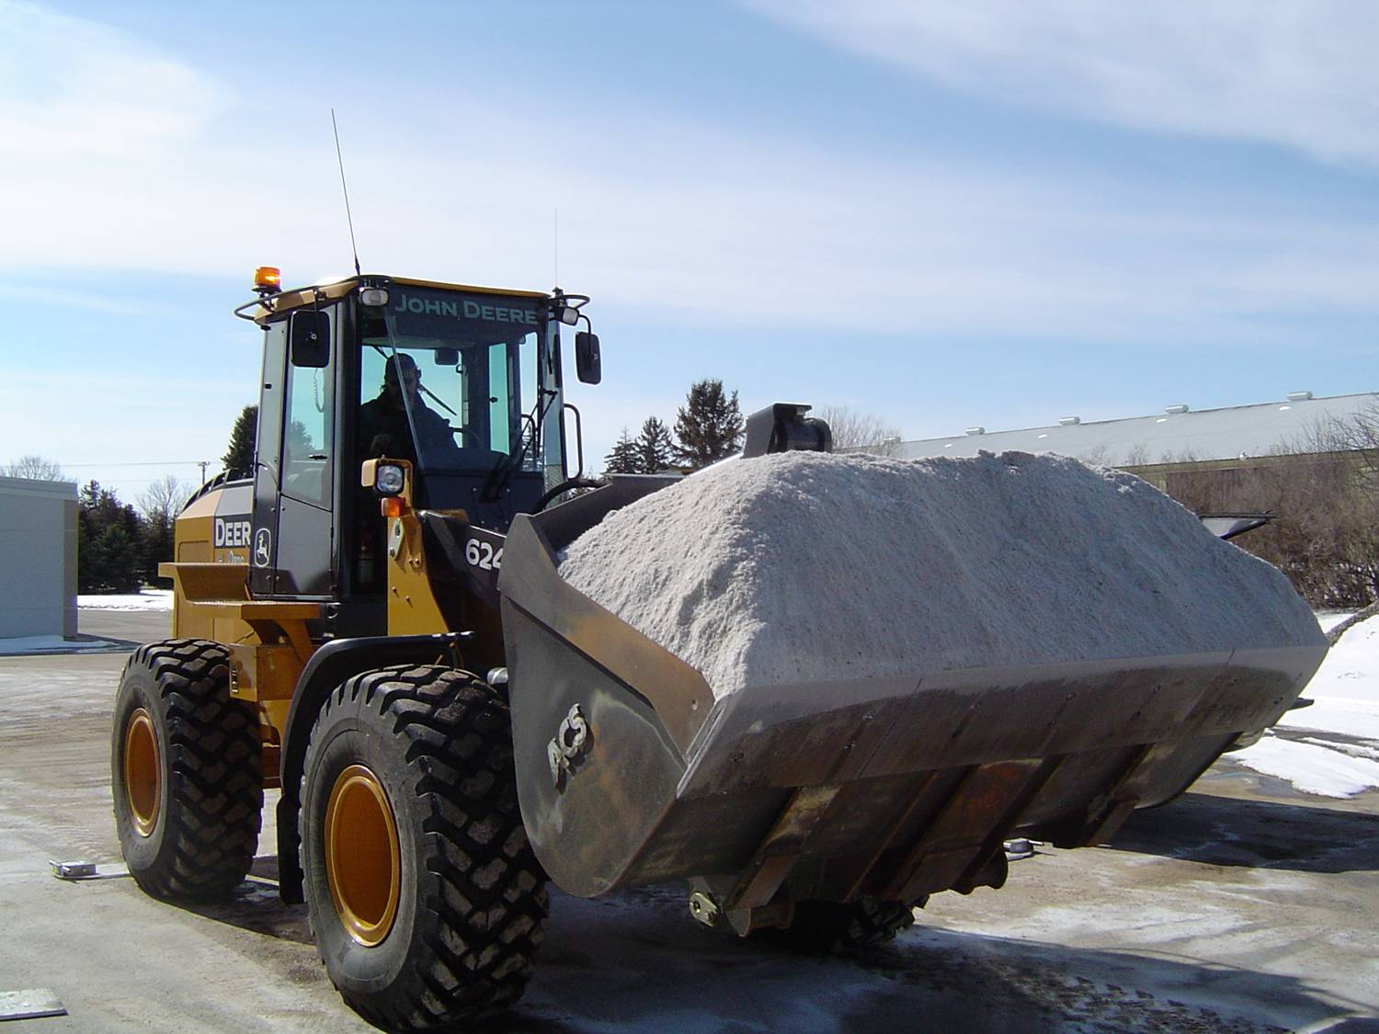
WARNING: if you start salting blow ice
Consistent upkeep throughout the blowing event will be needed.
It can take a lot of work and a lot of salt.
Chemical deicer may cause more ice to form.
Notes:
WARNING: The roads will need consistent upkeep throughout the event. It can take a lot of work and a lot of salt to maintain the road once you start salting Chemical deicer may cause more ice to form from salt melting the snow then refreezing
Picture credit: Fortin Consulting Inc.

Slide 62
Test Question
If snow is blowing across the road should you salt it or let it blow?
Salt it
Let it blow
Notes:
Note to presenters: you may choose to hide this slide.
Test question:
If snow is blowing across the road should you salt it or let it blow?
Salt it (no)
Let it blow (yes)

Slide 63
Test Question
If snow is blowing across the road should you salt it or let it blow?
Salt it
Let it blow
Notes:
Note to presenters: you may choose to hide this slide.
Test question:
If snow is blowing across the road should you salt it or let it blow?
Salt it (no)
Let it blow (yes)

Slide 64
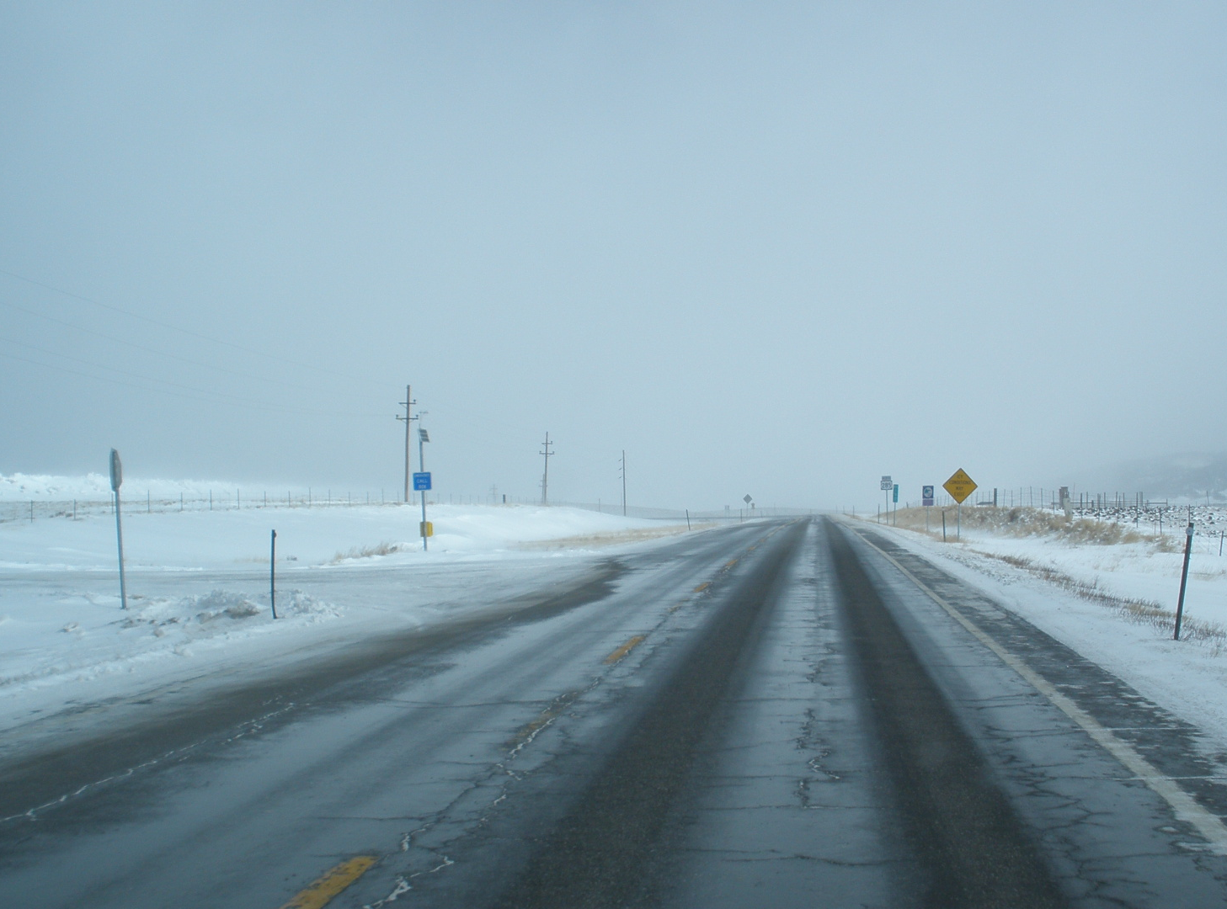
When melted snow or ice on the road freezes
Refreeze
Notes:
Freeze ice occurs when melted snow or ice on the road freezes. This freezing could be caused by a dropping of pavement temperature or when a chemical treatment becomes too dilute.
At this slide you can ask what do you do when you know the road is going to refreeze? What do you do if you don't have time to melt and dry the road before the temps drop and the suns warmth is fading?
Slide credit: WYDOT

Slide 65
Test Question
Refreeze occurs when snow or ice on the road melts, stays on the road, and refreezes.
False
True
Notes:
Note to presenters: you may choose to hide this slide.
Test question:
Refreeze occurs when snow or ice on the road melts, stays on the road, and refreezes.
False (no)
True (yes)

Slide 66
Test Question
Refreeze occurs when snow or ice on the road melts, stays on the road, and refreezes.
False
True
Notes:
Note to presenters: you may choose to hide this slide.
Test question:
Refreeze occurs when snow or ice on the road melts, stays on the road, and refreezes.
False (no)
True (yes)

Slide 67
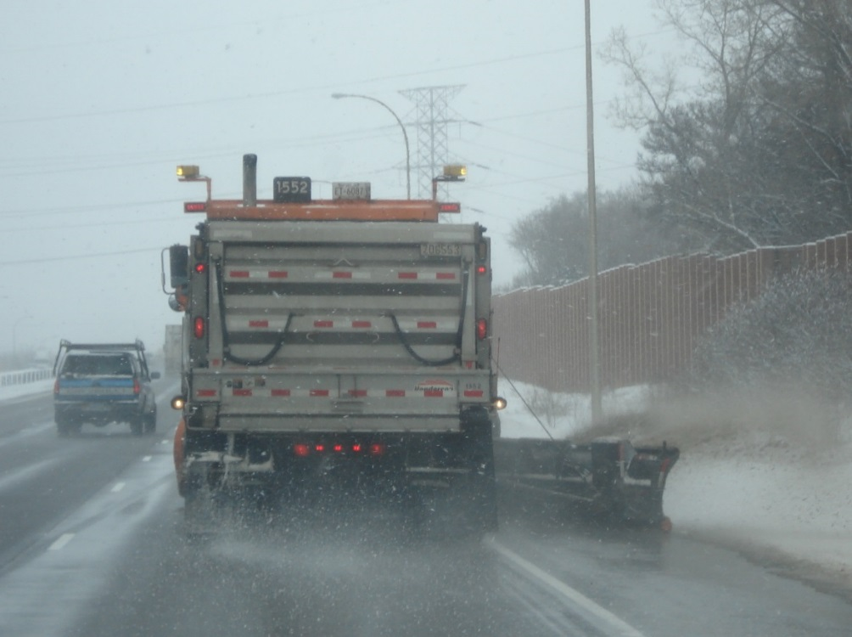
Preventing Refreeze
If slush is on the road plow before it freezes.
If moisture is still on the road and temperatures are dropping reapplication of deicer.
Note to presenters: Insert your procedure here. Delete this yellow box before making presentation.
Notes:
Tackle the problem before there is refreeze! If there is slush on the roads plowing can help to clear it off. In sunny days the liquids on the road may evaporate, doing the job for you.
Reapplication of chemical deicers can help prevent refreeze if the previously applied deicers have become diluted. If there is water on the roads, dry salt may be used if they work at the correct pavement temperature for the application.
Always be aware of the pavement temperature and apply appropriate products. For example, with the temps raising and then lowering to refreeze if there is humidity and Mag Chloride was applied it would also pull moisture out of the air. That moisture then is available for refreezing. It is important to pay attention not only to application rates, temps but also the humidity in the air. This will not stop the roadway treatment. You just need to be aware of all aspects of the treatment.
Note to presenters: Insert your procedure here. Delete this yellow box before making presentation.
Photo credit: Fortin Consulting, Inc.

Slide 68
Test Question
It was a sunny day causing slushy roads, the temperature will begin dropping before it can evaporate.
How do you prevent refreeze?
Plow
Apply Direct Liquid Application
Sand
Do nothing
Notes:
Note to presenters: you may choose to hide this slide.
Test question:
It was a sunny day causing slushy roads, the temperature will begin dropping before it can evaporate. How do you prevent refreeze?
Plow (yes)
Apply Direct Liquid Application (no)
Sand (no)
Do nothing (no)

Slide 69
Test Question
It was a sunny day causing slushy roads, the temperature will begin dropping before it can evaporate.
How do you prevent refreeze?
Plow
Apply Direct Liquid Application
Sand
Do nothing
Notes:
Note to presenters: you may choose to hide this slide.
Test question:
It was a sunny day causing slushy roads, the temperature will begin dropping before it can evaporate. How do you prevent refreeze?
Plow (yes)
Apply Direct Liquid Application (no)
Sand (no)
Do nothing (no)

Slide 70
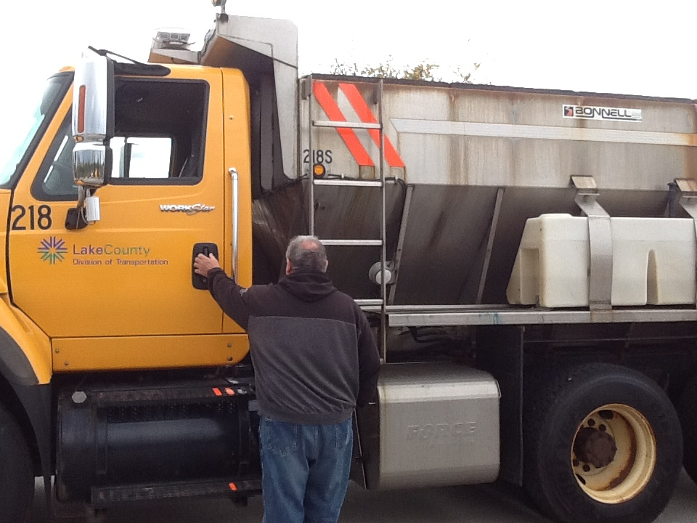
Mitigating refreeze
Pre-wet deicers
Sand at cold temperatures
Note to presenters: Insert your procedure here. Delete this yellow box before making presentation.
Notes:
Once the liquid has frozen into ice apply pre-wet if you have it available and it is appropriate for the pavement temperature. Wetting the salt allows it to act more quickly. If pavement temperatures are colder than the chemical deicers are appropriate for, sand may be used to give temporary traction.
Note to presenters: Insert your procedure here. Delete this yellow box before making presentation.
Photo credit: Fortin Consulting Inc.

Slide 71
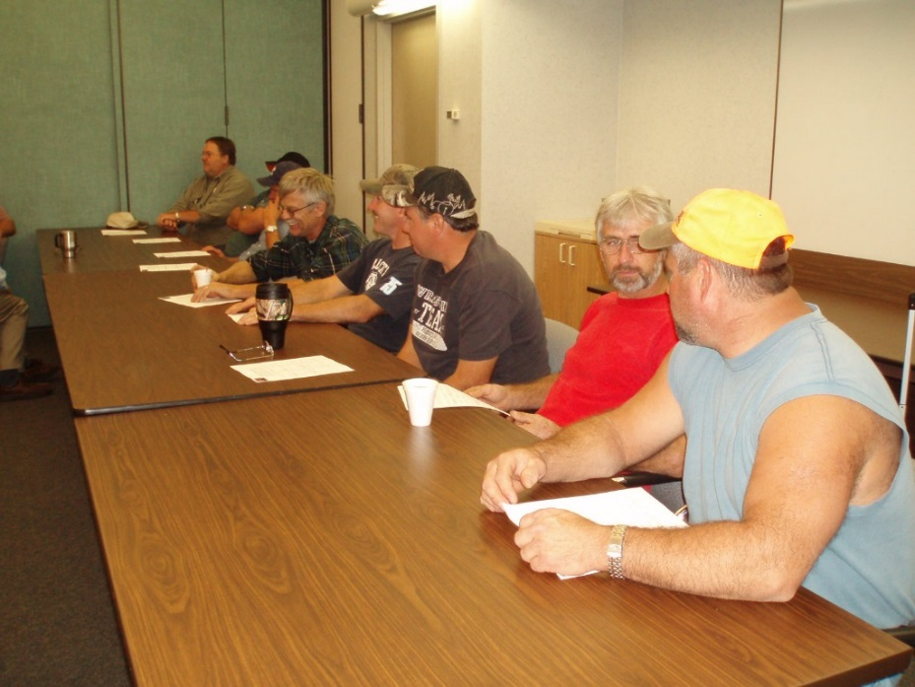
Post storm review
How well was the storm handled?
What worked, what didn’t?
Would a different approach work better?
Notes:
Hold a post storm review to determine if another approach would prevent falling behind the storm. Account for the rate of precipitation in the discussion. If you have a snow rate of 1" per hour, there is no way to stay ahead of the storm. Anti-ice to prevent a strong bond and then do the best you can during the storm event. Be proactive in the post storm clean up.
Photo credit: Fortin Consulting Inc.

Slide 72
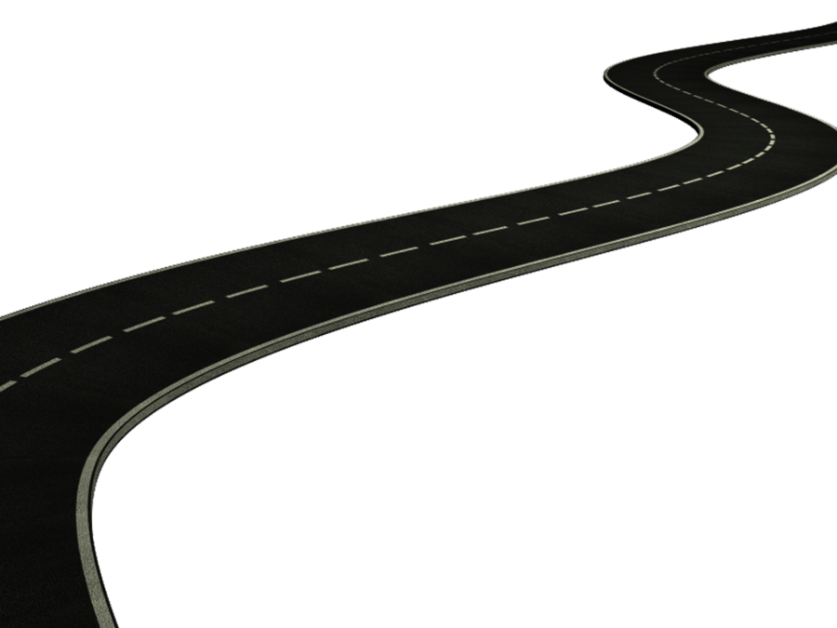

Take time to understand different types of ice
You now know the warning signs!
Be proactive.
Stop ice from forming on the roadways.
Be efficient at removing ice from the roadways.
You can do it!
Notes:
Take time to understand different types of ice
You now know the warning signs!
Be proactive
Stop ice from forming on the roadways
Be efficient at removing ice from the roadways
You can do it!

Slide 73
Additional Resources
AASHTO, Clear Roads Computer Based training:
  Deicers: Unit 6 Application Techniques Slide 11 covers Black Ice formation
Clear Roads Training Module 4: Material Use
Clear Roads Training Module 7: Deicing
Clear Roads Training Module 8: Anti-icing
Clear Roads Training Module 15: Drift Control and Wind
Clear Roads Training Module 17: Bridge Frost

Slide 74
Acknowledgements
Training contents were developed by Fortin Consulting Inc., under the direction of the Clear Roads Advisory Team.
Connie Fortin – connie@fortinconsulting.com
Professional formatting and training aids were developed by the University of Minnesota, Center for Transportation Studies.
Jim Grothaus– Groth020@umn.edu
Ann Johnson – Johns421@umn.edu
Members of the Clear Roads Advisory Team include:
  Mike Sproul, Dave Wieder, Cliff Spoonemore, Monty Mills, David Frame,
  Mike Lashmet, Clay Adams, Justun Juelfs, and Tom Peters

Slide 75
This presentation was developed with funding from the Clear Roads research program, which brings together transportation professionals and researchers from around the country to drive innovation in the field of winter maintenance.
Find additional information and resources at
http://clearroads.org/

Slide 76
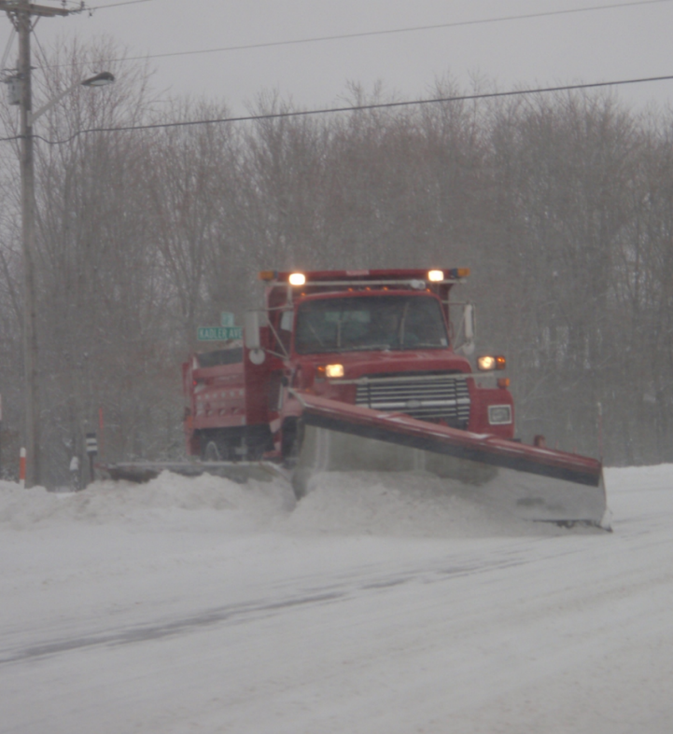
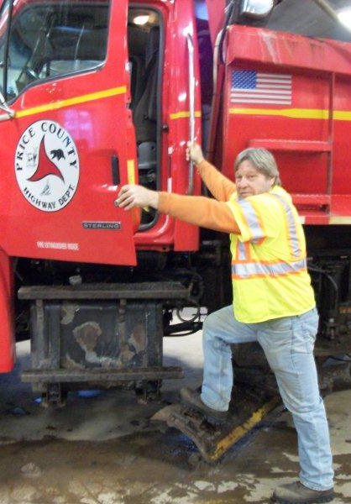
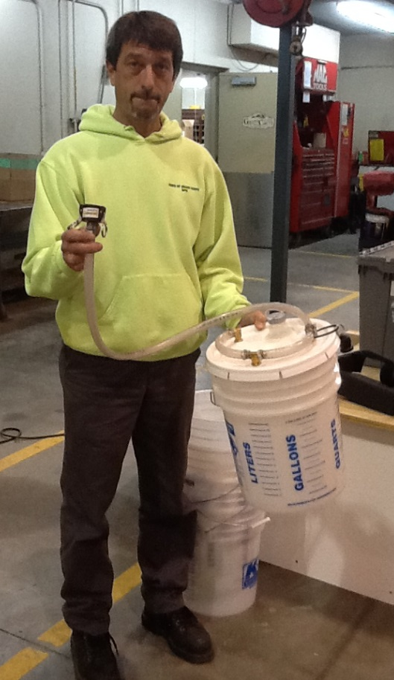
Thank You for your Good Work!
Notes:
Thank you for your time today. Have a good winter!

