Slide 1
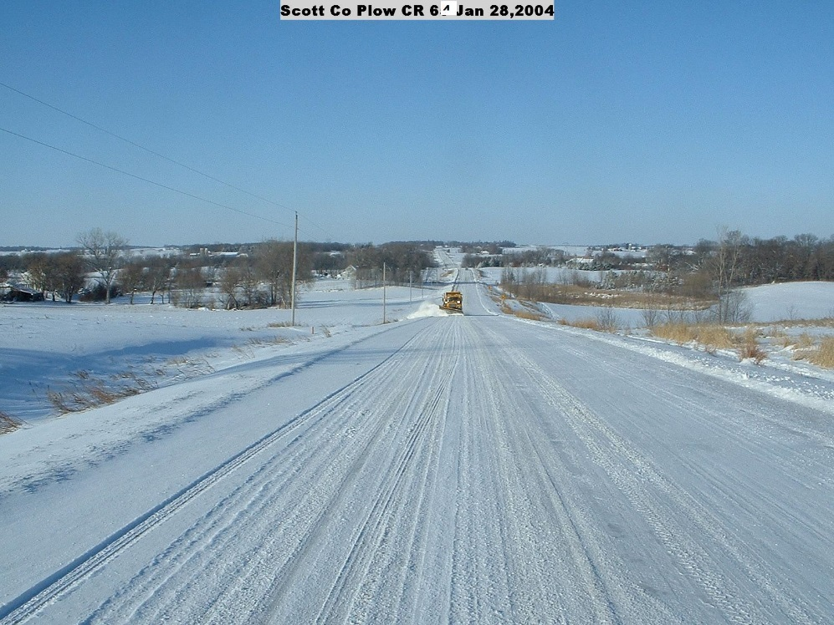
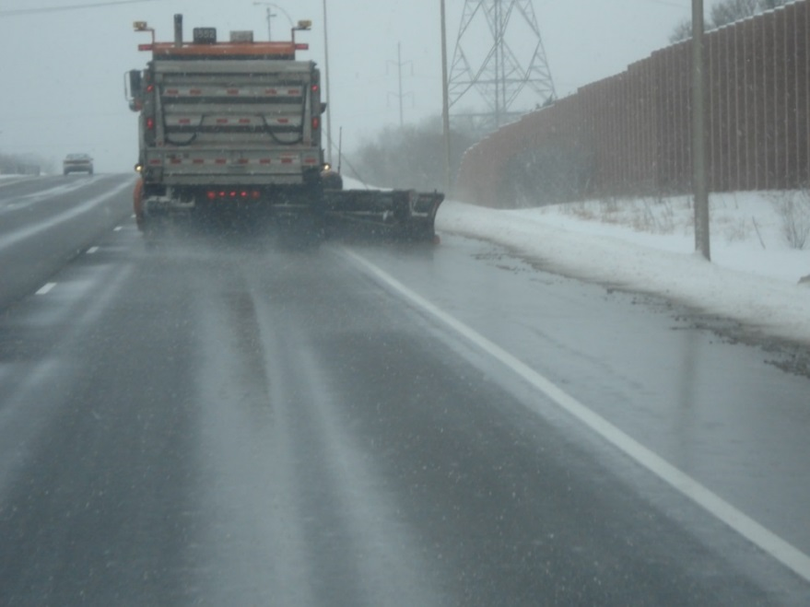

Module 11 – Level of Service
2016 Created for Clear Roads by:
U of MN Center for Transportation Studies &
Fortin Consulting Inc.

Slide 2
Training for Winter Maintenance Supervisors and Operators
2016 Created for Clear Roads by:
U of MN Center for Transportation Studies &
Fortin Consulting Inc.

Slide 3
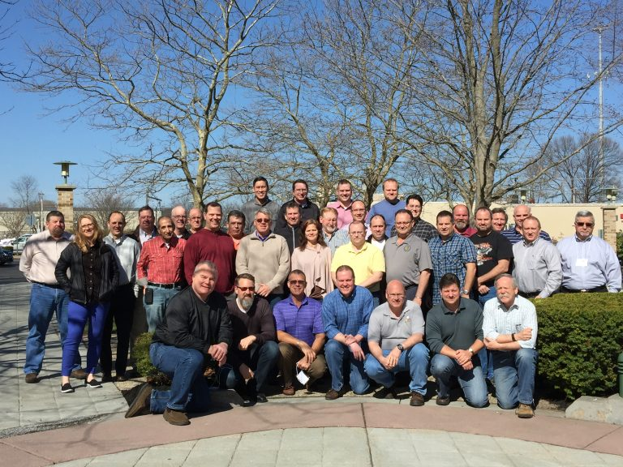
Winter maintenance professionals are a very powerful and important group
Notes:
Photo: clear roads website
Note to presenters: These first 7 slides can be used or hidden.
Or, replace with photos of your staff.

Slide 4
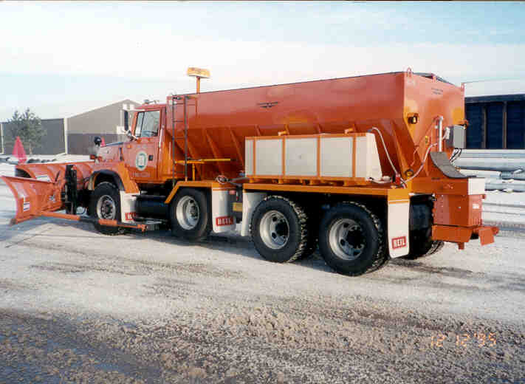
You do a great job of taking care of our roads!

Slide 5
This is one of a series of 22 winter maintenance training modules developed by the Clear Roads Program. All of the modules are available online at www.clearroads.org
Modules include information on the following:
Plowing
Truck operations
Spreading
Material use
Pre-wetting
Brine production
De-icing and anti-icing
Level of service
Ice formation
Freeze point depressants
Environmental issues
Drift control
Weather
Avalanche management
Bridge frost
Safety
Notes:
Note to presenters: The website www.clearroads.org can be accessed here if a live internet connection is available.
A list of all the modules is given here:
Plowing procedures
Truck operations
Spreading
Material use
Pre-wetting
Brine production
De-icing
Anti-icing
Safety
De-icing agent management policy
Level of service
Ice formation
Freeze point depressants
Environmental issues
Drift control
Weather
Bridge frost
Avalanche management

Slide 6


Module 11 – Level of Service
2016 Created for Clear Roads by:
U of MN Center for Transportation Studies &
Fortin Consulting Inc.

Slide 7
FACILITATOR NOTES (do not show during class)
This is a priority 1 module to be developed for Clear Roads national training. It will address three audiences. Slides can be customized for the audience.
Slide Legend
Entry-level plow drivers
Experienced plow drivers
Supervisors
Notes:
Note to facilitator: do not show this slide during class

Slide 8
This module will contain these topics
Inform students of the common factors considered when determining acceptable level of service.
Level of service guidelines from several states DOTs with ranging Annual Average Daily Traffic (AADT).
Benefits of managing areas based on need, regain time and available resources.
Notes:
This module covers an LOS guidelines from several states DOT’s with ranging AADT, the benefits of managing areas based on need, regain time and available resources.

Slide 9
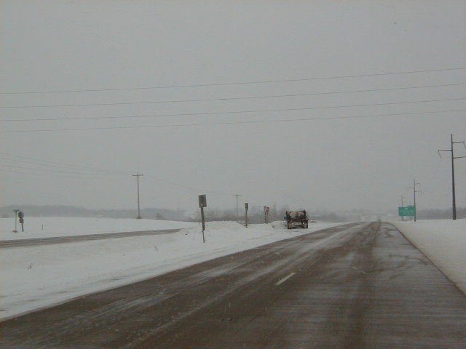
Terms to know
Level of Service - abbreviated LOS, is an agency's ability to produce a service within a set time, cost or resource.
LOS
Notes:
Definition of LOS from APWA Reporter http://www.apwa.net/Resources/Reporter/Articles/2007/6/The-Bakers-Potluck
Level of service: abbreviated LOS, is an agency's ability to produce a service within a set time, cost or resource.

Slide 10
Test Question
What does LOS mean?
Lots Of Snow
Leverage Our Snowplows
Level Of Service
Legislative Official Support to each state
Notes:
Note to presenters: you may choose to hide this slide.
Test Question:
What does LOS mean?
Lots Of Snow
Leverage Our Snowplows
Level Of Service
Legislative Official Support to each state

Slide 11
Test Question
What does LOS mean?
Lots Of Snow
Leverage Our Snowplows
Level Of Service
Legislative Official Support to each state
Notes:
Note to presenters: you may choose to hide this slide.
Test Question:
What does LOS mean?
Lots Of Snow
Leverage Our Snowplows
Level Of Service
Legislative Official Support to each state

Slide 12
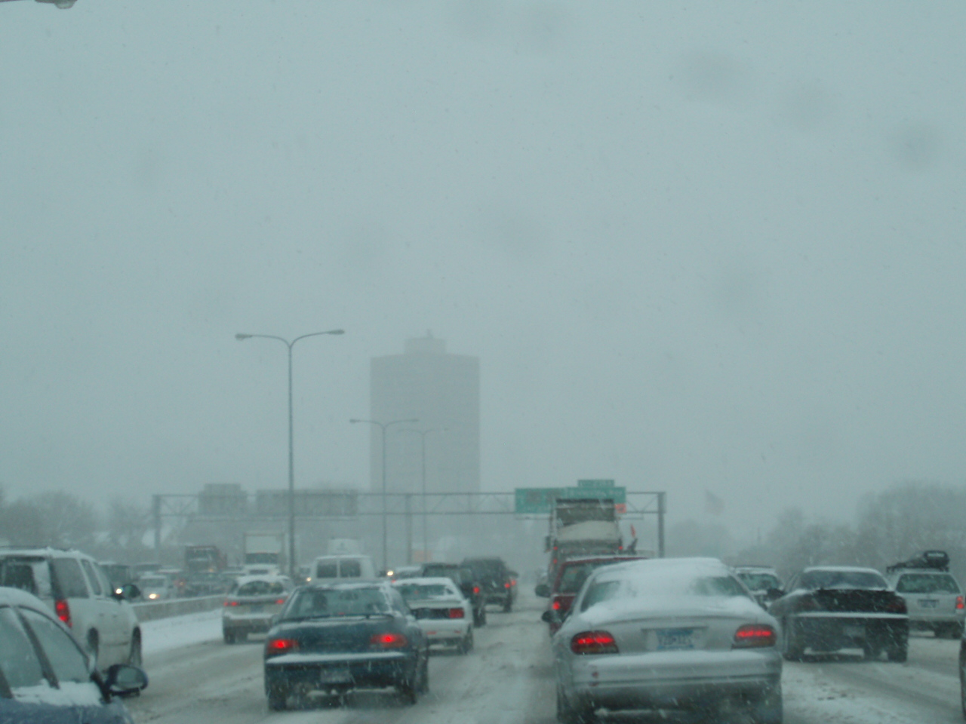
Terms to know
Annual Average Daily Traffic - abbreviated AADT, is the total volume of vehicle traffic on a highway or road over the course of a year divided by 365 days.
AADT
Notes:
This definition of AADT is from Wikipedia.

Slide 13
LOS
Provides a documented priority system for snow and ice control.
Prioritize resources to align with LOS goal.
We should see performance levels differ by service level.
LOS should allow for continuity of travel.
LOS should be reviewed and adjusted annually.
Review LOS with all operators so they understand their target.
Notes:
Slide based upon information from : IowaDOT_New-Operator-Snow-and-Ice-Training_slides_21-23.pptx

Slide 14
Test Question
Should all roads be assigned the same level of service?
Yes
No
Notes:
Note to presenters: you may choose to hide this slide.
Test Question:
Should all roads be assigned the same level of service?
Yes (no)
No(yes)

Slide 15
Test Question
Should all roads be assigned the same level of service?
Yes
No
Notes:
Note to presenters: you may choose to hide this slide.
Test Question:
Should all roads be assigned the same level of service?
Yes (no)
No(yes)

Slide 16



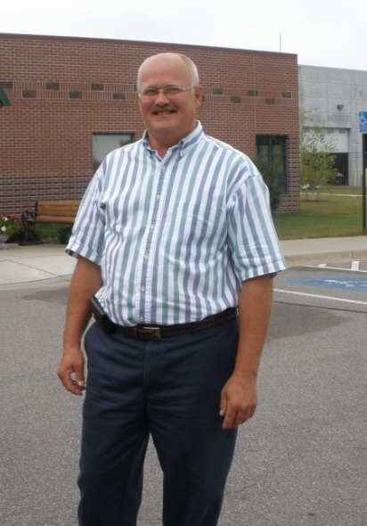

Who establishes your LOS?
Likely the state, county or city engineer by:
Gathering input from operations.
Verifying that the LOS calculations are workable for the plow routes.
Listening to public expectations.
Considering success and failures of the previous year.
Notes:
This is an area of maintenance where a goal is developed in one area of your organization and followed by another. The best LOS will be developed by looking at the numbers but also by talking to the operations staff, reviewing the track record of your organization, and recognizing public input. It is not an easy task to set LOS as it requires a balance of many variables.
Photo credit: Fortin Consulting Inc.
Cartoons: Microsoft clipart

Slide 17
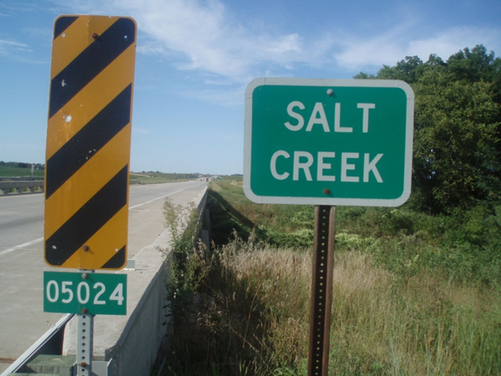
What could be considered in establishing LOS?
AADT
Speed limit
Road material
Shoulder material
Budget
Safety
Alternate routes
Economic impact
Available resources
School bus routes
Environmental cost
Driver expectations
Cycle time
Sporting events
Major concerts
Other factors?
Notes:
If you haven’t considered the environment in your LOS goals it is time to include that. Many factors should be weighed and balanced in order for you to set the most reasonable goals for your roads.
Other factors include:
Gravel roads
Paved roads with gravel shoulders
Paved roads with paved shoulders
Two way
Multi lane
Toll-way
Bridges
Ramps
Intersections
Tunnels
Hills
Curves
Photo credit: Fortin Consulting Inc.

Slide 18


Strive to meet LOS
Try not to exceed
Aim for the target!
Try not to fall short
LOS has been calculated to meet the needs of the traveling public, the needs of the agency, and the environment.
Exceeding or falling short will cause more stress on a resource than is needed.
Notes:
Images: Microsoft office clipart

Slide 19
Test Question
To maximize benefits for everyone (environment, public, your agency) how should you accomplish your LOS goals?
Meet LOS goals slower than expected
Meet LOS goals in expected time range
Meet LOS goals faster than expected
Doesn’t matter, will depend on the storm
Notes:
Note to presenters: you may choose to hide this slide.
Test Question:
To maximize benefits for everyone (environment, public, your agency) how should you accomplish your LOS goals?
Meet LOS goals slower than expected (no)
Meet LOS goals in expected time range (yes)
Meet LOS goals faster than expected (no)
Doesn’t matter, will depend on the storm (no)

Slide 20
Test Question
To maximize benefits for everyone (environment, public, your agency) how should you accomplish your LOS goals?
Meet LOS goals slower than expected
Meet LOS goals in expected time range
Meet LOS goals faster than expected
Doesn’t matter, will depend on the storm
Notes:
Note to presenters: you may choose to hide this slide.
Test Question:
To maximize benefits for everyone (environment, public, your agency) how should you accomplish your LOS goals?
Meet LOS goals slower than expected (no)
Meet LOS goals in expected time range (yes)
Meet LOS goals faster than expected (no)
Doesn’t matter, will depend on the storm (no)

Slide 21
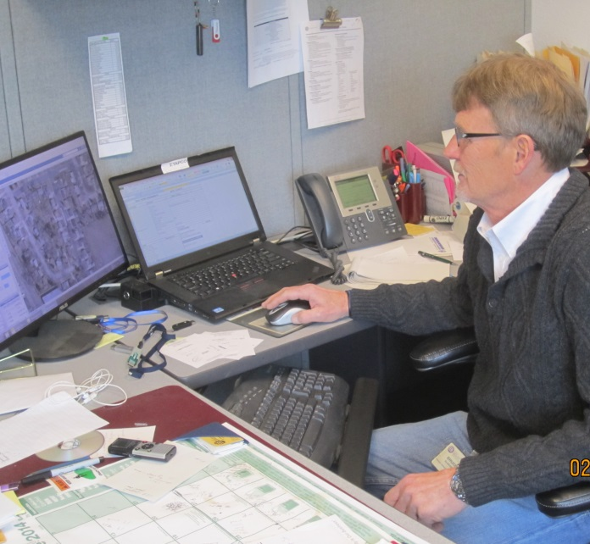
If you consistently don’t meet or exceed your LOS…
Revisit your LOS policy; it may be outdated (i.e. it may not be adjusted for the better performance anti-icing gives….)
Revisit your operations: why are you too slow? (i.e. you didn’t get plowing fast enough in the storm…)
Revisit your operations: why are you too fast? (i.e. too much salt applied to meet the need…)
Notes:
LOS policy should be reviewed and updated each year.
Note: participants may have interesting discussion points about their level of service and the challenges they have encountered trying to hit the target. This slide can be updated or replaced with examples that more truly reflect your situation.
Photo credit: City of Beloit, WI

Slide 22

Politics of LOS
Does the squeaky wheel influence LOS?
Who lives on that route?
What do the mayors, commissioners, governor want?
Are you really allowed a varying LOS in an urban or highly developed area?
What are your experiences?
How do you deal with it?
Notes:
Your engineering department may give you an LOS based on traffic, speed, and other logical factors, but that may influence your organization’s performance. Ask the group: how do you deal with this? This is a good area for a class discussion among supervisors, although keep it productive do not let it turn into a gripe session.
Image: Microsoft clipart

Slide 23

Benefits from a well thought-out LOS
Balance between safety, mobility, cost & environment.
Saves salt, time & money.
Less damage to the environment.
Provides customer safety.
Manages customer expectations.
It can be done consistently.
Notes:
There are many benefits to gain by standardizing our performance and setting targets to maximize the resource efficiency. It is easier to do on paper than in the field. It is good to keep the targets fresh in everyone's head as we move into winter, and good to review them frequently during winter operations.
Graphic: Microsoft clipart

Slide 24
LOS guidelines from several state DOTs with ranging AADT
Each organization will set LOS standards for their operations
Performance measurements that will help communicate that are:
Level of service maps
Definitions of each level of service
Pictures of roads in various conditions
Notes:
Some states use regain time which can be visual or in Idaho’s case they are working with friction measurement. Average travel speed post-storm is also another form of measurement.
Definition of LOS from: APWA Reporter http://www.apwa.net/Resources/Reporter/Articles/2007/6/The-Bakers-Potluck

Slide 25

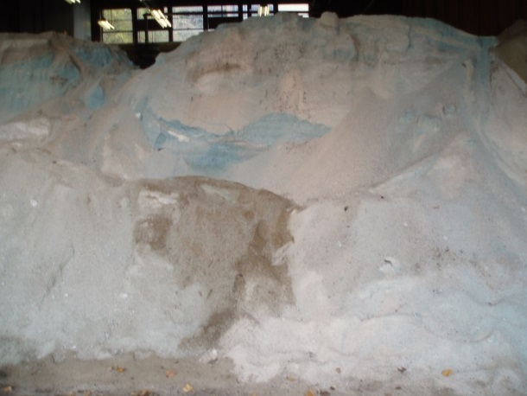
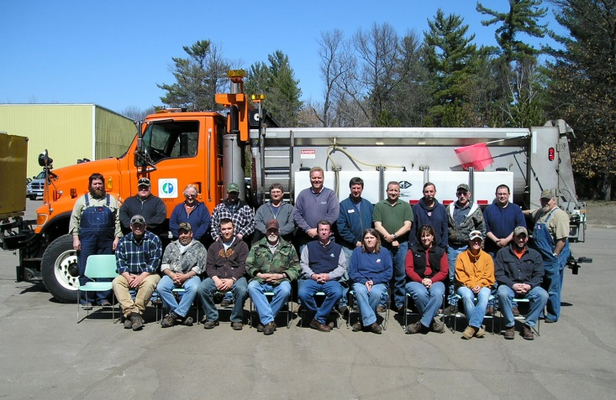


Tips from experienced supervisors
It’s important to have well defined LOS and a uniform way to measure when the goal has been met so resources can be reduced!
Notes:
According to Justun Juelff Lead Maintenance reviewer/Montana DOT: it’s important to have well defined LOS and a uniform way to measure when the goal has been met so resources can be reduced.
Photo credits: Fortin Consulting and MnDOT
Images: Microsoft clipart

Slide 26
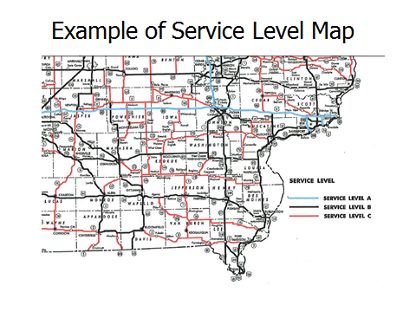
Note to presenters: Insert your level of service map here. Delete this yellow box before making presentation.
Notes:
Note to presenters: Insert your level of service map here. Delete this yellow box before making presentation.
Graphic from: IowaDOT_New-Operator-Snow-and-Ice-Training_slides_21-23.pptx

Slide 27
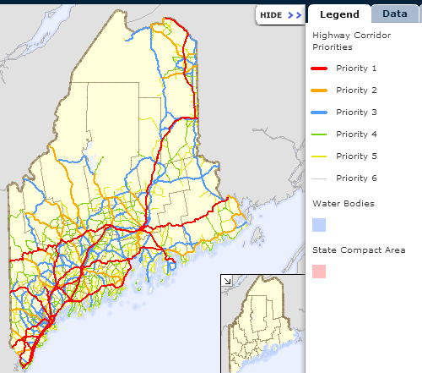
Example level of service map
Good idea
Note to presenters: Insert your level of service map here. Delete this yellow box before making presentation.
Notes:
Supervisors, if you want to protect our waters you should have them on the radar screen. Including them on route maps, LOS maps or any other maintenance maps is an easy way to remind us of them. Meeting our LOS using less salt is a great way to protect them.
Image source:
http://www.maine.gov/mdot/mapviewer/?show=HCP&hide=FFC,MEDOT%20Regions,Wetlands

Slide 28
Define service level
Example: Iowa Definitions
Service level A – Interstates
Service level B - commercial and industrial roadway network and roads with more than 5,000 vehicles per day
Service level C - roads with less than 5,000 vehicles per day
Note to presenters: Insert definitions here. Delete this yellow box before making presentation.
Notes:
Note to presenters: insert your own definitions here and delete this yellow box before making presentation.
This example comes from IowaDOT_New-Operator-Snow-and-Ice-Training_slides_21-23.pptx

Slide 29
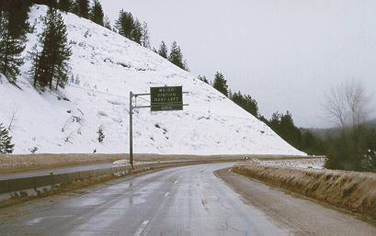
Example: Montana definitions
Level I – all interstates and other state maintained roadways with AADT >5000 vehicles per day.
Level II – all state maintained roadways with 1000-5000 vehicles per day.
Level III – all state maintained roadways with < 1000 vehicles per day.
Level IV – seasonal roadways.
Note to presenters: Insert your level of service descriptions here. Delete this yellow box before making presentation.
Notes:
Note to presenters: insert your own definitions here and delete this yellow box before making presentation.
This example comes from Montana DOT.

Slide 30

Describe what service the routes get
Example: Montana Definitions
Level I – Anti-icing & deicing, 24 hour coverage.
Level II – De-icing, maintained 4 am -12 am.
Level III – De-icing, maintained 4 am - 8 pm.
Level IV – No scheduled winter maintenance.
Note to presenters: Insert your description of service here. Delete this yellow box before making presentation.
Notes:
Note to presenters: insert your own definitions here and delete this yellow box before making presentation.
This example comes from Montana DOT.

Slide 31
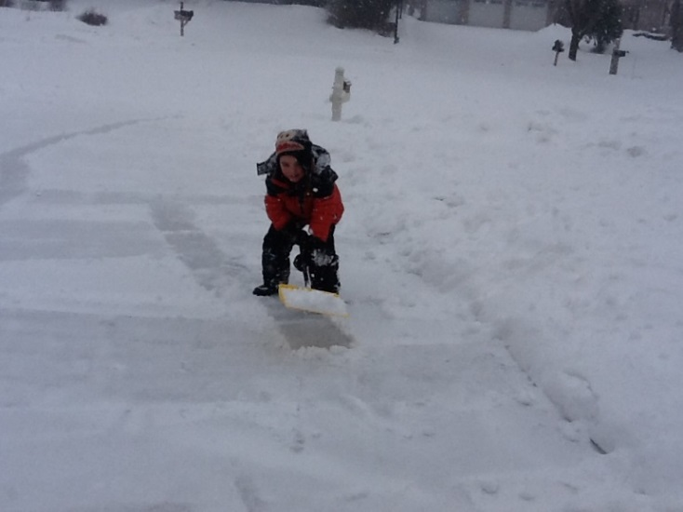
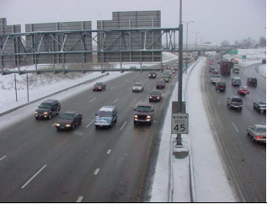
Describe road recovery time
Example: Montana recovery time
Level I – 4 -12 hours after the storm.
Level II – 8 - 24 hours after the storm.
Level III – 16 - 36 hours after the storm.
Level IV – No scheduled winter maintenance.
Note to presenters: Insert your recovery times here. Delete this yellow box before making presentation.
Notes:
Note to presenters: insert your own definitions here and delete this yellow box before making presentation.
This example comes Information on this slide taken from Montana DOT
Photo credit: Fortin Consulting Inc. and Wisconsin DOT

Slide 32
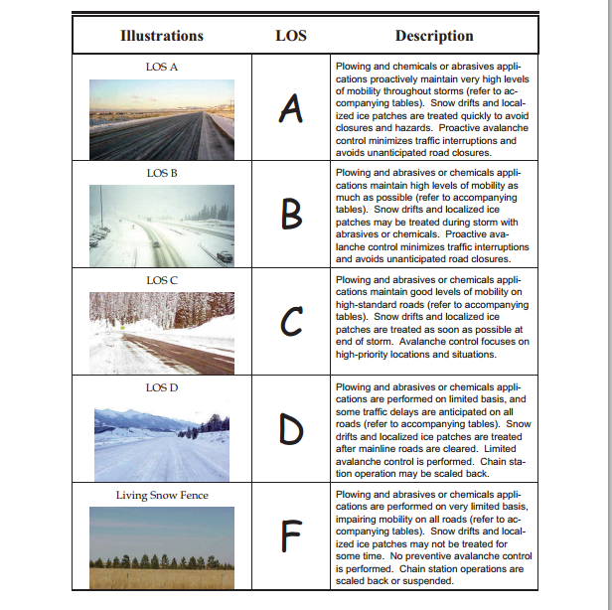
Illustrations are helpful
Example: Colorado illustrations/descriptions
Note to presenters: Insert photos of your standards here. Delete this yellow box before making presentation.
Notes:
This example is Colorado DOT’s description of LOS. It offers a visual reminder of the types of roads that have the various level of LOS associated with them.
Note to presenters: Insert photos of your standards here. Delete this yellow box before making presentation.

Slide 33
Test Question
Do all leading organizations use the same LOS standards?
Yes – The best in the business have agreed on the same LOS standards
No – Top performers don’t need LOS targets
No – Set the LOS based on how hard you are willing to work
No – Set the LOS based on your road use characteristics, customer demand, the environment, your budget and the capabilities of your organization
Notes:
Note to presenters: you may choose to hide this slide.
Test Question:
Do all leading organizations use the same LOS standards?
Yes – The best in the business have agreed on the same LOS standards (no)
No – Top performers don’t need LOS targets (no)
No – Set the LOS based on how hard you are willing to work (no)
No – Set the LOS based on your road use characteristics, customer demand, the environment, your budget and the capabilities of your organization(yes)

Slide 34
Test Question
Do all leading organizations use the same LOS standards?
Yes – The best in the business have agreed on the same LOS standards
No – Top performers don’t need LOS targets
No – Set the LOS based on how hard you are willing to work
No – Set the LOS based on your road use characteristics, customer demand, the environment, your budget and the capabilities of your organization
Notes:
Note to presenters: you may choose to hide this slide.
Test Question:
Do all leading organizations use the same LOS standards?
Yes – The best in the business have agreed on the same LOS standards (no)
No – Top performers don’t need LOS targets (no)
No – Set the LOS based on how hard you are willing to work (no)
No – Set the LOS based on your road use characteristics, customer demand, the environment, your budget and the capabilities of your organization(yes)

Slide 35
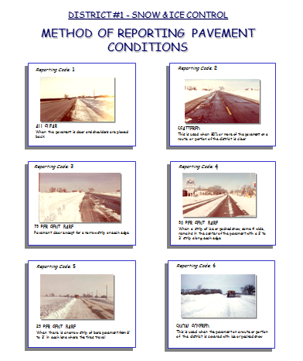
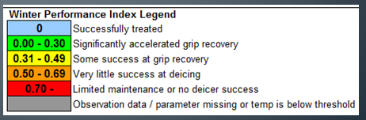
Document your progress
Visual guidelines
Friction sensors
Other tools
Note to presenters: Insert your visual guidelines or other tools you use here. Delete this yellow box before making presentation.
Notes:
Knowing when to stop and when to continue sounds easy but isn't so clear cut. Developing targets and tools to help recognize when you have achieved your target can help reduce confusion. Here is an example of a visual tool developed by Illinois DOT to help people recognize and quantify the state of their roads.
Friction sensors are also being used as a way to measure performance. Idaho DOT is doing a lot of work on this. The example of winter performance index legend on the slide is a calculation they make based on the friction of the road. Dennis Jensen Dennis.Jensen@itd.idaho.gov is a good contact if you want more information on this leading edge approach.
Photo credit: Illinois and Idaho DOT

Slide 36
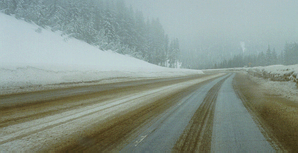
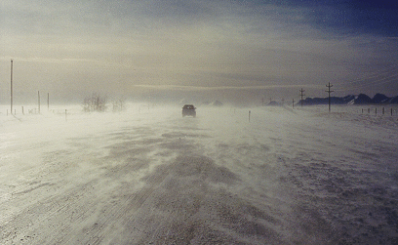
Driving conditions
Good
Track and report road conditions to see when you meet your LOS
Fair
Poor
Note to presenters: Insert photos of your standards here. Delete this yellow box before making presentation.
Notes:
What are the standards for your organization? Put photos here and delete this yellow box before making presentation.
You may also want to develop one page of examples with good conditions, a page with fair conditions and a page with poor conditions. Your rating scale may not be good, fair poor so change the titles accordingly.
Photo credit: Montana DOT

Slide 37
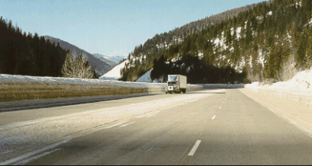
How do we meet our LOS most efficiently?
As salt becomes more scrutinized, challenge yourself to reach your goal using less salt.
What strategies allow you to be most effective/least wasteful with your materials.
Strategies will change with the event but the goal can be the same.
Notes:
Note to presenters: This is a good discussion slide. Likely your organization is successful at reaching their LOS targets. Challenge the supervisors to improve strategies to reach the goals using less salt. Ask: how would they do it? You could provide different scenarios such as 10 inch storm over 12 overs, freezing rain turning into 2 inches of slush and so on….
An interesting case study would be Idaho DOT’s use of friction sensors and RWIS to try to quantify and give more feedback on road conditions. Providing more information fosters better choices. Dennis.Jensen@itd.idaho.gov
Photo credit: Montana DOT

Slide 38
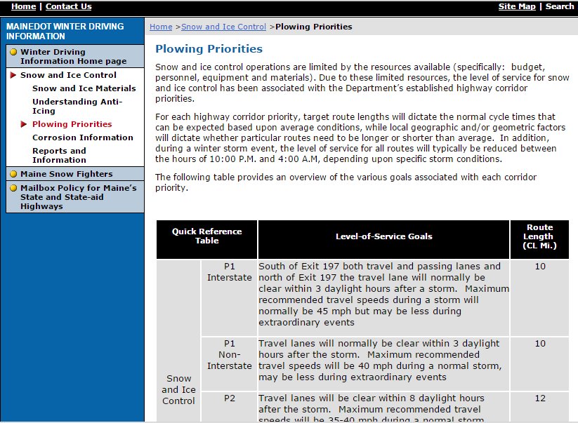
Educate drivers
Good idea
Notes:
This is a screen shot from: http://www.maine.gov/mdot/winterdriving/pp.htm
Presenters: Insert your LOS on your website and help your customers understand the LOS service they should expect. Ask participants: what other ways do you have to communicate with those that use your roads? Explore those opportunities to get everyone on the same page.
This example also points out desired traveling speeds for users while the road is not at LOS. It is good to let the users know that they won’t always be able to travel at the same speed that they are used to.
One experienced supervisor commented that he felt “Enforcement would be the only way the reduced speed limit would work”. That might be an interesting topic for discussion between agencies or even within the agency.

Slide 39
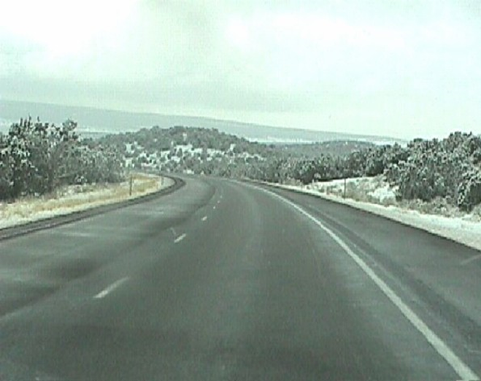

Should we exceed our LOS goals?
If we frequently exceed our LOS goals we should understand why:
Our LOS goals need updating. Likely we have new technology at work for us.
We aren’t training our crew on the desired LOS.
We are using more resources (salt, time) than required.
Notes:
Photo credit: Utah DOT
Image: Microsoft clipart

Slide 40
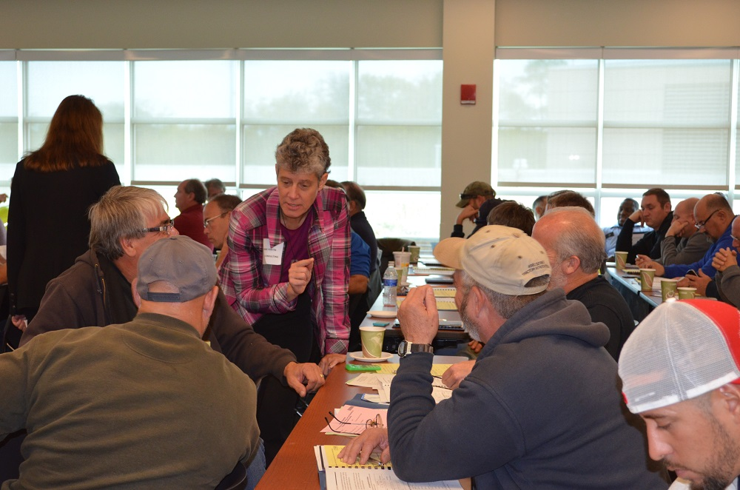
Educate your crew
Explain the LOS targets for their routes.
Reinforce that we do not want to exceed those targets.
Explain why we do not want to exceed those targets.
A job well done is meeting your LOS - not exceeding it!
Notes:
LOS targets have been set given the resources and goals of our operation. Meeting them delivers the most efficient and effective use of resources. Exceeding them typically means one of two things:
your LOS goal was not properly determined and should be re-evaluated (supervisor task)
more materials were applied than necessary to meet LOS (operator task)
Photo credit: Fortin Consulting Inc.

Slide 41
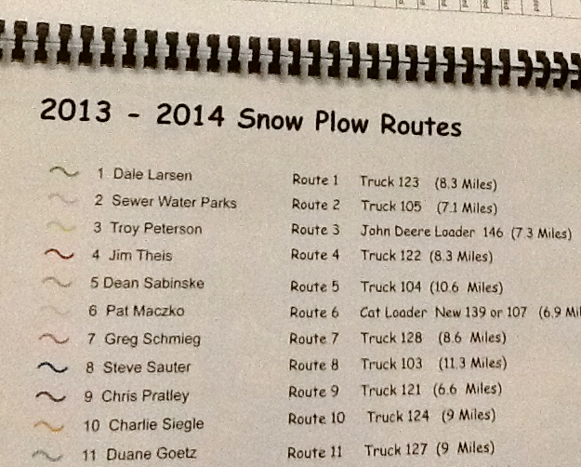
Understand the LOS for various areas of your route
A job well done is meeting your LOS - not exceeding it!
Notes:
Photos: FCI
LOS targets have been set given the resources and goals of our operation. Meeting them delivers the most efficient and effective use of resources. Exceeding them typically means one of two things. #1 your LOS goal was not properly determined and should be re-evaluated (supervisor task) #2 more materials were applied than necessary to meet LOS (operator task)

Slide 42
Test Question
Who is necessary to make LOS guidelines work?
Plow Driver
Supervisor
Engineer
All of the above
Notes:
Note to presenters: you may choose to hide this slide.
Test Question:
Who is necessary to make LOS guidelines work?
Plow Driver (no)
Supervisor (no)
Engineer (no)
All of the above (yes)

Slide 43
Test Question
Who is necessary to make LOS guidelines work?
Plow Driver
Supervisor
Engineer
All of the above
Notes:
Note to presenters: you may choose to hide this slide.
Test Question:
Who is necessary to make LOS guidelines work?
Plow Driver (no)
Supervisor (no)
Engineer (no)
All of the above (yes)

Slide 44
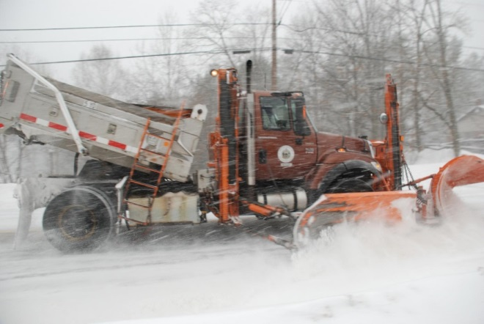
Success story
Maine DOT 2004
Reviewed practices
Redefined LOS
By 2014 they:
Retired 53 plow trucks based on route reprioritization and reclassification based on shift to anti-icing (savings of 1.3 million annually and 10 million savings in replacement cost for these vehicles).
Reduced storage needs by using more liquids.
Less leaching of stored salt & sand.
Less contamination of wells.
Reduced sweeping time by 7 weeks per year.
Notes:
Photo credit: Maine DOT
Excerpt from Establishing LOS Standards and Prioritizing Routes
In 2004 the Maine DOT (MDOT) started the process of reviewing its Maintenance and Operations practices. As a result in 2005 the level of service guidelines and maintenance management were redefined based on changes in practices; a shift from sanding to anti-icing. The LOS system used evolved from a tool used by only the Maintenance and Operations Department to full implementation across all MDOT programs including paving and capital projects. The redefined LOS priorities have been linked with plow route lengths, cycle times, and average salt usage and serve to develop asset-based budgets for their regions. A multi-state Maintenance Management System (MMS that was developed jointly with New Hampshire and Vermont allows for tracking of vehicle hours used, person hours, materials ordered and used, and various stockpile management activities. This data helps MDOT manage supplies, accomplishments and track efficiency throughout the season, as well as reconcile quantities purchased versus quantities used at the end of the season.
By 2014 and many iterations to systems, MDOT has realized cost savings and improved environmental stewardship as presented below:
MDOT was able to retire 53 plow trucks based on route reprioritization and reclassification based on the shift to anti-icing, and the trucks being able to take on longer routes. This represents an annual vehicle operating cost savings of approximately $25,000 per truck or $1.3 million for all trucks retired annually. This is also a $10 million savings in replacement costs for these vehicles.
MDOT was able to reduce sand and salt/sand storage needs by shifting to more anti-icing. Much of the material was stored in outside piles. By reducing the sand and salt/sand use this allowed for smaller, more affordable storage structure to be built. The original 3000 to 5000 yd3 buildings cost $500,000 to $600,000, but the smaller structures that store 500 to 700 yd3 cost $150,000 to $200,000. Providing a significant cost savings. By storing all of the material inside less material has been lost to the environment; there has been a decrease in leaching and contamination of wells, and a decrease in well contamination claims and replacement costs.
Cost savings that have been observed but not yet quantified by MDOT include reduced sweeping time, reduced sand/salt production time, reduced catch basin cleaning, reduced build-up of sand in culverts and ditches, a reduction in windshield claims to zero. As a result, MDOT has picked up roughly 7 extra weeks for summer work that was otherwise dedicated to these activities.”

Slide 45
Tips from experienced supervisors
We get most complaints as soon as the storm stops. People are more patient during the storm, but want instantly clear roads.
Note to presenters: use these tips or put your own here. Delete this yellow box before making presentation.
Suggestion: put messages on overhead bulletin boards or radio stations saying, “give us time to clear the road.” Inform the public and manage their expectations.
Notes:
Quote from Norm Ashfeld(retired MnDOT)
Note to presenters: use these tips or put your own here. Delete this yellow box before making presentation.

Slide 46
Tips from experienced supervisors
Our second most common area of complaints is transition areas where different levels of service meet.
Note to presenters: use these tips or put your own here. Delete this yellow box before making presentation.
Suggestion: Before winter, have the key operators that maintain transition areas meet and talk. For example, District 6 meet with Metro to discuss transition areas. Metro needs to back off on LOS when they near District 6, and District 6 needs to boost it up as they near Metro.
Notes:
Quote from Norm Ashfeld (retired MnDOT)
One experienced supervisor commented that he would not back off on LOS in his maintenance area. It would be better to increase LOS at the other district to make the road maintenance changes less abrupt. There isn't a right or wrong answer; the key is an approach that should be agreed upon between the organizations in the transition zones.
Note to presenters: use these tips or put your own here. Delete this yellow box before making presentation.

Slide 47
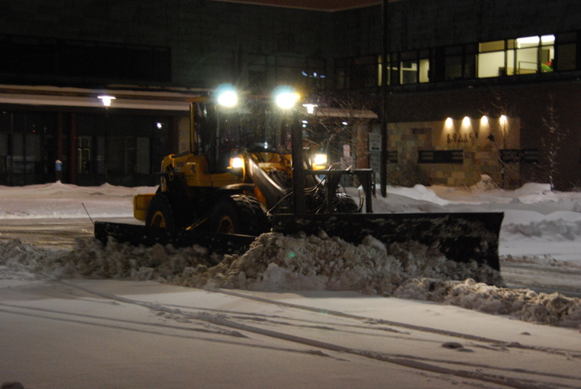
Tips from experienced supervisors
Note to presenters: use these tips or put your own here. Delete this yellow box before making presentation.
Modified levels of service can be employed at night time (keeping some trucks off the road) to allow rest for some operators.
Notes:
Note to presenters: use these tips or put your own here. Delete this yellow box before making presentation.
This quote is from Mike Lashment (NYSDOT)
Photo credit: City of Bloomington, MN

Slide 48
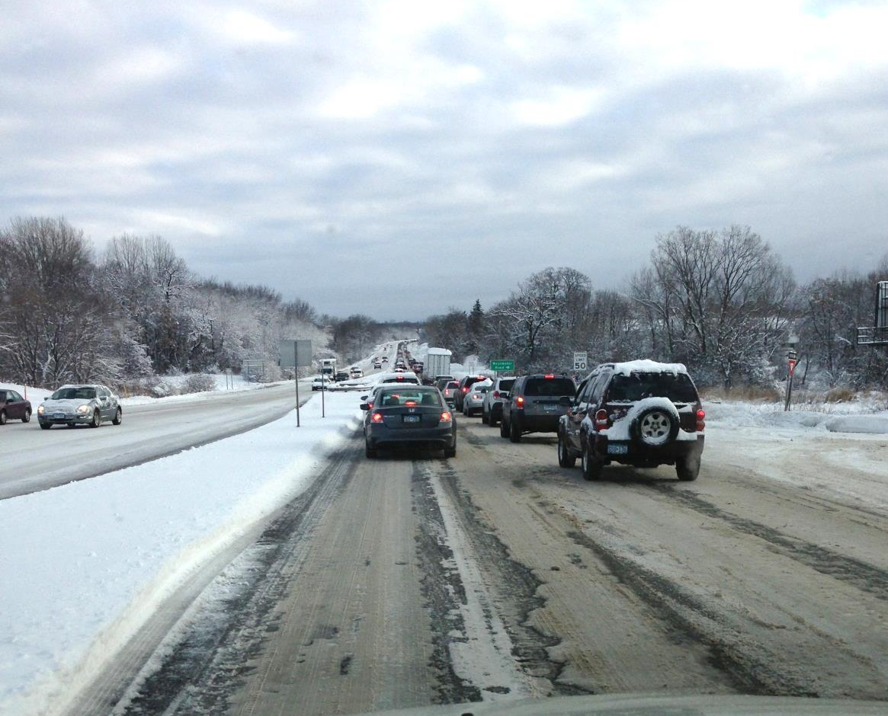
Tips from experienced supervisors
How to manage different LOS on same route?
Note to presenters: use these tips or put your own here. Delete this yellow box before making presentation.
Suggestion: Make sure operators know their LOS targets. They should still plow all routes in a sensible order but be aware to modify the salting practices depending on LOS.
Notes:
Note to presenters: use these tips or put your own here. Delete this yellow box before making presentation.
This tip is from Woody Woodruff (retired MnDOT Mankato area)
There may be other difficulties involved in meeting your LOS both on the end of not meeting it or exceeding it.
Photo credit: Fortin Consulting Inc.

Slide 49

Importance of Record Keeping
Shows that you follow policies including Levels of Service
Shows where efficiency can be improved
Helps with planning
Helps protect you from claims
Notes:
Record keeping is important as a means of material accountability, budgeting/cost tracking, performance tracking, support in the event of legal actions, media inquiries, and planning.

Slide 50
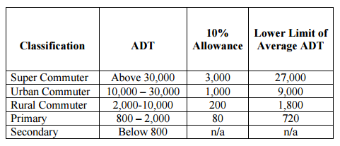
Level of Service
Keeping good records helps
To show you meet your level of service
To show you are following policy
To defend yourself when faced with a lawsuit
Notes:
Ask participants: When is it not possible to meet your level of service and how would you document this?
Credit: MnDOT Maintenance Manual http://www.dot.state.mn.us/maintenance/pdf/manual/Ch2.pdf

Slide 51
Storm Documentation
EXAMPLE:
Work orders
Patrol log
Material usage log
Equipment work orders
Fuel logs
Time sheets
Diary
TAPER log
Customize this slide for your operation
Insert a list of forms needed to be completed by operators for a storm. Delete this yellow box before making the presentation.
Notes:
Review the storm documentation needed for your agency.
Note to presenters: Insert a list of forms needed to be completed by operators for a storm here. Delete this yellow box before making presentation.
Slide credit: CDOT Snow Removal Operator Training

Slide 52
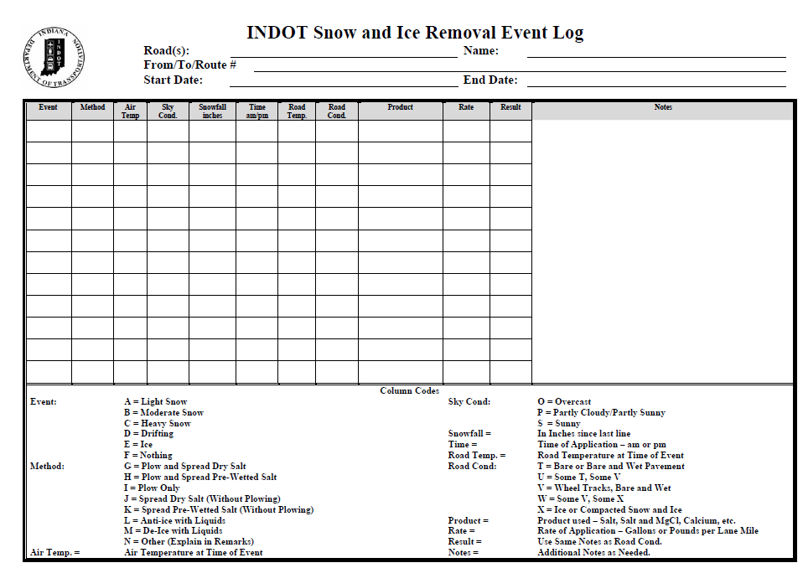
Document Your Operations
EXAMPLE:
Conditions- weather and road, pavement temp
Material type and quantity used
Timing
# of passes and when
Unusual conditions/circumstances
Customize this slide for your operation
Insert an example of your state’s event log and explain how to fill it out. Delete this yellow box before making the presentation.
Notes:
It is very important that plow drivers document the actions taken in response to a snow/ice event
This will include the road conditions throughout their shift, type and amount of deicer or anti-icer used, timing of operations, and the number of passes and when. If there are unusual conditions that affect the operations, those should be recorded. For example, road construction, accidents, major compaction problems, etc.
Note to presenters: Insert a copy of your state’s event log and explain how to fill it out. Delete this yellow box before making presentation.
Photo credit: INDOT

Slide 53
Example: T A P E R
T = Temperature
A = Application
P = Product
E = Event
R = Results
Notes:
Use this slide if your state uses the TAPER system to help explain. Hide this slide if it doesn’t use the TAPER system.
Slide credit: CDOT Snow Removal Operator Training

Slide 54
Event Log
Insert an example of your state’s event log. Delete this yellow box before making presentation.
Customize this slide for your operation
EXAMPLE
Notes:
Review this sequence of events as illustrated on this report, pay particular attention to the changes that took place in the highlighted entries. Note that this TAPER log really paints a good picture of what was done, when it was done, how it was done, who did it with what and what the outcome was like. If you had this information coming on to shift, would you really even need to talk to the person you are relieving?
Note to presenters: Insert an example of your state’s event log here. Delete the yellow box before making presentation.
Slide credit: CDOT Snow Removal Operator Training

Slide 55
Test Question
What should you record during the storm?
Type of product used
Application rate
Pavement temperature
All of the above
Notes:
Note to presenters: you may choose to hide this slide.
Test question: What do you need to record for the TAPER log?
Product (no)
Results (no)
Temperature (no)
All of the above (yes)

Slide 56
Test Question
What should you record during the storm?
Type of product used
Application rate
Pavement temperature
All of the above
Notes:
Note to presenters: you may choose to hide this slide.
Test question: What do you need to record for the TAPER log?
Product (no)
Results (no)
Temperature (no)
All of the above (yes)

Slide 57

A job well done is a job well documented
Filling out paperwork is important because it:
Shows that you follow policy
Improves efficiency of operations
Helps with planning
Notes:
Presenters: give a pep talk here! Everyone knows that filling out paperwork during or at the end of a long shift can be hard to be motivated to do, but it is very important because it:
Shows that you follow policy
Improves efficiency of operations
Helps with planning

Slide 58
Test Question
When you’ve been working all night and you’re tired, do you still have to fill out your paper work?
No
Yes
Notes:
Note to presenters: you may choose to hide this slide.
Test question: When you’ve been working all night and you’re tired do you still have to fill out your paper work?
No (no)
Yes (yes)

Slide 59
Test Question
When you’ve been working all night and you’re tired, do you still have to fill out your paper work?
No
Yes
Notes:
Note to presenters: you may choose to hide this slide.
Test question: When you’ve been working all night and you’re tired do you still have to fill out your paper work?
No (no)
Yes (yes)

Slide 60
OTHER
Insert any additional during the storm record keeping needs here, otherwise delete this slide. Delete this yellow box before making presentation if you use this slide.
Customize this slide for your operation
Notes:
Note to presenters: add any other information you’d like to include regarding decision making during the storm here. If you do not use this slide, hide it.

Slide 61
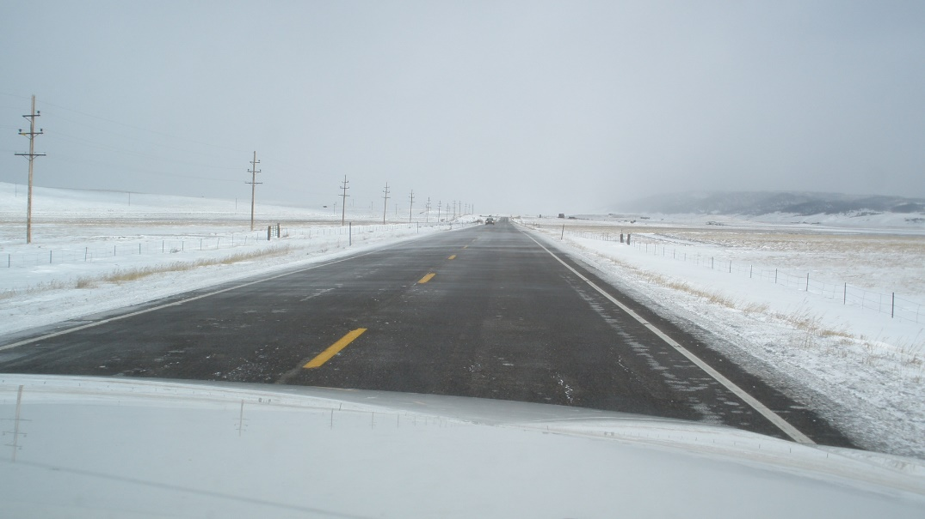
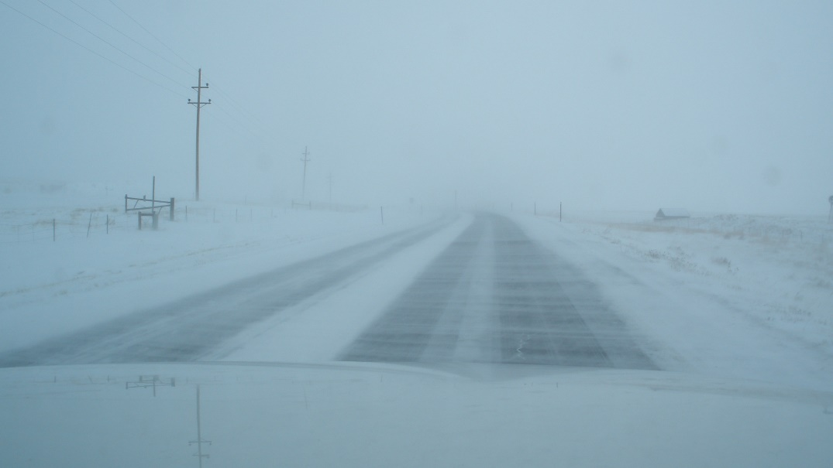
Level of Service Goal
Reviewing event documentation:
Materials Used + Plowing Strategy + # of Cycles + Other Factors
Are you able to meet your LOS goals?
Notes:
There are many factors that go into trying to meet your level of service goals such as material type and amount, plowing strategies, number of cycles, and others (ask for input). After each storm it is good to look at how the event went. How did you do and how can you improve for the next event?
Photo credits: Iowa DOT

Slide 62

Planning
Use records from previous years to help predict future materials, equipment, and maintenance needs.
Notes:
While no season or even event is the same, you can use records of previous years to help predict future needs in materials, equipment, and maintenance.
Photo credit: Microsoft clipart

Slide 63
OTHER
Insert any additional after the storm record keeping needs here, otherwise hide this slide. Delete this yellow box before making presentation.
Customize this slide for your operation
Notes:
Note to presenters: Insert any additional after the storm record keeping needs here, otherwise hide this slide. Delete this yellow box before making presentation.

Slide 64

Record Keeping is Important!
You can’t break any records if you’re not keeping track!
You are an important part of the record keeping puzzle!
Notes:
Photo credit: Microsoft clipart

Slide 65

Have you evaluated the effectiveness of your LOS guidelines?
Most agencies have not.
It is time to review them?
Make necessary revisions.
You deserve targets that optimize the variables (i.e. budget, time, salt, service, safety, public expectations…)
Notes:
Slide based on excerpts from the 2015 Draft “Snow and Ice Control Environmental BMP Manual” Western Transportation Institute

Slide 66
Test Question
Have most agencies reviewed the effectiveness of their LOS guidelines?
Yes
No
Notes:
Note to presenters: you may choose to hide this slide.
Test Question:
Have most agencies reviewed the effectiveness of their LOS guidelines?
Yes (no)
No (yes)

Slide 67
Test Question
Have most agencies reviewed the effectiveness of their LOS guidelines?
Yes
No
Notes:
Note to presenters: you may choose to hide this slide.
Test Question:
Have most agencies reviewed the effectiveness of their LOS guidelines?
Yes (no)
No (yes)

Slide 68

Give it a try!
Develop reasonable LOS goals.
Review and improve them annually.
Let your crew and the public know the LOS.
Encourage your team to meet the expectations.
Do the best you can do to be part of the solution!
“Happiness is waking up, looking at the clock and finding that you still have two hours left to sleep.” - Charles M. Schultz
Notes:
Establishing and maintaining LOS goals are difficult. However, a good attitude and an understanding of what we are trying to accomplish will help the situation.

Slide 69
Additional Resources
AASHTO, Clear Roads Computer Based training:
Proper Plowing Techniques: Unit 1 Pre-season Preparation
Winter Maintenance Management: Unit 2 Establishing Levels of Service
Deicing: Unit 5 Application Guidelines
Performance Measures for Snow & Ice Control: Unit 1 - 7
DRAFT Snow and Ice Control Environmental BMP Manual. Western Transportation Institute. Chapter 4. Not yet published June 2015. Provided as a resource for this module by Justun Juelff Montana DOT
Friction sensors and LOS
Dennis Jensen – Idaho DOT Dennis.Jensen@itd.idaho.gov
Notes:
This slide lists additional resources that can offer information about Level of Service.

Slide 70
Acknowledgements
Training contents were developed by Fortin Consulting Inc., under the direction of the Clear Roads Advisory Team.
Connie Fortin – connie@fortinconsulting.com
Professional formatting and training aids were developed by the University of Minnesota, Center for Transportation Studies.
Jim Grothaus – Groth020@umn.edu
Ann Johnson – Johns421@umn.edu
Members of the Clear Roads Advisory Team include:
Mike Sproul, Dave Wieder, Cliff Spoonemore, Monty Mills, David Frame,
Mike Lashmet, Clay Adams, Justun Juelfs, and Tom Peters

Slide 71
This presentation was developed with funding from the Clear Roads research program, which brings together transportation professionals and researchers from around the country to drive innovation in the field of winter maintenance.
Find additional information and resources at
http://clearroads.org/

Slide 72
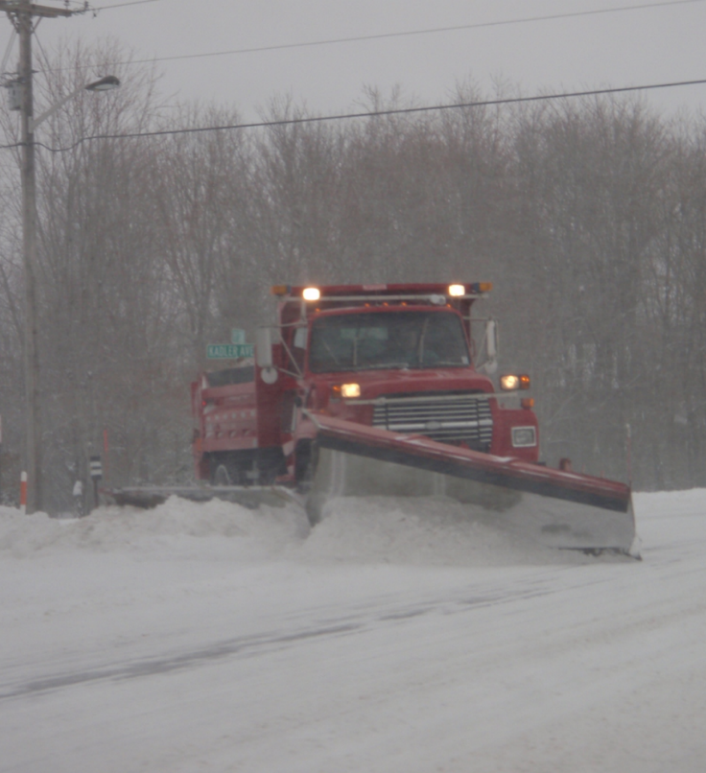
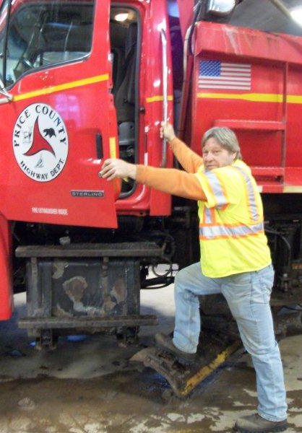
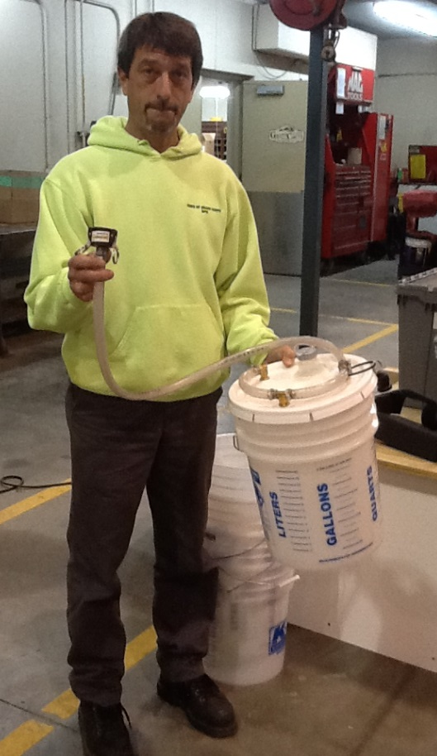
Thank You for Your Good Work!
Notes:
Thank you for your time today. Have a good winter!

