Slide 1
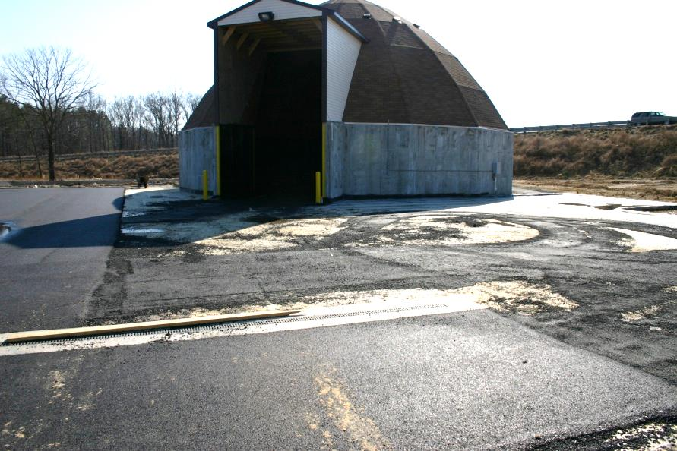

Module 10: Deicer Material Management Policy
2016 Created for Clear Roads by:
U of MN Center for Transportation Studies &
Fortin Consulting Inc.

Slide 2
Training for Winter Maintenance Supervisors and Operators
2016 Created for Clear Roads by:
U of MN Center for Transportation Studies &
Fortin Consulting Inc.

Slide 3
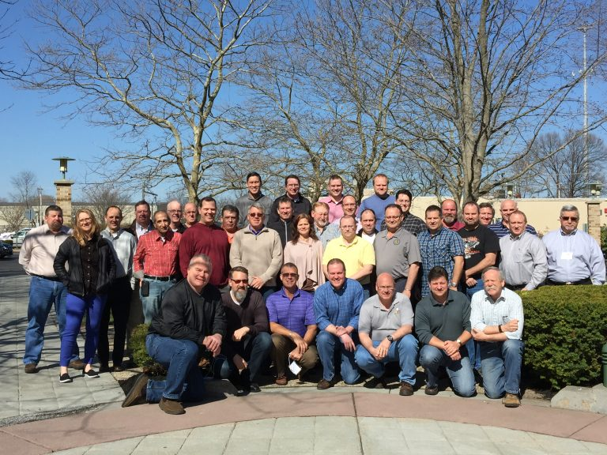
Winter maintenance professionals are a very powerful and important group
Notes:
Photo: clear roads website
Note to presenters: These first 7 slides can be used or hidden.
Or, replace with photos of your staff.

Slide 4
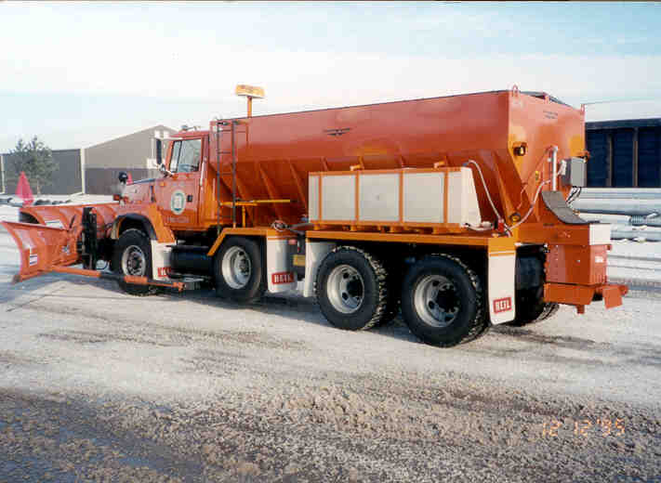
You do a great job of taking care of our roads!

Slide 5
This is one of a series of 22 winter maintenance training modules developed by the Clear Roads Program. All of the modules are available online at www.clearroads.org
Modules include information on the following:
Plowing
Truck operations
Spreading
Material use
Pre-wetting
Brine production
De-icing and anti-icing
Level of service
Ice formation
Freeze point depressants
Environmental issues
Drift control
Weather
Avalanche management
Bridge frost
Safety
Notes:
Note to presenters: The website www.clearroads.org can be accessed here if a live internet connection is available.
A list of all the modules is given here:
Plowing procedures
Truck operations
Spreading
Material use
Pre-wetting
Brine production
De-icing
Anti-icing
Safety
De-icing agent management policy
Level of service
Ice formation
Freeze point depressants
Environmental issues
Drift control
Weather
Bridge frost
Avalanche management

Slide 6
Module 10: Deicer Material Management Policy
2016 Created for Clear Roads by:
U of MN Center for Transportation Studies &
Fortin Consulting Inc.

Slide 7
FACILITATOR NOTES (do not show during class)
This is a priority 1 module to be developed for Clear Roads national training. It will address three audiences. Slides can be customized for the audience.
Slide Legend
Entry-level plow drivers
Experienced plow drivers
Supervisors
Notes:
Note to facilitator: do not show this slide during class

Slide 8
This module contains these topics
Storage of liquid and granular products.
Quality Assurance of both granular and liquid delivered materials.
Good housekeeping practices.
Storage inspection.
Notes:
This module covers storage, Quality Assurance and good housekeeping practices for de-icing materials and abrasives.

Slide 9
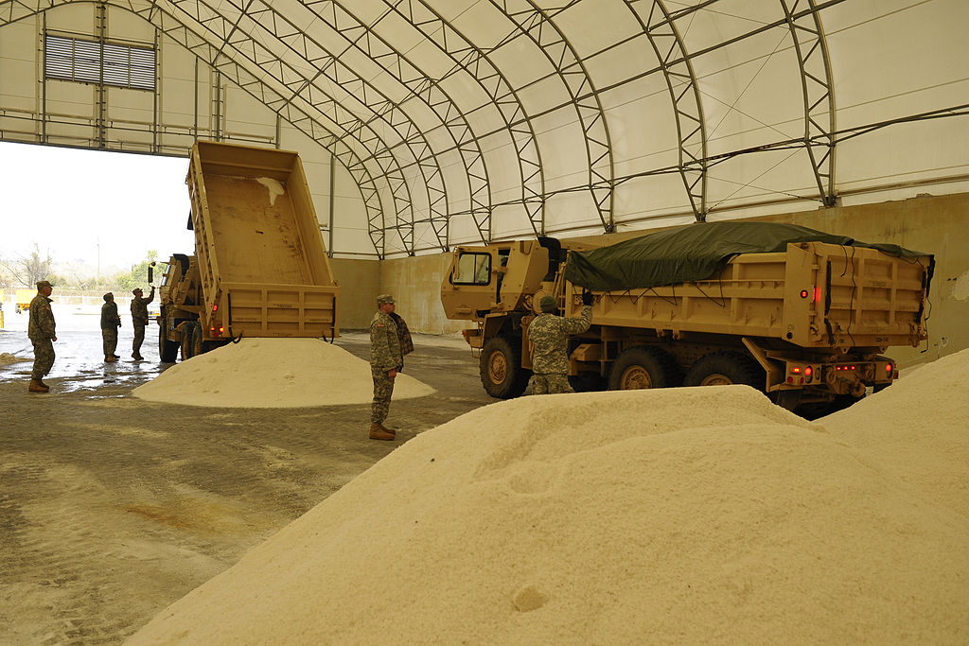
Storage of liquid and granular material
Notes:
The first section will discuss the storage of liquid and granular materials.
Photo credit: US Air National Guard

Slide 10
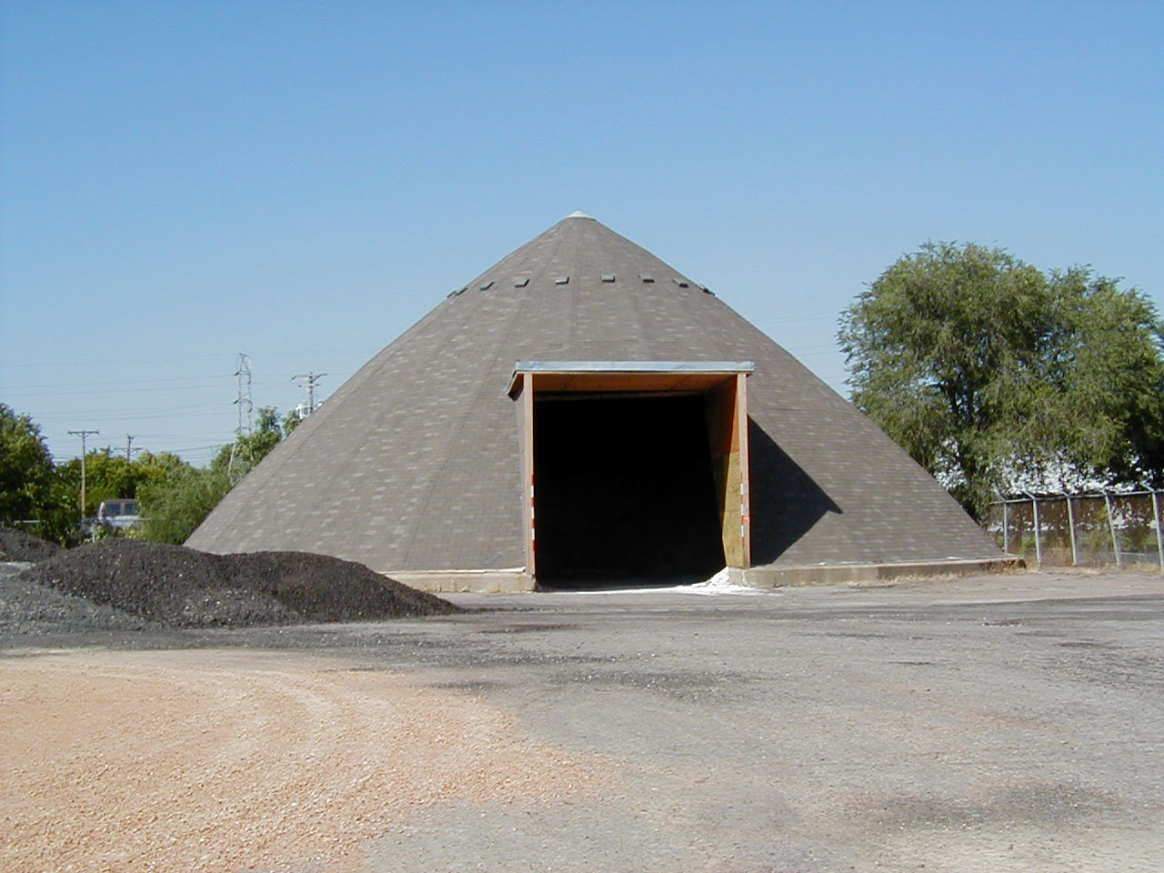
Proper stockpile storage
Rock salt – store indoors.
Winter sand – store indoors.
Treated salt – store indoors.
Store all on an impermeable pad so that no liquid can seep through the floor.
Notes:
All granular materials should be stored indoors. Many states have laws governing this, so check with yours.
This includes rock salt, winter sand, salt/sand mixes and pretreated stockpiles. Anything that contains salt is not stable, and should not be stored outdoors.

Slide 11

Test Question
Which products should be stored indoors?
rock salt
winter sand
treated salt
sand/salt mix
All of the above
Notes:
Note to presenters: you may choose to hide this slide.
Test question:
Which products should be stored indoors?
A. rock salt
B. winter sand
C. treated salt
D. sand/salt mix
E. All of the above

Slide 12
Test Question
Which products should be stored indoors?
rock salt
winter sand
treated salt
sand/salt mix
All of the above
Notes:
Note to presenters: you may choose to hide this slide.
Test question:
Which products should be stored indoors?
A. rock salt
B. winter sand
C. treated salt
D. sand/salt mix
E. All of the above (yes)

Slide 13
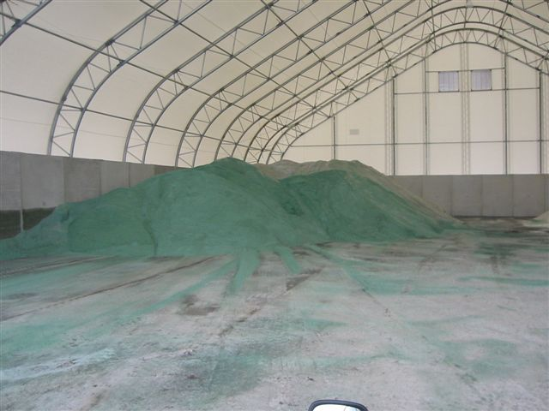
Good stockpile storage
Allows for delivery indoors.
Loading indoors.
Covered.
Impermeable floor.
No risk of overfilling.
Notes:
A good stockpile storage location allows for delivery and loading indoors, is covered with an impermeable floor, and is large enough to avoid the risk of overfilling.
A good example is a large structure with good air circulation and protection against rain, snow and wind, like the one shown here.

Slide 14
Test Question
Show the picture from slide 13 and ask:
Which of the following desirable features are shown on this storage shed?
large enough for all materials
indoor loading area
indoor delivery area
impermeable floor
All of the above
Notes:
Note to presenters: you may choose to hide this slide.
Test question:
Show the picture from slide 15 and ask:
Which of the following desirable features are shown on this storage shed?
A. Large enough for all materials
B. indoor loading area
C. indoor delivery area
D. impermeable floor
E. All of the above

Slide 15
Test Question
Which of the following desirable features are shown on this storage shed?
large enough for all materials
indoor loading area
indoor delivery area
impermeable floor
All of the above
Notes:
Note to presenters: you may choose to hide this slide.
Test question:
Show the picture from slide 15 and ask:
Which of the following desirable features are shown on this storage shed?
A. Large enough for all materials
B. indoor loading area
C. indoor delivery area
D. impermeable floor
E. All of the above

Slide 16
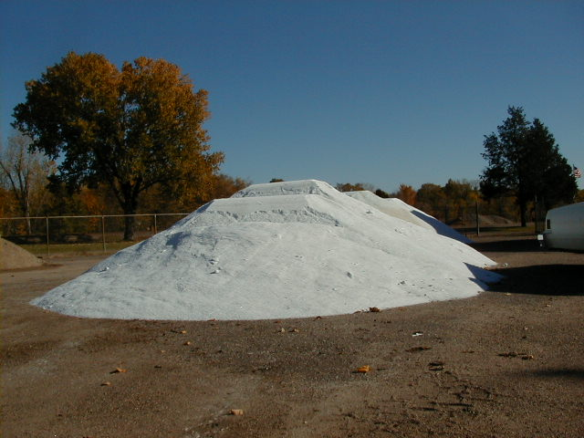
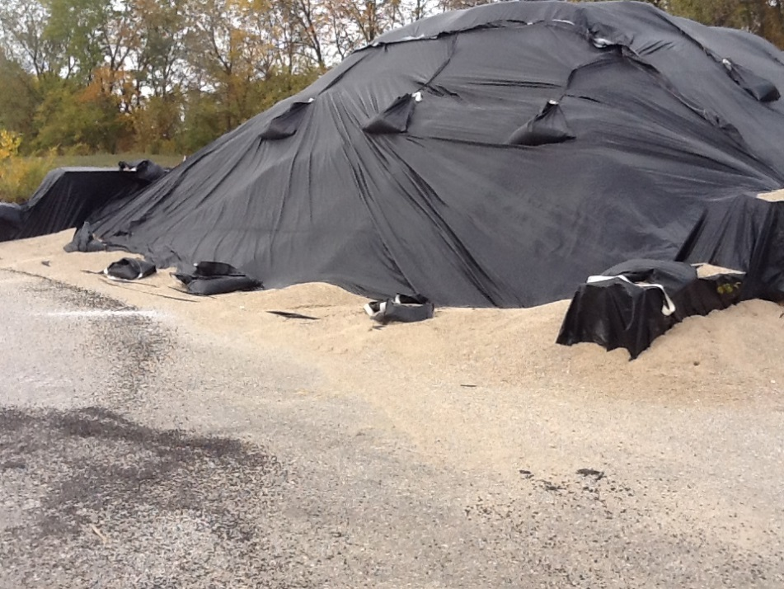
Example: Poor stockpile storage
Example: Good covered stockpile
However, no matter how good you tarp, indoor storage is preferred.
Notes:
Salt easily dissolves and will move through the soil to the groundwater below. Make sure your salt is on an impermeable (waterproof) pad. Also make sure the pad is in good repair.
Each state may have different laws governing storage of salt; check with yours for direction.
Improper salt storage may lead to contaminated soils and wells in the area.
Photo credit: Fortin Consulting Inc.

Slide 17
Test question
Show the picture from slide 16 and ask:
Which basic storage guidelines are violated in the photo on the left?
salt is stored on a non-waterproof pad
cover salt piles
placed close to trees
All of the above
Notes:
Note to presenters: you may choose to hide this slide.
Test question:
Show the picture from slide 18 and ask:
Which basic storage guidelines are violated in this photo?
A. salt is stored on a non waterproof pad
B. cover salt piles
C. placed close to trees
D. All of the above

Slide 18
Test question
Which basic storage guidelines are violated in the photo on the left?
salt is stored on a non waterproof pad
cover salt piles
placed close to trees
All of the above
Notes:
Note to presenters: you may choose to hide this slide.
Test question:
Show the picture from slide 18 and ask:
Which basic storage guidelines are violated in this photo?
A. salt is stored on a non waterproof pad
B. cover salt piles
C. placed close to trees
D. All of the above (yes)

Slide 19
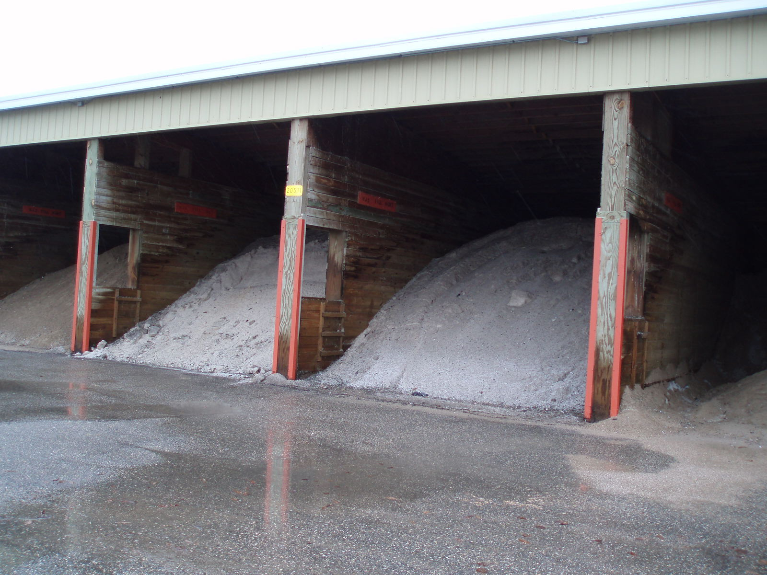
Salt is not contained No moisture control
Example: Poor stockpile storage
Notes:
Moisture should not enter the shed, but if it does it should not be directed out of the shed to flow across the parking lot, as shown here. Instead, it should be collected and removed with a sump, or directed to a contained storage area. Your state may have laws regarding runoff management from your storage area.
The safest approach for the environment is to contain salty runoff water within your facility, and allow it to runoff. A common practice is to direct the runoff from the parking lot where salt is stored into a holding pond or storm drain or ditch. These all are conveyances to rivers, wetlands, or lakes. Salt water should not flow into any of these areas!
Jimmy White, Virginia DOT has a good example of runoff management where the water is captured and re-used for brine making. That method is shown in one of the following slides.

Slide 20
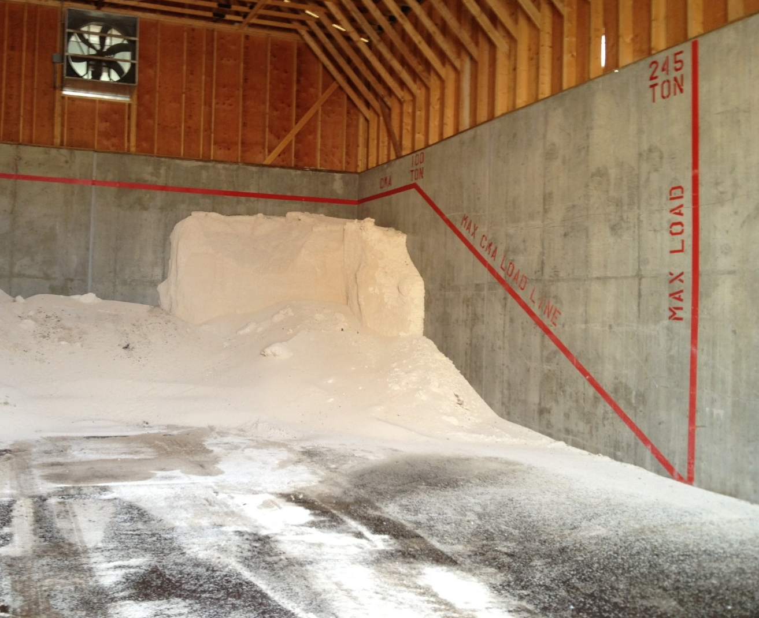
Positioning of granular products
Place granular stockpiles away from door of shed.
To get best control, paint a top fill line and a forward fill line in your shed. No salt should be placed beyond those lines.
Notes:
Granular piles should be placed away from the door of the shed. To get the best control, paint both a top fill line and a forward fill line on the walls of your storage shed. No salt should be placed beyond those lines. The safety of the structure can be compromised if piles are too high; the stress on the walls may cause failure.
This photo shows an example of the fill line on the walls that marks the fill location and amount. Notice the salt is placed in the back of the shed allowing space for loading indoors. Placing salt in the back of the shed also protects it from wind and rain if your shed does not have doors.
Photo credit: Michigan DOT

Slide 21
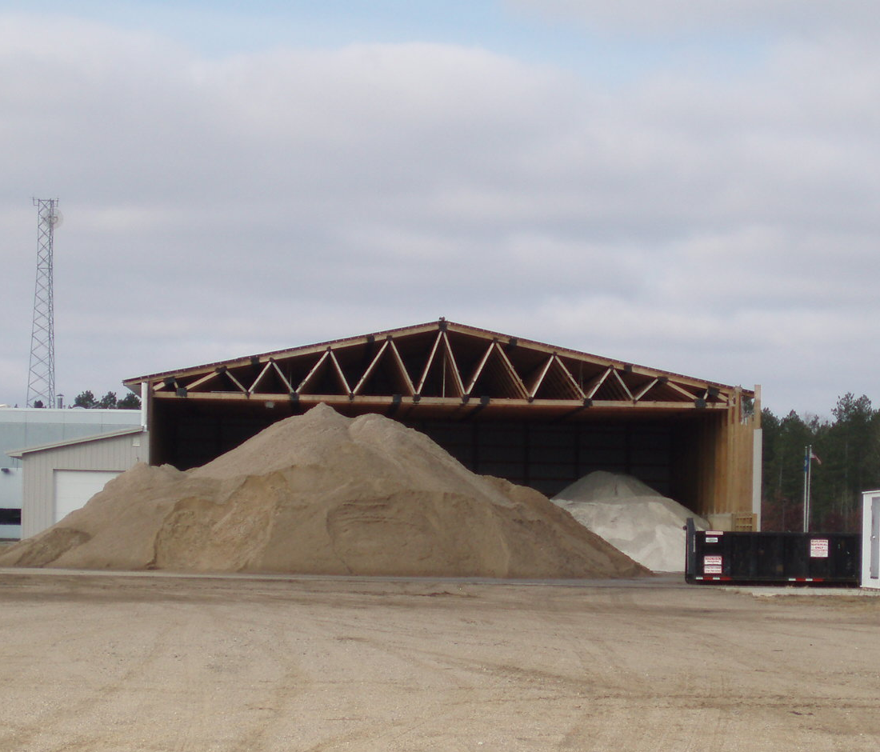
How about a new shed?
Add doors.
Orient shed away from direction of rain.
Allow loads to be delivered indoors.
Allow trucks to load indoors.
Big enough to hold all of your materials.
Floor sloped in, not out.
Notes:
When considering a new shed for salt storage, optimal features include:
Doors
Orienting the shed away from the predominant rain direction
Allowing space for inside delivery and loading
Enough space to contain several piles
A floor that slopes outward to facilitate drainage

Slide 22
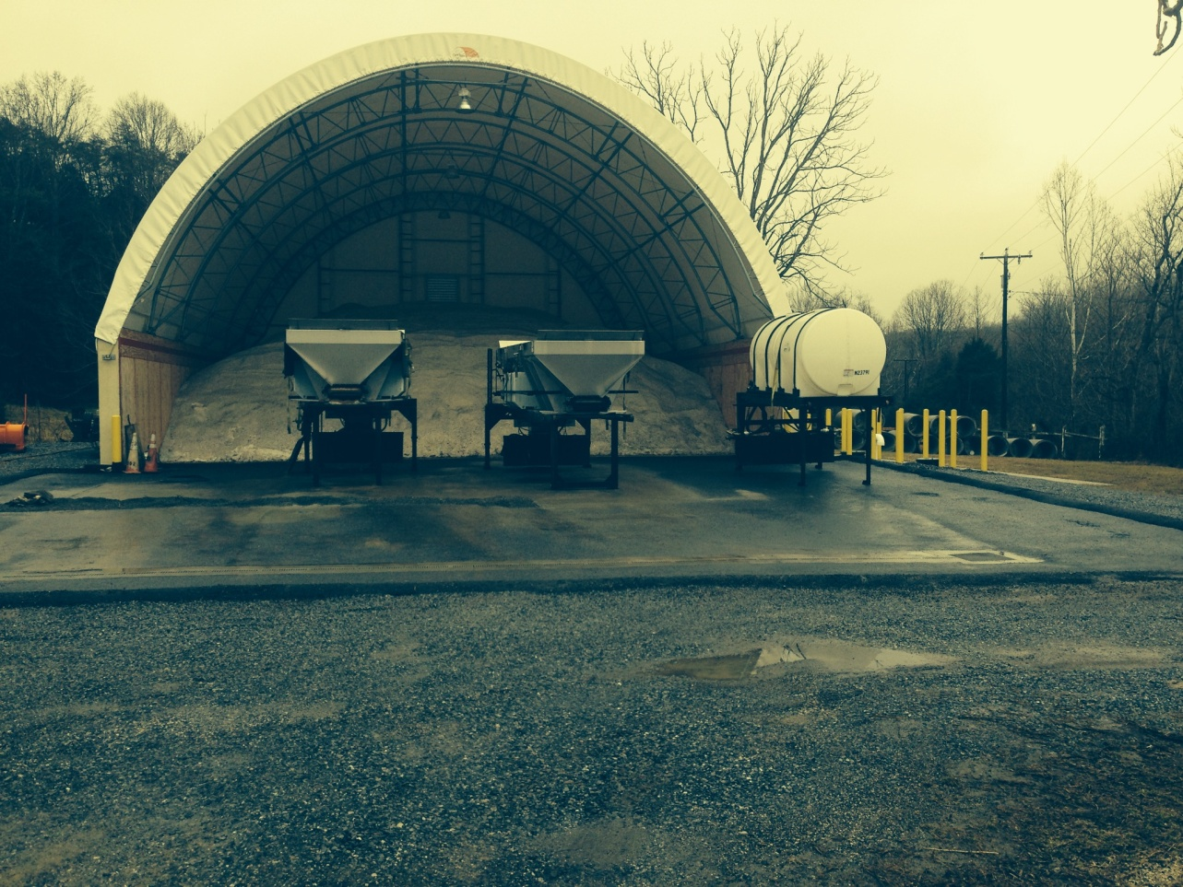
Why not re-use runoff water?
Salt runoff can be used to make brine. This photo shows a runoff gathering and reuse system. The runoff is routed directly into the brine making system.
This Virginia DOT system drains water into a holding tank.
Notes:
Salt runoff can be used to make brine. This photo shows a runoff gathering and reuse system.
This storage area of Virginia DOT drains all run off water into a holding tank that is reused in brine making. If the pad has no salt on it, they can turn a valve and direct water away from the holding tank. This brine is captured and modified for use later.
Photo credit: Virginia DOT

Slide 23
Note to presenter: The next slide shows indoor storage. If your agency does not allow or recommend indoor storage, delete the photo and add one that is appropriate for your area.
Hide this slide before making presentation.
Notes:
Note to presenter: The next slide shows indoor storage. If your agency does not allow or recommend indoor storage, delete the photo and add one that is appropriate for your area.
Hide this slide before making presentation.

Slide 24
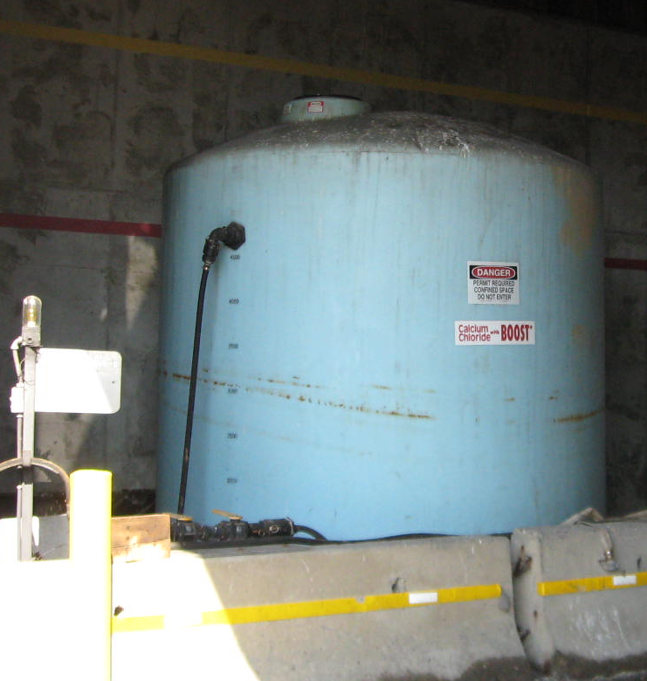
Proper liquid storage
Use labeled containers.
Provide secondary containment.
Follow your state’s guidelines for liquid storage.
Photo: Michigan DOT
Notes:
As we shift to using more and more liquids in winter maintenance, proper storage becomes even more important. Each state should have guidance on above or underground storage tanks, but may not have specific guidance on salt brine or similar products. As a minimal best practice, tanks should be labeled and provide double protection against leaks. Common methods of protection or secondary containment include purchasing a double wall tank (which is more expensive than single wall tank) and/or setting the tank in a containment area so that if the tank leaks the liquid can be recovered.
The above photo shows how jersey barriers with a rubber liner form a secondary containment area for this tank.

Slide 25
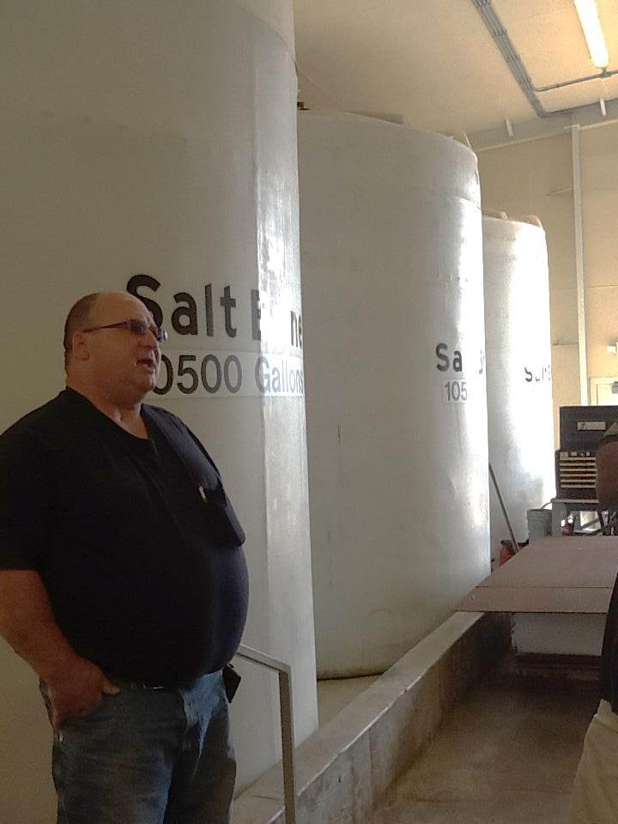
Secondary containment for liquids
Regardless of state regulations, use one or both of these methods for good housekeeping:
Use tanks with double walls.
Provide for a contained recovery area for spills.
Note: Each state may have different regulations for liquid storage. Insert a synopsis of you state’s here. Delete this yellow box before making presentation.
Notes:
Regardless of state regulations, use one or both of these methods for good housekeeping:
Use tanks with double walls
Provide for a contained recovery area for spills
This photo shows a good example of secondary containment. Notice the short concrete wall which creates a bathtub for leaking tanks.
Also of interest in this picture: note that the tanks are all labeled with the contents. In this example, the organization has determined indoor storage is appropriate for their climate and site.

Slide 26
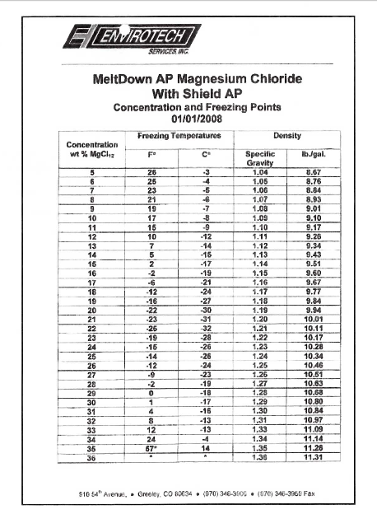
Positioning liquid products
Identify the eutectic freeze point of the liquid. If it is warmer than the outside temperature in the winter, you can store the tanks outdoors.
For example, this product has a eutectic freeze point of -26°F.
Notes:
It is important to identify the eutectic freeze point of the liquid product. If that number is warmer than the outside temperatures you can expect in a winter, store the tanks outdoors.
In this example, the table shows that salt brine has a eutectic freeze point of -6 degrees Fahrenheit. This may or may not allow for outside storage depending, on the range of winter temperatures in your area. Consider the eutectic freeze point to help you decide if it should be stored indoors or outdoors. The manufacture can give you this information, but note that, if you blend a product yourself, you are the manufacturer and will have to compute the eutectic freeze temperature.
Illustration: CDOT_De-Icer-Sampling-Program.pdf

Slide 27
Test Question
Should you store liquid deicers outdoors?
Yes, that’s always a good idea in case the tank leaks.
No, protect against hitting the tanks with your loaders.
Sometimes, depends on eutectic freeze point of the liquid.
Notes:
Note to presenters: you may choose to hide this slide.
Test question:
Should you store liquid deicers outdoors?
Yes, that’s always a good idea in case the tank leaks.
No, protect against hitting the tanks with your loaders.
Sometimes, depends on eutectic freeze point of the liquid.

Slide 28
Test Question
Should you store liquid deicers outdoors?
Yes, that’s always a good idea in case the tank leaks.
No, protect against hitting the tanks with your loaders.
Sometimes, depends on eutectic freeze point of the liquid.
Notes:
Note to presenters: you may choose to hide this slide.
Test question:
Should you store liquid deicers outdoors?
Yes, that’s always a good idea in case the tank leaks.
No, protect against hitting the tanks with your loaders.
Sometimes, depends on eutectic freeze point of the liquid. (yes)

Slide 29
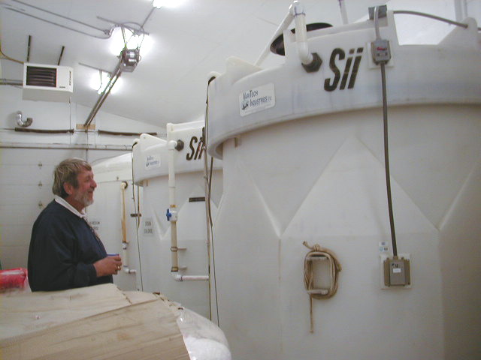
Example: Indoor storage
Notes:
This is an example of double wall tanks. This provides insurance so that, if one layer fails, the other holds the liquid. Double wall tanks are not fool-proof but they are much more reliable than single wall tanks. They are also much more expensive.
Providing secondary containment is a recommended best practice. This can be accomplished in one of two ways:
Using double wall tanks
Providing containment surrounding the tank that will catch liquid if it leaks. This area should not have a drain, and will allow for product recovery if a leak occurs.

Slide 30
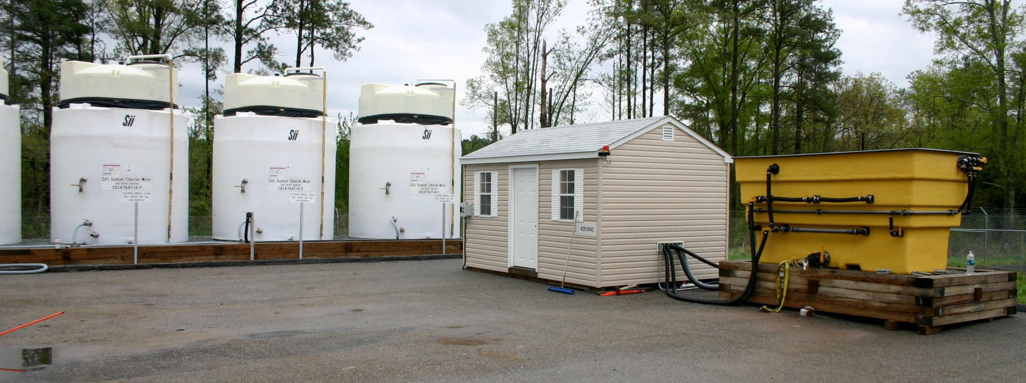
Example: Outdoor storage
Don’t forget to inspect tanks for UV damage,
as they will degrade over time.
Notes:
This slide shows an example of outdoor storage.
As noted earlier, identify the eutectic temperature range of liquids. This will help you determine if the product can be stored outdoors or indoors
For example the eutectic freeze temperature of salt brine is -6 degrees Fahrenheit, and the eutectic of calcium chloride is -60 degrees Fahrenheit. Whether these products can be stored outdoors depends on the local temperature range.
Photo credit: Virginia DOT

Slide 31
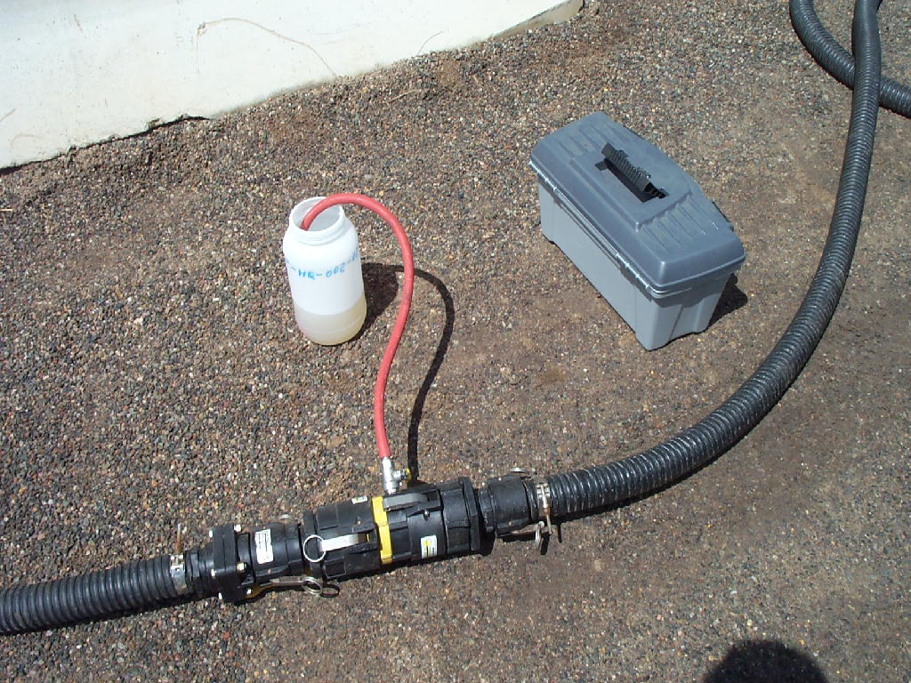
Quality Assurance of delivered materials – both granular and liquids
Notes:
The next section will discuss quality assurance of both granular and liquid delivered materials.

Slide 32
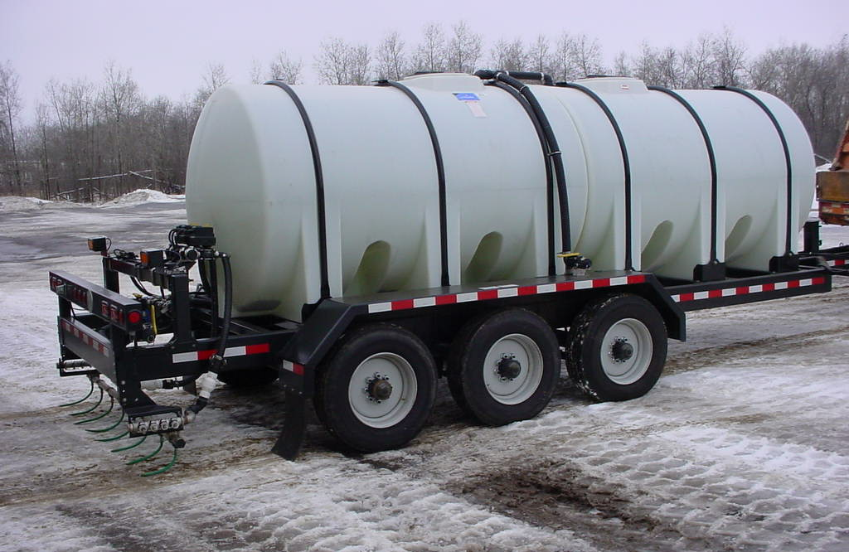
Testing liquid products
Notes:
Photo credit: Wisconsin DOT

Slide 33
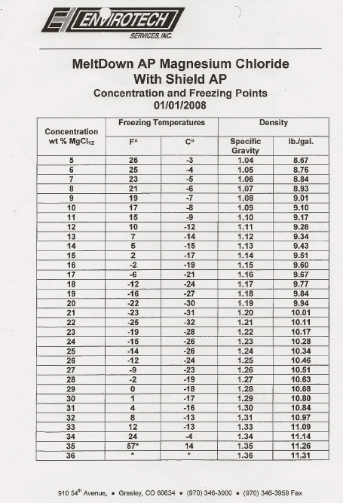
Know your target values before testing
This table shows an example of specific gravity information obtained from vendors. This data is needed prior to testing!
Notes:
Errors may occur in the shipping or manufacturing of liquid deicers. When receiving a product, you should test to verify that the specifications are still being met.
One parameter you may test for is specific gravity. Specific gravity is similar to density. A hydrometer can by used to measure specific gravity. However, test results may not be extremely precise. If a more accurate result is needed, a more precise analytical tool must be used. A testing lab will be able to provide tests with higher precision.
Illustration: CDOT_De-Icer-Sampling-Program.pdf

Slide 34
Quality testing of liquid deicers
Take sample in a sterile container.
Increase the accuracy of results by taking more samples per delivery from various delivery tanker fill levels.
Label and send to lab for analysis or test it yourself.
For less dispute, use a lab testing service or established DOT lab.
List those you recommend in your state here.
Notes:
When purchasing liquid deicers, the vendor should supply the target specific gravity or acceptable specific gravity range. When you receive a load, test it to make sure that the product meets the specifications. If the product does not meet the specifications, it will not perform as expected.
To test liquid deicers:
Take the sample in a sterile container
Increase the accuracy of results by taking more samples per delivery from various delivery tanker fill levels
Label and send the sample to a lab for analysis, or test it yourself
Note to presenters: for less dispute, use a lab testing service or established DOT lab. List those recommended labs here on this slide.
Photo: CDOT_De-Icer-Sampling-Program.pdf

Slide 35
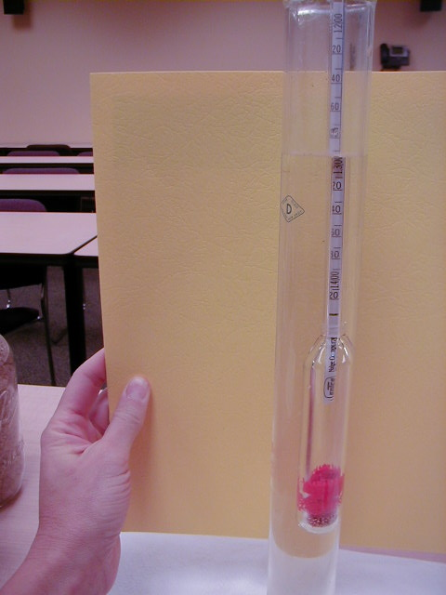
Test it yourself
Fill a beaker or jar with the liquid to be tested
Float a hydrometer in the liquid
Read the density results at the top of the liquid level
Compare the reading to your specification for that product
Notes:
Testing can be conducted at your facility. This photo a simple hydrometer, which can be used to measure. More advanced testing equipment many also be used and can be more precise. However the level of precision with the hydrometer is accurate enough for most users.
Also note that this photo shows a plastic hydrometer, which is as accurate as a glass hydrometer, and less likely to break.

Slide 36
Example: Magnesium Chloride Specific Gravity Chart
% By Weight Specific Gravity Freezing Point F Freezing Point C
10
11
12
13
14
15
16
17
18
19
21
21
22
23
24
25
26
27
28
29
30
1.086
1.096
1.105
1.114
1.123
1.132
1.142
1.151
1.161
1.170
1.180
1.190
1.200
1.210
1.220
1.230
1.241
1.251
1.262
1.273
1.283
17.9
15.7
13.1
10.3
7.3
4.0
0.4
-3.5
-7.7
-12.2
-17.2
-23.0
-27.0
-20.0
-14.0
-10.0
-6.0
-3.0
-1.0
1.0
3.0
-7.8
-9.1
-10.5
-12.1
-13.7
-15.9
-17.6
-19.7
-22.1
-25.6
-27.4
-30.5
-32.8
-28.9
-25.6
-23.3
-21.1
-19.4
-18.3
-17.2
-16.7
Notes:
This table shows an example of specific gravity for one product. Each product is likely to have a different specific gravity, and those values are available from the vendor.
Source: CDOT_Snowremoval-operator-training_slides_112-114_118-120_122.pptx

Slide 37
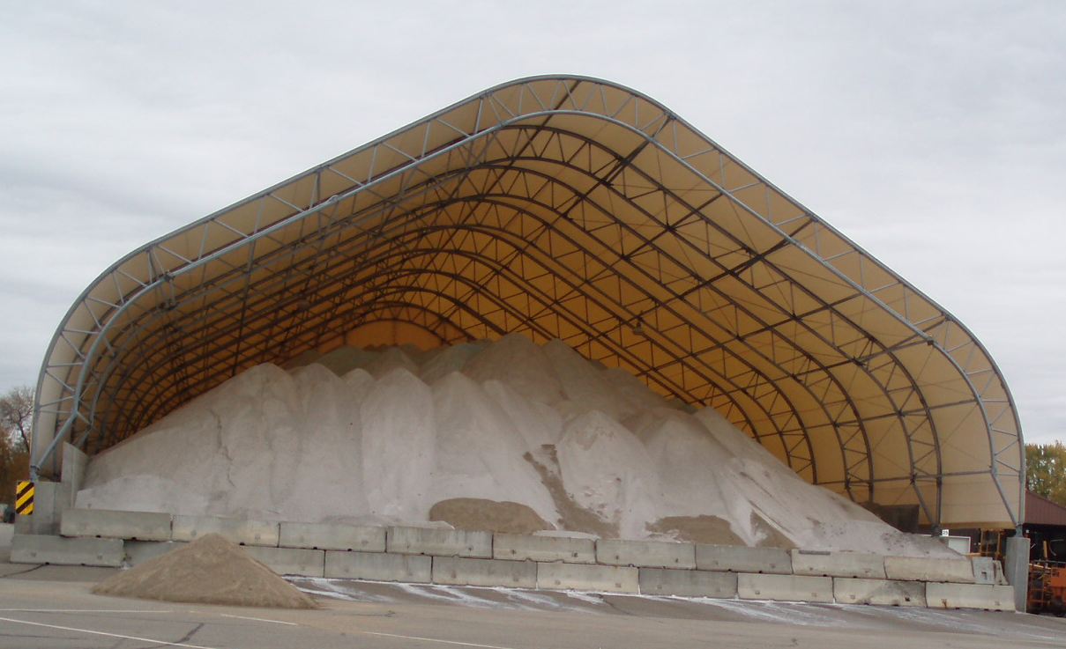
Quality testing of rock salt
Take a small sample from each load
Weigh it as soon as you take it
Remove the water, weigh it again
Determine % moisture
Compare to your spec
Take appropriate action
For less dispute, use a lab testing service or established DOT lab. Note to presenters: List those you recommend in your state, and delete this portion of the note before making presentation.
Notes:
Quality testing of rock salt is easy to do. The process is clearly outlined in the Minnesota Snow and Ice Control Field Manual available in the resources section of this course. To test the product, take a small sample from each load and weigh it as soon as possible. Dry it to remove the water, and weigh it again. Determine the moisture content, as outlined in the Snow and Ice Control Field Manual and compare it to your specification.
Testing the product yourself is easy, but if you want the results to be less disputed, use an independent testing lab.
For less dispute, use a lab testing service or established DOT lab. Note to presenters: List those you recommend in your state, and delete this portion of the note before making presentation.
Reference: MN Snow and ice control field handbook for snowplow operators explains how to do this step by step. (Pg 23-25)
http://www.lrrb.org/media/reports/200501REV.pdf

Slide 38
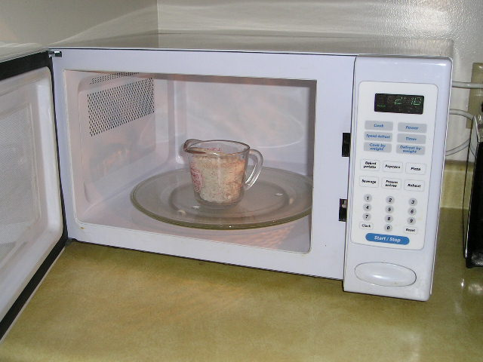
Example: drying out the sample
Notes:
Note that you do not need a large sample to test for moisture, but you do need a representative sample. Cook it on the stove or in the microwave to remove the moisture. Warm it gently, or the salt will pop like popcorn and leave your container, which will invalidate the test results. You can also put the sample in a sterilized sealed waterproof container and send it to a lab for analysis.

Slide 39
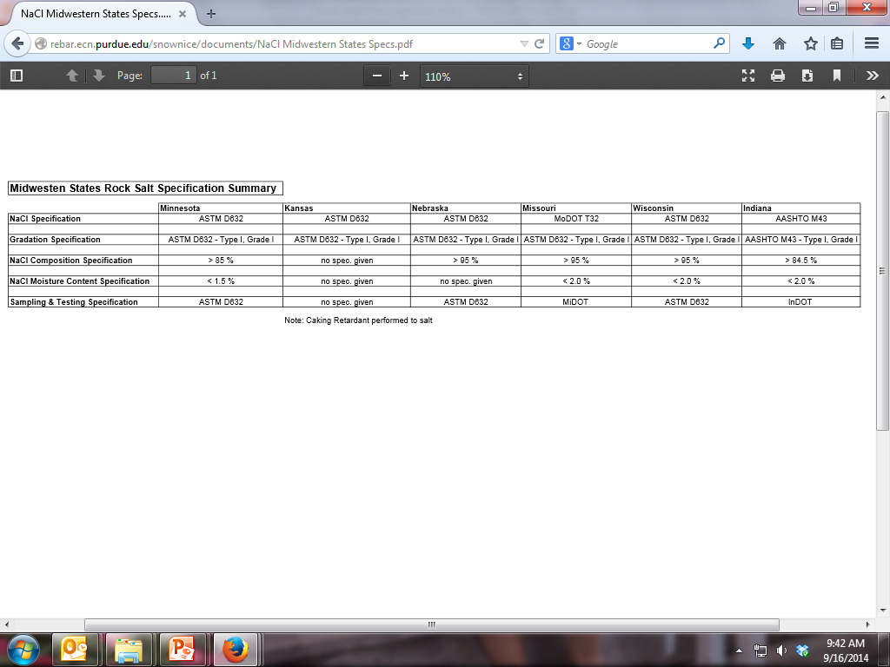
Compare to your salt moisture specification
Example Salt Specification
Note to presenters: Insert your state’s salt moisture specification here. Delete this yellow box before making presentation.
A common testing Specification is ASTM E534
Notes:
Salt specifications vary by state. This slide shows the specification for Wisconsin, which uses ASTM E-534 for moisture testing of salt.
Note to presenters: insert your states specifications here. Delete the yellow box before making presentation.
Chart: http://rebar.ecn.purdue.edu/snownice/documents/NaCl%20Midwestern%20States%20Spec

Slide 40
What about field testing?
Going beyond testing to, “Did I get what I ordered?”
you might want to set up some field tests to see how the products perform for you.
Watch Clear Roads video: Field guide to testing deicing chemicals https://www.youtube.com/watch?v=cIPTRCXRBDM
Note to presenters: This slide is optional and goes beyond the basic discussion of best practices. Delete this yellow box before making presentation if you choose to use the slide. Hide the slide if you do not want to use it.
Notes:
Note: This slide goes beyond the basic discussion of Best Practices and enters us into the arena of research. Therefore this slide might not be of interest for some organizations. For those organizations very interested in field trials this topic really should be expanded into its own training module. However if you want to provide guidance on field testing or comparing products, the 25 minute video linked here provides valuable information.
To access the video, make sure you have a live internet connection and speakers connected to your laptop.

Slide 41
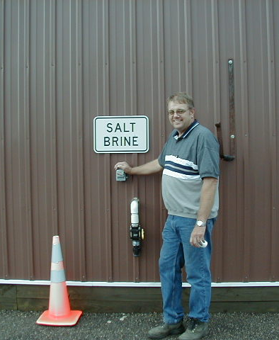
Good housekeeping
Keep site clean and tidy.
Label storage area clearly.
Poor storage is linked to groundwater pollution, which can be traced back to the source.
Don’t take shortcuts on storage.
Invest time to keep storage areas well maintained.
Notes:
This photo shows a good example of labeled storage, and a clean and tidy site.
Poor storage is linked to groundwater pollution, which can be traced back to the source.
Don’t take shortcuts on storage
Invest time to keep storage areas well maintained

Slide 42
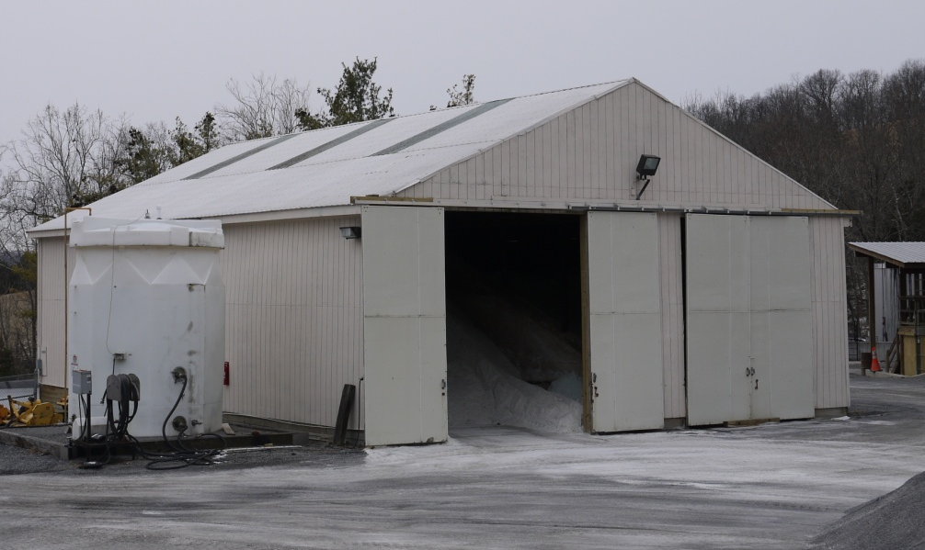
Good housekeeping
Keep doors closed to keep salt in the shed.
Don’t overfill the shed.
Sweep salt from the pad back into the shed.
Keep pad clear of salt.
Fix holes or cracks in building.
Notes:
Other good housekeeping tips are listed here:
Make sure all salt is contained in the shed
Don’t overfill the shed
- Sweep salt from pad back into shed
- Keep doors closed when not in use
Photo credit: Virginia DOT

Slide 43
Test Question
Which of the following are not good housekeeping practices?
Don’t overfill shed
Sweep pad in front of shed frequently
Hose off pad in front of shed frequently
Close doors when not in use

Slide 44
Test Question
Which of the following are not good housekeeping practices?
Don’t overfill shed
Sweep pad in front of shed frequently
Hose off pad in front of shed frequently
Close doors when not in use

Slide 45
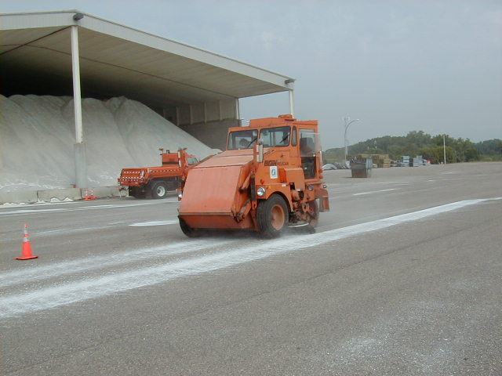
Sweep the loading area
Notes:
Sweep the loading area to keep salt in the pile and reduce the amount of salt that can be exposed to snow, rain and wind.

Slide 46
Delivery of materials
When you order rock salt or pretreated salt, consider requesting that it must be delivered to you in a tarped vehicle. This will reduce your chance of receiving a wet load.
Tarp should be impermeable.
Good idea!
Notes:
Work with your vendor. When ordering rock salt or pretreated salt, request that it be delivered to you in a tarped vehicle. This will reduce your chance of receiving a wet load. Tarped loads will require a little more work for them but a better product for you. This also provides the added benefit of less salt being lost in transport. Note that tarps should be impermeable and waterproof.

Slide 47
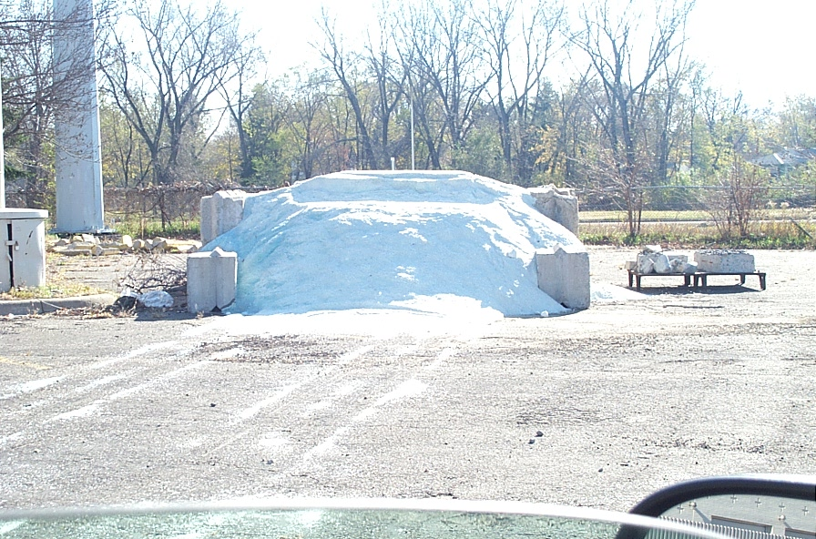
Storage inspections
Your job may require inspection of the storage location. Things to look for are on the following slide.
Notes:
Start of a mini section

Slide 48

Storage inspections
Check drainage area around the salt shed. Do not have water directed toward salt storage.
Inspect salt shed roof drainage.
Make sure sheds are not overfilled.
4. Verify surface under the salt pile and loading area is in good shape, with no cracks or holes.
5. Look for trail of dried or wet salt brine leaving the shed.
6. Make sure all granular salt and salt/sand are stored indoors.
7. Make any other observations that would put your salt pile at risk for leaching.
Notes:
When inspecting the storage conditions, check the following:
If sheds are overfilled, protect the pile with tarps. Make it a practice to not overfill sheds. If you don’t have enough storage capacity, work with neighboring organizations to share storage facilities.
If the shed is not watertight, water will enter the shed and run out of the shed. Remember all runoff should be contained in the shed or directed to an area where runoff can be contained and not moved into ditches, lakes, rivers, ponds or stormsewer systems.
The area outside of the storage shed should be kept free of salt. As noted earlier, sweep frequently to get the lost salt back into the pile.
When dissolved, salt tries to move in many directions. Make sure the pad has no cracks or holes in it where the salty water can penetrate. Downward movement of salt is likely to pollute your groundwater.
Look at the roof drainage to the shed. Is the water being directed away from the salt pile or into the salt pile. Make sure all water is being directed away from the salt pile.

Slide 49
Test Question
Which of the following should you not look for on a storage inspection?
Holes and cracks in the shed where water can get in
Pad has salt on it and needs sweeping
Doors are closed
No smoking sign posted in each shed
Notes:
Note to presenters: you may choose to hide this slide.
Test question:
Which of the following should you not look for on a storage inspection?
A. Holes and cracks in the shed where water can get in
B. Pad has salt on it and needs sweeping
C. Doors are closed
D. No smoking sign posted in each shed

Slide 50
Test Question
Which of the following should you not look for on a storage inspection?
Holes and cracks in the shed where water can get in
Pad has salt on it and needs sweeping
Doors are closed
No smoking sign posted in each shed
Notes:
Note to presenters: you may choose to hide this slide.
Test question:
Which of the following should you not look for on a storage inspection?
A. Holes and cracks in the shed where water can get in
B. Pad has salt on it and needs sweeping
C. Doors are closed
D. No smoking sign posted in each shed

Slide 51
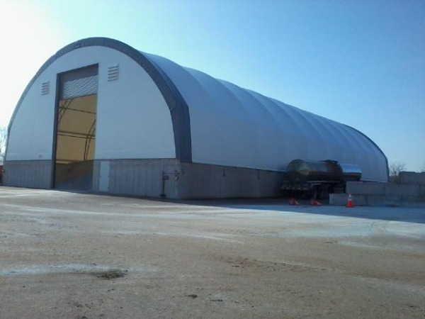
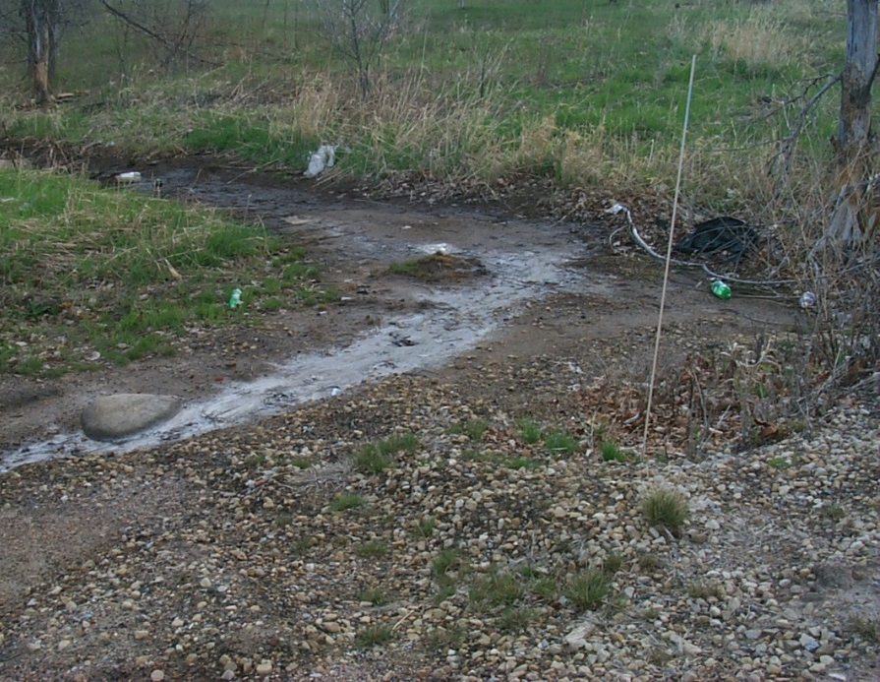
Better housekeeping needed! Salt is not kept inside
The area around the shed needs sweeping.
Salt here has migrated from storage area to the waterway nearby.
Notes:
These photos show poor housekeeping practices. On the left, the area needs sweeping, and the photo on the right shows where salt has migrated from the storage area to the nearby waterway.
Did you know that 1 teaspoon of salt contaminates about 5 gallons of water forever? Keep the salt contained in the storage building, and out of the water nearby. Salt that is improperly stored is not helping with public safety, it is only creating a public nuisance.
Photo credit left: Wisconsin DOT
Photo credit right: Fortin Consulting Inc.

Slide 52
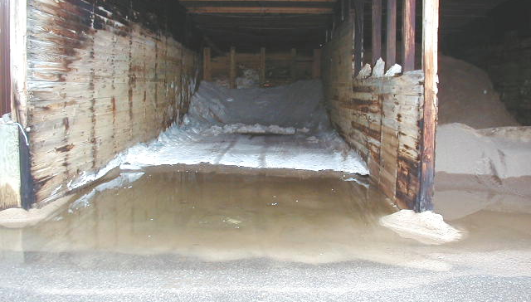
Slope pad and parking lot away from salt
This is an example of a bad condition: The parking lot runoff is entering the shed.
Notes:
This photo shows another example of poor housekeeping. Runoff from a nearby parking lot is entering the shed. The parking lot owners may have to re-grade the lot or build a berm to prevent this from happening. It is best to consider drainage before building a shed or placing a temporary stockpile outdoors. Any drainage problems need to be fixed quickly before they impact salt runoff.

Slide 53
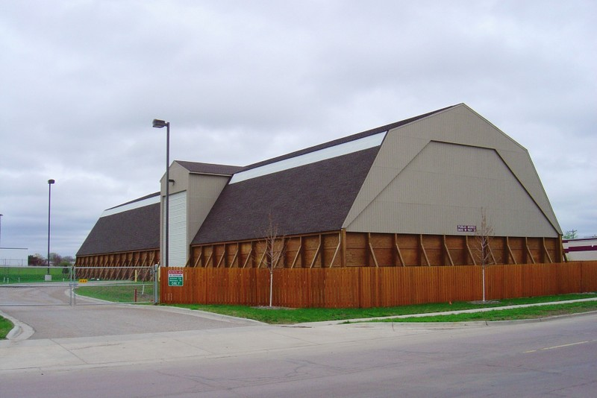
Good example: everything contained
Notes:
This photo shows a good example of salt storage, with everything contained in a secure facility.

Slide 54

Importance of Record Keeping
Keep records of de-icing policy, materials, treatments and effectiveness.
This helps you know what is and isn’t working, and where efficiency can be improved.
Helps with planning for future incidents, and helps protect you from claims.
Notes:
Record keeping is important as a means of material accountability, budgeting/cost tracking, performance tracking, support in the event of legal actions, media inquiries, and planning.

Slide 55
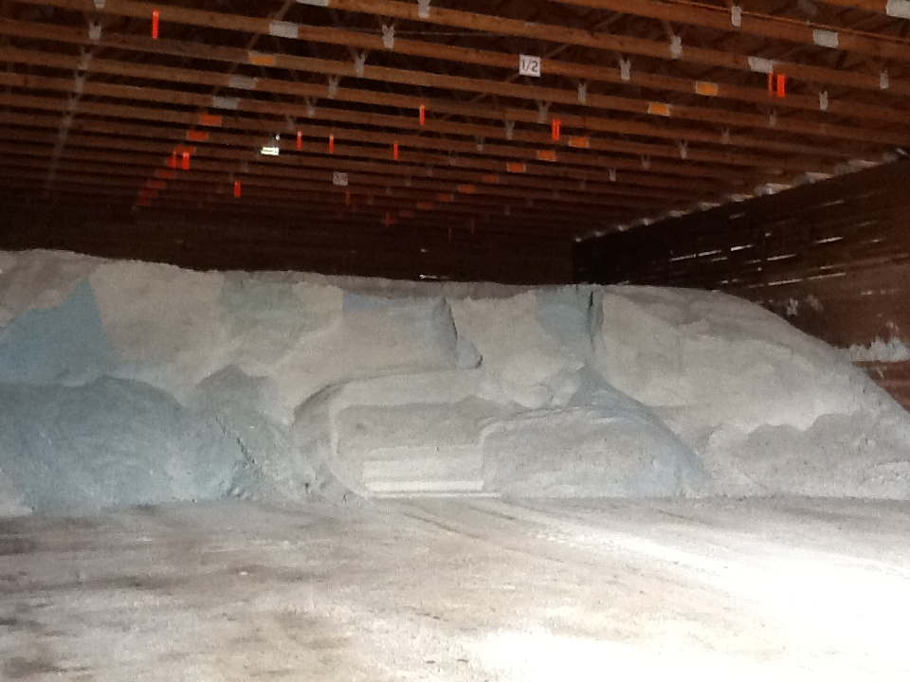
Material Accountability
Know how much you have
Know how much you use
Notes:
It is important to know how much salt you start with, how much you have throughout the season and how much salt you use. Knowing this helps with evaluating salt application efficiency, and for predicting order numbers in the future.

Slide 56
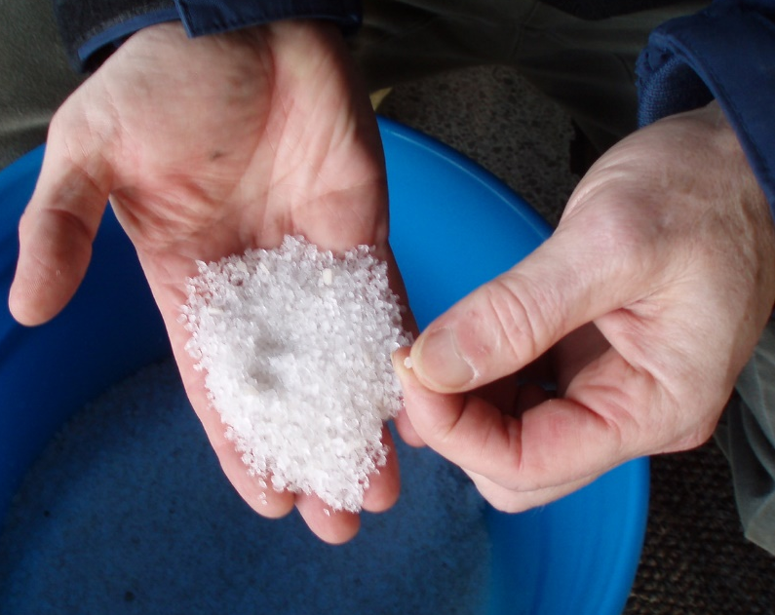
Record Keeping and Quality Control
Test the materials
Solids- test the moisture content
Liquids- test the specific gravity
Check that you get what you ordered
Keep accurate records on quantities ordered, received and used
If you see something wrong, tell your supervisor
Quality Control is vital
Notes:
Quality Control is vital. Every experienced user will inform you just how vital it is. If you do not have a quality control process in place, you can receive very different materials. This translates into effective vs. ineffective operations, environmental contamination, handling difficulties, equipment issues, and on and on.
Test the materials as shown here:
Solids- test the moisture content
Liquids- test the specific gravity
Check that you get what you ordered
Keep accurate records on quantities ordered, received and used
If you see something wrong tell your supervisor
If test results don’t meet the requirements for material ordered, we can reject the delivery.
Note: More information can be found in Module 10 Deicer Agent Management Policy.
Slide credit: CDOT Snow Removal Operator Training

Slide 57
Record Keeping and Quality Control
Take a small sample from each load
Weigh it as soon as you take it
Remove the water, weigh it again
Determine % moisture
Compare to your spec
Record results
Take appropriate action
For less dispute, use a lab testing service or established DOT lab.
Notes:
Reference: Minnesota Snow and ice control field handbook for snowplow operators explains how to do this step by step. (Pg 23-25)
Find it online at this link:
http://www.lrrb.org/media/reports/200501REV.pdf
You can do testing yourself or if you want the results to be less disputed, enlist the help of professional services within our outside of your organization.
Photo credit: Fortin Consulting, Inc.

Slide 58
Record Keeping and Materials Testing
Liquids: specific gravity
Document % and compare to specification
Don’t use it if it doesn't match the specification
Insert your state’s policy here. Delete this yellow box before making presentation.
Notes:
If the specific gravity doesn’t match the spec, there’s no way to know the temperature at which it will freeze on the road.
Note: There is more about material testing in Module 10 Deicer Management Policy.
Note to presenters: If you have a form or policy regarding record keeping for materials testing, include that information here (you could insert a photo of the cover of your document as an example).
Delete this yellow box before making presentation.
Photo credit: Fortin Consulting, Inc.

Slide 59
Test Question
True or False: It is important to test and record the concentration of your solution when making brine.
True
False
Notes:
Note to presenters: you may choose to hide this slide.
Test Question: Is it important to record the concentration of your solution when making brine?
a. True (yes)
b. False (no)

Slide 60
Test Question
True or False: It is important to test and record the concentration of your solution when making brine.
True
False
Notes:
Note to presenters: you may choose to hide this slide.
Test Question: Is it important to record the concentration of your solution when making brine?
a. True (yes)
b. False (no)

Slide 61
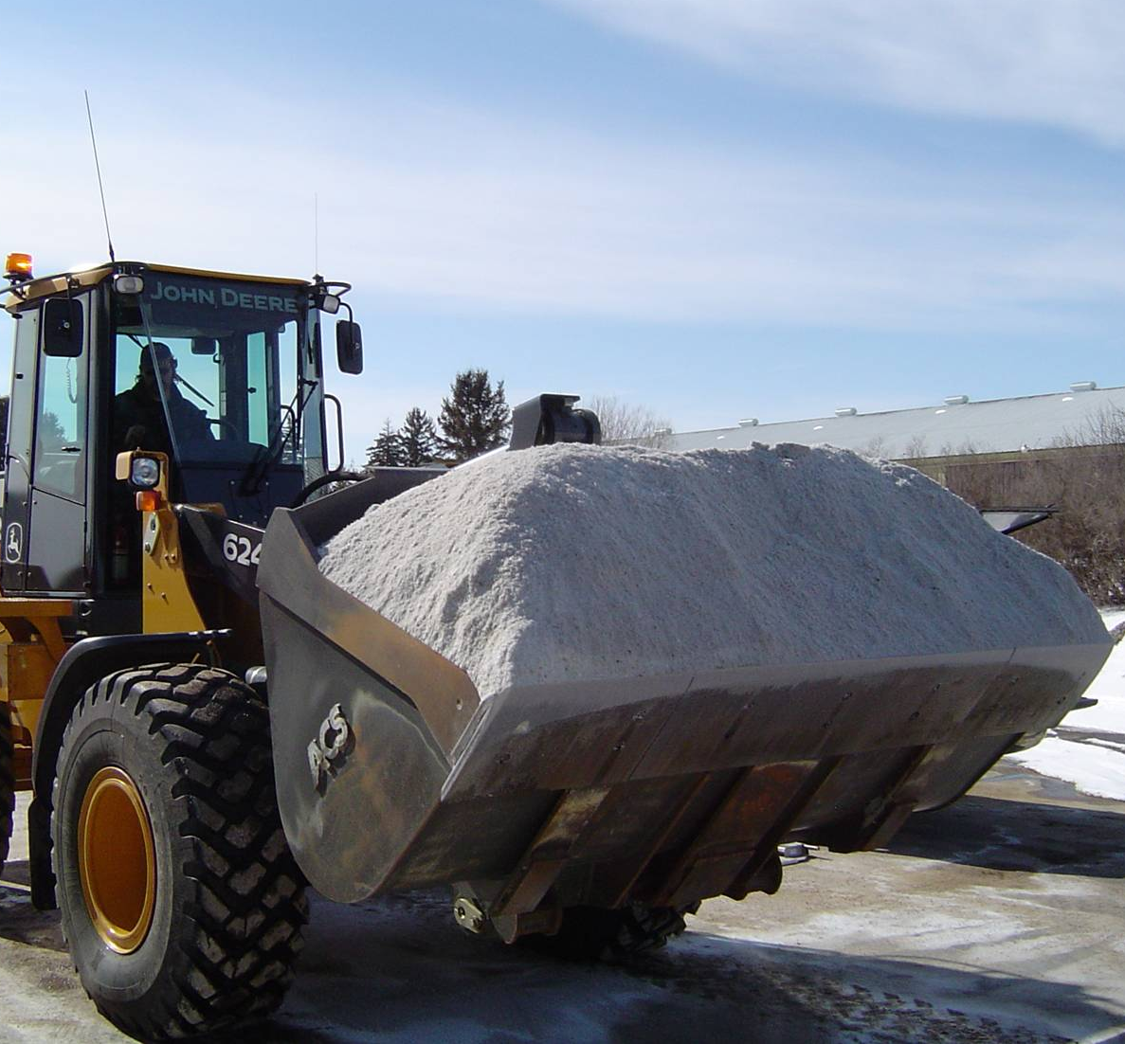
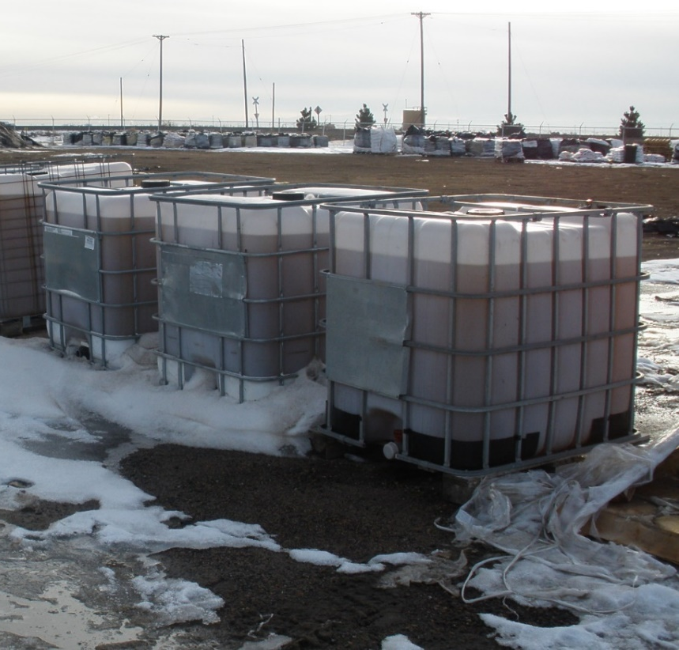
Document by Material Type
Solids
Liquids
Record any time you load, apply, or replace material
Notes:
It is important to know both what materials and the total of each that were used. This can help to predict the amount needed for future seasons as well as help in evaluating how well treatment went for an event.
Photo credits: Fortin Consulting, Inc.

Slide 62
Test Question
Which items should be documented?
Material use per storm
Material use per season
Material use per crew member
All of the above
Notes:
Note to presenters: you may choose to hide this slide.
Test question: Which items should be tracked?
Salt use per storm (no)
Salt brine use per season (no)
Winter sand use per crew member (no)
All of the above (yes)

Slide 63
Test Question
Which items should be documented?
Material use per storm
Material use per season
Material use per crew member
All of the above
Notes:
Note to presenters: you may choose to hide this slide.
Test question: Which items should be tracked?
Salt use per storm (no)
Salt brine use per season (no)
Winter sand use per crew member (no)
All of the above (yes)

Slide 64
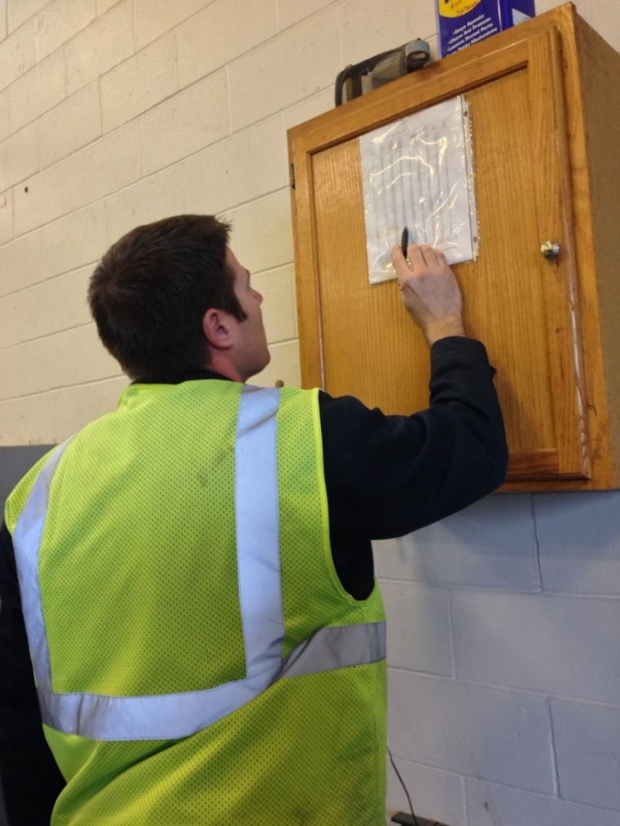
Recording Material Use
Keep track of driver use for insight into:
Individual storms
Each product totals
Winter season total
Leftover product totals
Notes:
You should record several different levels of material use by driver. Combine all this data for insight into individual storms, the winter season total, and what is leftover to store for the next season.
Having all this information helps in evaluating the efficacy of individual storm treatments went, how the whole winter went, and helps in next seasons ordering. It can also help in proving that policy is being followed if a lawsuit is brought against you.
Photo credit: Fortin Consulting, Inc.

Slide 65
Record Keeping
Keeping good records helps
Demonstrate how goals are met.
Demonstrates that you are following policy.
Identify ways to improve and change your approach.
Notes:
Keeping good records is important. It helps to:
demonstrate how goals are met.
demonstrates that you are following policy.
identifies ways to improve and change your approach.

Slide 66
Summary slide
In this module, you learned about good storage practices for both granular and liquid de-icing products. Containing the product, preventing leakage or runoff, and maintaining its quality by properly covering or containing it are key to good deicer management policies.
Notes:
In this module, you learned about good storage practices for both granular and liquid de-icing products. Containing the product, preventing leakage or runoff, and maintaining its quality by properly covering or containing it are key to good deicer management policies.

Slide 67
Additional resources
MN snow and ice control field handbook for snowplow operators http://www.lrrb.org/media/reports/200501REV.pdf
AASHTO, Clear Roads Computer Based training (available on CD):
Winter Maintenance Management: Unit 5 covers basics of storage facilities, storing liquid chemicals, dry materials storage, abrasive storage, materials delivery
Selecting Snow and Ice Control Materials to Mitigate Environmental Impacts: Unit 8 covers quality assurance documentation, field quality assurance procedures, sample collection procedures, lab testing
Deicing: Unit 3 covers loading dry materials, storage facilities, storing dry materials, storing liquid chemicals, bulk storage facilities, abrasive storage, material deliveries
Colorado DOT de-icer-sampler-program.pdf found on clear roads site under Reference Materials: Training for Supervisors and Operators
Salt testing specification
ASTM 534 http://www.astm.org/Standards/E534.htm
Notes:
Additional resources for this module are shown here.

Slide 68
Additional resources
AASHTO, Clear Roads Computer Based training:
Deicing:
Unit 1, “Introduction to De-icing and Common De-icing Materials”
Unit 5, “ Application Guidelines”
Unit 6, “Application Techniques”
Winter Maintenance Management:
Unit 4, “Selecting Snow and Ice Control Materials”

Slide 69
Additional Resources
MDSS research study on how MDSS works:
http://www.meridian-enviro.com/mdss/pfs/
Application rate chart - Minnesota snow and ice control field handbook for snowplow operators:
www.pca.state.mn.us/programs/roadsalt.html
The short-term toxicity of very common de-icing materials and the toxicity of deicing materials:
http://clearroads.org/wp-content/uploads/dlm_uploads/11-02_12-30-13-Final-Fact-Sheet.pdf
Video on material use (Iowa DOT posted on U-Tube)
https://www.youtube.com/watch?v=tVY4y4cE2vo&index=11&list=PLurY2WfsVWKn1Ekx7H_v8DjwJvXlolN9n

Slide 70
Acknowledgements
Training contents were developed by Fortin Consulting Inc., under the direction of the Clear Roads Advisory Team.
Connie Fortin – connie@fortinconsulting.com
Professional formatting and training aids were developed by the University of Minnesota, Center for Transportation Studies.
Jim Grothaus – Groth020@umn.edu
Ann Johnson – Johns421@umn.edu
Members of the Clear Roads Advisory Team include:
Mike Sproul, Dave Wieder, Cliff Spoonemore, Monty Mills, David Frame,
Mike Lashmet, Clay Adams, Justun Juelfs, and Tom Peters

Slide 71
This presentation was developed with funding from the Clear Roads research program, which brings together transportation professionals and researchers from around the country to drive innovation in the field of winter maintenance.
Find additional information and resources at
http://clearroads.org/

Slide 72
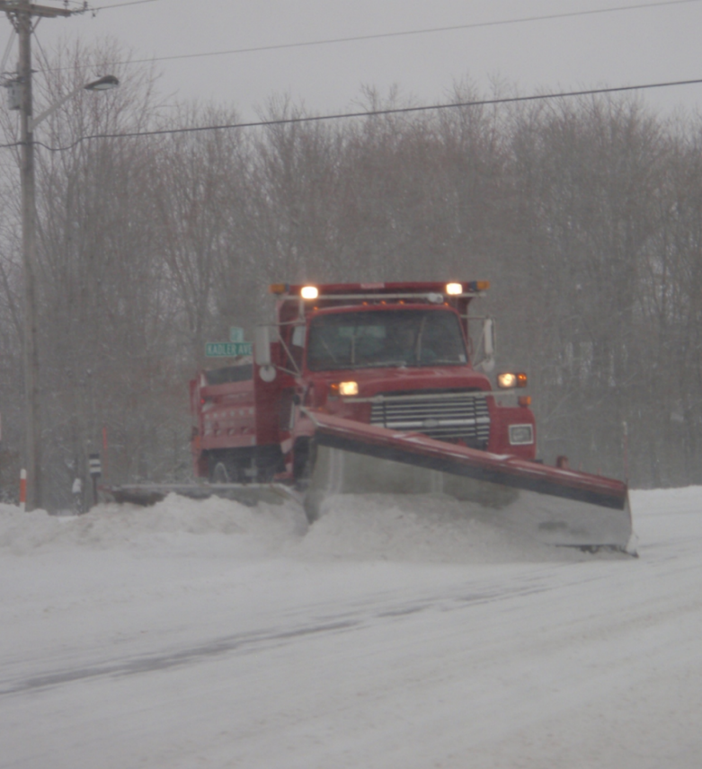
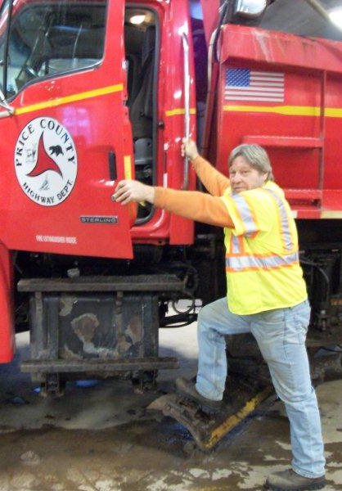
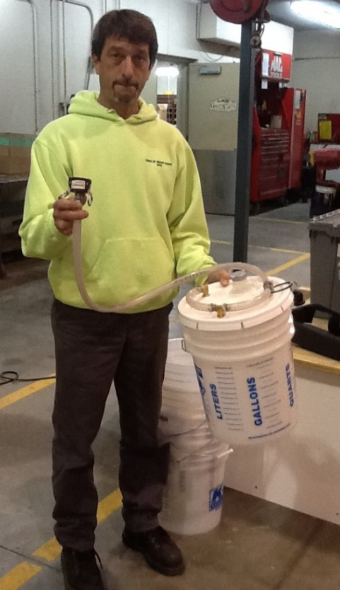
Thank you for your good work!
Notes:
Thank you for your time today. Have a good winter!

