Slide 1
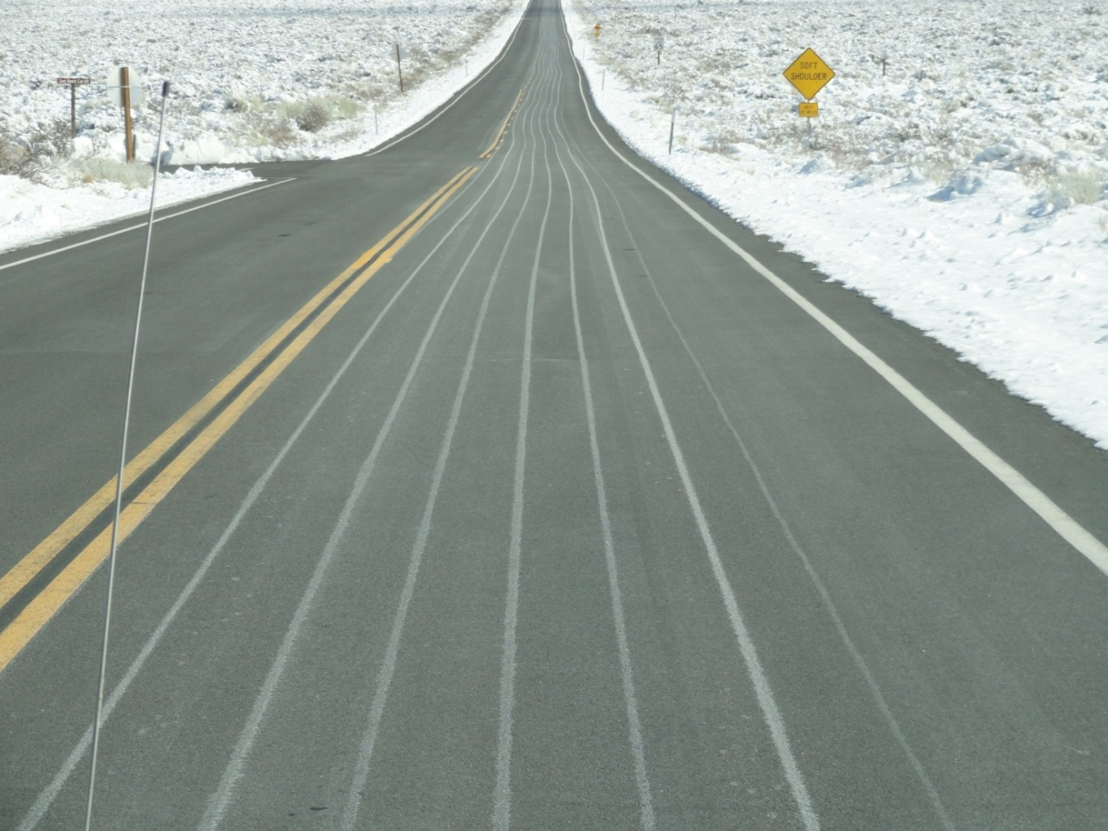

Module 8: Anti-icing
2016 Created for Clear Roads by:
U of MN Center for Transportation Studies &
Fortin Consulting Inc.

Slide 2
Training for Winter Maintenance Supervisors and Operators
2016 Created for Clear Roads by:
U of MN Center for Transportation Studies &
Fortin Consulting Inc.

Slide 3
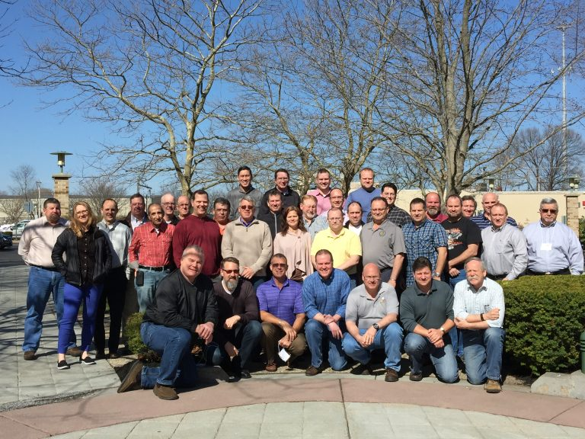
Winter maintenance professionals are a very powerful and important group
Notes:
Photo: clear roads website
Note to presenters: These first 7 slides can be used or hidden.
Or, replace with photos of your staff.

Slide 4
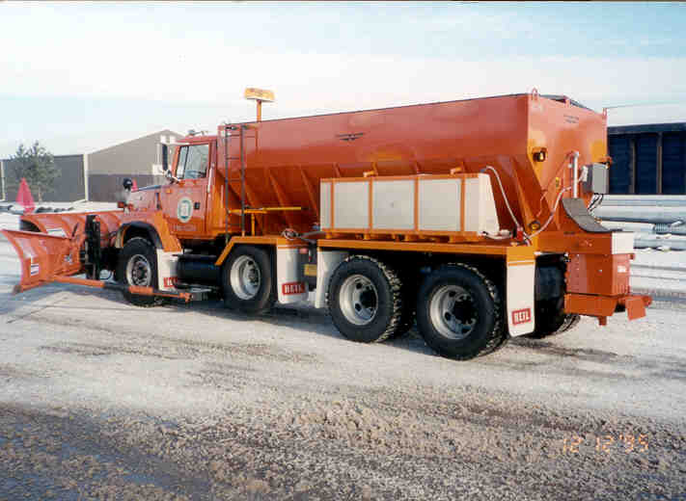
You do a great job of taking care of our roads!

Slide 5
This is one of a series of 22 winter maintenance training modules developed by the Clear Roads Program. All of the modules are available online at www.clearroads.org
Modules include information on the following:
Plowing
Truck operations
Spreading
Material use
Pre-wetting
Brine production
De-icing and anti-icing
Level of service
Ice formation
Freeze point depressants
Environmental issues
Drift control
Weather
Avalanche management
Bridge frost
Safety
Notes:
Note to presenters: The website www.clearroads.org can be accessed here if a live internet connection is available.
A list of all the modules is given here:
Plowing procedures
Truck operations
Spreading
Material use
Pre-wetting
Brine production
De-icing
Anti-icing
Safety
De-icing agent management policy
Level of service
Ice formation
Freeze point depressants
Environmental issues
Drift control
Weather
Bridge frost
Avalanche management

Slide 6
Module 8: Anti-icing
2016 Created for Clear Roads by:
U of MN Center for Transportation Studies &
Fortin Consulting Inc.

Slide 7
FACILITATOR NOTES (do not show during class)
This is a priority 1 module to be developed for Clear Roads national training. It will address three audiences. Slides can be customized for the audience.
Slide Legend
Entry-level plow drivers
Experienced plow drivers
Supervisors
Notes:
Note to facilitator: do not show this slide during class

Slide 8
This module will contain these topics
Advantages of anti-icing vs. deicing.
Materials that can be used for anti-icing.
Anti-icing equipment.
When to anti-ice (weather tools).
Where to anti-ice.
Notes:
This module covers advantages of anti-icing, materials that can be used for anti-icing, when to use anti-icing, equipment for anti-icing, and timing for anti-icing.

Slide 9
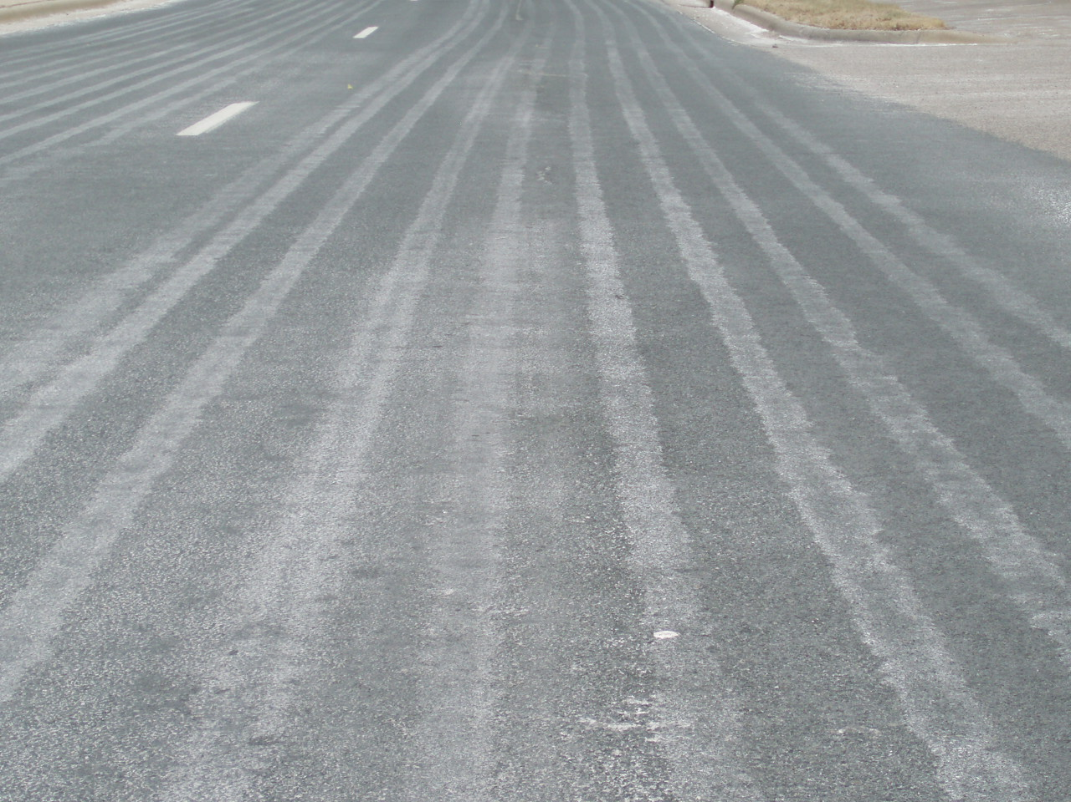
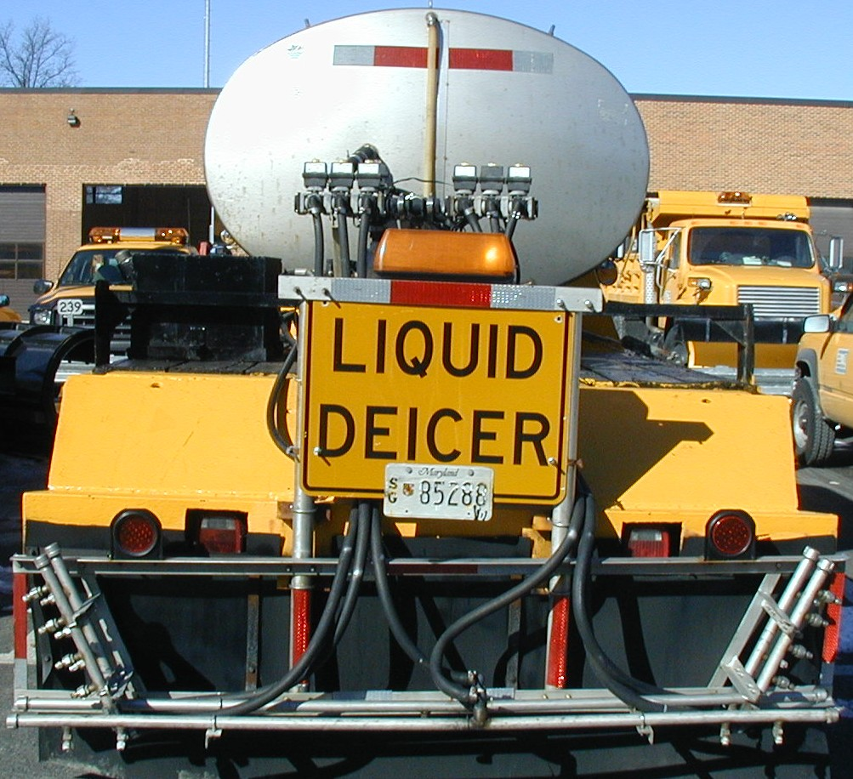
Anti-icing is “pre-treating the roadway”
Anti-icing is the application of de-icers
before there is frost, snow or ice on the roads.
It is typically done with liquids.
It chemically reduces the bond of snow to pavement.
It buys your crew time at the beginning of a storm.
Notes:
De-icing occurs after snow, ice or frost is on the road. It is where we spend most of our time in winter maintenance. De-icing can be done wastefully or efficiently and anywhere in between. It is our goal to encourage the smartest and most effective de-icing practices available. Interestingly enough, efficient de-icing often starts with anti-icing or other pro-active processes.
We are very familiar with de-icing which can lead to a reluctance to change. However if we frame the issue in a way that encourages us to explore options to make us more efficient, we have the opportunity to save money, time, and the environment without lowering our level of service.
Anti-icing buys your crew time since it starts the melting process on the first snow to fall almost immediately, and before the crews are deployed.
According to MDDOT:
Anti-icing helps SHA maintain highways in the best condition possible throughout a storm.
Anti-icing lessens the occurrence of snow pack.
Anti-icing increases traffic safety at a lower cost.
Anti-icing limits damage to the environment.
Source: MDDOT_Snow-College-Part-1_slides_3-5.pptx
Photo credits: Truck Photo by MD DOT, and background photo by Fortin Consulting Inc.

Slide 10
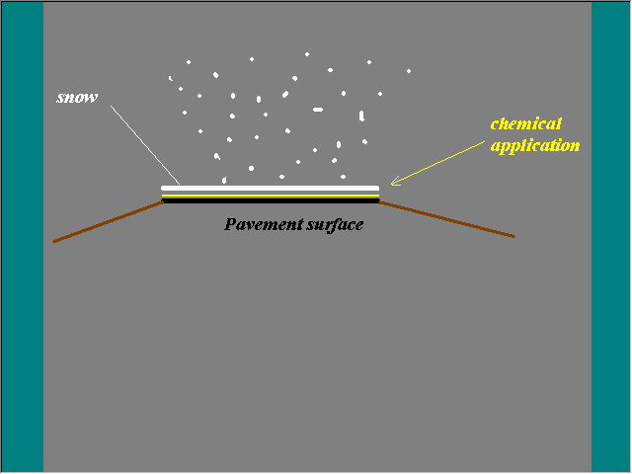
Liquid deicer is applied to the pavement surface before the snow falls. It melts the snow from the bottom up.
Notes:
Chemical layer prevents the bond of snow to the road.
“There are several advantages to anti-icing.
First, we’re applying the chemical during good conditions instead of adverse weather conditions and unsafe roads. And careful management may reduce the need for overtime.
The snow and ice that accumulates cannot bond to the pavement and can therefore be removed more easily and in a shorter time.
The shorter time equates to increased safety on the roads.
The anti-icing chemicals will result in a substantial reduction in subsequent chemical use during the storm, the amount of reduction depending on all the variable conditions of the road, traffic and storm.
Frost problems can be reduced or eliminated with anti-icing. Since frost is difficult to forecast, the preventive nature of anti-icing has proven to be effective in areas prone to frost or black ice conditions.”
Source: PennDOT_Snow-Academy-Part-4_slides_102-106.pptx
Image credit: Source: CDOT_Snow-removal-operator-training_slides_110-111.pptx

Slide 11
Test Question
Where is anti-icing liquid placed?
On top of the snow
On top of the ice
On top of the bare pavement
Under the bare pavement
Notes:
Note to presenters: you may choose to hide this slide.
Test Question:
Where is anti-icing liquid placed?
On top of the snow(no)
On top of the ice(no)
On top of the bare pavement (yes)
Under the bare pavement (no)

Slide 12
Test Question
Where is anti-icing liquid placed?
On top of the snow
On top of the ice
On top of the bare pavement
Under the bare pavement
Notes:
Note to presenters: you may choose to hide this slide.
Test Question:
Where is anti-icing liquid placed?
On top of the snow(no)
On top of the ice(no)
On top of the bare pavement (yes)
Under the bare pavement (no)

Slide 13
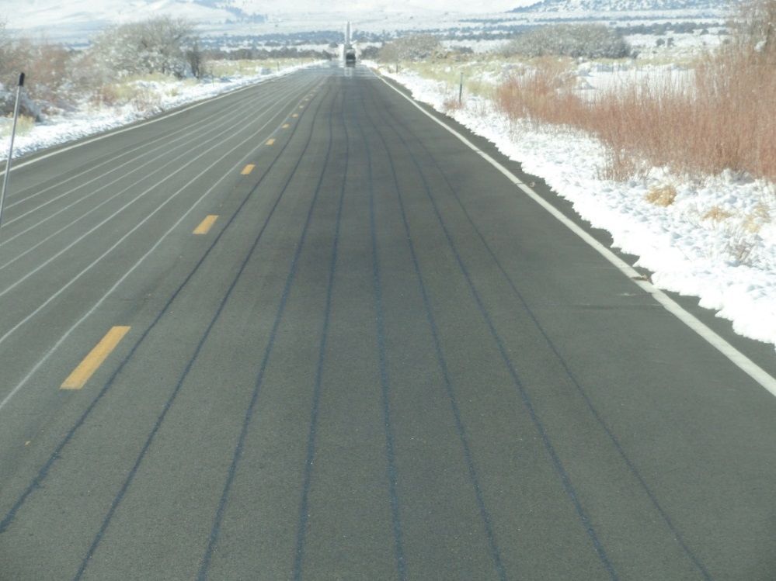
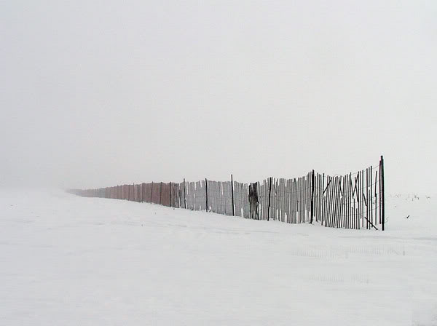
Anti-icing is a proactive strategy
Proactive: Anything we can do in advance of the roads becoming icy or snowy
Snow fences
Anti-icing
Notes:
Pro-active strategies vary but they all have one thing in common: they prevent or reduce the chances of the road from getting slippery. A good example of this is anti-icing. With anti-icing, the crew applies a light amount of liquid de-icer on the road prior to the storm event. This reduces the bond and makes clean up easier.
Another example of pro-activeness is installing snow-fencing. By planting snow fences in blowing drifting areas, you can reduce the amount of snow that ends up on the road. Thus less problems for you to fix.
Good road drainage is a proactive strategy. As snow and ice melt they drain off of the road. Melted snow doesn’t stay on the road to refreeze as the temperature drops.
Photo credit: CaDOT and Price County Wi, Highway Dept.
Note to presenter: this is a good slide to offer the discussion topic on what participants do that is proactive, and what they could add to their current strategies?

Slide 14
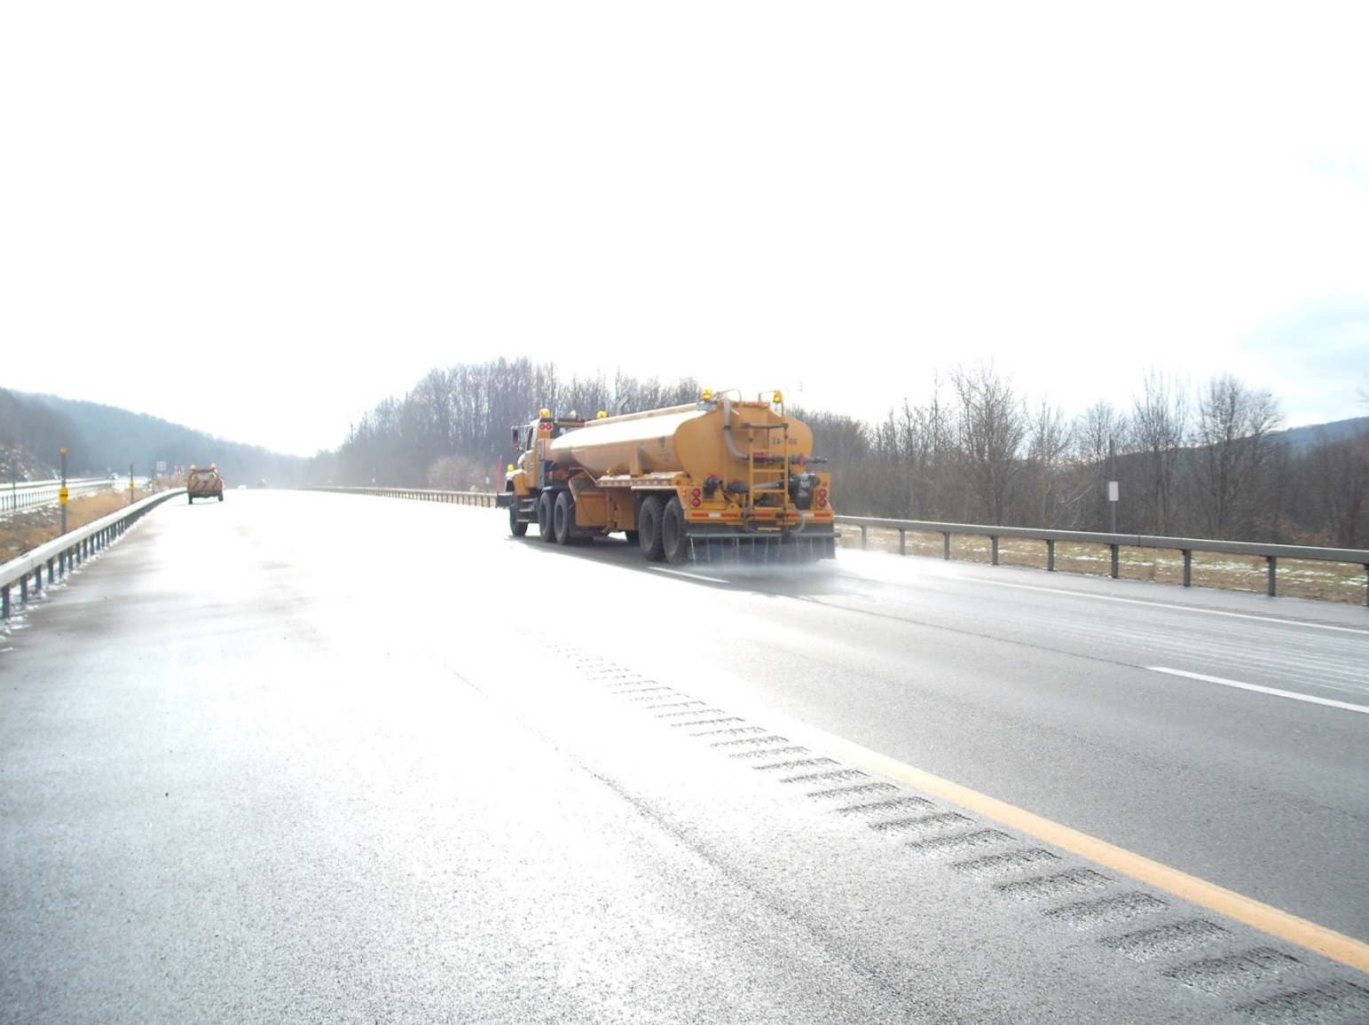
Anti-icing
Melts from the bottom up.
Weakens the bond between the road and snow/ice.
Prevents frost from occurring on roads or bridges.
Notes:
Pro-active strategies vary but they all have one thing in common: They prevent or reduce the chances of the road from getting slippery. A good example of this is anti-icing. With anti-icing the crew applies a light amount of liquid de-icer on the road prior to the storm event. This reduces the bond and makes clean up easier.
Another example of pro-activeness is snow-fencing. By putting up or planting snow fences in blowing drifting areas you can reduce the amount of snow that ends up on the road. Thus less problems for you to fix.
Good road drainage is a proactive strategy. As snow and ice melt they drain off of the road. Melted ice does not stay on the road to refreeze as the temperature drops.
Note to presenters: This is a good place for a class discussion on what activities they do that is proactive and what activities they could add that are proactive.
Photo credit: NYS DOT

Slide 15
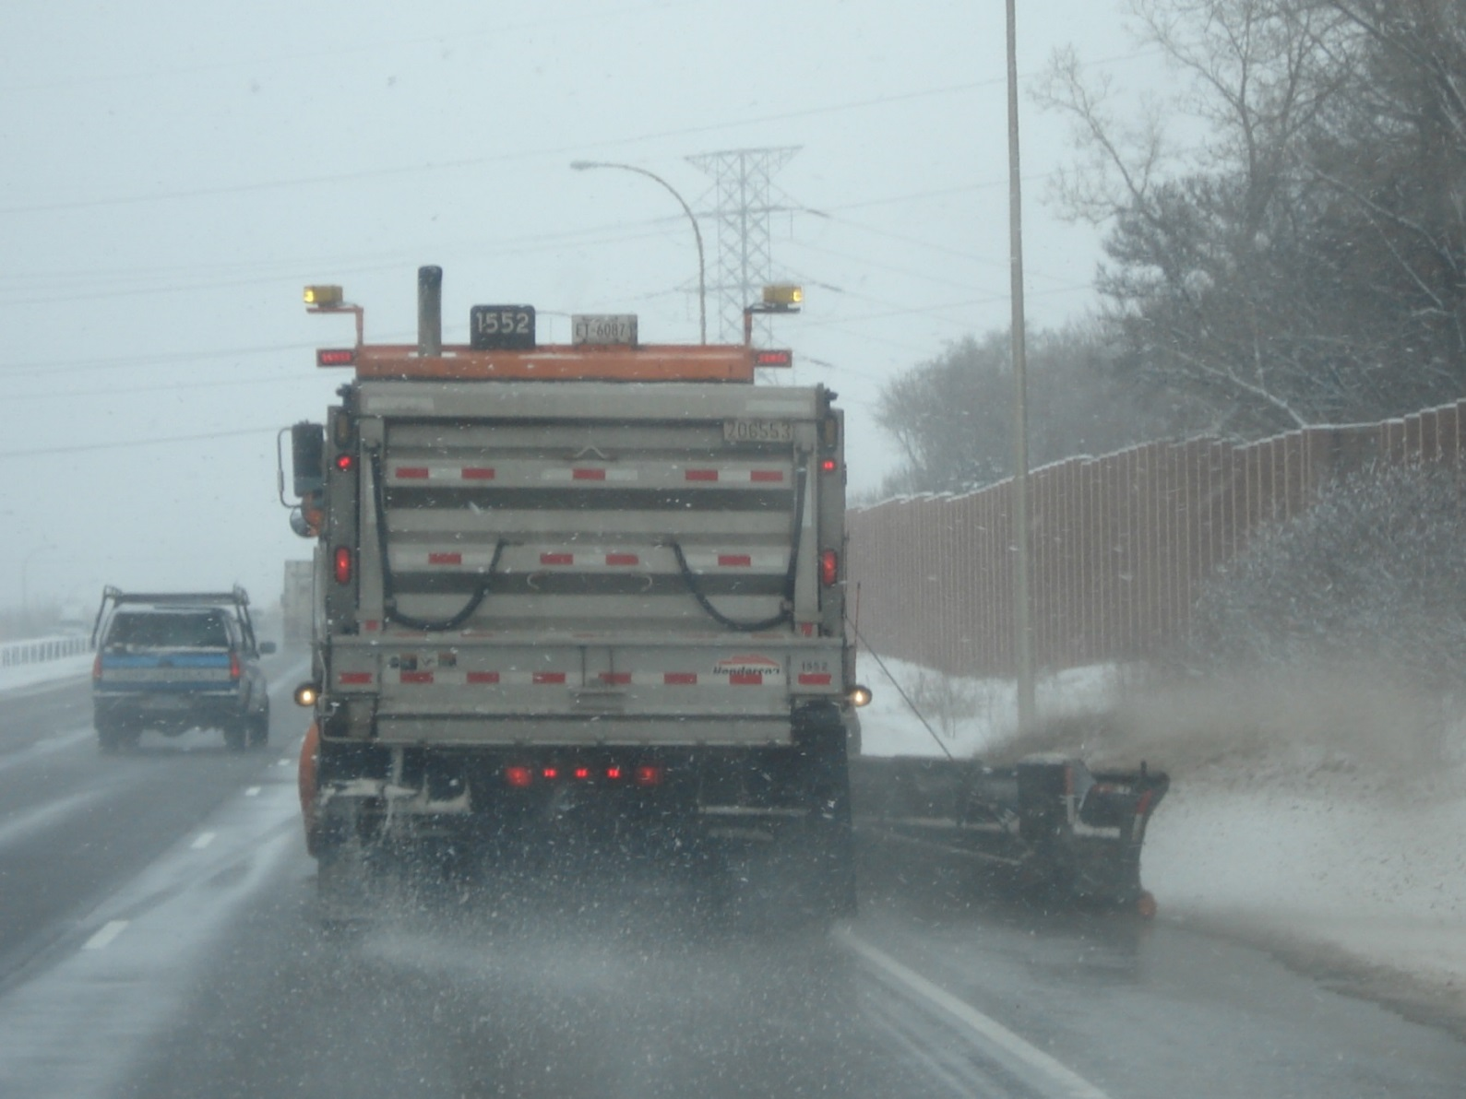
Plowing is a reactive strategy
Reactive: Anything we do after the roads become icy or snowy
Scraping
Plowing
De-icing
Sanding
Notes:
Reactive strategies are things we do once our roads have snow or ice on them. Typically de-icing strategies are more costly and less efficient than proactive strategies.
Examples of reactive strategies include de-icing, plowing, scraping, blowing, sanding. These are all activities we use when trying to recover our roads.
Any time we can be more proactive we can lessen our work in these areas.
Photo credit: Fortin Consulting Inc.

Slide 16
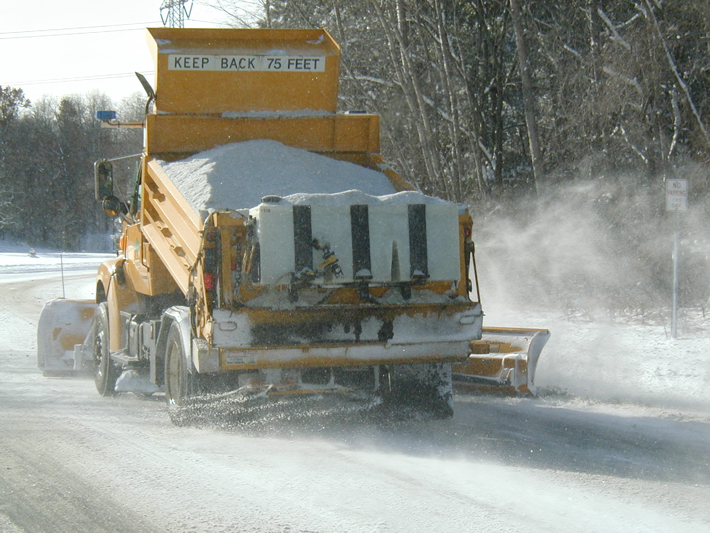
De-icing
Costs more in time & money
Is necessary as anti-icing, but by itself is not always enough. We can reduce it by being pro-active.
Notes:
De-icing is as necessary as anti-icing, but by itself is not always enough.
Photo credit: Fortin Consulting Inc.

Slide 17
Test Question
Is plowing and applying salt a proactive or reactive strategy?
Proactive
Reactive
Notes:
Note to presenters: you may choose to hide this slide.
Test Question:
Is plowing and applying salt a proactive or reactive strategy?
Proactive (no)
Reactive (yes)

Slide 18
Test Question
Is plowing and applying salt a proactive or reactive strategy?
Proactive
Reactive
Notes:
Note to presenters: you may choose to hide this slide.
Test Question:
Is plowing and applying salt a proactive or reactive strategy?
Proactive (no)
Reactive (yes)

Slide 19
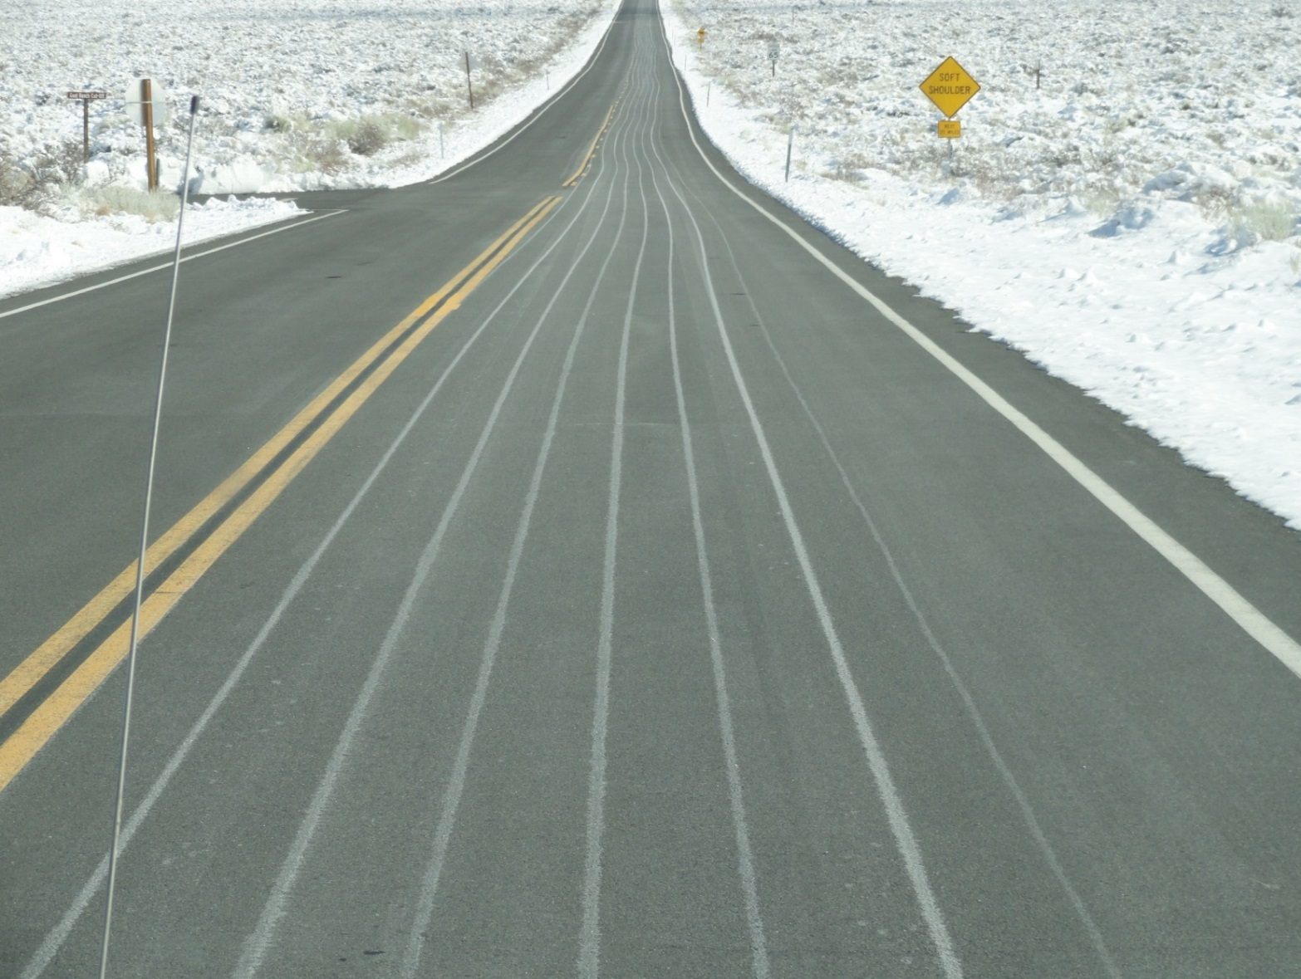

Proactive strategies
Save us time, money and reduces environmental impacts.
Can reduce the amount of de-icing material needed.
Should be a part of your operations.
Notes:
Anti-icing is one example of a proactive strategy; it is something we do in advance of a winter storm. Anti-icing is just another tool in our tool box that our operators can use to remove the snow and ice from the road. It is not a cureall and does not work by itself. Every time you salt during de-icing operations you are essentially adding salt to keep the bond loose (the same concept as anti-icing). However we typically refer to anti-icing as the action we take prior to a storm event.
Photo credit: California DOT
Image credit: Microsoft clipart

Slide 20
Test Question
What is a pro-active strategy?
Something done before the storm
Something done during the storm
Something done after the storm
A pro-football game
Notes:
Note to presenters: you may choose to hide this slide.
Test Question:
What is a pro-active strategy?
Something done before the storm (yes)
Something done during the storm(no)
Something done after the storm (no)
A pro-football game (no)

Slide 21
Test Question
What is a pro-active strategy?
Something done before the storm
Something done during the storm
Something done after the storm
A pro-football game
Notes:
Note to presenters: you may choose to hide this slide.
Test Question:
What is a pro-active strategy?
Something done before the storm (yes)
Something done during the storm(no)
Something done after the storm (no)
A pro-football game (no)

Slide 22
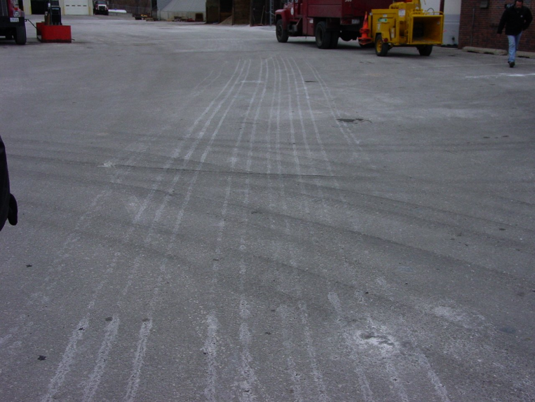
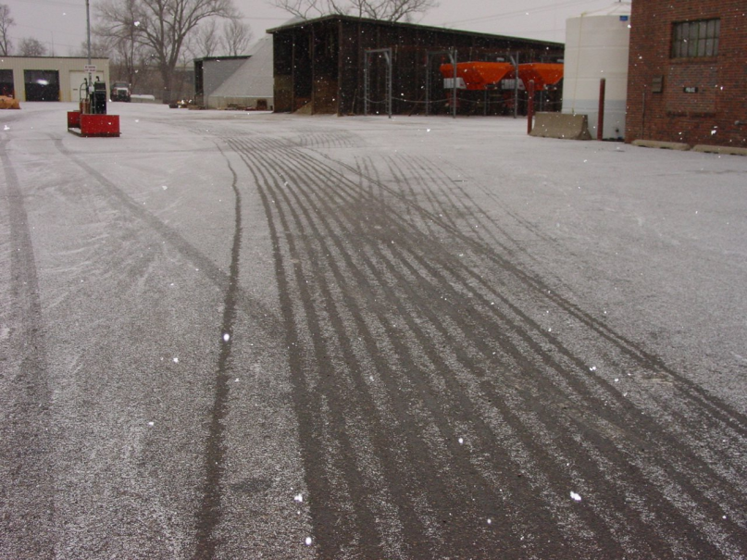
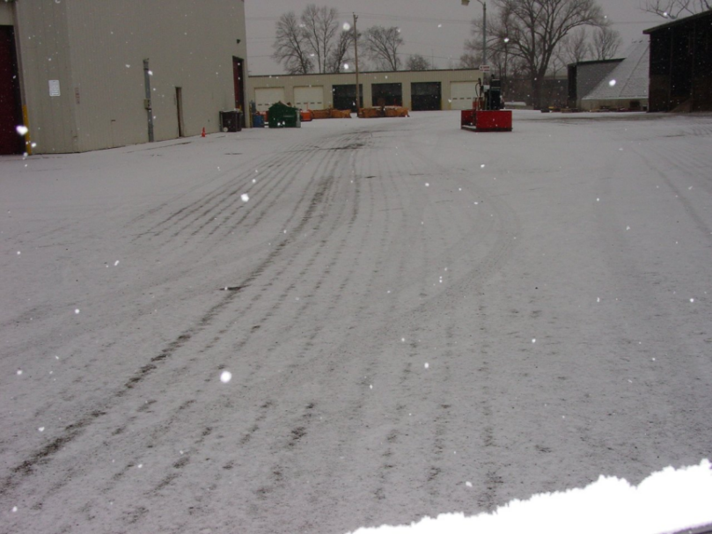
How anti-icing works
Applied before the storm
Melting during the storm
Anti-icing is not meant to melt everything, only to have a thin layer of melting between the pavement and the snow.
Snow covered during the storm
Notes:
22
Photos: Courtesy of Tom Broadbent
Anti-icing is not meant to melt everything, only to have a layer of melting between the pavement and the snow
Test question:
Will anti-icing melt most of the snow that falls on the road?
Yes (no)
No (yes)

Slide 23
Test Question
Will anti-icing melt most of the snow that falls on the road?
Yes
No
Notes:
Note to presenters: you may choose to hide this slide.
Test Question:
Will anti-icing melt most of the snow that falls on the road?
Yes (no)
No (yes)

Slide 24
Test Question
Will anti-icing melt most of the snow that falls on the road?
Yes
No
Notes:
Note to presenters: you may choose to hide this slide.
Test Question:
Will anti-icing melt most of the snow that falls on the road?
Yes (no)
No (yes)

Slide 25
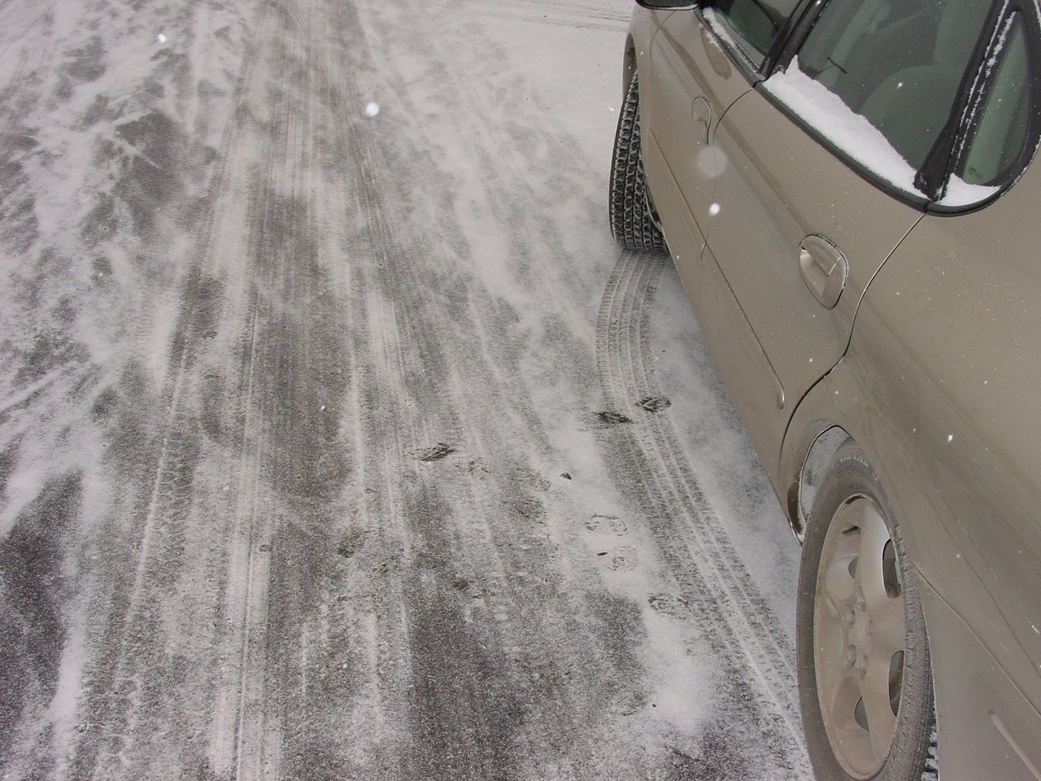
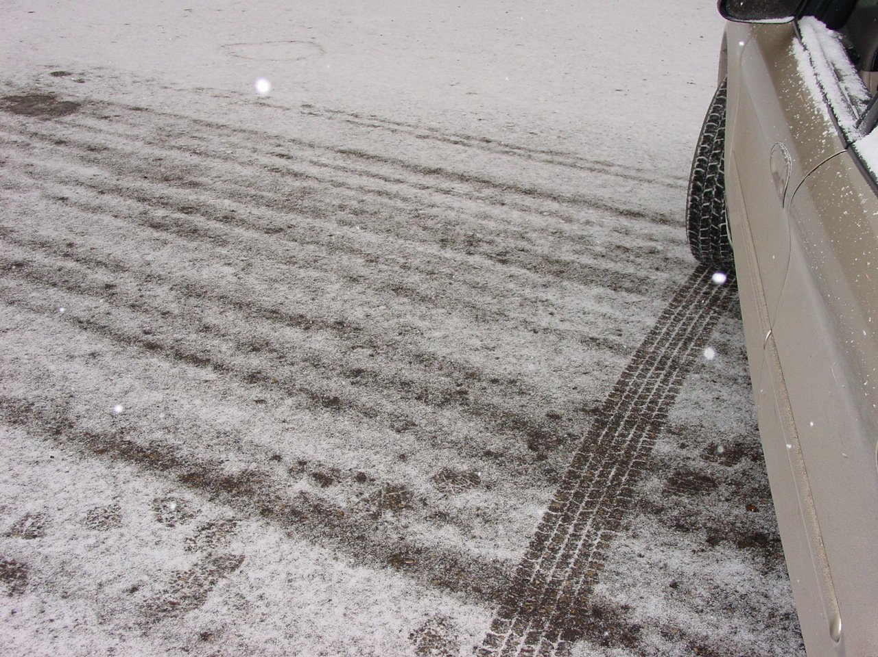
Without Anti-icing
With Anti-icing
Anti-icing doesn’t melt much but it prevents the bond as illustrated in these pictures.
Notes:
25
Note the difference between the anti-icing photo and the typical city street photo. These were taken on the same day, for the same storm, at the same time.
Advantages of anti-icing as described by: http://clearroads.org/wp-content/uploads/Pages_from_OhioDOT_Snow-and-Ice-Control-Course-Manual-105_pg_78-80.pdf
The roadway surface is never “lost”.
i. Operators respond proactively.
Anti-icing returns road surfaces to normal faster, resulting in fewer accidents and delays.
Using a liquid jumpstarts the melting process because salt needs moisture to be effective.
Brine doesn’t bounce or blow off the road surface so material is more efficiently used.
If the storm is delayed, salt residue remains on the road ready to begin work when precipitation does occur.
Crews can cover more territory by beginning treatment in advance of a storm.
Increased efficiency results in use of less salt, minimizing environmental concerns.
Photo credit: Tom Broadbent

Slide 26
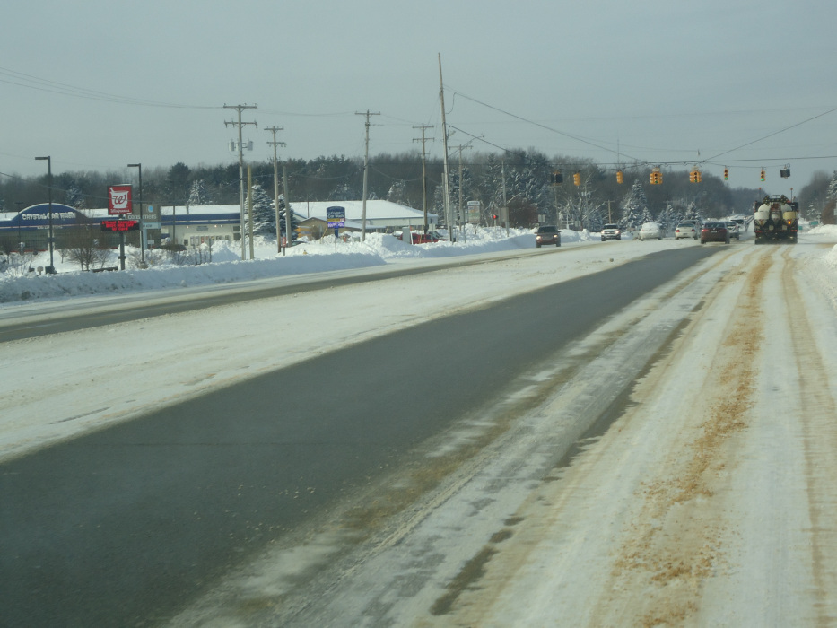
The clear driving lane was anti-iced
Snow didn’t bond
Snow bonded
Notes:
The small amount of liquid applied directly on the bare pavement provides a thin layer of melting. This allows you to clear your road quicker and easier. Areas of compaction on this photo are areas that were not anti-iced.
Photo credit: Price County Wi, Highway Dept.

Slide 27
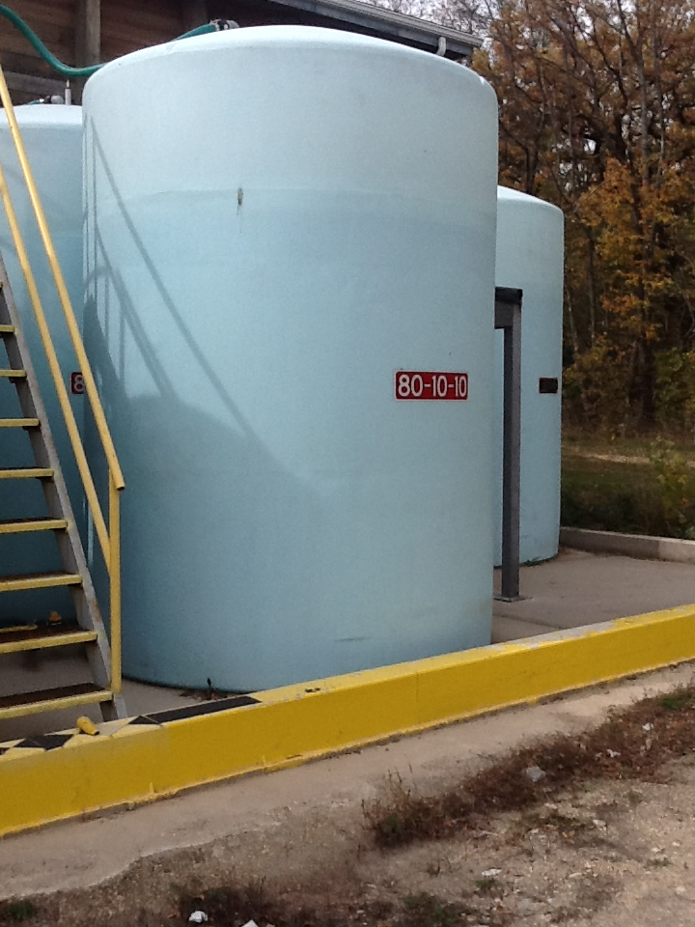
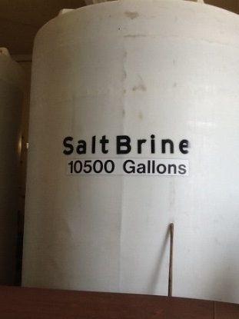
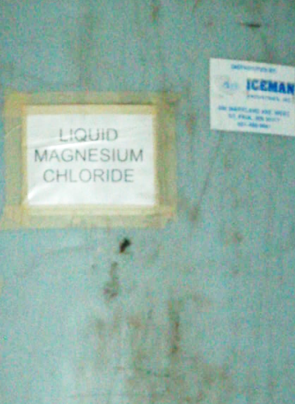
Materials that can be used for anti-icing
Any liquid de-icer
Most commonly used is NaCl or salt brine.
Next most common is a salt brine blend.
Often containing calcium or magnesium chloride and an organic component (beet juice, corn syrup…)
But can be straight Magnesium Chloride, Calcium Chloride, Acetates, or your de-icer of choice.
Note to presenters: describe which liquids you use for anti-icing here. Delete this yellow box before making presentation.
Notes:
Photos: FCI
To learn more about the pros and cons of the various de-icers see Clear Roads Module 4: Material Use
To learn more about brine see Clear Roads Module 6: Brine Production
Test Question:
What is the most common material used for anti-icing?
Salt brine (yes)
Rock salt (no)
Calcium Chloride (no)
Water (no)

Slide 28
Test Question
What is the most common material used for anti-icing?
Salt brine
Rock salt
Calcium Chloride
Water
Notes:
Note to presenters: you may choose to hide this slide.
Test Question:
What is the most common material used for anti-icing?
Salt brine (yes)
Rock salt (no)
Calcium Chloride (no)
Water (no)

Slide 29
Test Question
What is the most common material used for anti-icing?
Salt brine
Rock salt
Calcium Chloride
Water
Notes:
Note to presenters: you may choose to hide this slide.
Test Question:
What is the most common material used for anti-icing?
Salt brine (yes)
Rock salt (no)
Calcium Chloride (no)
Water (no)

Slide 30

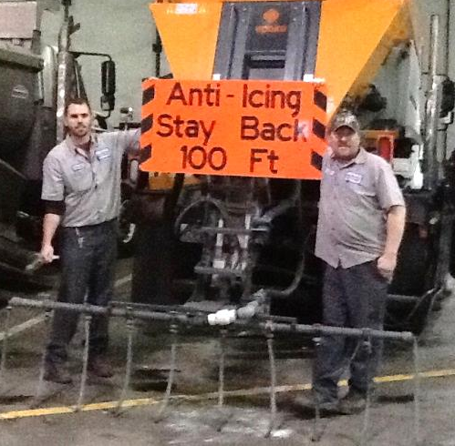
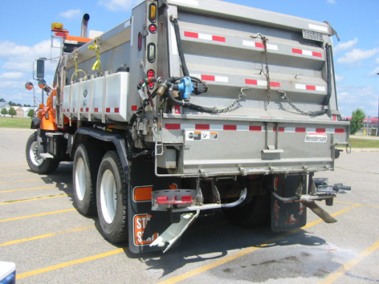
Anti-icing with pre-wet salt?
Anti-icing with liquids is the rule
Anti-icing with pre-wet is the exception
In storms starting with rain or freezing rain.
Use a very light rate.
The more liquid the better.
Timing is critical, must be done as the storm is starting.
Risk: very likely to leave the road before it is used.
Notes:
Pre-wet salt applied just before the storm will loosen the bond of snow and ice to the road, but it is very wasteful of salt. Granular salt needs moisture to work, and there is no moisture on the road prior to a storm. Because of this, most of it will be blown off the road prior to working. It is much more efficient to use a liquid.
Photo credit: Fortin Consulting Inc.
Image: Microsoft Office clip art

Slide 31
Anti-icing application rates
To standardize your performance, create and follow an application rate chart. The chart should be updated as your materials and techniques change.
EXAMPLE APPLICATION RATE CHART
Condition | Gallons per lane mile
 | CaCl₂ or MgCl₂ | Brine | Brine Blends
Regularly scheduled application | 15-25 | 20-40 | Ask manufacturer
Prior to frost or black ice | 15-25 | 20-40 | Ask manufacturer
Prior to light or moderate snow | 15-25 | 20-50 | Ask manufacturer
Note to presenters: add your anti-icing application rate table here. Delete this yellow box before making presentation.
Notes:
Table from http://miwintermaintenance.weebly.com/uploads/1/7/1/6/17161926/antiicing_mi_winter_maintenance_manual_2013.pdf
Users of straight magnesium chloride or calcium chloride stay on the very low edge of this chart. Users of salt brine vary in their application rates but tend towards the higher end of the chart. For other products purchased from vendors, seek their advice on application rates. For blends you make yourself, you are the manufacturer and are responsible for understanding how the blend will perform and assigning it an appropriate application rate. Take this responsibility seriously.
Note to presenters: add your anti-icing application rate table here. Delete this yellow box before making presentation.

Slide 32
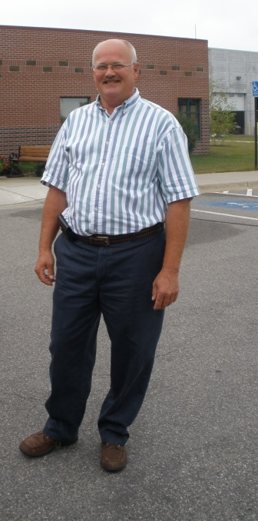
Tip from experienced operators
“We have a lot of cold weather and often anti-ice with straight Magnesium Chloride. We use the lowest end of the suggested application rates. We find the higher application rates cause us more problems than the lower application rates.”
Note to presenters: add your local tips here. Delete this yellow box before making presentation.
Notes:
Tip from Jeff Davies, City of Grand Rapids MN
Note to presenters: add your local tips here. Delete this yellow box before making presentation.

Slide 33
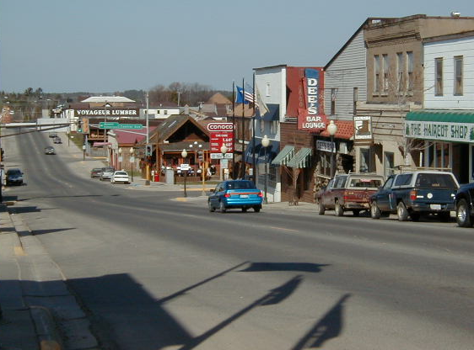
Regularly scheduled applications
Are typically not recommended because:
Can load up the roads with too much product.
Lead to excess applications of salt.
Increase corrosion of bridges.
Better to monitor the weather and apply when conditions are likely to need anti-icing.
Notes:
Regularly scheduled applications are not necessary. An example of a regularly scheduled application is “anti-ice every Monday and Friday”.
Understanding your roads and weather forecast will give you a good prediction of when frost or snow is likely to form or appear. Being pro-active and making good choices as to when to anti-ice will allow you to be the most efficient and the least wasteful in your operations.
Photo credit: Fortin Consulting Inc.

Slide 34
Test Question
Is it a good idea to anti-ice the roads on the same day(s) each week?
No, use weather forecasts to guide you
No, check to see if you have residual salt still on the road
No, pavements may be the wrong temperature
All of the above
Notes:
Note to presenters: you may choose to hide this slide.
Test Question:
Is it a good idea to anti-ice the roads on the same day(s) each week?
No, use weather forecasts to guide you (no)
No, check to see if you have residual salt still on the road (no)
No, pavements may be the wrong temperature(no)
All of the above(yes)

Slide 35
Test Question
Is it a good idea to anti-ice the roads on the same day(s) each week?
No, use weather forecasts to guide you
No, check to see if you have residual salt still on the road
No, pavements may be the wrong temperature
All of the above
Notes:
Note to presenters: you may choose to hide this slide.
Test Question:
Is it a good idea to anti-ice the roads on the same day(s) each week?
No, use weather forecasts to guide you (no)
No, check to see if you have residual salt still on the road (no)
No, pavements may be the wrong temperature(no)
All of the above(yes)

Slide 36
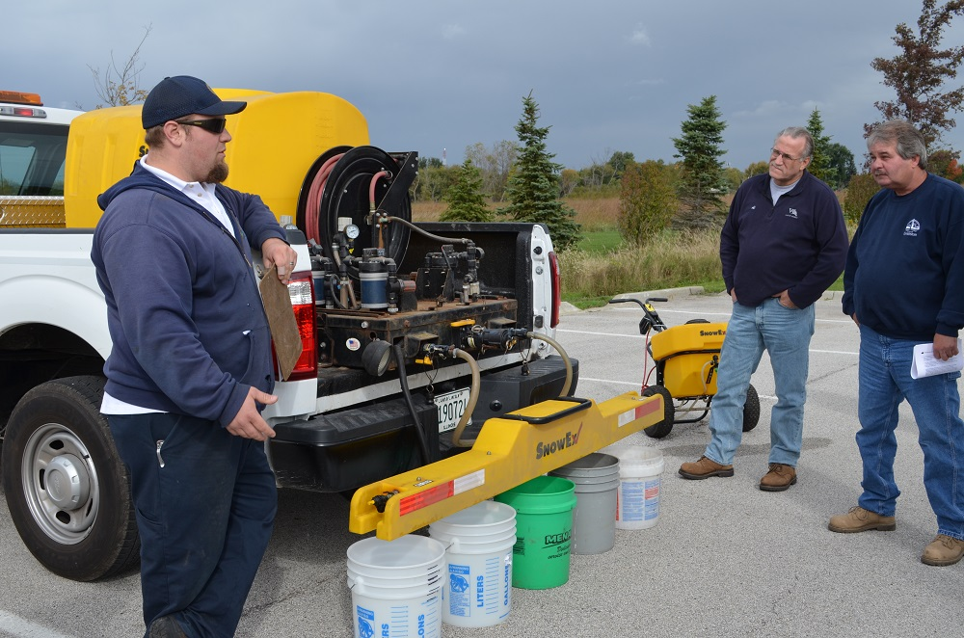
Take time to calibrate
Notes:
Calibration of anti-icing liquids is very important. We may not think of calibrating liquids but it is critical to our success. Over application, especially of hygroscopic liquids can get us into trouble. Clogged nozzles can result in an uneven spread pattern. All of this can be eliminated by calibrating before the season and re-calibrating if you have equipment changes.
Photo credit: Fortin Consulting Inc.

Slide 37
Test Question
Is it important to calibrate your anti-icing systems?
Yes
No
Notes:
Note to presenters: you may choose to hide this slide.
Test Question:
Is it important to calibrate your anti-icing systems?
Yes (yes)
No(no)

Slide 38
Test Question
Is it important to calibrate your anti-icing systems?
Yes
No
Notes:
Note to presenters: you may choose to hide this slide.
Test Question:
Is it important to calibrate your anti-icing systems?
Yes (yes)
No(no)

Slide 39

Cost savings
As your anti-icing operations grow, so will your cost savings. Anytime we integrate pro-active strategies we will increase our productivity.
Notes:
As your anti-icing operations grow, so will your cost savings. Anytime we integrate pro-active strategies we will increase our productivity.
Image credit: Microsoft Office clipart

Slide 40
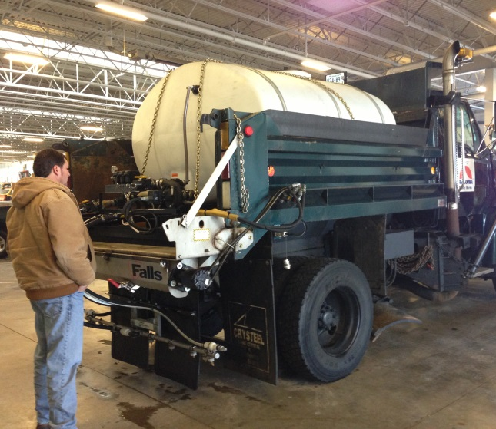
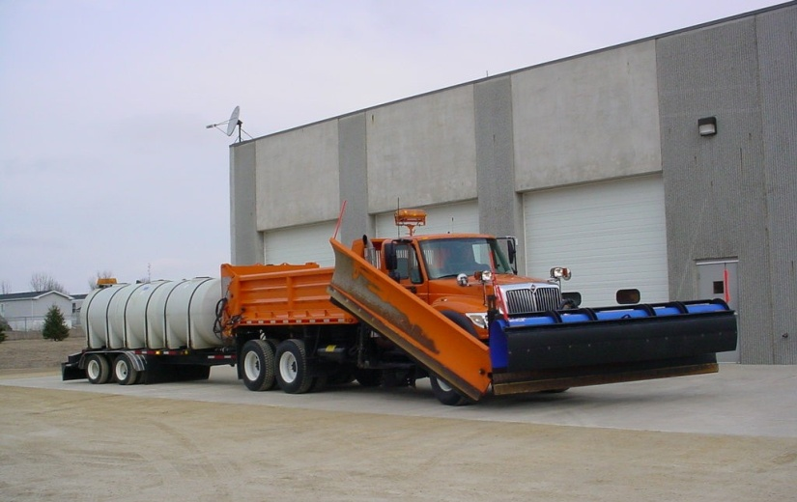
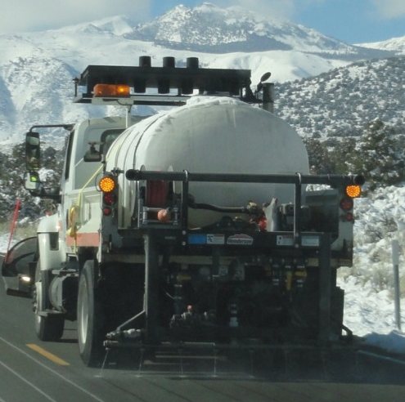
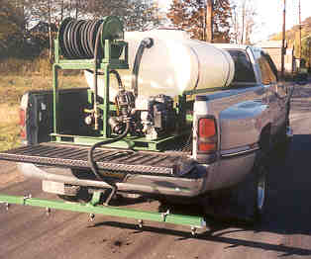
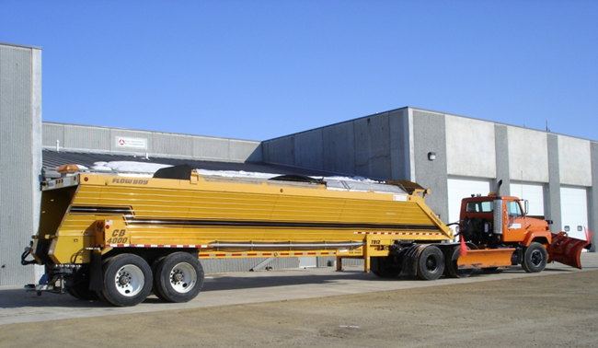
Anti-icing equipment
Equipment can range from semi-truck tankers to totes in the back of a pick up.
Notes:
Top Photos: IowaDOT_New-Operator-Snow-and-Ice-Training_Slides_17_136-139.pptx
As long as you have a tank and a spray bar you can anti-ice. Organizations generally start out small and grow into larger units as they grow in confidence with their anti-icing operations.
Advice on equipment can be found at http://clearroads.org/wp-content/uploads/Pages_from_MDOT_Winter-Operations-Trucking-Driving-School_pg_105-114.pdf
“When modifying dump trucks for a anti-icing program, it’s recommend that a 1,250 gallon tank be used in single axle dump trucks and a 2,000 gallon tank in tandem axle trucks. Consideration should be made for baffling tanks over 1,000 gallons. “
Photo credits: CA DOT and Fortin Consulting Inc

Slide 41
Test Question
What type of truck is needed for anti-icing?
One with a tank on it
A one ton
A tandem
A semi
Notes:
Note to presenters: you may choose to hide this slide.
Test Question:
What type of truck is needed for anti-icing?
One with a tank on it (yes)
A one ton(no)
A tandem(no)
A semi(no)

Slide 42
Test Question
What type of truck is needed for anti-icing?
One with a tank on it
A one ton
A tandem
A semi
Notes:
Note to presenters: you may choose to hide this slide.
Test Question:
What type of truck is needed for anti-icing?
One with a tank on it (yes)
A one ton(no)
A tandem(no)
A semi(no)

Slide 43

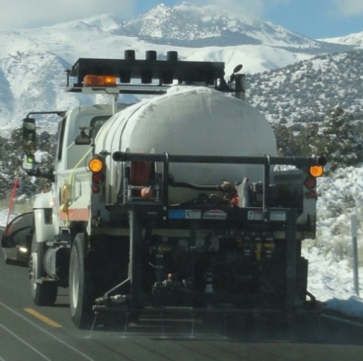
Anti-icing equipment
Note to presenters: insert photos or lists of your anti-icing equipment here...or hide this slide. Delete this yellow box before making presentation.
Notes:
Photo credits:
CA DOT, Fortin Consulting Inc.
Top Photos from IowaDOT_New-Operator-Snow-and-Ice-Training_Slides_17_136-139.pptx

Slide 44
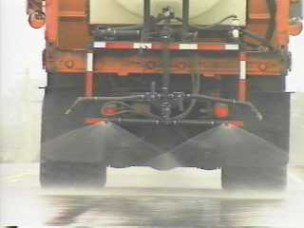
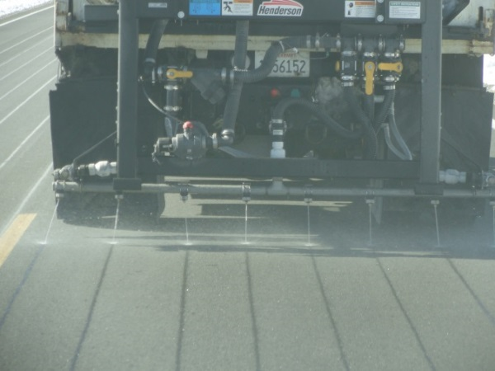
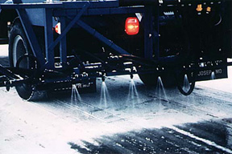
Anti-icing nozzles
More risk
Less risk
Streamer nozzles allow for a wet dry pattern and less risk of loss of friction on the roadway.
Notes:
Left and center Photos: CDOT_Snow-removal-operator-training_slides_110-111.pptx
Right photo: FCI
Anti icing has some risk involved by getting a dry road wet you lose friction. The wet dry pattern safe guards against this lose in friction. Another risk with anti-icing if you apply the wrong material, the wrong concentration, the wrong application rate or the wrong chemical for the conditions you have the possibility of making the road greasy or icy by anti-icing. The wet dry pattern offered by streamer nozzles in more forgiving in case of an error.
Advice on nozzles from :http://clearroads.org/wp-content/uploads/Pages_from_MDOT_Winter-Operations-Trucking-Driving-School_pg_105-114.pdf
“When applying liquids, streamer nozzles 1/4" or more in diameter should be used in order to prevent clogging due to suspended solids in the solution. Fan nozzles are not recommended as they spray the entire road surface with liquid, potentially making a slippery road. Streamer nozzles will apply the liquid in evenly spaced increments (see Figure 2). To allow for proper distribution of the anti-icing liquid on a roadway the streamer nozzles should be placed 10”-14” apart on the spray bar. “
Photo credits: Fortin Consulting Inc. and CDOT_Snow-removal-operator-training_slides_110-111.pptx

Slide 45
Test Question
Are streamer nozzles safer for anti-icing?
Yes
No
Notes:
Note to presenters: you may choose to hide this slide.
Test Question:
Are streamer nozzles safer for anti-icing?
Yes (yes)
No (no)

Slide 46
Test Question
Are streamer nozzles safer for anti-icing?
Yes
No
Notes:
Note to presenters: you may choose to hide this slide.
Test Question:
Are streamer nozzles safer for anti-icing?
Yes (yes)
No (no)

Slide 47
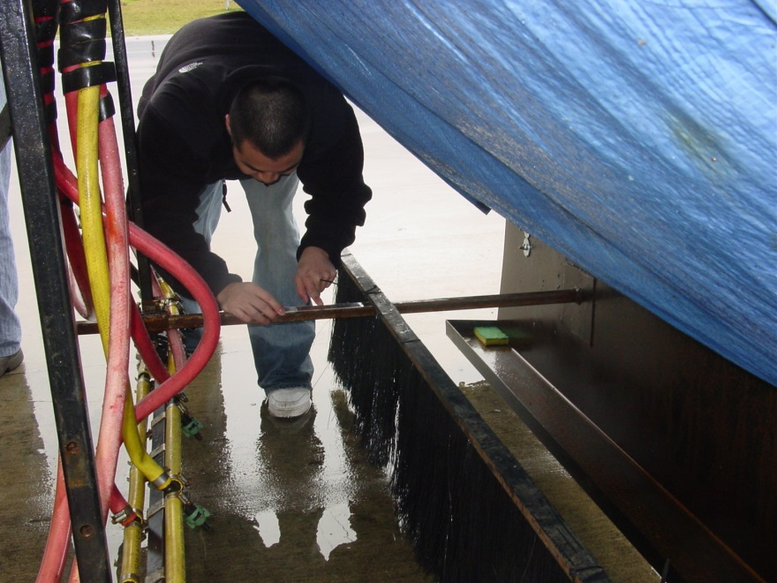
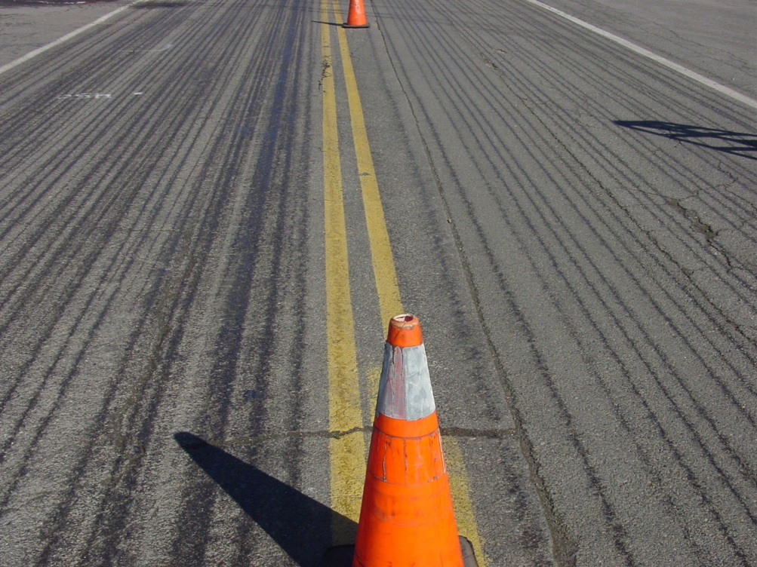
Drift control
Note: 30% more liquid is applied to the road by putting spray skirt 18 inches behind nozzles.
Notes:
According to an Oregon State University study, ODOT reduced drift by 30% by adding a spray skirt behind the spray bar.
Source: ODOT OSU De-icer Project Report.pdf
Photo credit: ODOT

Slide 48
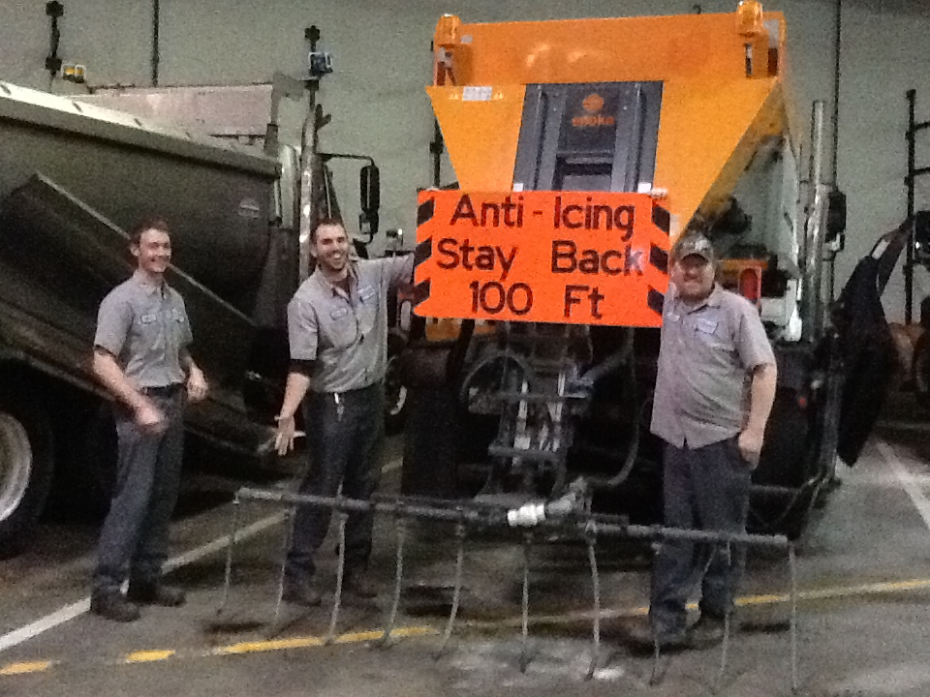
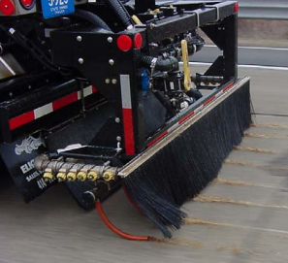
Drift control
Hoses
Hoses and Skirt
Notes:
By attaching hoses to the nozzles the application is literally striped onto the roadway with very little wasted liquid.
Other advice can be found at http://clearroads.org/wp-content/uploads/Pages_from_MDOT_Winter-Operations-Trucking-Driving-School_pg_105-114.pdf
Adjustable height applicator bars will allow operators to minimize the effect of wind and air turbulence from the trucks. Placing rubber mats on either side of the spray bar will also minimize over-spray. Rubber hoses that are just long enough to touch the ground can be put over the spray nozzles to apply the liquid at the road surface.
You can use these ideas or create your own!
Photo credits: MDOT and Fortin Consulting Inc.

Slide 49
Test Question
Can we improve efficiency of anti-icing by adding hoses, skirts or other wind reducing modifications?
Yes
No
Notes:
Note to presenters: you may choose to hide this slide.
Test Question:
Can we improve efficiency of anti-icing by adding hoses, skirts or other wind reducing modifications?
Yes (yes)
No(no)

Slide 50
Test Question
Can we improve efficiency of anti-icing by adding hoses, skirts or other wind reducing modifications?
Yes
No
Notes:
Note to presenters: you may choose to hide this slide.
Test Question:
Can we improve efficiency of anti-icing by adding hoses, skirts or other wind reducing modifications?
Yes (yes)
No(no)

Slide 51
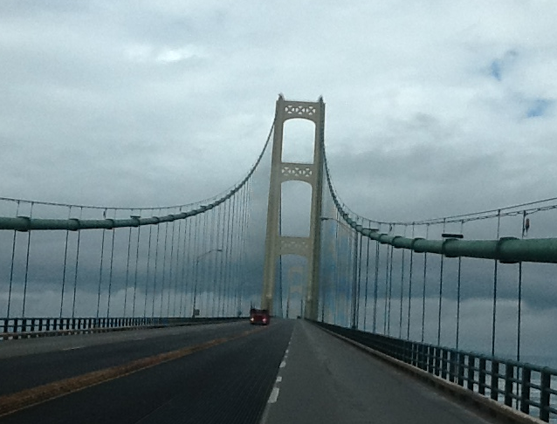
Where to anti-ice
Where frost or black ice is likely.
On any roads that you de-ice
Especially those demanding high level of service
Hills, curves, bridges.
Notes:
Anti-icing is pro-active which means it is appropriate for most areas that you anti-ice. Organizations tend to prioritize and apply anti-icing liquids to their most critical areas. Other areas may be anti-iced as their capacity grows. Those heavily invested in anti-icing treat a much higher percentage of their roads than those just starting out.
Photo credit: Fortin Consulting Inc.

Slide 52
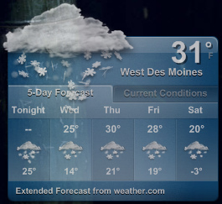
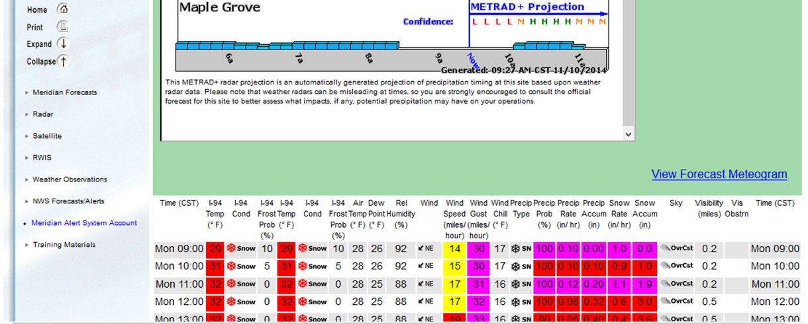
Weather forecast
Having and using weather and forecast information is one of the keys to successful and effective anti-icing.
There are many weather and weather forecasting tools and services available.
You need pavement temperature in addition to other weather information .
Note to presenters: mention or list the weather information you use here. Delete this yellow box before making presentation.
Notes:
Information for this slide is based on http://clearroads.org/wp-content/uploads/Pages_from_MDOT_Winter-Operations-Trucking-Driving-School_pg_105-114.pdf
More information on weather forecasts is found in Clear Roads Training Module 16: Weather Basics.
Since anti-icing is pro-active, you need to keep an eye on the weather and take action before the winter event.
Note to presenter: identify the weather information that you use locally. Discuss how each is used. Delete the yellow box before making presentation.
Picture credit: Jake Bouma
Forecast: snow. https://www.flickr.com/photos/30885355@N00/2245250544 are licensed under a Creative Commons Attribution Share-Alike 3.0 License

Slide 53
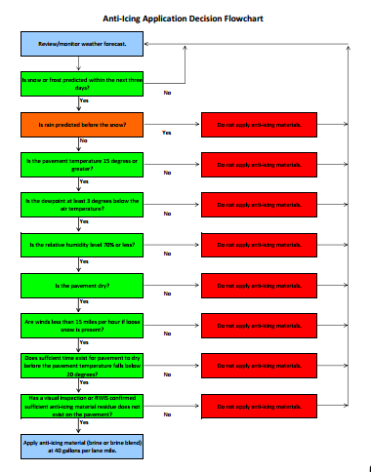
Time to develop a decision tree for anti-icing
If you are just getting into anti-icing or considering it, take time to look at other organizations anti-icing decision trees and develop one for your organization.
You can modify and improve the logic as you gain confidence and experience in anti-icing.
Notes:
This slide is for supervisors only.
Before jumping into anti-icing, take time to look at the work done by other organizations and look at their logic charts for when to and when not to anti-ice. A good starting point is for you to develop a chart for your organization. As you improve your techniques, grow in experience and as chemicals/equipment changes, keep your logic chart updated and accurate.
Figure credits:
Example on left, MaineDOT_Anti-Ice-Decision-Flow-Chart.pdf
Example on right, anti-icing decision tree: PennDOT_Snow-Academy-Part-4_slides_102-106.pptx

Slide 54
Anti-icing decision tree
Note to presenters: replace this flowchart with your decision tree here. Delete this yellow box before making presentation.
Notes:
This chart comes from the Maine DOT. Source: MaineDOT_Anti-Ice-Decision-Flow-Chart.pdf
Note to presenters: replace this flowchart with your decision tree here. Delete this yellow box before making presentation.

Slide 55

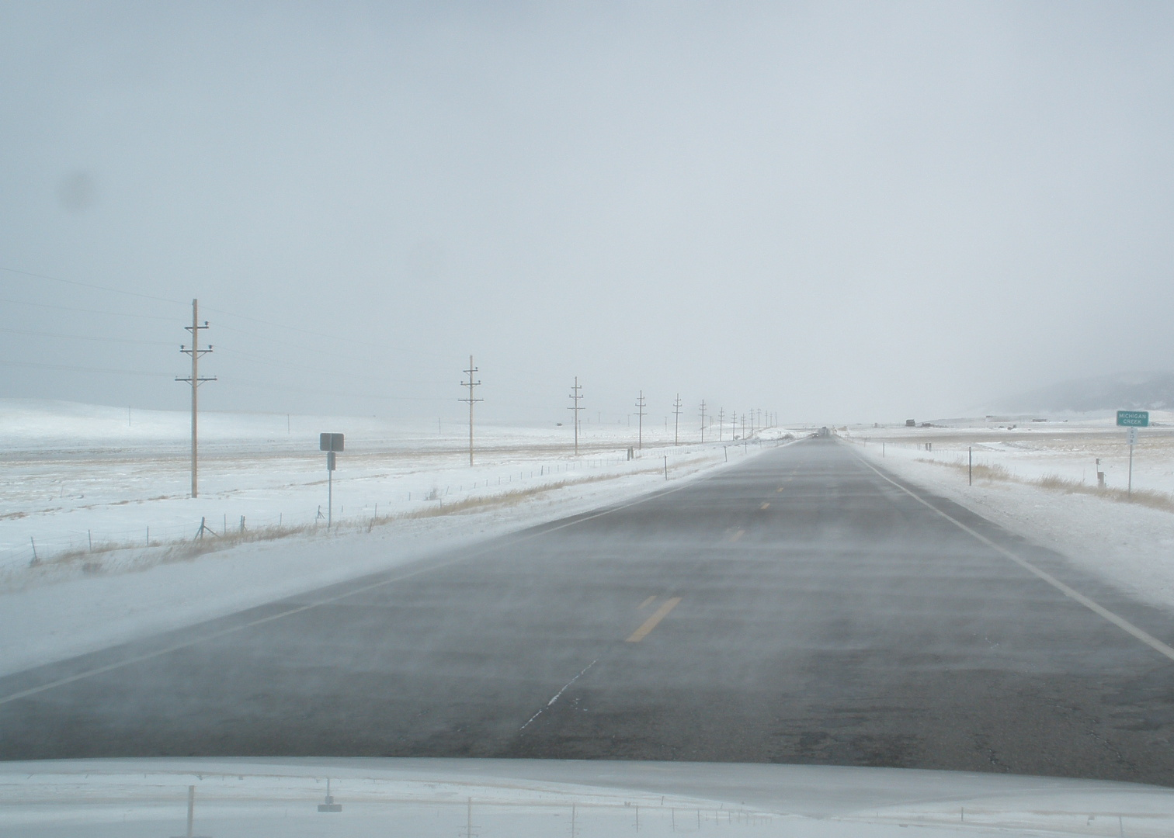

Avoid anti-icing if:
Drifting or blowing locations.
Predicted heavy rain.
Extreme cold pavement temperatures.
You don’t have the right equipment.
You haven’t calibrated your truck.
You haven’t tested your system on “safe” location. (parking lot, side road…)
You don’t understand the practical melting range of your de-icers.
Note to presenters: add other criteria from your own experience. For example: MN agencies have had problems when we anti-ice by the Ford Dam with hygroscopic products. Delete this yellow box before making presentation.
Notes:
Anti-icing is not always recommended. Here is a partial list of times when you would not want to anti-ice.
A good class discussion for groups that have anti-icing experience would be: under what conditions has anti-icing worked well for you and under what conditions has anti-icing failed.
Photo credit: Fortin Consulting Inc.

Slide 56
Test Question
Is anti-icing always a smart practice?
Yes
No
Notes:
Note to presenters: you may choose to hide this slide.
Test Question:
Is anti-icing always a smart practice?
Yes(no)
No(yes)

Slide 57
Test Question
Is anti-icing always a smart practice?
Yes
No
Notes:
Note to presenters: you may choose to hide this slide.
Test Question:
Is anti-icing always a smart practice?
Yes(no)
No(yes)

Slide 58
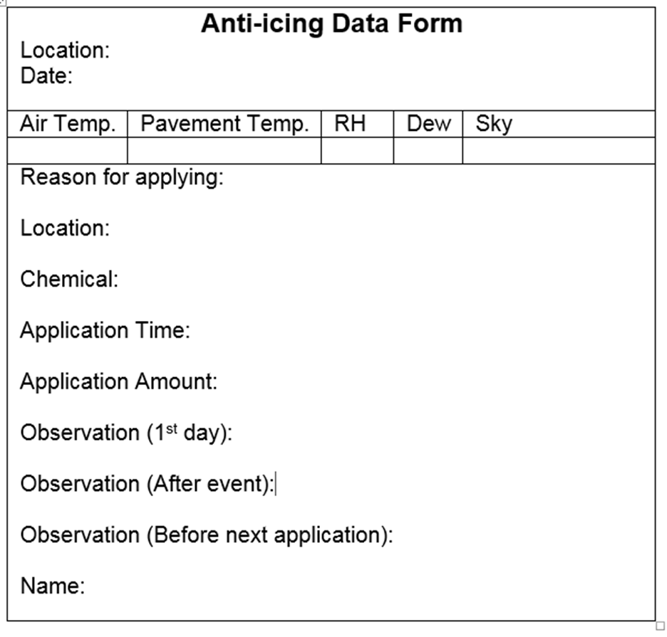
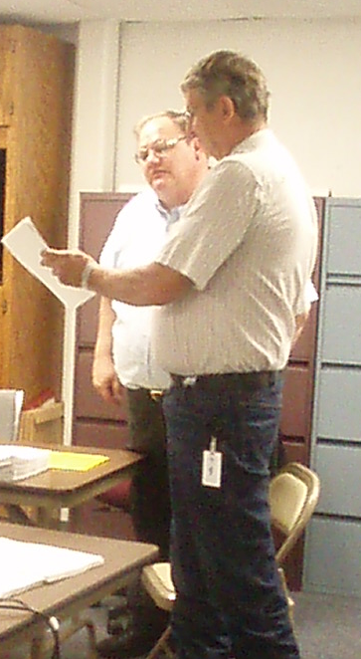
Document your experiences
The best way to learn BMP’s is to document what works and what doesn’t.
Share the information you learned with operators, supervisors etc.
Note to presenters: add your form here. Delete this yellow box before making presentation.
Notes:
This Anti-icing form comes from the Minnesota snow and ice control field handbook for snowplow operators (2012). Add your own form here and delete this yellow box before making presentation.
Tip from Price Co WI Hwy dept: “The best way to learn BMP’s is to document what works and what doesn’t. Be sure and share the information you learned with operators, supervisors etc. “
Photo credit: Fortin Consulting Inc.

Slide 59
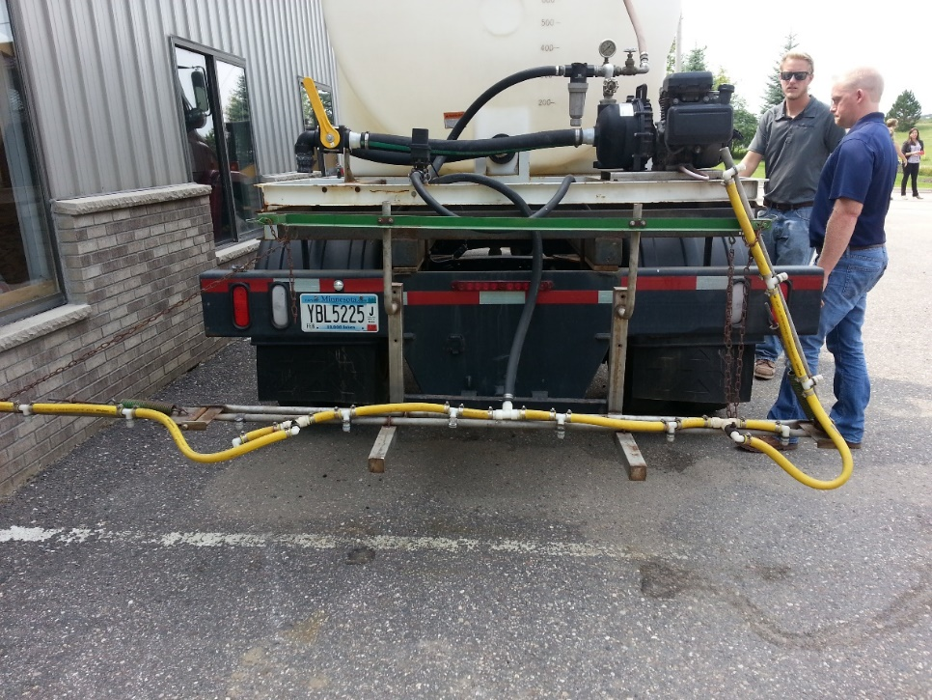
Record Keeping Before the Season
In this section we will be covering these topics:
Records of material purchasing
Records of material quality control
Record equipment inspections
Record equipment calibration
Customize this slide for your operation
Insert a copy of your truck inspection check list and procedure. Delete this yellow box before making presentation.
Notes:
In this section we will be covering the topics shown here.
Note to presenters: If any of the items on this list do not apply to you, delete them from the list, and hide the slides. If there is something else that you do before the season, add it in here and in the provided slide at the end of the section.
Also: insert a copy of your truck inspection checklist and procedure here. Delete this yellow box before making presentation.
Records of material purchasing
Records of material quality control
Record equipment inspections
Record equipment calibration
OTHER?
Note: More about these topics can be found in Module 23 – Getting Ready for Winter.

Slide 60
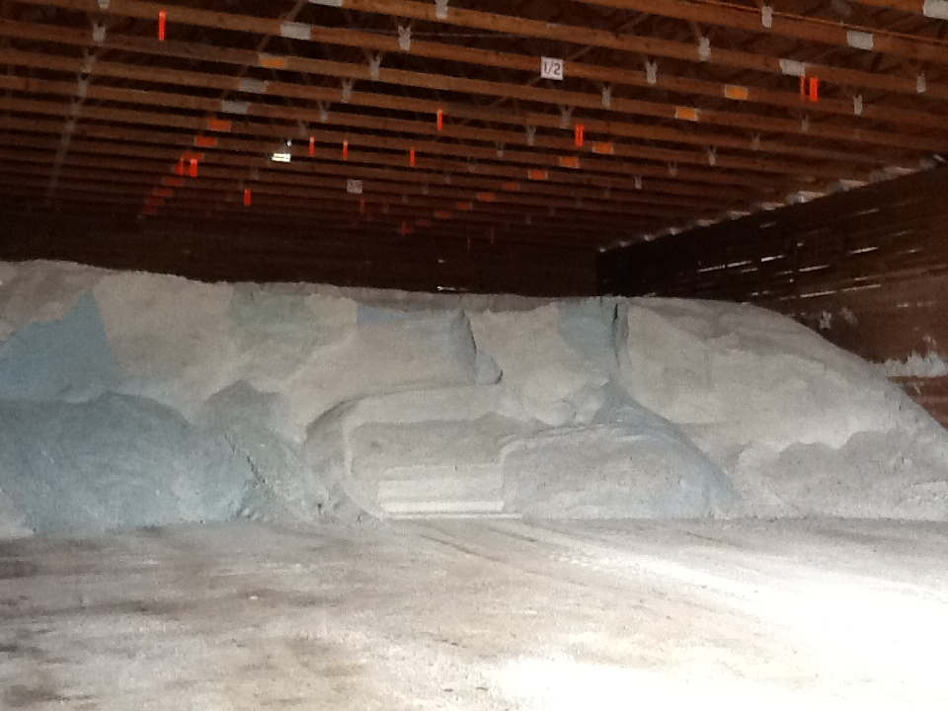
Material Accountability
Know how much you have
Know how much you use
Notes:
It is important to know how much salt you start with, how much you have throughout the season and how much salt you use. Knowing this helps with evaluating salt application efficiency, and for predicting order numbers in the future.

Slide 61
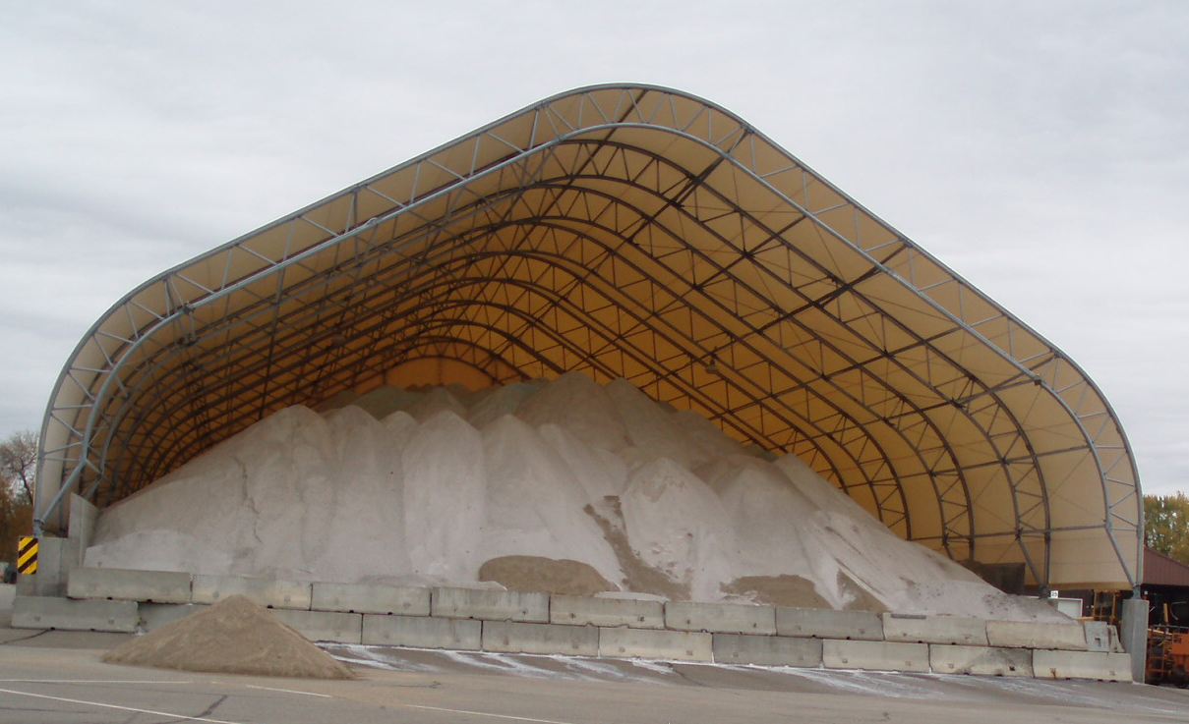
Record Keeping and Quality Control
Take a small sample from each load
Weigh it as soon as you take it
Remove the water, weigh it again
Determine % moisture
Compare to your spec
Record results
Take appropriate action
For less dispute, use a lab testing service or established DOT lab.
Notes:
Reference: Minnesota Snow and ice control field handbook for snowplow operators explains how to do this step by step. (Pg 23-25)
Find it online at this link:
http://www.lrrb.org/media/reports/200501REV.pdf
You can do testing yourself or if you want the results to be less disputed, enlist the help of professional services within our outside of your organization.
Photo credit: Fortin Consulting, Inc.

Slide 62
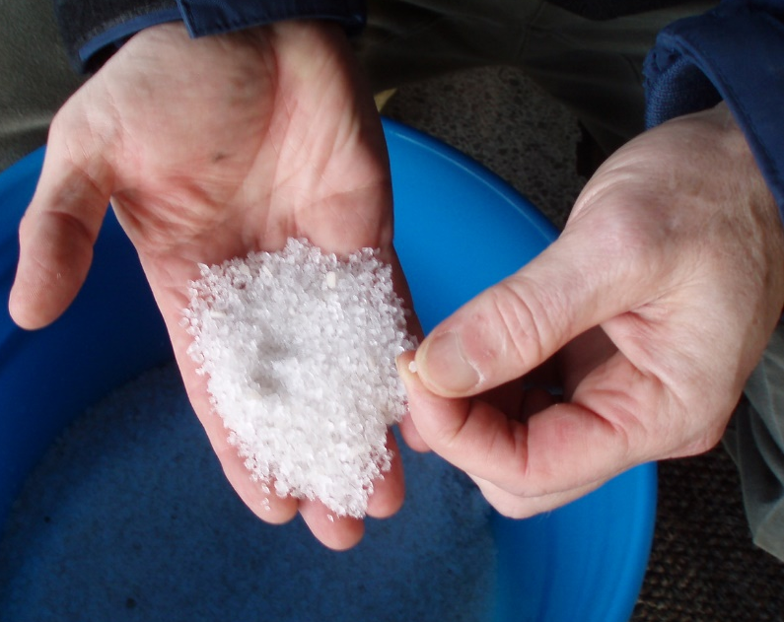
Record Keeping and Quality Control
Test the materials
Solids- test the moisture content
Liquids- test the specific gravity
Check that you get what you ordered
Keep accurate records on quantities ordered, received and used
If you see something wrong, tell your supervisor
Quality Control is vital
Notes:
Quality Control is vital. Every experienced user will inform you just how vital it is. If you do not have a quality control process in place, you can receive very different materials. This translates into effective vs. ineffective operations, environmental contamination, handling difficulties, equipment issues, and on and on.
Test the materials as shown here:
Solids- test the moisture content
Liquids- test the specific gravity
Check that you get what you ordered
Keep accurate records on quantities ordered, received and used
If you see something wrong tell your supervisor
If test results don’t meet the requirements for material ordered, we can reject the delivery.
Note: More information can be found in Module 10 Deicer Agent Management Policy.
Slide credit: CDOT Snow Removal Operator Training

Slide 63

Record keeping and Materials Testing
Liquids: specific gravity
Document % and compare to specification
Don’t use it if it doesn't match the specification
Insert your state’s policy here. Delete this yellow box before making presentation.
Notes:
If the specific gravity doesn’t match the spec, there’s no way to know the temperature at which it will freeze on the road.
Note: There is more about material testing in Module 10 Deicer Management Policy.
Note to presenters: If you have a form or policy regarding record keeping for materials testing, include that information here (you could insert a photo of the cover of your document as an example).
Delete this yellow box before making presentation.
Photo credit: Fortin Consulting, Inc.

Slide 64
Test Question
True or False: It is important to test and record the concentration of your solution when making brine.
True
False
Notes:
Note to presenters: you may choose to hide this slide.
Test Question: Is it important to record the concentration of your solution when making brine?
a. True (yes)
b. False (no)

Slide 65
Test Question
True or False: It is important to test and record the concentration of your solution when making brine.
True
False
Notes:
Note to presenters: you may choose to hide this slide.
Test Question: Is it important to record the concentration of your solution when making brine?
a. True (yes)
b. False (no)

Slide 66


Document by Material Type
Solids
Liquids
Record any time you load, apply, or replace material
Notes:
It is important to know both what materials and the total of each that were used. This can help to predict the amount needed for future seasons as well as help in evaluating how well treatment went for an event.
Photo credits: Fortin Consulting, Inc.

Slide 67
Test Question
Which items should be documented?
Material use per storm
Material use per season
Material use per crew member
All of the above
Notes:
Note to presenters: you may choose to hide this slide.
Test question: Which items should be tracked?
Salt use per storm (no)
Salt brine use per season (no)
Winter sand use per crew member (no)
All of the above (yes)

Slide 68
Test Question
Which items should be documented?
Material use per storm
Material use per season
Material use per crew member
All of the above
Notes:
Note to presenters: you may choose to hide this slide.
Test question: Which items should be tracked?
Salt use per storm (no)
Salt brine use per season (no)
Winter sand use per crew member (no)
All of the above (yes)

Slide 69
Storm Documentation
EXAMPLE:
Work orders
Patrol log
Material usage log
Equipment work orders
Fuel logs
Time sheets
Diary
TAPER log
Customize this slide for your operation
Insert a list of forms needed to be completed by operators for a storm. Delete this yellow box before making the presentation.
Notes:
Review the storm documentation needed for your agency.
Note to presenters: Insert a list of forms needed to be completed by operators for a storm here. Delete this yellow box before making presentation.
Slide credit: CDOT Snow Removal Operator Training

Slide 70

Document Your Operations
EXAMPLE:
Conditions- weather and road, pavement temp
Material type and quantity used
Timing
# of passes and when
Unusual conditions/circumstances
Customize this slide for your operation
Insert an example of your state’s event log and explain how to fill it out. Delete this yellow box before making the presentation.
Notes:
It is very important that plow drivers document the actions taken in response to a snow/ice event
This will include the road conditions throughout their shift, type and amount of deicer or anti-icer used, timing of operations, and the number of passes and when. If there are unusual conditions that affect the operations, those should be recorded. For example, road construction, accidents, major compaction problems, etc.
Note to presenters: Insert a copy of your state’s event log and explain how to fill it out. Delete this yellow box before making presentation.
Photo credit: INDOT

Slide 71
Example: T A P E R
T = Temperature
A = Application
P = Product
E = Event
R = Results
Notes:
Use this slide if your state uses the TAPER system to help explain. Hide this slide if it doesn’t use the TAPER system.
Slide credit: CDOT Snow Removal Operator Training

Slide 72
Event Log
Insert an example of your state’s event log. Delete this yellow box before making presentation.
Customize this slide for your operation
EXAMPLE
Notes:
Review this sequence of events as illustrated on this report, pay particular attention to the changes that took place in the highlighted entries. Note that this TAPER log really paints a good picture of what was done, when it was done, how it was done, who did it with what and what the outcome was like. If you had this information coming on to shift, would you really even need to talk to the person you are relieving?
Note to presenters: Insert an example of your state’s event log here. Delete the yellow box before making presentation.
Slide credit: CDOT Snow Removal Operator Training

Slide 73
Test Question
What should you record during the storm?
Type of product used
Application rate
Pavement temperature
All of the above
Notes:
Note to presenters: you may choose to hide this slide.
Test question: What do you need to record for the TAPER log?
Product (no)
Results (no)
Temperature (no)
All of the above (yes)

Slide 74
Test Question
What should you record during the storm?
Type of product used
Application rate
Pavement temperature
All of the above
Notes:
Note to presenters: you may choose to hide this slide.
Test question: What do you need to record for the TAPER log?
Product (no)
Results (no)
Temperature (no)
All of the above (yes)

Slide 75

A job well done is a job well documented
Filling out paperwork is important because it:
Shows that you follow policy
Improves efficiency of operations
Helps with planning
Notes:
Presenters: give a pep talk here! Everyone knows that filling out paperwork during or at the end of a long shift can be hard to be motivated to do, but it is very important because it:
Shows that you follow policy
Improves efficiency of operations
Helps with planning

Slide 76
Test Question
When you’ve been working all night and you’re tired, do you still have to fill out your paper work?
No
Yes
Notes:
Note to presenters: you may choose to hide this slide.
Test question: When you’ve been working all night and you’re tired do you still have to fill out your paper work?
No (no)
Yes (yes)

Slide 77
Test Question
When you’ve been working all night and you’re tired, do you still have to fill out your paper work?
No
Yes
Notes:
Note to presenters: you may choose to hide this slide.
Test question: When you’ve been working all night and you’re tired do you still have to fill out your paper work?
No (no)
Yes (yes)

Slide 78

Recording Material Use
Keep track of driver use for insight into:
Individual storms
Each product totals
Winter season total
Leftover product totals
Notes:
You should record several different levels of material use by driver. Combine all this data for insight into individual storms, the winter season total, and what is leftover to store for the next season.
Having all this information helps in evaluating the efficacy of individual storm treatments went, how the whole winter went, and helps in next seasons ordering. It can also help in proving that policy is being followed if a lawsuit is brought against you.
Photo credit: Fortin Consulting, Inc.

Slide 79
OTHER
Insert any additional during the storm record keeping needs here, otherwise delete this slide. Delete this yellow box before making presentation if you use this slide.
Customize this slide for your operation
Notes:
Note to presenters: add any other information you’d like to include regarding decision making during the storm here. If you do not use this slide, hide it.

Slide 80
Record Keeping
Keeping good records helps
Demonstrate how goals are met.
Demonstrates that you are following policy.
Identify ways to improve and change your approach.
Notes:
Keeping good records is important. It helps to:
demonstrate how goals are met.
demonstrates that you are following policy.
identifies ways to improve and change your approach.

Slide 81


Anti-icing is like frying eggs
By preparing the pan prior to frying eggs, the egg is easily removed, there’s very little work and easy clean up.
Notes:
Have you ever cooked an egg in a black cast iron frying pan? What if you forgot to add the grease before frying the egg? You end up eating egg crumbles and cleaning the pan is a lot of work (you need the green scratchy and some elbow grease.)
Most people can relate to this example. Anti-icing is similar: a pro-active measure to prevent the bond, which gives us easier snow removal with less chemicals and less work.

Slide 82
Tips from experienced superintendents
If using mag chloride or calcium chloride, use no more than 15 gallons per mile.
Do not do system-wide anti-icing unless the storm is imminent.
Anti-ice bridge decks and critical areas (for counties and cities, anti-ice the intersections and cross streets).
Stream spray only; no fan spraying.
Spend the $ and put together a unit that will accurately measure what you are applying.
Note to presenters: add your own tips here and delete this yellow box before making presentation.
Notes:
Tips from Norm Ashfeld, retired MNDOT Superintendent of the Minneaoplis/St.Paul Metro area.
Note to presenters: your students may have their own tips. This is a good lead into a class discussion if you have any experience in anti-icing in the group. Delete this yellow box before making the presentation.

Slide 83
Tips from experienced supervisors
Start with gravity fed equipment to apply liquid at the auger in the sander or directly to the spinner. (This is easier and less frustrating than with pumps to start).
Agencies need a good weather forecasting tool and training to help them apply materials accurately and efficiently.
Start with minimum application rates for liquids, especially if using magnesium chloride or calcium chloride.
New equipment purchases should include spreader controls that will measure granular and liquid materials.
Note to presenters: add your own tips here and delete this yellow box before making presentation.
Notes:
Tips from Woody Woodruff, retired MNDOT supervisor out of the Mankato area which is a city but also has many rural routes.
Note to presenters: your students may have their own tips. This is a good lead into a class discussion if you have any experience in anti-icing in the group. Delete this yellow box before making the presentation.

Slide 84




If you are a pro-active person
Anti-icing is for you!
Notes:
Take on the challenge and improve your operations. Anti-icing has proven itself and is a main stream activity. If you are already anti-icing, see how you can increase it. If you are all ready anti-icing, congratulate yourself on a job well done.
Photo credit: Fortin Consulting Inc.

Slide 85
Additional resources
AASHTO, Clear Roads Computer Based training:
Anti-icing/RWIS: Lesson 1 Introduction to Anti-icing and Winter Maintenance and Lesson 7: Anti-icing Practice in Winter Maintenance Operations
Deicing: Unit 4 Deicing Equipment
MI winter maintenance manual
http://miwintermaintenance.weebly.com/uploads/1/7/1/6/17161926/antiicing_mi_winter_maintenance_manual_2013.pdf
Clear Roads Training Modules
Module 4: Material Use
Module 6: Brine Production
Module 13: Science of Freeze Point Depressants
Module 16: Weather Basics

Slide 86
Acknowledgements
Training contents were developed by Fortin Consulting Inc., under the direction of the Clear Roads Advisory Team.
Connie Fortin – connie@fortinconsulting.com
Professional formatting and training aids were developed by the University of Minnesota, Center for Transportation Studies.
Jim Grothaus – Groth020@umn.edu
Ann Johnson – Johns421@umn.edu
Members of the Clear Roads Advisory Team include:
Mike Sproul, Dave Wieder, Cliff Spoonemore, Monty Mills, David Frame,
Mike Lashmet, Clay Adams, Justun Juelfs, and Tom Peters

Slide 87
This presentation was developed with funding from the Clear Roads research program, which brings together transportation professionals and researchers from around the country to drive innovation in the field of winter maintenance.
Find additional information and resources at
http://clearroads.org/

Slide 88



Thank you for Your Good Work!
Notes:
Thank you for your time today. Have a good winter!

