Slide 1
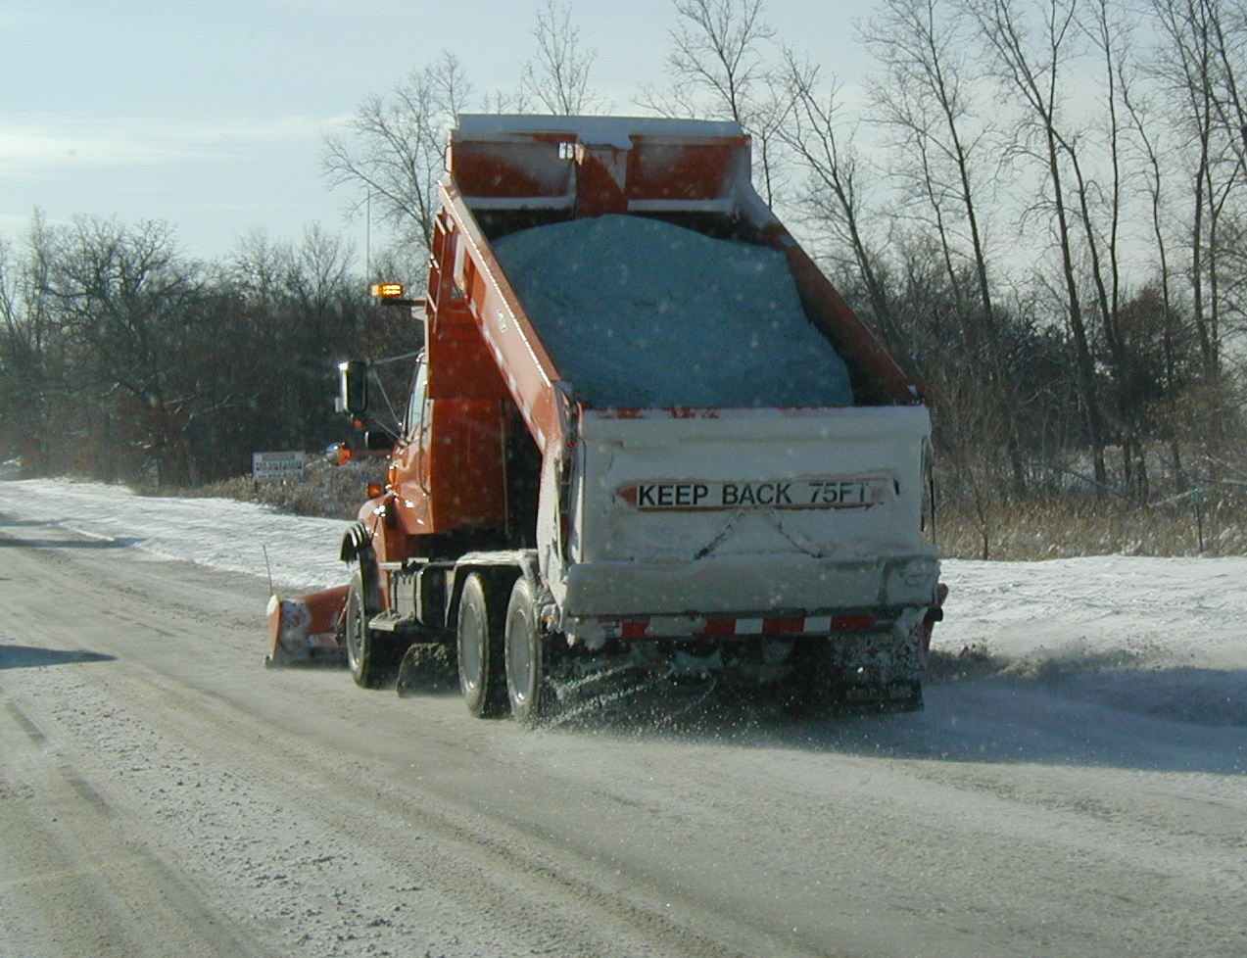

Module 7: De-icing
2016 Created for Clear Roads by:
U of MN Center for Transportation Studies &
Fortin Consulting Inc.

Slide 2
Training for Winter Maintenance Supervisors and Operators
2016 Created for Clear Roads by:
U of MN Center for Transportation Studies &
Fortin Consulting Inc.

Slide 3
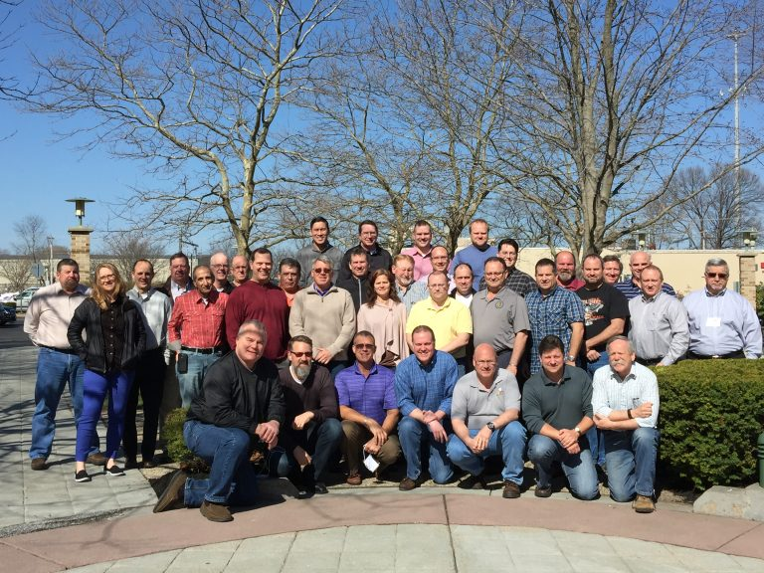
Winter maintenance professionals are a very powerful and important group
Notes:
Photo: clear roads website
Note to presenters: These first 7 slides can be used or hidden.
Or, replace with photos of your staff.

Slide 4
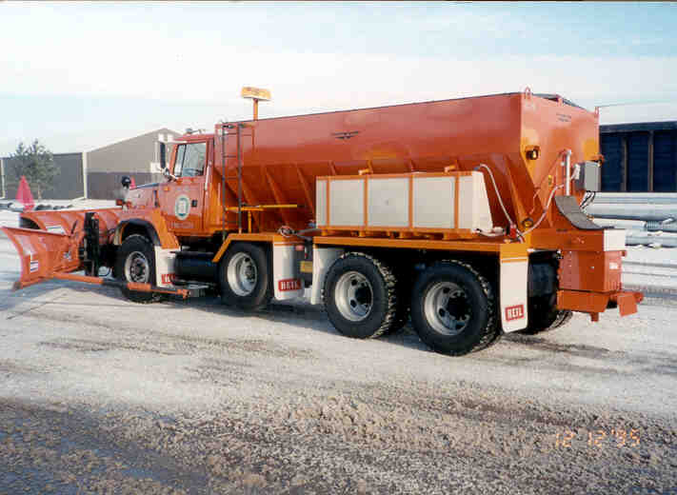
You do a great job of taking care of our roads!

Slide 5
This is one of a series of 22 winter maintenance training modules developed by the Clear Roads Program. All of the modules are available online at www.clearroads.org
Modules include information on the following:
Plowing
Truck operations
Spreading
Material use
Pre-wetting
Brine production
De-icing and anti-icing
Level of service
Ice formation
Freeze point depressants
Environmental issues
Drift control
Weather
Avalanche management
Bridge frost
Safety
Notes:
Note to presenters: The website www.clearroads.org can be accessed here if a live internet connection is available.
A list of all the modules is given here:
Plowing procedures
Truck operations
Spreading
Material use
Pre-wetting
Brine production
De-icing
Anti-icing
Safety
De-icing agent management policy
Level of service
Ice formation
Freeze point depressants
Environmental issues
Drift control
Weather
Bridge frost
Avalanche management

Slide 6
Module 7: De-icing
2016 Created for Clear Roads by:
U of MN Center for Transportation Studies &
Fortin Consulting Inc.

Slide 7
FACILITATOR NOTES (do not show during class)
This is a priority 1 module to be developed for Clear Roads national training. It will address three audiences. Slides can be customized for the audience.
Slide Legend
Entry-level plow drivers
Experienced plow drivers
Supervisors
Notes:
Note to facilitator: do not show this slide during class

Slide 8
This module will contain these topics
Deicing as a response strategy as compared to anti-icing (reactive vs. proactive).
What conditions are appropriate for deicing.
  What are appropriate application rates for those conditions.
Recommendations for the use of liquids in deicing.
  As stand-alone treatments
  As pre-wet material
Notes:
This module will contain discussions on:
Deicing as a response strategy as compared to anti-icing (reactive vs. proactive)
What conditions are appropriate for deicing
What are appropriate application rates for those conditions
Recommendations for the use of liquids in deicing
As stand-alone treatments
As pre-wet material
Note that many of the topics covered in this module are expanded in other modules. See the last slide of this presentation on additional resources.

Slide 9
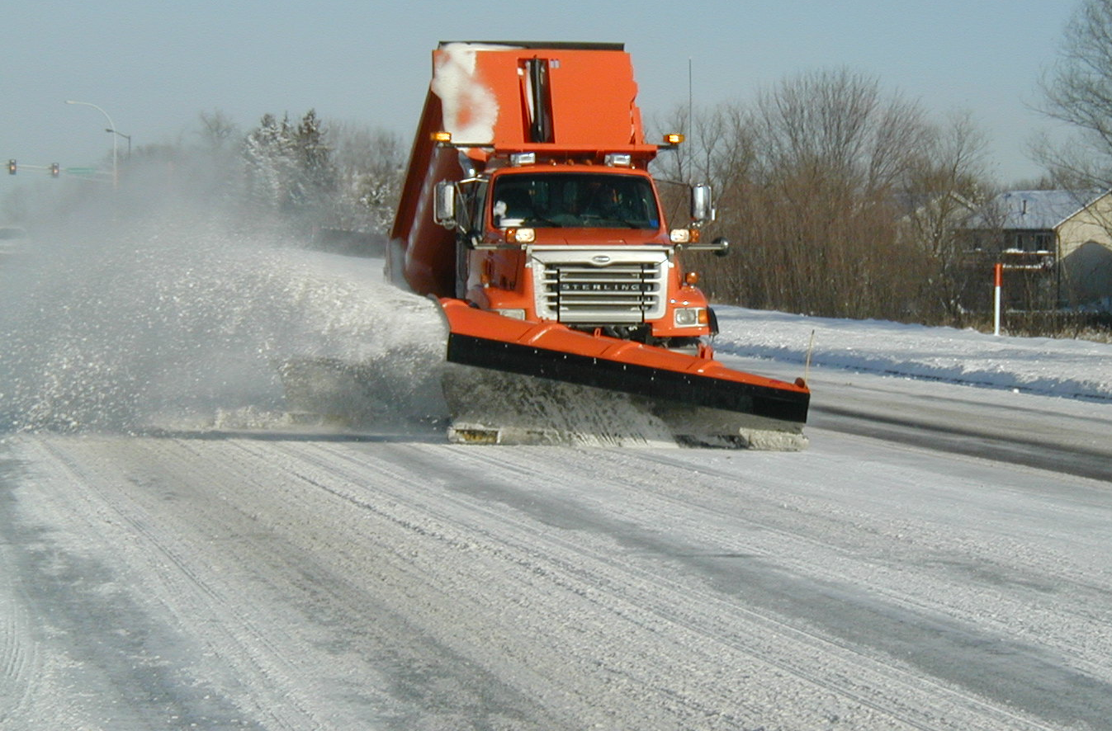
De-icing
De-icing is the removal of snow, ice or frost from the roadway after it is on the roadway.
It is typically done with chemicals.
This is the “traditional” method of winter maintenance. This module explores ways to do it most efficiently.
Notes:
De-icing occurs after snow, ice or frost is on the road. It is where we spend most of our time in winter maintenance. De-icing can be done wastefully or efficiently and anywhere in between. It is our goal to encourage the smartest and most effective de-icing practices available. Interestingly enough efficient de-icing often starts with anti-icing or other pro-active processes.
We are very familiar with de-icing and because of this there is sometimes a reluctance to change. However if we frame it in a way that encourages us to explore options to make us more efficient, we have the opportunity to save money, time and the environment without lowering our level of service.
Photo credit: Fortin Consulting Inc.

Slide 10
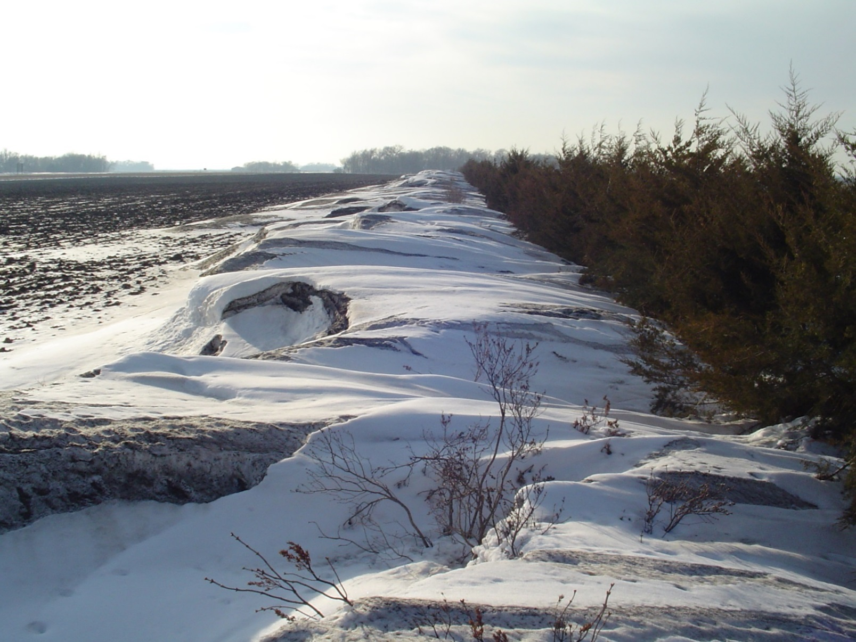
Proactive strategies
Anti-icing
Snow fencing
Anything we can do in advance of the roads becoming icy or snowy:
Reduces the bonding of the snow and ice to the road.
Prevents frost from occurring on roads or bridges.
Stops snow from blowing on the roads.
Notes:
Pro-active strategies vary but they all have one thing in common: they prevent or reduce the chances of the road from getting slippery. A good example of this is anti-icing. With anti-icing, the crew applies a light amount of liquid de-icer on the road prior to the storm event. This reduces the bond and makes clean up easier.
Another example of pro-activeness is installing snow-fencing. By planting snow fences in blowing drifting areas, you can reduce the amount of snow that ends up on the road. Thus less problems for you to fix.
Good road drainage is a proactive strategy. As snow and ice melt they drain off of the road. Melted snow doesn’t stay on the road to refreeze as the temperature drops.
Photo credit: CaDOT and Price County Wi, Highway Dept.
Note to presenter: this is a good slide to offer the discussion topic on what participants do that is proactive, and what they could add to their current strategies?

Slide 11
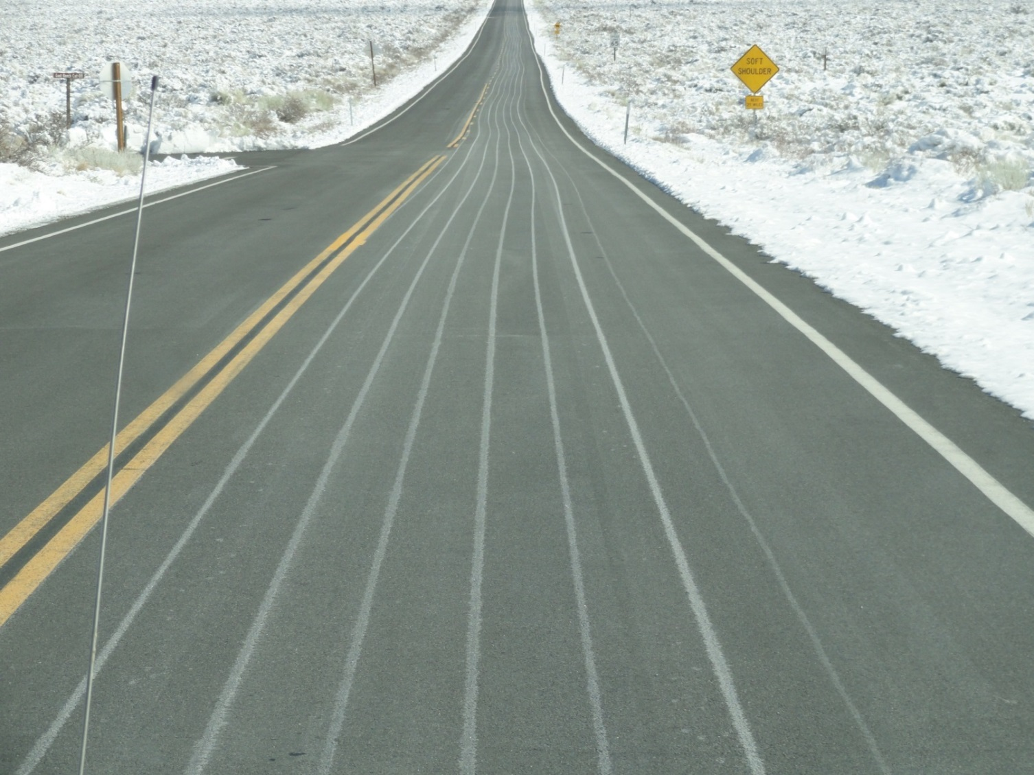

Proactive strategies
Save us time and money, and reduces environmental impacts to make the roads safer!
Notes:
Anti-icing is one example of a proactive strategy…it is something we do in advance of a winter storm.
Photo credit: California DOT
Image: Microsoft clipart

Slide 12
Test Question
What is a pro-active strategy?
Something done before the storm
Something done during the storm
Something done after the storm
A pro-football game
Notes:
Note to presenters: you may choose to hide this slide.
Test Question:
What is a pro-active strategy?
Something done before the storm (yes)
Something done during the storm(no)
Something done after the storm (no)
A pro-football game (no)

Slide 13
Test Question
What is a pro-active strategy?
Something done before the storm
Something done during the storm
Something done after the storm
A pro-football game
Notes:
Note to presenters: you may choose to hide this slide.
Test Question:
What is a pro-active strategy?
Something done before the storm (yes)
Something done during the storm(no)
Something done after the storm (no)
A pro-football game (no)

Slide 14
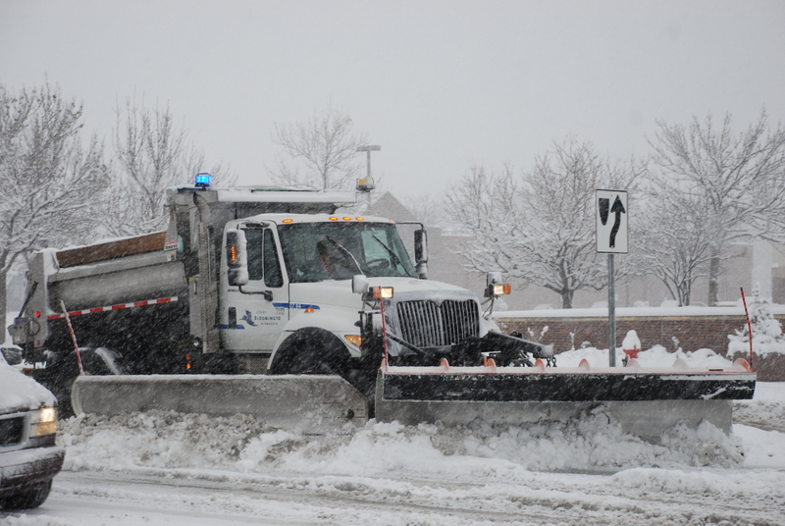
Reactive strategies
Anything we do after the
roads become icy or snowy
Scraping
Plowing
Sanding
De-icing
Notes:
Reactive strategies are things we do once our roads have snow or ice on them. Typically de-icing strategies are more costly and less efficient than proactive strategies.
Examples of reactive strategies include de-icing, plowing, scraping, blowing, sanding. These are things we do when we are trying to recover our roads.
Any time we can be more proactive we can lessen our work in these areas. It should be stressed that reactive measures cost the public much more than just money, and that reactive vs. proactive cost commuter’s time, and more important personal injuries because the inability to get out in front of the storm.
Photo credit: Fortin Consulting Inc.

Slide 15
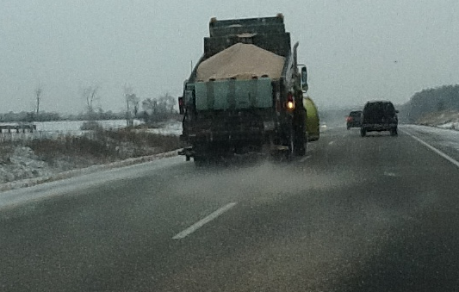
Reactive strategies
Costs us quite a bit in time, money and environmental impacts to make the roads safer!
And are still our largest component of winter maintenance
Notes:
Re-active strategies are more costly than pro-active strategies. For example if I check and change the oil in my vehicle on a regular basis I have a small and regular cost in time and materials. If I blow up my engine because I didn’t check my oil and I ran my vehicle without oil, I have a large expense and a big project ahead of me.
Photo credit: Fortin Consulting Inc.

Slide 16
Test Question
Is plowing and applying salt a proactive or reactive strategy?
Proactive
Reactive
Notes:
Note to presenters: you may choose to hide this slide.
Test Question:
Is plowing and applying salt a proactive or reactive strategy?
Proactive (no)
Reactive (yes)

Slide 17
Test Question
Is plowing and applying salt a proactive or reactive strategy?
Proactive
Reactive
Notes:
Note to presenters: you may choose to hide this slide.
Test Question:
Is plowing and applying salt a proactive or reactive strategy?
Proactive (no)
Reactive (yes)

Slide 18
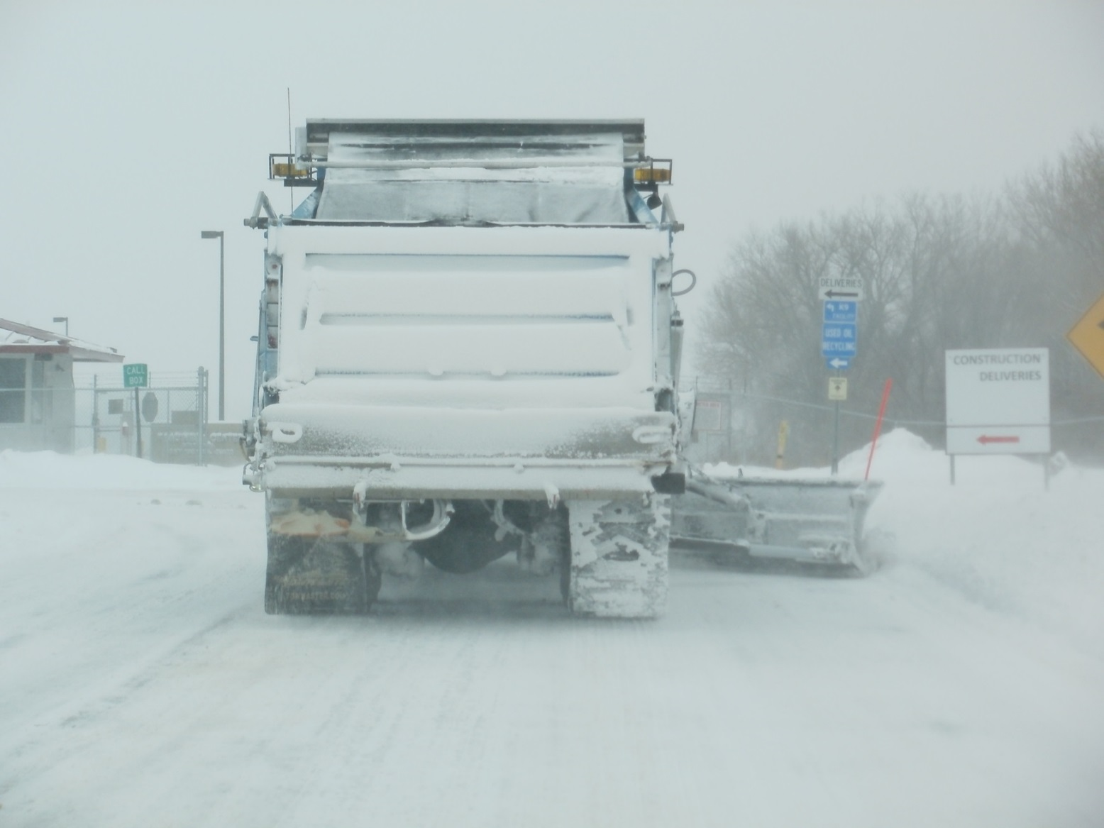
What conditions are appropriate for deicing?
Anytime there is snow or ice on the road, unless your level of service allows it to be there.
Notes:
De-icing strategies vary greatly depending on the variables present. There isn’t a simple chart that can describe what to do at any given time. There are some guidelines that can help steer you in a better direction.
Photo credit: Ramsey County, MN

Slide 19

What conditions are appropriate for deicing?
No easy answer!
It depends on many variables:
Pavement temperature & trend
Type of de-icers
Amount of snow/ice on road
Weather forecast
Level of service target
Wind
.....and so on…..
Notes:
The experience of your leaders is very important in making de-icing decisions; they are familiar with your routes and local weather conditions (lake effect, drifting areas, which bridges freeze first…). This experience combined with the latest innovations in winter maintenance can move your organization ahead!
Some claim that there are 66,000 variables to a snow storm. Whether this number is right or not doesn’t matter; the truth is that winter storms are variable and you have to adjust your game plan based on what the weather throws your way. “One size (or strategy) does not fit all”!

Slide 20
Note to presenters:
Note: Hide this slide before making presentation.
As we go through this next section you can either teach the examples we have or add in your own.
This section would be an excellent class exercise for supervisors who will be making the tough de-icing decisions. It may be an opportunity for them to discuss the contributing factors in de-icing decision making.
Any progress made in this area should be incorporated into application rate or decision-making charts to help them standardize their operations.
Notes:
Note to presenters: As we go through this next section you can either teach the examples we have or add in your own.
This section would be an excellent class exercise for supervisors who will be making the tough de-icing decisions. It may be an opportunity for them to discuss the contributing factors in de-icing decision making.
Any progress made in this area should be incorporated into application rate or decision-making charts to help them standardize their operations.
Hide this slide before making the presentation. To do that, select it in the slide sorter. Then, right click the mouse and select “Hide Slide” at the bottom of the list.

Slide 21
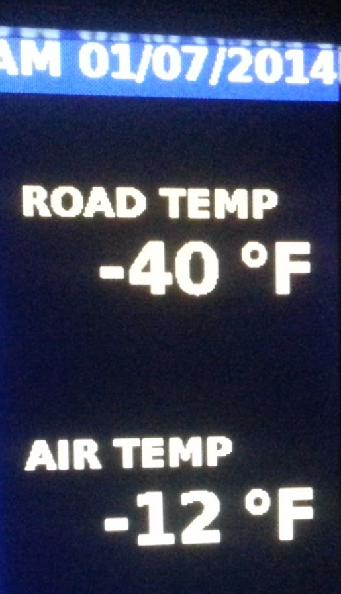
Consider pavement temperature & trend
Examples:
If pavements are 15° and dropping, dry salt is ineffective.
  Integrate liquids
If pavement temperatures are rising and will top 32°.
  Minimum amount of chemical needed (i.e. 50 lbs/mile)
Notes:
One consideration is pavement temperature and trend.
This slide presents a good opportunity for a class discussion or group activity. Based on pavement temperature and trend what should you do or not do. On this slide a few examples are listed. The situations you can come up with are endless.
Also consider the types of pavement. The bridges need more attention than the roads.
Photo credit: City of Grand Rapids, MN

Slide 22
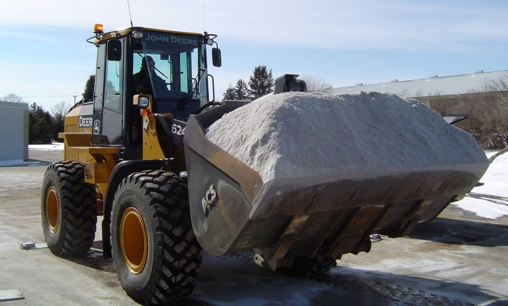
The variety & forms of materials you have determine your options
Example considerations:
If you only have rock salt & winter sand
  You will have a low level of service and will waste material trying to force performance at colder temps.
If you have liquid MgCl₂ or CaCl₂
  You can pre-wet or slurry salt
  on 1° pavements and
  get performance. The higher the liquid ratio, the faster your performance.
Notes:
Note to presenters: This is a great opening for class discussion or break out groups. Ask them to discuss: what types (salt, sand..) and what forms (liquid, granular) of materials do you use, and what could you get to allow more options?
Your materials (de-icers and abrasives) are your tools. You need a variety of types and forms of them in order to use the most effective for the conditions. Sand for when conditions are to cold or too rainy for de-icing. Rock salt for melting power. Salt brine for quick melting on warm days. Brine blends or Mgcl2 or CaCl2 for cold winter days. One tool will not provide you with the flexibility you need to be efficient and effective in winter maintenance.
One more example: If it is 0 degrees and dropping and you only have dry salt or sand, what should you apply? The answer is sand. Salt will not be on your road long enough for it to help you; you must wait until the pavement temperatures warm up. The discussion that could follow this is how do we get better materials so we have something that can melt in colder temperatures.
Note that Module 4: Material Use does a better job of describing the pros and cons of the various materials than the few slides included in this module.
Photo credit: Fortin Consulting Inc.

Slide 23
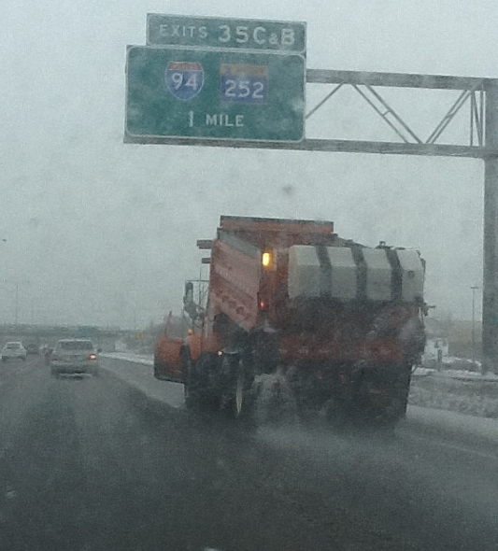
The amount of snow/ice on the road guides your choices
Examples:
Thin layer of ice on 25° degree pavement:
Direct liquid application of salt brine.
It is 10 am, 2 inches of snow on 30° & rising pavement:
Plow, apply minimum amount of chemical
( i.e. 50 lbs/mile) and let the sun assist you.
Notes:
Note to presenters: This is another slide to promote a class discussion or group activity. Based on the type and amount of snow, ice, frost on your roads, what should you do or not do? On this slide a few examples are listed. The situations you can come up with are endless.
One more example: Compacted snow/ice on road, pavement temperatures steady at 20 degrees. Plow with underbody blades, apply pre-wet salt at 20 gallons per ton. Use 200 lbs/mile
The application rates and strategies are up to you but the consistent theme is how do we get our level of service in the most chemically efficient way. Salt is causing us major environmental problems and how we manage our de-icing activities is directly tied into this. In the above example if we can get the same performance using 150 lbs/mile, we should do it. If you are having a class discussion, challenge your audience on how to do it with less chemicals and see what they come up with.
Photo credit: Fortin Consulting Inc.

Slide 24
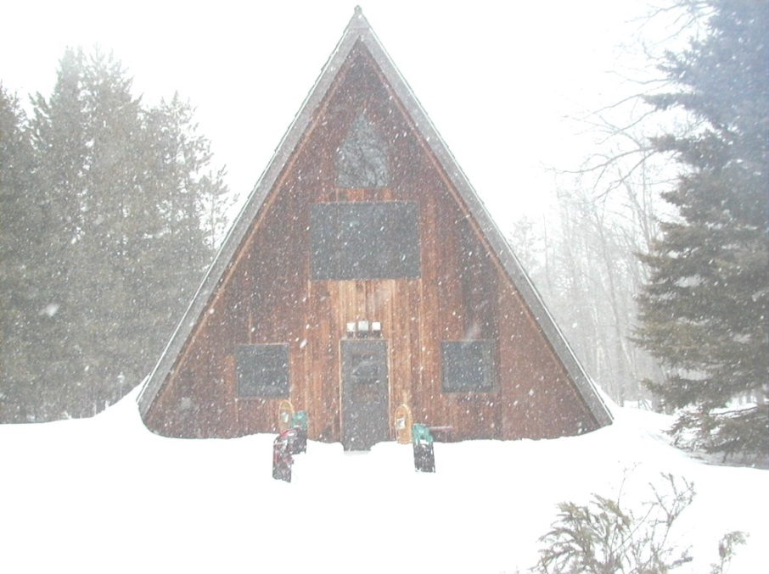
Weather Forecast
Examples:
It is snowing & 10 inches of snow forecast in the next 12 hours:
Plow, spot apply chemical only at critical areas.
It is snowing, we are staying on top of it and it is predicted to stop shortly. Pavement temps are 26°:
Plow, apply pre-wet salt at 100-140 lbs/mile.
Notes:
Note to presenters: This is one more opportunity for class discussion or break out groups.
Ask: How do weather forecasts influence what you are doing as you manage the winter storm? A few examples are given on this slide. Many more examples can be given such as the example of warm weather during the storm with cold temps and high winds moving in. Use scenarios that you have experienced.
The application rate in example is taken from MN Snow and Ice Control field handbook for snowplow operators. This application rate is not necessarily right but merely an example, as we have mentioned many other factors come in to play that should be considered.
Photo credit: Fortin Consulting Inc.

Slide 25
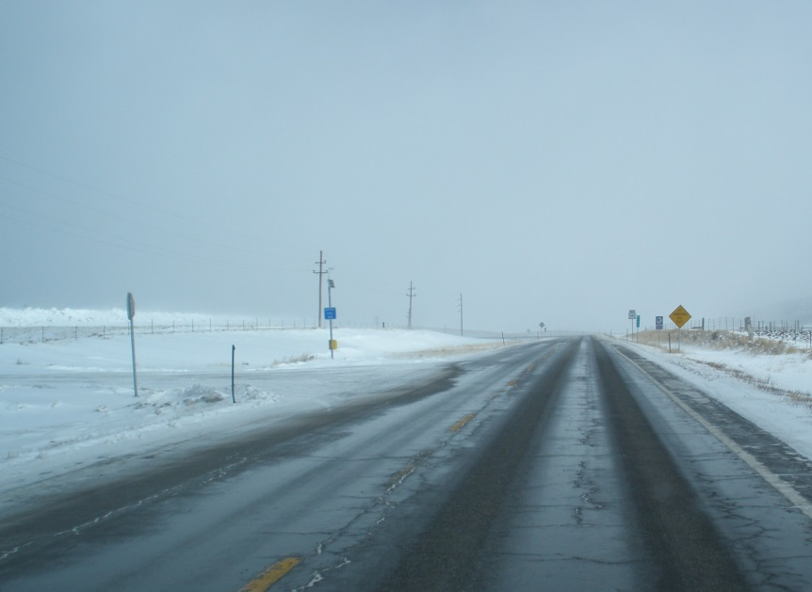
Level of Service
Examples:
Low volume rural roads, snowpack is acceptable:
Sand the intersections, curves, hills & bridges.
High volume, high speed
Interstate. Cannot lose the road:
Pre-wet salt is needed with nearly
every pass.
Notes:
The slide gives examples of how your de-icing operations will change based on your level of service target. Many examples can be given, the best would be examples from your service area.
For group discussion
Ask participants: How does our level of service affect de-icing operations? How can we get this level of service with less chemicals?
Photo credit: Fortin Consulting Inc.

Slide 26

Cycle Time
Examples:
Cycle time 6 hours:
You will need a heavier application
rate that will continue to work after it is diluted by snow melt.
Cycle time 2 hours:
Can put it on sparingly and keep an eye out for areas that need more attention on subsequent passes.
Notes:
This slide gives examples of how your de-icing operations will change based on your cycle time or how often the snow plow operator will be on the same stretch of road. What we want to avoid is to apply de-icers in the amount needed to complete one pass of the route with out running out and without having any left in the truck.
Ask your participants: How does our level of service affect our de-icing operations? How can we get this level of service with less chemicals?
Image credit: Microsoft clipart

Slide 27


Wind and other influences
Examples:
Snow blowing across the freeway. Not sticking to road:
Do not salt.
Snow blowing across freeway sticking to road:
Plow and apply pre-wet salt.
Notes:
The slide gives examples of how your de-icing operations will change based on wind. We do not need to limit it to wind, and could also discuss cloud cover or other influences on our road maintenance.
Figure credit: Microsoft clipart

Slide 28
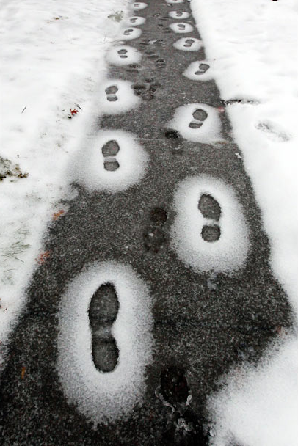
Deicing goal
Meet your level of service goal
As efficiently as possible
With the smallest amount of chemicals
There is not just
one way to do this.
Make your own path!
Notes:
Photo: FCI

Slide 29
Test Question
Is there one strategy for de-icing that we can always follow?
Yes – 300 lbs per lane mile
Yes – Fill up the truck and make your load last 1 pass
Yes – Salt on warm days and sand on cold days
No – there are too many variables
Notes:
Note to presenters: you may choose to hide this slide.
Test Question:
Is there one strategy for de-icing that we can always follow?
Yes – 300 lbs per lane mile (no)
Yes – Fill up the truck and make your load last 1 pass(no)
Yes – Salt on warm days and sand on cold days(no)
No – there are too many variables(yes)

Slide 30
Test Question
Is there one strategy for de-icing that we can always follow?
Yes – 300 lbs per lane mile
Yes – Fill up the truck and make your load last 1 pass
Yes – Salt on warm days and sand on cold days
No – there are too many variables
Notes:
Note to presenters: you may choose to hide this slide.
Test Question:
Is there one strategy for de-icing that we can always follow?
Yes – 300 lbs per lane mile (no)
Yes – Fill up the truck and make your load last 1 pass(no)
Yes – Salt on warm days and sand on cold days(no)
No – there are too many variables(yes)

Slide 31
Test Question
What are our deicing goals?
Meet our level of service
Be as efficient as possible
Use the smallest amount of chemicals
All of the above
Notes:
Note to presenters: you may choose to hide this slide.
Test Question:
What are our de-icing goals?
Meet our level of service (no)
Be as efficient as possible (no)
Use the smallest amount of chemicals (no)
All of the above (yes)

Slide 32
Test Question
What are our deicing goals?
Meet our level of service
Be as efficient as possible
Use the smallest amount of chemicals
All of the above
Notes:
Note to presenters: you may choose to hide this slide.
Test Question:
What are our de-icing goals?
Meet our level of service (no)
Be as efficient as possible (no)
Use the smallest amount of chemicals (no)
All of the above (yes)

Slide 33
What are the appropriate application rates?
No easy answer!
Create an application rate table
  Based on pavement temps & trends.
  Based on the various materials you use.
  Based on the weather conditions.
  Should be populated with the lowest rates that get the job done.
  Continue to refine your table as you get new products & techniques.
We will become more efficient as we
standardize our procedures.
Application rate charts are a good step!
Tip from experienced supervisor: This is a good slide to be used in a pre-storm meeting with operators.
Notes:
Note to presenters: this is a good supervisor slide to be used in a pre-storm meeting with operators (Norm Ashfeld, Retired MnDOT).
Application rate charts can be on the computer, printed out or programmed into MDSS. Application rate decisions should be based on facts, and the more facts we have the better decisions we can make. To start with we need pavement temperature and pavement temperature trend. We need the type of materials you might apply and we need to understand how much of each material we need given the pavement temperature. If we have other facts such as the amount of moisture on the road it can help us make even better decisions.
One common misgiving is that we need enough de-icer to melt everything on the road. This is not what we should be trying to do. Our mission should be to break the bond between the pavement and the snow/ice so we can mechanically remove the snow/ice. If we use application rates large enough to melt everything on the road we are being wasteful of our resources and causing unneeded environmental damage.

Slide 34
Deicing Application Rate Guidelines 24’ of pavement (typical two-lane road)
These guidelines are a starting point Reduce or increase rates incrementally based on your experience.
Pavement Temp. (ºF) and Trend (↑↓) | Weather Condition | Maintenance Actions | Lbs/two-lane mile
 |  |  | Salt Prewetted/ Pretreated With Salt Brine | Salt Prewetted/ Pretreated With Other Blends | Dry Salt | Winter Sand (abrasives)
25-30°↓ | Snow | Plow, apply chemicals | 120-160 | 100-140 | 150-200 | not recommended
 | Frz. Rain | Apply chemical | 160-240 | 140-210 | 200-300 | 400
20-25º ↑ | Snow or Frz. Rain | Plow & apply chemical | 160-240 | 140-210 | 200-300 | 400
20-25 ° ↓ | Snow | Plow and apply chemical | 200-280 | 175-250 | 250-350 | not recommended
 | Frz. Rain | Apply chemical | 240-320 | 210-280 | 300-400 | 400
15-20º ↑ | Snow | Plow & apply chemical | 200-280 | 175-250 | 250-350 | not recommended
 | Frz. Rain | Apply chemical | 240-320 | 210-280 | 300-400 | 400
15-20º ↓ | Snow or Frz. Rain | Plow and apply chemical | 240-320 | 210-280 | 300-400 | 500 for frz. rain
0 to 15 º ↓ ↑ | Snow | Plow, treat with blends, sand hazardous areas | not recommended | 300-400 | not recommended | 500-750 spot treat as needed
<0 º | Snow | Plow, treat with blends, sand hazardous areas | not recommended | 400-600 | not recommended | 500-750 spot treat as needed
Note to presenters: insert your application rate table here.
Delete this yellow box before making presentation.
Notes:
This chart is taken from Minnesota Snow and Ice Control Field handbook for snowplow operators 2012 (see additional resources for link to this chart). Insert your own application rate table here, and delete this yellow box before making presentation.

Slide 35
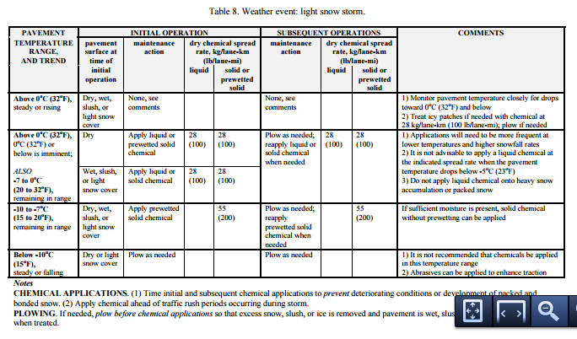
Example: Federal Highway Administration guidelines has a series of application rate charts in Appendix C
Notes:
These charts were published in 1996. Online link: http://www.fhwa.dot.gov/publications/research/safety/95202/95202.pdf
They have scenarios for light snow storm, light snow storm with period(s) of moderate or heavy snow, moderate or heavy snow storm, frost or black ice and freezing rain. Clear Roads looked at updating these charts in 2012 by assembling a team of experts. It was decided after much study to leave the charts as is and not change them at that time.

Slide 36
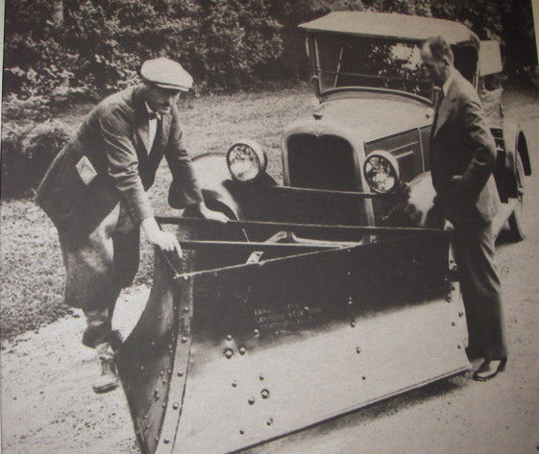
What we don’t want:
Old school thinking:
Fill up the truck, spread it evenly over the route so when we come back to the shop the truck is empty.
Repeat for all conditions.
Notes:
This slide shows a common practice, but it should no longer be used. We need to calibrate our equipment, develop application rate charts and apply the right type and amount of chemical to do the job.
If this “old school” method is used in your operation you have a big opportunity to make changes to improve your performance.
Photo: Source unknown, FCI took a picture of this hanging on the wall in someone's shop.

Slide 37
Test Question
Should we have an application rate table that we follow?
Yes – based on pavement temps
Yes – based on air temps
Yes – based on dew point
No – fill up the truck and spread it evenly on your route
Notes:
Note to presenters: you may choose to hide this slide.
Test Question:
Should we have an application rate table that we follow?
Yes – based on pavement temps (yes)
Yes – based on air temps (no)
Yes – based on dew point (no)
No – fill up the truck and spread it evenly on your route(no)

Slide 38
Test Question
Should we have an application rate table that we follow?
Yes – based on pavement temps
Yes – based on air temps
Yes – based on dew point
No – fill up the truck and spread it evenly on your route
Notes:
Note to presenters: you may choose to hide this slide.
Test Question:
Should we have an application rate table that we follow?
Yes – based on pavement temps (yes)
Yes – based on air temps (no)
Yes – based on dew point (no)
No – fill up the truck and spread it evenly on your route(no)

Slide 39
Recommendations for the use of liquids in deicing
Liquids are fast acting and stay on target.
Granular products have more melting power.
Abrasives provide temporary traction.
Understand how your tools work
Mix and match them to meet the needs of your road conditions.
Notes:
More information on materials is available in Module 4: Material use

Slide 40

Applying dry salt is not a recommended practice
As we become more efficient and effective in de-icing we look for ways to reduce waste
Dry salt applications work, but there are better ways to get the same results.
Dry salt applications are wasteful of salt, much of it bounces off of the road.
  If you are using dry salt, re-examine your plowing policy, your anti-icing policy and your deicing policy. One or all might need to be updated.
Notes:
Liquids added into dry salt allow us to use less and waste less.
Better mechanical removal strategies will leave us with less to melt.
Anti-icing before an event can reduce the bond and the amount of chemicals needed to clear the road.
If you are still using dry salt as your primary tool, it is time to look at how much salt you use and how you can lower it.
Figure credit: Microsoft clipart

Slide 41
Applying dry salt is not a recommended practice
Applying dry material to dry pavement may result in losing up to 80 percent of the material.
Notes:
Image: Microsoft clipart
http://clearroads.org/wp-content/uploads/Pages_34-39_from_MoDOT_Snow-and-Ice-Training-Participant-Book.pdf
There are better practices for us to follow if we want clear roads and less wasted salt. Applying dry salt is a practice that we are familiar with but it is a practice we should discontinue.

Slide 42
Test Question
Is applying dry salt a recommended practice?
Yes
No
Sometimes
Only when it is too cold for liquids
Notes:
Note to presenters: you may choose to hide this slide.
Test Question:
Is applying dry salt a recommended practice?
Yes (no)
No (yes)
Sometimes (no)
Only when it is too cold for liquids (no)

Slide 43
Test Question
Is applying dry salt a recommended practice?
Yes
No
Sometimes
Only when it is too cold for liquids
Notes:
Note to presenters: you may choose to hide this slide.
Test Question:
Is applying dry salt a recommended practice?
Yes (no)
No (yes)
Sometimes (no)
Only when it is too cold for liquids (no)

Slide 44

  Pre-wet salt works better than dry salt
Salt cannot melt snow & ice…must change phase into a liquid….
Salt
Brine
Brine can melt snow & ice
Notes:
Pre-wet refers to the process of having both liquid and granular on the truck. At application time the liquid is discharged onto the granular and the result is a wet salt applied to the road.
Dry salt cannot melt snow and ice; it must dissolve first. The brine is what can melt snow and ice.

Slide 45

Whenever we add liquids
We improve our performance because salt is slow. Salt needs to move to a liquid state before it begins to work as a deicing agent.
Notes:
Liquids offer us faster performance and more accurate application. See module 5 on pre-wetting for more detailed information on this subject.

Slide 46
  Pre-wet applications
Liquids have the potential to make salt work faster.
Depending on the ratio and the type, they can reduce the bounce and work at colder temperatures.
Salt
Brine
Dry salt is sloooooow……
Notes:
Dry salt is Sloooooow
It cannot melt anything until it has dissolved….so we wait……which costs us time, salt, performance, money, the environment….

Slide 47

Pre-wetting
Typically you can reduce your application rate 30% if you are pre-wetting!
Some report up to 50% savings.
Savings depend on speed of application, ratio of liquid to granular, spread pattern,
material selection and many factors.
Notes:
Refer to Module 5 – Pre-wetting for more information on pre-wetting.
References: MN Snow and Ice Control Field Handbook for Snowplow operators 2012
http://clearroads.org/wp-content/uploads/Pages_34-39_from_MoDOT_Snow-and-Ice-Training-Participant-Book.pdf
Figure credit: Microsoft clipart

Slide 48
Test Question
Is pre-wetting salt almost always recommended?
Yes
No
Notes:
Note to presenters: you may choose to hide this slide.
Test Question
Is pre-wetting salt almost always recommended?
Yes (yes)
No(no)

Slide 49
Test Question
Is pre-wetting salt almost always recommended?
Yes
No
Notes:
Note to presenters: you may choose to hide this slide.
Test Question
Is pre-wetting salt almost always recommended?
Yes (yes)
No(no)

Slide 50
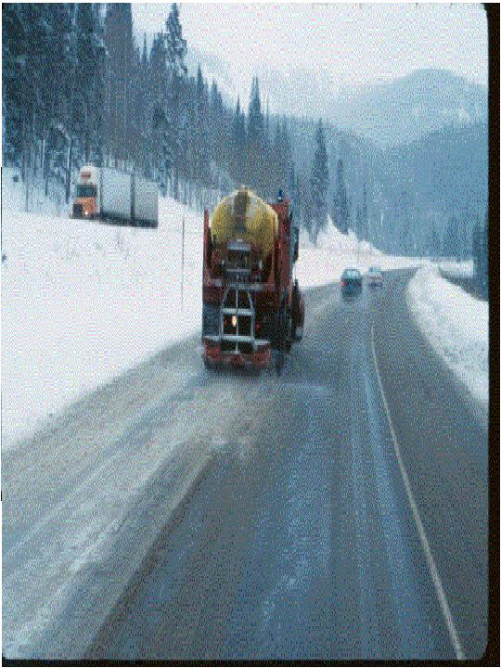
Direct Liquid Application (D.L.A.)
No rock salt
Notes:
This photo from CDOT shows direct liquid application. They recommend for direct liquid application, a rate of 30 to 80 gallons per mile.
Photo credit: CDOT taken from CDOT_Snow-removal-operator-training_slides_112-114_118-120_122.pptx

Slide 51
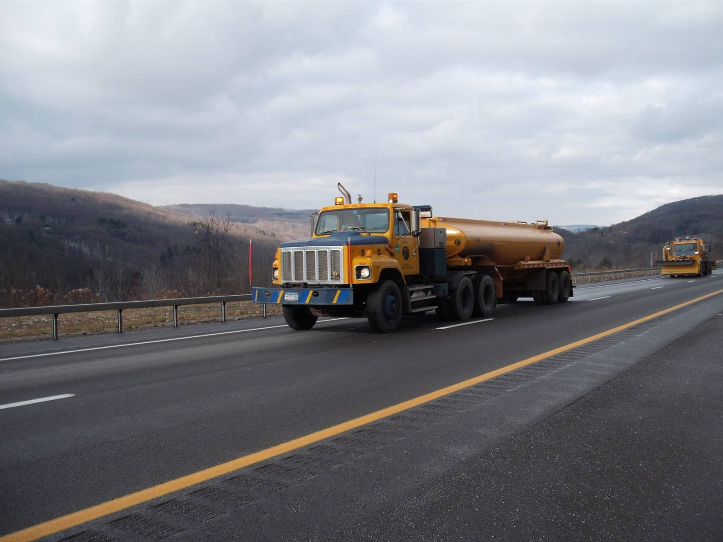
D.L.A. is not for everyone…
Do not use D.L.A. if you do not have significant experience using liquids in other areas of your operation. This is the most difficult of the liquid applications.
Notes:
DLA is the most difficult of the liquid applications because you must be able to get under the snow and ice and melt bottom up. Melting top down with liquids can get you into a difficult situation. Liquids have less melting power and can dilute faster. You don’t want this to happen on top of snow pack.
However it is a growing trend and many organizations have had success with DLA. If you do it right it can be one of the most efficient tools we have.
Photo credit: NYS DOT

Slide 52
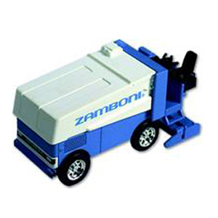
Here’s a tip
Have enough bar pressure to melt holes through snow/ice so the deicer can spread out under it. This breaks the bond.
If you gently spray on top of snow and ice, you will
act like the Zamboni.
Notes:
Liquids can be very effective at breaking the bond between snow/ice and the pavement, but the challenge is to get them beneath the snowpack so they can do their job.
When spread on top of the snowpack, liquids are ineffective and can cause melt and refreeze unless they are applied in large enough quantities to melt everything on the road.
Figure credit: Microsoft clipart

Slide 53

Best use of direct liquids
Liquids are the best tool for a thin layer of ice or frost
Notes:
Liquids applied before a frost event can prevent the road from becoming slippery, but this is discussed in Clear Roads training Module 8: Anti-icing and Module: 17: Bridge Frost
If you did not anticipate frost, freezing rain, or black ice and you have a thin layer of frost or ice on your road, direct liquid application is the smartest choice. There is not enough moisture on the road to dissolve road salt; it will bounce off the road with out doing anything. Liquids applied will immediately resolve the situation with the least amount of material and the shortest amount of time.
Figure credit: Microsoft clipart

Slide 54
Pros and cons of liquid only applications
Can ice up the road if you do not penetrate and melt from beneath
Have no granular for problem areas on board
Less melting power
Less environmental harm
Tricky to use
Works fast
Less waste
Costs less
Cons
Pros
Notes:
This chart illustrates only a few of the pros and cons. Because there is less waste with liquids we can draw the conclusion that there is less environmental harm because we need fewer materials to get the job done.
Using direct liquids successfully requires a different approach than applying rock salt. Care must be taken to penetrate through the snow or ice and reach the pavement or you may create a slippery road.
Doing a liquid-only application is typically done with a tanker truck not a dump truck. Because of this you are limited to the liquid. It may be on your route that it would be better to put down a pre-wet mixture in places of more compaction but you will not have the option.
Note to presenters: This would be a good slide to discuss with supervisors as they should be able to talk about the successes, failures, road blocks or fears they have with Direct Liquid Applications.

Slide 55

Build a winning team
Before the storm or before the shift meet to discuss the game plan.
Communicate and adjust during the storm.
Review after the storm what worked, what didn’t work.
*Involve everyone*
It’s just like playing baseball!
Prepare for the game.
Play the game, making adjustments as needed
  move the outfielders in for batter #7
Next day, at practice, the coach goes over what did and didn’t work in your game.
  Make adjustments for the next game. (Stop stealing second with lefty pitcher, need to hit the cut off better)
Geared towards building a winning team.
Notes:
It is true that all storms are different. That being said, our operations will improve faster if we take the time to evaluate how we performed during an event and make the necessary adjustments. By involving everyone in this process, not only do we have more information to work with but we increase understanding and buy-in of the operators.
Figure credit: Microsoft clipart

Slide 56
Test Question
What is the purpose of a post-storm review?
To review your effectiveness in last storm event
To discuss problems
To discuss successes
To come up with a better plan for future events
Notes:
Note to presenters: you may choose to hide this slide.
Test question:
What is the purpose of a post-storm review?
To review your effectiveness in last storm event(no)
To discuss problems (no)
To discuss successes(no)
To come up with a better plan for future events (yes)

Slide 57
Test Question
What is the purpose of a post-storm review?
To review your effectiveness in last storm event
To discuss problems
To discuss successes
To come up with a better plan for future events
Notes:
Note to presenters: you may choose to hide this slide.
Test question:
What is the purpose of a post-storm review?
To review your effectiveness in last storm event(no)
To discuss problems (no)
To discuss successes(no)
To come up with a better plan for future events (yes)

Slide 58

Importance of Record Keeping
Keep records of materials, quantities, treatments and effectiveness.
This helps you know what is and isn’t working, and where efficiency can be improved.
Notes:
Record keeping is important as a means of material accountability, budgeting/cost tracking, performance tracking, support in the event of legal actions, media inquiries, and planning.

Slide 59
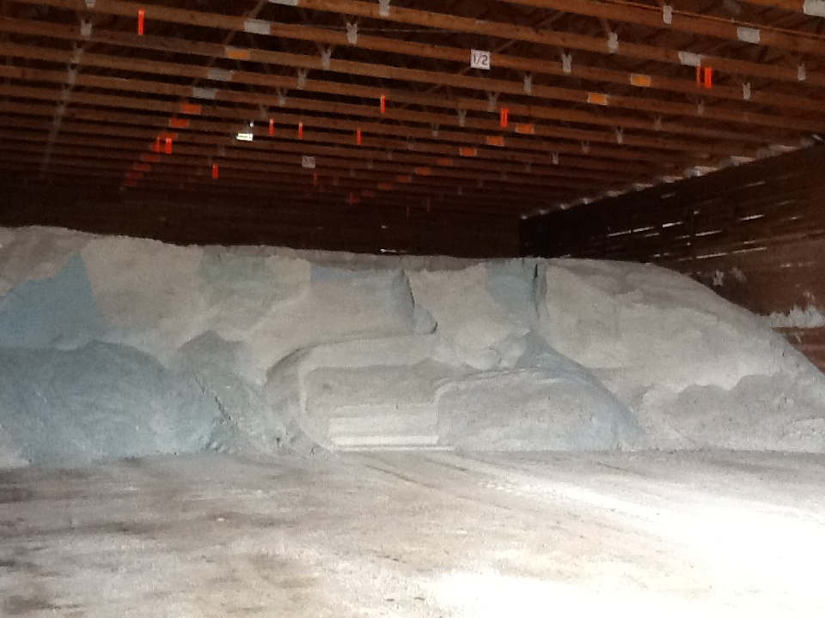
Material Accountability
Know how much you have
Know how much you use
Notes:
It is important to know how much salt you start with, how much you have throughout the season and how much salt you use. Knowing this helps with evaluating salt application efficiency, and for predicting order numbers in the future.

Slide 60
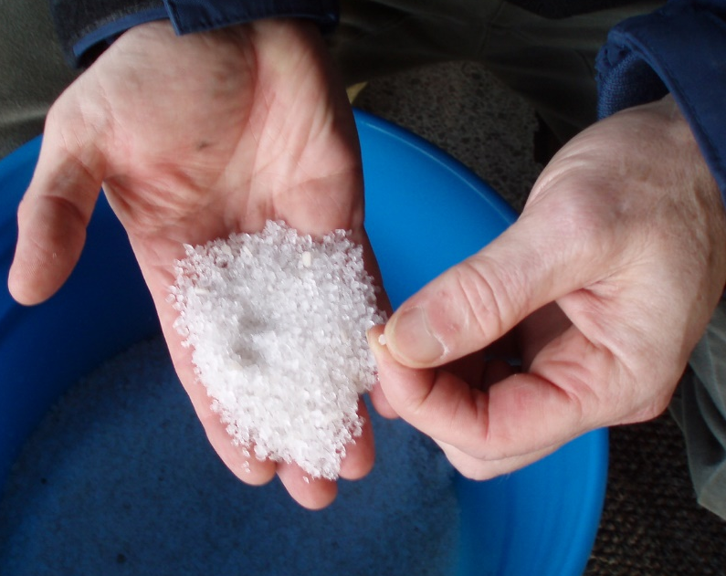
Record Keeping and Quality Control
Test the materials
Solids- test the moisture content
Liquids- test the specific gravity
Check that you get what you ordered
Keep accurate records on quantities ordered, received and used
If you see something wrong, tell your supervisor
Quality Control is vital
Notes:
Quality Control is vital. Every experienced user will inform you just how vital it is. If you do not have a quality control process in place, you can receive very different materials. This translates into effective vs. ineffective operations, environmental contamination, handling difficulties, equipment issues, and on and on.
Test the materials as shown here:
Solids- test the moisture content
Liquids- test the specific gravity
Check that you get what you ordered
Keep accurate records on quantities ordered, received and used
If you see something wrong tell your supervisor
If test results don’t meet the requirements for material ordered, we can reject the delivery.
Note: More information can be found in Module 10 Deicer Agent Management Policy.
Slide credit: CDOT Snow Removal Operator Training

Slide 61
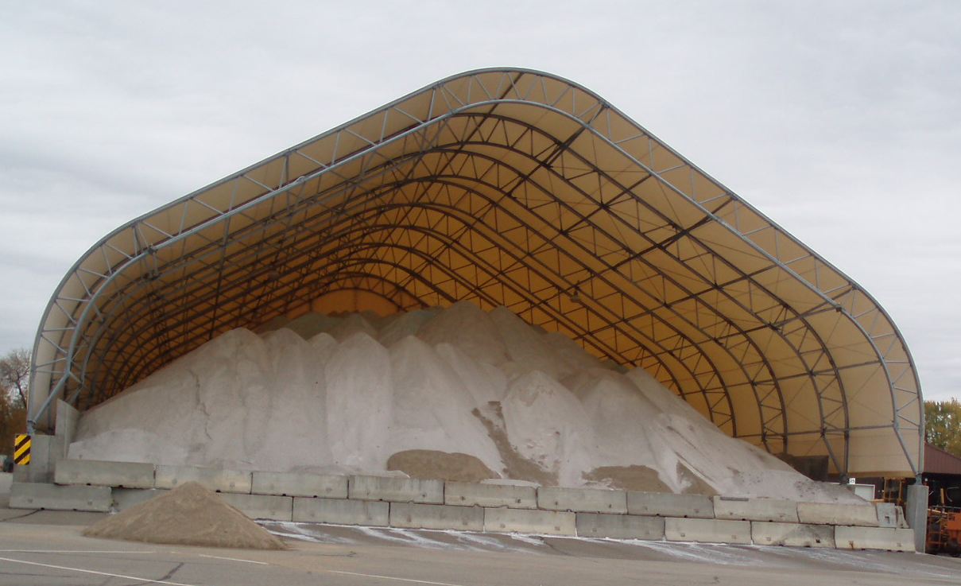
Record Keeping and Quality Control
Take a small sample from each load
  Weigh it as soon as you take it
  Remove the water, weigh it again
  Determine % moisture
  Compare to your spec
  Record results
  Take appropriate action
For less dispute, use a lab testing service or established DOT lab.
Notes:
Reference: Minnesota Snow and ice control field handbook for snowplow operators explains how to do this step by step. (Pg 23-25)
Find it online at this link:
http://www.lrrb.org/media/reports/200501REV.pdf
You can do testing yourself or if you want the results to be less disputed, enlist the help of professional services within our outside of your organization.
Photo credit: Fortin Consulting, Inc.

Slide 62
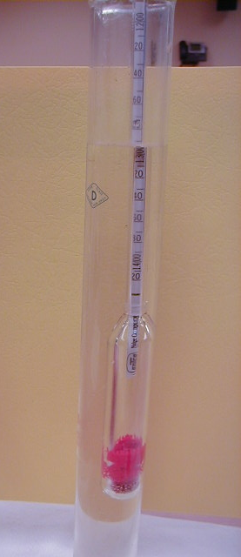
Record Keeping and Materials Testing
  Liquids: specific gravity
  Document % and compare to specification
  Don’t use it if it doesn't match the specification
Insert your state’s policy here. Delete this yellow box before making presentation.
Notes:
If the specific gravity doesn’t match the spec, there’s no way to know the temperature at which it will freeze on the road.
Note: There is more about material testing in Module 10 Deicer Management Policy.
Note to presenters: If you have a form or policy regarding record keeping for materials testing, include that information here (you could insert a photo of the cover of your document as an example).
Delete this yellow box before making presentation.
Photo credit: Fortin Consulting, Inc.

Slide 63
Test Question
True or False: It is important to test and record the concentration of your solution when making brine.
True
False
Notes:
Note to presenters: you may choose to hide this slide.
Test Question: Is it important to record the concentration of your solution when making brine?
a. True (yes)
b. False (no)

Slide 64
Test Question
True or False: It is important to test and record the concentration of your solution when making brine.
True
False
Notes:
Note to presenters: you may choose to hide this slide.
Test Question: Is it important to record the concentration of your solution when making brine?
a. True (yes)
b. False (no)

Slide 65
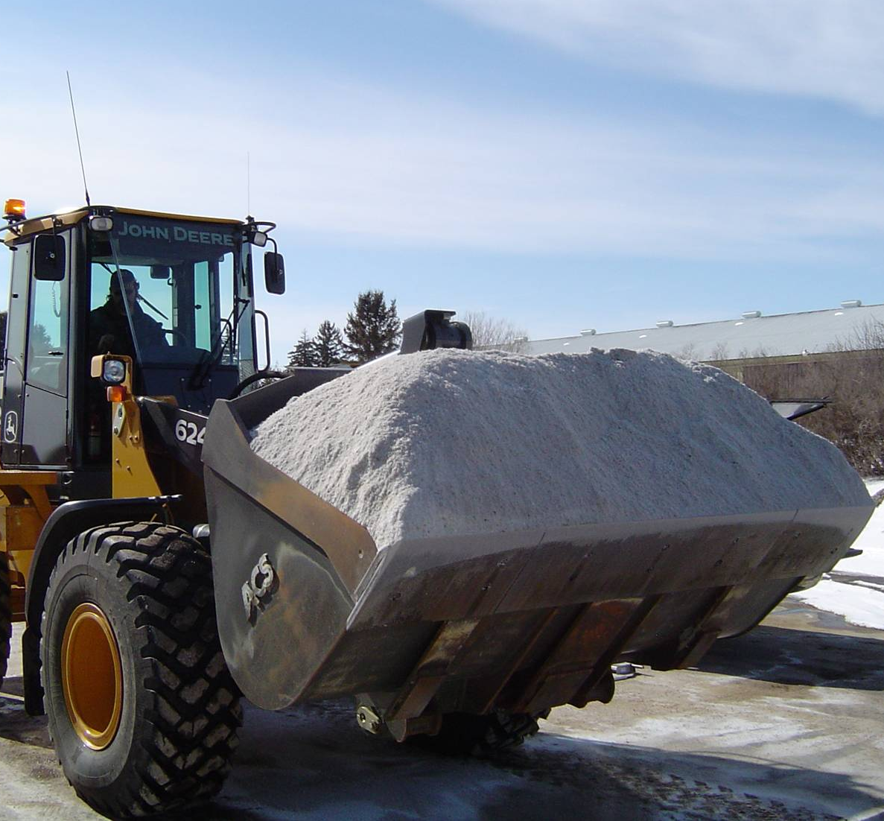
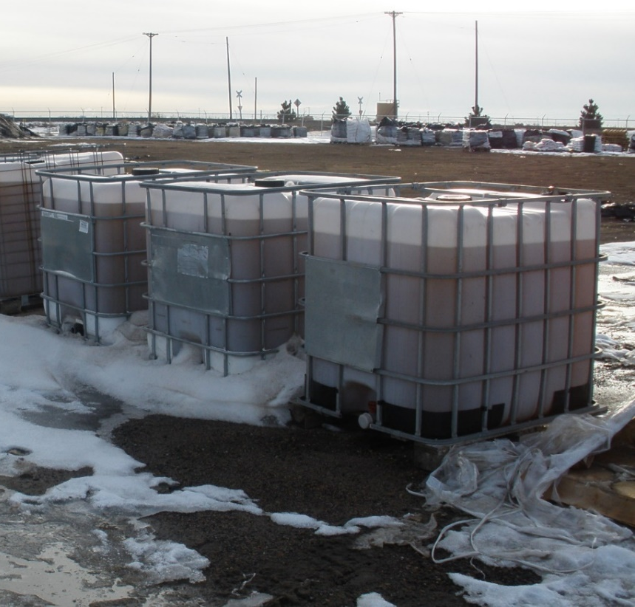
Track by Material Type
Solids
Liquids
Record any time you load, apply, or replace material.
Notes:
It is important to know both what materials and the total of each that were used. This can help to predict the amount needed for future seasons as well as help in evaluating how well treatment went for an event.
Photo credits: Fortin Consulting, Inc.

Slide 66
Test Question
Which items should be tracked?
Material use per storm
Material use per season
Material use per crew member
All of the above
Notes:
Note to presenters: you may choose to hide this slide.
Test question: Which items should be tracked?
Salt use per storm (no)
Salt brine use per season (no)
Winter sand use per crew member (no)
All of the above (yes)

Slide 67
Test Question
Which items should be tracked?
Material use per storm
Material use per season
Material use per crew member
All of the above
Notes:
Note to presenters: you may choose to hide this slide.
Test question: Which items should be tracked?
Salt use per storm (no)
Salt brine use per season (no)
Winter sand use per crew member (no)
All of the above (yes)

Slide 68
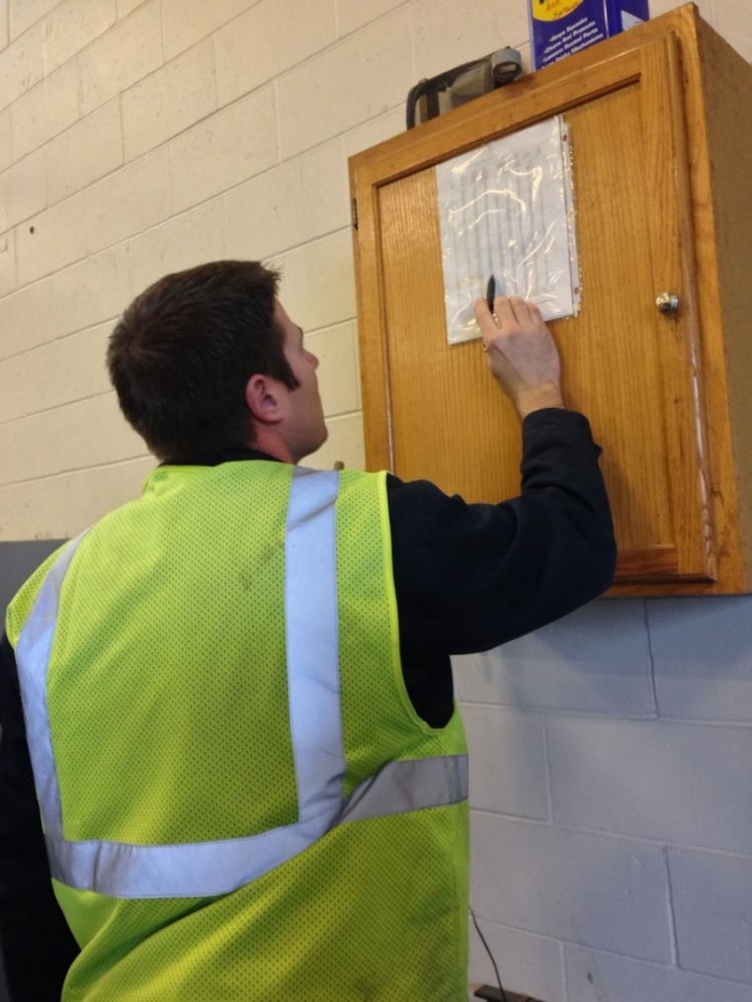
Recording Material Use
Keep track of driver use for insight into:
Individual storms
Each product totals
Winter season total
Leftover product totals
Notes:
You should record several different levels of material use by driver. Combine all this data for insight into individual storms, the winter season total, and what is leftover to store for the next season.
Having all this information helps in evaluating the efficacy of individual storm treatments went, how the whole winter went, and helps in next seasons ordering. It can also help in proving that policy is being followed if a lawsuit is brought against you.
Photo credit: Fortin Consulting, Inc.

Slide 69
Storm Documentation
EXAMPLE:
Work orders
Patrol log
Material usage log
Equipment work orders
Fuel logs
Time sheets
Diary
TAPER log
Customize this slide for your operation
Insert a list of forms needed to be completed by operators for a storm. Delete this yellow box before making the presentation.
Notes:
Review the storm documentation needed for your agency.
Note to presenters: Insert a list of forms needed to be completed by operators for a storm here. Delete this yellow box before making presentation.
Slide credit: CDOT Snow Removal Operator Training

Slide 70
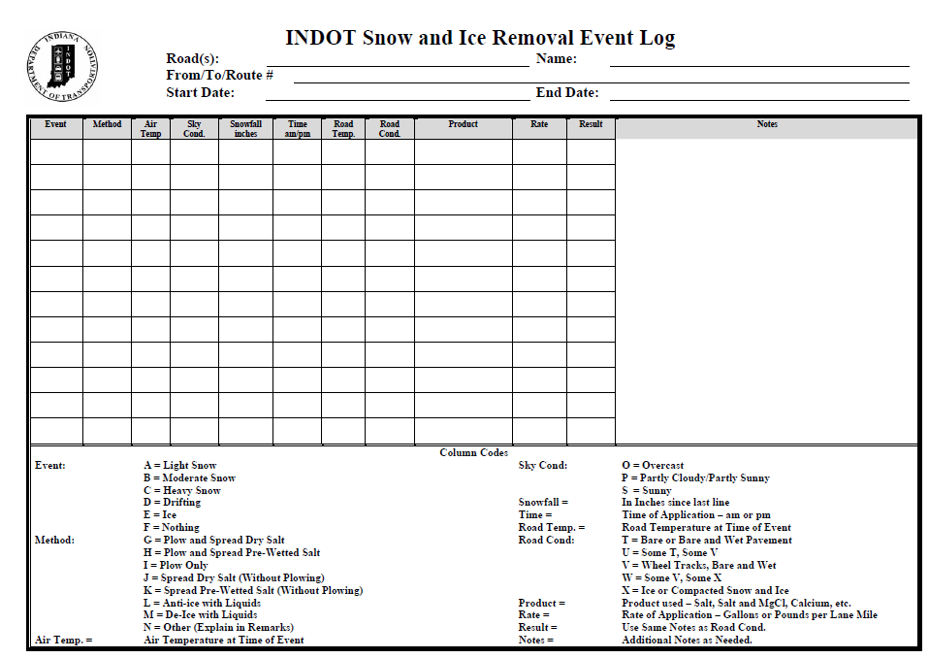
Document Your Operations
EXAMPLE:
Conditions- weather and road, pavement temp
Material type and quantity used
Timing
# of passes and when
Unusual conditions/circumstances
Customize this slide for your operation
Insert an example of your state’s event log and explain how to fill it out. Delete this yellow box before making the presentation.
Notes:
It is very important that plow drivers document the actions taken in response to a snow/ice event
This will include the road conditions throughout their shift, type and amount of deicer or anti-icer used, timing of operations, and the number of passes and when. If there are unusual conditions that affect the operations, those should be recorded. For example, road construction, accidents, major compaction problems, etc.
Note to presenters: Insert a copy of your state’s event log and explain how to fill it out. Delete this yellow box before making presentation.
Photo credit: INDOT

Slide 71
Example: T A P E R
T = Temperature
A = Application
P = Product
E = Event
R = Results
Notes:
Use this slide if your state uses the TAPER system to help explain. Hide this slide if it doesn’t use the TAPER system.
Slide credit: CDOT Snow Removal Operator Training

Slide 72
Event Log
Insert an example of your state’s event log. Delete this yellow box before making presentation.
Customize this slide for your operation
EXAMPLE
Notes:
Review this sequence of events as illustrated on this report, pay particular attention to the changes that took place in the highlighted entries. Note that this TAPER log really paints a good picture of what was done, when it was done, how it was done, who did it with what and what the outcome was like. If you had this information coming on to shift, would you really even need to talk to the person you are relieving?
Note to presenters: Insert an example of your state’s event log here. Delete the yellow box before making presentation.
Slide credit: CDOT Snow Removal Operator Training

Slide 73
Test Question
What should you record during the storm?
Type of product used
Application rate
Pavement temperature
All of the above
Notes:
Note to presenters: you may choose to hide this slide.
Test question: What do you need to record for the TAPER log?
Product (no)
Results (no)
Temperature (no)
All of the above (yes)

Slide 74
Test Question
What should you record during the storm?
Type of product used
Application rate
Pavement temperature
All of the above
Notes:
Note to presenters: you may choose to hide this slide.
Test question: What do you need to record for the TAPER log?
Product (no)
Results (no)
Temperature (no)
All of the above (yes)

Slide 75

A job well done is a job well documented
Filling out paperwork is important because it:
Shows that you follow policy
Improves efficiency of operations
Helps with planning
Notes:
Presenters: give a pep talk here! Everyone knows that filling out paperwork during or at the end of a long shift can be hard to be motivated to do, but it is very important because it:
Shows that you follow policy
Improves efficiency of operations
Helps with planning

Slide 76
Test Question
When you’ve been working all night and you’re tired, do you still have to fill out your paper work?
No
Yes
Notes:
Note to presenters: you may choose to hide this slide.
Test question: When you’ve been working all night and you’re tired do you still have to fill out your paper work?
No (no)
Yes (yes)

Slide 77
Test Question
When you’ve been working all night and you’re tired, do you still have to fill out your paper work?
No
Yes
Notes:
Note to presenters: you may choose to hide this slide.
Test question: When you’ve been working all night and you’re tired do you still have to fill out your paper work?
No (no)
Yes (yes)

Slide 78
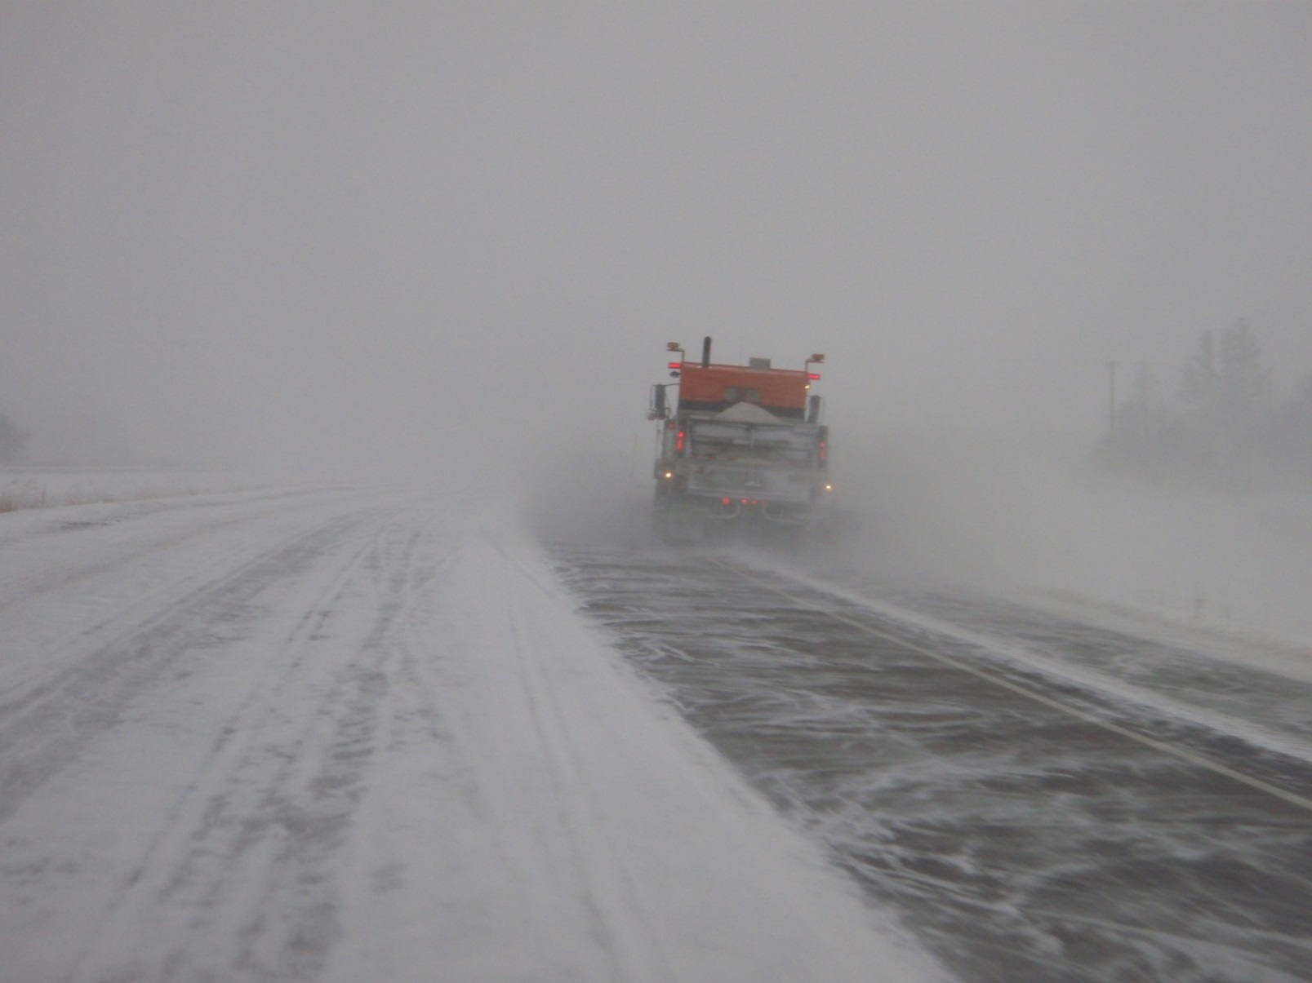
Deicing is the heart and soul of winter maintenance
Continue to look for new and better ways to meet your level of service in the most efficient way.
Strive to use less chemicals in deicing!
You can do it!
Notes:
More accurately providing good winter driving conditions through proper winter maintenance techniques is the heart and soul of winter maintenance.
Photo credit: Fortin Consulting Inc.

Slide 79

“What we need are critical lovers of America - patriots who express their faith in their country by working to improve it.” ~Hubert H. Humphrey
Notes:
Everything we do on the road benefits or weakens the country we live in. By giving our best performance and continuing to push ourselves forward in the pursuit of improved winter maintenance with less chemicals, we will protect our country and those living in it.
Figure credit: Microsoft clipart

Slide 80
Additional Resources
AASHTO, Clear Roads Computer Based training:
  Deicing: Unit 5 Application Guidelines
FHWA MANUAL OF PRACTICE FOR AN EFFECTIVE ANTI-ICING PROGRAM
Note: Although this is titled anti-icing it has a lot of information on de-icing, especially Appendix C. http://www.fhwa.dot.gov/publications/research/safety/95202/95202.pdf
Michigan Winter Maintenance manual
http://miwintermaintenance.weebly.com/uploads/1/7/1/6/17161926/aftertheevent_mi_winter_maintenance_manual_2013.pdf
Minnesota Snow and Ice Control field handbook for Snowplow Operators.
http://www.mnltap.umn.edu/publications/handbooks/documents/snowice.pdf
Clear Roads training modules
  Module 3- Spreaders
  Module 16 – Weather
  Module 8 – Anti-icing
  Module 4- Material Use
  Module: 17: Bridge Frost
  Module 5: pre-wetting

Slide 81
Acknowledgements
Training contents were developed by Fortin Consulting Inc., under the direction of the Clear Roads Advisory Team.
Connie Fortin – connie@fortinconsulting.com
Professional formatting and training aids were developed by the University of Minnesota, Center for Transportation Studies.
Jim Grothaus – Groth020@umn.edu
Ann Johnson – Johns421@umn.edu
Members of the Clear Roads Advisory Team include:
  Mike Sproul, Dave Wieder, Cliff Spoonemore, Monty Mills, David Frame,
  Mike Lashmet, Clay Adams, Justun Juelfs, and Tom Peters

Slide 82
This presentation was developed with funding from the Clear Roads research program, which brings together transportation professionals and researchers from around the country to drive innovation in the field of winter maintenance.
Find additional information and resources at
http://clearroads.org/

Slide 83
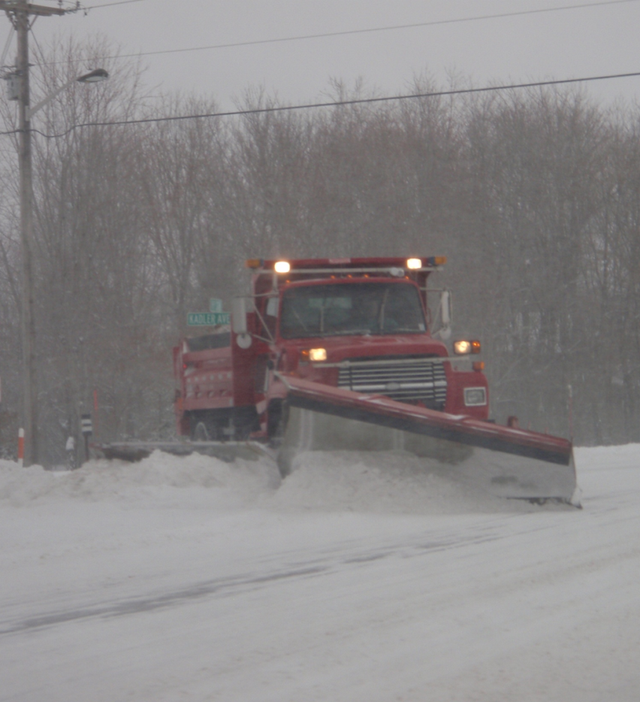
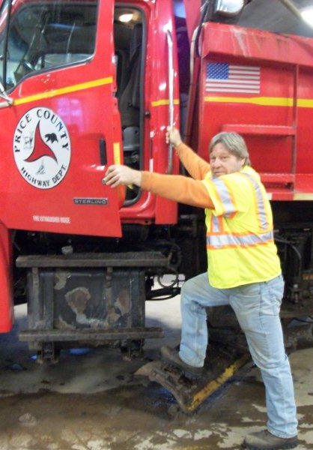
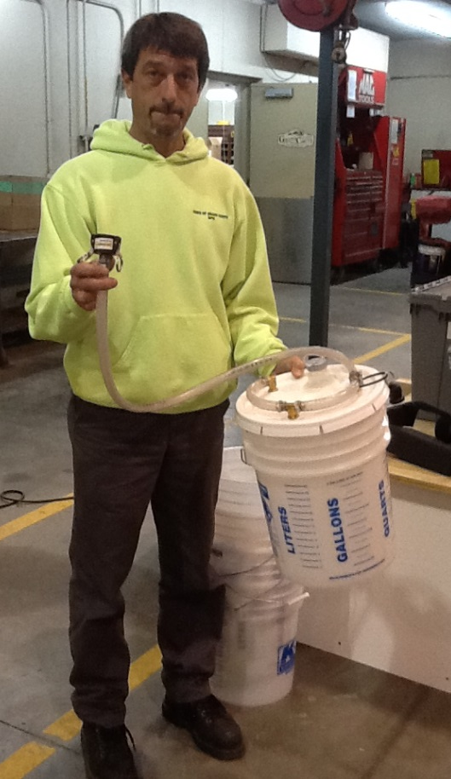
Thank You for Your Good Work!
Notes:
Thank you for your time today. Have a good winter!

