Slide 1
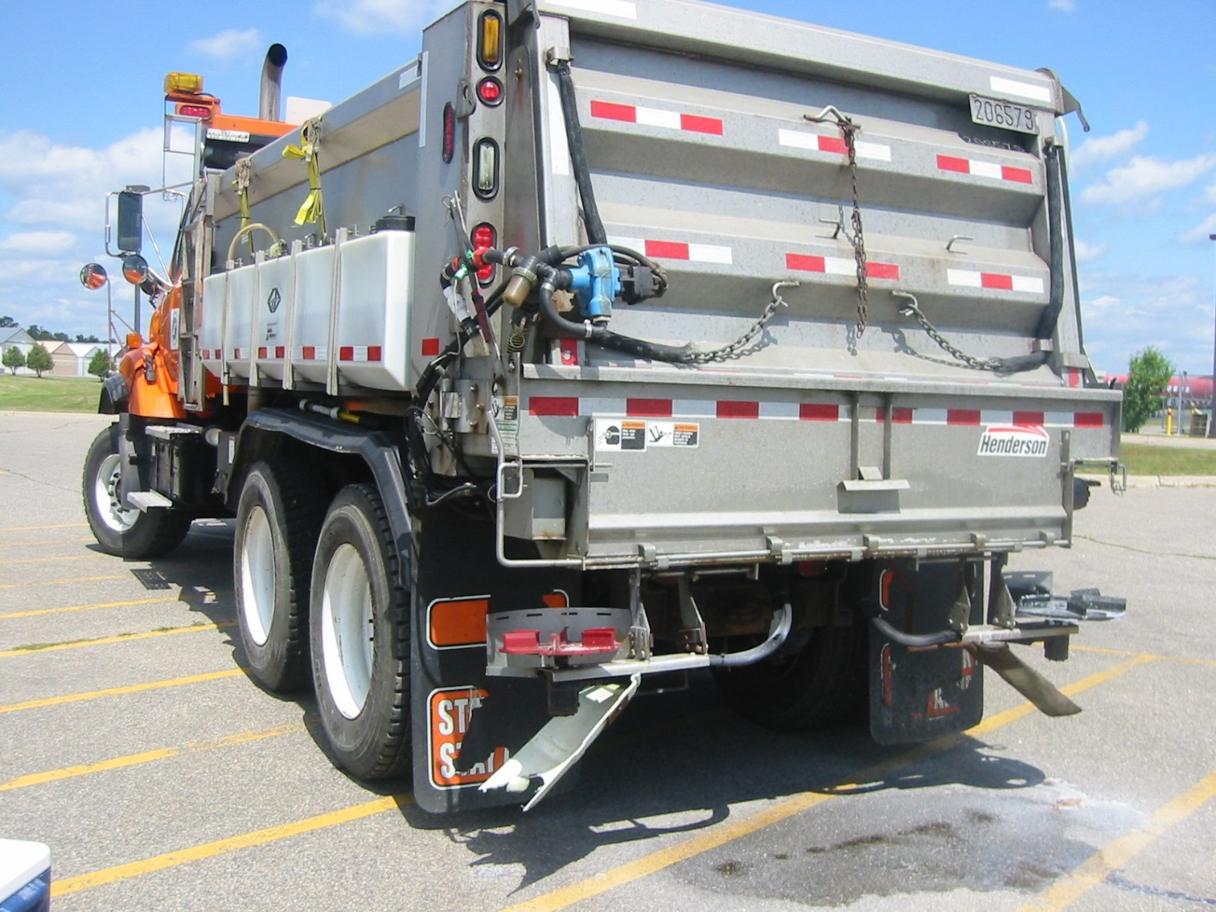

Module 5: Pre-wetting
2016 Created for Clear Roads by:
U of MN Center for Transportation Studies &
Fortin Consulting Inc.

Slide 2
Training for Winter Maintenance Supervisors and Operators
2016 Created for Clear Roads by:
U of MN Center for Transportation Studies &
Fortin Consulting Inc.

Slide 3
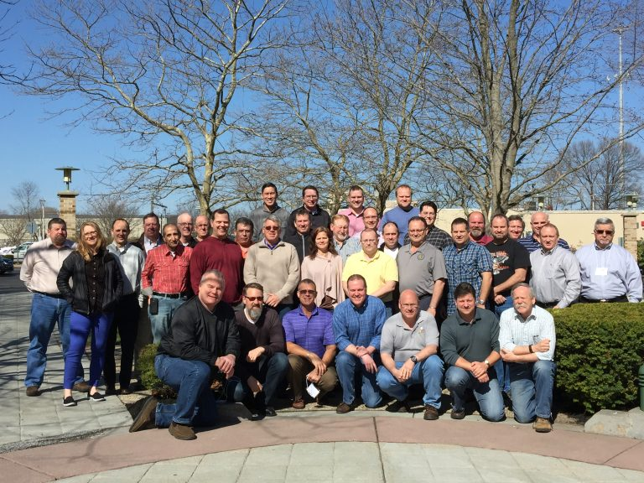
Winter maintenance professionals are a very powerful and important group
Notes:
Photo: clear roads website
Note to presenters: These first 7 slides can be used or hidden.
Or, replace with photos of your staff.

Slide 4
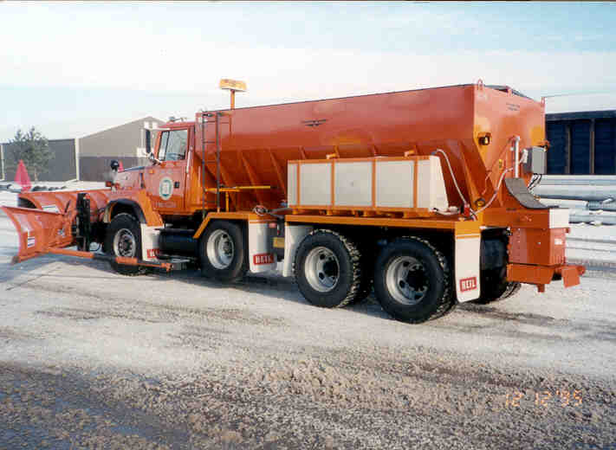
You do a great job of taking care of our roads!

Slide 5
This is one of a series of 22 winter maintenance training modules developed by the Clear Roads Program. All of the modules are available online at www.clearroads.org
Modules include information on the following:
Plowing
Truck operations
Spreading
Material use
Pre-wetting
Brine production
De-icing and anti-icing
Level of service
Ice formation
Freeze point depressants
Environmental issues
Drift control
Weather
Avalanche management
Bridge frost
Safety
Notes:
Note to presenters: The website www.clearroads.org can be accessed here if a live internet connection is available.
A list of all the modules is given here:
Plowing procedures
Truck operations
Spreading
Material use
Pre-wetting
Brine production
De-icing
Anti-icing
Safety
De-icing agent management policy
Level of service
Ice formation
Freeze point depressants
Environmental issues
Drift control
Weather
Bridge frost
Avalanche management

Slide 6

Module 5: Pre-wetting
2016 Created for Clear Roads by:
U of MN Center for Transportation Studies &
Fortin Consulting Inc.

Slide 7
FACILITATOR NOTES (do not show during class)
This is a priority 1 module to be developed for Clear Roads national training. It will address three audiences. Slides can be customized for the audience.
Slide Legend
Entry-level plow drivers
Experienced plow drivers
Supervisors
Notes:
Note to facilitator: do not show this slide during class

Slide 8
This module will contain these topics
Benefits to pre-wetting materials that improve cold weather performance, reduce bounce, scatter, and related strategies to reduce
material use.
Methods of pre-wetting (e.g. on-board spray units, pug mill mixing on site, delivered pre-wet).
Use of saddle tanks for on-board pre-wetting systems.
Notes:
This module covers all of the topics on this slide:
Benefits to pre-wetting materials that improve cold weather performance, reduce bounce, scatter, and related strategies to reduce
material use.
Methods of pre-wetting (e.g. on-board spray units, pug mill mixing on site, delivered pre-wet).
Use of saddle tanks for on-board pre-wetting systems.

Slide 9
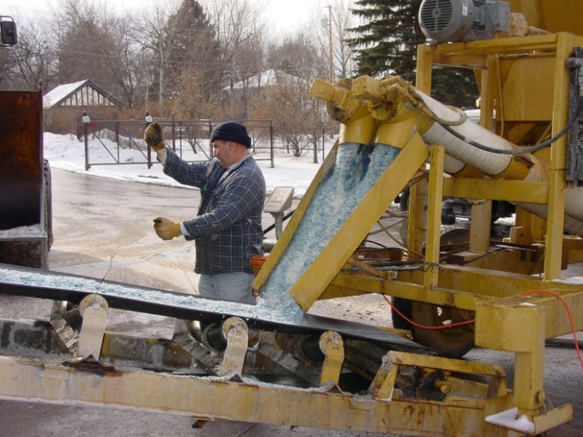
Pre-wetting
The process of adding liquid to dry material before applying it to the road
- rock salt
- sand
Most common liquids used
- Sodium chloride (brine)
- Magnesium chloride
- Calcium chloride
- Organic (i.e. beet juice)
- Brine blends
- often dye is added
The liquid can be added
- at the stockpile
- on the truck
Notes:
“This work is too preliminary to provide any guidance on specific 471 field application practices at this point, but a few practical generalizations may be made:
472 this study supports the qualitative field observations that there is a benefit to be achieved in deicing at temperatures near the salt eutectic (-6 0 F/-21.1 0 473 C) by pre-wetting salt with brines 474 and that enhancement of the ice melting rate of the solid salt is likely an important 475 contributing mechanism,
there may be further benefit that can be achieved by increasing 476 the ratio of pre-wetting brine to salt beyond the commonly used rate of 8 gallons/ton (33.4 477 L/metric ton) at very cold temperatures,
beyond a certain point, more pre-wetting brine is 478 not better – optimal pre-wetting ratios need to be better determined under field conditions, 479 but the benefit in enhancing the ice melting rate of rock salt will be limited to a ratio of brine 480 that permits optimal contact between salt crystals, brine, and ice, and
MgCl2 (and 481 presumably CaCl2) brines are more effective than NaCl brine, and the benefit provided by 482 “hot mixes” of these increases with the percent Mg”
Slide source: “Cargill%20-%20Koefod%202015%20TRB%20Paper%20defusion%20study.pdf”
Photo credits: Upper photo: Fortin Consulting Inc.; Lower photo: Wisconsin DOT

Slide 10
Benefits of pre-wetting materials to improve cold weather performance and speed of melting
Notes:
Benefits to pre-wetting materials to improve cold weather performance and speed of melting will be covered in the next slides.

Slide 11
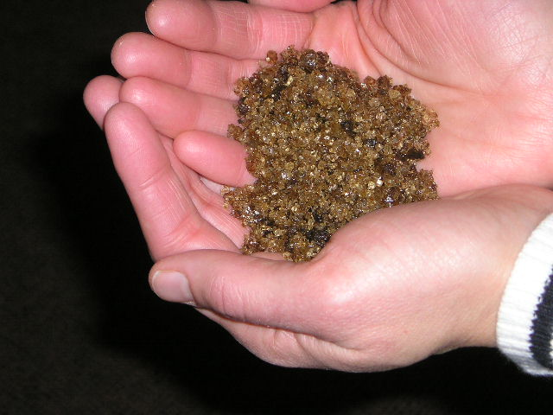
Benefits to pre-wetting materials for a faster performance
Liquids work faster than granular products.
Rock salt can melt down to -6°F, but it melts slower and slower as pavement temperatures drop.
Adding liquid speeds up
rock salt.
Some liquids will speed
up salt more than others
at cold temperatures.
Notes:
Rock salt can melt ice down to pavement temps of -6 but it takes a long time…hours! We can help if melt faster by adding liquid. Not all liquids are equal when giving salt a performance advantage in cold weather. However they all will help some.
Photo credit: Fortin Consulting Inc.

Slide 12
How to get salt to work in the cold
Pre-wetting with salt brine will reduce the time it takes for salt to start melting ice. This is true even at very cold temperatures, but MgCl₂ and CaCl₂ boost it even more.
Dry Salt
Wet Salt
Salt effectiveness in 20 minutes at 5°F
Notes:
Pre-wetting even with plain salt brine will significantly increase the ice melting rate of salt even at very cold temperatures, but MgCl2 and CaCl2 boost it even more” is a quote from Scott Koefod ,Cargill chemist Jan 2015 as he tried to put into very simple terms his very complex research on the subject.
Slide reference: S. Koefod, “Effect of Pre-wetting Brines on the Ice Melting Rate of Salt at Very Cold Temperatures,” Presentation to Transportation research Board 94th Annual Meeting, January, 2015, Washington, D.C. (Note – this paper has been recommended for publication in the Transportation Research Record, but is awaiting final confirmation).
Note to presenters: when you discuss this concept, discuss it in context of relative speed. The real question when it comes to whether salt is “effective” or not is: How fast must it melt ice to be fast enough? As you point out, salt is a very slow ice melter at temps below 0. Based on Scott’s recent lab tests, if a high enough pre-wetting rate is used, you can triple the ice melt rate of salt with plain salt brine even at a temp of -4° F. Keep in mind that you are tripling an ice melt rate that is already very small. Pre-wetting with MgCl2 will make salt melt ice up to 7 times faster. He ultimately prefers to defer to the experience of the winter maintenance professionals regarding specific application rates at a given temperature, but this kind of information can help people understand what their options are and how making adjustments may be able to optimize their results.
Photo: Wisconsin DOT transportation bulletin #22

Slide 13
Test Question
Does wet salt work faster than dry salt?
A. yes
B. no
Notes:
Note to presenters: you may choose to hide this slide.
Test question:
Does wet salt works faster than dry salt
Yes (yes)
no

Slide 14
Test Question
Does wet salt work faster than dry salt?
A. yes
B. no
Notes:
Note to presenters: you may choose to hide this slide.
Test question:
Does wet salt works faster than dry salt
Yes (yes)
no

Slide 15
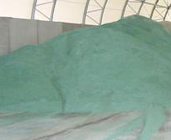
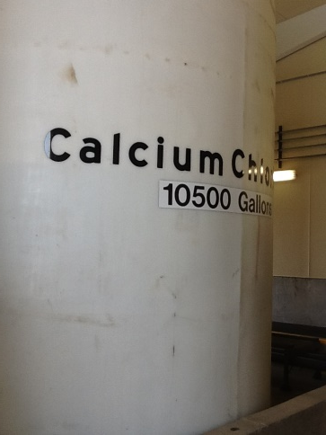
For better performance in very cold weather
Use pretreated salt (6-8 gallons/ton)
and pre-wet the pre-treated salt)
Use MgCl₂ or CaCl₂
instead of brine.
MgCl₂ or CaCl₂ or blend
Notes:
Without changing your set up, you can still improve your cold weather performance. Look to use the highest liquid/granular ratio you can. One way to do that is to double up your pretreated salt and pre-wet it at discharge. This way you don’t need new tanks and you get better results.
Salt brine alone will help some but MgCl2 or CaCl2 will help more.
Photo credit: Fortin Consulting Inc.

Slide 16
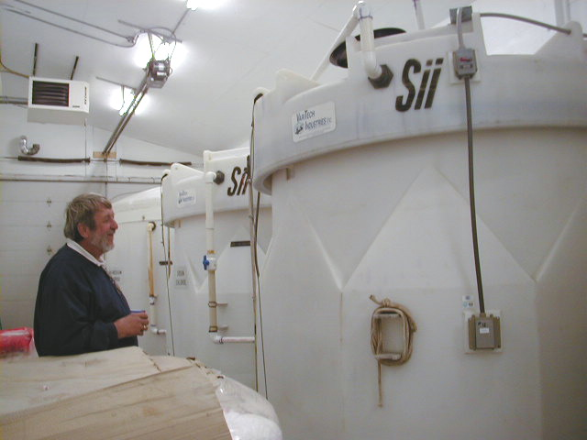
For better performance in very cold weather
Liquids
MgCl₂ or CaCl₂ or blend
Increase liquid ration in pre-wetted salt (30 + gallons/ton).
Use MgCl₂, CaCl₂ or a blend instead of brine.
This is also referred to as “slurry”
*Although we do not know the optimal liquid to granular ratio, it is believed to be over 30 gallons/ton.
It is possible that the optimal liquid to granular ratio will be different at different pavement temperatures.
Notes:
Without changing your set up, you can still improve your cold weather performance. Look to use the highest liquid/granular ratio you can. One way to do that is to double up your pretreated salt and pre-wet it at discharge. This way you don’t need new tanks and you get better results.
Salt brine alone will help some but MgCl2 or CaCl2 will help more.
Photo credit: Fortin Consulting Inc.

Slide 17
Questions that remain
What is the optimal liquid to granular ratio for various pavement temperatures?
What is the optimal liquid to use?
We know at -4°F MgCl₂ works much better than brine.
For other temperatures, will this be true?
Notes:
Scott Koefod, Chemist for Cargill just completed some new interesting research on optimal ratio of liquid/granular products at very cold temperatures (just above rock salts eutectic temperature). Lab tests are good, but they can give different results than field tests. With the lack of information we have on this subject, it is true to say that as an industry we are adjusting on the fly: adding more liquids, changing the liquids, watching to see what is happening. However there is frustration in the industry that we don’t have guidelines.

Slide 18
Test Question
The process of pre-wetting includes:
Adding liquid to rock salt.
Adding liquid to sand.
Adding liquid to brine.
A and B.
Notes:
Note to presenters: you may choose to hide this slide.
Test question:
The process of pre-wetting includes:
Adding liquid to rock salt.
Adding liquid to sand.
Adding liquid to brine.
A and B.

Slide 19
Test Question
The process of pre-wetting includes:
Adding liquid to rock salt.
Adding liquid to sand.
Adding liquid to brine.
A and B.
Notes:
Note to presenters: you may choose to hide this slide.
Test question:
The process of pre-wetting includes:
Adding liquid to rock salt.
Adding liquid to sand.
Adding liquid to brine.
A and B.

Slide 20
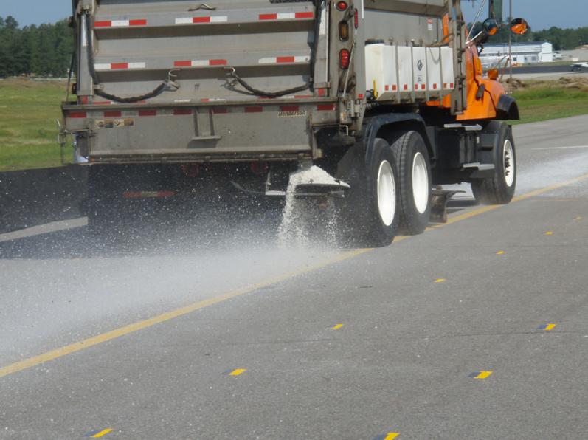
Benefits to pre-wetting materials to reduce bounce and scatter
Wet salt bounces less than dry salt.
The wetter it is, the less it bounces.
Slow driving speeds are the biggest factor in reducing bounce.
Turn the spinner down/off.
35 mph
Dry salt tends to bounce
off of the road before it has the chance to work
Notes:
Photo : City of Grand rapids MN
Many factors influence bounce and scatter, three are listed here:
Use wet salt and the wetter the better as far as bounce goes
Drive as slow as possible when applying salt
Use a narrow spread pattern, turn down or turn off your spinner
On your application rate charts you should have different rates for dry and wet material. No one does this but you could also have different application rates for the speed you are traveling. As you drive faster you lose more salt and you need to apply more salt for the same result. Might be good to make an application rate chart that illustrates this for the crew to see.
For more ideas on how to reduce bounce and scatter see the “spreader” training module.

Slide 21
Test Question
To waste the least amount of salt you should:
Drive slow
Apply wet salt
Turn spinner down or off
All of above
Notes:
Note to presenters: you may choose to hide this slide.
Test question:
To waste the least amount of salt you should:
Drive slow (no)
Apply wet salt (no)
Turn spinner down or off (no)
All of above(yes)

Slide 22
Test Question
To waste the least amount of salt you should:
Drive slow
Apply wet salt
Turn spinner down or off
All of above
Notes:
Note to presenters: you may choose to hide this slide.
Test question:
To waste the least amount of salt you should:
Drive slow (no)
Apply wet salt (no)
Turn spinner down or off (no)
All of above(yes)

Slide 23
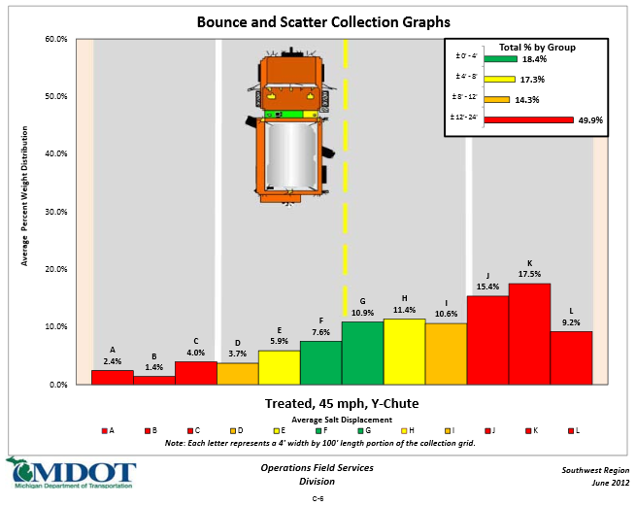
At 45 miles per hour salt doesn’t stay on the road
In GREEN, 18% of the salt stayed on target
In RED, 50% bounced off of the road
http://michigan.gov/documents/mdot/Final_ReportNov2012_404228_7.pdf
Notes:
This example shows 2 tests - one at 25 mph and one at 45 mph. The green in the picture is salt that landed on target, the yellow is salt that stayed on the road but not on target, the red is salt that bounced off of the road.
Graphic credit: Fortin Consulting Inc.

Slide 24
Test Question
Does salt frequently bounce off of the road before it can melt snow and ice?
Yes
No
Notes:
Note to presenters: you may choose to hide this slide.
Test Question:
Does salt frequently bounce off of the road before it can melt snow and ice?
Yes ( yes)
No (no)

Slide 25
Test Question
Does salt frequently bounce off of the road before it can melt snow and ice?
Yes
No
Notes:
Note to presenters: you may choose to hide this slide.
Test Question:
Does salt frequently bounce off of the road before it can melt snow and ice?
Yes ( yes)
No (no)

Slide 26
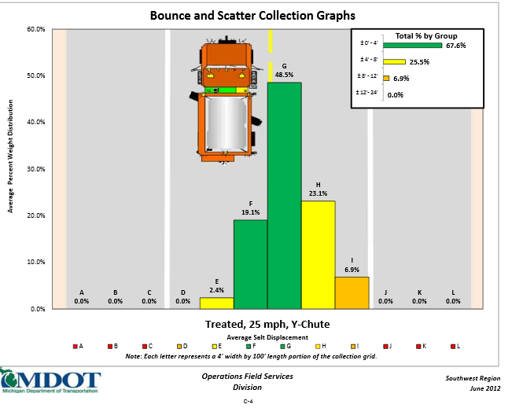
At 25 miles per hour, salt stays on the road
In GREEN, 68% of the salt stayed on target
And none bounced
off the road.
http://michigan.gov/documents/mdot/Final_ReportNov2012_404228_7.pdf
Notes:
This example shows 2 tests - one at 25 mph and one at 45 mph. The green in the pictures is salt that landed on target, the yellow is salt that stayed on the road but not on target, the red is salt that bounced off of the road.

Slide 27
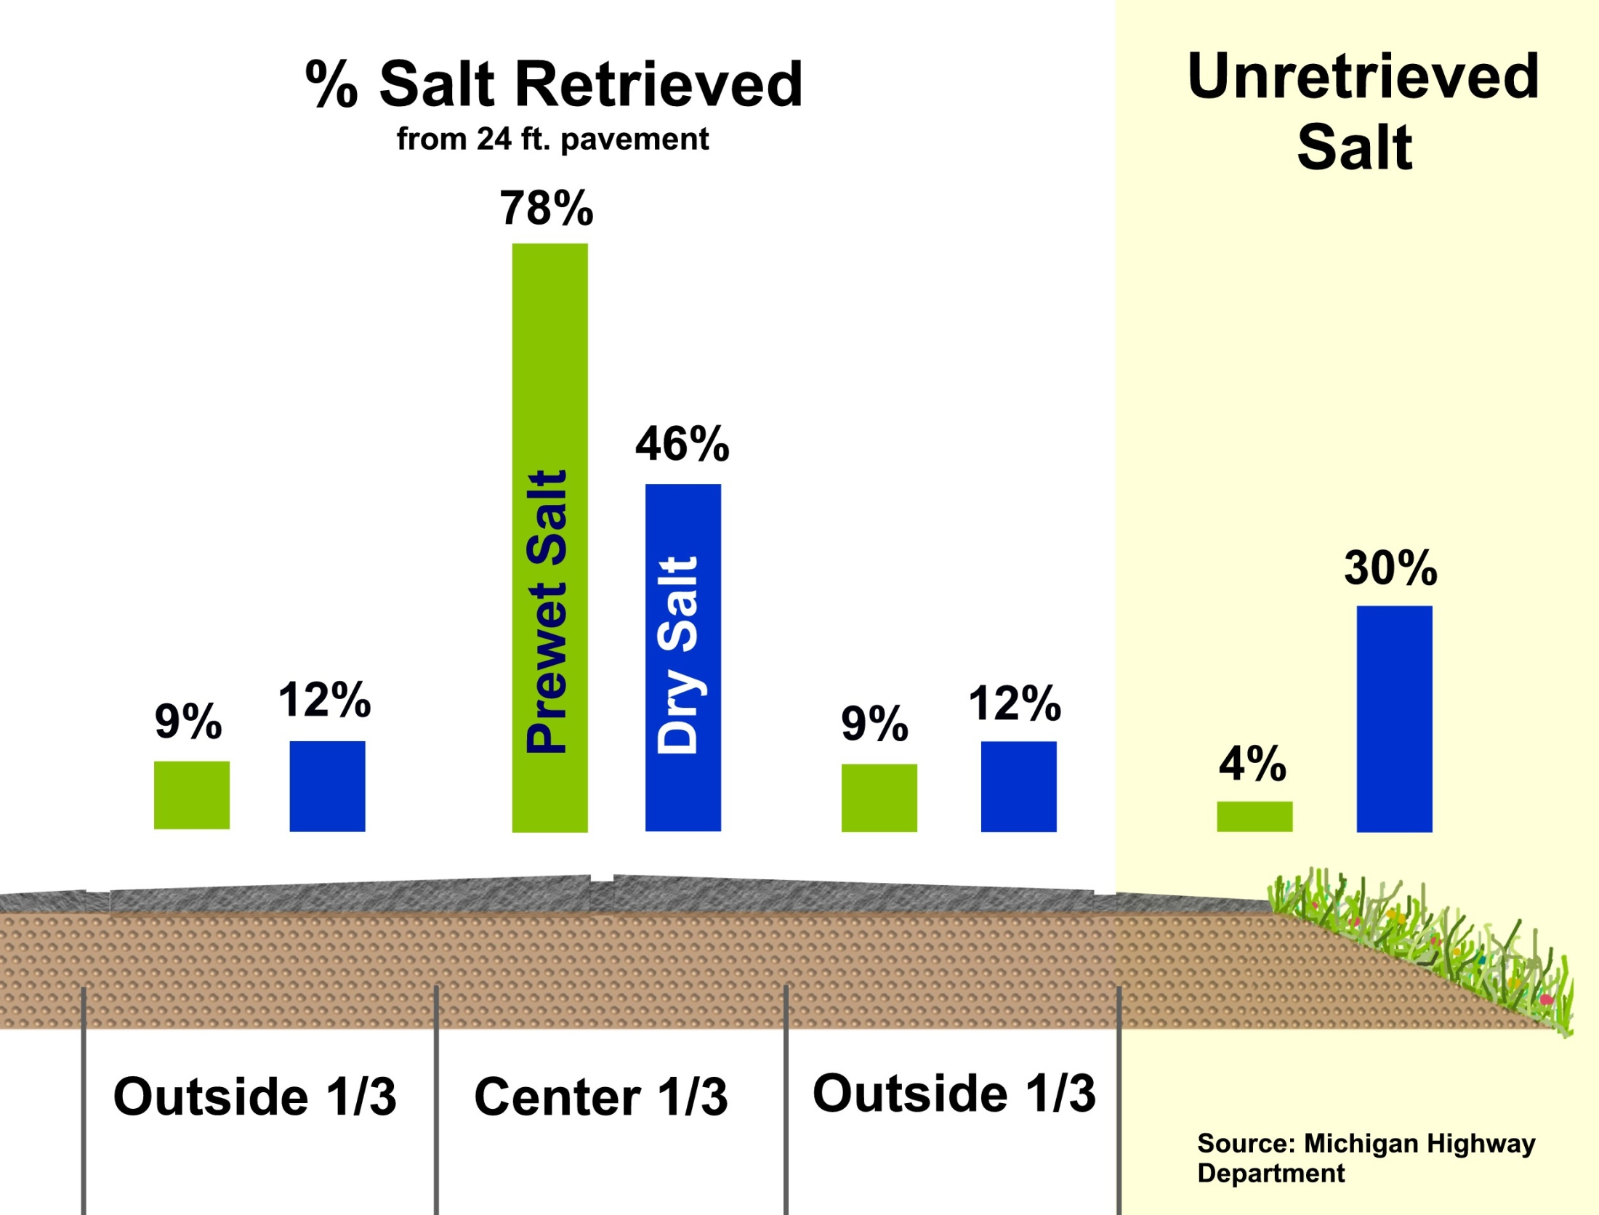
We save even more salt if we get it wet!
Notes:
This refers to research from MDOT that shows wet salt is more likely to stay on target than dry salt. You will notice that 30% of the dry salt immediately bounces into the ditch upon application.
We also know that as salt gets wetter, it bounces less so the bounce depends on how wet it is.
Slide credit: IowaDOT_New-Operator-Snow-and-Ice-Training_Slides_18_136-138_140-142.pptx

Slide 28
Test Question
The process of pre-wetting reduces:
How much salt a truck can hold.
The efficacy of the rock salt.
The bounce and scatter after application.
The speed of the auger.
Notes:
Note to presenters: you may choose to hide this slide.
Test question:
The process of pre-wetting reduces:
How much salt a truck can hold.
The efficacy of the rock salt.
The bounce and scatter after application.
The speed of the auger.

Slide 29
Test Question
The process of pre-wetting reduces:
How much salt a truck can hold.
The efficacy of the rock salt.
The bounce and scatter after application.
The speed of the auger.
Notes:
Note to presenters: you may choose to hide this slide.
Test question:
The process of pre-wetting reduces:
How much salt a truck can hold.
The efficacy of the rock salt.
The bounce and scatter after application. (yes)
The speed of the auger.

Slide 30
One truckload economics
25 mph
0% loss
45 mph
50% loss
9.6 tons on the road
10 tons wet salt applied
4% loss
10 tons dry salt applied
30% loss
4.8 tons on the road
25 mph
0% loss
45 mph
50% loss
7 tons on the road
3.5 tons on the road
Notes:
The percent loss shown are taken from an example of the studies done by MDOT as shown in previous slides. Your spreader type, spread pattern, % wet, pavement conditions and other variables will give you different loss percentage. However, this is an interesting example to work through to understand roughly what you might be losing in salt. For example, if you have your spinner turned up high, you will lose more salt, if your pavement is snow covered, you will lose less salt. We cannot accurately predict what your exact losses will be, but this exercise will certainly get you thinking about it.
To figure out % loss:
9.6 = 4% loss
4.8 = 52% loss
7 = 30% loss
3.5 = 65% loss

Slide 31
One winter economics
Cost per ton
Tons that bounce off the road
Total wasted $
Example: 200,000 tons used per year
Applied dry at 45 mph
$70 per ton
130,000 tons that bounce off the road
Total wasted $9,100,000 (9 million!)
Note to presenters: this is an example. Update this slide with your organization’s numbers or use it as an example of the way it is shown. Delete this yellow box before making presentation.
Notes:
To figure out % loss look at previous slide and the items in the far right column will correspond to these loss percentages:
9.6 = 4% loss
4.8 = 52% loss
7 = 30% loss
3.5 = 65% loss
Note to presenters: It is likely your organization’s data will be more complicated than this example. You might apply ¼ of your salt dry at 45 mph, ¼ wet at 45 mph, ¼ dry at 35 mph, ¼ wet at 25 mph or so on. However you can still model it behind the scenes and learn for yourself what your losses might be.
Update this slide with your organization’s numbers or use it as an example of the way it is shown. Delete the yellow box before making presentation.

Slide 32


How much do we save if we get it wet?
Do a return on investment calculation
Cost to equip trucks.
Cost to set up liquid storage.
Cost to purchase liquids or pretreated salt each year.
# years we can use that equipment.
How much LESS salt we can use each year.
With the big cost savings in using less salt you will find that the equipment soon pays for itself .
…IF YOU TURN DOWN THE APPLICATION RATE.
Notes:
This slide outlines the input variables for a return on investment calculation.
Images: Microsoft clipart

Slide 33

How much do we save if we slow down?
Do a return on investment calculation
No cost to change speed of driving/applying policy.
Costs associated with slower cycle time.
Any risks to driver if we drive slower?
How much LESS salt can we use each year.
Slowing down will save you $ IF YOU TURN DOWN THE APPLICATION RATE.
Notes:
More information on return on investment calculations:
Do a return on investment calculation
No cost to change speed of driving/applying policy
Costs associated with slower cycle time
Any risks to driver if we drive slower?
How much LESS salt can we use each year
Slowing down will save you $ if YOU TURN DOWN THE APPLICATION RATE
Images: Microsoft clipart

Slide 34
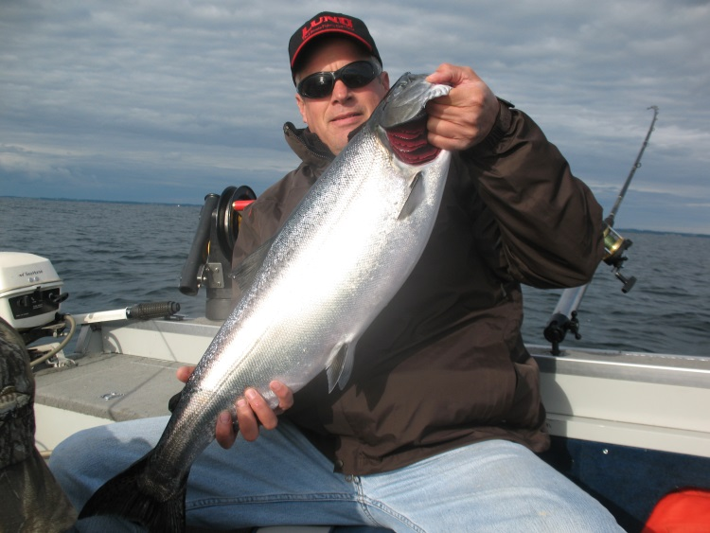
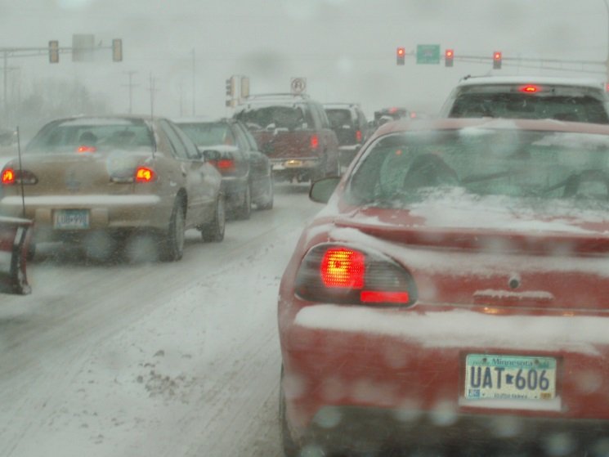

Save money time and the environment!
Pre-wet application rates can be reduced by 30% as compared to dry salt. Some organizations see up to a 50% reduction.
Saves money, reduces pollution, improves effectiveness of winter maintenance
Notes:
Text from: http://clearroads.org/wp-content/uploads/Pages_from_MDOT_Winter-Operations-Trucking-Driving-School_pg_115-122.pdf
Image: Microsoft clipart
Photos: FCI
Would be a good time to ask the class what their results have been by using pre-wet salt. Most drivers will report an increased speed of melting. One thing we might not think about or do is turn down the application rate. Wet salt gives us many advantages and we don’t need as much to accomplish the same results.
Test question:
Can you save money and improve performance by using wet salt?
Yes ( yes)
No (no)
Photo credit: Fortin Consulting Inc.
Images: Microsoft clipart

Slide 35
Test Question
Can you save money and improve performance by using wet salt?
Yes
No
Notes:
Note to presenters: you may choose to hide this slide.
Test question:
Can you save money and improve performance by using wet salt?
Yes ( yes)
No

Slide 36
Test Question
Can you save money and improve performance by using wet salt?
Yes
No
Notes:
Note to presenters: you may choose to hide this slide.
Test question:
Can you save money and improve performance by using wet salt?
Yes ( yes)
No

Slide 37
Test Question
The process of pre-wetting increases:
How much salt a truck can hold.
The efficacy of the rock salt.
Money saved due to less salt lost.
The speed of the auger.
Both B and C.
Notes:
Note to presenters: you may choose to hide this slide.
Test question:
The process of pre-wetting increases:
How much salt a truck can hold.
The efficacy of the rock salt.
Money saved due to less salt lost.
The speed of the auger.
B and C.

Slide 38
Test Question
The process of pre-wetting increases:
How much salt a truck can hold.
The efficacy of the rock salt.
Money saved due to less salt lost.
The speed of the auger.
Both B and C.
Notes:
Note to presenters: you may choose to hide this slide.
Test question:
The process of pre-wetting increases:
How much salt a truck can hold.
The efficacy of the rock salt.
Money saved due to less salt lost.
The speed of the auger.
B and C.

Slide 39
Methods of pre-wetting
On-board spray units
Pug-mill mixing on site
Delivered pre-wet
Notes:
Methods of Pre-Wetting include: on-board spray units, pugmill mixing on site, and delivered pre-wet

Slide 40



Pre-wetting solids
Solid chemicals can be pre-wet in 3 ways:
Pre-treating the stock pile
Pre-wetting single load
Pre-wetting by on-board spreader systems
Notes:
We will cover each method in this unit.
Slide source: OhioDOT_Snow-and-Ice-Control-Course-Presentation-105_slides_129-131.pptx

Slide 41
Pre-treating stockpile
Two choices:
Make or purchase large amount to store
Make just what is needed per storm event
Both need to be stored under cover
Notes:
You can make a big or small stockpile of wet salt. All piles should be stored under cover.
Large stockpiles need higher quality storage as they have the tendency to remain in storage longer and pre-treated stockpiles are more likely to leach than dry stockpiles.
Note: storage of salts is covered more thoroughly in the “ De-icing agent management” module.

Slide 42
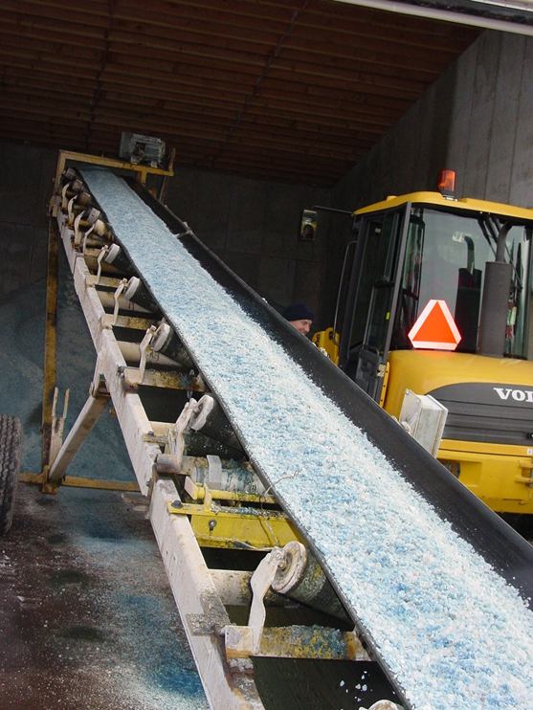
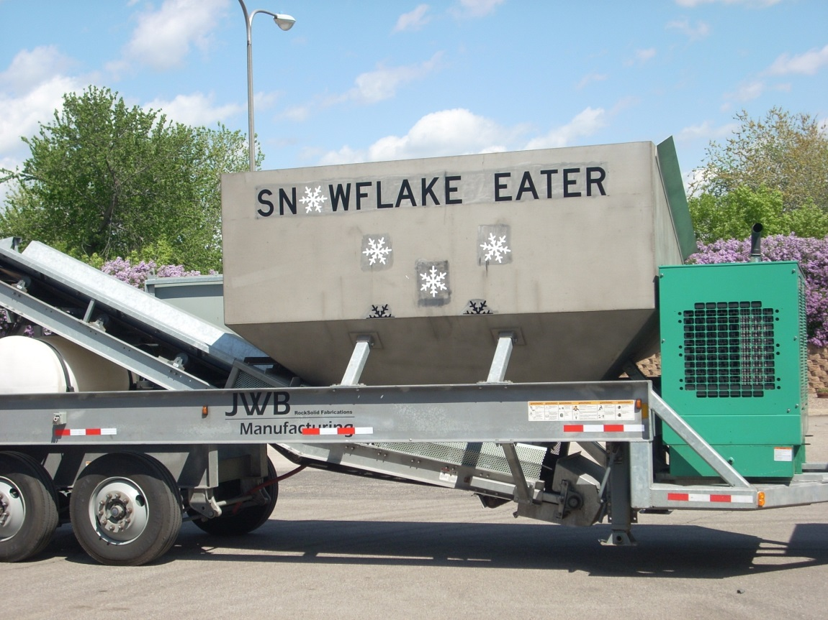
Pre-treating stockpiles
Notes:
MnDOT has a travelling unit that goes around to the various truck stations so they can pre-treat their stockpiles. Other organizations have various methods for mixing stockpiles. Some organizations purchase large quantities of pre-treated salt from a vendor and have it delivered. When purchasing pre-treated salt from a vendor you are less likely to have a leaching problem than if you make it yourself.
Photo credits: Fortin Consulting, Inc. and MnDOT

Slide 43
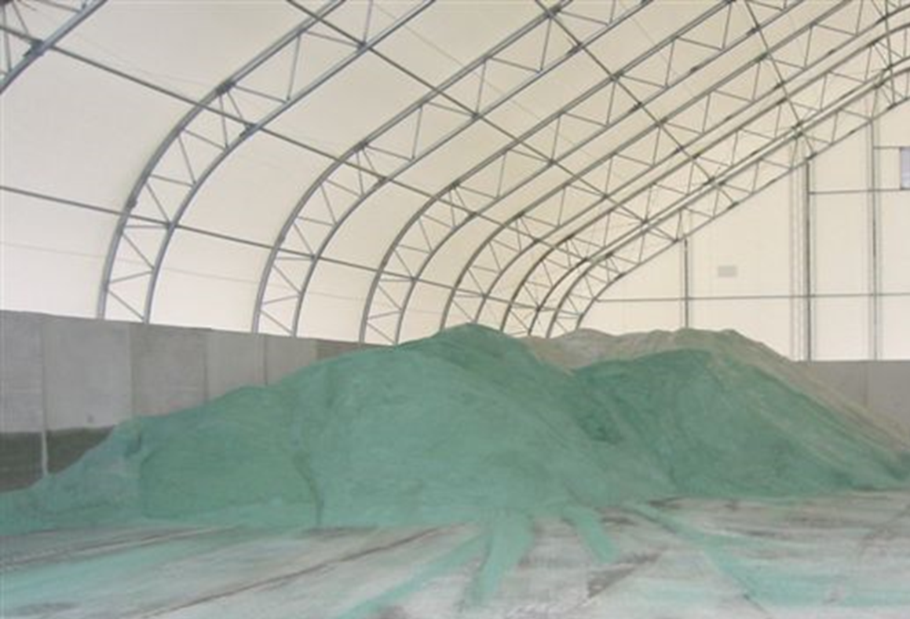
Stockpile pre-treatment
Vendor pre-treated salt
There are no new equipment or tanks to purchase or maintain.
Reduced corrosion of the trucks since it contains a corrosion inhibitor.
It costs more than rock salt. But, because the salt is pre-wet, less salt can be used to achieve the same level of service.
Needs good storage, or will leach.
Notes:
This shows great storage for pre-treated stockpile of salt! How does your storage compare.
Slide source: http://clearroads.org/wp-content/uploads/Pages_from_MDOT_Winter-Operations-Trucking-Driving-School_pg_115-122.pdf
Photo credit: Fortin Consulting Inc.

Slide 44
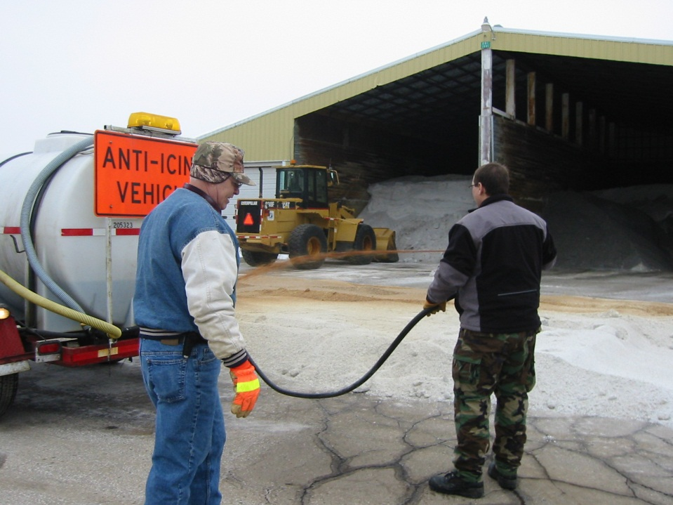
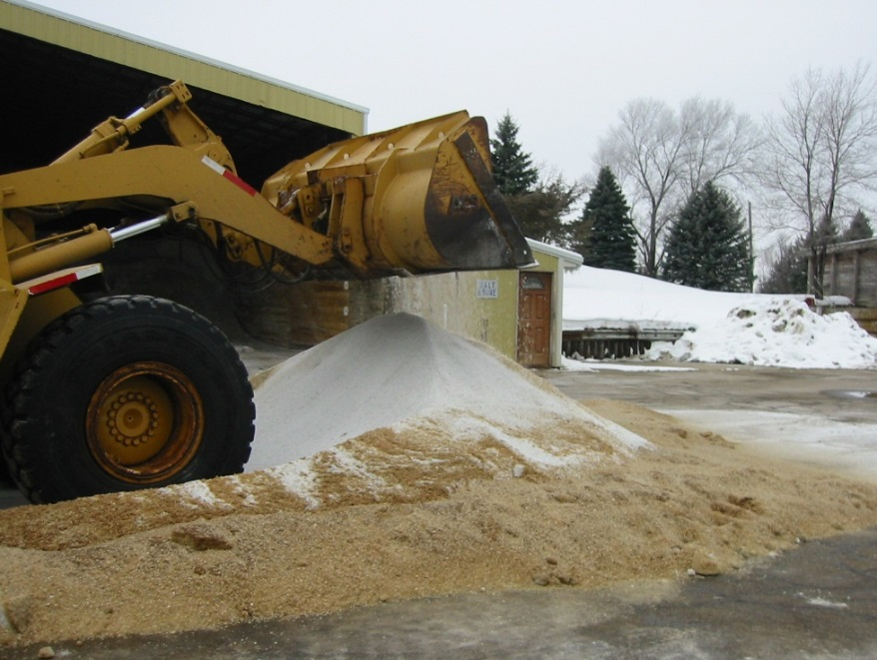
Mixing salt prior to a storm
Do this in small quantities that can be used during the storm
Best practice: mix indoors and keep the pile covered
Notes:
When you mix the salt yourself, take into account the moisture content already in the salt, the volume of dry salt and the gallons of liquid.
A typical recommendation is ratio of 4-6 gallons per ton. More than this is likely to leach. If your salt is already high in moisture less liquid will stay in the pile and you will need to adjust your ratio.
Photo credit: MnDOT

Slide 45
Pre-storm event
Batching: This method is the same as pre-treating the stockpile, just on a smaller scale.
Typically mix up enough salt to last through a storm and store until needed.
One problem is that it is possible to run out before the storm is over.
Then you are stuck using dry salt or taking people off of the road to mix more.
Notes:
If you are mixing small batches on a per storm basis, the ratio of salt to liquid isn't as critical. However if you have leftover salt the storage of it may prove difficult if you have more than 4-6 gallons per ton mixed in. In that case store it in a shed with a concave bottom (birdbath) so that moisture from the pile and moisture drawn to the pile by the hygroscopic liquids will remain contained.
Slide source: http://clearroads.org/wp-content/uploads/Pages_from_MDOT_Winter-Operations-Trucking-Driving-School_pg_115-122.pdf

Slide 46
Test Question
Solid chemicals can be pre-wet in ways including:
Pre-treating the stock pile
Pre-wetting single load
Pre-wetting by on-board spreader systems
All of the above
Notes:
Note to presenters: you may choose to hide this slide.
Test question:
Solid chemicals can be pre-wet in ways including:
Pre-treating the stock pile
Pre-wetting single load
Pre-wetting by on-board spreader systems
All of the above

Slide 47
Test Question
Solid chemicals can be pre-wet in ways including:
Pre-treating the stock pile
Pre-wetting single load
Pre-wetting by on-board spreader systems
All of the above
Notes:
Note to presenters: you may choose to hide this slide.
Test question:
Solid chemicals can be pre-wet in ways including:
Pre-treating the stock pile
Pre-wetting single load
Pre-wetting by on-board spreader systems
All of the above

Slide 48
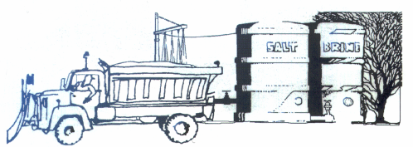
Pre-wet single load
Note to presenters: hide this slide if you are using more progressive methods. Delete this yellow box before making the presentation.
This isn’t a very common practice. It can be used to bridge the gap until you get better methods.
Notes:
Note to presenters: hide this slide if you are using more progressive methods. Delete the yellow box before making the presentation.
Very corrosive to the truck, not very good coverage of salt to moisture. Better than no liquids but low on the list of ways to use liquids.
Image credit: Maine DOT

Slide 49
Pre-wetting a loaded truck
Many different ways:
Spray liquid onto a loaded truck by an overhead spray bar.
Operators spray liquid onto each bucket of salt as they load the truck.
Use a conveyor system, spraying liquid chemical on the salt as it travels up the belt to the truck.
Those that have used this technique report more corrosive effects on their trucks.
Difficult to get uniform particle coating.
Note to presenter: Hide this slide if you are using more progressive methods. Delete this yellow box before making presentation.
Notes:
Note to presenter: Hide this slide if you are using more progressive methods. Delete the yellow box before making presentation.
This method is an older method and not recommended if you have a more concise method to pre-wet your salt.
Slide source: http://clearroads.org/wp-content/uploads/Pages_from_MDOT_Winter-Operations-Trucking-Driving-School_pg_115-122.pdf

Slide 50
Test Question
Pre-wetting materials in the truck can lead to:
Uneven particle coating
Corrosive effects on the truck
Wet gloves
A and C
Notes:
Note to presenters: you may choose to hide this slide.
Test question:
Pre-wetting materials in the truck can lead to:
Uneven particle coating
Corrosive effects on the truck
Wet gloves
A and C

Slide 51
Test Question
Pre-wetting materials in the truck can lead to:
Uneven particle coating
Corrosive effects on the truck
Wet gloves
A and C
Notes:
Note to presenters: you may choose to hide this slide.
Test question:
Solid chemicals can be pre-wet in ways including:
Pre-wetting materials in the truck can lead to:
Uneven particle coating
Corrosive effects on the truck
Wet gloves
A and C

Slide 52
Pre-wetting by on-board spreader systems
On-board tank locations
Dump truck tail gate
Side of v-box
Side of dump truck
In box
Discharge location
at spinner
at auger
Notes:
There are many ways to configure your truck for pre-wet operations. You have a variety of locations to choose from as to where you locate your tanks. You can use more than one of these locations. Always keep an eye open for ways to include bigger tanks.
The most common discharge location is at the spinner. Often with just one discharge point. Some organizations have experimented and use more than one discharge point at the spinner in hopes to get better coverage.
Those that want the best mixing of liquid to granular choose to mix in the auger. There are claims that by mixing in the auger you get the salt more evenly covered. Some have problems with the auger freezing or jamming when they discharge liquids in the auger. Some have overcome these problems and stick with this technology.
Whatever you choose, get the salt as wet as you can.
Slide source:
OhioDOT_Snow-and-Ice-Control-Course-Presentation-105_slides_129-131.pptx

Slide 53
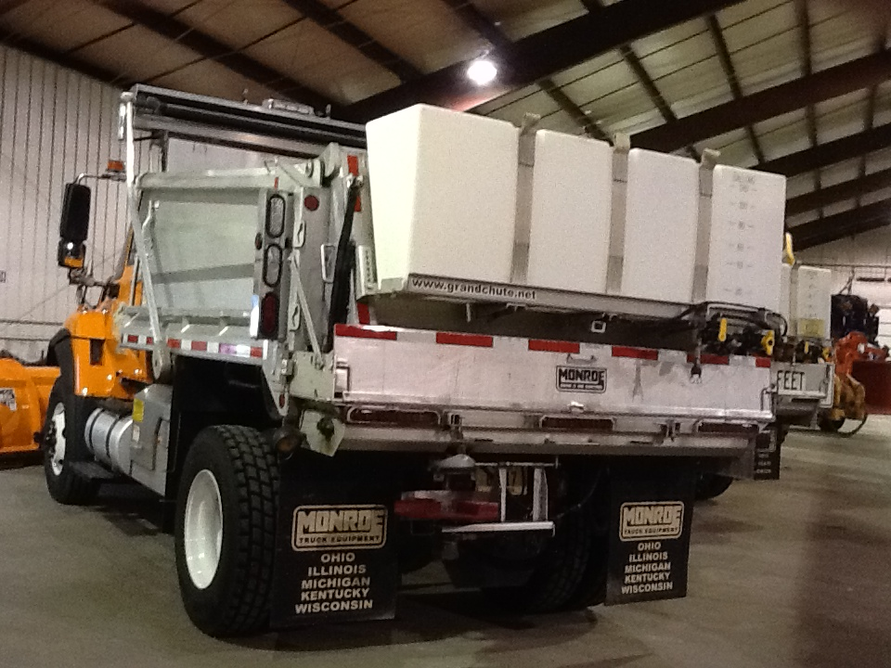
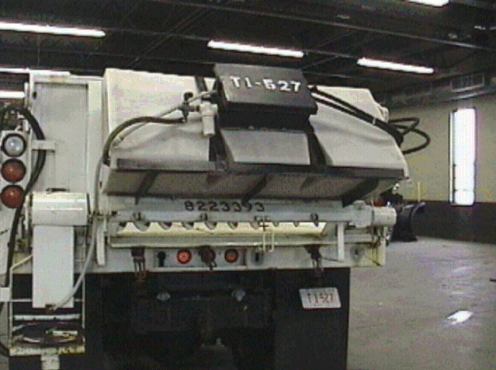
Tailgate tanks
Notes:
As liquids started becoming popular tail gate tanks were very common. As the amount of liquid we use increases the side tanks are becoming more common. However it is possible to do any combination of tanks and the more the better!
Slide source:
Highway Technician Academy:OhioDOT_Snow-and-Ice-Control-Course-Presentation-105_slides_129-131.pptx
Photo credits: Ohio DOT and Fortin Consulting Inc.

Slide 54
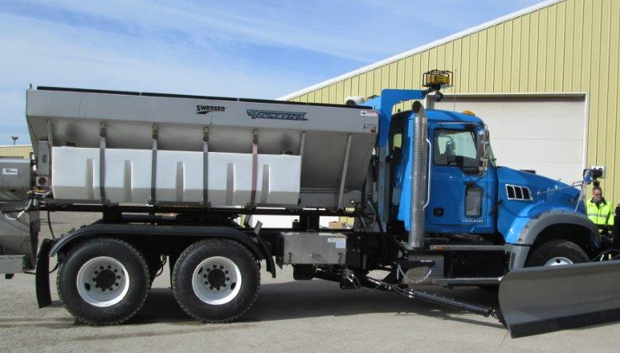
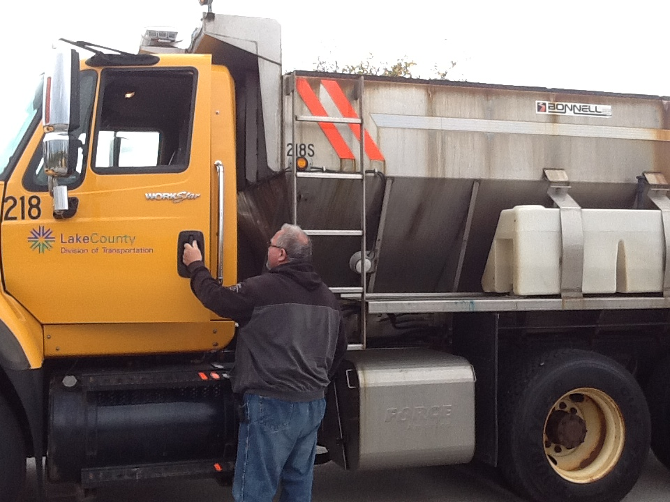
V-box saddle tanks
Notes:
The most common use of tanks is in a v-box.
Photo credits: Ramsey County, MN and Fortin Consulting Inc.

Slide 55
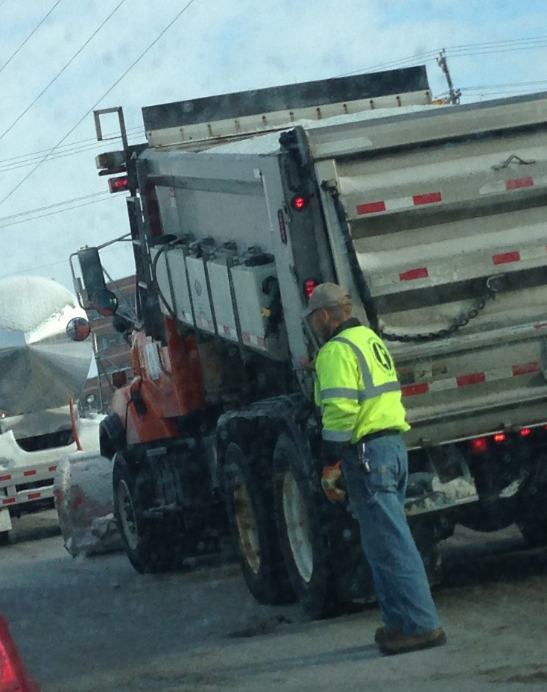
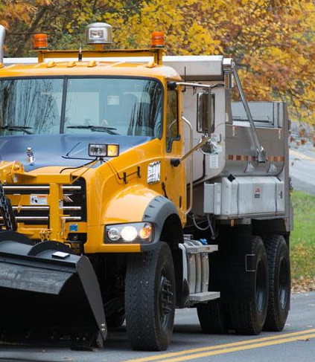
Dump truck saddle tanks
Notes:
The most common use of tanks is in dump trucks; they hold more liquid than tail gate tanks. Remember tanks are not “loader proof” and are very easy to hit. Be careful when loading trucks equipped with tanks.
Photo credits: NYSDOT and Fortin Consulting Inc.

Slide 56
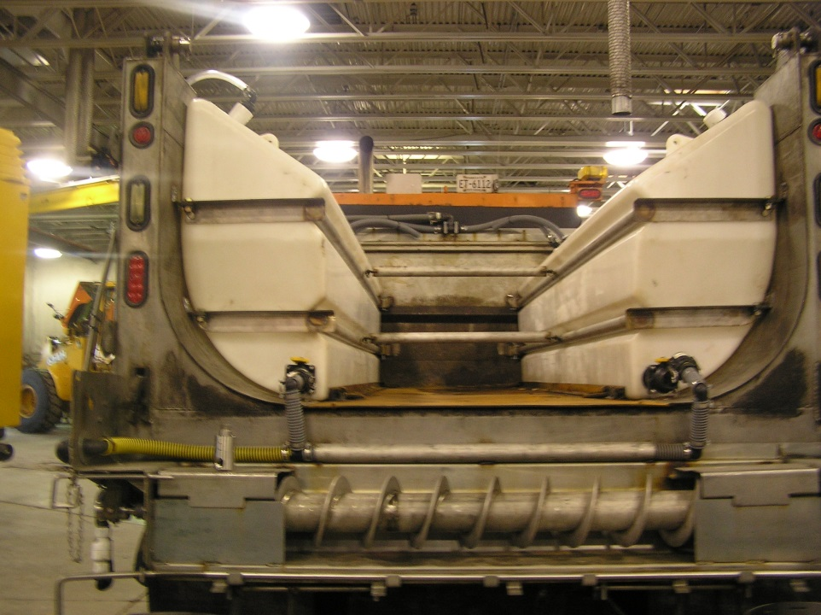
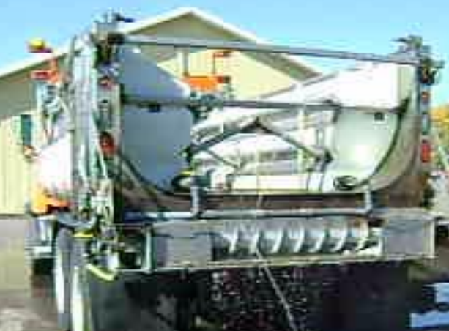
Internal tanks
Notes:
As we use more liquids we need less granular product so we can use some of our box space for tanks.
For more information on slurry see MnDOT district 6 ppt: http://freshwater.org/wp-content/uploads/2012/07/MNDOT-D6West-plow-truck-slurry-conversion.pdf
Photo credit: MnDOT

Slide 57
Test Question
Where can you place liquid tanks?
Tail gate
Side of truck
Inside box
All of the above
Notes:
Note to presenters: you may choose to hide this slide.
Test question:
Test question: Where can you place liquid tanks?
Tail gate (no)
Side of truck(no)
Inside box(no)
All of the above(y

Slide 58
Test Question
Where can you place liquid tanks?
Tail gate
Side of truck
Inside box
All of the above
Notes:
Note to presenters: you may choose to hide this slide.
Test question:
Test question: Where can you place liquid tanks?
Tail gate (no)
Side of truck(no)
Inside box(no)
All of the above(y

Slide 59
Discharge locations
at spinner
at auger
Notes:
The most common discharge location is at the spinner, often with just one discharge point. Some organizations have experimented and use more than one discharge point at the spinner in hopes to get better coverage.
Those that want the best mixing of liquid to granular choose to mix in the auger. There are claims that by mixing in the auger you get the salt more evenly covered. Some have problems with the auger freezing or jamming when they discharge liquids in the auger. Some have overcome these problems and stick with this technology.
Whatever you choose, get the salt as wet as you can.

Slide 60
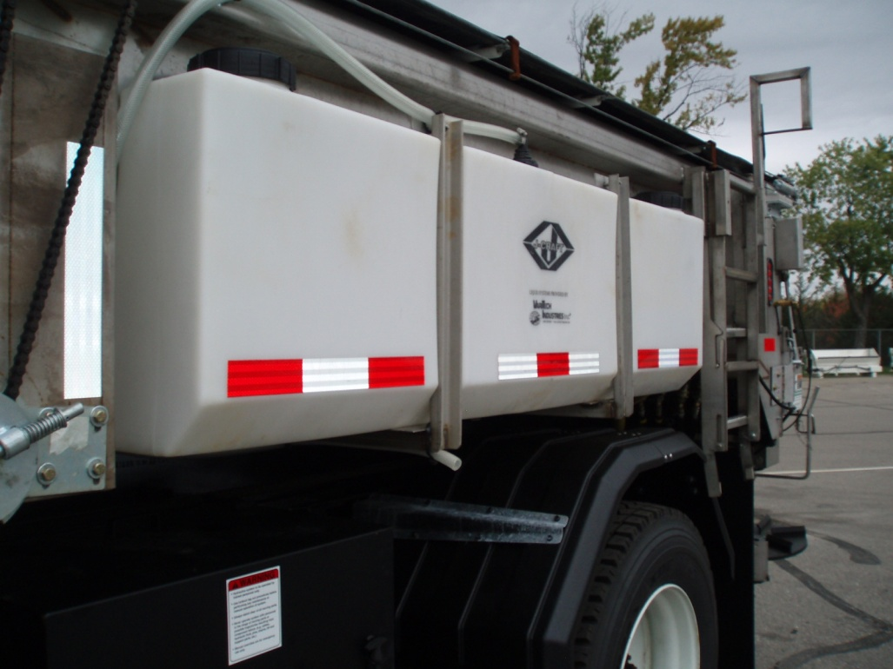
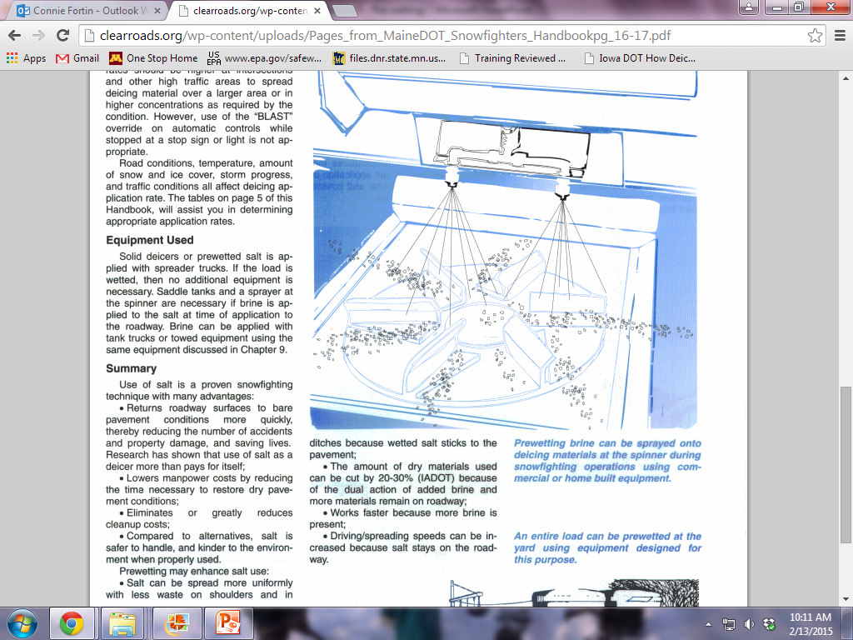
On-board tanks, spray onto spinner
Notes:
Some systems are gravity flow, some use ground speed controls to adjust the material flow rate in relation to vehicle speed. Ground speed systems are always the most accurate. Gravity flow systems seem to have the advantage of less maintenance problems. Some notes derived from: OhioDOT_Snow-and-Ice-Control-Course-Presentation-105_slides_129-131.pptx
Image credit: Maine DOT
Photo credit: Fortin Consulting Inc.

Slide 61
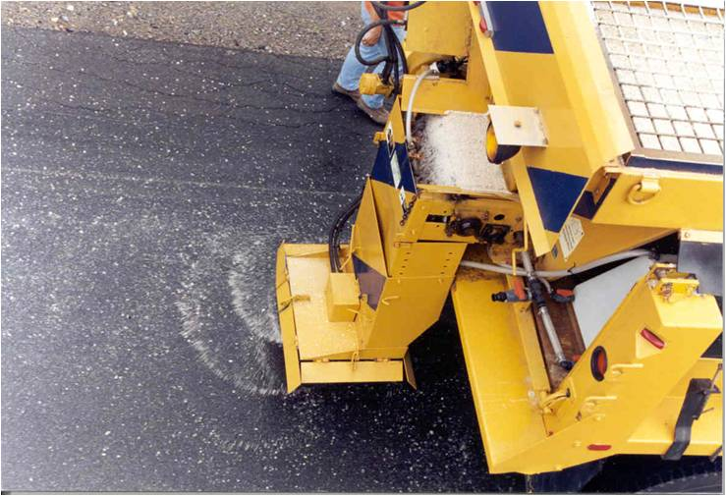
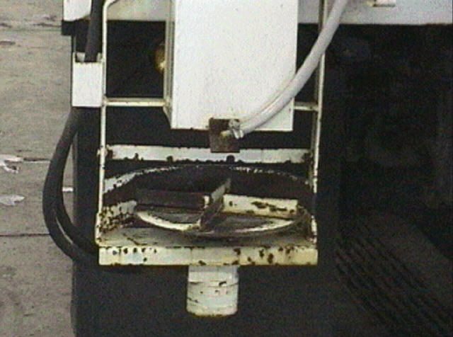
Adding liquid at the spinner
Notes:
This is the most common method.
Note to presenters: ask the participants the following questions:
What configuration do you use?
What do you see as the pros and cons of it?
How could it be more improved to give you better performance?
Photo credits: NYSDOT and Ohio DOT

Slide 62
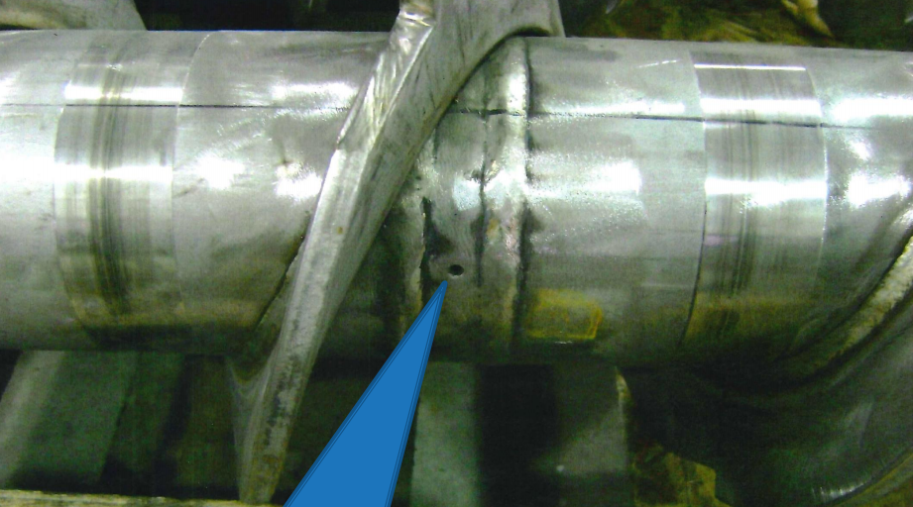
Adding liquid at the auger
Notes:
Those pushing the edge for higher performance seem to come back to this system. How to route the liquid through the auger so salt is more evenly covered in liquid before discharge.
Note to presenter: Ask the participants the following questions:
Have you tried this?
What worked or did not work for you?
Note: If you haven’t tried it, perhaps it is time to give it a try.
Photo credit: MnDOT District 6

Slide 63
Test Question
Truck mounted pre-wetting tanks can be located in/on:
Dump truck tail gate
Side of v-box
Side of dump truck
In box
All of the above
Notes:
Note to presenters: you may choose to hide this slide.
Test question:
Truck mounted pre-wetting tanks can be located in/on:
Dump truck tail gate
Side of v-box
Side of dump truck
In box
All of the above

Slide 64
Test Question
Truck mounted pre-wetting tanks can be located in/on:
Dump truck tail gate
Side of v-box
Side of dump truck
In box
All of the above
Notes:
Note to presenters: you may choose to hide this slide.
Test question:
Truck mounted pre-wetting tanks can be located in/on:
Dump truck tail gate
Side of v-box
Side of dump truck
In box
All of the above

Slide 65
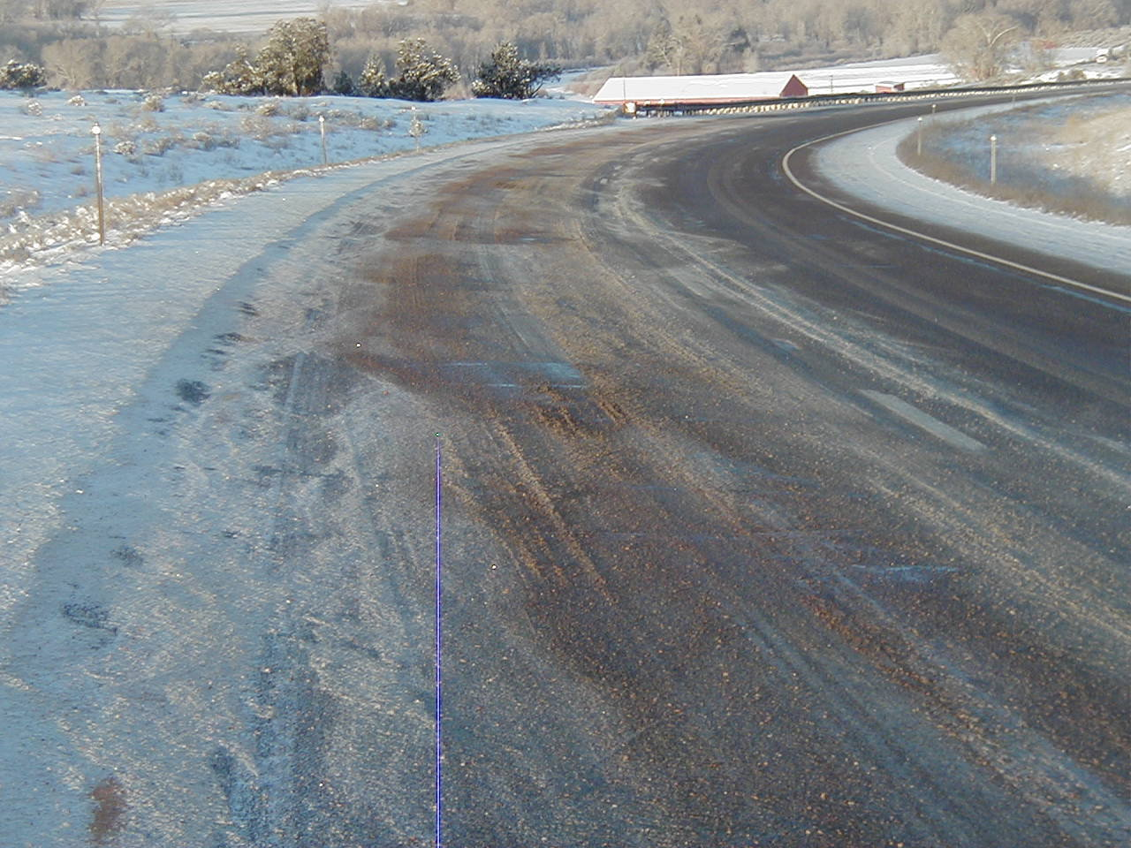
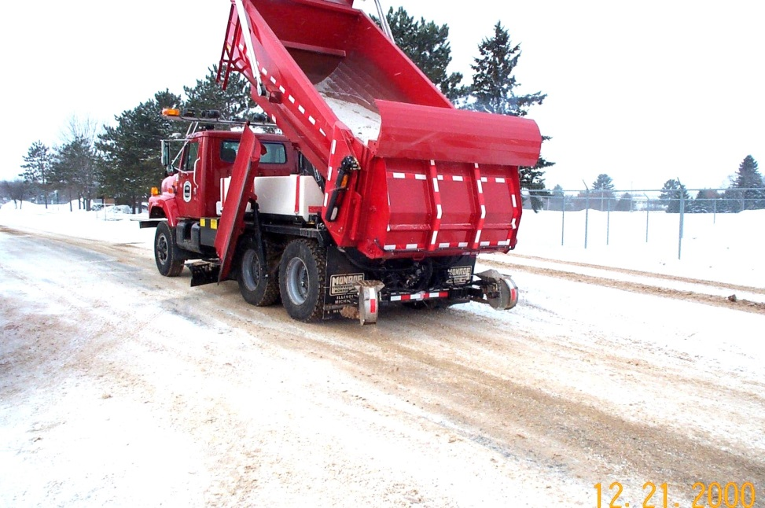
Pre-wet salt or sand
Notes:
Wet materials bounce less and work faster. With sand the trick is you don’t want too much melting, but you want to glue the sand on the road similar to sandpaper.
Photo credits; Wisconsin and Colorado DOTs

Slide 66
Test Question
What materials can you pre-wet?
Sand
Salt
Both
Notes:
Note to presenters: you may choose to hide this slide.
Test question: What materials can you pre-wet?
Sand(no)
Salt(no)
Both (yes)

Slide 67
Test Question
What materials can you pre-wet?
Sand
Salt
Both
Notes:
Note to presenters: you may choose to hide this slide.
Test question: What materials can you pre-wet?
Sand(no)
Salt(no)
Both (yes)

Slide 68
Pre-wetted sand
PROS
Adheres to roadway.
Chances of refreeze less than other products.
Works from top down.
Keeps snow pack from bonding.
Cost savings, reduces sand and liquid usage.
Desired product in snow areas, where colder temperatures exist.
CONS
Additional storage and containment.
Mixing of product is time consuming.
Can plug sanders.
Depending on what type of liquid deicer used to pre-treat sand, can leach out of sand.
Note to presenter: remove this slide if you don’t use pre-wetted sand, or change the list to reflect the pros and cons you have encountered. Delete this yellow box before making presentation.
Notes:
Note to presenter: Note to presenter: remove this slide if you don’t use pre-wetted sand, or change the list to reflect the pros and cons you have encountered. Delete this yellow box before making presentation.
Also, these are Colorado's list of pros and cons. Your list might be different. Change the list to reflect your findings.
Slide source: CDOT_Snow-removal-operator-training_slides_91-109_114.pptx

Slide 69
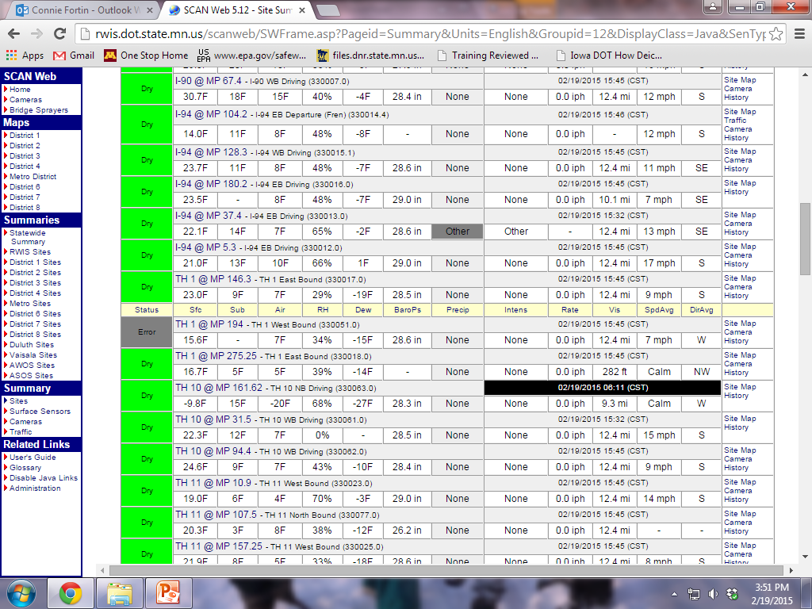
Too cold for salt…
Sand is typically applied when the temperatures are too low for salt to work.
When sand is applied it should be pre-wet so it doesn’t blow off the roadway.
surface
Air
Notes:
This quote is from Mike Sproul, Wisconsin DOT.
It shows a snapshot from MN RWIS showing pavement temperature at -9.8 and air temp at -20 at 4 pm…start of rush-hour.

Slide 70
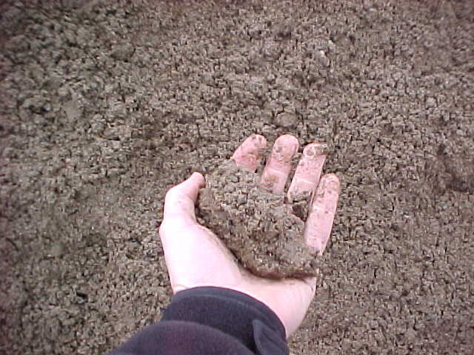
Pre-wetted sand
8 gallons per ton of sand.
Sand balls up in hand.
Unable to squeeze any product from sand.
8 gallons maximum is recommended (due to plugging grates and sanders).
500 lbs per lane mile.
Reduces sand usage.
More effective than salt/sand mixes.
Note to presenter: These rates are suggested by CDOT. Put your own recommendations here and delete this yellow box before making presentation.
Notes:
There wasn’t much information on pre-wet sand from the clear roads group.
Note to presenter: These rates are suggested by CDOT. Put your own recommendations here and delete the yellow box before making presentation.
Whichever method you use, make sure to look for ways to reduce material use.
Slide source: CDOT_Snow-removal-operator-training_slides_91-109_114.pptx ( we removed the reference to caliber 2000)
Photo credit: Colorado DOT

Slide 71
Notes:
A Montana study (5) reported that pre-wetting of abrasives before application can reduce the amounts applied by 50 percent in cold temperatures. Abrasives can be pre-wet with any of the available liquid chemicals. As with solid chemicals, dry abrasive is pre-wet with 35 to 45 L of liquid per metric ton (8 to 10 gal per U.S. ton). These rates will and should vary with experience, temperature, and storm conditions.
Source: Williams, D. Past and Current Practices of Winter Maintenance at the Montana Department of Transportation (MDT), Montana Department of Transportation, 2001.
Slide source: CDOT_Snow-removal-operator-training_slides_91-109_114.pptx

Slide 72
Test Question
Pre-wetting sand can help with:
Adherence to roadway.
Reducing refreeze.
Keeps snow pack from bonding.
All of the above.
Notes:
Note to presenters: you may choose to hide this slide.
Test question:
Pre-wetting sand can help with:
Adherence to roadway.
Reducing refreeze.
Keeps snow pack from bonding.
All of the above.

Slide 73
Test Question
Pre-wetting sand can help with:
Adherence to roadway.
Reducing refreeze.
Keeps snow pack from bonding.
All of the above.
Notes:
Note to presenters: you may choose to hide this slide.
Test question:
Pre-wetting sand can help with:
Adherence to roadway.
Reducing refreeze.
Keeps snow pack from bonding.
All of the above.

Slide 74

Pre-wetted salt
Start out programs with 8-12 gallons/ton.
We are not sure of the optimal amount.
Some use up 60 gallons/ton.
More liquid is better!
Notes:
Most organizations purchase tanks that deliver liquid in a ratio of 8-12 gallons per ton. This is a good starting point but should not be the ending point. Learn how this can work for you and continue to explore increasing your liquid to granular ratio.
Photo credit: Fortin Consulting Inc.

Slide 75
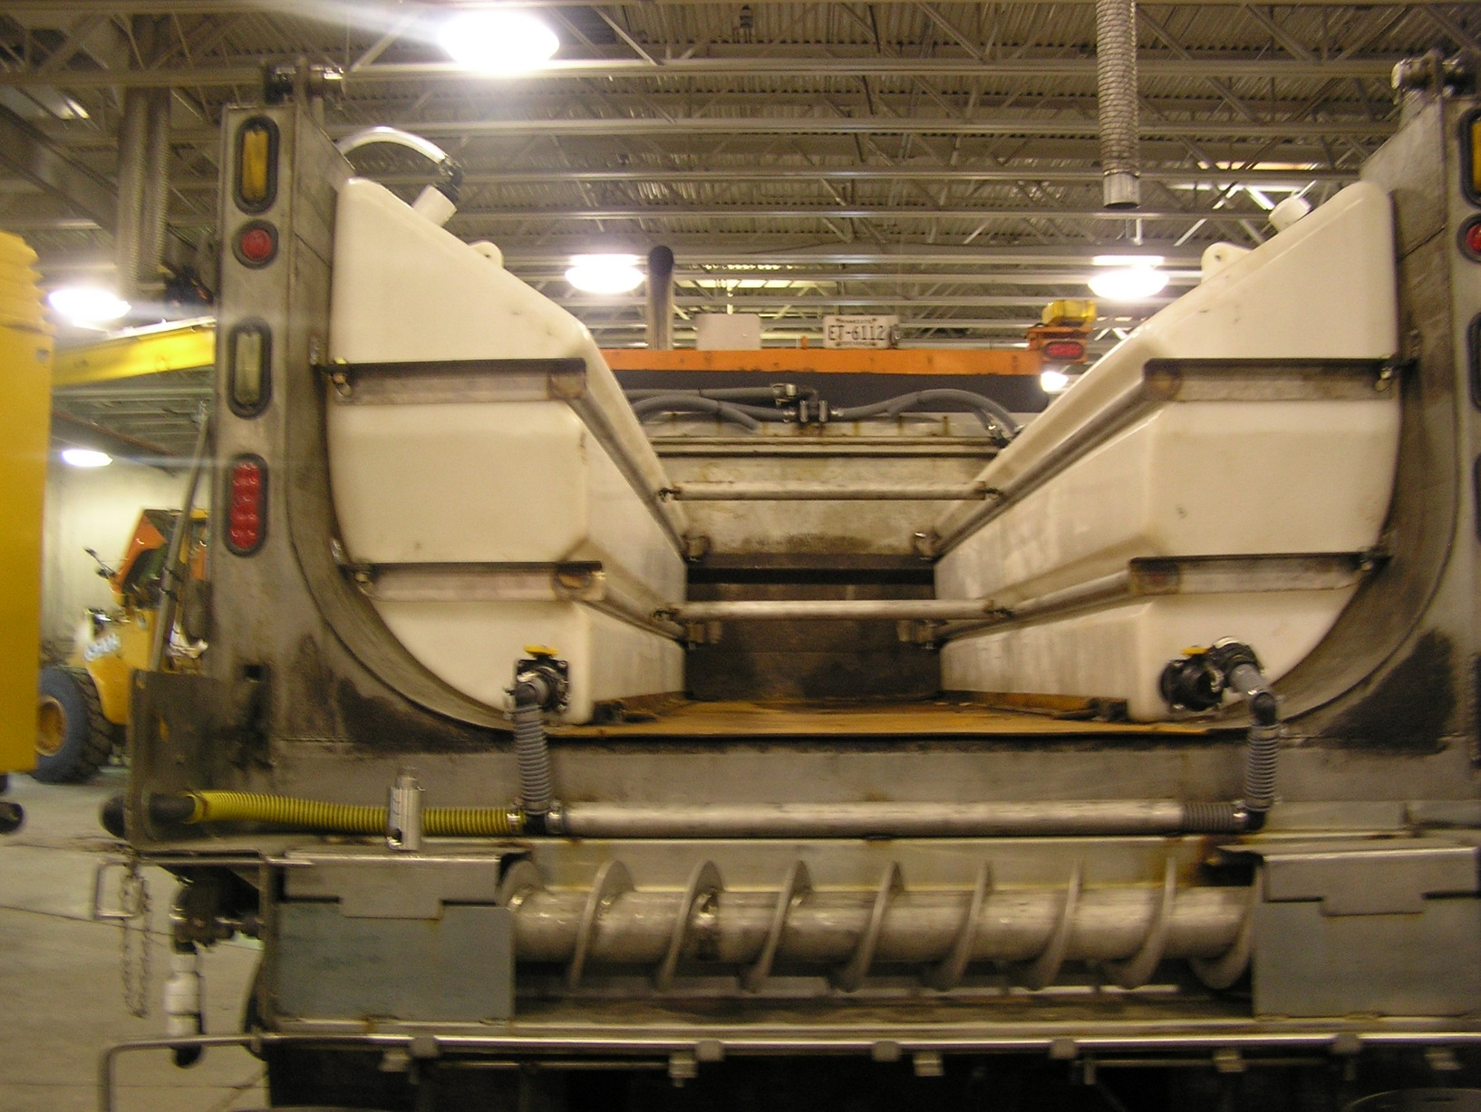
Slurry truck – higher liquid to granular ratio
More liquids are in our future
Notes:
The topic of slurry also comes up in the “spreader” module. You may want to look at this if you are interested in presenting more on slurries. For this module it is brought up as an option and to get the organization to look ahead to wetter salt.
Photo credit: MnDOT

Slide 76
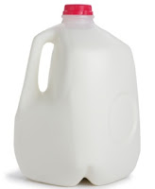
Adding liquids = adding salt
For a savings to occur, you must drop your application rates
Dry = 200 lbs/mile
Prewet at 10 gal/ton= 202.3 lbs/mile
Forgot to turn rate down
200 lbs/mile plus 1 gallon of brine
Total salt used 200+2.3 = 202.3
Prewet at 10 gal/ton = 141.6 lbs/mile
Turn rate down 30%
140 lbs/lane mile plus less than 1 gallon brine
Total salt used 140+1.6 pounds of salt in brine
2.3 lbs salt per gallon brine
Example
Notes:
We need to make it perfectly clear that by adding liquid you are adding salt. There are no cost savings unless you reduce your application rates!
From Mike Sproul, Wisconsin DOT: “I think in the statement ‘more liquid is better’, we’re missing the point that if you’re using more liquid you should be using less solid. And the better part and the savings comes from using less solids.”
Image credit: Microsoft clipart
In Wisconsin most folks use 12-20 gal/ton to pre-wet salt. At the same time they’re suppose to dial back the application rate by 100 lb/lm when they pre-wet.
And when they do this they tell us they get the same results.
At 23% concentration 20 gallons of salt brine contains about 38 pounds of salt.
Our average application rate is 300 lb/lm dry. And 200 lb/lm pre-wet with 20 gal/ton.
2000 lbs of dry salt now pre-wet weighs 2038 pounds. So if the spreader is set at 200 lb/lm you’re actually placing 205 (2038/10) pounds of salt.
That’s a savings of 95 pounds of salt and if you’re getting the same results it’s better.
And if you’re able to raise the liquid rate even higher and at the same time lower the solids that theoretically should be better too.

Slide 77
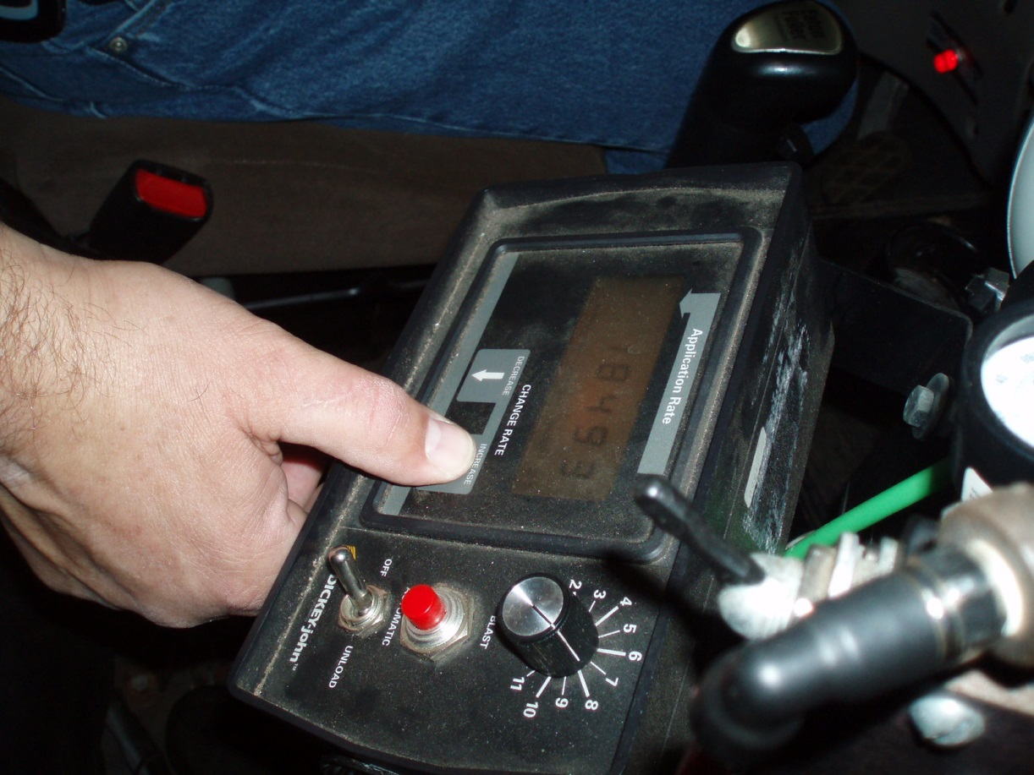

With pre-wetting you have a better tool.
Turn down the application rate.
Notes:
On your application rate charts you should have different rates for dry and wet material. The application rates for wet materials should be less. The wetter it is the less the rate should be. You are likely going to have to make your own chart so study what works for you, document it, and keep trying to reduce your rates. The changes you make can help you reduce your application rates. Pre-wet salt is one of them.
Photo credit: Fortin Consulting Inc.

Slide 78

The wetter your salt, the easier your job!
Pre-treat the stockpile.
Use on-board pre-wetting.
Keep increasing the % of liquid.
Slow down when applying.
Turn down the application rate!
Notes:
Wet salt is a more effective and efficient use of salt. However you still must take control and turn down the application rates
Photo credit: Microsoft clipart

Slide 79
Test Question
True or false: Pre-wetting materials automatically saves money.
True
False
Notes:
Note to presenters: you may choose to hide this slide.
Test question:
True or false: Pre-wetting materials automatically saves money.
True
False

Slide 80
Test Question
True or false: Pre-wetting materials automatically saves money.
True
False
Notes:
Note to presenters: you may choose to hide this slide.
Test question:
True or false: Pre-wetting materials automatically saves money.
True
False

Slide 81

Importance of Record Keeping
Keep records of materials, quantities, treatments and effectiveness.
This helps you know what’s working, what’s needed, and shows where efficiency can be improved.
Notes:
Record keeping is important as a means of material accountability, budgeting/cost tracking, and performance tracking.

Slide 82
Record Keeping
Keeping good records helps
Demonstrate how goals are met.
Demonstrates that you are following policy.
Identify ways to improve and change your approach.
Notes:
Keeping good records is important. It helps to:
demonstrate how goals are met.
demonstrates that you are following policy.
identifies ways to improve and change your approach.

Slide 83
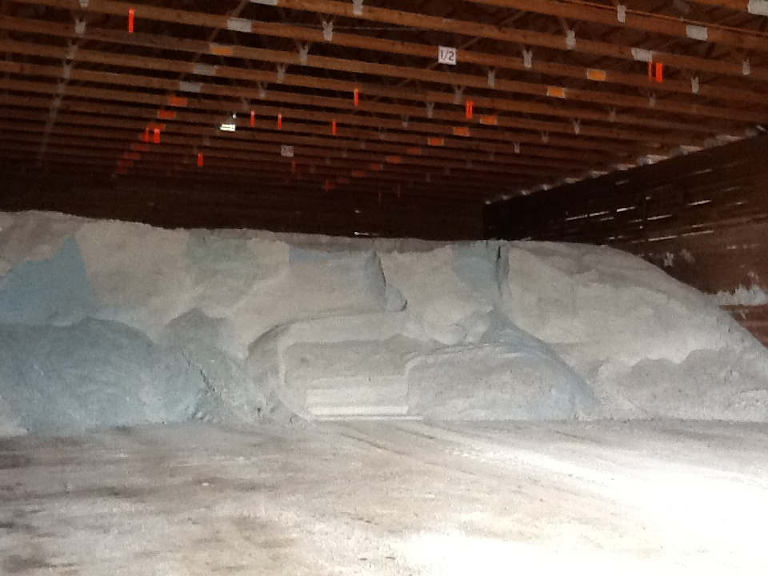
Material Accountability
Know how much you have
Know how much you use
Notes:
It is important to know how much material you start with, how much you have throughout the season and how much you use. Knowing this helps with evaluating efficiency, and for predicting order numbers in the future.

Slide 84
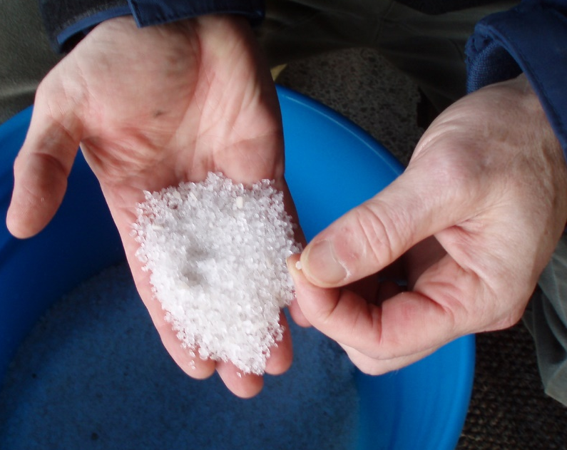
Record Keeping and Quality Control
Test the materials
Solids- test the moisture content
Liquids- test the specific gravity
Check that you get what you ordered
Keep accurate records on quantities ordered, received and used
If you see something wrong, tell your supervisor
Quality Control is vital
Notes:
Quality Control is vital. Every experienced user will inform you just how vital it is. If you do not have a quality control process in place, you can receive very different materials. This translates into effective vs. ineffective operations, environmental contamination, handling difficulties, equipment issues, and on and on.
Test the materials as shown here:
Solids- test the moisture content
Liquids- test the specific gravity
Check that you get what you ordered
Keep accurate records on quantities ordered, received and used
If you see something wrong tell your supervisor
If test results don’t meet the requirements for material ordered, we can reject the delivery.
Note: More information can be found in Module 10 Deicer Agent Management Policy.
Slide credit: CDOT Snow Removal Operator Training

Slide 85
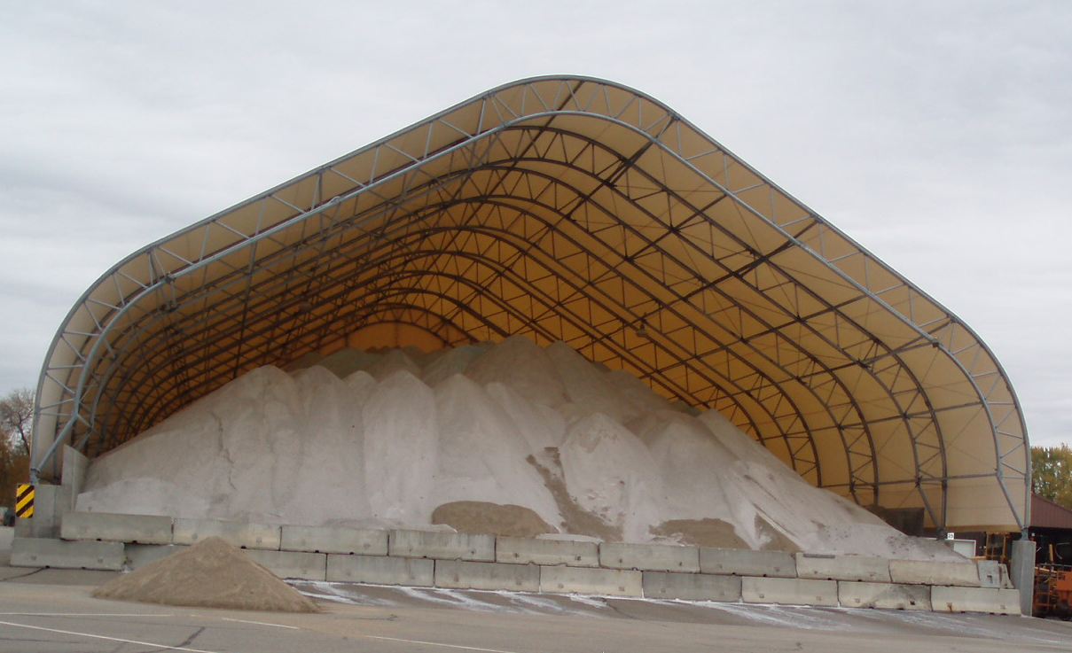
Record Keeping and Quality Control
Take a small sample from each load
Weigh it as soon as you take it
Remove the water, weigh it again
Determine % moisture
Compare to your spec
Record results
Take appropriate action
For less dispute, use a lab testing service or established DOT lab.
Notes:
Reference: Minnesota Snow and ice control field handbook for snowplow operators explains how to do this step by step. (Pg 23-25)
Find it online at this link:
http://www.lrrb.org/media/reports/200501REV.pdf
You can do testing yourself or if you want the results to be less disputed, enlist the help of professional services within our outside of your organization.
Photo credit: Fortin Consulting, Inc.

Slide 86
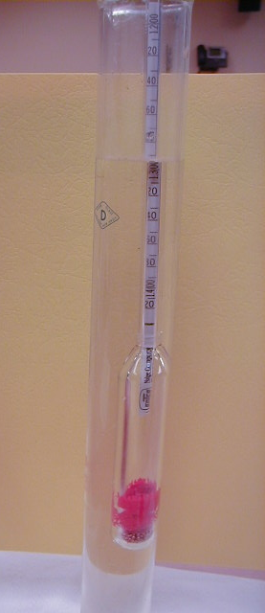
Record keeping and Materials Testing
Liquids: specific gravity
Document % and compare to specification
Don’t use it if it doesn't match the specification
Insert your state’s policy here. Delete this yellow box before making presentation.
Notes:
If the specific gravity doesn’t match the spec, there’s no way to know the temperature at which it will freeze on the road.
Note: There is more about material testing in Module 10 Deicer Management Policy.
Note to presenters: If you have a form or policy regarding record keeping for materials testing, include that information here (you could insert a photo of the cover of your document as an example).
Delete this yellow box before making presentation.
Photo credit: Fortin Consulting, Inc.

Slide 87
Test Question
True or False: It is important to test and record the concentration of your solution when making brine.
True
False
Notes:
Note to presenters: you may choose to hide this slide.
Test Question: Is it important to record the concentration of your solution when making brine?
a. True (yes)
b. False (no)

Slide 88
Test Question
True or False: It is important to test and record the concentration of your solution when making brine.
True
False
Notes:
Note to presenters: you may choose to hide this slide.
Test Question: Is it important to record the concentration of your solution when making brine?
a. True (yes)
b. False (no)

Slide 89
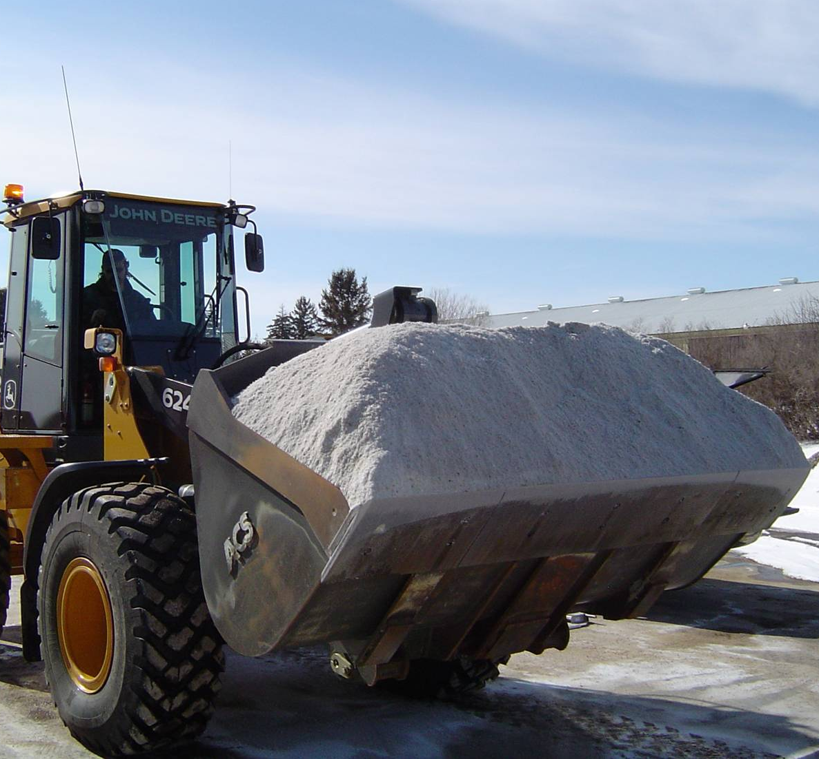
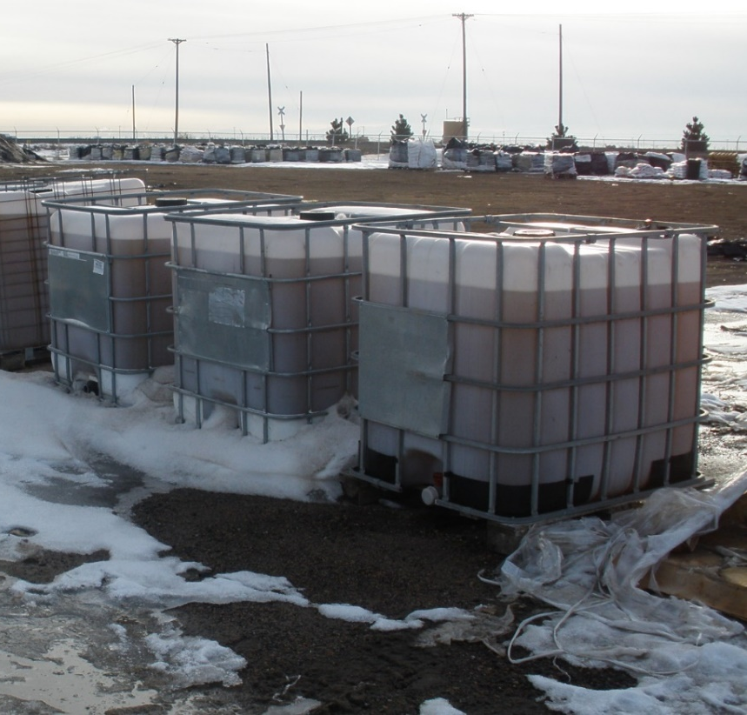
Track by Material Type
Solids
Liquids
Record any time you load, apply, or replace material
Notes:
It is important to know both what materials and the total of each that were used. This can help to predict the amount needed for future seasons as well as help in evaluating how well treatment went for an event.
Photo credits: Fortin Consulting, Inc.

Slide 90
Test Question
Which items should be documented?
Material use per storm
Material use per season
Material use per crew member
All of the above
Notes:
Note to presenters: you may choose to hide this slide.
Test question: Which items should be tracked?
Salt use per storm (no)
Salt brine use per season (no)
Winter sand use per crew member (no)
All of the above (yes)

Slide 91
Test Question
Which items should be documented?
Material use per storm
Material use per season
Material use per crew member
All of the above
Notes:
Note to presenters: you may choose to hide this slide.
Test question: Which items should be tracked?
Salt use per storm (no)
Salt brine use per season (no)
Winter sand use per crew member (no)
All of the above (yes)

Slide 92
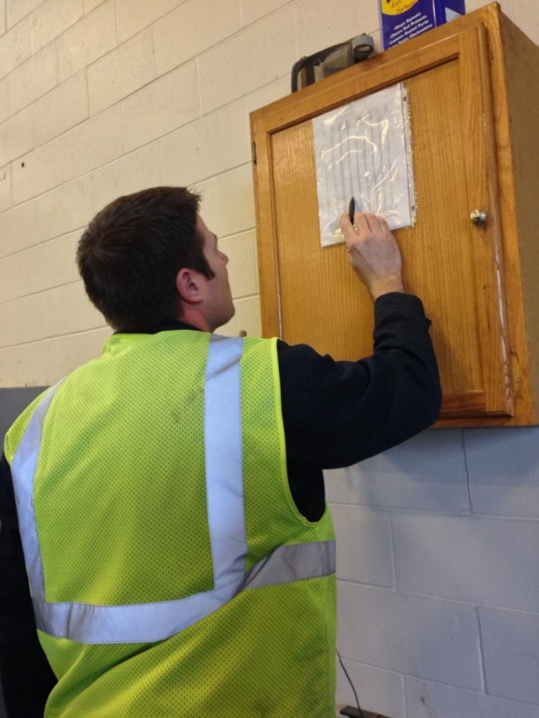
Recording Material Use
Keep track of driver use for insight into:
Individual storms
Each product totals
Winter season total
Leftover product totals
Notes:
You should record several different levels of material use by driver. Combine all this data for insight into individual storms, the winter season total, and what is leftover to store for the next season.
Having all this information helps in evaluating the efficacy of individual storm treatments went, how the whole winter went, and helps in next seasons ordering. It can also help in proving that policy is being followed if a lawsuit is brought against you.
Photo credit: Fortin Consulting, Inc.

Slide 93
Storm Documentation
EXAMPLE:
Work orders
Patrol log
Material usage log
Equipment work orders
Fuel logs
Time sheets
Diary
TAPER log
Customize this slide for your operation
Insert a list of forms needed to be completed by operators for a storm. Delete this yellow box before making the presentation.
Notes:
Review the storm documentation needed for your agency.
Note to presenters: Insert a list of forms needed to be completed by operators for a storm here. Delete this yellow box before making presentation.
Slide credit: CDOT Snow Removal Operator Training

Slide 94
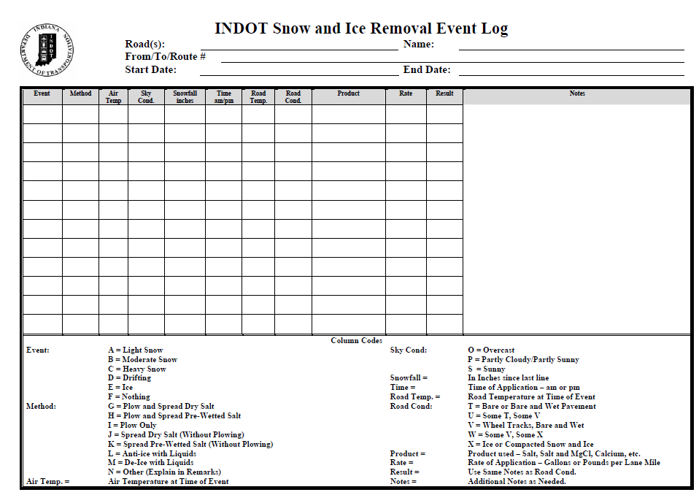
Document Your Operations
EXAMPLE:
Conditions- weather and road, pavement temp
Material type and quantity used
Timing
# of passes and when
Unusual conditions/circumstances
Customize this slide for your operation
Insert an example of your state’s event log and explain how to fill it out. Delete this yellow box before making the presentation.
Notes:
It is very important that plow drivers document the actions taken in response to a snow/ice event
This will include the road conditions throughout their shift, type and amount of deicer or anti-icer used, timing of operations, and the number of passes and when. If there are unusual conditions that affect the operations, those should be recorded. For example, road construction, accidents, major compaction problems, etc.
Note to presenters: Insert a copy of your state’s event log and explain how to fill it out. Delete this yellow box before making presentation.
Photo credit: INDOT

Slide 95
Example: T A P E R
T = Temperature
A = Application
P = Product
E = Event
R = Results
Notes:
Use this slide if your state uses the TAPER system to help explain. Hide this slide if it doesn’t use the TAPER system.
Slide credit: CDOT Snow Removal Operator Training

Slide 96
Event Log
Insert an example of your state’s event log. Delete this yellow box before making presentation.
Customize this slide for your operation
EXAMPLE
Notes:
Review this sequence of events as illustrated on this report, pay particular attention to the changes that took place in the highlighted entries. Note that this TAPER log really paints a good picture of what was done, when it was done, how it was done, who did it with what and what the outcome was like. If you had this information coming on to shift, would you really even need to talk to the person you are relieving?
Note to presenters: Insert an example of your state’s event log here. Delete the yellow box before making presentation.
Slide credit: CDOT Snow Removal Operator Training

Slide 97
Test Question
What should you record during the storm?
Type of product used
Application rate
Pavement temperature
All of the above
Notes:
Note to presenters: you may choose to hide this slide.
Test question: What do you need to record for the TAPER log?
Product (no)
Results (no)
Temperature (no)
All of the above (yes)

Slide 98
Test Question
What should you record during the storm?
Type of product used
Application rate
Pavement temperature
All of the above
Notes:
Note to presenters: you may choose to hide this slide.
Test question: What do you need to record for the TAPER log?
Product (no)
Results (no)
Temperature (no)
All of the above (yes)

Slide 99

A job well done is a job well documented
Filling out paperwork is important because it:
Shows that you follow policy
Improves efficiency of operations
Helps with planning
Notes:
Presenters: give a pep talk here! Everyone knows that filling out paperwork during or at the end of a long shift can be hard to be motivated to do, but it is very important because it:
Shows that you follow policy
Improves efficiency of operations
Helps with planning

Slide 100
Test Question
When you’ve been working all night and you’re tired, do you still have to fill out your paper work?
No
Yes
Notes:
Note to presenters: you may choose to hide this slide.
Test question: When you’ve been working all night and you’re tired do you still have to fill out your paper work?
No (no)
Yes (yes)

Slide 101
Test Question
When you’ve been working all night and you’re tired, do you still have to fill out your paper work?
No
Yes
Notes:
Note to presenters: you may choose to hide this slide.
Test question: When you’ve been working all night and you’re tired do you still have to fill out your paper work?
No (no)
Yes (yes)

Slide 102
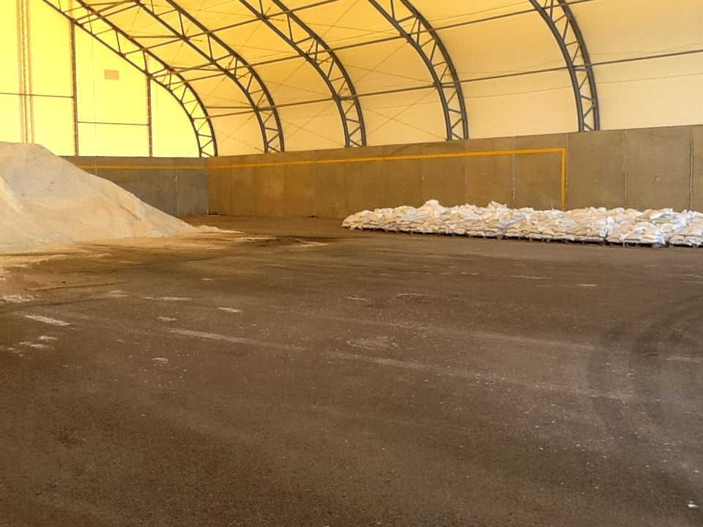
Check Records and Verify Total Materials Used
Notes:
As the winter progresses, reviewing records and verifying how much material has been used can help with planning, seeing if and when you need new shipments of salt, if a driver is over plowing, how well records are being kept.
This can be looked at on a storm to storm basis and up to the current point of the season.
Photo credit: Fortin Consulting, Inc.

Slide 103
Additional Resources
AASHTO, Clear Roads Computer Based training:
Deicing: Unit 4 Deicing Equipment, Unit 5 Application Guidelines and Unit 6 Application Techniques
Pre-wetting research
Reference: S. Koefod, “Effect of Pre-wetting Brines on the Ice Melting Rate of Salt at Very Cold Temperatures,” Presentation to Transportation research Board 94th Annual Meeting, January, 2015, Washington, D.C.
Reference S. Koefod, “ Effect of Pre-wetting Brines on the Ice Melting Rate of Salt at Very Cold Temperatures”, TRB, 2015. http://pubsindex.trb.org/view/2015/C/1338579
Bounce and scatter research
http://michigan.gov/documents/mdot/Final_ReportNov2012_404228_7.pdf
Notes:
AASHTO, Clear Roads Computer Based training:
Deicing: Unit 4 Deicing Equipment, Unit 5 Application Guidelines and Unit 6 Application Techniques
Pre-wetting research
Reference: S. Koefod, “Effect of Pre-wetting Brines on the Ice Melting Rate of Salt at Very Cold Temperatures,” Presentation to Transportation research Board 94th Annual Meeting, January, 2015, Washington, D.C.
Reference S. Koefod, “ Effect of Pre-wetting Brines on the Ice Melting Rate of Salt at Very Cold Temperatures”, TRB, 2015. http://pubsindex.trb.org/view/2015/C/1338579
Bounce and scatter research
http://michigan.gov/documents/mdot/Final_ReportNov2012_404228_7.pdf

Slide 104
Acknowledgements
Training contents were developed by Fortin Consulting Inc., under the direction of the Clear Roads Advisory Team.
Connie Fortin – connie@fortinconsulting.com
Professional formatting and training aids were developed by the University of Minnesota, Center for Transportation Studies.
Jim Grothaus – Groth020@umn.edu
Ann Johnson – Johns421@umn.edu
Members of the Clear Roads Advisory Team include:
Mike Sproul, Dave Wieder, Cliff Spoonemore, Monty Mills, David Frame,
Mike Lashmet, Clay Adams, Justun Juelfs, and Tom Peters

Slide 105
This presentation was developed with funding from the Clear Roads research program, which brings together transportation professionals and researchers from around the country to drive innovation in the field of winter maintenance.
Find additional information and resources at
http://clearroads.org/

Slide 106
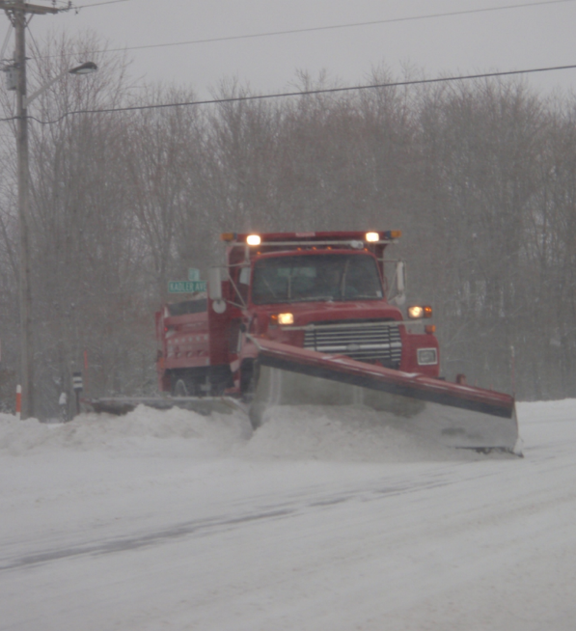


Thank you for your good work!
Notes:
Thank you for your time today. Have a good winter!

