Slide 1
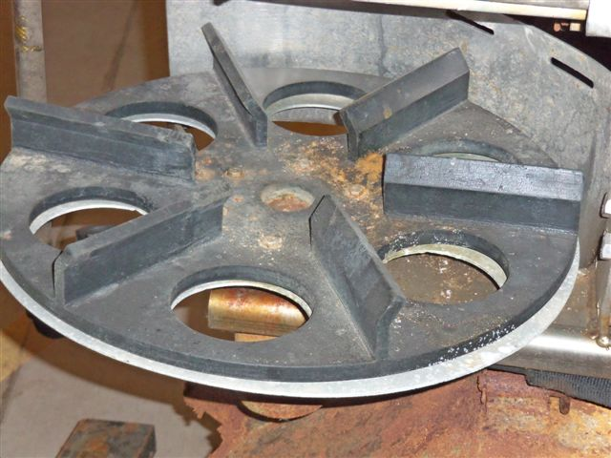
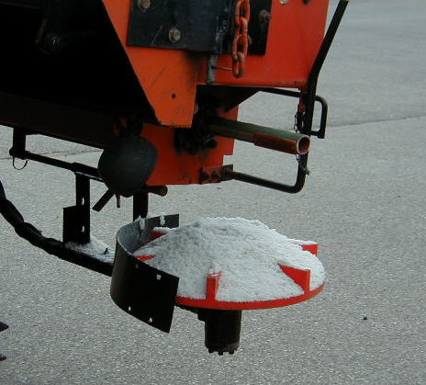

Module 3: Spreader Procedures
2016 Created for Clear Roads by:
U of MN Center for Transportation Studies &
Fortin Consulting Inc.

Slide 2
Training for Winter Maintenance Supervisors and Operators
2016 Created for Clear Roads by:
U of MN Center for Transportation Studies &
Fortin Consulting Inc.

Slide 3
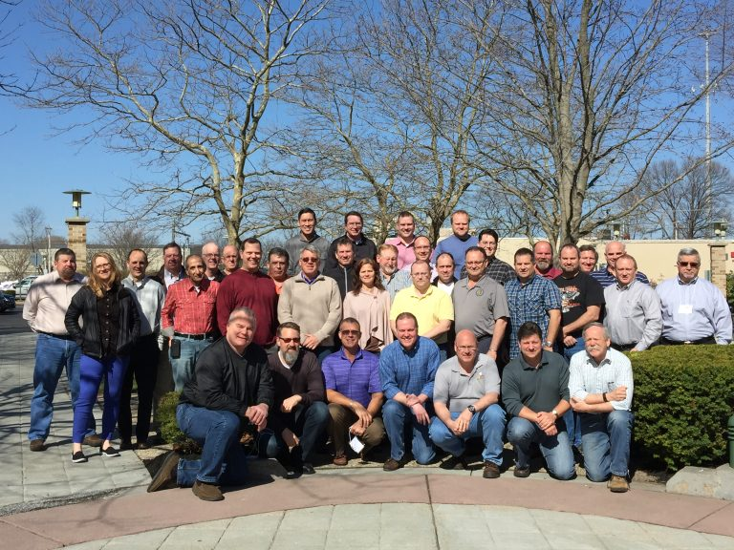
Winter maintenance professionals are a very powerful and important group
Notes:
Photo: clear roads website
Note to presenters: These first 7 slides can be used or hidden.
Or, replace with photos of your staff.

Slide 4
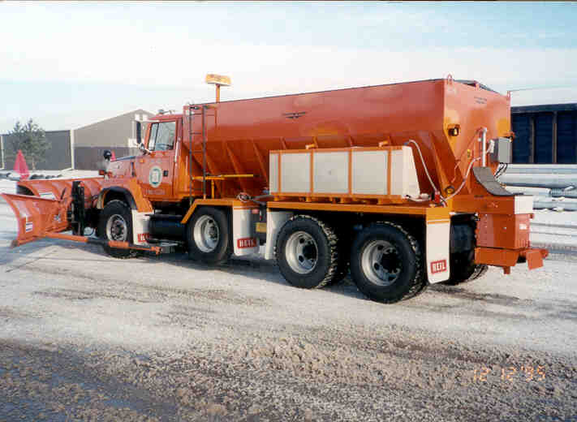
You do a great job of taking care of our roads!

Slide 5
This is one of a series of 22 winter maintenance training modules developed by the Clear Roads Program. All of the modules are available online at www.clearroads.org
Modules include information on the following:
Plowing
Truck operations
Spreading
Material use
Pre-wetting
Brine production
De-icing and anti-icing
Level of service
Ice formation
Freeze point depressants
Environmental issues
Drift control
Weather
Avalanche management
Bridge frost
Safety
Notes:
Note to presenters: The website www.clearroads.org can be accessed here if a live internet connection is available.
A list of all the modules is given here:
Plowing procedures
Truck operations
Spreading
Material use
Pre-wetting
Brine production
De-icing
Anti-icing
Safety
De-icing agent management policy
Level of service
Ice formation
Freeze point depressants
Environmental issues
Drift control
Weather
Bridge frost
Avalanche management

Slide 6
Module 3: Spreader Procedures
2016 Created for Clear Roads by:
U of MN Center for Transportation Studies &
Fortin Consulting Inc.

Slide 7
FACILITATOR NOTES (do not show during class)
This is a priority 1 module to be developed for Clear Roads national training. It will address three audiences. Slides can be customized for the audience.
Slide Legend
Entry-level plow drivers
Experienced plow drivers
Supervisors
Notes:
Note to facilitator: do not show this slide during class

Slide 8
This module contains information about:
Different types of spreaders
Spread controllers
Calibrating spreader units
Spreading speeds
Spin speeds and pattern to reduce bounce and scatter
Use of saddle tanks for on-board pre-wetting
Slurry units
Notes:
This module covers different types of spreaders, spread controllers, calibration of spreader units, spin speeds and patterns to reduce bounce and scatter, use of saddle tanks, and slurry units.

Slide 9
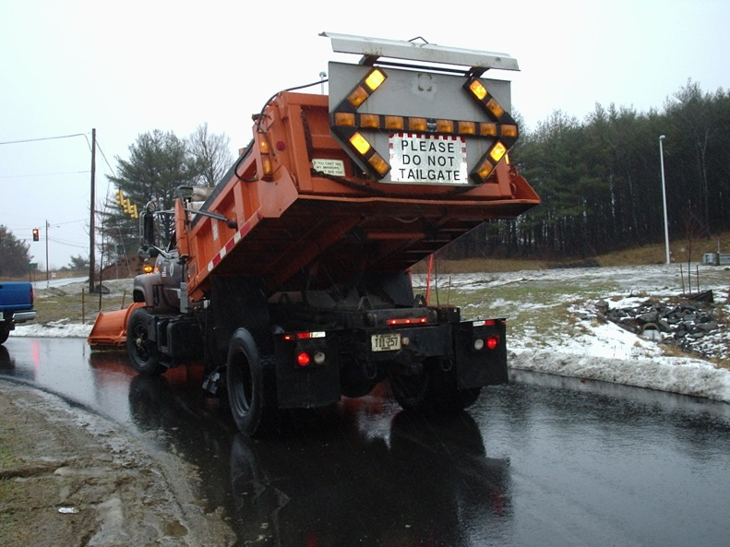
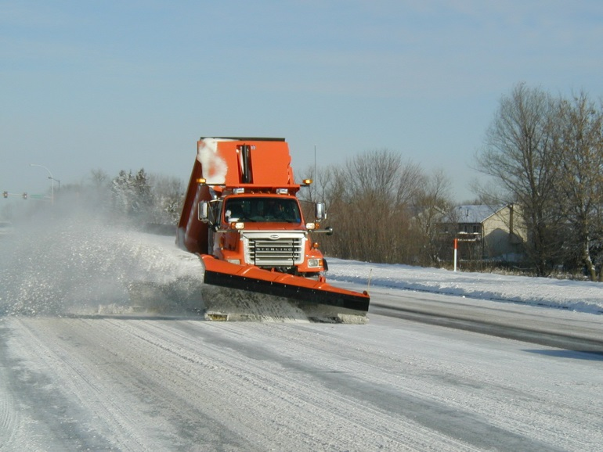
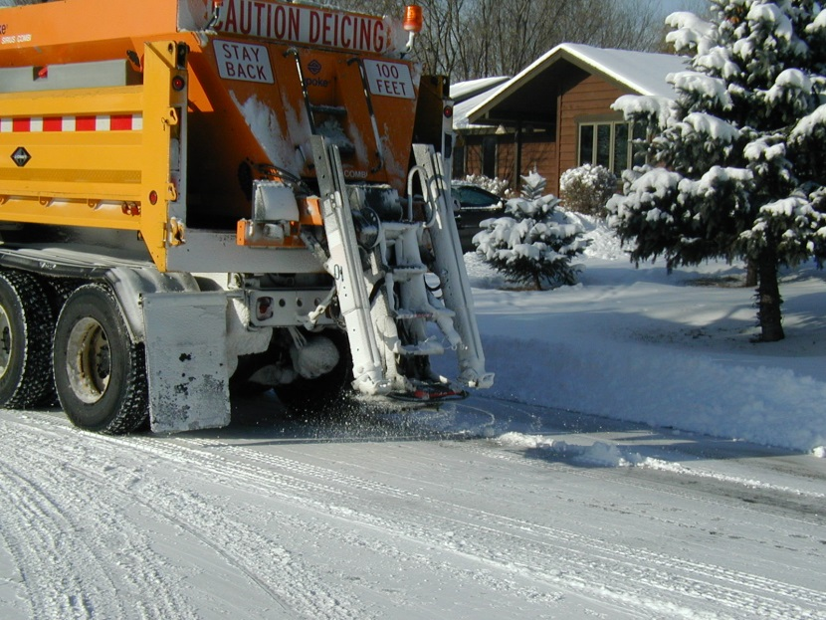
Delivery systems
Dump truck
V-box
Notes:
Start of a mini section
How does the granular salt leave the truck? Most common are augured salt from a dump truck. Dump trucks are valuable tools for winter or summer maintenance thus widely used. However the vbox has many advantages in winter maintenance. As it is able to more efficiently deliver salt. It can run on a auger or conveyor system.
Note to instructors:
When instructing supervisors, include all of the delivery system slides so they understand the options for ordering equipment.
When instructor entry-level staff, just include the slides that correspond to your fleet and explain how they work.

Slide 10

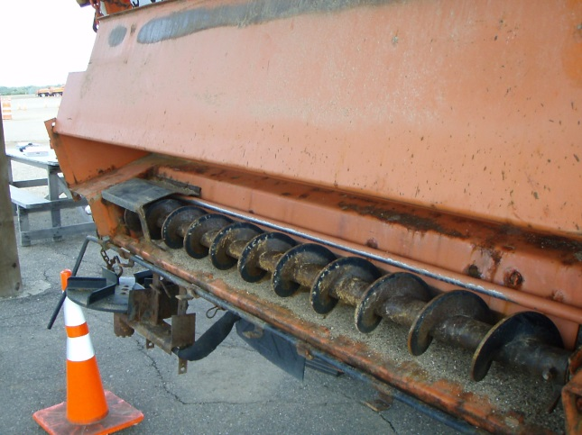
Rear dump (auger)
Notes:
Augered salt from a dump truck - The trucks box needs to raise in order to keep salt available for the auger. The auger turns and a measured amount of salt is discharged. Some challenges with dump trucks and salt spreading is that it requires extra attention from the driver to make sure salt has moved within the box to the auger so the box has to be raised and increasing heights. This makes it a hazard for driving under bridges, under wires or even bringing the truck back into the garage.
The efficiency of salt flow is lower with augered systems since they require the box adjustments and on full loads if the box is raised at all it is easy for the salt to flow out the box over the top of the truck. Therefore as we move to lower salt use and more precise delivery rates, the auger systems are at a disadvantage.
The dump truck is a very useful part of a year-round fleet so it has been used for snow and ice operations virtually forever. It also has the ability to deal better will slightly clumped salt than the auger systems.

Slide 11

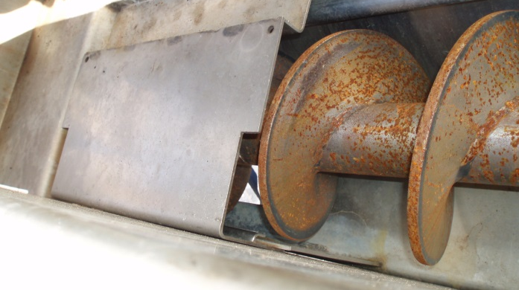
Front dump (auger)
Notes:
Front dump systems are not as common as rear dump systems. Maine has used these for years and they have them set up to discharge in the front on the driver’s side. The biggest advantages are that the driver can see the salt being discharged, and that the gets driver better traction as it drives over the discharged salt.
Discussion topic: It would be interesting is to see if, by the bounce and scatter is reduced by discharging in the front since you are driving over it. It would also be interesting to see if the tire action in smashing the salt to smaller particle sizes creates a faster acting salt .
An advantage of front dump systems: To use a front dump system you have to be able to convert your back dump system used in the summer months. Maine DOT has done this for years, according to Brian Burns (the Maine DOT representative on the clear roads committee).

Slide 12
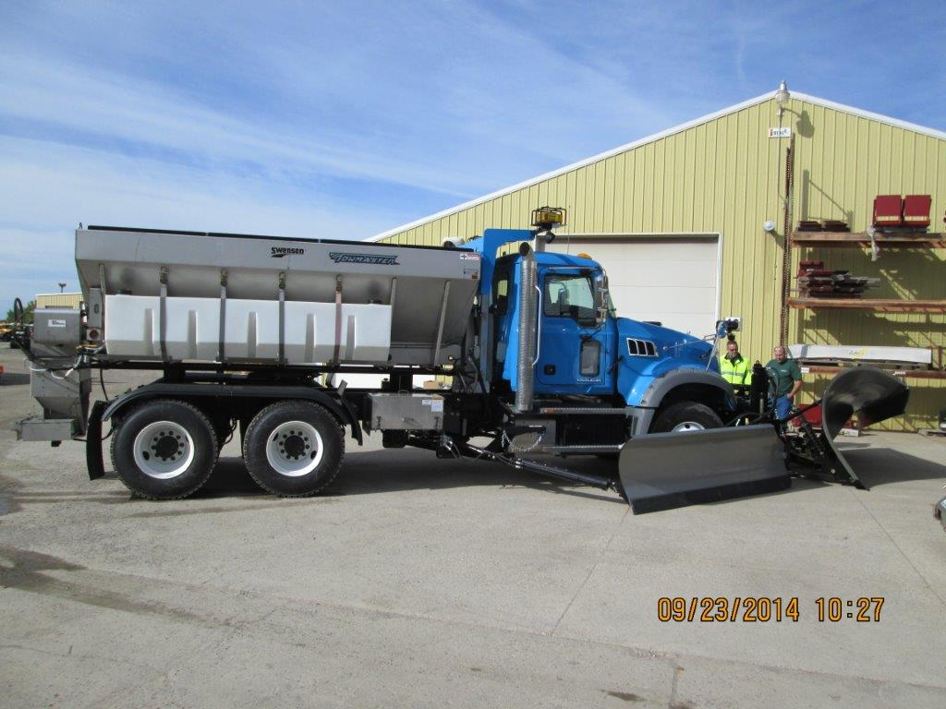
V-box (auger)
The V-box has the advantage of gravity always moving the salt to the lowest spot so the operator doesn’t have to raise the box.
Notes:
Dual augers run down the center of the box. As mentioned before, V-box are more efficient at evenly discharging salt than dump trucks. Some have complained about auger systems in that they do not perform well when salt gets chunky. This augered system in the v-box offers much promise.
Photo credit: Ramsey County, MN

Slide 13
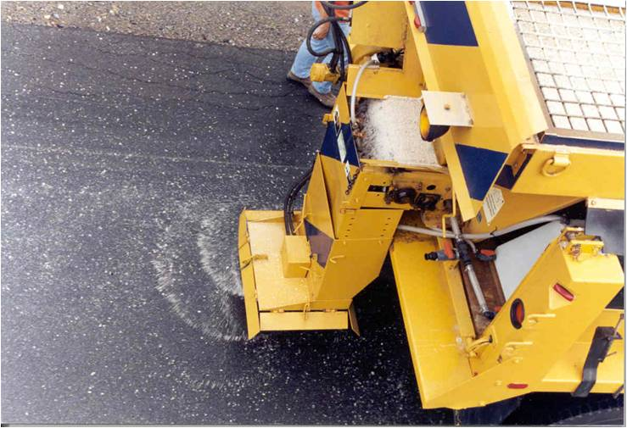
V – box (conveyor)
Notes:
V-box with conveyor to deliver salt to discharge point. V-box systems work with gravity in that salt naturally settles in the lowest elevation of the box. The conveyer is located in the lowest section so that assures that if salt is present in the truck it will be available to the conveyor.

Slide 14
Test Question
Which type of truck is more efficient at delivering salt to the auger or conveyor?
Dump truck
V-box
Note for instructors: you can hide test questions, mix them in during training or remove them to use as a test at the end. See Instructor Notes for guidance.
Notes:
Note to presenter: you may choose to hide this slide.
Which type of truck is more efficient at delivering salt to the auger or conveyor?
Dump truck (no)
V-box (yes)

Slide 15
Test Question
Which type of truck is more efficient at delivering salt to the auger or conveyor?
Dump truck
V-box
Notes:
Which type of truck is more efficient at delivering salt to the auger or conveyor?
Dump truck (no)
V-box (yes)

Slide 16
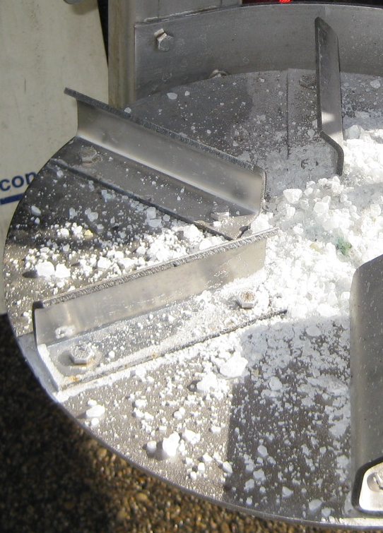
Spreader innovations
Find ways to keep the salt on the road longer.
Use the right amount of salt at the right time. Too much salt wastes money and in not environmentally sound.
Spreader innovations can save money, increase the speed of melting and protect the environment.
Notes:
Photo: FCI
In this section there will be examples of spreader innovations. Integrate these into your fleet or invent your own system for gently and accurately placing de-icers on the pavement. This is an area that has many possibilities for creative thinking and experimenting without having to spend much money. If you invent something that works good, share your idea with others. In Minnesota, there is an OPERA fund that is open to cities and counties to get funds to try new innovations. Here is the link: http://www.ltap.umn.edu/about/program/opera/
There may be grant opportunities in your state too. If so, take advantage of it. The best innovations come from those who understand the problem and the equipment, like your operators and mechanics.

Slide 17
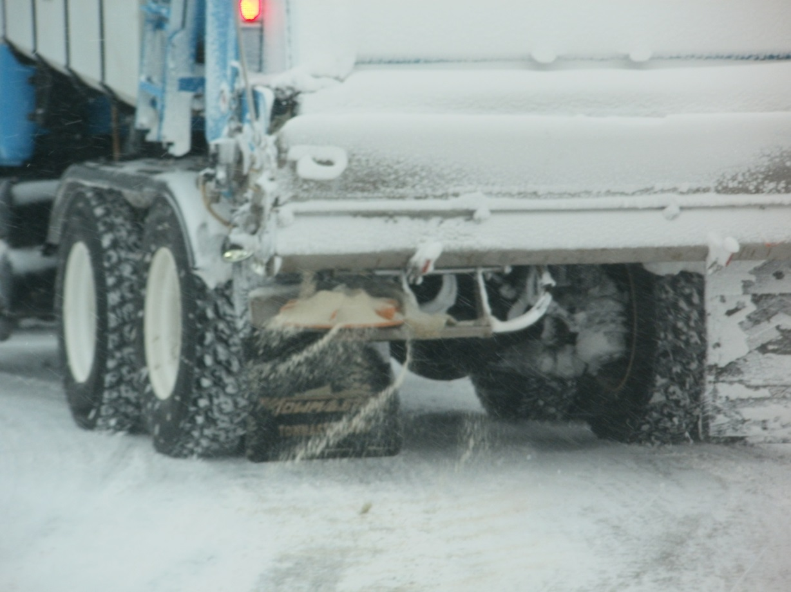
Basic side discharge
Traditional tailgate spreader with liquid pre-wet to reduce bounce and scatter.
Notes:
Good things to observe here:
Liquids in use
Very light spread pattern
Low spinner speed
Areas for improvement lower spinner
Drill holes in spinner
Add chute to spinner
Add skirt to spinner
Turn off spinner
Photo credit: Ramsey County, MN

Slide 18
Center discharge
This plow truck has two augers in bottom of a v-box spreader.
Notes:
Semi-trailer. 2 augers in bottom of v-box. Chute to lower delivery point in center of truck, which has ability to deliver salt directly behind or at an angle to the side.
Photo credit: Ramsey County, MN

Slide 19

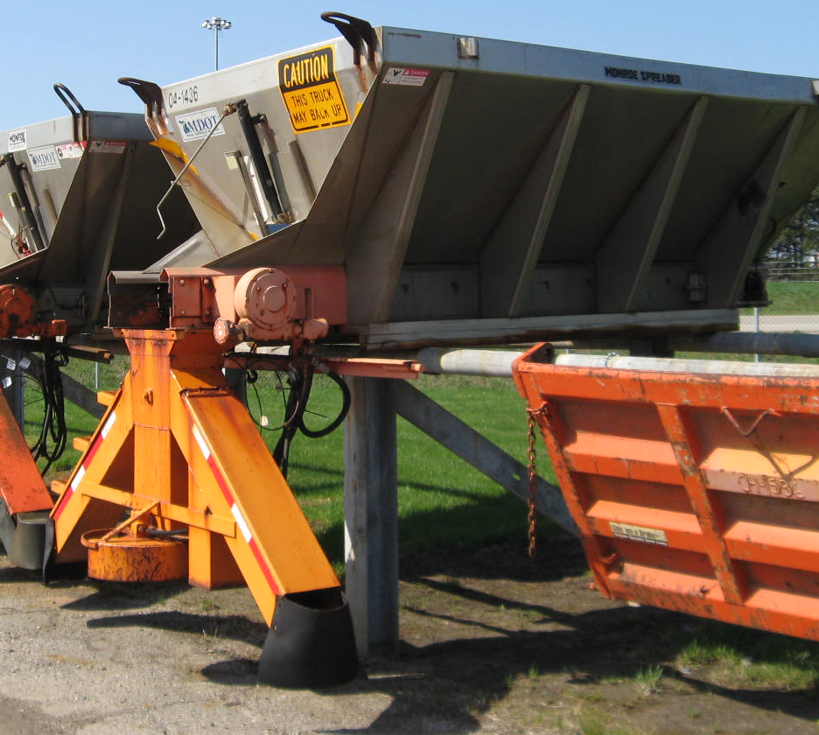
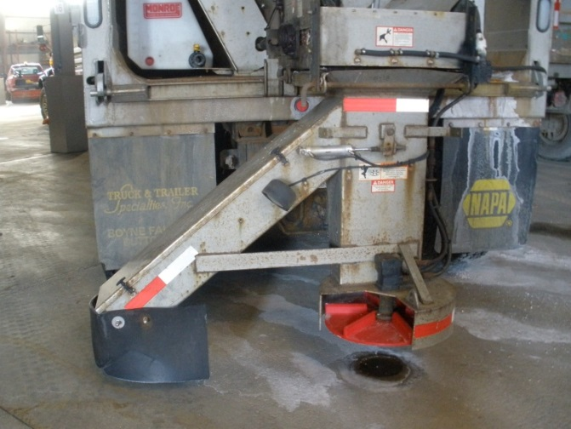
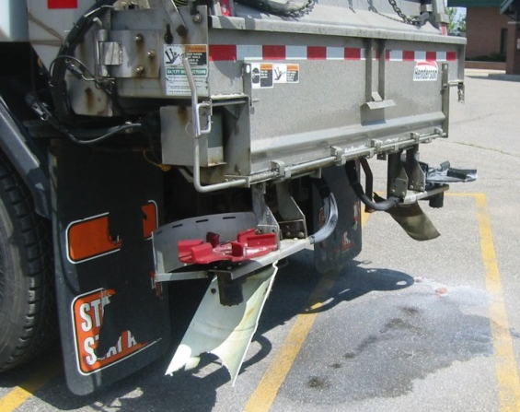
Chutes
An easy way to guide valuable products GENTLY to the ground.
Not a new idea but a good one!
Photo: Michigan DOT
Notes:
Since chutes guide the salt from the truck to the pavement there is less salt bounced off of the road.
Several drawings of chutes in CAD format are now available on the MN LTAP website, at this link:
http://www.mnltap.umn.edu/about/programs/opera/fact/documents/washingtoncad.pdf
Photo credit: Fortin Consulting, Inc.

Slide 20
Test Question
How can a chute help you?
Increases the bounce of the salt
Decreases the bounce of the salt
Notes:
Note to presenter: you may choose to hide this slide.
How can a chute help you?
Increases the bounce of the salt (no)
Decreases the bounce of the salt (yes)

Slide 21
Test Question
How can a chute help you?
Increases the bounce of the salt
Decreases the bounce of the salt
Notes:
How can a chute help you?
Increases the bounce of the salt (no)
Decreases the bounce of the salt (yes)

Slide 22
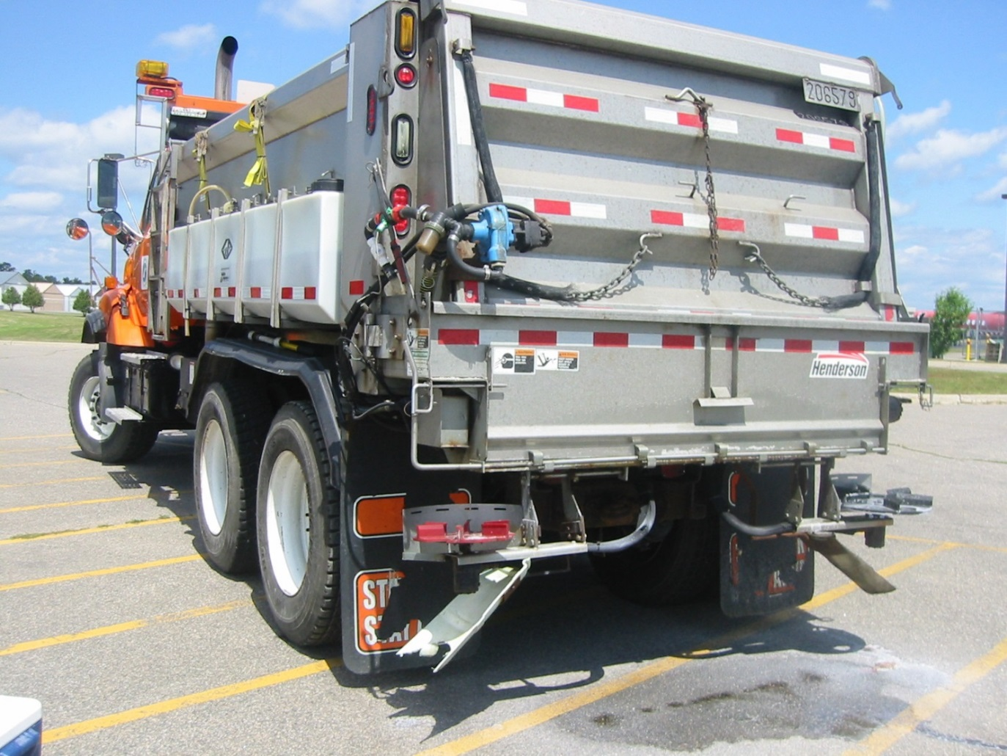
Dual side discharge
Dual side discharge onto spinner; when off, the spinner drops to chute and liquid
pre-wet.
Awesome!
Notes:
Good things to observe here:
Liquids in use
With dual discharge onto spinner, the driver can select which to use to hit center of road or superelevation target more accurately.
Chute eases salt to ground with less bounce
Photo credit: Ramsey County, MN

Slide 23
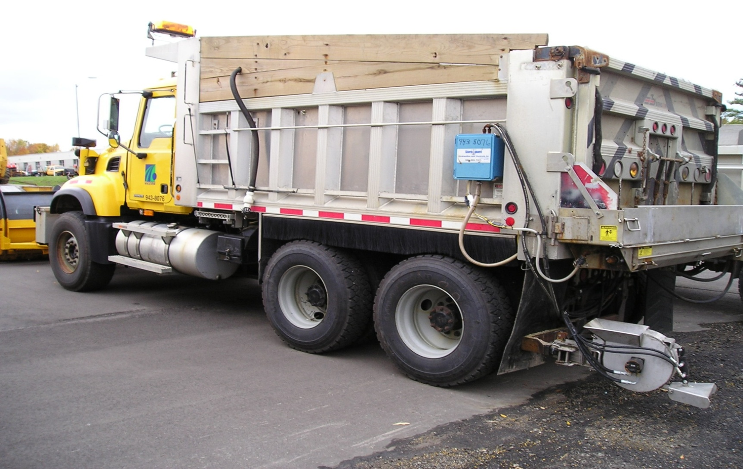
Zero velocity
Notes:
This slide is taken from an online presentation located at this link:
http://clearroads.org/wp-content/uploads/PennDOT_Snow-Academy-Part-4_slides_41-45.pptx
Zero velocity spreaders are expensive but they allow you to discharge salt as if you were standing still. For example, if a truck is traveling at 30 mph and applying salt, it will discharge at 30 mph in the opposite direction. This is essentially the same as discharging salt without moving.
These are very good at reducing bounce and scatter if a faster application speed is used. They have a maximum speed at which they are effective; the manufacture can provide guidance for each product.
Photo credit: Pennsylvania DOT

Slide 24
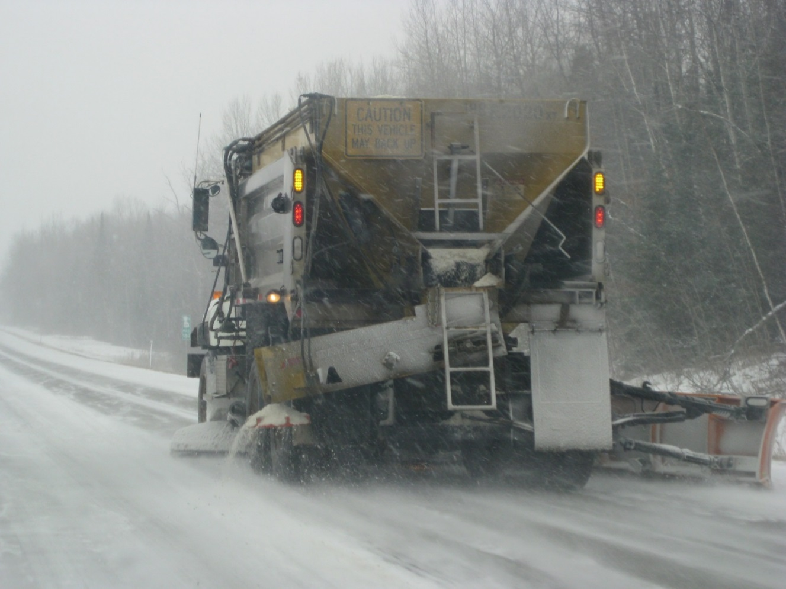
Chute from center to side of truck
Narrow spread pattern on centerline or super elevated edge of road.
Will melt & slowly migrate across drive lanes toward ditch or storm drain.
Note spinner speed
Notes:
Salt is often applied in granular form. As it dissolves, it runs downhill but continues melting. Because of this, it is advantageous to apply the salt to the highest spot of the road.
Especially on high speed roads, a very narrow spread pattern is desired. Low speed low volume roads are more forgiving, and we can widen our spread pattern a bit.
Photo credit: Michigan DOT

Slide 25
Drill holes in the spinner
Photo: Fortin Consulting inc
Notes:
By drilling holes in the spinner (some do it in the center of the flights, some on the ends of the flights), more salt can pass through to the chute or skirt. This still allows the option to spread a wider pattern if needed.
Note the white layer on this photo. It is a used sign from the sign shop attached to the bottom to give the spinner extra strength.

Slide 26
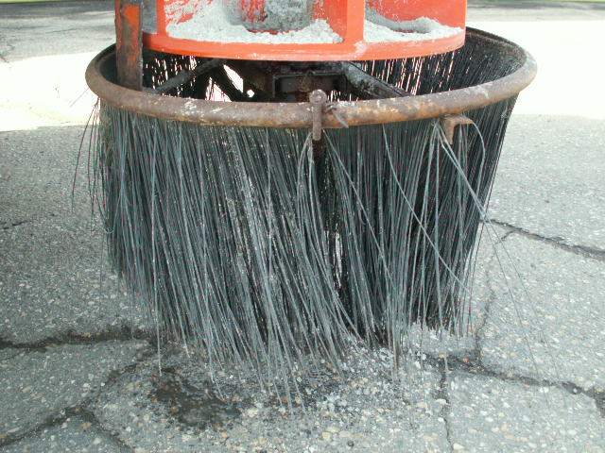
Skirts
Notes:
The MnDOT Mankato Truck Station is pleased with how the skirts work to reduce bounce and scatter. Note the holes drilled in the spinner to allow more salt to pass through it.
Photo credit: Fortin Consulting Inc.

Slide 27
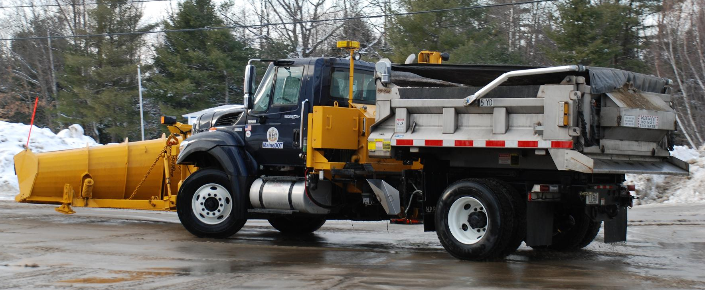
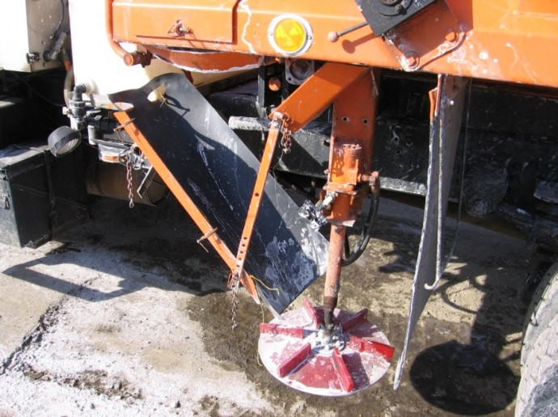
Reducing bounce and scatter:
Auger → chute → spinner (set low to ground)
Tarped loads also reduce salt waste!
Notes:
This chute is used to ease salt from auger to spinner, with the spinner low to ground. This shows the setup on a front dump truck. The tarp seen on the top picture is a recommended practice. This keeps the salt dry and workable, and also prevents it from leaking over the top of the truck when raising the box or turning corners with a full load.
Photo credit: Maine DOT

Slide 28
Test Question
What would be a reason to modify our spreaders?
Find ways to increase the bounce of the salt
Find ways to decrease the bounce of the salt
Notes:
Note to presenter: you may choose to hide this slide.
Why should spreaders be modified?
To find ways to increase the bounce of the salt (no)
To find ways to decrease the bounce of the salt (yes)

Slide 29
Test Question
What would be a reason to modify our spreaders?
Find ways to increase the bounce of the salt
Find ways to decrease the bounce of the salt
Notes:
Why should spreaders be modified?
To find ways to increase the bounce of the salt (no)
To find ways to decrease the bounce of the salt (yes)

Slide 30
Showcase your spreader innovations here or hide this slide
Notes:
Each organization likely has their own inventions they would like to talk about. Insert any photos you have here. If you do not have any photos to insert, you may hide this slide.
Photo credit: Fortin Consulting, Inc.

Slide 31
Spreading speeds
One great way to reduce “bounce and scatter” of road salt is to reduce the speed at which the truck is traveling when it is applying salt.
Notes:
One way to reduce bounce and scatter of road salt is to reduce the speed at which the truck is travelling when it is applying salt.
There are many other ways to reduce bounce and scatter. These will be covered later in this module, and again in the “Material Use” module.

Slide 32
How much salt bounces off the road when it is applied depends on:
Truck speed
Spread pattern
Drop distance
Target location
Characteristics of the road
Characteristics of the deicer
How much bounces off after it is applied depends on traffic volume and speed.
Notes:
How much bounces off when it is applied depends on the following:
Truck speed
Spread pattern
Drop distance
Target location
Characteristics of the road
Characteristics of the deicer
How much bounces off after it is applied depends on traffic volume and speed.

Slide 33
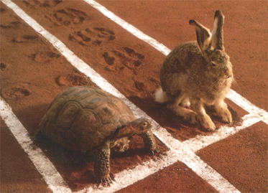
Go as slow as reasonable to reduce salt waste
Awesome!

Slide 34
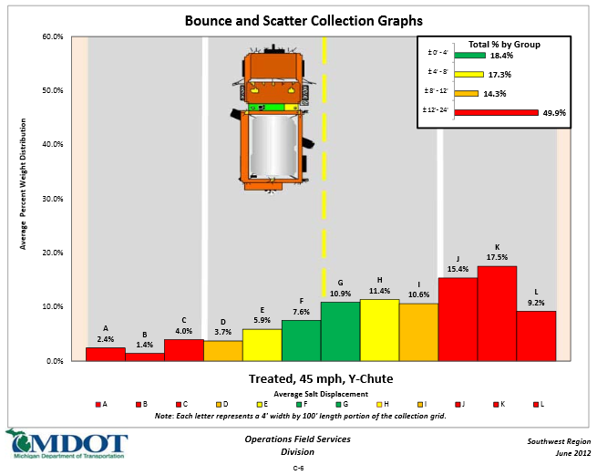
At 45 miles per hour salt doesn’t stay on the road
Note below: in the green area, only 18% of the salt stayed in the target area and 50% bounced off of the road.
WOW
This is the same as backing up your truck to your favorite fishing lake and dumping in ½ of the salt. In both cases the salt does not protect the road, and in both cases it pollutes the water.
Notes:
This example shows the results of two tests: one at 25 mph and one at 45 mph. The green bars shown on the graph represent salt that landed on target, the yellow is salt that stayed on the road but not on target, the red is salt that bounced off of the road.
Graphic credit: http://michigan.gov/documents/mdot/Final_ReportNov2012_404228_7.pdf

Slide 35
Test Question
Does salt frequently bounce off of the road before it can melt snow and ice?
Yes
No
Notes:
Note to presenter: you may choose to hide this slide.
Does salt frequently bounce off of the road before it can melt snow and ice?
Yes (yes)
No (no)

Slide 36
Test Question
Does salt frequently bounce off of the road before it can melt snow and ice?
Yes
No
Notes:
Does salt frequently bounce off of the road before it can melt snow and ice?
Yes (yes)
No (no)

Slide 37

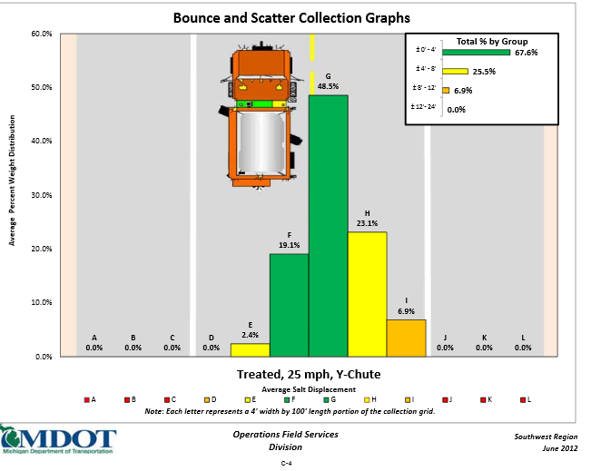
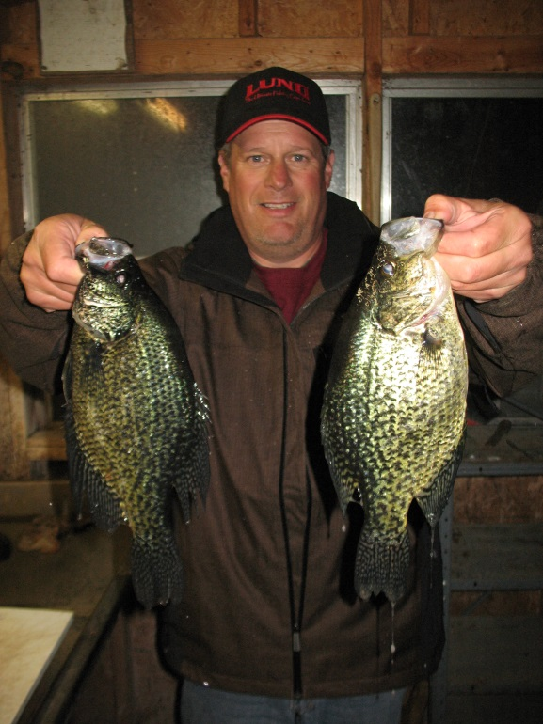
At 25 miles per hour salt stays on the road
Note below: in the green area, 68% of the salt stayed in the target area and none bounced off the road.
No salt wasted
Notes:
This example shows the results of two tests: one at 25 mph and one at 45 mph. The green bars shown on the graph represent salt that landed on target, the yellow is salt that stayed on the road but not on target, the red is salt that bounced off of the road.
Graphic credit: http://michigan.gov/documents/mdot/Final_ReportNov2012_404228_7.pdf
Photo credit: Fortin Consulting, Inc.

Slide 38
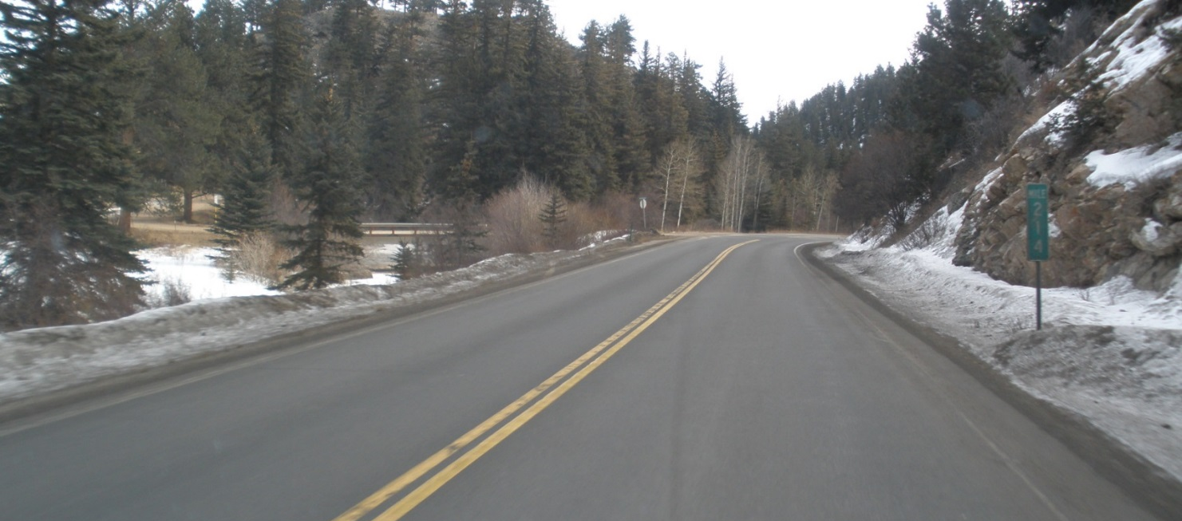
Spinner speeds
To reduce bounce and scatter:
Reduce spinner speed.
Windrow the salt on the skip stripe.
Traffic will spread salt, you don’t need to do it.
Notes:
Placing a windrow of salt on the centerline, at the superelevated crown, or in the middle of the road will give your salt the best chance of dissolving and working before it is blown off of the road by your spreading technique or passing cars. To give the salt the best chance turn down your spinner! Think of traffic as a giant spinner; just lay it down and let them do the work.
Photo credit: Fortin Consulting, Inc.

Slide 39
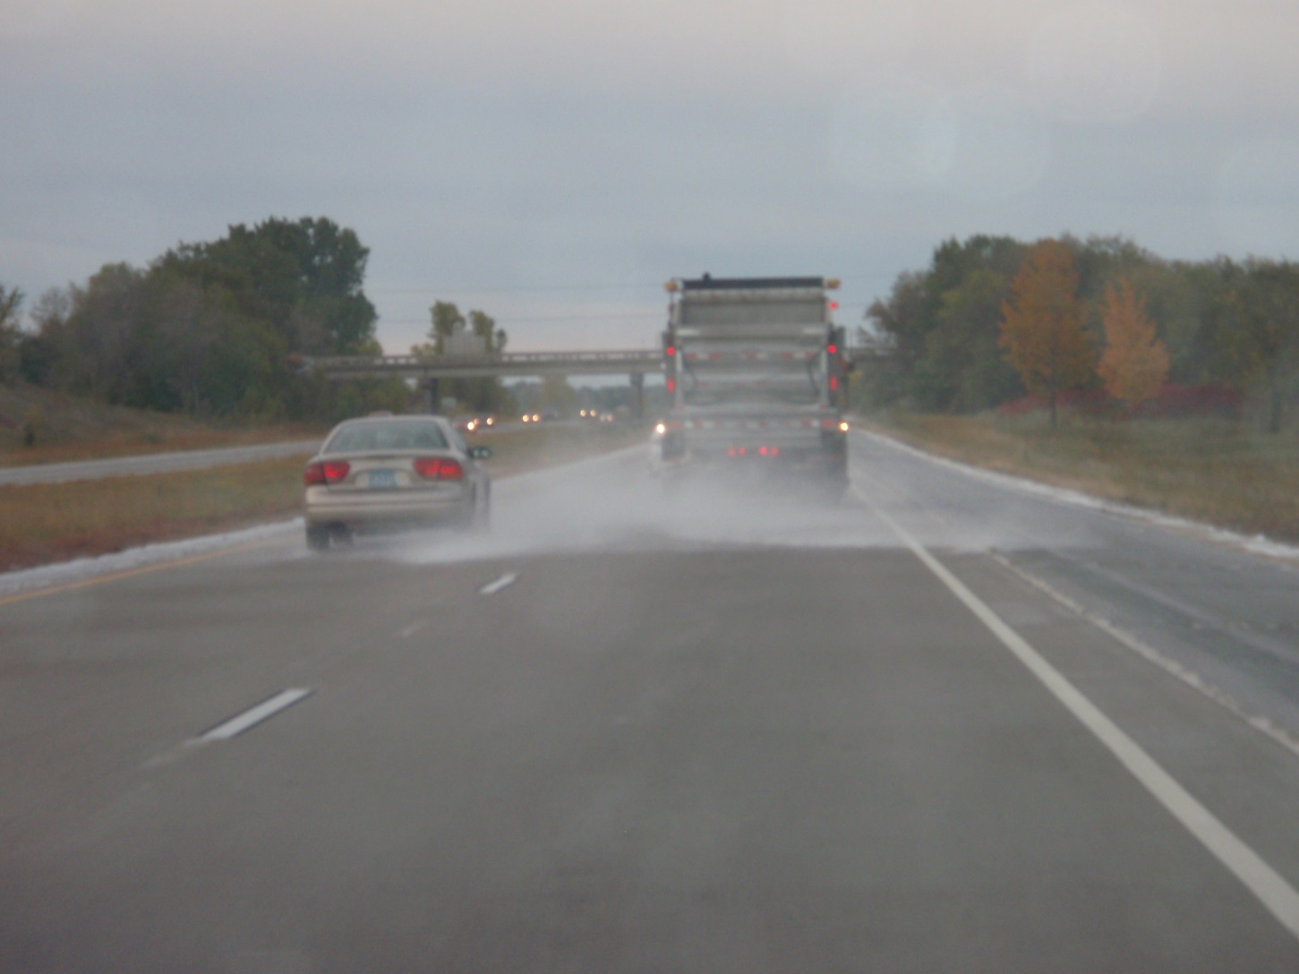
Bad example
Notes:
Notice the wide spread pattern in this photo: an inefficient way to use salt.
Discussion: Why would they be applying dry salt to a road without any accumulation of snow or ice?
The reason…a microscopic layer of ice is making the road slippery. So that begs this question…why not use liquids?
Dry salt needs to dissolve before it can melt snow and ice, there is not enough moisture present to dissolve the dry salt. It likely will all blow off of the road…. wasted. There are more problems depicted here than the spread pattern!
Photo credit: Fortin Consulting, Inc.

Slide 40
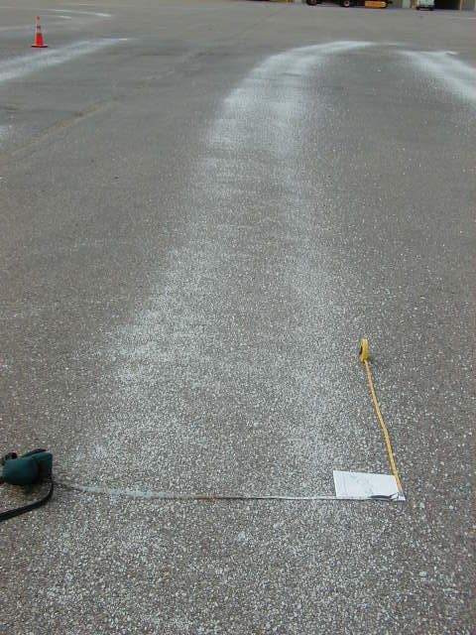
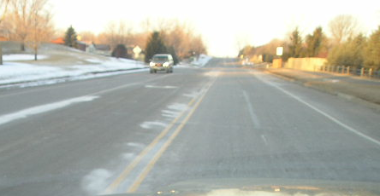
Good examples
Notes:
Notice narrow spread patterns. This is an efficient way to use salt!
Photo credit: Fortin Consulting, Inc.

Slide 41
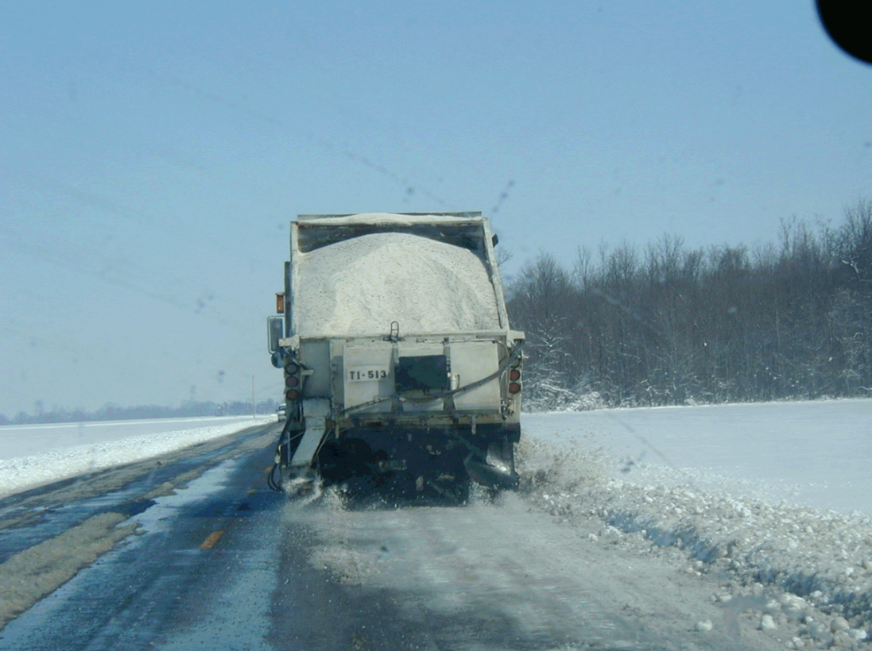
Better placement
Dual spinners, dual chutes
Awesome
Slide salt to the pavement. Chose spinner to increase your odds of being able to apply to the center of the road.
Notes:
These slides are available at this link:
OhioDOT_Snow-and-Ice-Control-Course-Presentation-105_slides_132-134_139-140_147-150.pptx

Slide 42

If you are spreading wide…
Think again! Think thin!
The biggest problem we have with salt is keeping it on the road long enough for it to dissolve and work.
Salt works once it is dissolved so put it gently in the middle, let it dissolve and work for you as it migrates through the drive lanes.
Wide spread patterns cost us a lot!

Slide 43
Test Question
To create a windrow or narrow spread pattern, what are the best spinner speeds?
Off
Low
Medium
High
Notes:
Note to presenter: you may choose to hide this slide.
To create a windrow or narrow spread pattern, what is the best spinner speed?
Off (yes)
Low (no)
Medium (no)
High (no)

Slide 44
Test Question
To create a windrow or narrow spread pattern, what are the best spinner speeds?
Off
Low
Medium
High
Notes:
To create a windrow or narrow spread pattern, what is the best spinner speed?
Off (yes)
Low (no)
Medium (no)
High (no)

Slide 45
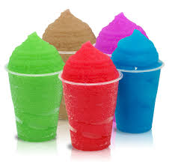
Slurry
The more liquid we use, the less granular is needed. Over the years the industry has been shifting from dry salt to slightly wet salt to very wet salt to liquid only routes.
Slurry is a very wet salt (similar texture to the slushy drinks we are familiar with).
Notes:
As the industry has evolved, we have moved from traction on top of snow and ice (sand) to melting. Our goal is faster and faster melting that costs us less money, saves time and is less harmful to our lakes, rivers and drinking water. The slurry mixture gives us hope in this area. Most organizations are not at this stage, and are using more like 8 to 12 gallons per ton. Slurry mixes may contain as much as 60 gallons per ton. The ideal ratio is not yet known or agreed upon, but the wetter the better is a common saying in the industry.

Slide 46
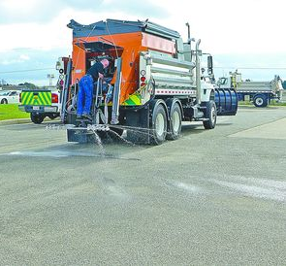
Why Slurry?
Liquids work faster, stay on target better and cause less environmental damage.
Liquids don’t have as much melting power.
A slurry combo is very powerful and effective in melting snow and ice with less wasted time and material.
Notes:
Photo credit: Ohio DOT

Slide 47
Test Question
What is a slurry?
An impaired driver
A Sane Lane driver in a hurry
A salt mixture that contains a lot of liquids
All of the above
Notes:
Note to presenter: you may choose to hide this slide.
What is a slurry?
An impaired driver (no)
A Sane Lane driver in a hurry (no)
A salt mixture that contains a lot of liquids (yes)
All of the above (no)

Slide 48
Test Question
What is a slurry?
An impaired driver
A Sane Lane driver in a hurry
A salt mixture that contains a lot of liquids
All of the above
Notes:
What is a slurry?
An impaired driver (no)
A Sane Lane driver in a hurry (no)
A salt mixture that contains a lot of liquids (yes)
All of the above (no)

Slide 49
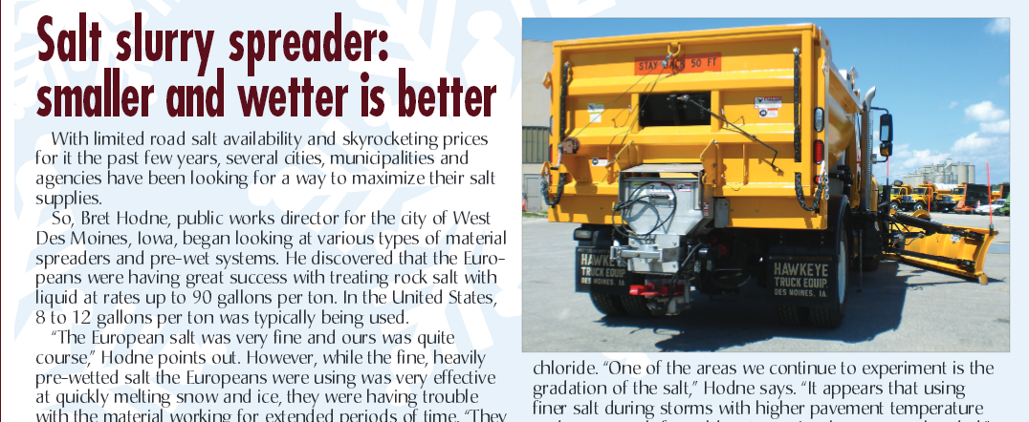
Make one, buy one, try one!
Notes:
Graphics credit: http://www.ttspec.com/getattachment/New-Technologies/BETTER-20ROADS-20MAGAZINE-20--20ORIGINAL-20FILE.pdf

Slide 50
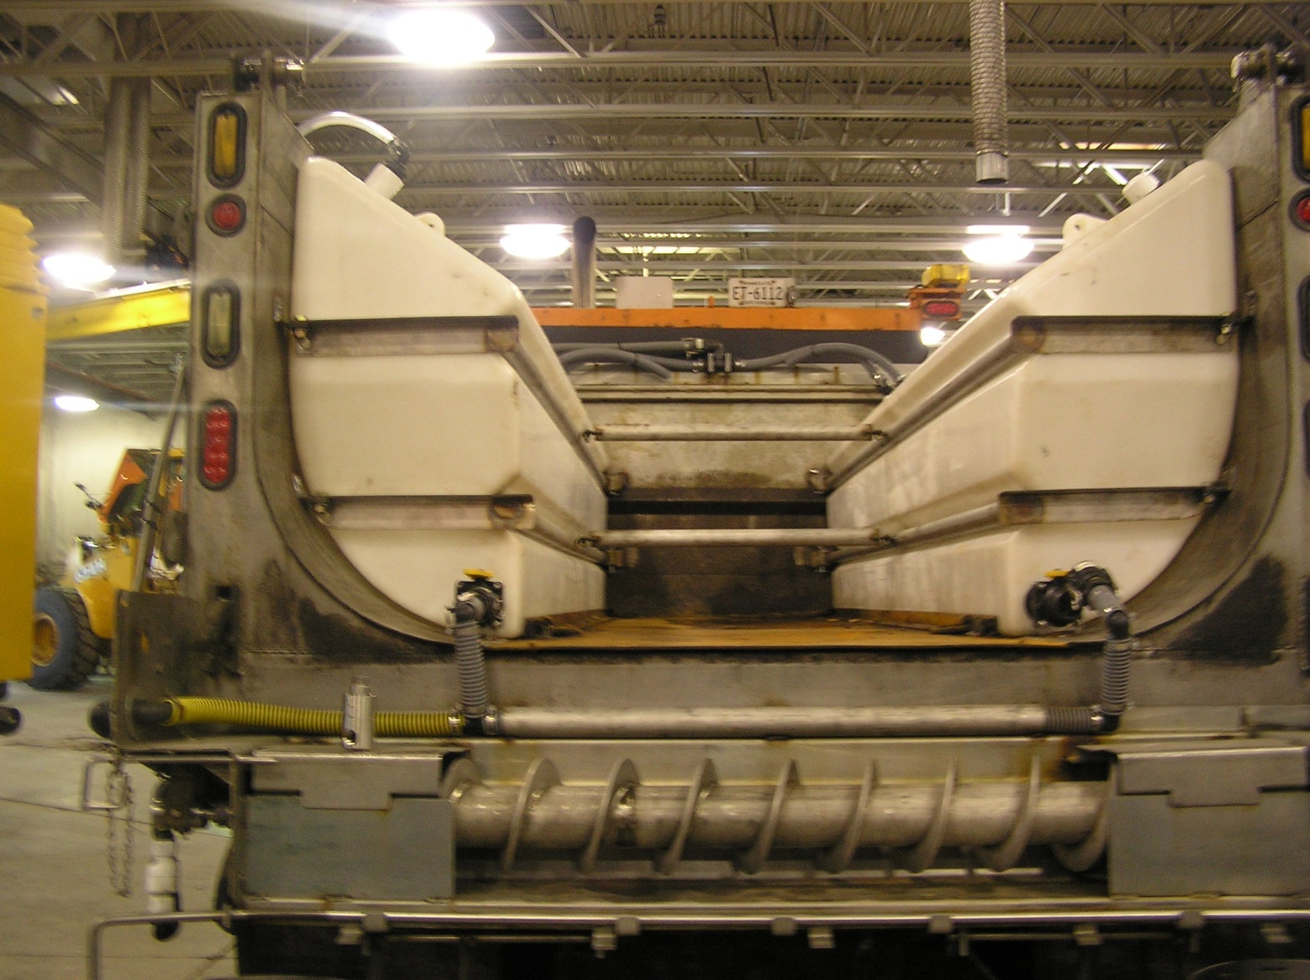
Slurry Truck experiment – higher liquid to granular ratio
The future is in higher liquid to granular ratios!
Notes:
This is an example of one MnDOT truck station experimenting with a truck that can give a higher liquid to granular ratio.
Photo credit: Minnesota DOT

Slide 51
Test Question
Why use a slurry mix?
Works faster than dry salt
Stays in place better than dry salt
Can use less salt
All of the above
Notes:
Note to presenter: you may choose to hide this slide.
Why use a slurry mix?
Works faster than dry salt (no)
Stays in place better than dry salt (no)
Is cheaper than dry salt (no)
All of the above (yes)

Slide 52
Test Question
Why use a slurry mix?
Works faster than dry salt
Stays in place better than dry salt
Can use less salt
All of the above
Notes:
Why use a slurry mix?
Works faster than dry salt (no)
Stays in place better than dry salt (no)
Is cheaper than dry salt (no)
All of the above (yes)

Slide 53
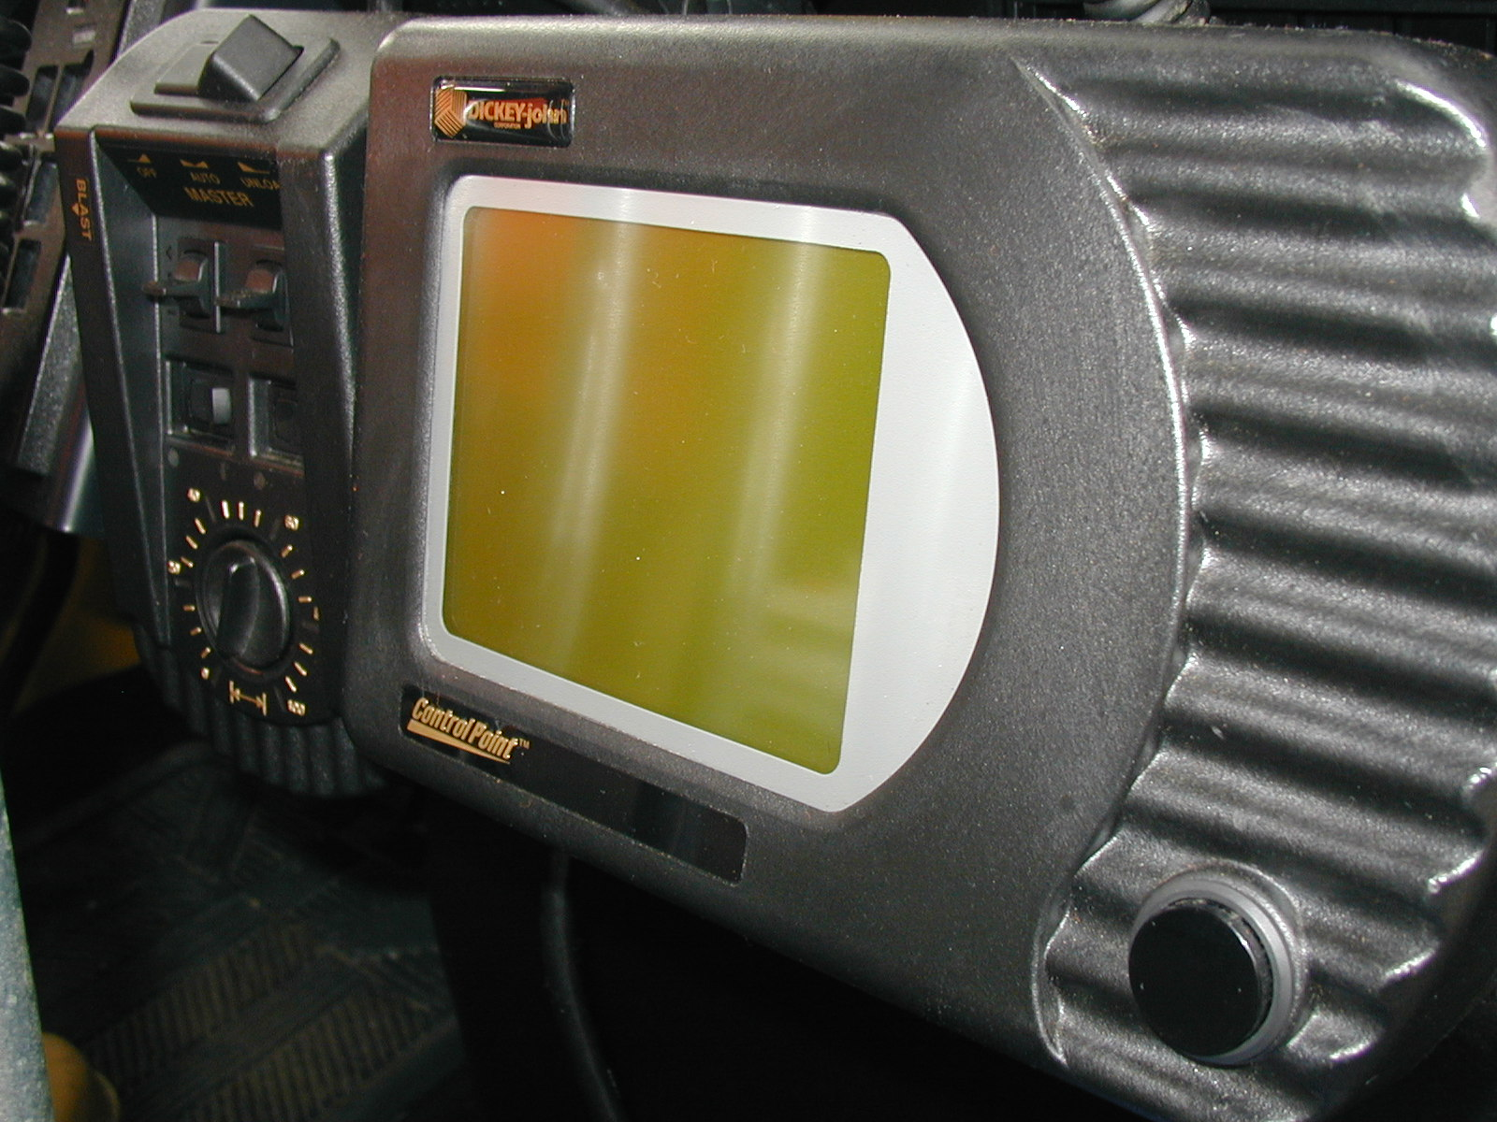
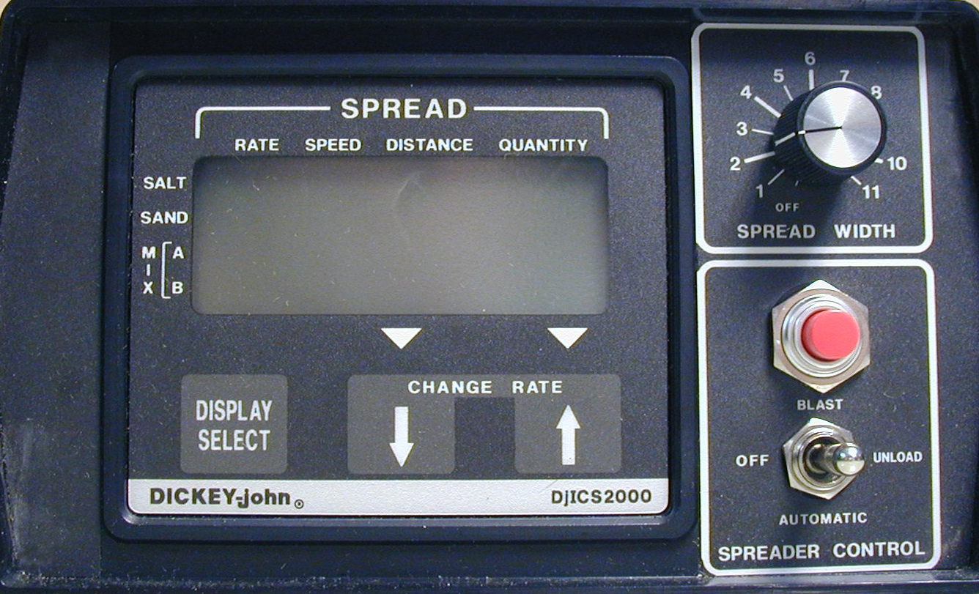
Spreader controls
Notes:
The next section focuses on spreader controls.

Slide 54

Open loop systems are not as accurate
Any manual system (those without a computer in the cab).
Some computer controlled systems.
if there is NO feedback coming from the auger, pump or other deliver device to the computer.
Some systems may come this way (bad choice)
Or you may have a system that is broken
Notes:
Closed loop systems allow the user to select an application rate in the cab; the computer in the cab gives and gets feedback from the delivery devices. This is a more accurate way to deliver material. The computer compensates for the speed of the vehicle and delivers the target application rate.
Open loop systems are often lower tech, don’t involve a computer, are common in older trucks, and are rapidly being phased out as their counterparts have proven to be a much more efficient and effective tool.

Slide 55

Closed loop systems are great!
Closed loop systems:
Feedback to and from auger, pump, conveyor or other delivery mechanism to computer in the cab.
Notes:
Closed loop systems allow the user to select an application rate in the cab; the computer in the cab gives and gets feedback from the delivery devices. This is a more accurate way to deliver material. The computer compensates for the speed of the vehicle and delivers the target application rate.
Open loop systems are often lower tech, don’t involve a computer, are common in older trucks, and are rapidly being phased out as their counterparts have proven to be a much more efficient and effective tool.

Slide 56
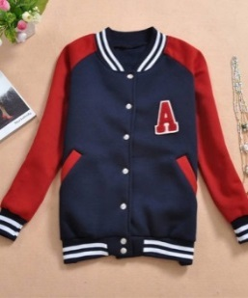
Ground speed controlled systems
Type in your desired application rate on the cab’s computer.
The computer keeps the application rate consistent as you change speeds or even stop.
No matter how fast the spinner is going or any other modifications you make to reduce bounce and scatter, you will always get the application rate you selected.
If you want to be on the varsity team for snow and ice,
you need ground speed controllers
Notes:
Ground speed controllers are a basic tool in an efficient snow and ice control operation.
Among other things, the voluntary targets set by Environment Canada by 2019 call for ground speed electronic controllers to be used to apply salt at the proper rate. This pertains to all public entities that are responsible for the use of road salts, as well as companies that hold a concession or lease to manage a public road.
Information taken from the article entitled, “Canada Issues National Goals to Limit Environmental Harm”, published in Road Salts, by Peter Menyasz, Dec. 30, 2014.

Slide 57
Ground Speed Controllers
DICKEY - JOHN ICS2000
Notes:
MDDOT_Snow-College-Part-1_slides_34-36.pptx
Each organization has a variety of controllers operational in their fleet at any given time. Most organizations still have a mix of manual and ground speed controllers, but more progressive organizations have moved to 100% ground speed controlled spreaders. Within each fleet, there are typically a variety of models of controllers as the newer trucks have the latest versions.

Slide 58
DICKEY - JOHN CONTROL POINT
Ground Speed Controllers
Insert pictures of your ground speed controllers here, or hide this slide
Notes:
Insert photos of your ground speed controllers here, or hide this slide.

Slide 59
Test Question
What influences the amount of material discharged with a ground speed controlled system?
The speed you are travelling
Your application rate selection
The type of spinner you are using
The amount of fuel you have left
Notes:
Note to presenters: you may choose to hide this slide.
What influences the amount of material discharged with a ground speed controlled system?
The speed you are travelling (no)
Your application rate selection (yes)
The type of spinner you are using (no)
The amount of fuel you have left (no)

Slide 60
Test Question
What influences the amount of material discharged with a ground speed controlled system?
The speed you are travelling
Your application rate selection
The type of spinner you are using
The amount of fuel you have left
Notes:
What influences the amount of material discharged with a ground speed controlled system?
The speed you are travelling (no)
Your application rate selection (yes)
The type of spinner you are using (no)
The amount of fuel you have left (no)

Slide 61
Warning: Blast Button
Can be a useful tool but present some concerns:
Commonly overused & violates all attempts to reduce salt use.
Proper training, blast setting restrictions and use strategy are all important to avoid wasted salt.
Notes:
These slides are available at this link:
MDDOT_Snow-College-Part-1_slides_34-36.pptx
Note that your crew may relate to this slide better if you include a picture in of one of your blast buttons here. Each controller has a different look.
A blast button allows the driver to deliver more salt in small areas, but they are commonly overused. A strategy for proper use is good. Progressive organizations restrict the amount of salt that can be delivered by the blast button (500 pounds) to keep the salt waste down to a manageable level.
Two areas of thought pertaining to the use of blast buttons are as follows:
Spot salt use the blast button on intersections and hills to save salt, or
set the application rate to a low amount (150 lbs/mile) and salt the route to save salt.
Restricting the volume of salt that can be discharged by the blast button is recommended and training on proper use of the blast button is needed. Blast mode increases bounce and scatter and goes against all of the steps in winter maintenance to use proper amounts of salt, in strategic locations, and in optimal spread patterns.
Photo credit: Maryland DOT

Slide 62
Insert a photo of your blast button here or hide this slide
Notes:
Insert a photo of your blast button here or hide this slide.

Slide 63
Test Question
Blast buttons:
Allow the user to put down more salt in a spot
Waste salt
Are over used
All of the above
Notes:
Note to presenter: you may choose to hide this slide.
Blast buttons:
Allow the user to put down more salt in a spot (no)
Waste salt (no)
Are over used (no)
All of the above (yes)

Slide 64
Test Question
Blast buttons:
Allow the user to put down more salt in a spot
Waste salt
Are over used
All of the above
Notes:
Blast buttons:
Allow the user to put down more salt in a spot (no)
Waste salt (no)
Are over used (no)
All of the above (yes)

Slide 65
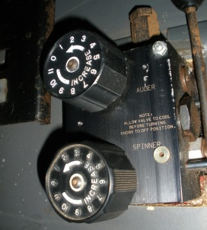
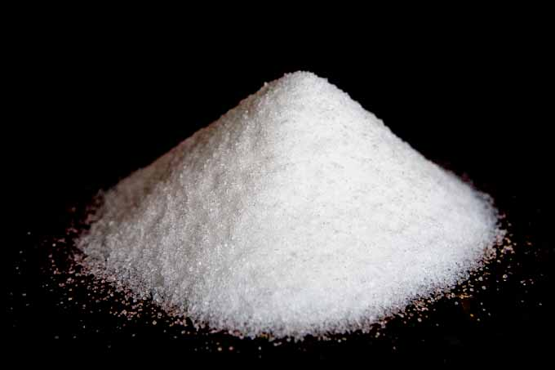

Manually controlled systems
Turn a knob or lever to select your application rate.
The rate will change as you change speeds.
This technology is still used but is being phased out with computer controlled systems which offer us much more accuracy!
Same setting lower speed
Same setting higher speed
Notes:
This slide shows the issues relating to manually controled systems.
Photos are from Fortin Consulting, Inc,. and Microsoft clipart

Slide 66
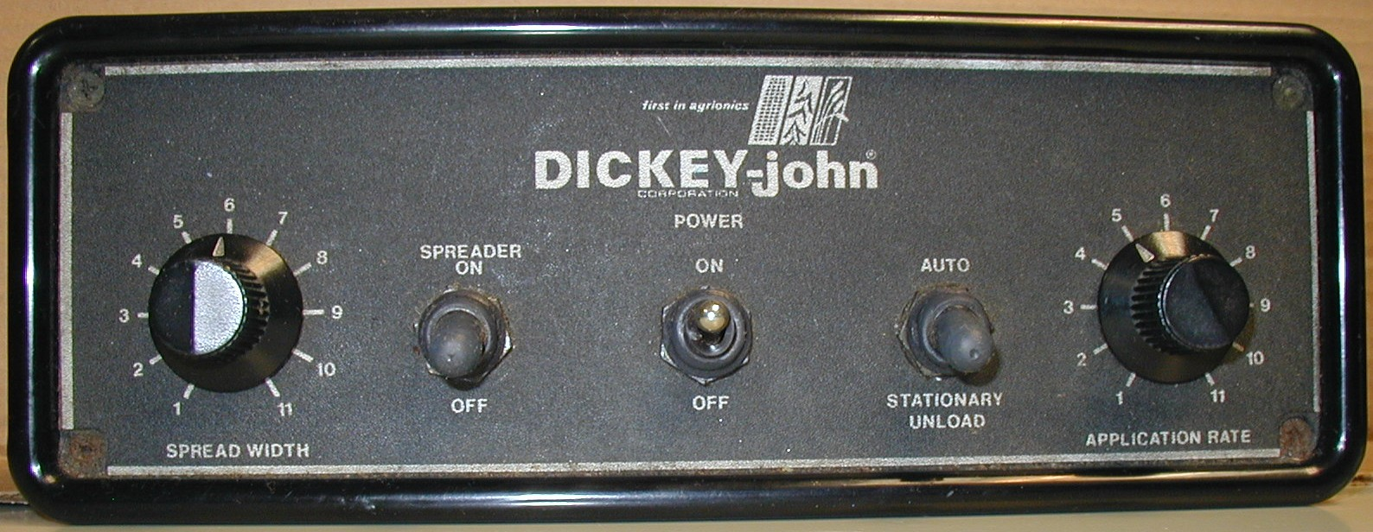

Manual Controls
Insert photos of your manual controls here or hide this slide
Notes:
MDDOT_Snow-College-Part-1_slides_34-36.pptx
Many senior plow drivers have experienced these control systems and may be hesitant to switch over to the computer-driven systems. With proper training and a little time to use them, most drivers quickly switch to preferring these systems. However, give them the opportunity to become familiar with these systems before using.
Photo credit: Fortin Consulting, Inc. and Maryland DOT

Slide 67
Test Question
Which system gives you more control over your application rates?
Manual controllers
Ground speed controllers
Notes:
Note to presenters: you may choose to hide this slide.
Which system gives you more control over your application rates?
Manual controllers (no)
Ground speed controllers (yes)

Slide 68
Test Question
Which system gives you more control over your application rates?
Manual controllers
Ground speed controllers
Notes:
Which system gives you more control over your application rates?
Manual controllers (no)
Ground speed controllers (yes)

Slide 69
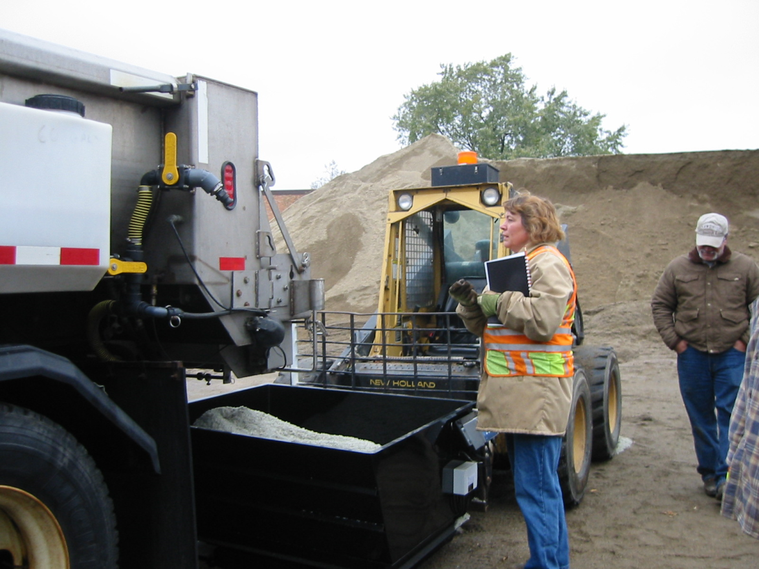
Calibrating spreader units
Notes:
Photo: MNDOT
Note to presenter: This section on calibration may not be appropriate for all crew members.
Calibration for entry level plow drivers is not recommended because they will not be involved in calibrating trucks.

Slide 70
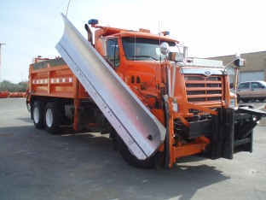
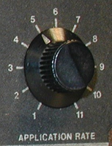
Calibration is:
The process of figuring out how much material is applied in a fixed period of time
at each setting.
for each type of material.
for each truck
Salt
Salt/Sand
Notes:
Calibration is often done for 1 minute per setting. A longer time period yields more accurate results. For example, if you ran the spreader for 30 seconds and multiplied by 2, you could estimate what is discharged in 1 minute. However the error is greater than if you ran the calibration for the entire one minute.
To reduce error further you can take more than 1 sample at each setting and average the results. For example, run setting 5 three times, for 1 minute each and average the results. This is more accurate than running setting 5 one time and recording the result.
This might seem like extra work, and it is. Calibrating in any way is a good first step. Then, look for ways to improve the accuracy of your calibration process or the frequency of it.
It is generally recommended to calibrate all equipment once a year.
Photo credit: Fortin Consulting, Inc.

Slide 71
What would you need to calibrate for?
6 trucks, salt, 11 settings
6 trucks, salt/sand, 11 settings
Salt
Salt/Sand
Notes:
Here is a mini flow chart of how the process goes:
Choose a truck
Chose a material
Choose a setting
Time the discharge
Weigh the discharge
Record the discharge
Repeat for next setting
Repeat for next material
Repeat for next truck
Photo credit: Fortin Consulting, Inc.

Slide 72
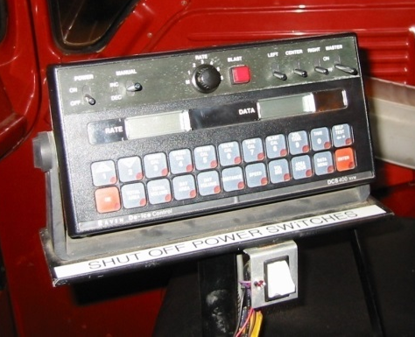
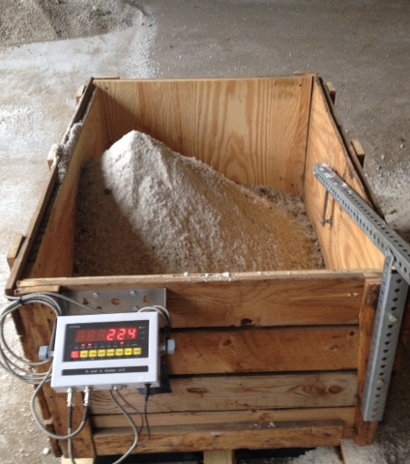
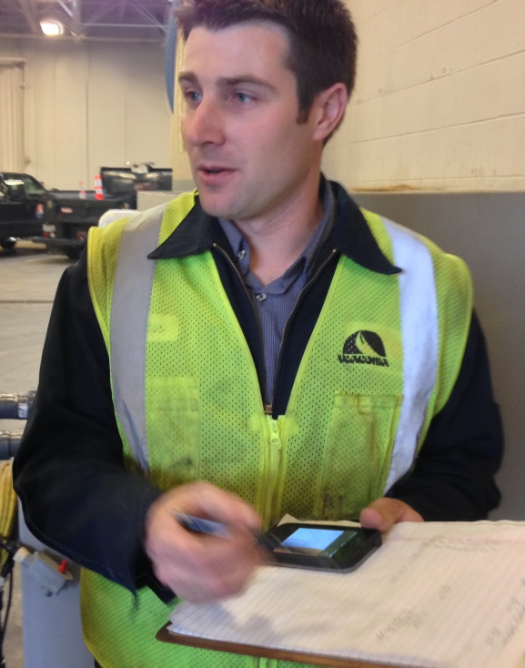

Pick your setting, discharge material for 1 minute, weigh it, record it. Repeat for all settings, all materials, and all trucks.
Calibration
Notes:
The picture shows that both ground speed controls and manual control should be calibrated!
The middle picture shows a homemade catch box with scale. This allows the user to clear the scale for each setting and not empty the box until it is full. Your crew will like this because it eliminates lifting of salt to weigh it. You can also purchase box scales like this from the manufacturer.
Depending on your budget and your crew’s interest in lifting salt, you can choose the option that best fits your organization.
Photo credits:
Steve Chlebeck of Fortin Consulting, Inc.

Slide 73
Example manual controls
Cab Card: 11 settings, Truck #1, Salt
Date | 9/10/2015 | Unit | #1 | Salt
Setting | Pounds Per Minute | 5 MPH (X 12) | 10 MPH (X 6) | 15 MPH (X 4) | 20 MPH (X 3) | 25 MPH (X 2.4) | 30 MPH (X 2) | 35 MPH (X 1.7)
1 | 5 | 60 | 30 | 20 | 15 | 12 | 10 | 8
2 | 10 | 121 | 60 | 40 | 30 | 24 | 20 | 17
3 | 15 | 180 | 90 | 60 | 45 | 36 | 30 | 25
4 | 15 | 180 | 90 | 60 | 45 | 36 | 30 | 25
5 | 30 | 360 | 180 | 120 | 90 | 72 | 60 | 50
6 | 40 | 480 | 240 | 160 | 120 | 96 | 80 | 68
7 | 40 | 480 | 240 | 160 | 120 | 96 | 80 | 68
8 | 60 | 720 | 360 | 240 | 180 | 144 | 120 | 100
9 | 65 | YOU | FILL | IN | EVERY | THING | IN | RED
10 | 70 | … | … | … | … | … | … | …
11 | 90 | … | … | … | … | … | … | …
Remember: YOU Need a second chart for salt/sand
Notes:
Note to instructors: If you do not have any manual controlled systems, hide this slide
This chart should be copied, one placed in the truck and one in the shop. The truck version should be laminated.
73

Slide 74
For computer spreaders
One extra step:
You must “true” your computer so that what is being discharged = the quantity you typed in.
For example if you selected 200 lbs/mile and the discharge was 212 lbs/mile then you need to adjust this in your computer.
One less step:
You don’t need a cab card anymore!
Notes:
If you have ground speed controllers, work with your vendor to get training on how to calibrate your equipment. The vendor is usually very happy to teach you how to use your equipment properly, and eventually you will be able to do it on your own.
However when you get the newer version of your controllers the training cycle will start over. Calibration isn’t difficult, but plan ahead to schedule time with your vendor. In the fall they get very busy.

Slide 75
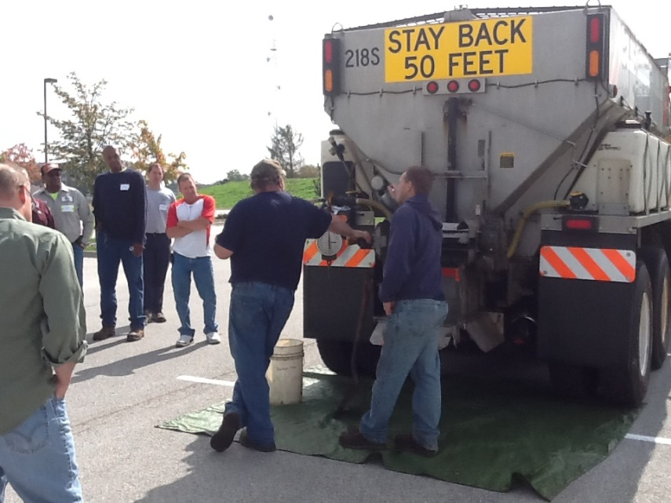
Calibrate:
Every truck each year
Superstars run a second round of calibration part way through the winter
And if you change
Hydraulics, battery, auger, gate setting or opening.
Or
If there is a change to anything that will influence the flow rate or the computer
If you suspect something is wrong
Notes:
Calibrate in the fall of the year! Most shops report best success by training a team of 2 or 3 people to be responsible for calibrating the fleet at any given shop.
Photo credit: Fortin Consulting, Inc.

Slide 76
Test Question
Which trucks should be calibrated each year?
Our new trucks
All trucks
Some of the trucks
Only trucks with computer controlled spreaders
Notes:
Note to presenters: you may choose to hide this slide.
Which trucks should be calibrated each year?
Our new trucks (no)
All trucks (yes)
Some of the trucks (no)
Only trucks with computer controlled spreaders (no)

Slide 77
Test Question
Which trucks should be calibrated each year?
Our new trucks
All trucks
Some of the trucks
Only trucks with computer controlled spreaders
Notes:
Which trucks should be calibrated each year?
Our new trucks (no)
All trucks (yes)
Some of the trucks (no)
Only trucks with computer controlled spreaders (no)

Slide 78
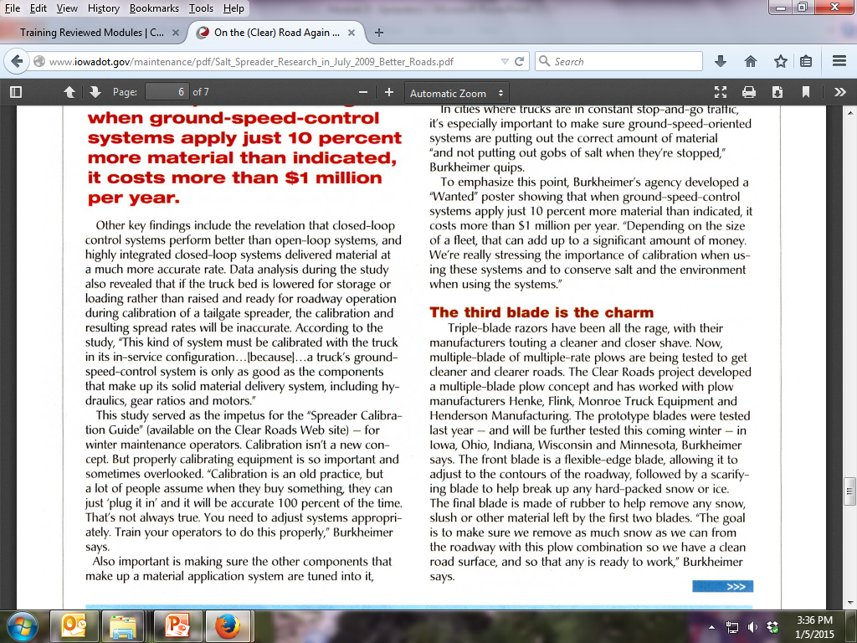
Tips from experienced mechanics:
Calibrate under actual use conditions
This from the July 2009 Issue of Better Roads:
Notes:
Information from the July 2009 issue of Better Roads magazine is shown on the next two slides.
http://www.iowadot.gov/maintenance/pdf/Salt_Spreader_Research_in_July_2009_Better_Roads.pdf

Slide 79
…from July 2009 Issue of Better Roads:
Notes:
http://www.iowadot.gov/maintenance/pdf/Salt_Spreader_Research_in_July_2009_Better_Roads.pdf

Slide 80

Calibration saves salt, saves money, saves the environment and improves your ability to perform accurately and efficiently.
Notes:
These notes reflect the estimated savings for Wisconsin sent by Clear Roads Committee member Mike Sproul in 2014.

Slide 81

Example: Iowa calibration salt savings
An average statewide 5%
calibration error equates to:
9,532 tons of salt
(95 rail cars!)
$648,176
Create a salt savings slide for your organization and insert it here, or use the Iowa example.
Notes:
IowaDOT_New-Operator-Snow-and-Ice-Training_Slides_41-45_49-52_144-146.pptx
Note to presenters: revise this slide to reflect your predicted salt savings with a 5% calibration error.

Slide 82
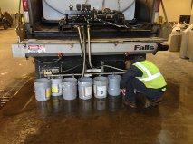

Don’t forget to calibrate the liquids
Your work isn’t done until everything is calibrated
Notes:
We aren’t covering much about liquids in this section, but if the user wants they can add more information about this here.
The liquids are discharged by either gravity flow or pumps and present a similar situation as the manual and ground speed controllers when discharging granular products.
If you don’t calibrate you don’t know what you are putting on the road. Those that don’t calibrate are in the “minor leagues” of winter maintenance.
Photo credit: Fortin Consulting, Inc.

Slide 83

Calibration brings you to the major leagues
of winter maintenance!
Notes:
Photo credit: Fortin Consulting, Inc.

Slide 84
Test Question
If you calibrate your equipment you are:
In the “Major Leagues” of winter maintenance
In the “Minor Leagues” of winter maintenance
Sitting on the bench
Traded for a 143 round draft choice
Notes:
Note to presenters: you may choose to hide this slide.
If you calibrate your equipment you are:
In the “Major Leagues” of winter maintenance (yes)
In the “Minor Leagues” of winter maintenance (no)
Sitting on the bench (no)
Traded for a 143 round draft choice (no)

Slide 85
Test Question
If you calibrate your equipment you are:
In the “Major Leagues” of winter maintenance
In the “Minor Leagues” of winter maintenance
Sitting on the bench
Traded for a 143 round draft choice
Notes:
If you calibrate your equipment you are:
In the “Major Leagues” of winter maintenance (yes)
In the “Minor Leagues” of winter maintenance (no)
Sitting on the bench (no)
Traded for a 143 round draft choice (no)

Slide 86

Importance of Record Keeping
Keep records of equipment inspections, repairs, calibration, frequency, and effectiveness.
This helps you manage equipment, and shows what is and isn’t working.
Helps with planning for events, equipment acquisition, and helps protect you from claims.
Notes:
Record keeping is important as a means of material accountability, budgeting/cost tracking, performance tracking, support in the event of legal actions, media inquiries, and planning.

Slide 87

Keep Records of Truck Inspections
Example:
Ensure the “attack angle” is set correctly for plow and wing
Inspect the plows and plow gear for any damage
Ensure salt distribution system is working properly
Notes:
This slide probably lists mechanic’s tasks rather than a driver’s tasks. As a manager, you should get records of everything that is done. Before winter, trucks must be made winter-ready. This includes adding plows, tanks, and spray bars. This should all be done and records made before the first snow event occurs.
Note to presenters: Insert your pre-season truck inspection here. Delete this yellow box before making presentation.
Photo credit: Fortin Consulting, Inc.

Slide 88

Records of truck inspections
Make sure your employees know how to fill out and where to turn in their inspection forms
EXAMPLE
Customize this slide for your operation
Insert a copy of your truck inspection check list and procedure. Delete this yellow box before making presentation.
Notes:
Make sure your crew fills out an inspection form for each truck and submits it to you. Keep them in a safe place. If an action is needed based on this inspection, take the appropriate steps to have any needed repairs or equipment purchased in a timely fashion.
Note: For more about truck inspections see Module 23 Getting Ready for Winter.
Note to presenters: Insert a copy of your truck inspection checklist and procedure here. Delete this yellow box before making presentation.

Slide 89
Keep records of Calibtation Activities
Setting | Output
2 | 153
3 | 224
4 | 327
5 | 394
Notes:
Calibrate all trucks before the season starts. If you are using more than one material, calibrate for each material. Calibration is an important part of keeping track of materials. It also allows you to better meet your level of service goals as well as estimate how much material is being applied.
Photo credit: Steve Chlebeck

Slide 90

Calibrate and record for liquids too
Notes:
Trucks should be calibrated for any liquids as well.

Slide 91

Records of truck calibration
EXAMPLE
Customize this slide for your operation
Insert a copy of your truck calibration form and any instructions. Delete this yellow box before making presentation.
Notes:
Usually there will be a team of people who will calibrate; not all of the drivers. This slide is so that everyone knows that this is taking place.
Note to presenters: Insert a copy of your truck calibration form and any instructions here. Delete this yellow box before making presentation.
Photo credit: MnDOT http://www.dot.state.mn.us/maintenance/pdf/research/SaltSanderCalibrationGuide.pdf

Slide 92
Storm Documentation
EXAMPLE:
Work orders
Patrol log
Material usage log
Equipment work orders
Fuel logs
Time sheets
Diary
TAPER log
Customize this slide for your operation
Insert a list of forms needed to be completed by operators for a storm. Delete this yellow box before making the presentation.
Notes:
Review the storm documentation needed for your agency.
Note to presenters: Insert a list of forms needed to be completed by operators for a storm here. Delete this yellow box before making presentation.
Slide credit: CDOT Snow Removal Operator Training

Slide 93

Document Your Operations
EXAMPLE:
Conditions- weather and road, pavement temp
Material type and quantity used
Timing
# of passes and when
Unusual conditions/circumstances
Customize this slide for your operation
Insert an example of your state’s event log and explain how to fill it out. Delete this yellow box before making the presentation.
Notes:
It is very important that plow drivers document the actions taken in response to a snow/ice event
This will include the road conditions throughout their shift, type and amount of deicer or anti-icer used, timing of operations, and the number of passes and when. If there are unusual conditions that affect the operations, those should be recorded. For example, road construction, accidents, major compaction problems, etc.
Note to presenters: Insert a copy of your state’s event log and explain how to fill it out. Delete this yellow box before making presentation.
Photo credit: INDOT

Slide 94
Event Log
Insert an example of your state’s event log. Delete this yellow box before making presentation.
Customize this slide for your operation
EXAMPLE
Notes:
Review this sequence of events as illustrated on this report, pay particular attention to the changes that took place in the highlighted entries. Note that this TAPER log really paints a good picture of what was done, when it was done, how it was done, who did it with what and what the outcome was like. If you had this information coming on to shift, would you really even need to talk to the person you are relieving?
Note to presenters: Insert an example of your state’s event log here. Delete the yellow box before making presentation.
Slide credit: CDOT Snow Removal Operator Training

Slide 95
Test Question
What should you record during the storm?
Type of product used
Application rate
Pavement temperature
All of the above
Notes:
Note to presenters: you may choose to hide this slide.
Test question: What do you need to record for the TAPER log?
Product (no)
Results (no)
Temperature (no)
All of the above (yes)

Slide 96
Test Question
What should you record during the storm?
Type of product used
Application rate
Pavement temperature
All of the above
Notes:
Note to presenters: you may choose to hide this slide.
Test question: What do you need to record for the TAPER log?
Product (no)
Results (no)
Temperature (no)
All of the above (yes)

Slide 97

A job well done is a job well documented
Filling out paperwork is important because it:
Shows that you follow policy
Improves efficiency of operations
Helps with planning
Notes:
Presenters: give a pep talk here! Everyone knows that filling out paperwork during or at the end of a long shift can be hard to be motivated to do, but it is very important because it:
Shows that you follow policy
Improves efficiency of operations
Helps with planning

Slide 98


Document Equipment Maintenance and Repairs
After the storm if you need any repairs submit this form
Insert your equipment repair form here. Delete this yellow box before making presentation.
EXAMPLE
Notes:
If any problems are noted in your post trip inspection be sure to record them and submit the information so that the truck can be repaired in time for the next event.
Go over your equipment repair form and how to fill it out.
Note to presenters: insert your equipment repair form here. Delete this yellow box before making presentation.
Picture credit: Ohio, http://www.puco.ohio.gov/emplibrary/files/Trans/Enforcement/forms/Vehicle%20Inspection,%20Repair%20and%20Maintenance%20Record%20Form.pdf

Slide 99
Record Keeping
Keeping good records helps
Demonstrate how goals are met.
Demonstrates that you are following policy.
Identify ways to improve and change your approach.
Notes:
Keeping good records is important. It helps to:
demonstrate how goals are met.
demonstrates that you are following policy.
identifies ways to improve and change your approach.

Slide 100
Acknowledgements
Training contents were developed by Fortin Consulting Inc., under the direction of the Clear Roads Advisory Team.
Connie Fortin – connie@fortinconsulting.com
Professional formatting and training aids were developed by the University of Minnesota, Center for Transportation Studies.
Jim Grothaus – Groth020@umn.edu
Ann Johnson – Johns421@umn.edu
Members of the Clear Roads Advisory Team include:
Mike Sproul, Dave Wieder, Cliff Spoonemore, Monty Mills, David Frame,
Mike Lashmet, Clay Adams, Justun Juelfs, and Tom Peters

Slide 101
This presentation was developed with funding from the Clear Roads research program, which brings together transportation professionals and researchers from around the country to drive innovation in the field of winter maintenance.
Find additional information and resources at
http://clearroads.org/

Slide 102



Thank you for your good work!
Notes:
Thank you for your time today. Have a good winter!

Slide 103
Additional resources
AASHTO, Clear Roads Computer Based training:
Deicing:
Unit 4, “Deicing Equipment”
Unit 7, “ Periodic Activities & Equipment Maintenance”
Equipment Maintenance:
Unit 2, “Common Types of Winter Maintenance Equipment”
Unit 7, “Periodic Maintenance”

